Slide 1
Repositories of Open Educational Resources (OER)
Mrs.Sushumna Rao, Independent Ed-tech Consultant
Repositories of Open Educational Resources (OER) © 2024 by Sushumna Rao is licensed under CC BY 4.0

Slide 2
By the end of this Webinar…
You will be equipped with the knowledge needed to explore OER repositories and utilise open educational resources (OERs) to enhance your teaching methodologies.

Slide 3
Recap: OER
Any educational resources (including curriculum maps, course materials, textbooks, streaming videos, multimedia applications, podcasts, and any other materials that have been designed for use in teaching and learning) that are openly available for use by educators and students, without an accompanying need to pay royalties or license fees.​ - (UNESCO, 2002)​

Slide 4
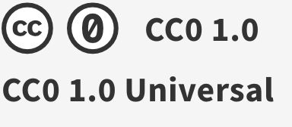
Recap: Creative Commons Licenses
More accommodating
More restrictive

Slide 5
What is a Repository?
A large collection of freely accessible educational resources
Accommodate a wide range of subjects and grade levels
Offered by government agencies and educational institutions, individual OER enthusiasts
Institutional Repositories
Subject-Specific Repositories
Aggregated Repositories

Slide 6
Examples of OER Repositories (India)
DIKSHA (Digital Infrastructure for Knowledge Sharing) Platform by MoE, Government of India
SWAYAM (Study Webs of Active-learning for Young Aspiring Minds) by MHRD
e-PG Pathshala by UGC
E-Adhyayan
NDLI​

Slide 7
OER Repositories
Wikimedia Commons, Wiki Books​
OER Commons​
COL Commons
MERLOT​
Open Textbook Library​
OpenStax​
Libre Texts​
Saylor Academy​
Lumen learning​
Khan Academy​
PHET Simulations​
Skills Commons​

Slide 8
Role of Repositories in Accessing OER
Search and Discoverable openly licensed content
Quality, peer reviewed
Centralized
Sustainable, Accessible
Supporting Open content, open licenses with authoring option

Slide 9
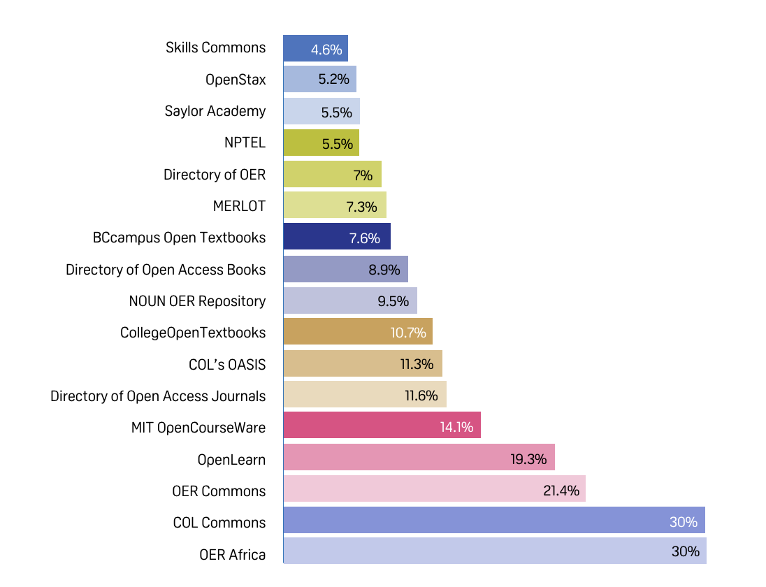
Repositories used during Covid-19
From the report of Open Educational Resources in the Commonwealth 2021
Notes:
platforms/repositories most accessed during the period

Slide 10
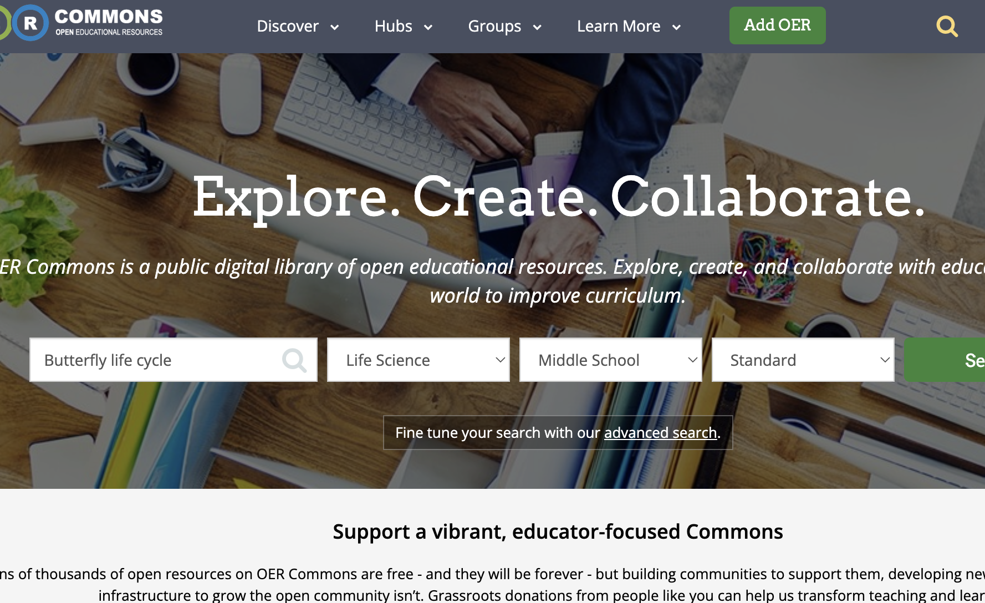
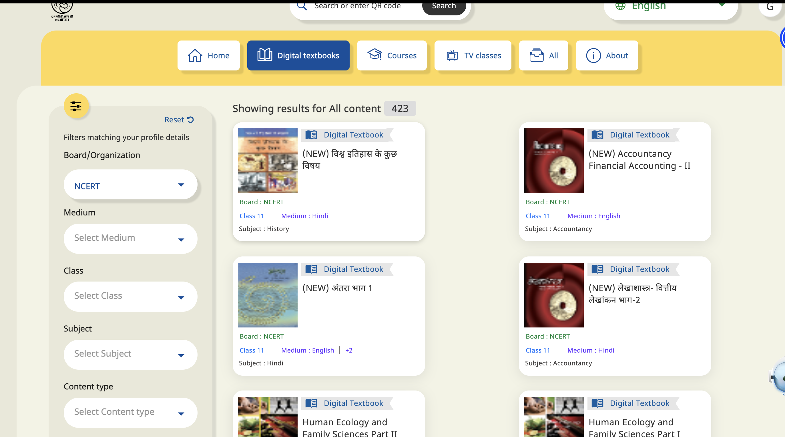
Searching OER Repositories
Search process
Identify keywords
Use advanced search If available
Evaluate results

Slide 11
Let’s Explore OER Repositories

Slide 12
DEMO_DIKSHA

Slide 13
DEMO_OER Commons

Slide 14
OER in Diverse and Inclusive Classrooms
Often available in multiple formats (text, audio, video)
Culturally relevant content
Multilingual content
Accessible to ALL

Slide 15
Future Trends
Growing trend of adapting/adopting OER
Enhanced technology integration
Collaborative OER development /OER authoring platforms with peer review systems
Inclusive and Diverse OER

Slide 16
Sharing is Caring
"The beauty of OER is not just that it provides free access to educational resources, but that it opens up the possibility for educators and students to innovate, customize, and create new learning experiences." ― David Wiley

Slide 17
Let’s Contribute, Collaborate
Share your OER based lesson plans and resources with others
Contribute to OER community
Join online communities
Learn, practice more about OER

Slide 18
Thank You!
Q & A

