Slide 1
OER adaptation, development and use as integrated within curriculum
ICT tools for OER, Unesco ICT Forum, India, 2016
Dr. Airina Volungevičienė
Prof. Habil. Dr. Margarita Teresevičienė,
Vytautas Magnus University, Lithuania

Slide 2
Vytautas Magnus University http://vdu.lt

Slide 4
http://www.vdu.lt

Slide 5
Studyonline.lt

Slide 7
http://eden-online.org

Slide 8
Back to Open Education Open Educational Resources

Slide 9
Problem addressed
Despite the rapid development of Open Education movement, there are still many challenges identified by education organizations, teachers and trainers, e-learning centre staff members and also learners themselves that prevent the uptake and mainstreaming of open education using and developing of Open Educational Resources (OERs)
One of the major challenge is to integrate OERs in curriculum designing because of lack of skills and competences of participants:
to find and use OER
to find and adapt OER
to develop OERs
to select ICT tools that meet the didactical requirements and are most suitable for one or another purpose

Slide 10
http://Openprof.eu

Slide 11
http://openprof.eu/oer

Slide 12
Collaborative online document for hands – on activities https://goo.gl/KHtyvN

Slide 13
The aim of the session
to experiment the training material enabling learners to develop the following competences:
to select the best ICT tools to adapt/ develop OERs for a learning activity
to design a learning activity integrating OERs

Slide 14
1) to select the best ICT tools to adapt/ develop OERs for a learning activity
set the requirements for ICT tool for OER development/adaptation
choose ICT tool for OER development/adaptation according the functionality
develop/adapt OER using selected ICT tool
choose the license and mark developed/adapted OER with CC license

Slide 15
2) to design a learning activity integrating OERs
to identify the “place” of OERs in curriculum (learning activities)
to contextualize OERs systematically with the learning curriculum (from the point of view of conscious curriculum designing and quality assurance)

Slide 16
Training material
The session will be organized in a step – by – step activities composed of presentation of the session moderators and hands – on practical learning using training material „ICT tools to develop and adapt OER“ developed during European Union Erasmus+ program Project „Open Professional Collaboration for Innovation“ (2014-1-LT01-KA202-000562)

Slide 17
a) setting requirements for ICT tool for OER development/adaptation
1) to select the best ICT tools to adapt/ develop OERs for a learning activity
Step 1. Think about the type of OER you are going to develop
Will you develop:
A document?
A presentation?
A video/ audio file?
A collaborative artefact?

Slide 18
a) setting requirements for ICT tool for OER development/adaptation
Step 2. What functionality do you need from a chosen ICT tool?
Will you need to upload the document online?
Will you need to collaborate with other people?
Will you need formatting (various text formats, colors, etc.)?
Will you need to add pictures?
What other functions of ICT tool do you need?

Slide 19
a) setting requirements for ICT tool for OER development/adaptation
Step 3. What requirements will you raise for the editability of OER?
Download (possibility to download OER in editable version)
Online (possibility to edit OER online)
Limited access (possibility to edit OER for registered users)
Unlimited access (possibility to edit OER without registration)
Individual development (possibility to edit OER individually)
Collaborative development (possibility to edit OER collaboratively)
Other requirements??

Slide 20
a) setting requirements for ICT tool for OER development/adaptation
Step 4. What requirements will you raise for the usability and accessibility of an OER?
does the tool allow the use free of charge?
is it intuitive to use?
how attractive it is?
can you add Creative Commons license on you work?
do you have further requirements for usability and accessibility that you have?

Slide 21
Assignment 1

Slide 22
Template available from training material

Slide 23
Template – for presentation format

Slide 24
Template for collaborative document format

Slide 25
Template for video / audio format

Slide 26
b) choosing ICT tools for OER development/adaptation according the functionality
1) to select the best ICT tools to adapt/ develop OERs for a learning activity
Step 1. Examples of ICT tools for different OER types and formats

Slide 27
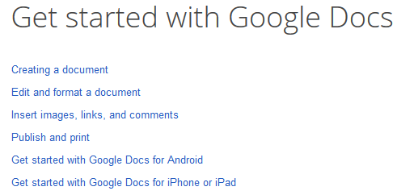
ICT tools for documents
Example:
Description
Functionality
Editability
How to use?

Slide 28
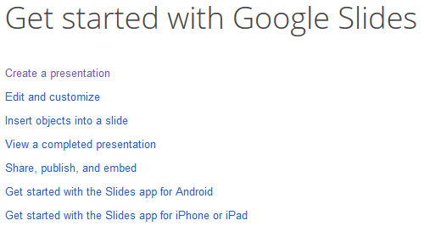
ICT tools for presentations
Examples
Description
Functionality
Editability
How to use?

Slide 29
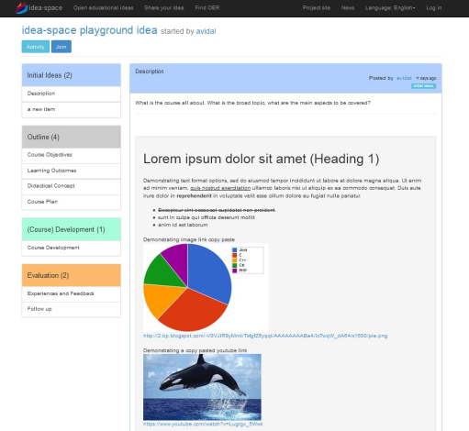
ICT tools for collaboration
Examples
Description
Functionality
Editability
How to use?

Slide 30
ICT tools for video/ audio
Examples
Description
Functionality
Editability
How to use?

Slide 31
b) choosing ICT tools for OER development/adaptation according the functionality
Step 2. search and select ICT tools for OER adaptation or development

Slide 32
Assignment 2

Slide 33
c) develop/adapt OER using selected ICT tool

Slide 34
d) choose the license and mark developed/adapted OER with CC license
(this Unit is adaptation of "Marking your work with a CC license", “Publish” and “Best practices for attribution” all by Creative Commons, used under CC BY )
Step 1. Identify Creative Commons licensing types
Step 2. Select your OER CC license

Slide 35
Creative Commons

Slide 36
Assignment 4

Slide 37
Choose the licence

Slide 38
Examples: website licencing

Slide 39
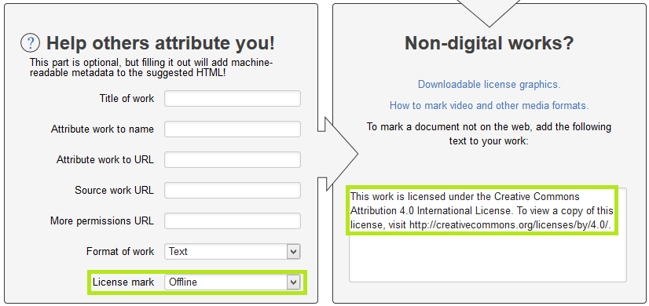
Example: document

Slide 40
Example: presentation

Slide 41
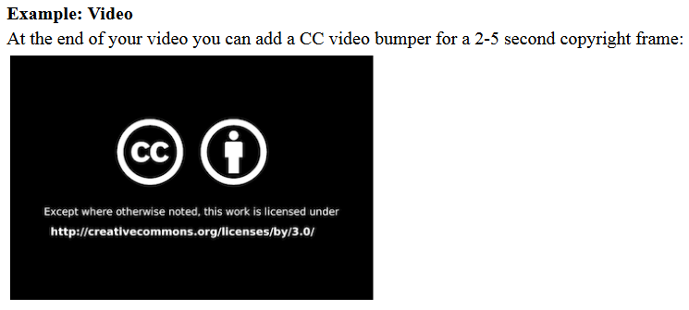
Example: video

Slide 42
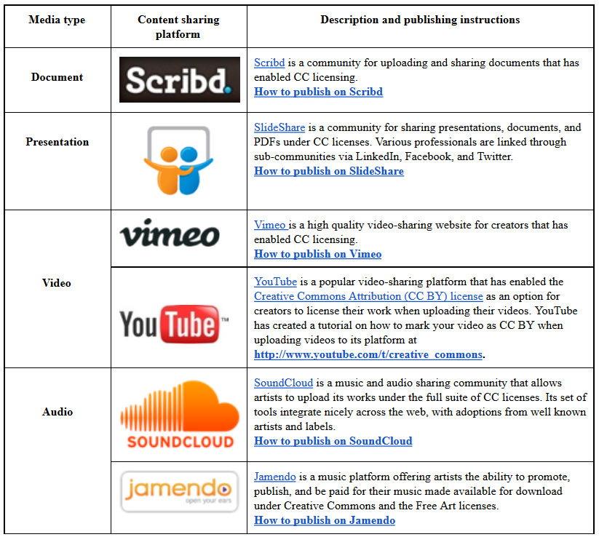
Publishing OER at CC-enabled content sharing platforms

Slide 43
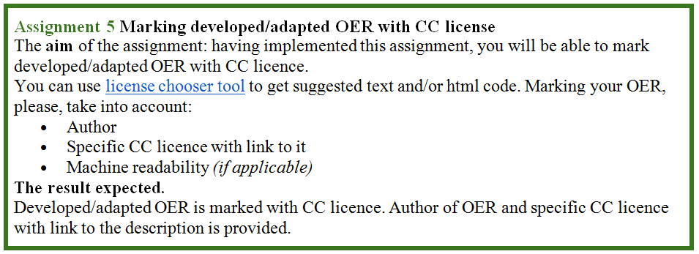
Assignment 5.

Slide 44
Contribution
Training material on “ICT tools to develop and adapt OERs“ was developed in the framework of Erasmus+ program project
OpenPROF – Open Professional Collaboration for Innovation
TM is available at
http://openprof.eu/training-material/Training_material_on_ICT_tools

Slide 45
http://openprof.eu/oer

Slide 46
Discussion: how was your process of developing/ adapting OERs?

Slide 47
2) to design a learning activity integrating OERs
to identify the “place” of OERs in curriculum (learning activities)
to contextualize OERs systematically with the learning curriculum (from the point of view of conscious curriculum designing and quality assurance)

Slide 48
TEL Curriculum designing

Slide 49
Re-thinking the types of learning/ teaching methods
D.Leclercq, M.Poumay, University of Liege, Belgium

Slide 50
Developing learning activities
Specific objective(s) | To be able to: Select... Describe... Draw...
Steps to achieve specific objectives | Go and find... Open... and write about... Use.... and present... …
Expected output/ indicators | A blog entry … A drawing... A math task solved...
Evaluation criteria | ………………… .............. .............
Evaluation tools | Test/ assignment
OER
OER

Slide 51
Resources: The JISC Open Educational Resources infoKit quality considerations
Can the content be described as follows?
Relevant, accurate, appropriate level of detail, objective, current and jargon-free
Of good provenance (consider the reputation of the author/institution), with a list of references if appropriate
Free of advertising
Does it fit my chosen pedagogy?
Learning outcomes are stated and match with learner’s needs
Engaging and interactive
Set at the appropriate level, with any prerequisite skills/understandings state
The time required to study is stated and equates to the importance of the learning outcomes achieved
https://oersynth.pbworks.com/w/page/51320241/EvaluationToolkit

Slide 52
Discussion
What role do you see for OERs in curriculum designing?

Slide 53
Thank you for your participation.
Dr. Airina Volungevičienė
Prof. Habil. Dr. Margarita Teresevičienė,
Vytautas Magnus University, Lithuania
Airina.volungeviciene, margarita.tereseviciene
[at]vdu.lt

