Slide 1

SWAYAM
&
SWAYAM PRABHA
INITIATIVES OF MHRD
Uma Kanjilal

Slide 2

SWAYAM (Study Webs of Active Learning for Young Aspiring Minds) - India MOOCs
SWAYAM PRABHA – DTH Project for educational excellence
Both Initiatives soft launched on August 15, 2016

Slide 3

In India where there is shortage of qualified
faculty and resource crunch in setting up physical
infrastructure to reach out the learners at mass
scale, MOOCs seems to be a viable solution.
However, instead of emulating the western world we need to design a solution that suits best with the
country’s pressing need to impart quality mass
education.

Slide 4
As one of the pillars of the ‘Digital India’ Initiative
of Government of India, SWAYAM seeks to bridge
the digital divide for learners who have hitherto
remained untouched by the digital revolution and
have not been able to join the mainstream of the
knowledge economy.

Slide 5

Massive Open Online Course (MOOC)
Massive - potential of extremely large enrolments
Open - both enrolment and resources point of view.
-- Courses are open to anyone without any restrictions or any prior learning requirements.
-- Open courses that are free for anyone interested in
registering with open courseware that can be downloaded, saved, and reused.
Online - content delivery mode.
Course - how a course operates requiring enrolment, a
definite timeline, instruction delivery and assessment.

Slide 6








Are MOOCs Really Open? MOOC or MOC?
No, all rights reserved.
Partial, CC BY-NC on some
No, non-OER license.
Yes, CC BY or CC BY-SA
No, all rights reserved.
Note: some institutions using CC anyway.
Most MOOCs are open only in the sense of free enrollment.

Slide 7

Components of a MOOC
Syllabus - learning objectives, scope of the topics, readings, discussions, assignments, and quizzes or tests, weekly schedule.
Readings and video lectures- archived material in xMOOC, and in a cMOOC, presentation by the facilitator each week or invite a guest lecture.
Learner Interaction- centralized discussions forums in xMOOCs or distributed open spaces viz. blogs, wikis, Facebook pages, and Twitter in cMOOCs.
Assessment and Certification- Quizzes, assignments, activities and projects for self-evaluation or with peer evaluation. In some cases it may lead to certification.

Slide 8
Growth of MOOCs
550+ universities. 4200+ courses. 35 million students.
Ecosystem developed around MOOCs with hundreds of people employed full-time, thousands of people involved in the creation of MOOCs, many millions in funding, and, millions in revenue.
The big three (Coursera, Udacity, edX) employ more than a hundred people each.
universities are employing teams of video assistants, instructional designers, TA’s, and other staff to support the more than 3,000 instructors that have created these courses.
22 of the top 25 US universities in US News World Report rankings are now offering courses online for free.
Source: https://www.class-central.com/report/moocs-stats-and-trends-2015/

Slide 9
Ten Most Popular Courses in 2015
A Life of Happiness and Fulfilment (Indian School of Business & Coursera)
Introduction to Programming with MATLAB (Vanderbilt University & Coursera)
The Great Poems Series: Unbinding Prometheus (OpenLearning)
Marketing in a Digital World (UIUC & Coursera)
Fractals and Scaling (Santa Fe Institute & Complexity Explorer)
What is a Mind? (University of Cape Town & FutureLearn)
Algorithms for DNA Sequencing (Johns Hopkins University & Coursera)
Mindfulness for Wellbeing and Peak Performance (Monash University & FutureLearn)
Programming for Everybody: Getting Started with Python (University of Michigan & Coursera)
CS100.1x: Introduction to Big Data with Apache Spark (UC Berkeley & edX)
Source: https://www.class-central.com/report/moocs-stats-and-trends-2015/

Slide 10
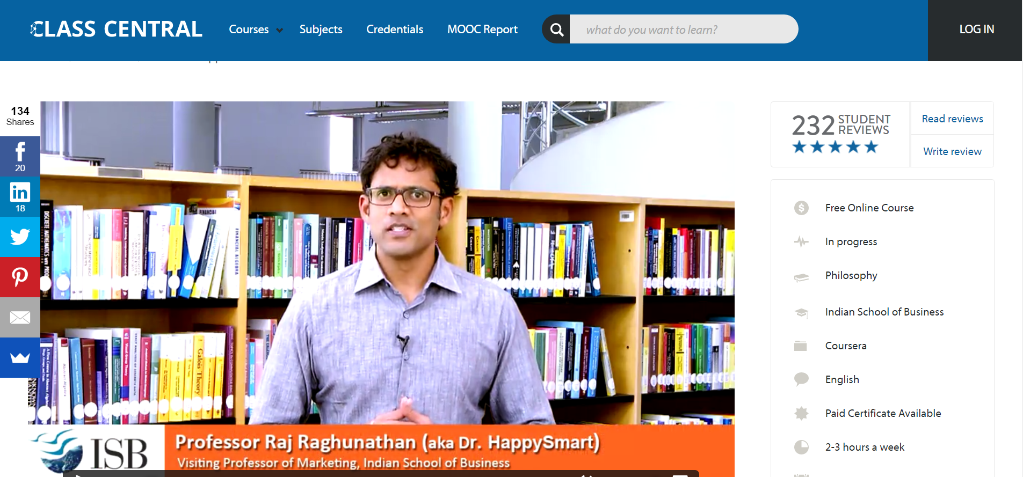
https://www.class-central.com/mooc/2860/coursera-a-life-of-happiness-and-fulfillment

Slide 11

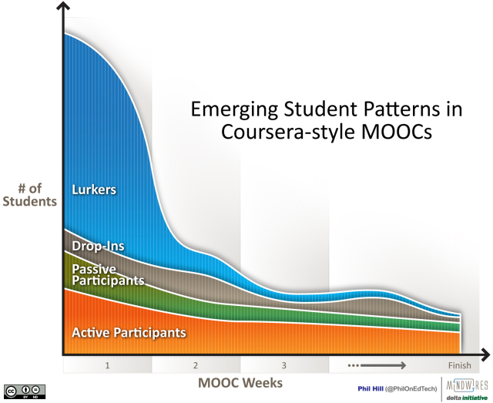
Source: http://mfeldstein.com/emerging_student_patterns_in_moocs_graphical_view/

Slide 12
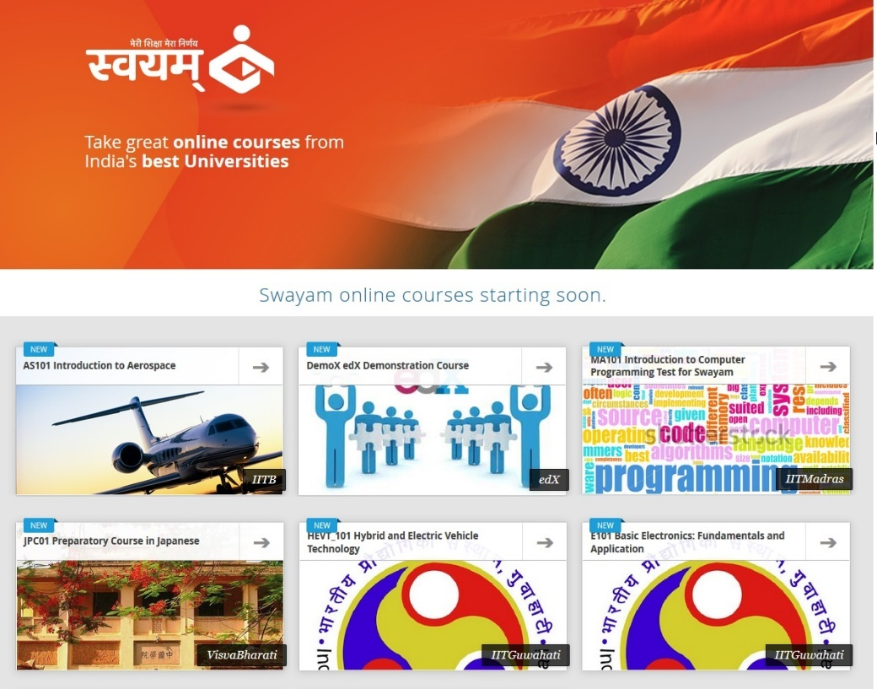
SWAYAM, Built on Open-edX

Slide 13
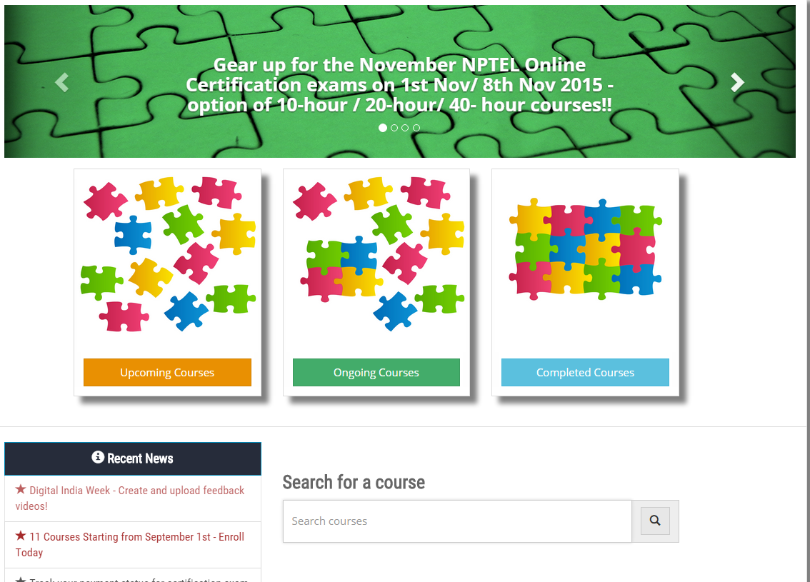
http://nptel.ac.in/noc

Slide 14
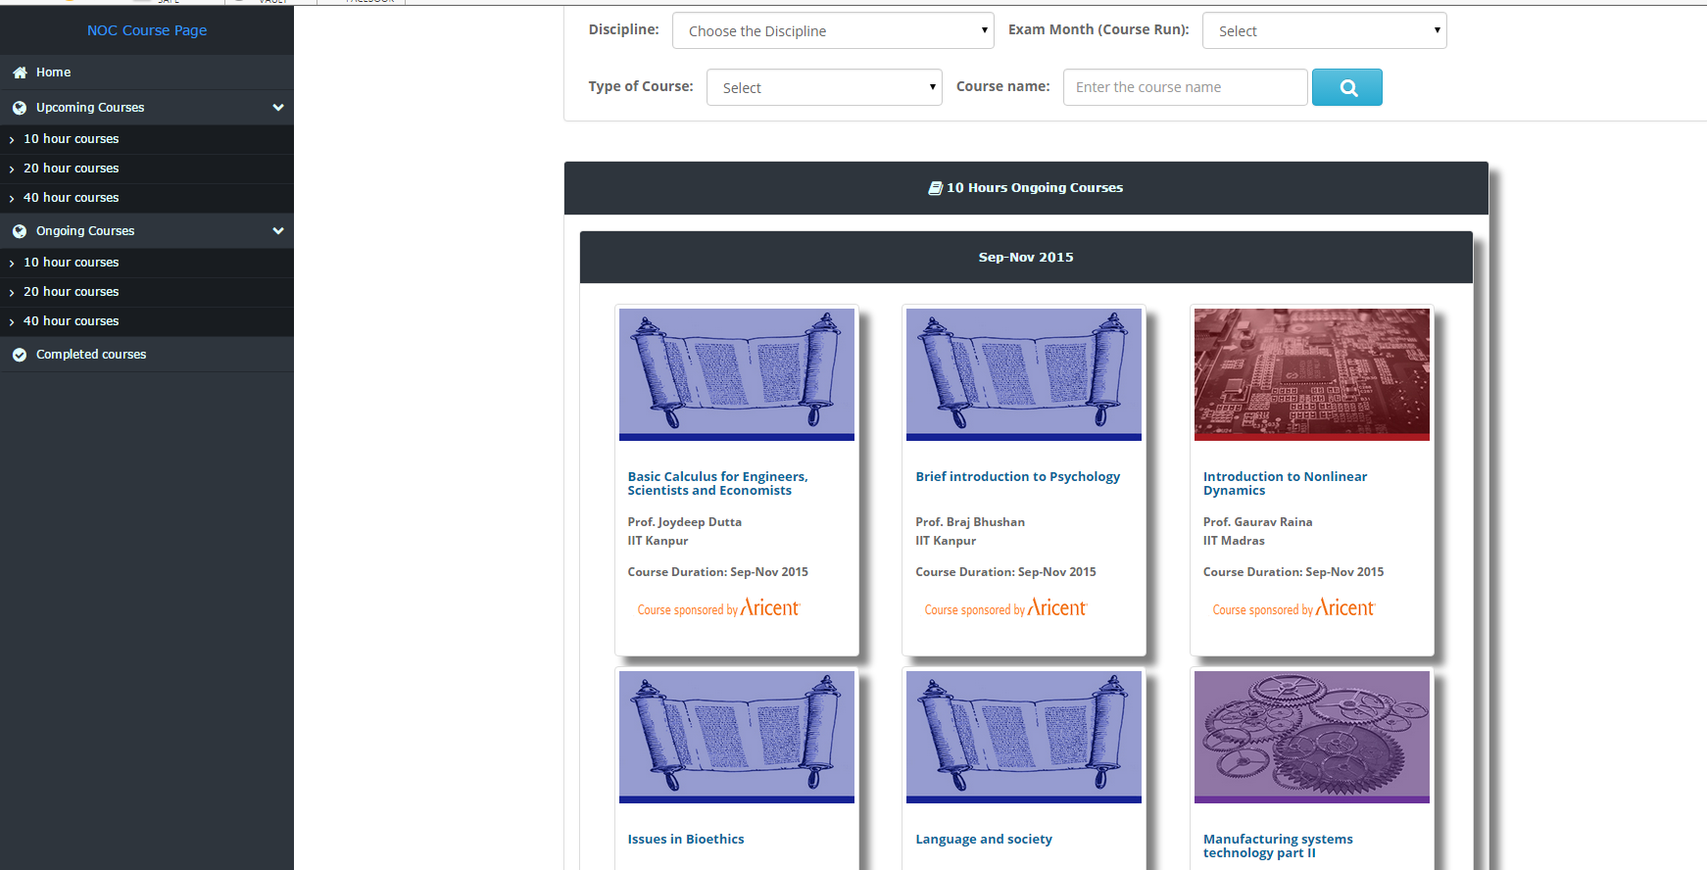
http://nptel.ac.in/noc

Slide 15
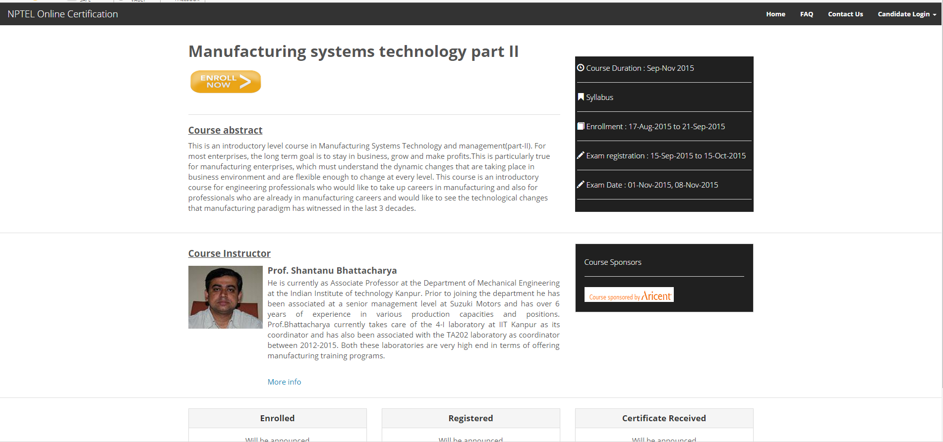
http://nptel.ac.in/noc

Slide 16



NPTEL Online Certification (NOC)
Open Online Course (Enrollment is free)
  onlinecourses.nptel.ac.in
Proctored Exam(optional for a free)
  cities across the country
Certificate
  e-verifiable, from IITs

Slide 17
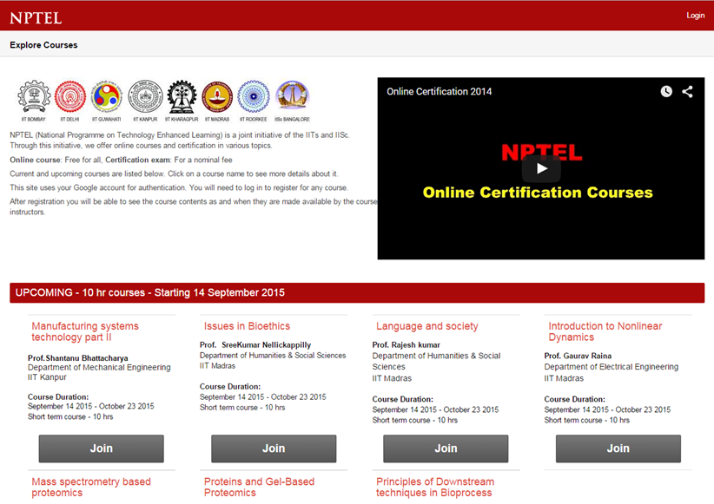
onlinecourses.nptel.ac.in

Slide 18
https://onlinecourses.nptel.ac.in
Certification Exam
Course Content - Video Lectures
Discussion Forums
Assignments
‘Hangouts in Air’ by Faculty
Inputs from Faculty / TAs
NPTEL Open Online Courses

Slide 19
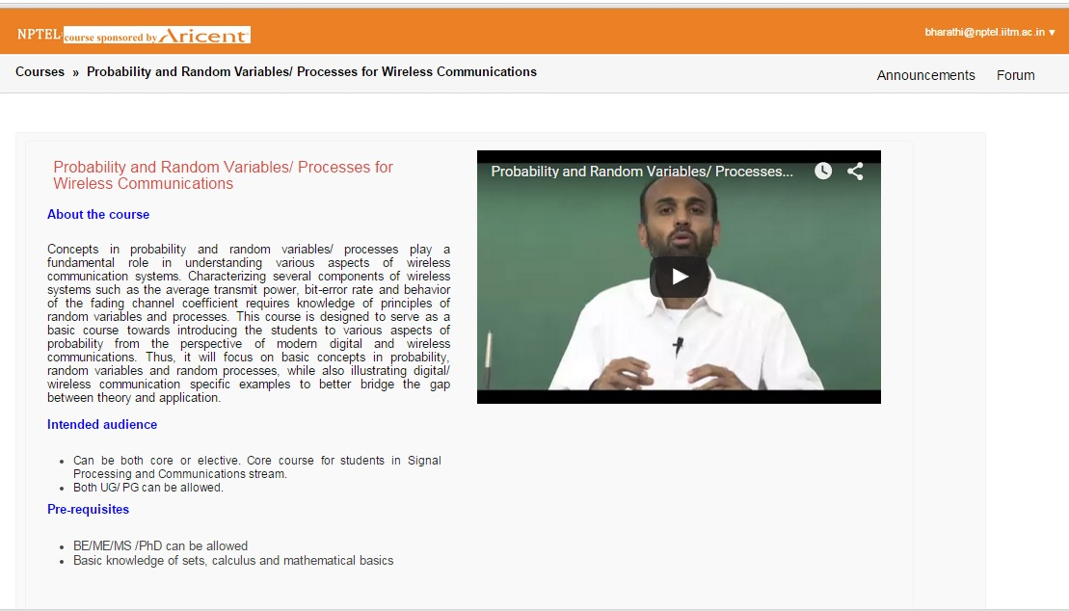
Course Introduction Page

Slide 20
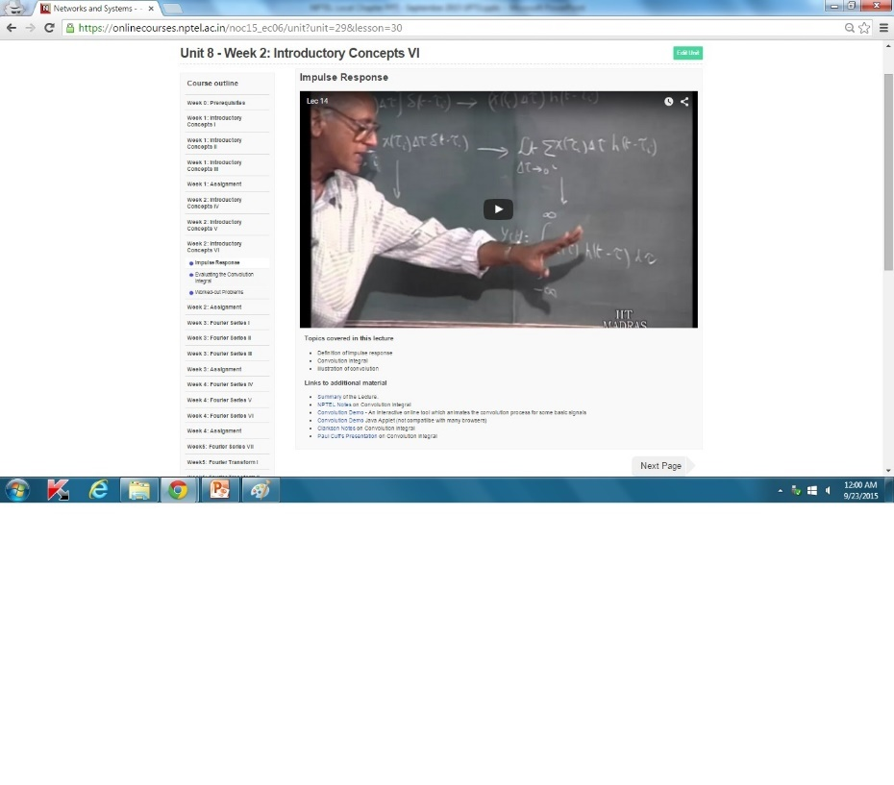
Course Lesson Page

Slide 21
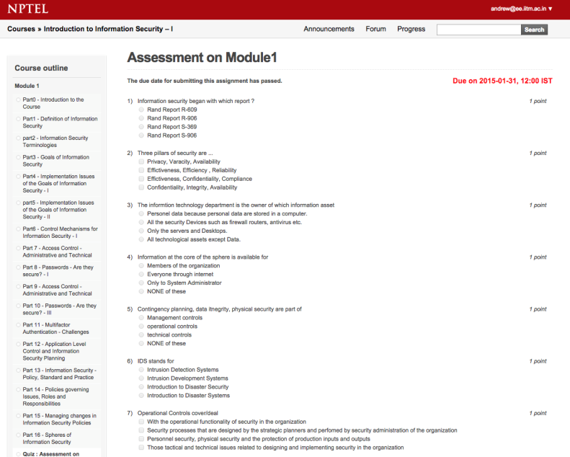
Assessment Questions

Slide 22
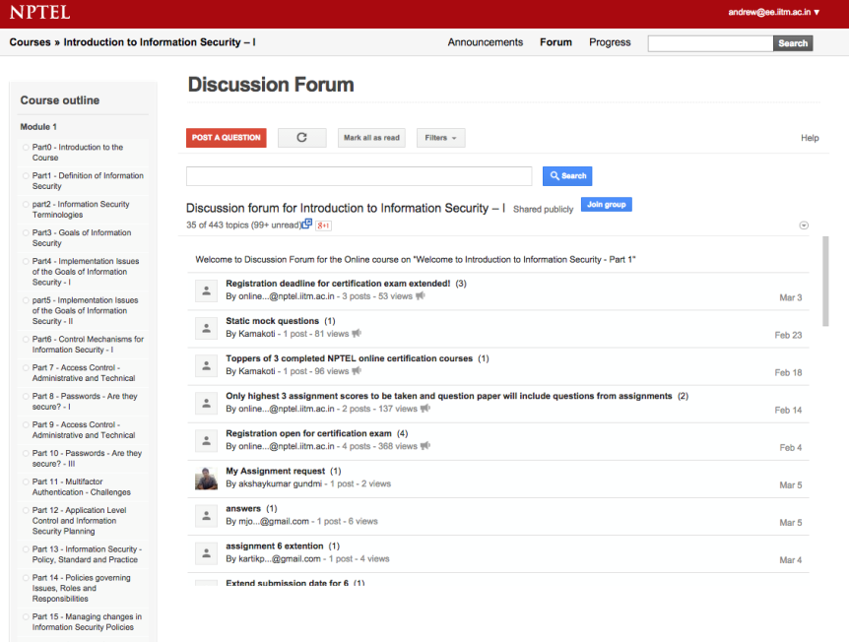
Discussion Forum

Slide 23
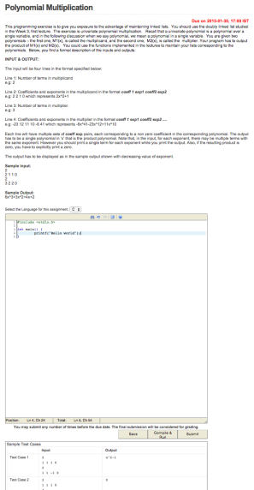
Features of Online Course Portal
Usual features
  Videos, Forum, Assignments
Unique features
  Hands-on programming
    C, C++, Java, Verilog
  Subjective assignments
    grading by TAs possible
  Mentors
    monitor student grades

Slide 24
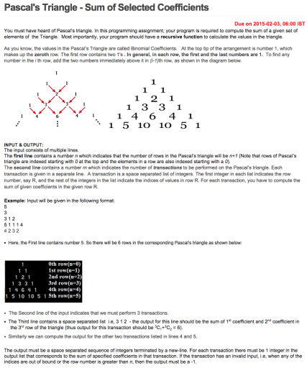
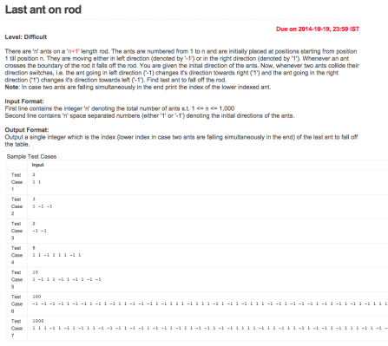
Sample Programming Assignments

Slide 25

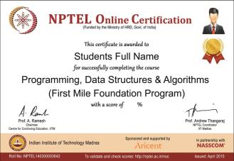
Features of Certification Process
Proctored exam
  run by a partner
  centers across the country
  around Rs. 1000 per student
  programming exam for programming courses
Certificate
  from IITs
  e-verifiable through url
  with NASSCOM, if fitting

Slide 26
Types of Courses
Half-semester: 20 hours
  8 weeks, 2.5 hours of lecture per week
  Weekly assignments
  Run like a typical MOOC
Full-semester: 40 hours
  12 weeks, 3-4 hours of lecture per week
  Two quizzes or practice exams
  Mostly use existing NPTEL course material for self-study
10 hr courses (1 credit equivalent)
  4-5 weeks, 2-2.5 hrs of lecture per week
Disciplines
  Engineering & Sciences
  Humanities /Management

Slide 27
SWAYAM is a:
  One-stop web and mobile based interactive platform courses ranging from High School to University level.
  High quality learning experience using multimedia on anytime, anywhere basis.
  State of the art system that allows easy access, monitoring and certification.
  Peer group interaction and discussion forum to clarify doubts
  Hybrid model of delivery that adds to the quality of classroom teaching.

Slide 28
National Coordinators
Sl. No | National MOOCs Coordinator | Sectors
1. | University Grants Commission (UGC) | Non Technology Post Graduation Degree Programme
2. | NPTEL | Technical / Engineering UG & PG degree programme.
3. | Consortium for Educational Communication | Non Technology Under Graduation degree programme.
4. | IGNOU | Diploma and Certificates
5. | CBSE, NCERT & NIOS | Classes 9th to 12th
6. | IIM Bangalore | Management Courses
7. | NITTTR, Chennai | Teacher Training

Slide 29
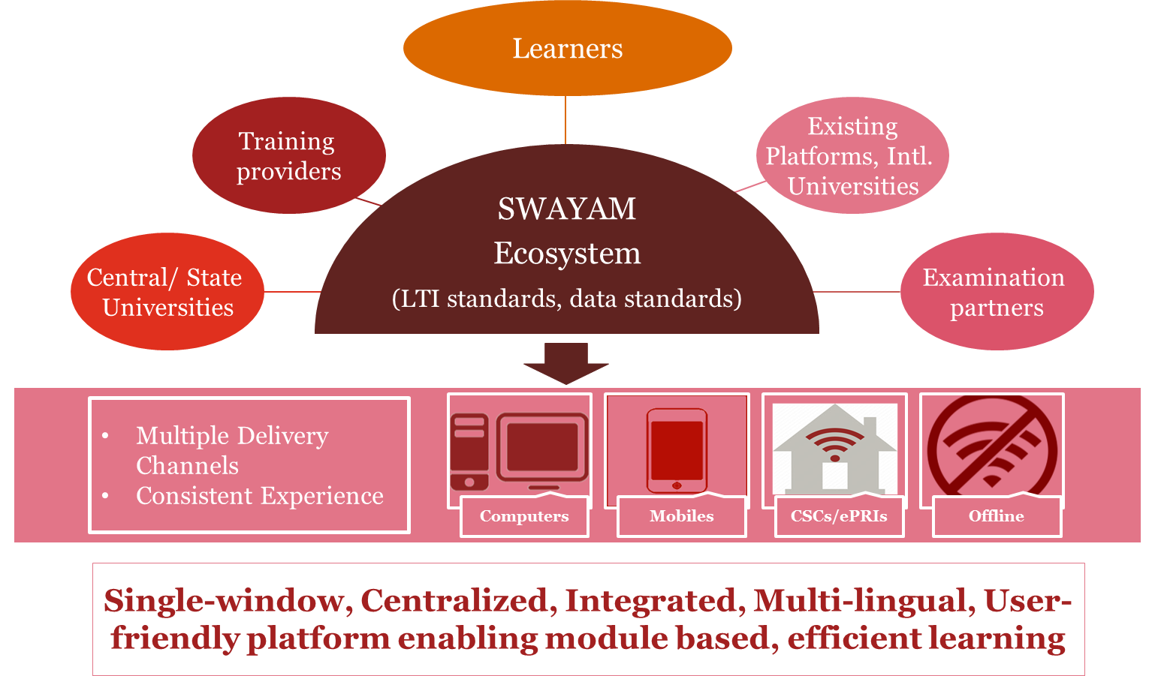

Slide 30
    Four quadrant approach
      Quadrant-I is e-Tutorial: Video and Audio Content in an organisd form, Animation, Simulations, video demonstrations, Virtual Labs, etc.
      Quadrant-II is e-Content: PDF, Text, e-Books, illustrations, video demonstrations, documents and Interactive simulations wherever required.
      Quadrant-III is Web Resources: Related Links, Wikipedia Development of Course, Open source Content on Internet, Case Studies, books including e-books, research papers & journals, Anecdotal information, Historical development of the subject, Articles, etc.
      Quadrant-IV is Self-Assessment: Problems and Solutions, which could be in the form of Multiple Choice Questions, Fill in the blanks, Matching Questions, Short Answer Questions, Long Answer Questions, Quizzes, Assignments and solutions, Discussion forum topics and setting up the FAQs, Clarifications on general misconceptions.

Slide 31

Elements for the overall SWAYAM courses
Syllabus Template (including a course description with key learning outcomes, descriptions of faculty, a detailed course content outline, expectations for participation, certification, and faculty communication, netiquette guidelines, and academic integrity).
Pre- and post-course surveys
Course overview to orient on: What is the course about? What does the course include? What will I learn in the course? How do I use the course features?
Course timeline for scheduling learning activities (week-wise detailed plans)
List of Announcements to deliver reminders for due dates and course transitions.
Instructions on synchronous and asynchronous engagements (prompts for students to post in the Discussion Forum, polling questions throughout the course, interaction with faculty/ TA (eTutor) as per instruction)

Slide 32
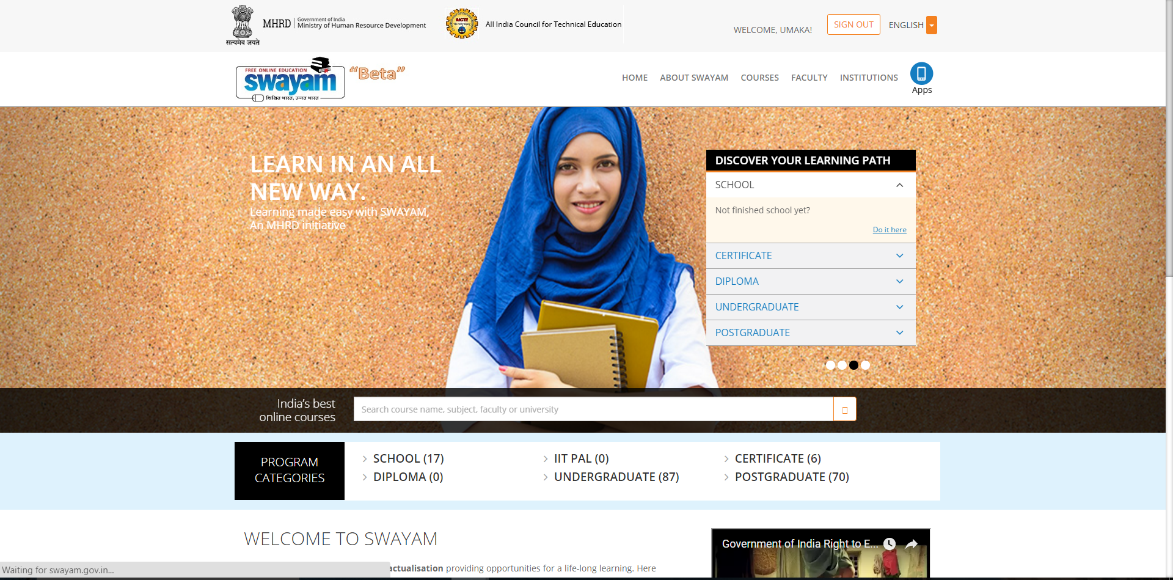
Swayam.gov.in

Slide 33
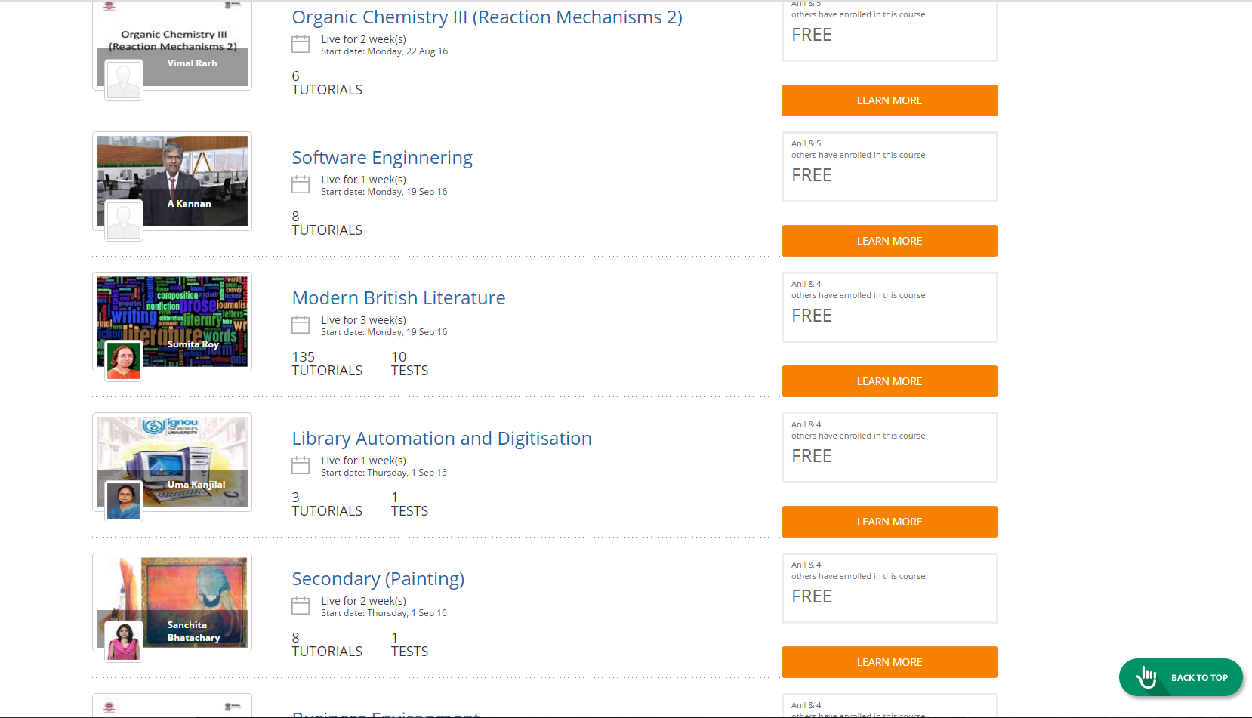

Slide 34
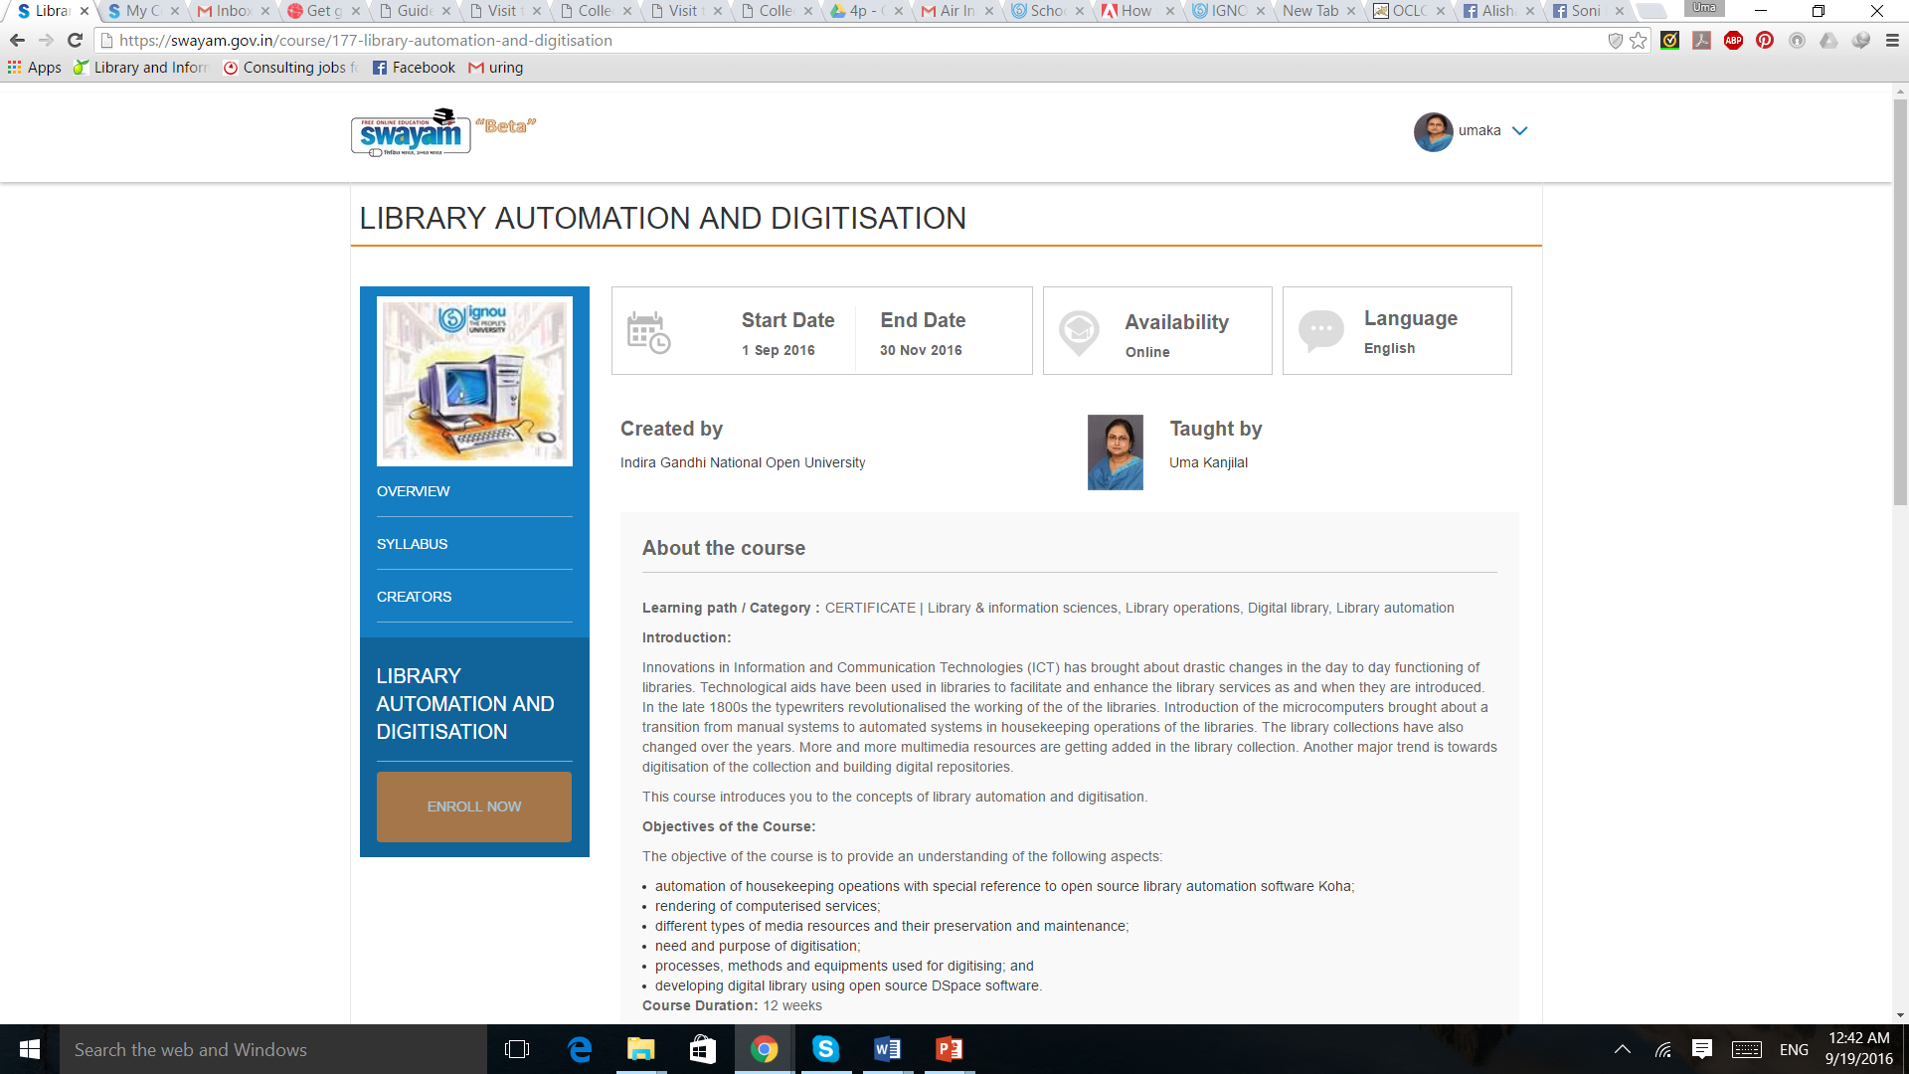
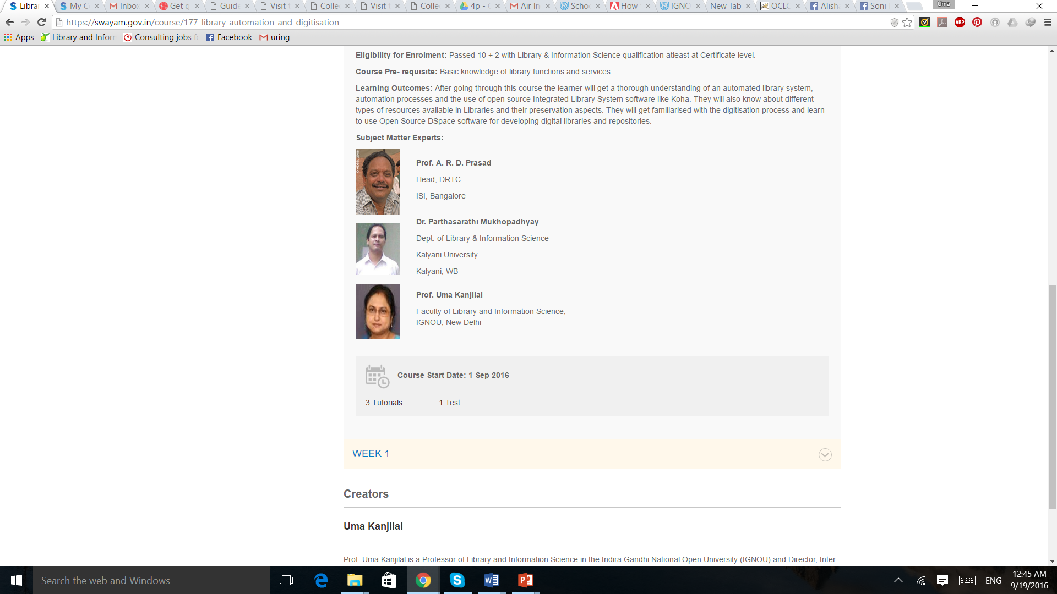

Slide 35
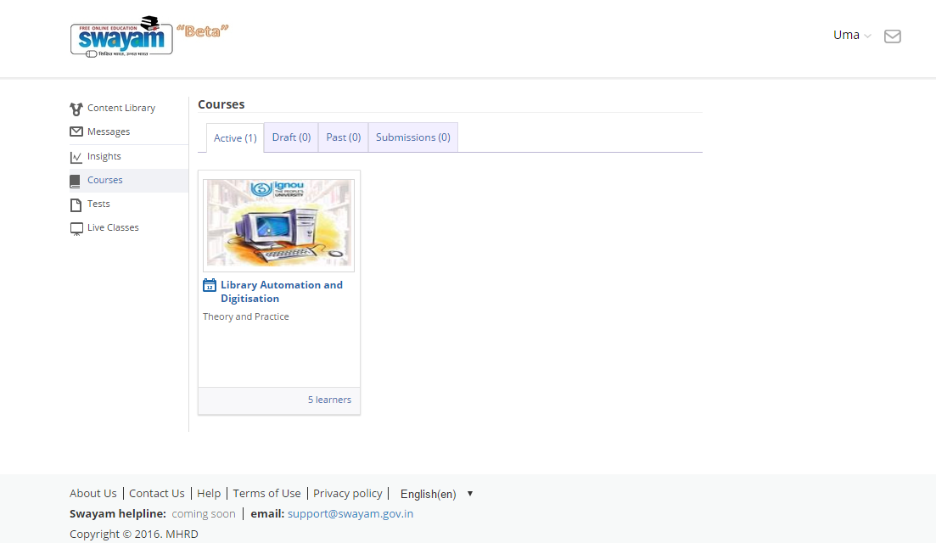

Slide 36
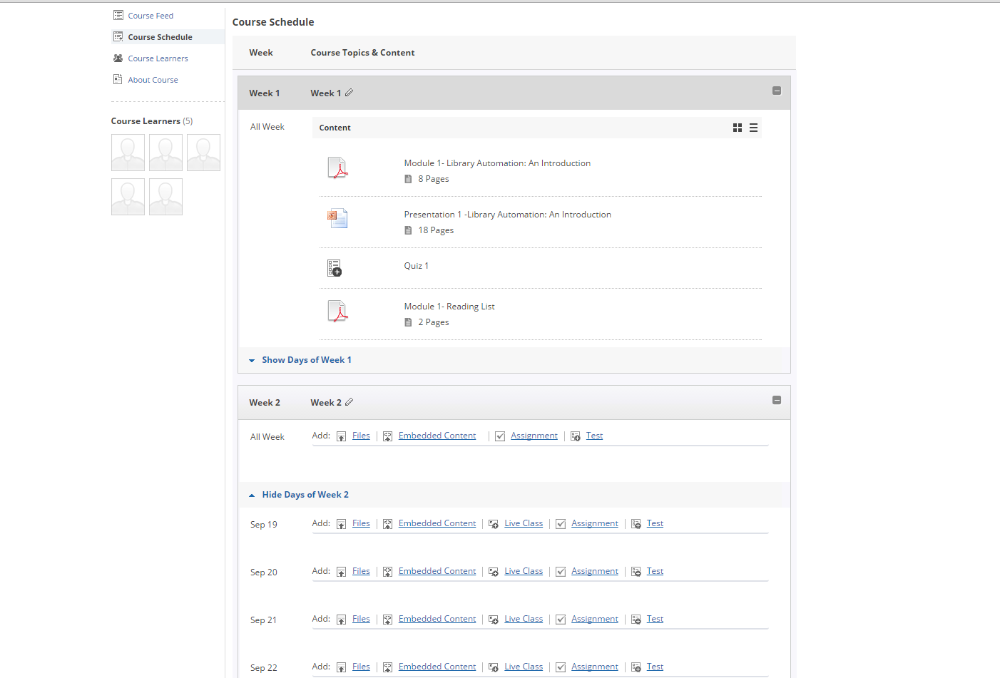

Slide 37
Weekly lesson plan template
Week 1:Introduction, Learning Outcomes
Content | Activities | Assessment
Video/s | Assignments | Quiz
Multimedia e-content (inclusive | Discussion | Peer Assessment
of graphics/ animations/ | Practical assignment (as per | Any other…
scenarios/ case-study) | requirement)
Textual Handout | Any other…
Reading list (core and
supplementary)

Slide 38

Continuous Assessment Options
Multiple choice tests (quiz tool)
Tutor Marked Assignments
Activity based assessment:
- Write a commentary, review, comparison, analysis, and observation within your community, reflection (peer assessment).
- Response to a text, video or other media object for homework (peer assessment).
- Prepare a presentation and upload (text, photo, video, PPT).

Slide 39

Certification through SWAYAM
  Accepted and approved evaluation format in alignment with CBCS or any other system that UGC, AICTE, etc. may implement from time to time for credit-based courses, with a term/semester end proctored examination.
  The proctored exam to be conducted nationwide through an exam partner.
  Learners can get a certificate after they have registered for, written the exam and successfully passed.
  The online assignments/quizzes may carry weightage in the final consolidated score.

Slide 42
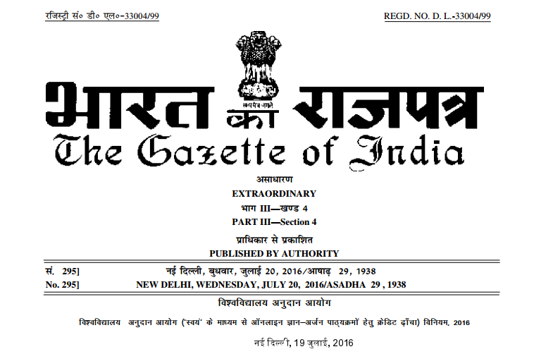

Slide 43
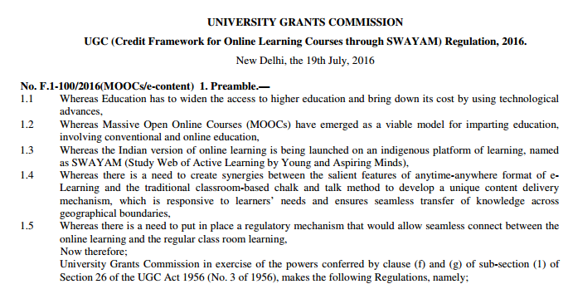

Slide 44
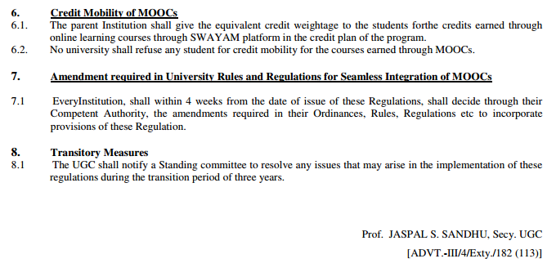


Slide 45
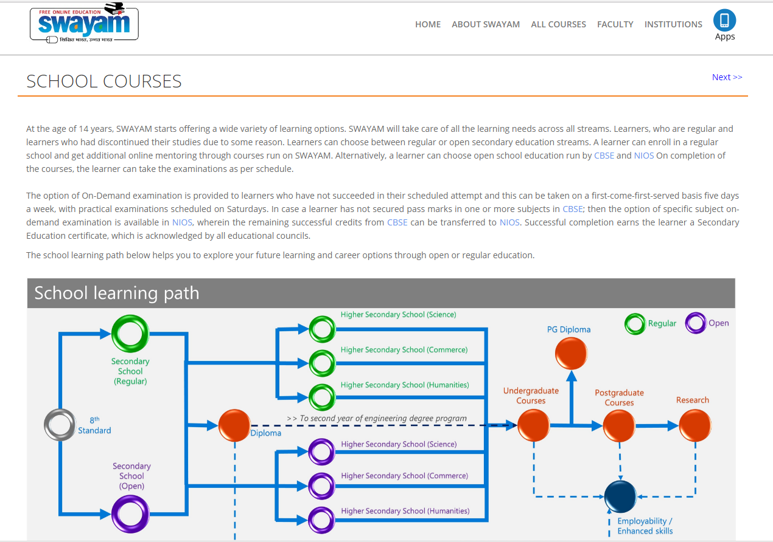

Slide 46
SWAYAM PRABHA – DTH Project for educational excellence
MHRD project using two GSAT-15 transponders to run (32) DTH channels to telecast high quality educational programmes on 24X7 basis.
Satellite up-linking station at the Bhaskaracharya Space Application Centre of Gujarat (BISAG).
The subscribers of Free DTH service of Doordarshan can view these Educational channels using the same Set Top Box and TV. No additional investment is required.
video lessons of SWAYAM would be converted into appropriate format and transferred to BISAG for transmission on the DTH channels.
Every day, there will be new content of at least 4 hours which would be repeated 6 times a day.
Curriculum based course contents covering diverse disciplines.
Channel partners – IITs, NPTEL, UGC, CEC, IGNOU, NCERT and NIOS

Slide 47

ORGANISATIONAL STRUCTURE & ROLES
Operations and Monitoring Group
Technical Committee
(6) National Coordinators: NPTEL, UGC, CEC, IGNOU, NCERT, NIOS
(32) Channel Coordinators for managing the channels
Subject Matter Experts (SMEs) for content creation and delivery
Technical Committee

Slide 48

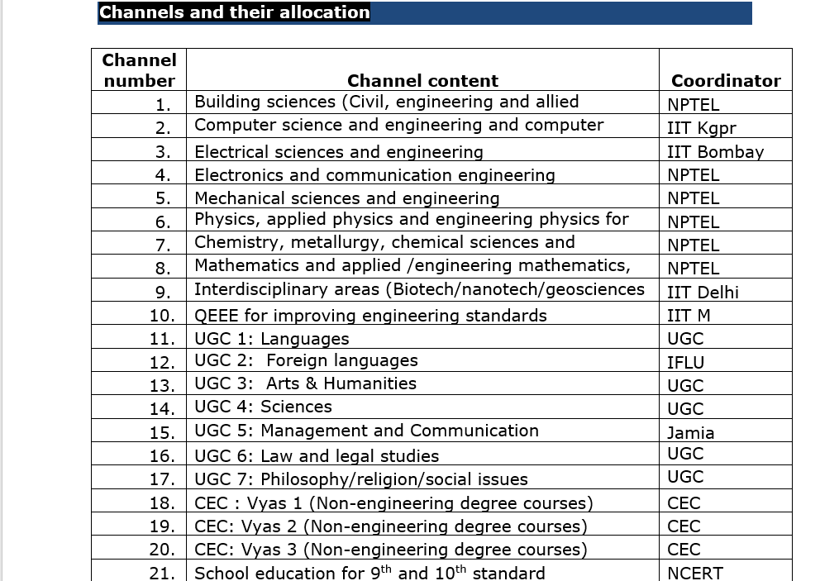
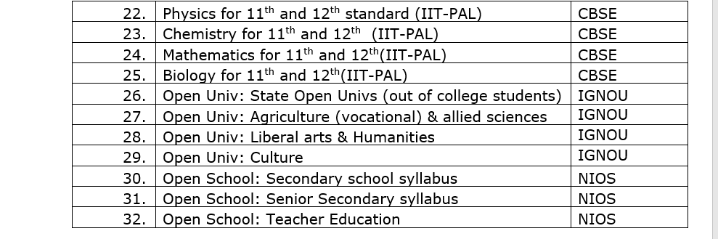

Slide 49
Major MOOCs Issues requiring attention
MOOCs at present are courses not curricula. Only 20% at the moment acceptable for credit earning.
Learning environment is not just content and self assessment. How to mentor 30 million?
Large number of users are only window shoppers, this is bound to happen in SWAYAM as well.
MOOCs do not provide the kind of engagement to encourage learning.
Credit given by the institutions creating MOOCs. Acceptance by other institutions is going to be a major issue.
How the proctored exams are to be conducted for 30 million learners envisaged for SWAYAM in three years?

Slide 50
Thank You
ukanjilal@ignou.ac.in

