Slide 1


PDF | ePub | Flipbook | QR Code
Understanding eBooks types and possibilities
Welcome

Slide 2
What are eBooks
An e-book or electronic book is a non-editable text that is converted into a digital format and displayed and read on an electronic device, such as a tablet or smartphone.
While so many people have access to an e-book over multiple electronic devices, no one should be able to change the content without the author’s permission.
"an electronic version of a printed book“.

Slide 3

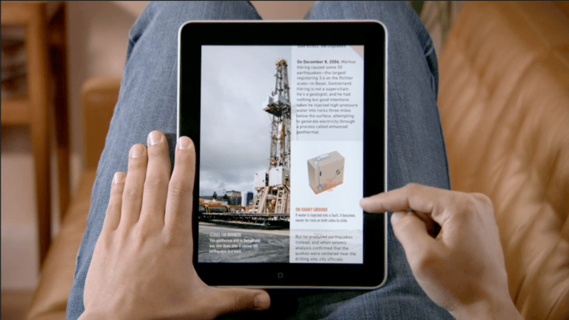

Types of eBooks
PDF (Portable Document Format)
FLIPBOOK
EPUB (electronic publication)

Slide 4
PDF vs FLIPBOOK
PDf | Flipbook
Old PDFs are Image based. | Improves visual appearance of your PDF files.
None audible | Text to speech features are available
to open a PDF we must first download it | You don’t need to download them, they work smoothly on all smartphones, tablets, laptops and computers.
Format versions for PC and Tablet | Same files for all Devices – PC, Tablet, Mobile Phones, iPod

Slide 5


PDF vs ePub (ePub 3.2)
PDF files are not easily reflowable | Reflowable
None audible | Text to speech features are available
Conversion of PDF files to a web- friendly format is difficult. | EPUB is written primarily in two languages, XML and XHTML. This means it works well with most types of software.
Most of the old PDF are Image based | Text based
Format versions for PC and Tablet | Same files for all Devices – PC, Tablet, Mobile Phones, iPod
 | EPUB is also an open format, which means that anyone can use it.

Slide 6
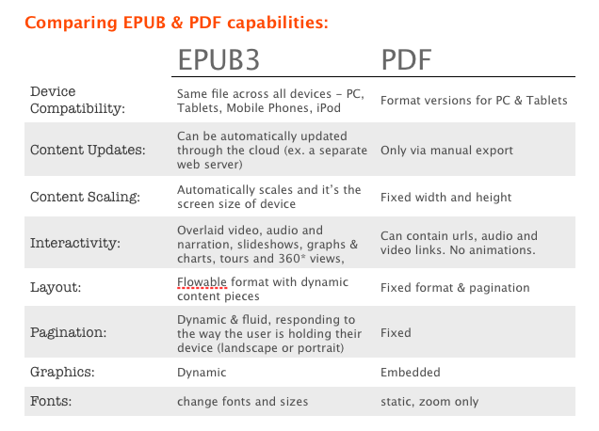
Contd.

Slide 7



eBooks Available on Following Places
NCERT Official Website
PDF Versions are available
DIKSHA Portal and Mobile App
eBooks, eResources with Energized textbooks
ePathshala Portal and Mobile App
Flipbook and ePub format are available

Slide 8
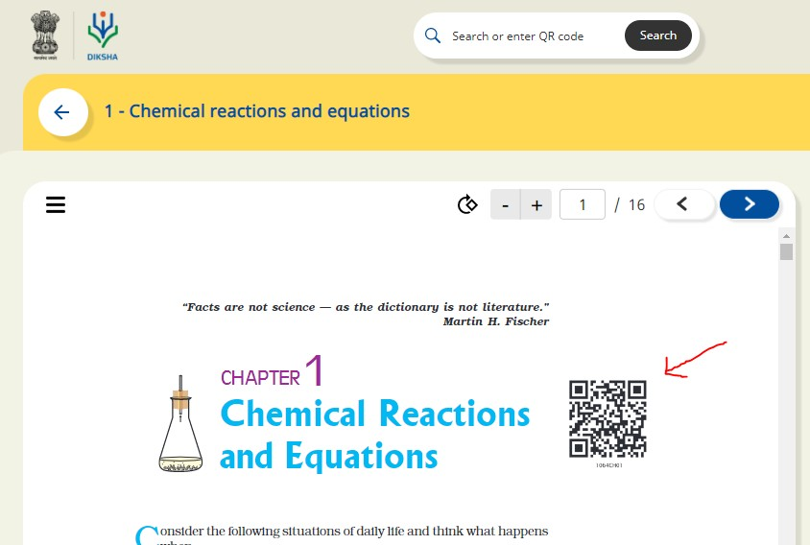
Energized Textbook
Energized Textbook (ETB) is a feature aimed at providing access to digital content for various topics in physical textbooks.
QR codes are attached to physical textbooks and related content is created on DIKSHA. This document explains the procedure of scanning QR Codes in DIKSHA and accessing related content using QR code.

Slide 9
QR Code- quick response code
A QR Code is a two-dimensional barcode that is readable by smartphones.
Static QR Codes encode the content directly in the image itself. You can think of them like regular printed text, just represented in different way. That means you cannot update the content once generated. Because the content is directly encoded in the image, they also grow in size with the amount of content they store.

Slide 10
Steps to generate QR code by Google Sheet?
Step 1: Firstly we need to create 4 columns named Domain URL, Code, Complete URL and QR Code on a Google sheet.
Step 2: Fill the columns as following:
Domain URL- We have to write domain name (https://epathshala.nic.in/QR/?id=)
Code: We have to write code of the title like (1064CH01)
Complete URL: =CONCAT(A2,B2)
QR code:
=image("http://qrickit.com/api/qr.php?addtext="&B2&"&qrsize=300&t=p&e=m &d="&C2)
Step 3: To download QR codes we need to download it as PDF first as below.
Go to : File→ Download as→ PDF Document (.pdf)

Slide 11
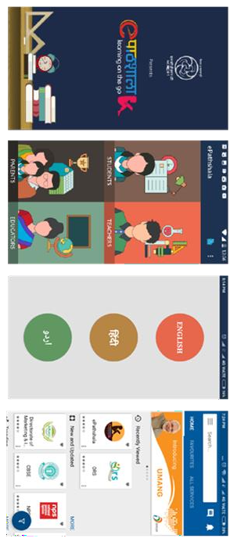
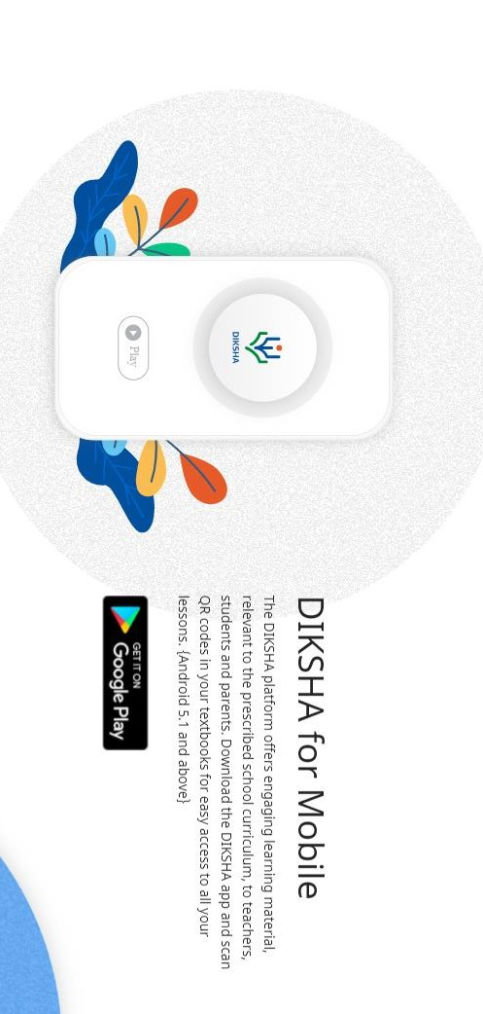
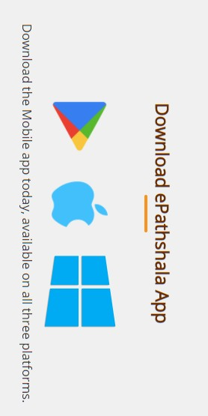

DIKSHA and ePathshala Mobile App

Slide 12
Thank you
Doubts and Questions
Shalini Malhotra ,Technical Team lead,CIET,NCERT

