Slide 1
Orientation of State Resource Groups (SRGs) on Development of eContents for DIKSHA (2023-24)
Accessible Digital Resources, CWSN Vertical
Date: 30/10/2023, Session – 03
Time: 02.00 -03.00 pm
Presented by : Dr Rajesh D, Associate Professor – DICT & Training

Slide 2
ASSISTIVE TECHNOLOGIES
“Disability results from the interaction between persons with impairments and attitudinal and environmental barriers that hinder their full and effective participation in society on an equal basis with others”-(CRPD-2006)
Any Software, Device/gadget or system that can assist person with special needs.
A major prerequisite to achieve inclusive education
The Universal Design for Learning (UDL) has a great role to play.

Slide 3
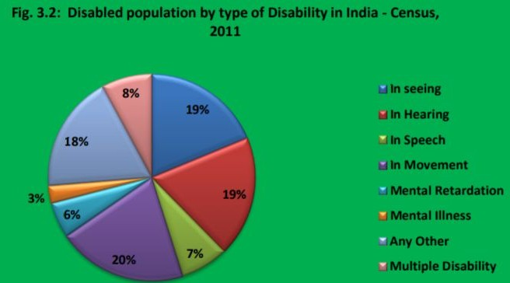
CWSN - STATISTICAL DATA
As per the Census 2011, differently abled population in India is 26.8 million (2.21%)

Slide 4
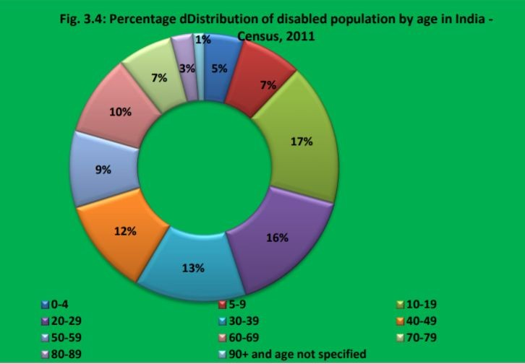
CWSN
CENSUS DATA
2011

Slide 5
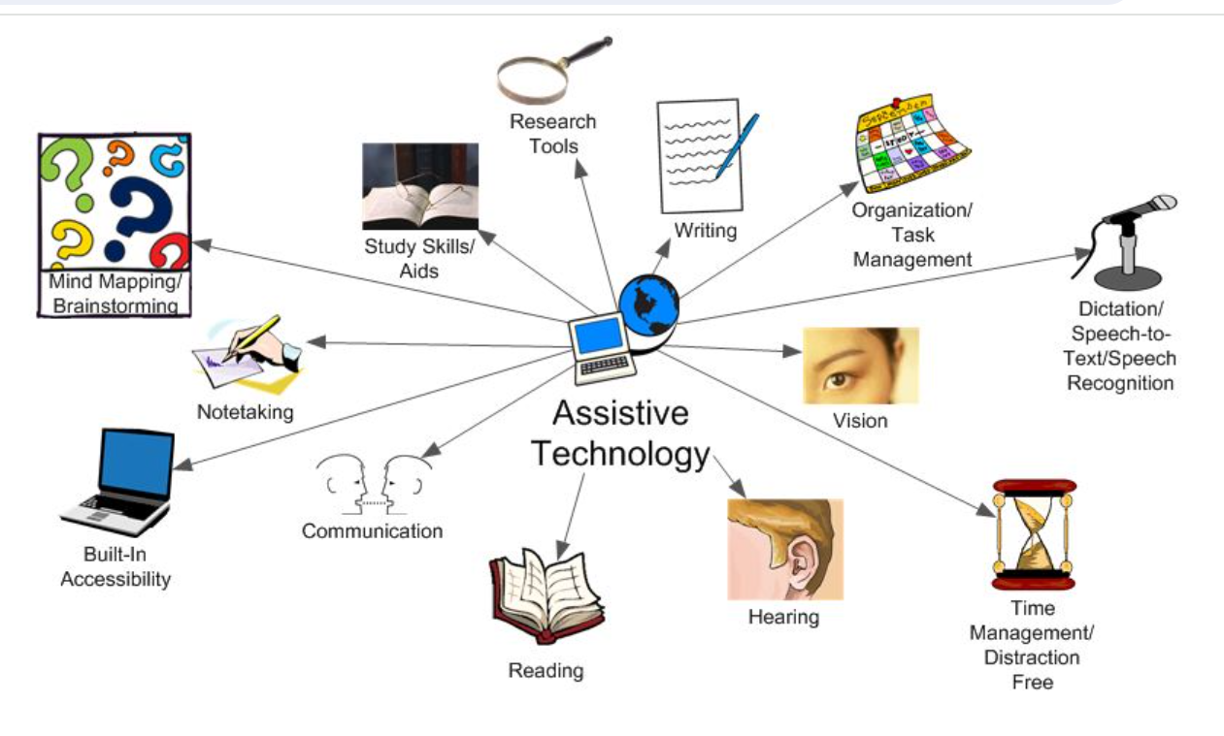
Source: https://www.augsburg.edu/class/groves/assistive-technology/everyone/

Slide 6
Common Assistive Technologies
Text-to-speech
Speech-to-text (dictation)
Word prediction
Screen reader
Screen recorder
Optical Character Recognition (OCR) -converts text in image ﬁles into digital text
braille displays
screen magniﬁers

Slide 7
Text to Speech (TTS)
Technology that reads digital text aloud Convert words into audio
Helpful for people who struggle with reading
Reading speed can usually be controlled - speed up or slow down
Some TTS tools can also read text aloud from images.

Slide 8
Types of TTS Tools
Built-in text-to-speech in devices (desktop and laptop computers, smartphones, digital tablets, and Chromebooks)
Web-based tools: Some websites have TTS tools on-site
Text-to-speech apps: users can download TTS apps on smartphones and tablets
Text-to-speech software

Slide 9
Online AI tools for Learning
OCR - https://www.onlineocr.net/
TTS - https://www.naturalreaders.com/
Dictation - https://speechnotes.co/, https://dictation.io/
Screen Reader - JAWS, NVDA and Narrator (Windows). Screen magniﬁcation - magniﬁer app on Windows

Slide 10
Built-in Assess ability Features in Android
For reading: TalkBack, a screen reading feature, uses TTS technology to read aloud text from websites, emails and more. The tool’s voice can be changed, and the reading speed can be adjusted.
For writing: Built-in dictation. By pressing the microphone button in the onscreen Google keyboard, users can type with their voices. The keyboard also has built-in word prediction, which suggests words.
For motor skills: Accessibility Menu (on-screen) to control your Android device. You can control gestures, hardware buttons, navigation, and more.
Take screenshots, Lock your screen, Open Google Assistant, Open Quick Settings and Notifications, Turn volume up or down, Turn brightness up or down.

Slide 11
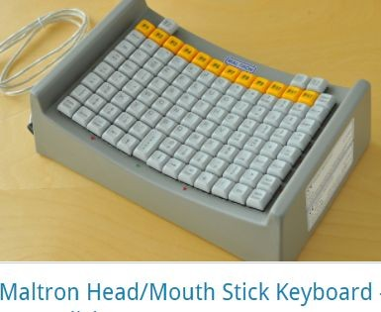
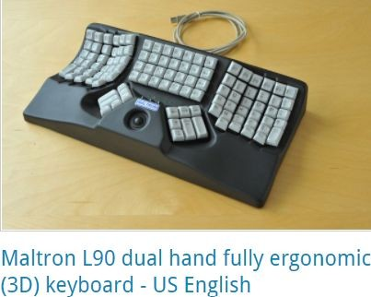
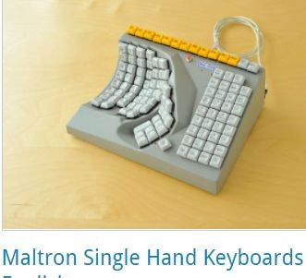
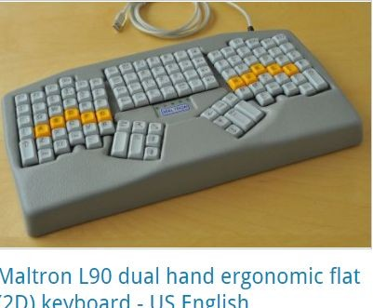
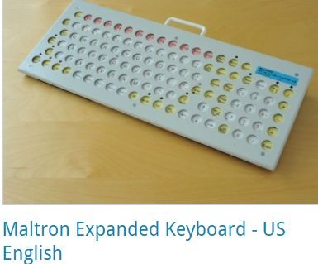
Alternative Key Boards
v

Slide 12
Alternative Input Devices
Head pointers
Single switch entry devices
Foot switches
Sip-and-puff switches - https://youtu.be/Bhj5vs9P5cw
Eye-tracking software
Augmentative and Alternative Communication (AAC) tool
Dynavox AAC device - https://youtu.be/g95TO20hnmo
Braille display - refreshable. converts the digital text on the screen into braille
Braille notetaker - https://youtu.be/dV0KZtVmcIo

Slide 13
Ensuring Web Accessibility as an E- Content Developer
Web is fundamentally designed to work for all people, whatever their hardware, software, language, location, or ability.
However, when web sites, applications, technologies, or tools are badly designed, they can create barriers

Slide 14
Ensuring Web Accessibility as an E-Content Developer..Contd…
Alternative Text for Images - for people who cannot see and use a screen reader
Keyboard Input - those who cannot use a mouse due to limited ﬁne motor control. Helps assistive technologies that mimic the keyboard, such as speech input.
Transcripts for Audio - people who are deaf or hard of hearing, as well as to search engines
Sign language interpretation of audio content
Operable user interface and navigation

Slide 15
Thank You

