Slide 1
Professional Audio Editing Soft wares

Slide 2
What is Audacity?
Audacity is a free open source digital audio editor and recording computer software application, available for Windows, macOS/OS X, Linux and other operating systems.
Interestingly, you do not need sound mixer or other sophisticated device to use it.

Slide 3
What facilities it gives?
You can record by default microphone or by external microphone.
You can edit, import and export audio files.
You can mix tracks by using envelop.
You can create effects and even increase amplitude.
You can use multiple tracks.

Slide 4
How to get it?
Go to google and type Audacity downloads.
It will take you to the options.
Install the software x 2.2.1
Install Lame_v3.99.3_for_Windows to mix down
Tutorials are also available.

Slide 5
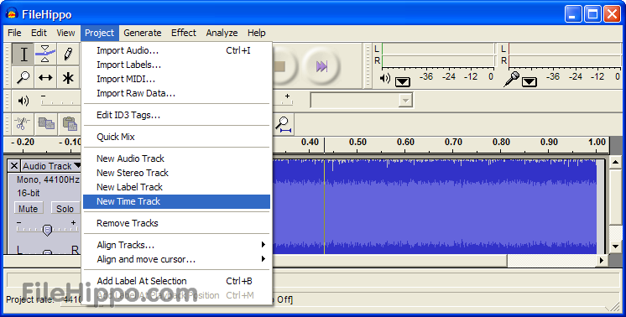
How to begin…??
Step-1- Go to file and click “New” a new window will appear
Step-2- Go to “Tracks’ toggle down and click on “Add New”
A New Track will appear in which you can record your voice or sound.
You can insert more tracks by same exercise.

Slide 6
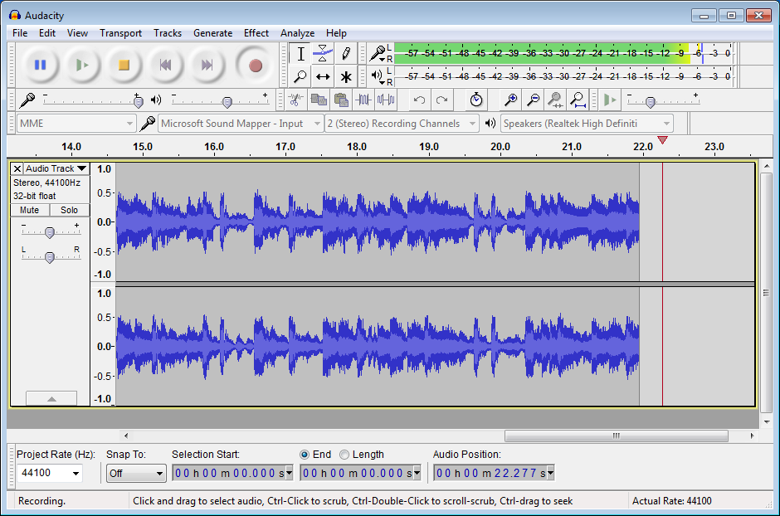
How to Record?
You have two option either by default microphone or by external microphone. Ensure that proper silence around is maintained.
Click on the Red recording button and speak. Recording begins.
Stop by STOP button or by the SPACE Bar of you computer.

Slide 7
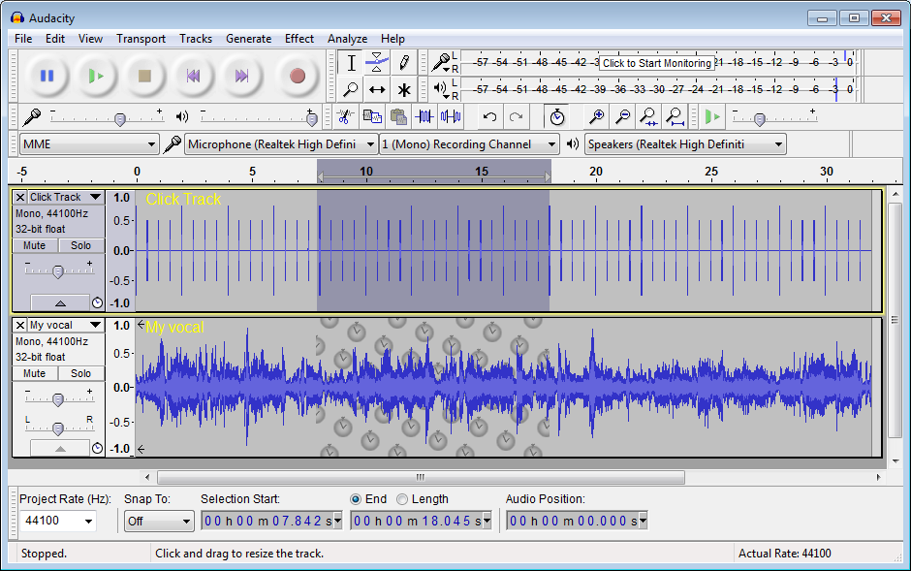
Post Recording process…!! Editing…
You need editing to remove unwanted sounds such as fumble, repeated sentences, coughing, pops etc
Step-1
Go to the selection tool and select the portions you want to delete.
Step-2-
Press “Delete” either in your system or go to “Edit” in menu. Editing over!! Save!!

Slide 8
How to add music and sound effects??
To make programme effective, music and sound effects are very important!!
Step-1- You are done with editing and saved the file and Track -1
Step-2- Now, go to the option “Tracks”, toggle down and click on “Add New”. A new Track will appear in which you have to put Music or Sound effects.
Step-3- Ensure that you have already some music in your computer.
Step-4-Click on the File in the task bar and choose option “Import”

Slide 9
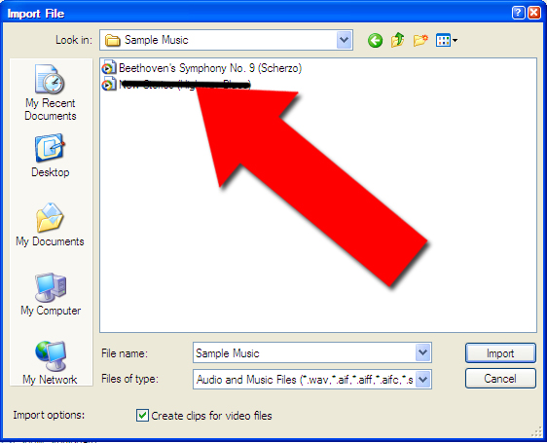
Import Music
Step-4- When you click on the import option, your system will ask for the destination of AUDIO music file.
Go to destination and select the piece of sound.
It will be imported to the new track.
Now you have two tracks.

Slide 10
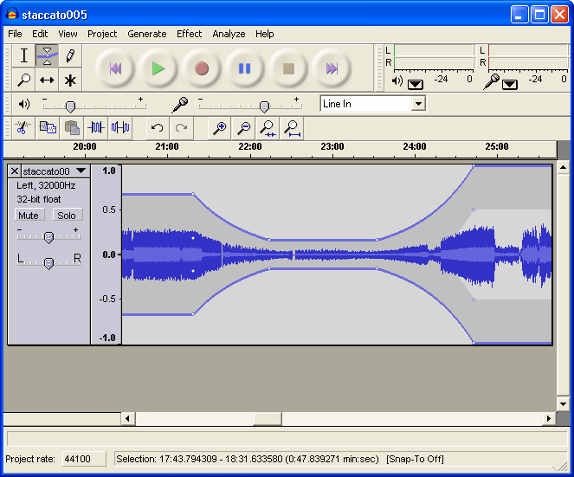
How to mix down both tracks??
Step-1- Go to option “Envelop” and adjust the music level
Now select both the tracks by dragging the mouse over them.
Go to File in the menu bar and click on “Export”
Toggle down and click on “Export selected area.
Soft ware will mix down your programme.

