Slide 1
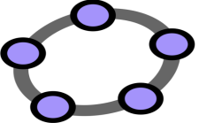
Geo Gebra
Presented By : Ms. Ana Gupta
Designation : Academic Consultant(Mathematics)

Slide 2
What is Geo-Gebra
GeoGebra is a Dynamic Mathematics Software (DMS) for teaching and learning mathematics.
GeoGebra software used for all levels of education that brings together geometry, algebra, spreadsheets, graphing, statistics and calculus in one engine

Slide 3
Uses and Features of Geo-Gebra
GeoGebra was created to help students gain a better understanding of mathematics.
Teachers and students can build animations , simulators
Ready to use applets are available
Practice mathematical experiments and discoveries both in classroom and at home
We can use it for active and problem-oriented teaching

Slide 4
Availability of GeoGebra
GeoGebra is open source software under the GNU General Public License and freely available at www.geogebra.org
You can access the online version: https://www.geogebra.org/classic
OR
Download as desktop app: https://www.geogebra.org/download

Slide 5
Home Page of GeoGebra
ALGEBRA WINDOW
GRAPHIC AND GEOMETRIC WINDOW

Slide 6
Graphing
Plot functions with sliders and solve equations
Geometry
Create interactive geometric constructions
3D Graphics
Graph functions, surfaces and many more 3D objects
CAS
Spreadsheet
Solve math problems with our powerful computer algebra system
Spreadsheet-Analyze data and do statistics connected with graphing
Probability
Visualize parameters and distributions quickly
Components of GeoGebra

Slide 7
Tools used in Geo-Gebra
Sliders
Sliders are graphical representations of numbers. They enable you to easily change a number by dragging a point on a segment.
Check Boxes
Check Boxes are graphical representations of Boolean variables, i.e. variables that can take be either true or false.
Input Boxes
Input Boxes are another way to enable users to set the value of an object. It can be a good way of accurately setting the value of a number, but you can also let the user specify functions, expressions, text etc.

Slide 8
EXAMPLES OF USING GEOGEBRA
VISUALIZING- Students can see abstract concepts.
Representation and Experiments – Students can make connections and discover various properties of particular topic.

Slide 9
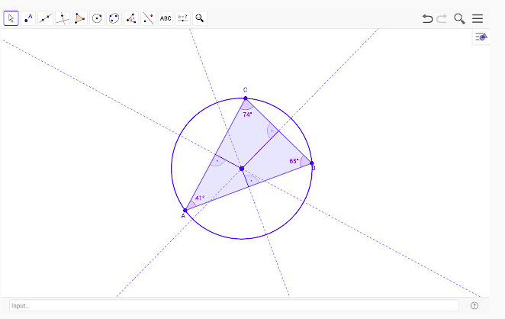
GEOGEBRA GEOMETRY

Slide 10
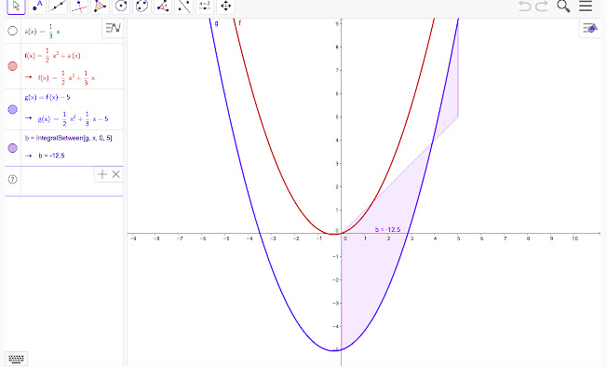

Slide 13
Why GeoGebra?
GeoGebra comes with an easy-to-use interface and many features that help you create, modify, and share math simulations and models.
It comes with multiple platforms and dynamic math software that brings together tables, graphing, geometry, algebra, calculus, and statistics in a free easy-to-use package.

Slide 14
Demonstration
of GeoGebra Software

Slide 15
Virtual Labs on DIKSHA

Slide 16
Features
Aligned to CBSE
curriculum
Interactive 2D/3D simulations
Authentic content
Simulations model real life environment
Intuitive feedback and guidance

Slide 17
WHAT WILL WE EXPERIENCE Following resources are available on Virtual Labs on DIKSHA to enhance your learning experience: ● Theory and Procedure provide information of the concept related to the experiment. ● Animation and Video help in visualizing theoretical concepts. ● Simulation provide real time experience of performing experiments.

Slide 18
● Viva voce is for self evaluation, you can assess how much you have grasped the concept. ● Feedback is meant for improving the resources from user’s perspective. Steps to reach at your desired place

Slide 19
Available Resources

Slide 20
DIKSHA HOMEPAGE

Slide 21
Virtual labs Vertical

Slide 22
Steps to reach eContent of class 6-12

Slide 24
Click on Explanation Resources

Slide 25
DEMONSTRATION
OF VIRTUAL LABS FOR MATHEMATICS

Slide 26
THANK YOU

