Slide 1
Development of Animation resources
Presented by.
Dr. Prachi Sharma

Slide 2
What do you understand by Animation?
Cartoons
Graphics
Moving Pictures

Slide 3
Animation
Animation is a technique in which static images that cannot move can be shown moving, speaking and reacting.

Slide 4
This is a process where the pictures are arranged in a sequence that creates an illusion of motion in that scene.

Slide 5
Importance of Animations in Education
Using animation in education is fun
The quality of education can be enhanced with the inclusion of animation in classroom teaching.
Animations can be used for engaging visual impact
Any concept can be presented in lively and visually engaging manner..
Students learn better with visuals and graphics than the traditional teaching methods.
Organ Story E.g.https://www.youtube.com/watch?v=y5rita8a9_E

Slide 6
Way to incorporate Animation in Education
Analyse content to identify concepts suitable for teaching through animation
Enhancing the quality of class presentation
Making visualization more interesting and easier
Eg. https://www.youtube.com/watch?v=CnU71tx5VDg

Slide 7
Advantages
Visualize subjects for better understanding
Make learning faster
Improve engagement
Motivate learner to learn more

Slide 8
Disadvantages
Requires a lot of effort and time
Technical knowledge know-how
Cost-consuming
Require bandwidth

Slide 9
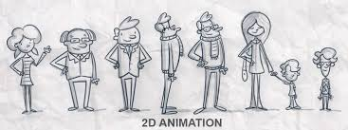
Types of Animation
2D Animation - 2D animation in which 2 dimensions of any object are visible, in which you can only estimate the length and width of the image used in the animation. This type of 2D animation was first used in cartoons.

Slide 10
Example of 2D animation
https://www.youtube.com/watch?v=csI3yilRPcY

Slide 11
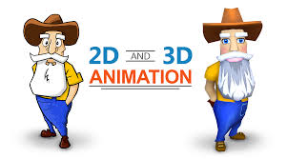
3D Animation - 3D animation is that in which any object can be rotated up to 360 degrees and we can see the 3 dimension length, width and thickness of the object.

Slide 12
Example of 3D animation
https://www.youtube.com/watch?v=BbLF41ndFU8

Slide 13
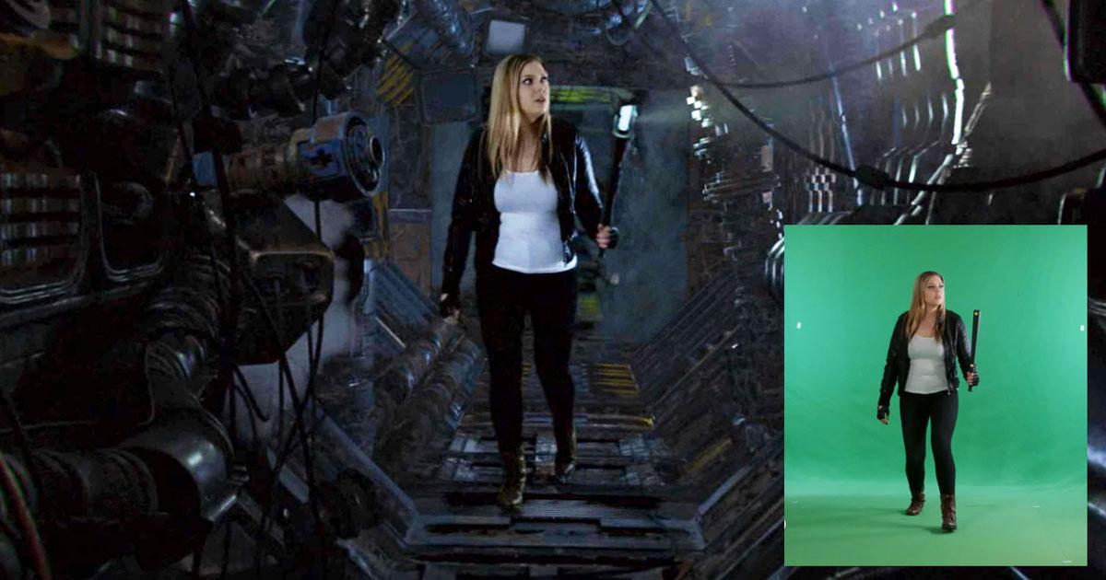
VFX Animation - In this type of animation, a picture and scene is shot in a blue and green background, and then some special effects are used in its background and later that scene is seen as something It is either not possible to do in the natural state or there may be some danger in doing it, this is the work of VFX animation.

Slide 14
Development & Dissemination process
Stop Motion Animation

Slide 15
Stop Motion Animation

Slide 16
Stop Motion Animation
Stop motion animation is a type of technique by which objects can be moved automatically. In this, some pictures are drawn, their different photos are clicked in different positions, and when these images are played in a sequence, a movement appears in it called stop motion animation.

Slide 17
Types of Stop Motion Animation
Object-Motion — moving or animating objects.
Claymotion — moving clay.
Cutout-Motion — moving paper/2D material.
Puppet Animation — moving puppets.

Slide 18
Tools for Animation
Blender
Synfig Studio
Pencil 2D
OpenToonz
Maefloresta Tupitube
GIMP
Krita
Stop Motion Studio

Slide 19
Stop Motion Studio

Slide 20
Material Required
Smartphone
Story line
Storyboard

Slide 21
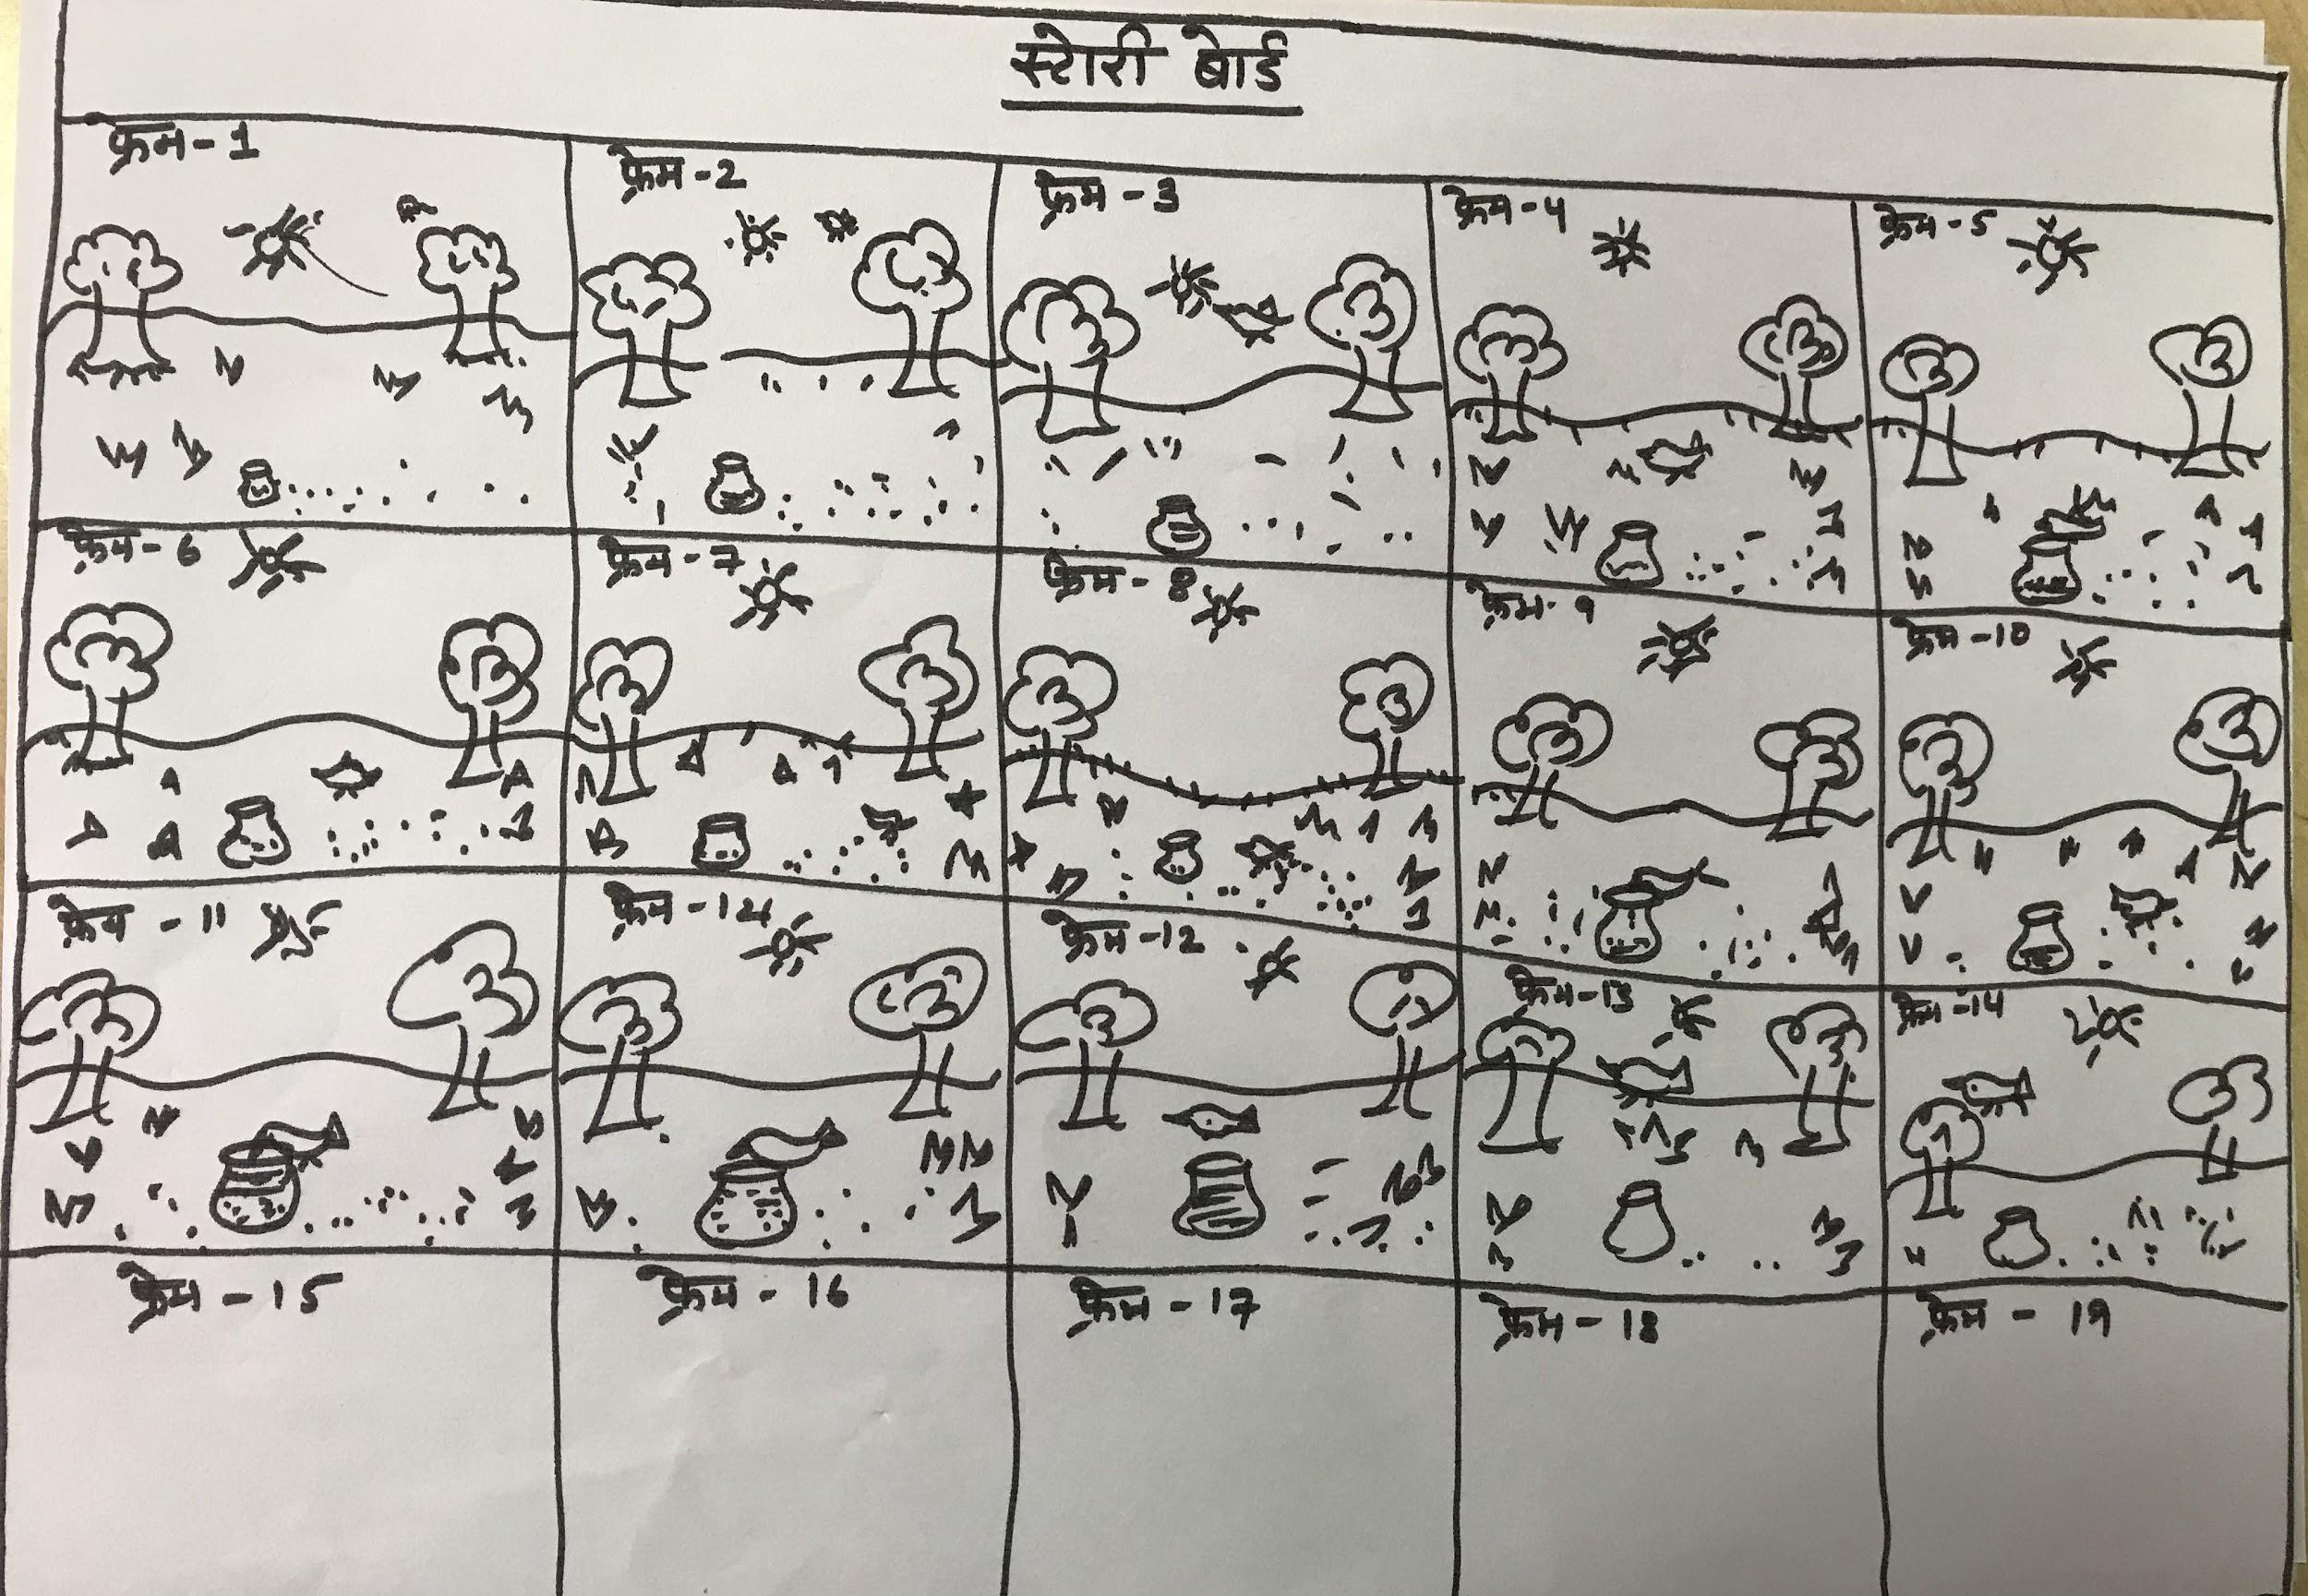
Storyboard

Slide 22
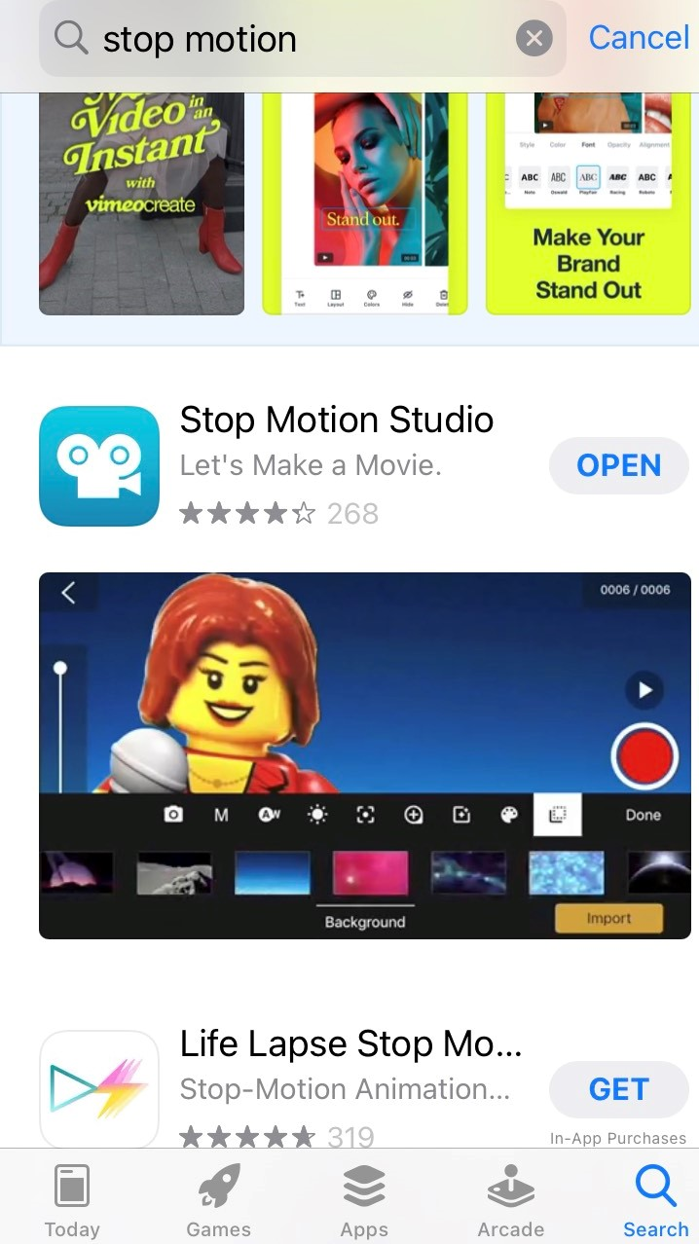
Steps

Slide 23
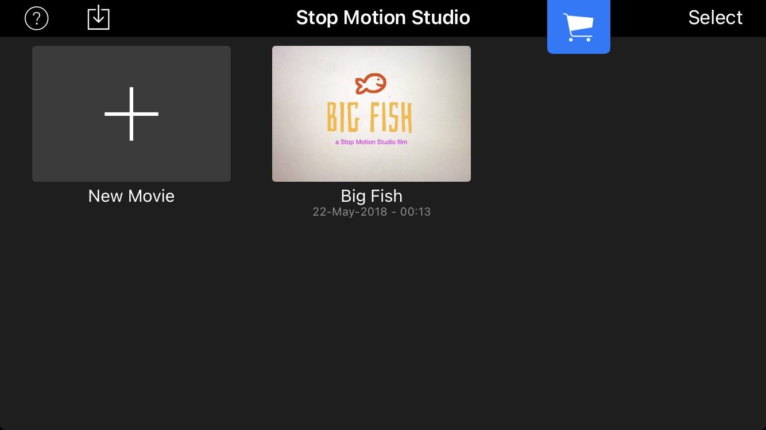

Slide 24
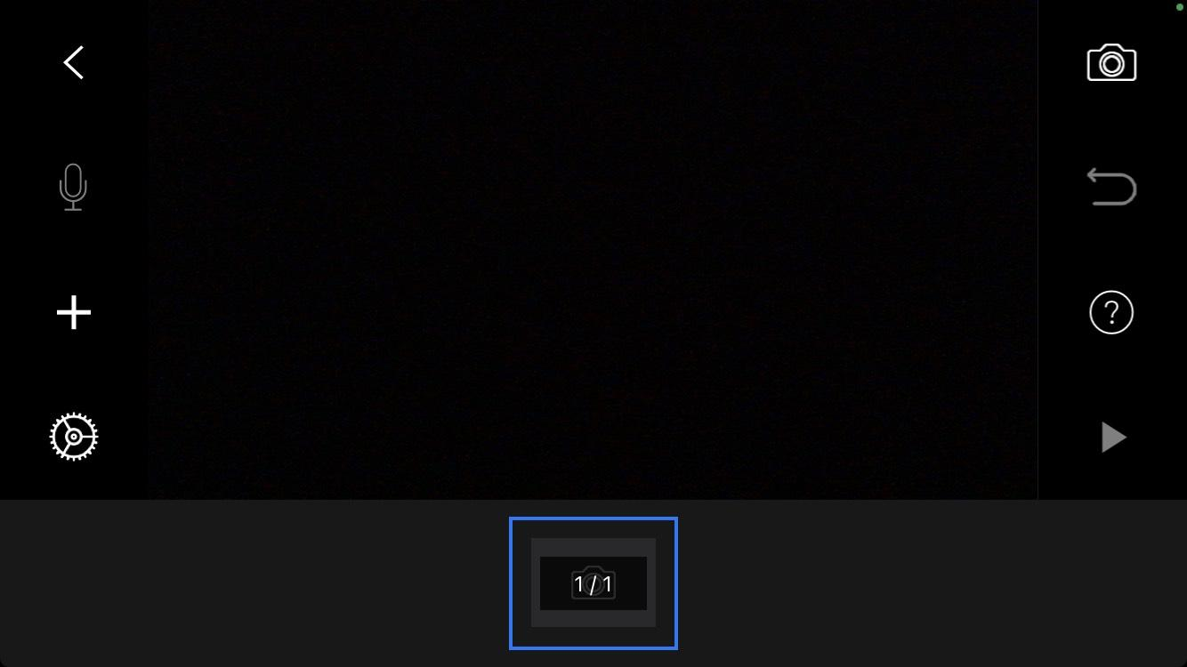

Slide 25
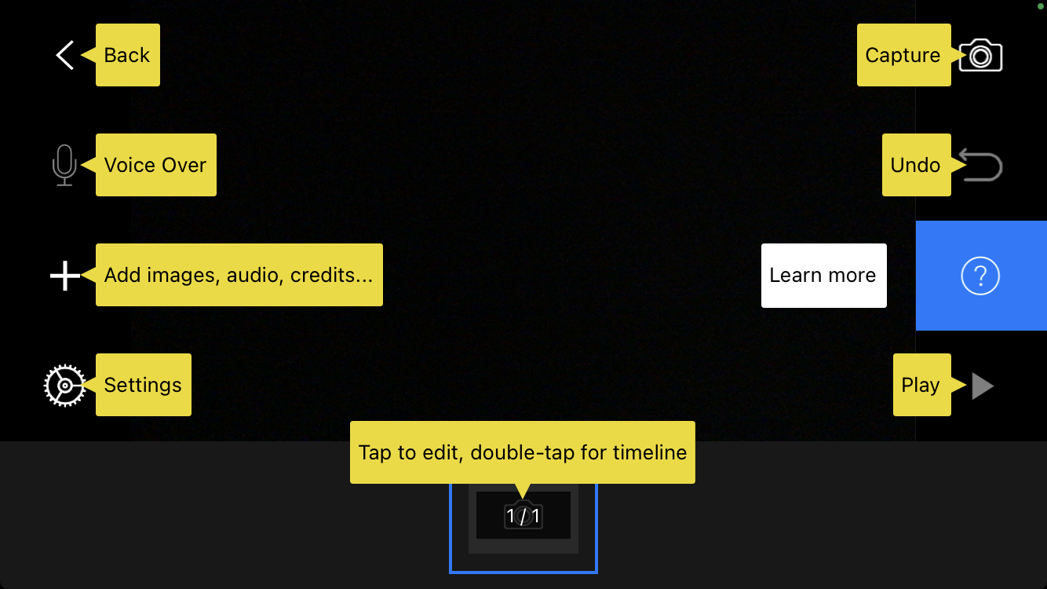

Slide 27
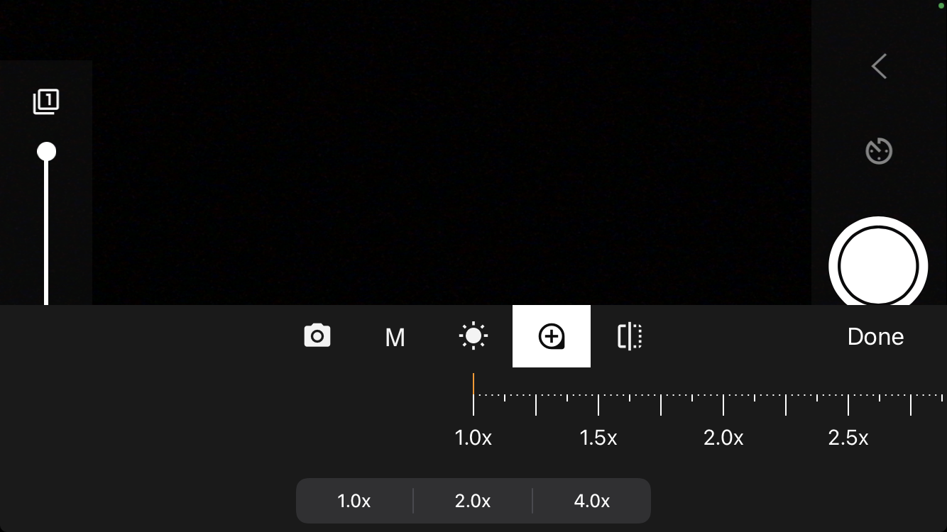

Slide 29
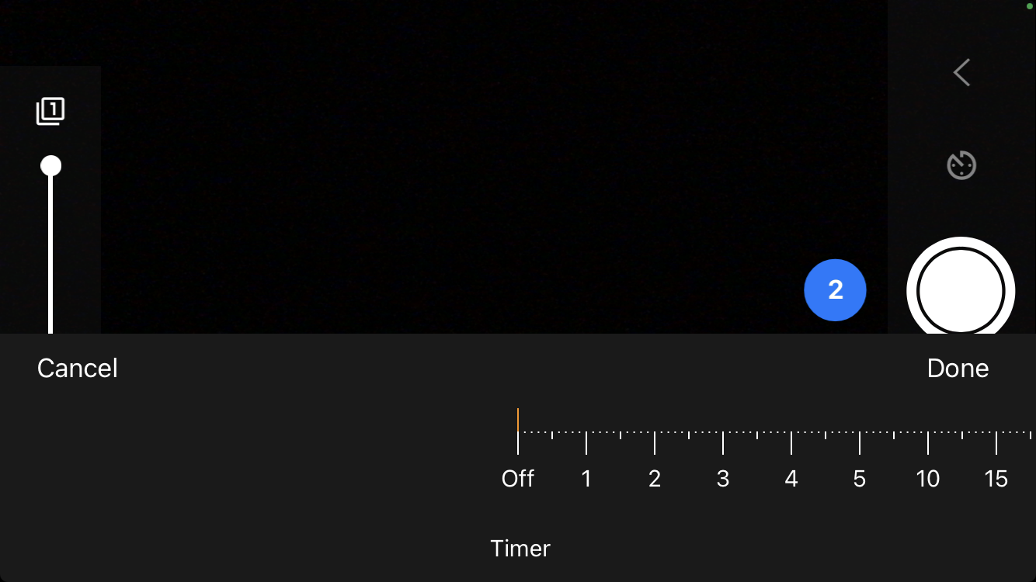

Slide 30
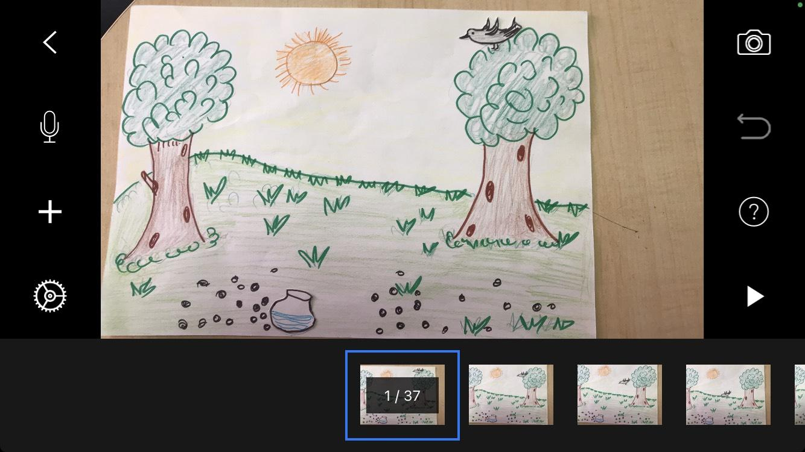

Slide 31
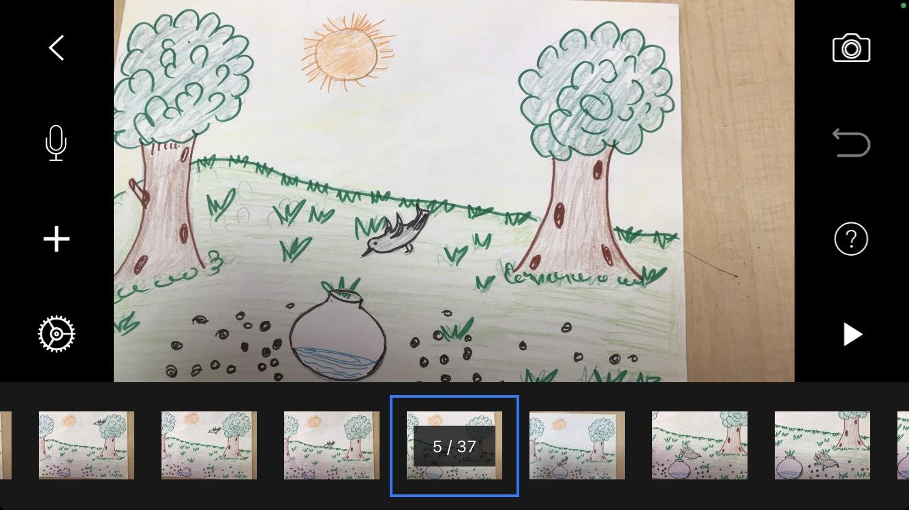

Slide 32
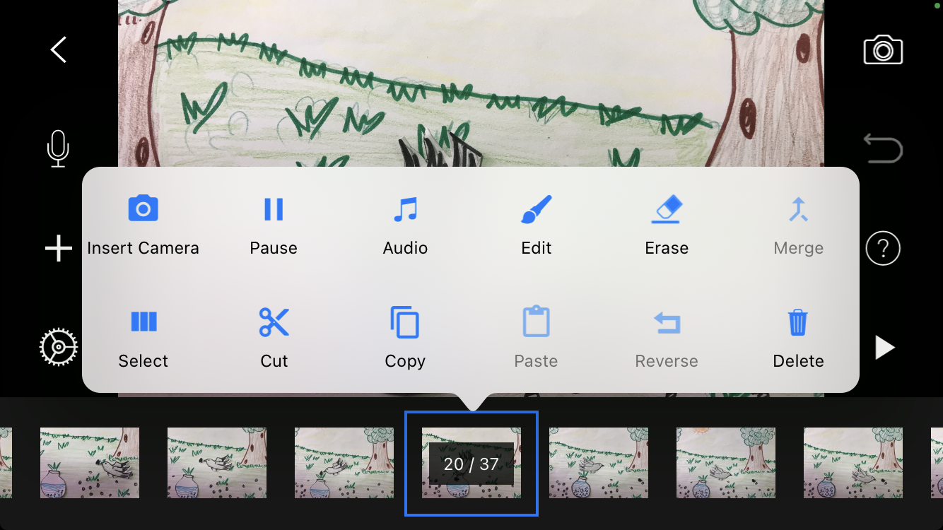

Slide 33
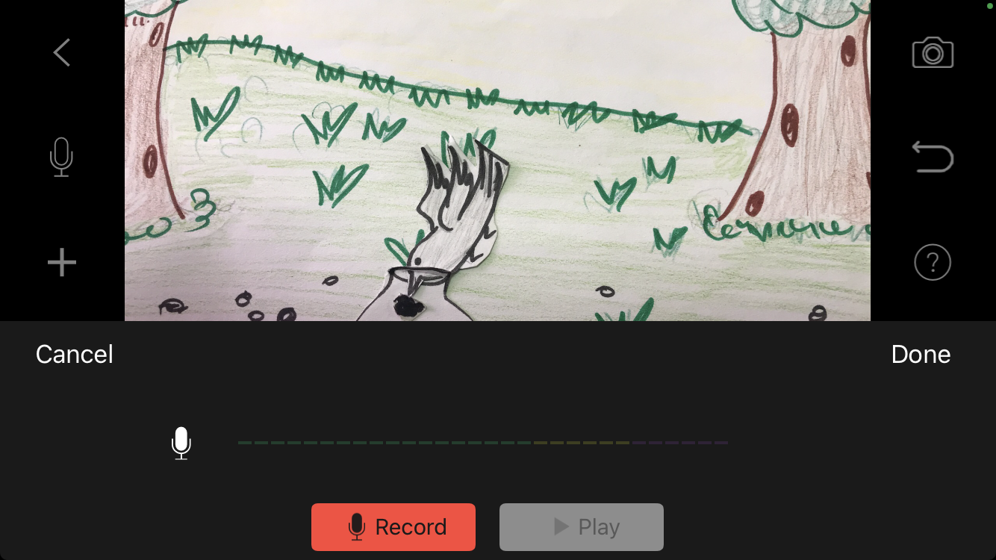

Slide 34
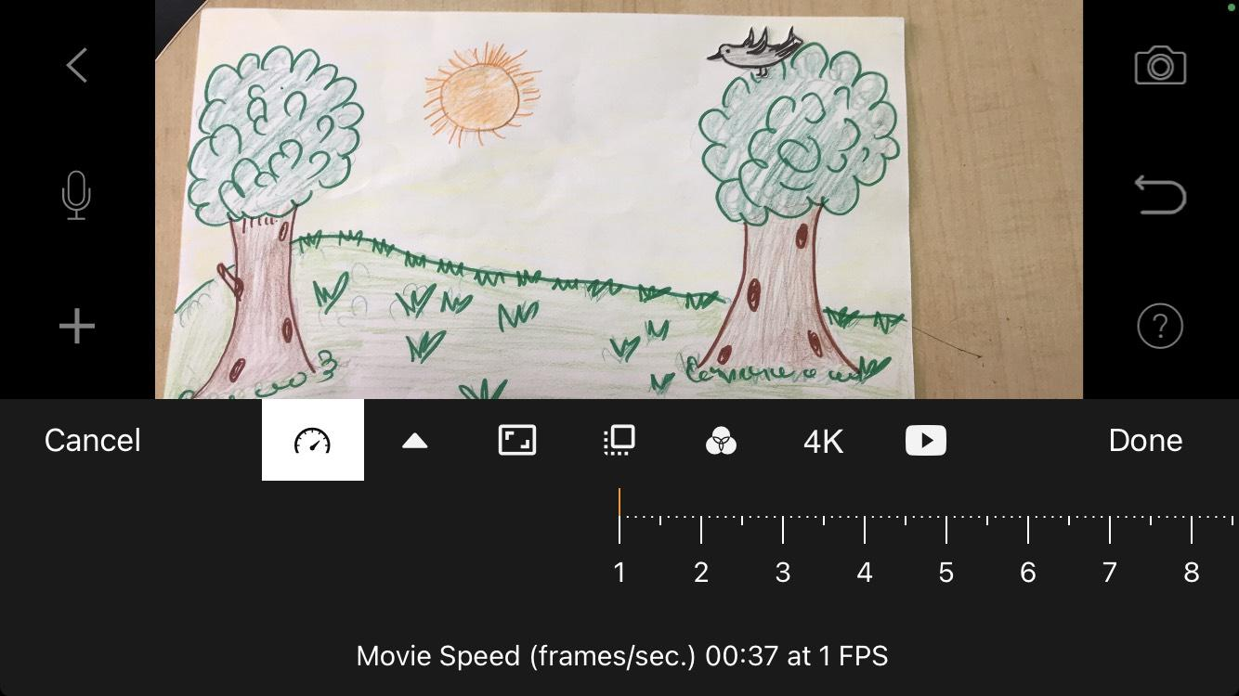

Slide 35
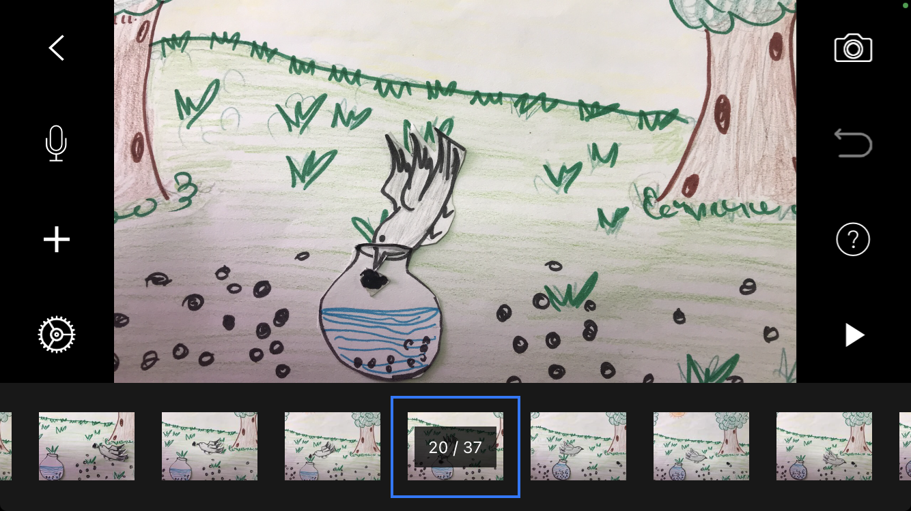

Slide 36
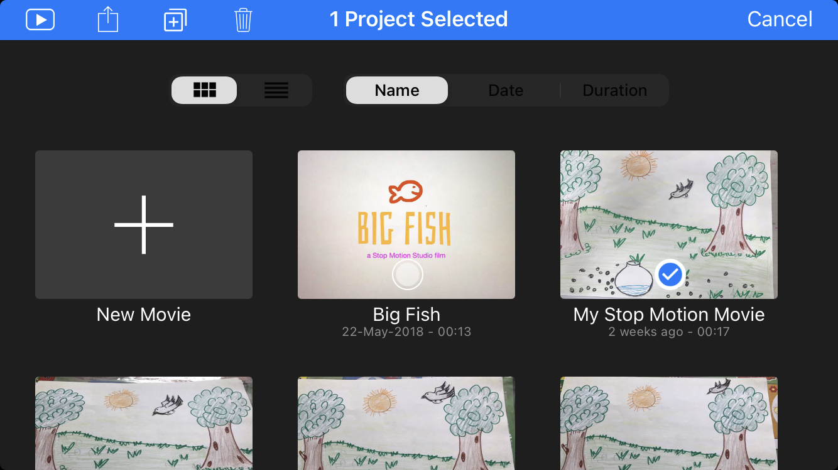

Slide 37
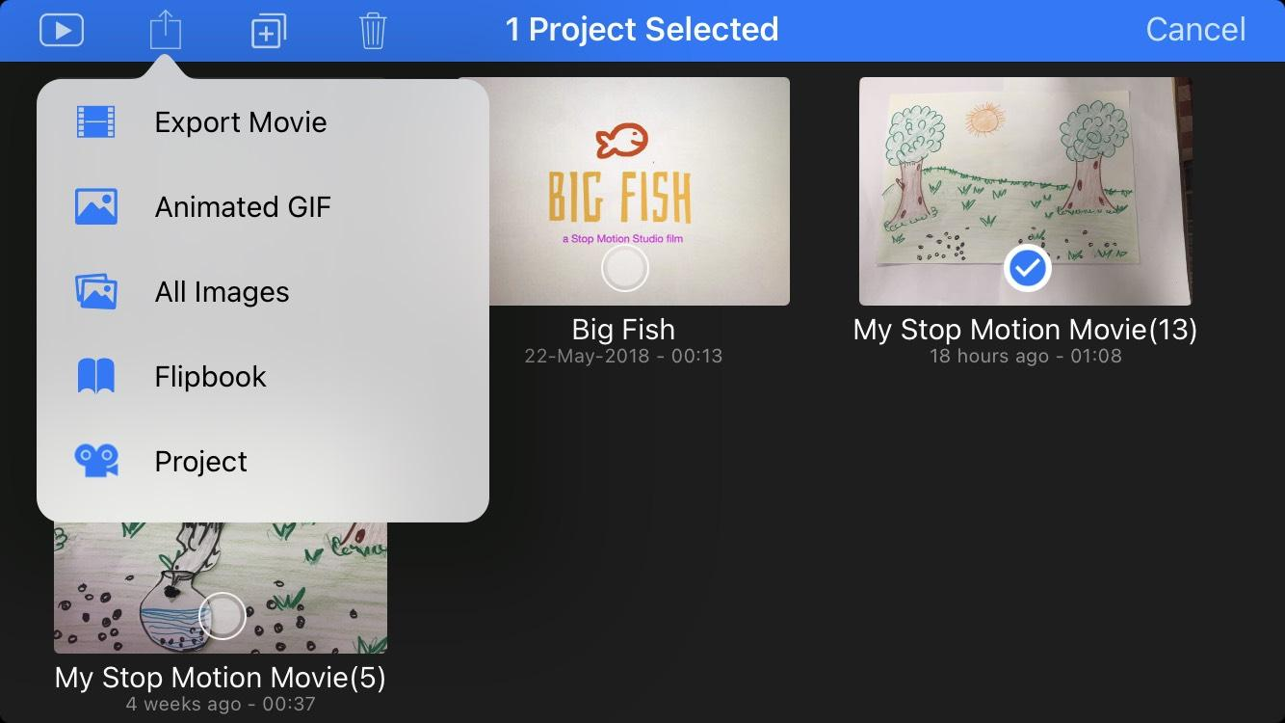

Slide 38
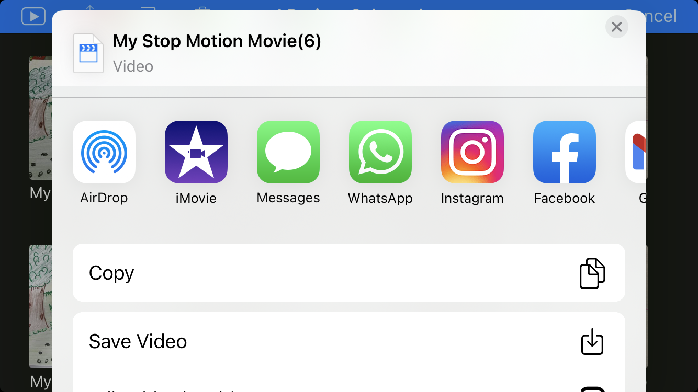

Slide 39
Example of Stop Motion Animation
https://www.youtube.com/watch?v=ktBXT4D3OuQ

Slide 40
https://create.kahoot.it/share/stop-motion-animation/99596b3f-ed20-468c-8482-cb33aec88bda

Slide 41
THANK YOU

