Slide 1
Graphic Resources & Education

Slide 2
What are Graphics?
A graphic is an image or visual representation of an object combine text, illustration, and color
Charts
Maps
Diagrams
Photographs
Image
Drawings
Painting

Slide 3
IMPORTANCE OF GRAPHICS
Better memory for pictures than for corresponding words
User can extract information on a subject
Conceptual development in an exciting way
Complex information can be communicated effectively
Visual representation of Data
Graphics can add valuable context and information
Graphic provides unique, time-saving resources
Convey information quickly and easily to the masses

Slide 4
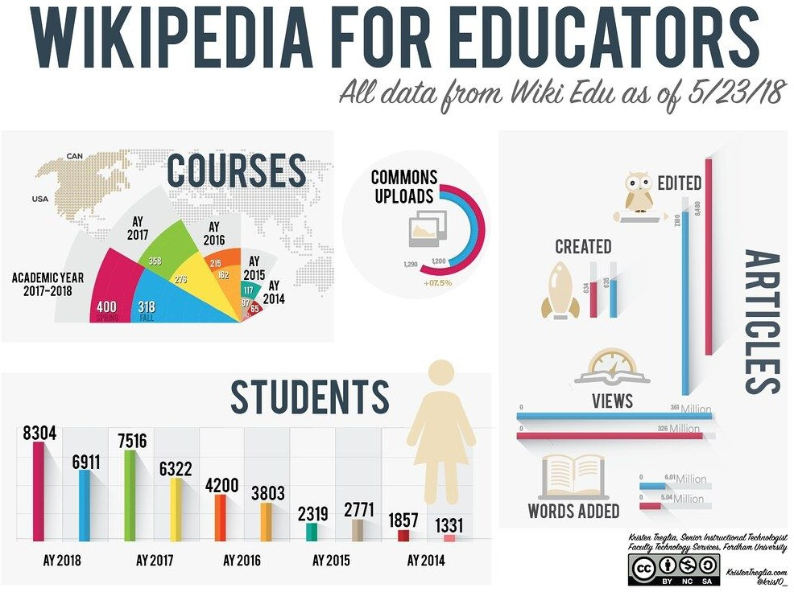
INFOGRAPHICS

Slide 5
What are Infographics
Infographics are graphic visual representations of information, data, or knowledge
5

Slide 6
EDUCATIONAL USE
used as visuals aids
as discussion starters
introduce a topic or give an overview of the lesson
for visualizing data
6

Slide 7
FEATURES
Comprehensive Appealing Retentive
7

Slide 8
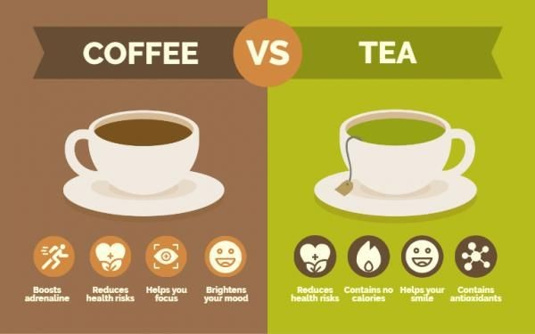
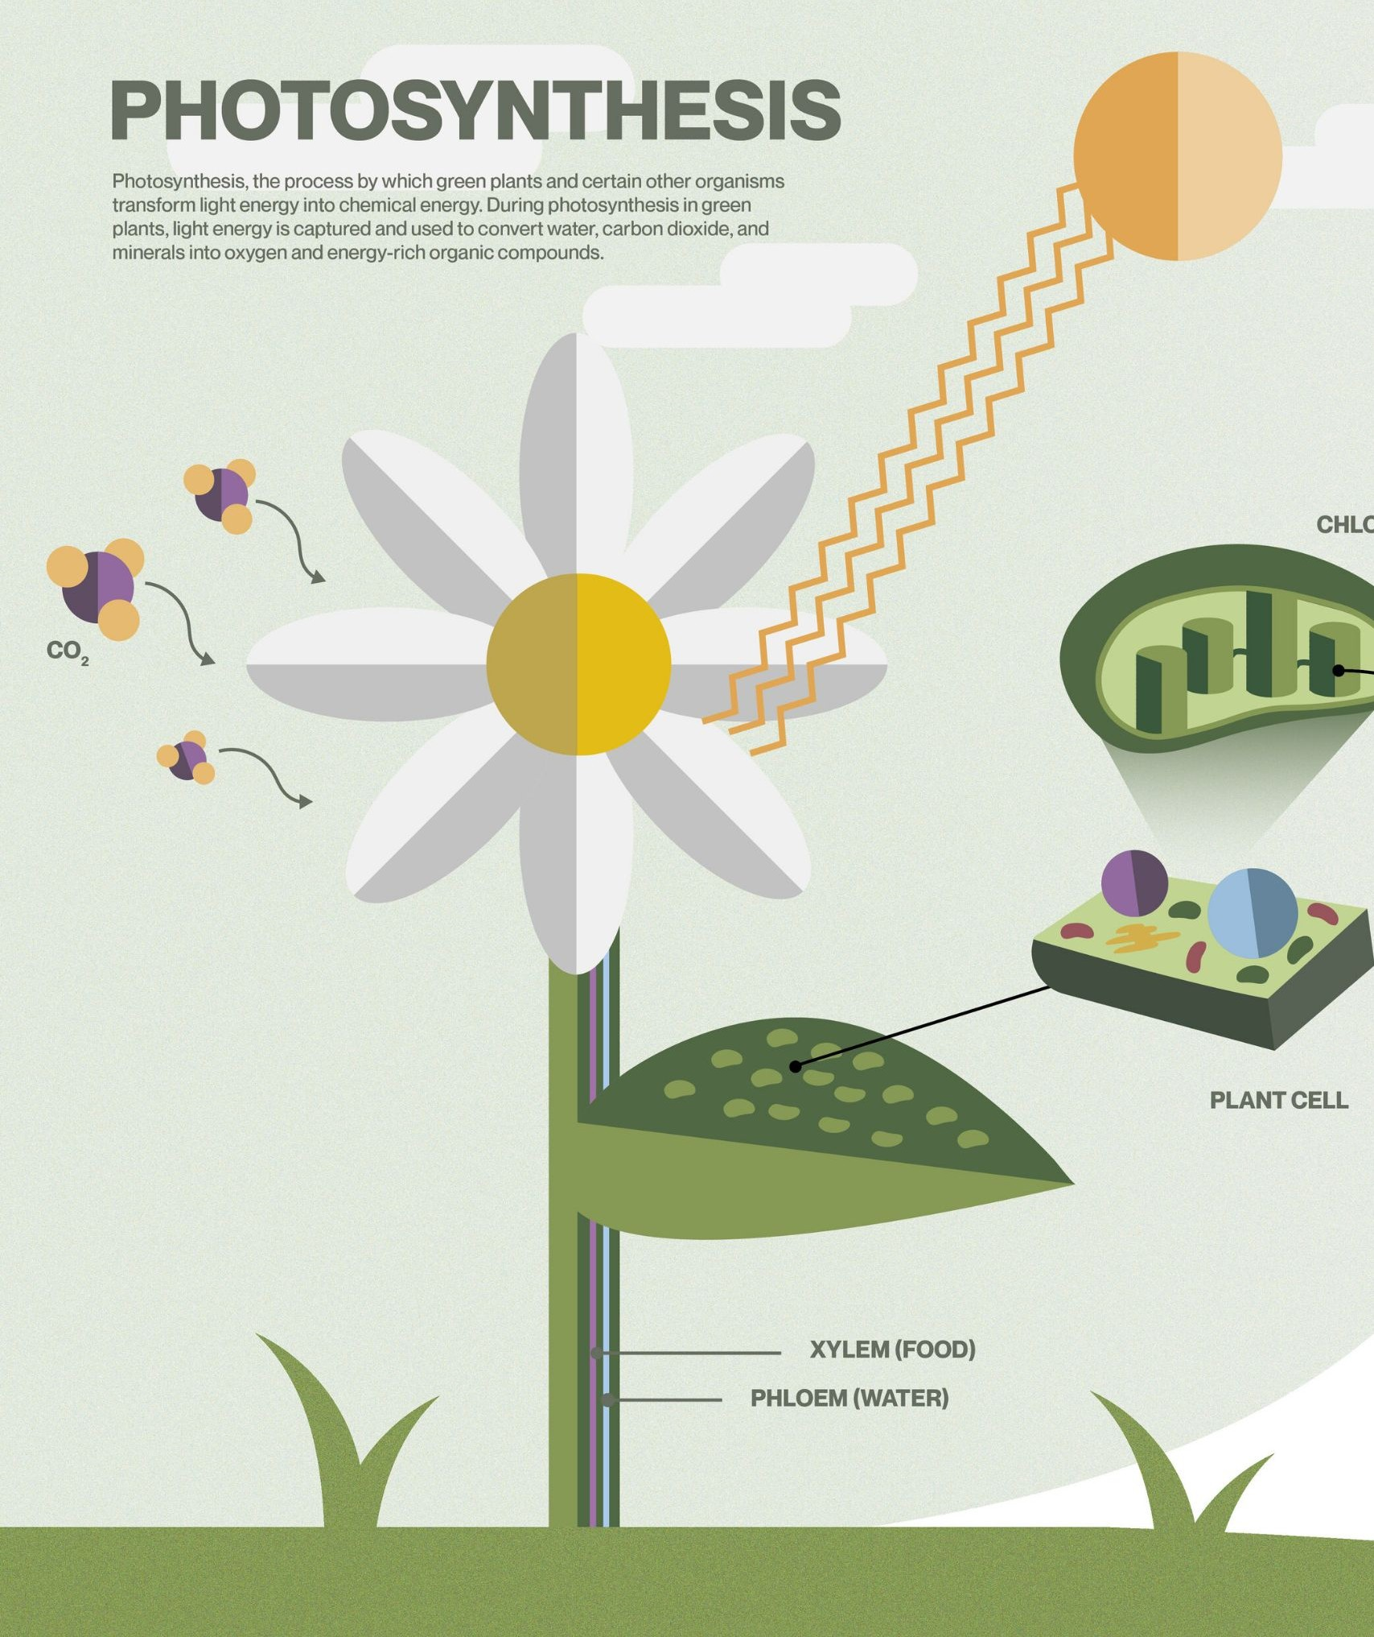
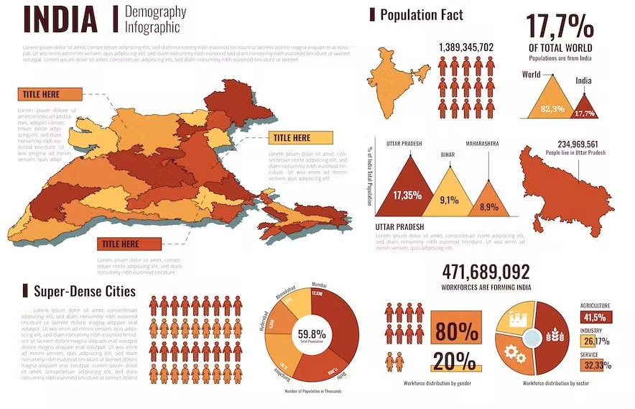
8

Slide 9
Infographic Tools
□Canva
□Easelly
□Venngage
□Piktochart
□Visme
□Infogram
□Vizualize.me

Slide 10
CANVA

Slide 11
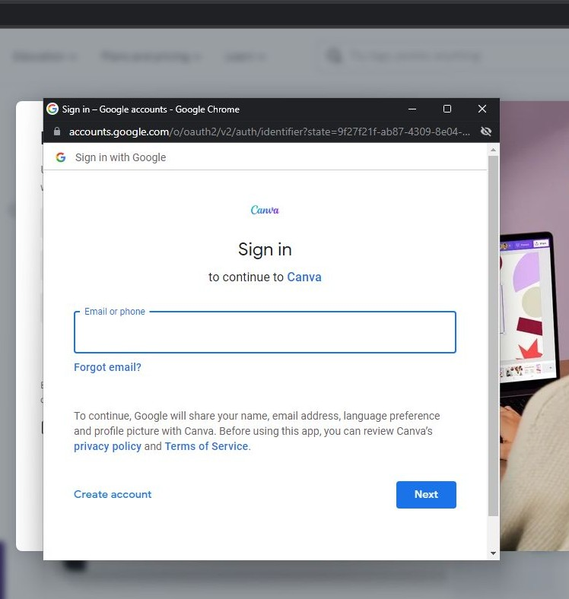
Creating an Account

Slide 12
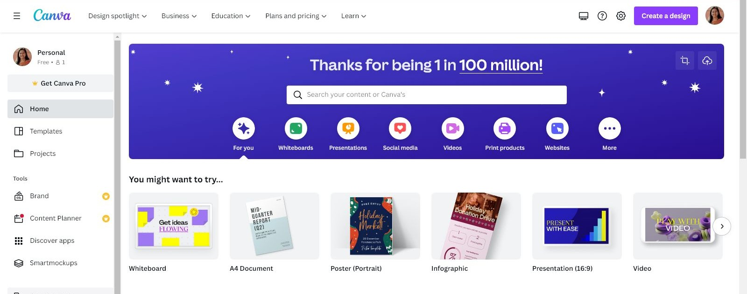
Canva Homepage

Slide 13
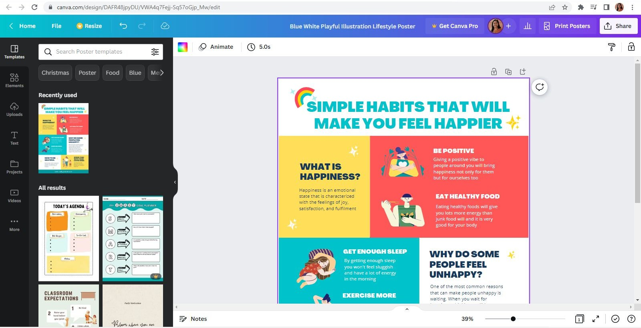
Choosing Template

Slide 14
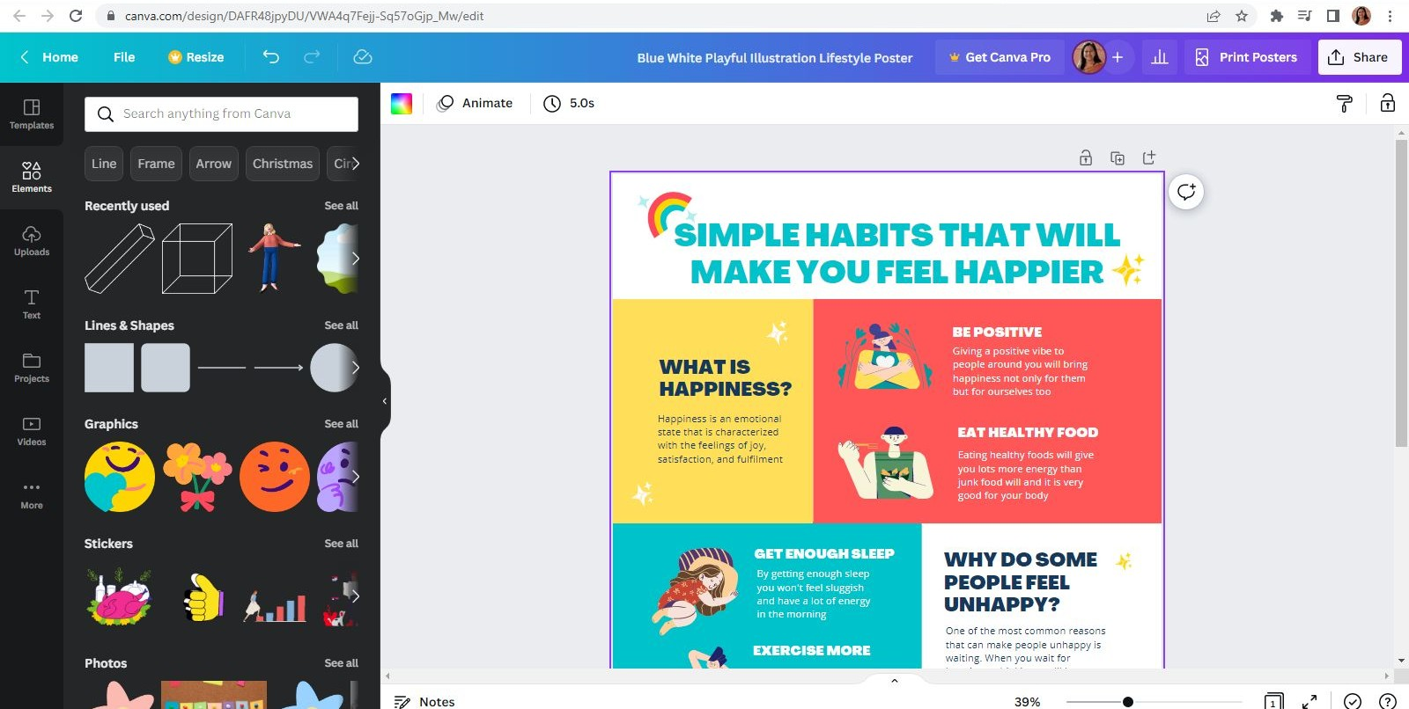
ADDING ELEMENTS

Slide 15
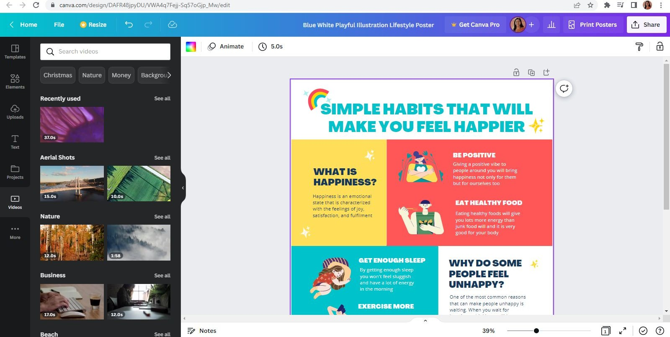
ADDING VIDEOS

Slide 16
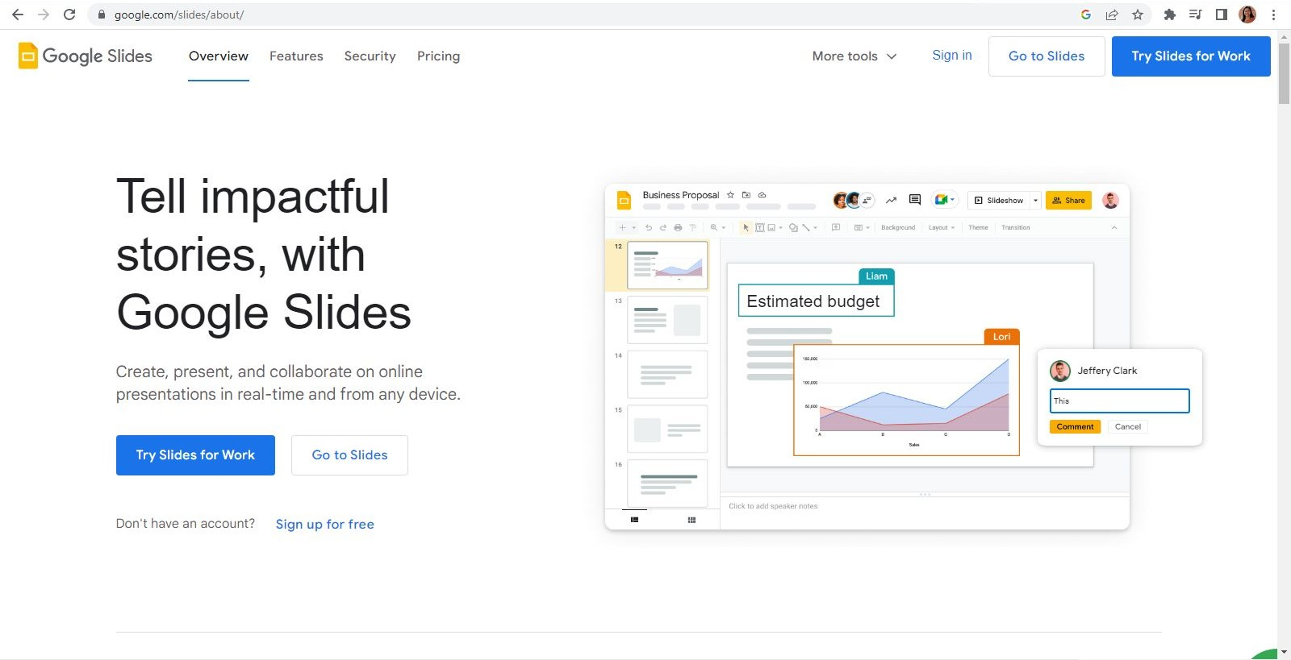
GOOGLE SLIDES

Slide 17
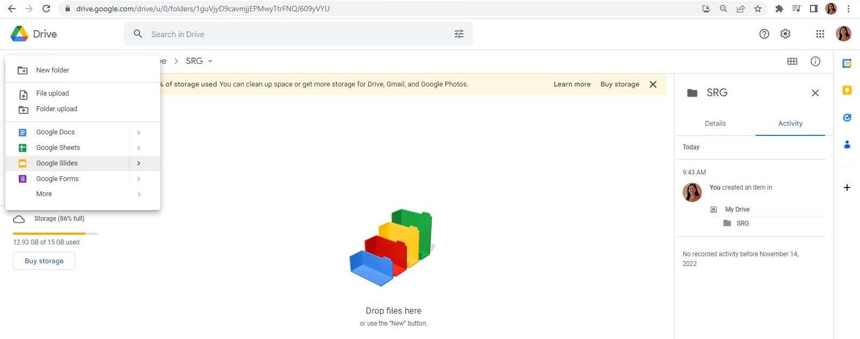
Through Gmail account

Slide 18
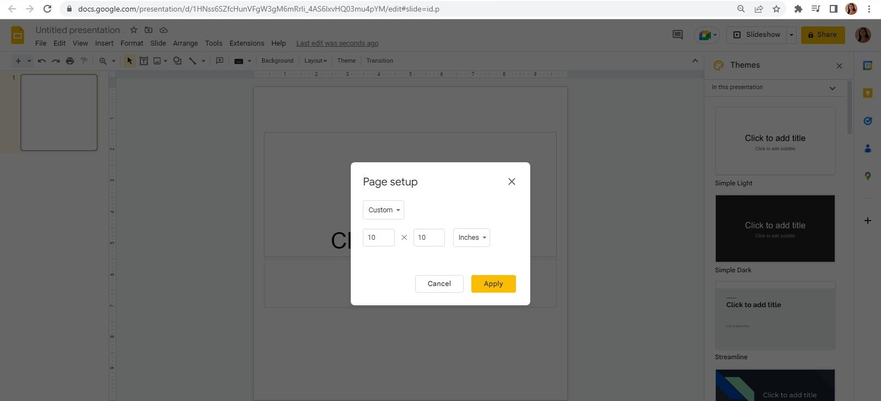
Page Setup

Slide 19
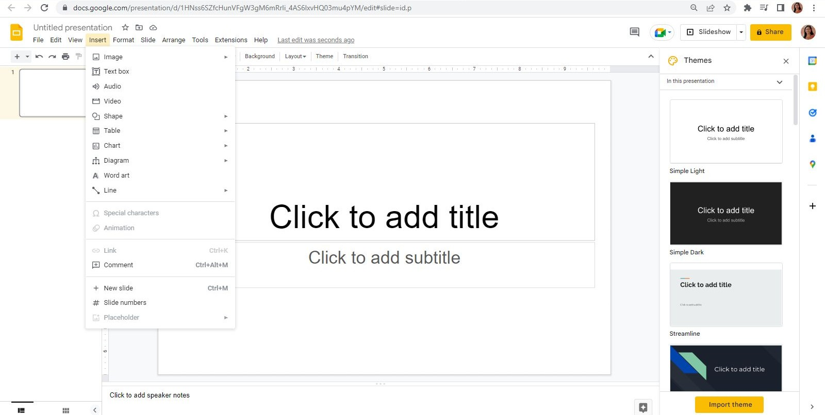
Insert various media types

Slide 20
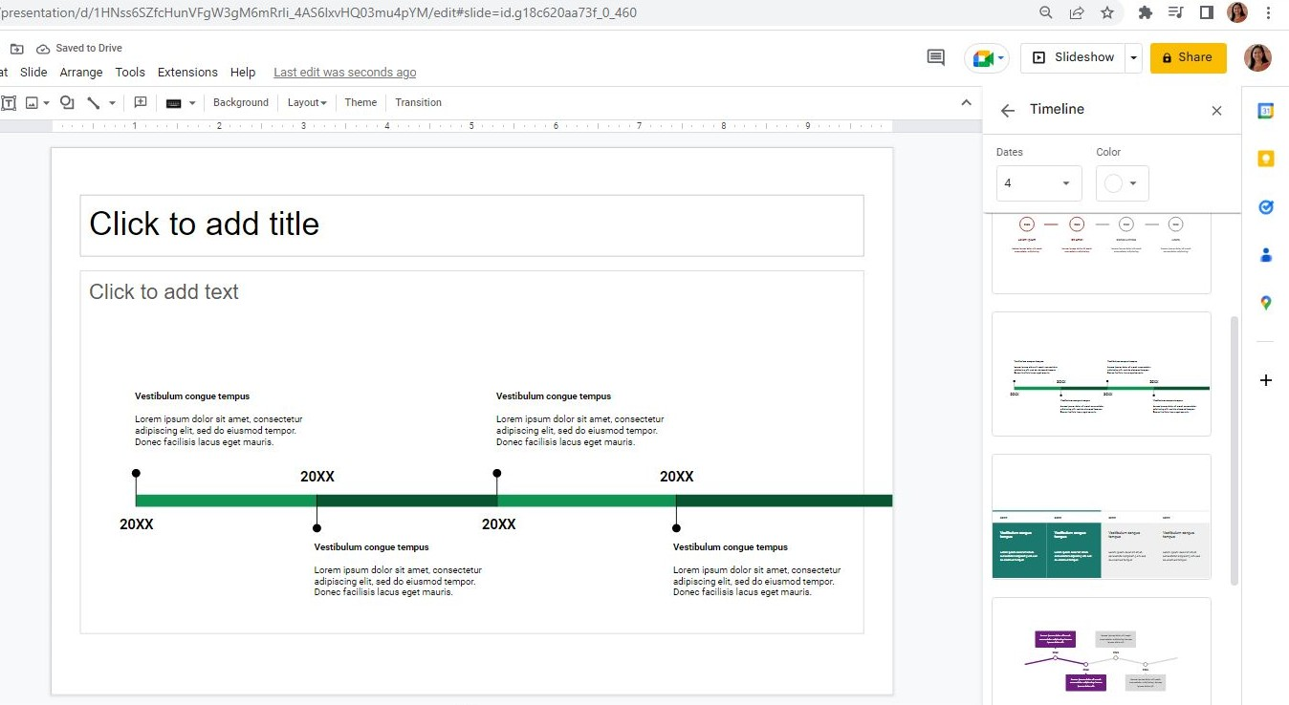
Insert various Types of Diagrams

Slide 21
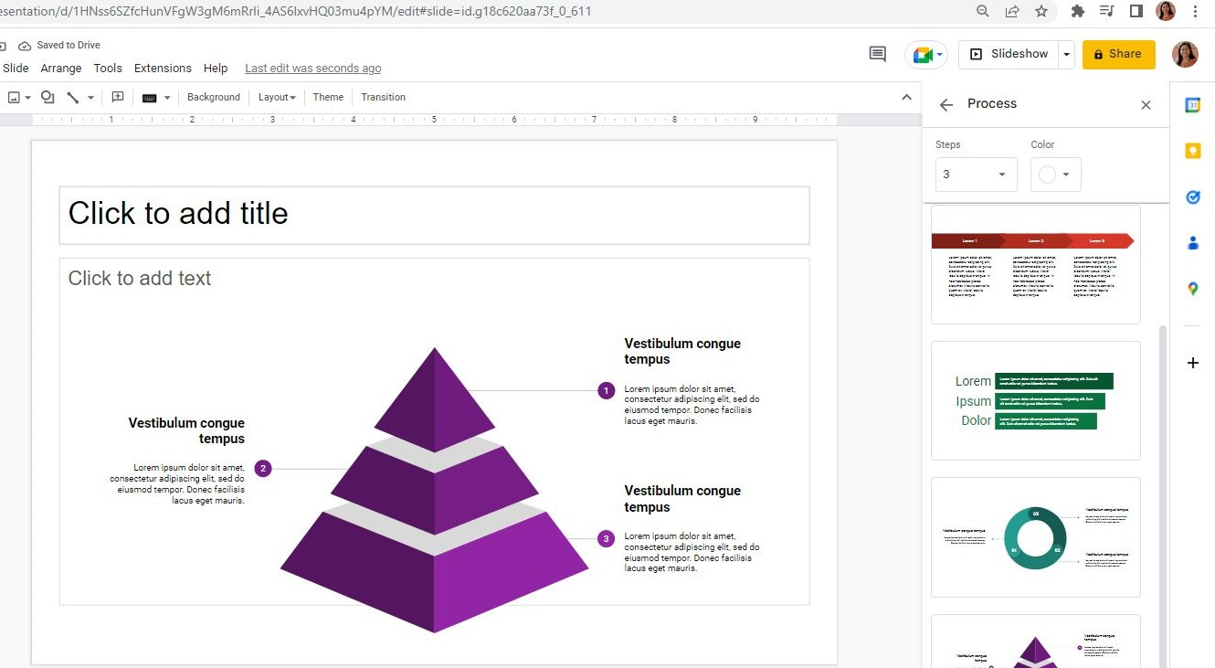

Slide 22
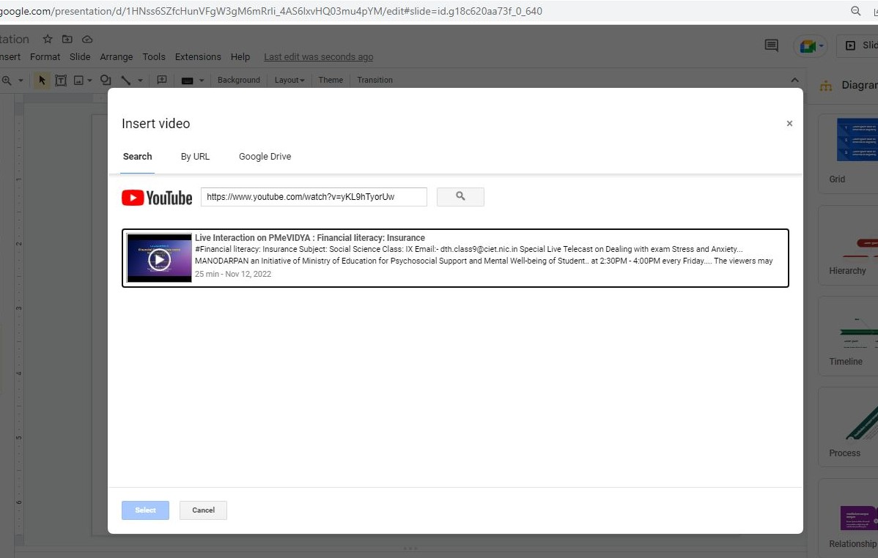
Inserting Videos

Slide 23
Slidesgo
https://slidesgo.com/theme/animals-life-cycle-class#search-Lesson&position-9&results-53

Slide 24
Some Examples
https://slidesgo.com/theme/arrow-timeline-infographics#search-timeline&positio n-14&results-42&rs=search
https://slidesgo.com/theme/tv-series-social-media#search-media&position-5&res ults-20&rs=search
https://slidesgo.com/theme/causes-of-global-warming-lesson-for-elementary#se arch-School&position-5&results-1239

Slide 25
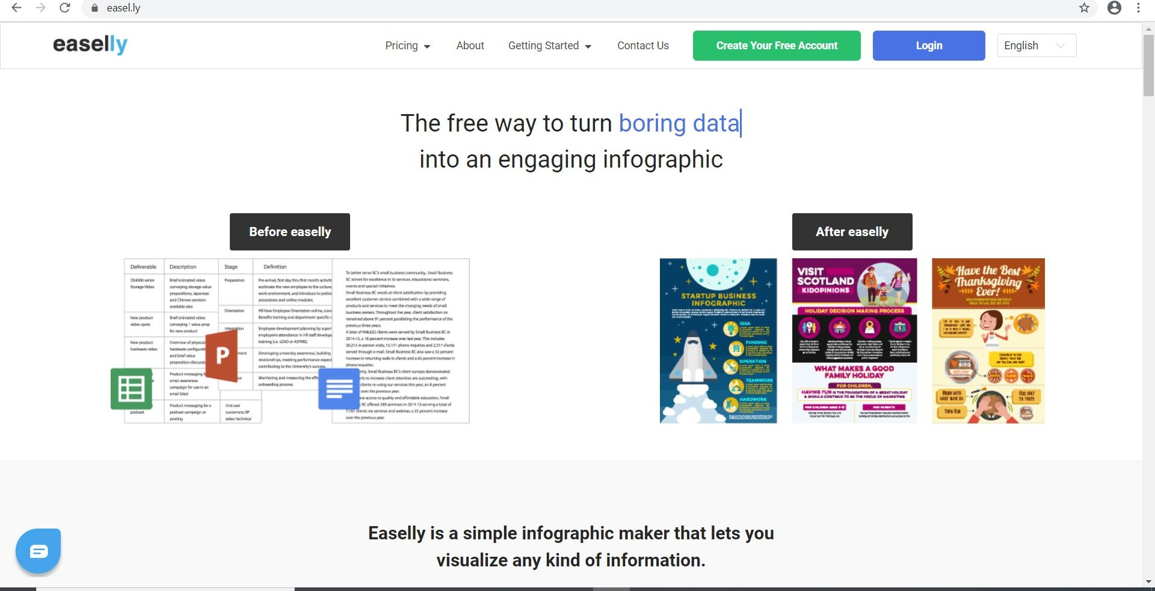
EASELLY

Slide 26
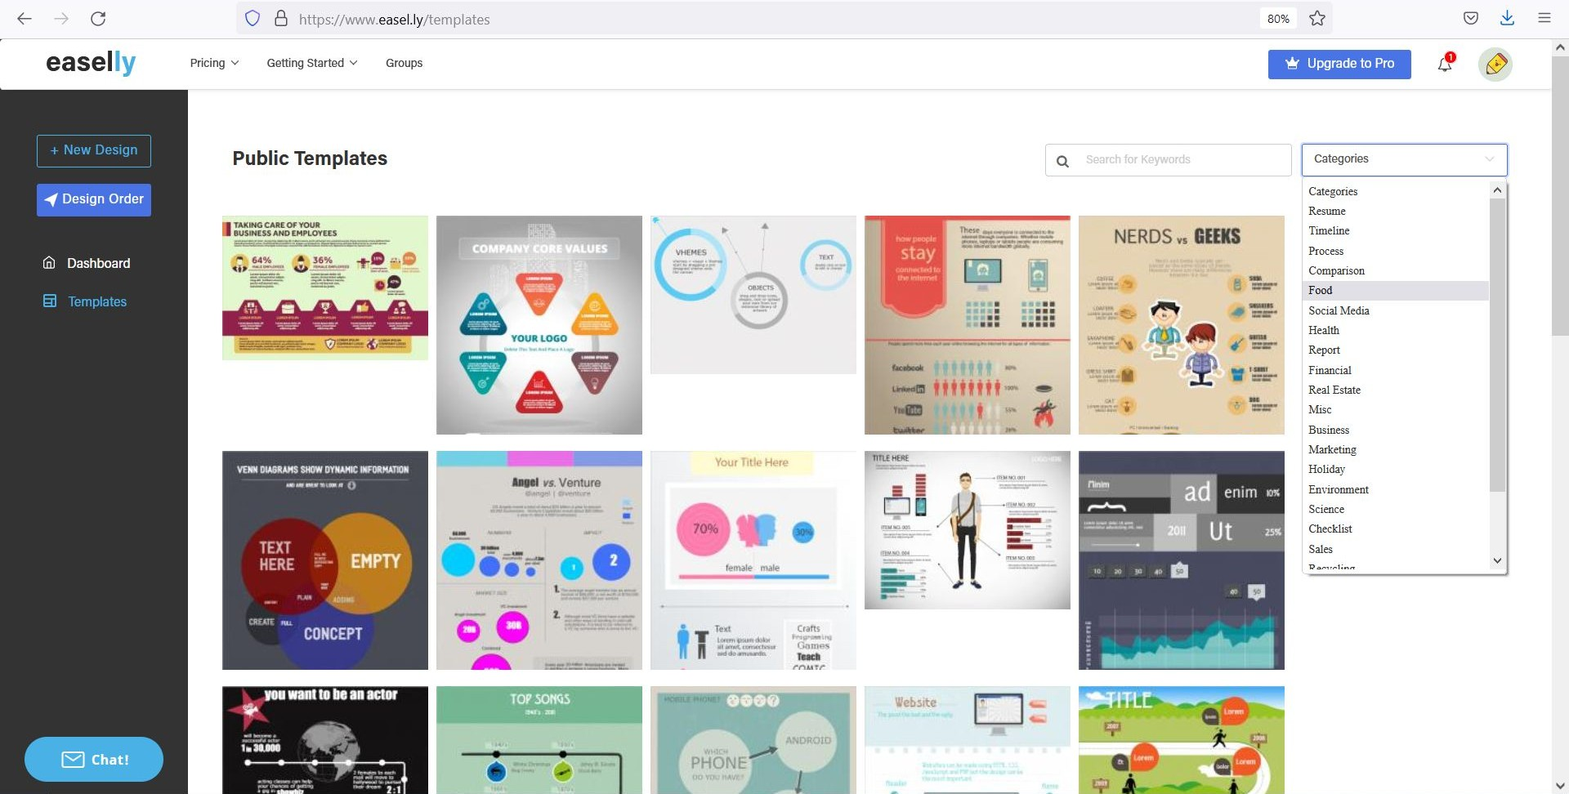
SAMPLE TEMPLATES
Categories of Templates

Slide 27
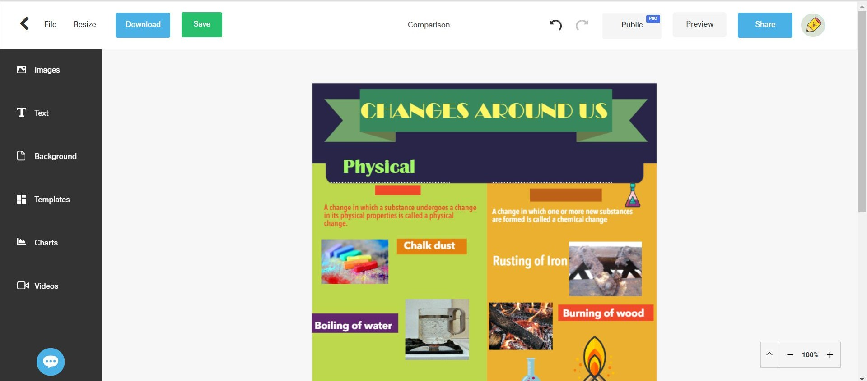
TOOL BAR

Slide 29
Timeline Infographics
JAN
FEB
MAR
APR
MAY
Mercury
Mercury is the closest planet to the Sun
Mars
Despite being red, Mars is actually a cold place
Jupiter
Jupiter is a gas giant and the biggest planet
Saturn
It’s composed of hydrogen and also helium
Neptune
Neptune is the farthest planet from the Sun

Slide 30
Thank You

