Slide 1
UNDERSTANDING EBOOKS TYPES AND POSSIBILITIES
Welcome

Slide 2
What are eBooks
An e-book or electronic book is a non-editable text that is converted into a digital format and displayed and read on an electronic device, such as a tablet or smartphone.
While so many people have access to an e-book over multiple electronic devices, no one should be able to change the content without the author’s permission.
"an electronic version of a printed book“.

Slide 3
How Many Types of eBooks?
EPUB (Electronic Publication): EPUB is a widely used and open standard format for eBooks. It is designed to be reflowable, meaning the content adjusts to the screen size of the device, making it suitable for various devices like eReaders, tablets, and smartphones.
MOBI (Mobipocket): MOBI is another popular eBook format. It was initially developed for Mobipocket eReader devices and is commonly used for Amazon Kindle eBooks. Amazon has since transitioned to using the Kindle's proprietary format, AZW, which is based on MOBI.
AZW (Amazon Kindle Format): AZW is Amazon's proprietary eBook format. It is based on MOBI but includes additional features and encryption. Amazon has also introduced the newer KF8 format (Kindle Format 8) for more advanced eBook designs.
PDF (Portable Document Format): While not specifically designed for eBooks, PDF is a versatile format widely used for digital documents. PDFs maintain a consistent layout regardless of the device, but they may not be as adaptable to different screen sizes.
iBooks (Apple iBooks Format): iBooks format is used for eBooks on Apple devices such as iPads and iPhones. It supports interactive features, multimedia elements, and rich formatting.

Slide 4
How Many Types of eBooks?
CBZ and CBR: These formats are used for comics and manga eBooks. CBZ is essentially a collection of image files (usually in a ZIP archive), while CBR is the same concept but in a RAR archive.
DjVu: DjVu is a format primarily used for scanned documents, especially those with complex images and diagrams. It's known for its high compression ratios, making it suitable for documents with lots of images.
LIT (Microsoft Reader): LIT was developed by Microsoft for their Microsoft Reader software. However, this format has become less common over time.
HTML: Some eBooks are distributed as HTML files, which can be read in web browsers or eBook reading software.
Plain Text (TXT): While not a specialized eBook format, plain text files can be used for simple eBooks that do not require complex formatting or images.
Interactive and Multimedia eBooks: These types of eBooks go beyond traditional text and may include interactive elements, videos, audio clips, and animations. They often use formats like EPUB 3 or proprietary formats.

Slide 5
WHAT IS DIGITIZATION OF TEXTBOOKS?
Digitization of textbooks refers to the process of converting traditional print textbooks into digital formats that can be accessed and read on electronic devices such as computers, tablets, e-readers, and smartphones. It involves transforming the content, layout, and features of the printed textbook into a digital version that can be viewed and interacted with electronically.

Slide 6
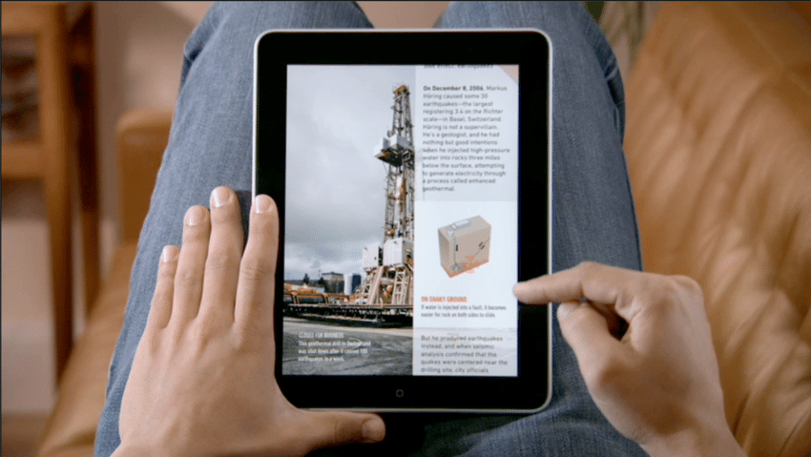
NCERT uses three types of e-books
PDF (Portable Document Format)
FLIPBOOK
EPUB (electronic publication)

Slide 7
WHAT IS EPUB3?
EPUB 3 (Electronic Publication 3) is a standard format for digital publications and e-books. It is the latest version of the EPUB standard developed by the International Digital Publishing Forum (IDPF) and was first introduced in 2011.
EPUB 3 is designed to provide a flexible and feature-rich platform for creating and distributing electronic publications. It offers several enhancements over previous versions, allowing for more interactive and multimedia-rich content.

Slide 8
WHY DO WE NEED EPUB?
Cross-Platform Compatibility: EPUB files are compatible with a variety of devices, including e-readers, tablets, smartphones, and computers. EPUB works on different operating systems and can be read using various software and apps. This cross-platform compatibility ensures that digital publications can reach a wide audience and be accessed on different devices.
Reflowable Content: EPUB allows for reflowable text, meaning the content can adapt and adjust to different screen sizes and font settings. This ensures that readers can adjust the font size, switch between portrait and landscape orientations, and customize the reading experience to their preferences. Reflowable content enhances readability and accessibility, particularly for people with visual impairments or reading difficulties.

Slide 9
WHY DO WE NEED EPUB?
Interactive Features: EPUB supports interactive elements such as hyperlinks, multimedia content (videos, audio), quizzes, and interactive exercises. These features enable publishers to create engaging and interactive reading experiences. Interactive elements can enhance learning materials, provide additional context, and promote active participation from readers.
Accessibility: EPUB incorporates accessibility features to make digital publications more inclusive. These features include adjustable font sizes, compatibility with screen readers, support for alternative text for images, and text-to-speech functionality. EPUB's accessibility features ensure that individuals with visual impairments or reading disabilities can access and engage with the content.

Slide 10
WHY DO WE NEED EPUB?
Enhanced Design and Styling: EPUB supports CSS (Cascading Style Sheets), which enables publishers to apply advanced styling and layout options. This allows for more visually appealing and professional-looking digital publications. EPUB's design capabilities enable the creation of aesthetically pleasing e-books, textbooks, and other digital materials.
Dynamic Updates and Revisions: EPUB allows for easy updates and revisions of digital publications. Publishers can modify and update the content of EPUB files, ensuring that readers have access to the most current and accurate information. This is particularly valuable for textbooks and educational materials that may require regular updates to reflect new research, revised curriculum, or changes in information.

Slide 11
WHY DO WE NEED EPUB?
Cost-Effective Distribution: EPUB offers a cost-effective distribution model for digital publications. EPUB files can be easily distributed and shared electronically, eliminating the need for physical printing and distribution costs. This makes it easier for authors, publishers, and educators to reach a global audience without incurring significant expenses.
Environmental Sustainability: By embracing EPUB, we can reduce the consumption of paper and contribute to environmental sustainability. Digital publications eliminate the need for printing and shipping physical books, reducing the carbon footprint associated with the publishing industry.

Slide 12
KEY DIFFERENCES BETWEEN EPUB AND PDF
 | EPUB | PDF
Content Reflow ability: | EPUB files are designed for reflowable content, meaning the text and layout adapt to different screen sizes and font settings. EPUB allows readers to adjust font sizes, switch between portrait and landscape orientations, and customize the reading experience. | PDF files have fixed layouts that maintain the precise positioning of text, images, and other elements. PDFs are typically designed to replicate the original printed document's appearance.
Interactivity and Multimedia: | EPUB supports interactive elements such as hyperlinks, multimedia content (videos, audio), interactive quizzes, and embedded scripts. EPUB provides a more engaging and interactive reading experience, especially for textbooks and e-books with interactive features. | PDF can include hyperlinks and multimedia content, its interactive capabilities are more limited compared to EPUB.

Slide 13
KEY DIFFERENCES BETWEEN EPUB AND PDF
 | EPUB | PDF
Accessibility Features: | EPUB has built-in accessibility features, such as adjustable font sizes, text-to-speech functionality, compatibility with screen readers, and support for alternative text for images. These features ensure that EPUB files are more accessible to individuals with visual impairments or reading difficulties. | PDF can be made accessible, but it often requires additional steps and may have limitations in terms of flexibility and compatibility with accessibility tools.
Layout and Design: | EPUB offers more flexibility in terms of layout and design. It can handle complex page structures, responsive designs, and supports CSS (Cascading Style Sheets) for advanced styling. EPUB is well-suited for e-books and publications with dynamic layouts, such as textbooks and novels. | PDF, on the other hand, preserves the exact layout of the original document, including fonts, images, and formatting. PDF is often used for documents where maintaining the visual integrity of the original layout is crucial, such as official forms, legal documents, and brochures.

Slide 14
KEY DIFFERENCES BETWEEN EPUB AND PDF
 | EPUB | PDF
Device Compatibility: | EPUB files are designed to be compatible with a wide range of devices, including e-readers, tablets, smartphones, and desktop computers. EPUB is supported by various reading applications and platforms. | PDF files are also widely supported across devices and platforms, but certain devices or applications may have limitations in terms of displaying or interacting with PDFs.
Editing and Authoring: | EPUB files can be easily created and edited using various software tools. EPUB authoring tools provide features for content creation, editing, and formatting. PDF, on the other hand, is primarily used for preserving and sharing documents in a read-only format. | Editing PDFs typically requires specialized software, and the process is more involved compared to editing EPUB files.

Slide 15
Sigil:
The EPUB Editor

Slide 16
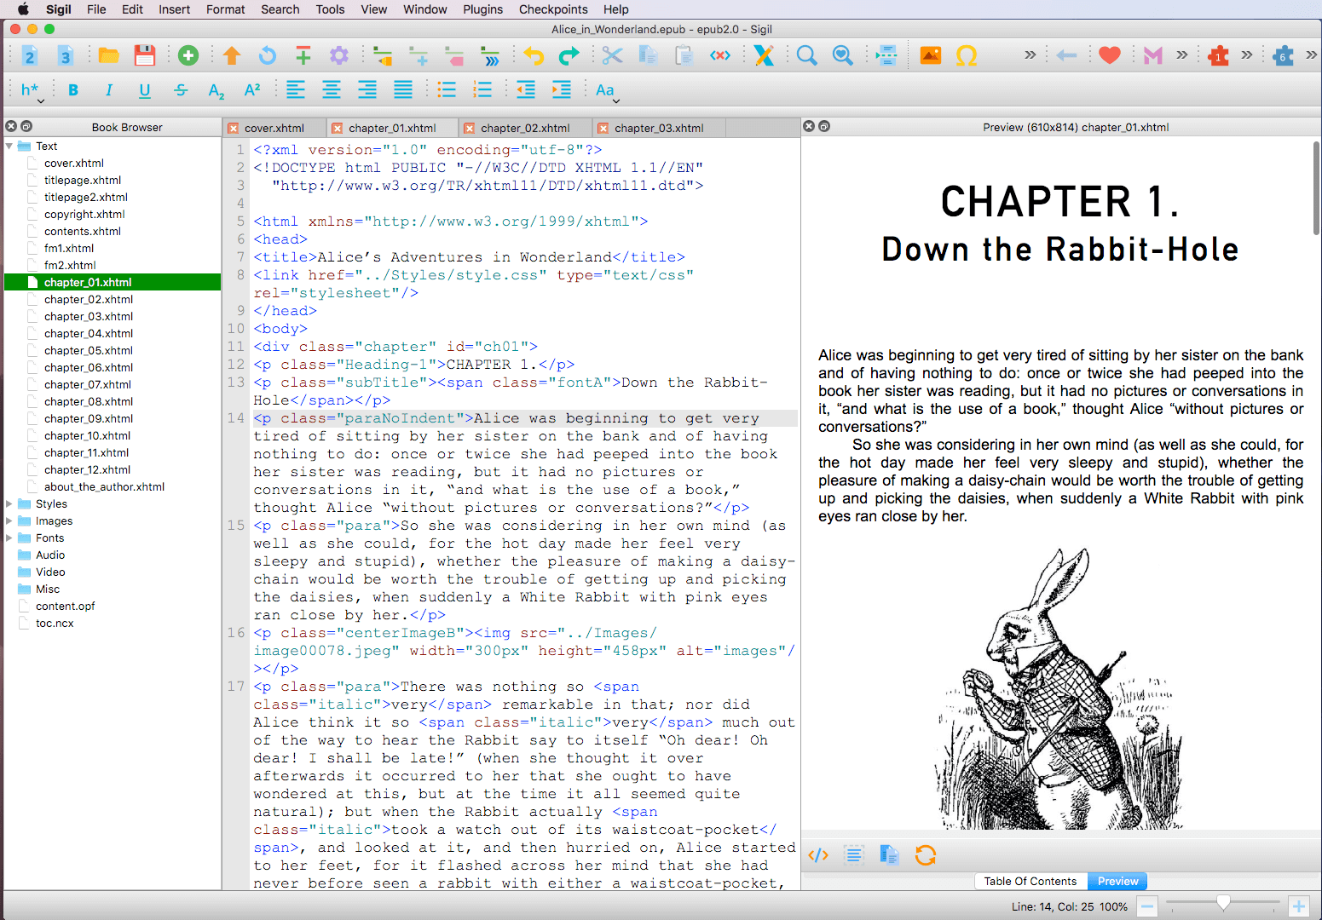
User Interface
— Windows, Menus and Toolbars —

Slide 17
eBooks Available on Following Places
NCERT Official Website
PDF Versions are available
DIKSHA Portal and Mobile App
eBooks, eResources with Energized textbooks
ePathshala Portal and Mobile App
Flipbook and ePub format are available

Slide 18
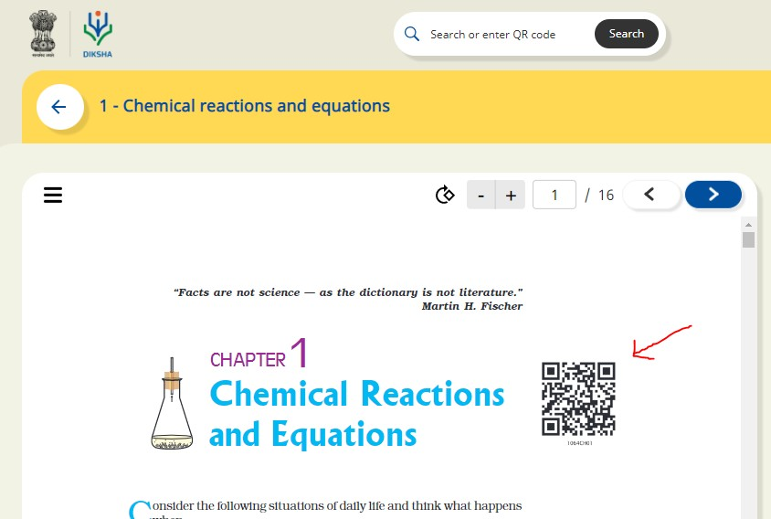
Energized Textbook
Energized Textbook (ETB) is a feature aimed at providing access to digital content for various topics in physical textbooks.
QR codes are attached to physical textbooks and related content is created on DIKSHA. This document explains the procedure of scanning QR Codes in DIKSHA and accessing related content using QR code.
Explore DIKSHA: https://diksha.gov.in/

Slide 19
QR Code- quick response code
A QR Code is a two-dimensional barcode that is readable by smartphones.
Static QR Codes encode the content directly in the image itself. You can think of them like regular printed text, just represented in different way. That means you cannot update the content once generated. Because the content is directly encoded in the image, they also grow in size with the amount of content they store.

Slide 20
Steps to generate QR code by Google Sheet?
Step 1: Firstly we need to create 4 columns named Domain URL, Code, Complete URL and QR Code on a Google sheet.
Step 2: Fill the columns as following:
Domain URL- We have to write domain name (https://epathshala.nic.in/QR/?id=)
Code: We have to write code of the title like (1064CH01)
Complete URL: =CONCAT(A2,B2)
QR code:
=image("http://qrickit.com/api/qr.php?addtext="&C2&"&qrsize=300&t=p&e=m&d="&C2)
Step 3: To download QR codes we need to download it as PDF first as below.
Go to : File→ Download as→ PDF Document (.pdf)

Slide 21
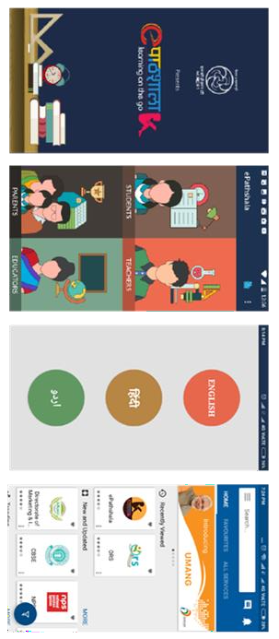
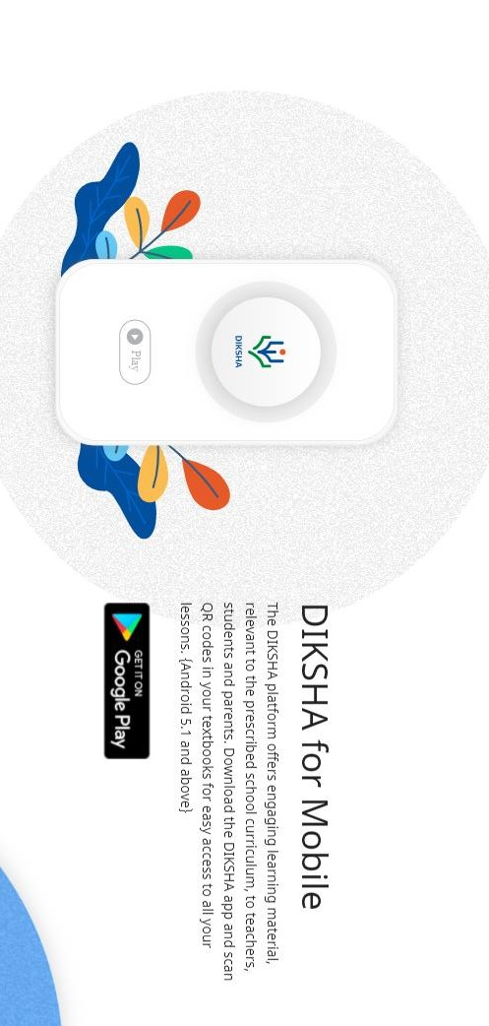
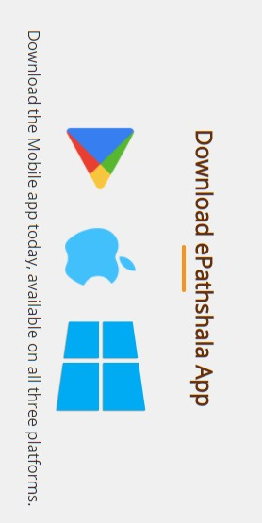
DIKSHA and ePathshala Mobile App

Slide 22
Thank you Doubts and Questions
Mohd Salman
Technical Consultant, lCIET,NCERT

