Slide 1
Script to Screen
Process of Developing Digital Content

Slide 2
PEDAGOGICAL CONSIDERATIONS
Learning Theories
Learning Objectives
Individual Differences

Slide 3
DEVELOPMENT PROCESS
Steps in Script Development and Production
Know your Audience
Select the Theme /Topic
Development of Briefs
Research on the subject
Sequence the Content
Select the Presentation Format
Devices of Holding Children’s Attention
song, riddle, music, sound effects, fun/humor, pause and rest
Interactivity
Involve Children
Elements of a Good Script
An Attractive Start
Clarity of Concept
Objective based Content
Known to unknown Approach
Interactive
Simple Language
Smooth Transition
Component of Humor / Fun
Reinforcement with variety and linkage
Smooth close down

Slide 4
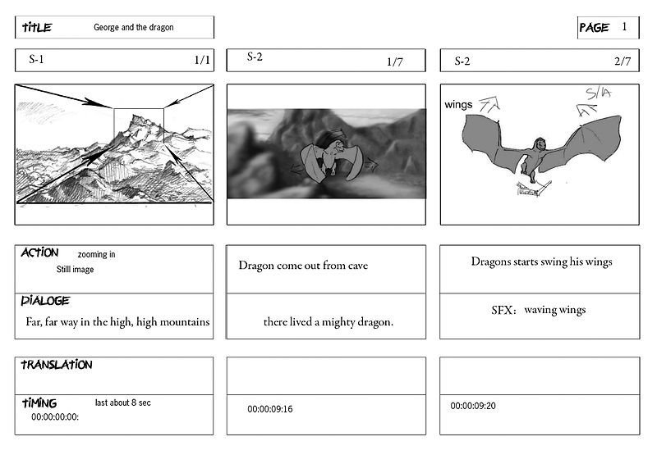
DEVELOPMENT OF A STORY BOARD
What is a storyboard
A storyboard is a graphic representation of how your video will unfold, shot by shot. It’s made up of a number of squares with illustrations or pictures representing each shot, with notes about what’s going on in the scene and what’s being said in the script during that shot. Think of it as sort of a comic book version of your script.

Slide 5
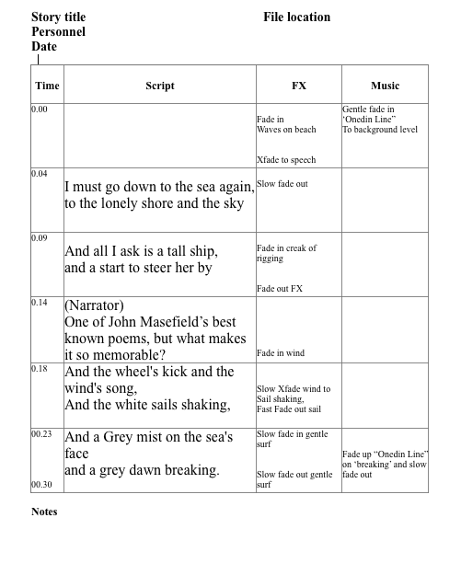
Audio Storyboard

Slide 6
NEED OF A STORYBOARD
TIPS : STORYBOARD
Best way to share the vision
Makes production easier
Saves time
Use the “Sketch it” method
Go with the rapid template
Use collaboration tools

Slide 7
What You Need?
Source of moving and still images.
Means of importing them into a PC.
Software to optimise each clip and string the clips together.
Means of exporting the resulting masterpiece.

Slide 8
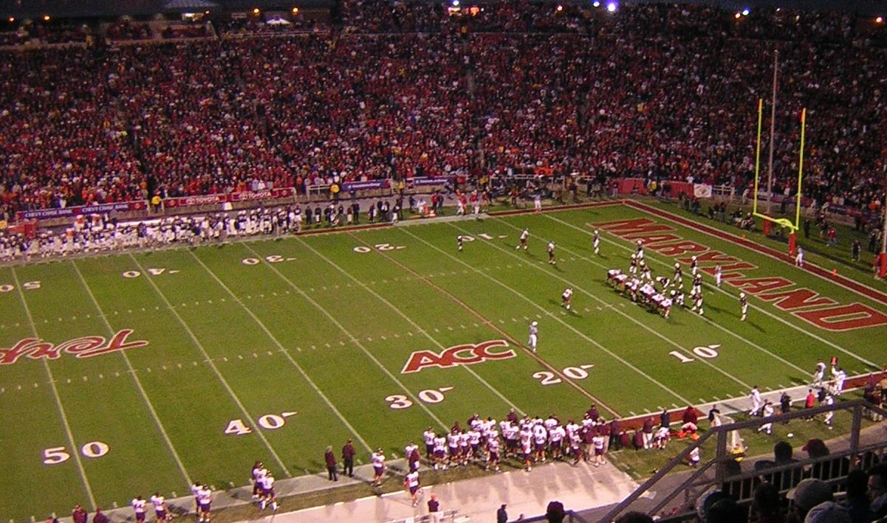
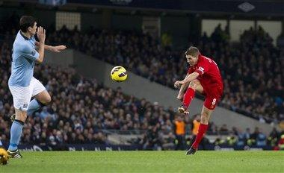
Camera Shots
Wide Shot
Idea about the setting
Often establish a scene or place giving an audience context for the following action
Any figures will be very small.
Long Shot
Figures will be seen from head to foot
The audience will be able to identify more detail
Will also be able to see where they are or what is going on around them
Introduction of character
Mid Shot or Medium Shot (MS)
Easy Recognition and identification

Slide 9
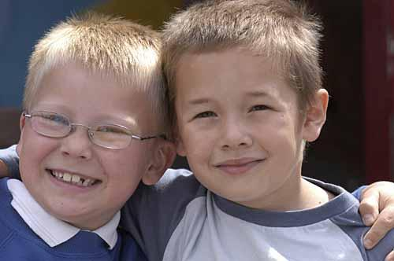
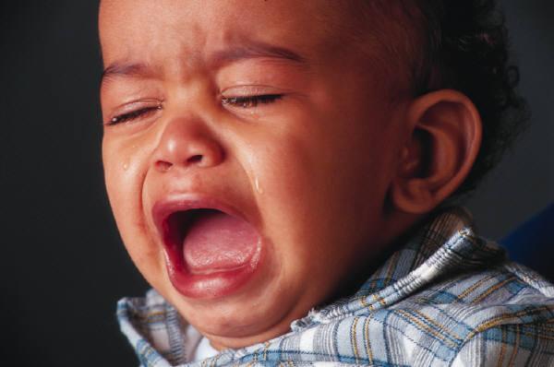
Camera shots (Continued)
Medium Close Up (MCU)
Close Up (CU)
Big Close Up (BCU)
Extreme Close Up (ECU)

Slide 10
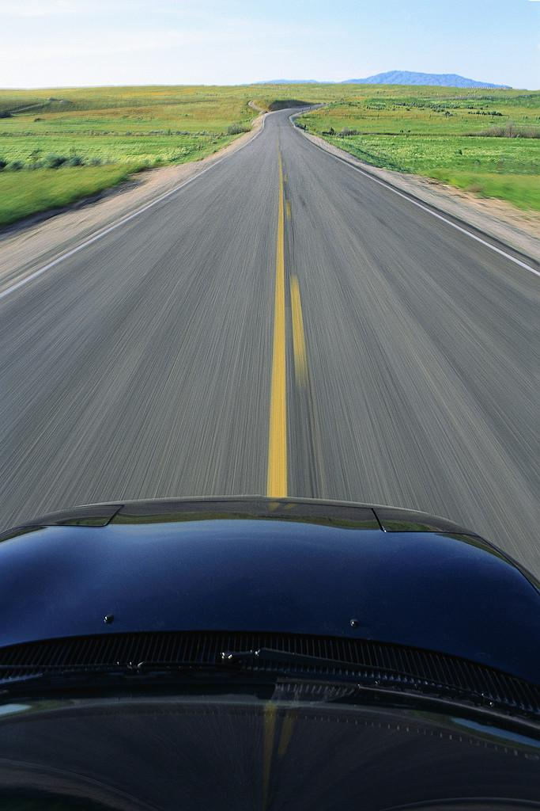
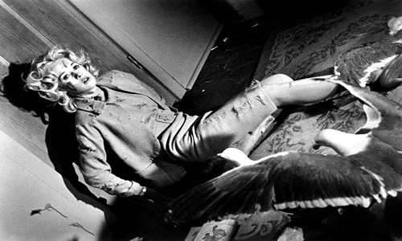
Camera angles
Top angle
Over the shoulder
POV
Dutch Angle
Birds Eye View

Slide 11
Do’s of ‘Filming
Don'ts of ‘Filming
Start recording before the action takes place. You can always trim any excess later.
Stop recording after the action takes place. You can always trim any excess later.
Also take stills shots of useful information.
Avoid excessive zooming. Frame the shot first.
If you must zoom during a shot, avoid jerkiness.
Avoid fast panning of static views.
The objective is to minimise audience nausea.

Slide 12
ENJOY CREATING MORE!
THANKYOU!

