Slide 1
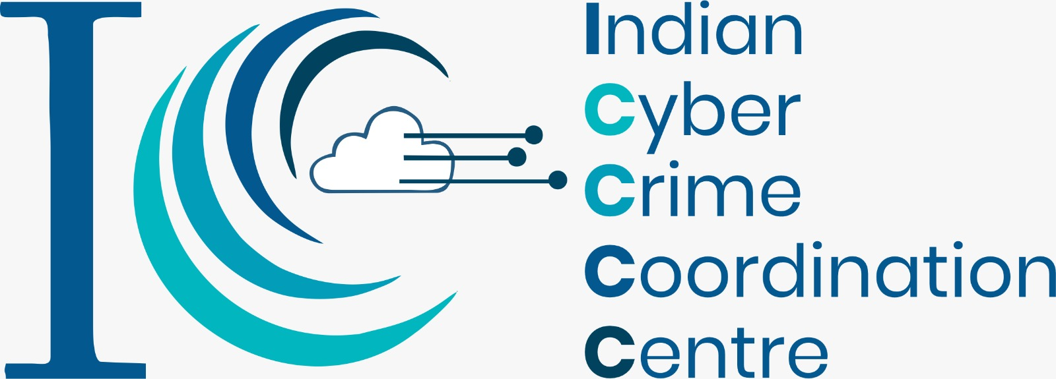
Defending Against Digital Threats: Recognising and Avoiding Cyber Threats

Slide 2
Digital Assets
Digital Files
Financial Assets
Intellectual Property
Online Accounts
Digital Credentials
Digital Art and Collectibles
Personal Data
Business Data
Software and Applications
Domain Names
E-books and Digital Publications
Online Courses and Educational Content
Website Content
Cloud-based Storage

Slide 3
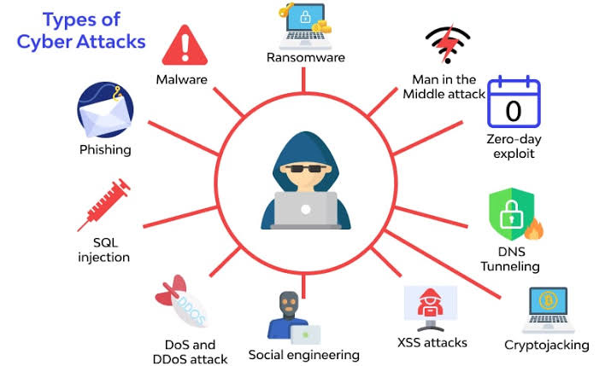
Cyber Attacks
Password Attack

Slide 4
Aspects of Cyber Security
 | Confidentiality |  | Data Protection
 | Integrity |  | Incident Response
 | Availability |  | Network Security
 | Authentication |  | Endpoint Security
 | Authorisation |  | Awareness and Trainings
Notes:
Confidentiality: Ensuring that sensitive data is accessible only to authorized individuals and protected from unauthorized disclosure.
Integrity: Safeguarding the accuracy, reliability, and trustworthiness of data and systems by preventing unauthorized modifications or tampering.
Availability: Ensuring that systems and resources are accessible and functional when needed, and protected against denial-of-service (DoS) attacks or other disruptions.
Authentication: Verifying the identity of users, devices, or systems to grant appropriate access privileges and prevent unauthorized access.
Authorization: Granting and managing access privileges based on the principle of least privilege, ensuring that users and systems can only access what is necessary for their roles or functions.
Network Security: Protecting computer networks from unauthorized access, malware, and other threats through measures such as firewalls, intrusion detection/prevention systems (IDS/IPS), and secure network configurations.
Endpoint Security: Securing individual devices such as computers, laptops, mobile devices, and Internet of Things (IoT) devices to prevent unauthorized access and protect against malware or other threats.
Data Protection: Implementing measures to safeguard sensitive data through encryption, data backup, secure storage, and secure data handling practices.
Incident Response: Establishing processes and procedures to respond promptly and effectively to cybersecurity incidents, including identifying, containing, mitigating, and recovering from security breaches.
Security Awareness and Training: Educating users and employees about cybersecurity best practices, promoting a security-conscious culture, and helping them understand the potential risks and how to protect against them.

Slide 5
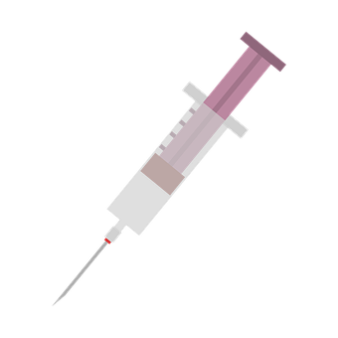
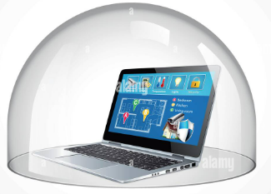
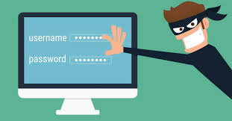
Cyber Attack
Malware Attack
Password Attack
Social Engineering

Slide 6
Malware
 | Virus
 | Worms
 | Trojan Horse
 | Key logger
 | Spyware
 | Adware
 | Ransom ware

Slide 7
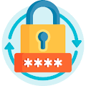
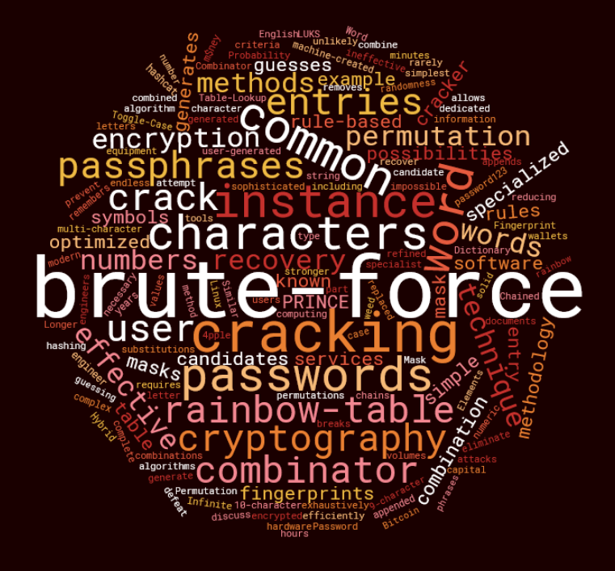
Password Attack
Dictionary
Brute Force
Keylogger
Shoulder Surfing
Rainbow Table

Slide 8
Wifi Router Security
 | Wifi Attacks
 | Evil Twin Attack
 | Jamming Signals
 | Misconfiguration Attack
 | Honey Spot Attack
 | Unauthorised/Adhoc Connection Attack
 | Precautions
 | Avoid public WiFi networks
 | Use VPN connection if you have to use public WiFi network.
 | Always change the default credentials of your router.

Slide 9
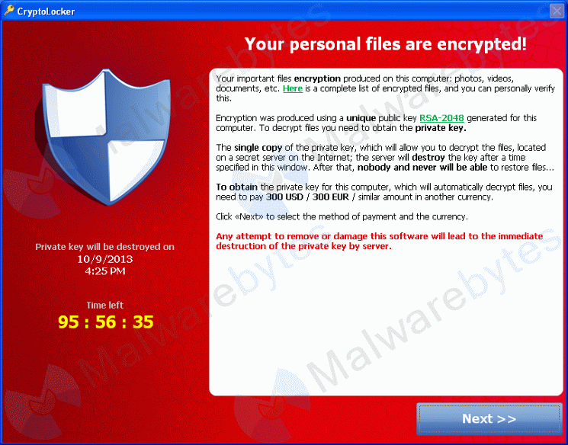
Ransomware
Ransomware is a type of malware that prevents or limits users from accessing their system, often encrypting data in an unrecoverable fashion. Ransomware forces its victims to pay the ransom through certain online payment methods in order to grant access to their systems, or to get their data back

Slide 10
7 Big Hackings that Hurt Indian Businesses
AIIMS
SpiceJet
Oil India
Haldiram
Indiabulls Group
Andhra Pradesh and Telangana power utilities
Tech Mahindra

Slide 11
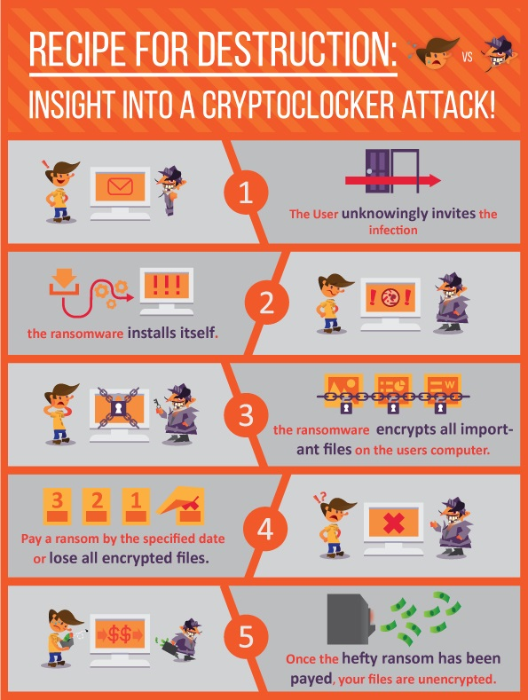
Ransomware Life-Cycle Phases:
Distribution Campaign
Infection
Staging
Scanning
Encryption
Ransom Demand

Slide 12
Common Attack Vectors
Social engineering
Unsafe web browsing
Malvertising
Email campaigns
Web exploits
Phishing scams
Infected removable media
Exploited accounts
Out of date, end of life, un-patched vulnerable computing system

Slide 13
Cost of Ransomware Attacks
Loss of Data and Information
Employee Downtime and Loss of Production
Ransom Costs
IT Consultant Time and Labor
Forensic Investigation Cost
Data Leak and Compliance Issues
Impact on Reputation and Loss of Business Relationships
IT Infrastructure Upgrades/Overhaul

Slide 14
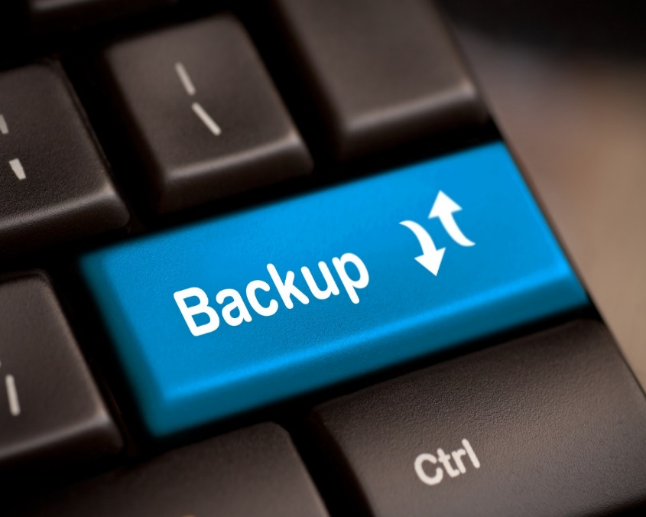
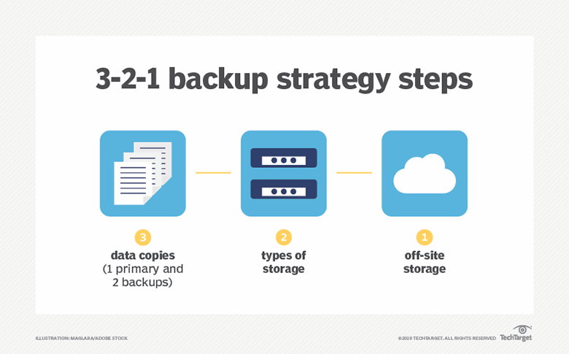
The Three Commandments
Thou shall backup
Thou shall backup Again
Thou shall backup once More
On and offsite full system imaging
Hourly incremental snapshots
Avoid using external USB drives
Only single guarantee to recovering data

Slide 15
Distributed Denial of Service Attack (DDoS)
What is a DDoS Attack?
Definition: A DDoS attack is a malicious attempt to disrupt the regular functioning of a network, service, or website by overwhelming it with a flood of internet traffic.
Key characteristics:
Distributed nature
Multiple sources
High volume of traffic
How Does a DDoS Attack Work?
Step 1: Botnet creation
Step 2: Command and control (C&C) communication
Step 3: Attack launch
Step 4: Victim overwhelmed
Step 5: Service disruption

Slide 16
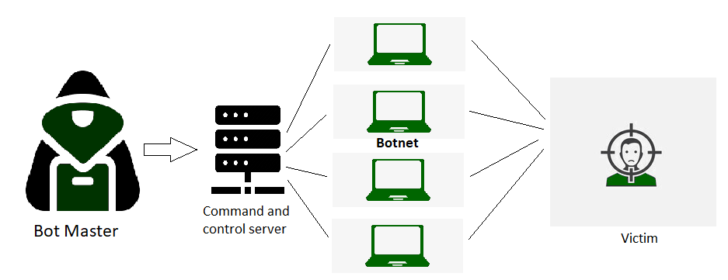
Distributed Denial of Service Attack (DDoS)
DDoS Attack means "Distributed Denial-of-Service (DDoS) Attack" and it is a cybercrime in which the attacker floods a server with internet traffic to prevent users from accessing connected online services and sites.

Slide 17
Distributed Denial of Service Attack (DDoS)
Motivations Behind DDoS Attacks
Financial gain: Extortion, ransom demands
Competitive advantage: Disrupting a competitor's online presence
Ideological motivations: Activism, hacktivism
Revenge or personal grudges
: Impact of DDoS Attacks
Service disruption and downtime
Financial losses
Reputation damage
Customer dissatisfaction
Increased security risks

Slide 18
Types of DDoS Attacks
Volumetric Attacks:
ICMP Flood(ping)
UDP Flood
SYN Flood
Protocol Attacks: (Reflection attacks)
DNS Amplification
NTP Amplification (network time protocol)
SSDP Reflection(simple service discovery protocol)
Application Layer Attacks:
HTTP Flood
Slowloris(http response)
DNS Query Flood

Slide 19
DDoS Mitigation Techniques
Network-Level Defenses:
Traffic filtering and rate limiting
Firewalls and Intrusion Prevention Systems (IPS)
Blackholing and Sinkholing
Content Delivery Networks (CDNs)
DDoS Protection Services:
Cloud-based DDoS protection
Scrubbing Centers
Load balancing and scaling
Incident response planning

Slide 20
Best Practices for DDoS Prevention
Conduct a risk assessment and understand your network's vulnerabilities
Implement a layered defense strategy
Regularly update and patch software and systems
Monitor network traffic and look for anomalies
Have an incident response plan in place

Slide 21
Network Security
 | Use Strong Passwords |  | Secure Wireless Networks
 | Update Firmware and Software |  | Implement Access Controls
 | Segment the Network |  | Regularly Backup Data
 | Enable Firewalls |  | Educate Users
 | Use Network Monitoring and Intrusion Detection System |  | Monitor and Log Network Activity

Slide 22
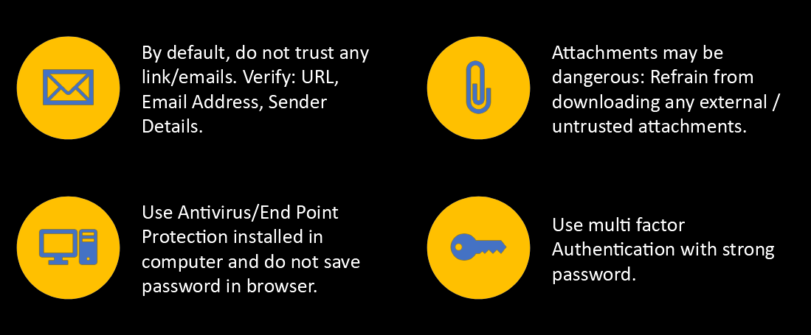
Email & Internet Security
By default, do not trust any link/emails. Verify: URL, Email Address, Sender Details.
Attachments may be dangerous: Refrain from downloading any external / untrusted attachments.
Use Antivirus/End Point Protection installed in computer and do not save password in browser.
Use multi factor Authentication with strong password.

Slide 23
Securing Desktops
 | Use Strong Passwords |  | Encrypt Data
 | Keep Operating Systems and Software Updated |  | Regular Data Backups
 | Install and Maintain Antivirus/Anti-Malware Software |  | Secure Wi-Fi Connections
 | Enable Firewall Protection |  | Physical Security
 | Secure Web Browsing |  | Implement Device Tracking and Remote Wiping
 | Implement Least Privilege Principle |  | User Education and Awareness

Slide 24
CCTV Security
Consider buying from a reliable source
Think carefully about the choice of hardware
Get full training
Separate the IT network from networked IP CCTV
Practice strong password policies
Avoid remote accessing the system from public Wi-Fi

Slide 25
CCTV Security
Avoid cloud-based CCTV and integrated security systems
Automatically update software
Prevent physical access to CCTV and integrated security system components
Disable common access on network switches
Think about the benefit of creating unique subnet and IP addresses
Consider locking down the network using MAC addressing

Slide 26
Securing Removable Media
 | Use Trusted Sources |  | Regularly Update Software
 | Scan for Malware |  | Scan Removable Media
 | Enable Write Protection |  | Use Secure Erase Methods
 | Encrypt Sensitive Data |  | Physically Secure Removable Media
 | Implement Device Control Policies |  | Train Users

Slide 27
STUXNET: A Game-Changing Cyber Weapon
Introduction
Stuxnet: a groundbreaking cyber weapon that changed the landscape of cyber warfare.
Discovered in 2010, Stuxnet was unlike any malware seen before.
Targeted specifically at Iran's nuclear program, it had far-reaching implications for global cybersecurity.
Objective and Target
Stuxnet's primary objective was to disrupt and disable Iran's uranium enrichment facilities.
Specifically targeted the Natanz nuclear facility in Iran.
Aimed to undermine Iran's nuclear ambitions by sabotaging their centrifuges.

Slide 28
The SolarWinds Hack
Introduction:
The SolarWinds hack: one of the most significant cyberattacks in recent history.
Discovered in December 2020, it exposed vulnerabilities in the software supply chain.
Targeted numerous organizations, including government agencies and major corporations.
Overview of the SolarWinds Hack:
Advanced Persistent Threat (APT) campaign carried out by a sophisticated threat actor.
Compromised the SolarWinds Orion software, a widely used IT management tool.
Used the compromised software to infiltrate victims' networks

Slide 29
The Kundankulam Cyber Attack: Uncovering the Threat to Nuclear Facilities
Introduction:
The Kundankulam cyber attack: a significant incident targeting a critical infrastructure facility.
Occurred in 2019, highlighting the vulnerabilities of nuclear power plants to cyber threats.
Raises concerns about the potential consequences of cyberattacks on such facilities.
Overview of the Kundankulam Cyber Attack:
A targeted attack on the Kudankulam Nuclear Power Plant (KKNPP) in India.
The attack reportedly originated from a North Korean hacker group known as Lazarus.
Aimed to gain unauthorized access and potentially disrupt the facility's operations.

Slide 30
The AIIMS Ransomware Attack: Safeguarding Healthcare from Cyber Threats
Introduction:
The AIIMS ransomware attack: a significant cybersecurity incident targeting a renowned healthcare institution.
Occurred in 2023, highlighting the vulnerability of healthcare organizations to ransomware attacks.
Raises concerns about the impact of such attacks on critical healthcare services.
Overview of the AIIMS Ransomware Attack:
AIIMS (All India Institute of Medical Sciences) was targeted by a sophisticated ransomware attack.
Ransomware is a type of malware that encrypts files and demands a ransom for their release.
The attack disrupted critical hospital systems and potentially compromised patient data.

Slide 31
Thank You
Indian Cyber Crime Coordination Centre
Ministry of Home Affairs
5th Floor. NDCC-II Building
Jai Singh Road
New Delhi - 110 001
Davinder Kumar
Sr. Consultant (I4C-MHA)
Mobile: 9354806172
eMail: kumar.davinder@nic.in

