Slide 1
THE CYBER PARENTING GUIDE UNDERSTANDING THE BOOMERS TO GEN Z Prof. Raakesh. Kriplani Pioneer Psychologist and Cyber Psychologist

Slide 2
What we will cover today.
Cause effect relationship
How families got shrink
What we lost in last 70 years
Super – concept
Different Generation perspective

Slide 3
Before 1950s integrated family clan

Slide 4
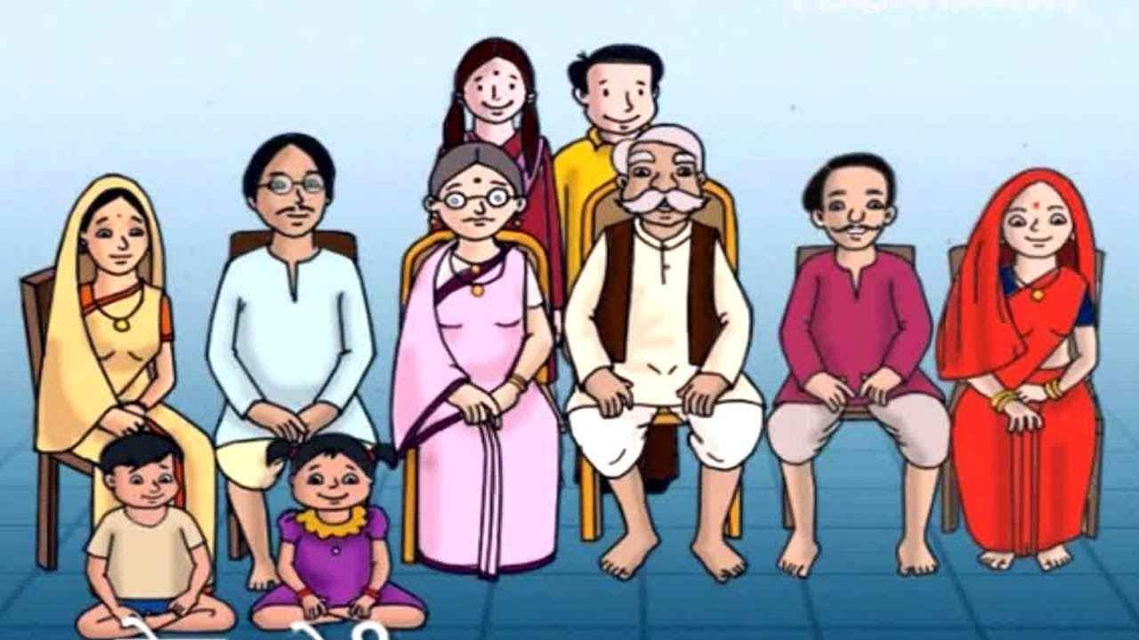
1970’S complete family

Slide 5
1980S we shrink into 4 members

Slide 6
1990S into 3

Slide 7
DINK Group

Slide 8
Later Live in relationship

Slide 9
Concept of Singlehood since 2000

Slide 10
Entered into Self obsession

Slide 11
New -ME GENERATION

Slide 12
Entry of Tv

Slide 13
Old family integrated serials 80s

Slide 14
1990s- change in values through soaps and TV

Slide 15
Family communication -1980

Slide 16
Cards company restricted our Expression

Slide 17
And Mobile revolution in 1990 with Pin and chats

Slide 18
Abbreviated message.

Slide 19
Started -Short message .

Slide 20
Expressio n throughEmojis

Slide 21
WE ALSO HAVE STARTED FACING-LONELINESS

Slide 22
THREE DEMANDS-SINCE 1990/2000

Slide 23
CONCEPT OF SUPER KID

Slide 24
Demand for super husband

Slide 25
Demand for super wife..

Slide 26
AS A RESULT

Slide 27
TYPES
Generations
Baby boomers
X
Y
Z
Alpha
BETA

Slide 28
Types of generation
Turkle’s Goldilock’s Effect

Slide 29
Generational Overview - Indian Context
In India, the Baby Boomer Generation encompasses individuals born roughly between the late 1940s and the early 1960s.
In terms of technology, they experienced a gradual shift from traditional modes of communication to early technological advancements like landline telephones, radio, and limited television access.

Slide 30
BABY BOOMERS
This generation experienced significant societal changes, including India's independence, rapid urbanization, and the economic liberalization of the 1990s.

Slide 31
Characteristics of the Baby Boomer Generation in India:
Strong emphasis on traditional values such as respect for elders, family unity, and cultural heritage.
A significant portion of this generation was witness to the post-independence era, and they actively participated in nation-building activities.

Slide 32
Technological Exposure during Upbringing in India:
Limited exposure to digital technology during their formative years.
Television became more prevalent in urban households, but it wasn't as widespread in rural areas during their youth.

Slide 33
BABY BOOMERS
Computers and internet access were not commonplace in households until much later in their lives, often well into adulthood or their professional careers.

Slide 34
Parenting Approaches in India's Baby Boomer Generation:
Emphasis on discipline, education, and career stability in parenting.
Parental guidance was based on traditional values and teachings rather than digital influence.
Limited exposure to technology influenced their cautious approach to embracing technological advancements in parenting styles.

Slide 35
Challenges Arising from the Digital Age for Baby Boomer Parents in India:
Rapid Technological Evolution: The swift evolution of technology can be overwhelming for Baby Boomer parents. They might struggle to keep up with the latest gadgets, social media platforms, and digital trends that their children are exposed to.

Slide 36
Generation Gap and Communication:
Communication gaps between Baby Boomer parents and their tech-savvy children are common. Differences in understanding technology and its impact on daily life create challenges in fostering open dialogues and understanding each other's perspectives.

Slide 37
BABY BOOMERS
Digital Safety Concerns: Baby Boomer parents may face difficulties in monitoring their children's online activities, given their limited understanding of digital platforms. Concerns regarding online safety, exposure to inappropriate content, and cyberbullying are prevalent.

Slide 38
Adaptation Struggles:
The need to adapt parenting styles to accommodate digital influences can be daunting. Baby Boomer parents may find it challenging to strike a balance between embracing technology for educational purposes and limiting excessive screen time.

Slide 39
Educational Support
: Limited knowledge about digital tools and online educational resources might hinder Baby Boomer parents' ability to actively support their children's learning experiences in a digital environment.

Slide 40
SOCIAL
Social Impact: The digital age has altered social dynamics. Baby Boomer parents might face challenges in comprehending the impact of social media on their children's social interactions, mental health, and overall well-being.

Slide 41
Adaptation Struggles and Concerns:
Resistance to technological advancements due to unfamiliarity or discomfort with digital tools.
Concerns about the potential negative effects of excessive screen time on their children's development.
Frustration or feelings of inadequacy when attempting to navigate and understand complex digital platforms and devices.

Slide 42
TYPES OF GENERATIONS.

Slide 43
Gen X – 1961 – 1981
Take job seriously
Entrepreneurial
Apathetic/cynical
Low level of trust toward authority
Alienated as kids
Era of the Latchkey Child
Parent/child Involvement: Distant

Slide 44
Characteristics of Generation X in India:
Born roughly between the early 1960s to the early 1980s in India.
Experienced economic and political changes like globalization and technological advancements during their formative years.
Often referred to as the 'Latchkey Generation' due to their experience of both parents working, leading to more independence and self-reliance.

Slide 45
Technological Exposure during Upbringing:
Witnessed the advent of personal computers, video games, and early forms of the internet during their youth.
Limited but increasing exposure to technology compared to the Baby Boomer Generation.
Gradually adapting to digital advancements during their adolescence and early adulthood.

Slide 46
Generation X's Approach to Parenting in India
Psychological Inputs from Generation X on Cyber Parenting:
Embracing technology as it became more integrated into daily life and work.
Adopting a more pragmatic and adaptable approach to parenting, blending traditional values with technological advancements.
Encouraging independence and critical thinking in their children while navigating digital spaces.

Slide 47
Technology Adaptation in Parenting Styles:
Leveraging technology for educational purposes and communication within the family.
Setting boundaries and guidelines for screen time and online activities.
Striving to stay updated with technological trends to better understand and guide their children.

Slide 48
Challenges Faced by Generation X Parents in India
Specific Challenges in Cyber Parenting:
Balancing traditional parenting values with the rapid evolution of technology.
Managing the pervasive influence of social media and digital distractions on their children's lives.
Addressing concerns regarding online safety, privacy, and cyberbullying.

Slide 49
Challenges Faced by Generation X Parents in India
Specific Challenges in Cyber Parenting:
Balancing traditional parenting values with the rapid evolution of technology.
Managing the pervasive influence of social media and digital distractions on their children's lives.
Addressing concerns regarding online safety, privacy, and cyberbullying.

Slide 50
Balancing Technology with Parenting Approaches
Struggles in Balancing Technology and Parenting:
The dilemma of allowing enough exposure to technology for educational purposes without overindulgence.
Navigating conflicts arising from differing viewpoints on screen time and digital engagement within the family.
Striving to maintain a healthy balance between offline activities, family time, and screen-based interactions.

Slide 51
Coping Strategies for Generation X Parents
Effective Coping Strategies:
Engaging in open dialogues with children about responsible digital citizenship and online safety.
Seeking guidance from educational resources and parenting communities to better understand the digital landscape.
Emphasizing quality time and offline activities to ensure a holistic upbringing while leveraging technology for educational and developmental purposes.

Slide 52
1980 to 2000

Slide 53
Characteristics of Millennials in India:
Born approximately between the early 1980s to the mid-1990s in India.
Shaped by globalization, economic reforms, and rapid technological advancements.
Known for their adaptability, digital fluency, and inclination towards innovation and social change.

Slide 54
Types of Generations

Slide 55
More Characteristics of the Millennialism
Parent/Child Involvement: Intruding
Get trophies for participation rather than victory
Share a lot of information about themselves
Expect to get to the top quickly
Think they are equal to authority
Increase rate of anxiety and depression
Gap between optimism growing up and reality

Slide 56
Technological Exposure during Upbringing:
Growing up alongside the proliferation of the internet, mobile phones, and social media.
Highly immersed in digital technology from an early age, experiencing a shift towards more accessible and advanced digital tools.

Slide 57
Millennials' Approach to Parenting in India
Psychological Inputs from Millennials on Cyber Parenting:
Embrace technology as an integral part of daily life and child development.
Prioritize open communication and digital literacy within the family to navigate the online world.
Incorporate technology into parenting, utilizing educational apps, online resources, and interactive platforms.

Slide 58
Integration of Technology into Parenting Styles:
Using technology to facilitate learning and engagement, encouraging exploration and creativity.
Implementing digital monitoring tools and parental control features for online safety.
Advocating for a balanced approach, emphasizing both offline and online experiences for their children.

Slide 59
Challenges Faced by Millennial Parents in India
Unique Challenges in Cyber Parenting:
Managing the vast array of digital distractions and ensuring focused learning amidst technological stimuli.
Navigating the fine line between enabling digital literacy and overexposure to screen-based activities.
Coping with the pressures of social media and its impact on their children's self-esteem and social interactions.

Slide 60
Impact of Technological Immersion on Parenting Practices:
Struggles with setting boundaries for screen time and maintaining a healthy digital lifestyle.
Addressing concerns about online safety, cyberbullying, and exposure to inappropriate content.
Balancing their own technological dependency while guiding their children's digital behavior.

Slide 61
AND WE ARE TALKING ABOUT.

Slide 62
Generation Z - Overview in Indian Context
Characteristics of Generation Z in India:
Born approximately from the mid-1990s to the early 2010s in India.
Shaped by a highly digitized world, witnessing the rapid evolution of technology and social media.
Known for being tech-savvy, adaptable, and accustomed to instant access to information.

Slide 63
Gen Z
Digital Natives: Gen Z grew up in a world where digital technology and the internet were already prevalent. They are highly proficient in using smartphones, social media, and various digital platforms.
employment and income generation.

Slide 64
Gen Z
Tech-Savvy: Gen Z is known for its technological prowess. They tend to be early adopters of new digital tools and are often skilled at using technology for various tasks, including communication, learning, and entertainment.

Slide 65
Gen Z
Entrepreneurial Spirit: Many Gen Z individuals are entrepreneurial and value the idea of starting their own businesses or side hustles. They are attracted to opportunities for self-

Slide 66
Gen Z
Diversity and Inclusion: Gen Z is one of the most diverse generations, both culturally and socially. They tend to be more inclusive and accepting of different races, ethnicities, genders, sexual orientations, and identities.

Slide 67
Gen Z
Socially Conscious: Gen Z is often socially and environmentally conscious. They are concerned about social justice issues, climate change, and human rights, and they are more likely to engage in activism and advocacy.

Slide 68
Gen Z
Pragmatic and Realistic: Gen Z came of age during times of economic uncertainty and global events like the Great Recession and the COVID-19 pandemic. As a result, they tend to be pragmatic and practical when it comes to their career and financial choices.

Slide 69
Gen Z
Short Attention Spans: Due to the constant bombardment of information in the digital age, Gen Z may have shorter attention spans and prefer shorter, bite-sized content. They are skilled at multitasking but may struggle with deep focus.

Slide 70
Gen Z
Independent Learners: Gen Z is known for its ability to learn independently, often relying on online resources, tutorials, and educational apps. They value flexibility in education and may seek non-traditional learning pathways.

Slide 71
Gen Z
Financial Prudence: Given the economic challenges they witnessed during their formative years, Gen Z tends to be financially cautious and may prioritize saving and financial stability.

Slide 72
Gen Z
Political Engagement: Gen Z is becoming increasingly politically engaged and active, often using social media and grassroots organizing to advocate for their beliefs and causes.

Slide 73
This generation also called

Slide 74
Technological Exposure during Upbringing:
Immersed in digital technology from birth, with access to smartphones, social media, and online platforms being integral to their upbringing.
Experience a tech-driven education system with a heavy reliance on digital tools and online learning.

Slide 75
Generation Z's Approach to Parenting (as future parents) in India
Anticipated Psychological Inputs on Cyber Parenting:
An inclination towards utilizing cutting-edge technology to enhance parenting practices.
Increased awareness of online safety and privacy concerns due to their inherent familiarity with digital platforms.
A more collaborative and connected approach to parenting using social networks and digital communities.

Slide 76
Preparing for Next Generation's Parenting Styles:
Embracing innovative technologies like AI, VR, and IoT to create personalized and immersive learning experiences for their children.
Prioritizing digital literacy and critical thinking skills, preparing children to navigate the evolving digital landscape responsibly.

Slide 77
Challenges for Future Generation Z Parents in India
Foreseen Challenges for Generation Z Parents:
Coping with the rapid pace of technological advancements and their impact on parenting methodologies.
Striking a balance between reliance on technology for parenting and maintaining human connection and emotional bonding.
Addressing ethical dilemmas and privacy concerns associated with emerging technologies in parenting.

Slide 78
Technological Advancements and Their Implications:
Exploring challenges related to the integration of AI, automation, and smart devices in parenting roles.
Understanding and mitigating potential risks associated with children's exposure to advanced tech like AI-powered content and virtual environments.

Slide 79
Present Generation

Slide 80
Alpha Generation - Overview in Indian Context
Born roughly from the mid-2010s to the mid-2020s in India.
Growing up in an era of unparalleled technological advancement, characterized by the omnipresence of smart devices, AI, and IoT.
Often referred to as the "tech-native" generation, as technology is seamlessly integrated into their daily lives from infancy.

Slide 81
ALPHA
Technology Natives: Gen Alpha is growing up in a highly digital and tech-savvy world. They are often referred to as "digital natives" because they have been exposed to technology from a very young age and are comfortable using digital devices and the internet.

Slide 82
ALPHA
Diversity and Inclusivity: Gen Alpha is expected to be one of the most diverse generations in history, with a wide range of ethnic backgrounds and cultures represented. They are likely to be more inclusive and accepting of diversity.

Slide 83
ALPHA
Global Awareness: Due to the internet and social media, Gen Alpha has access to a wealth of information from around the world. They may have a greater awareness of global issues and be more globally connected than previous generations.

Slide 84
ALPHA
Environmental Consciousness: Growing up in an era of increased environmental awareness, Gen Alpha is likely to be more environmentally conscious and concerned about issues such as climate change and sustainability.

Slide 85
ALPHA
Individuality: Gen Alpha is expected to value individuality and self-expression. They may be more open to exploring diverse interests and identities.

Slide 86
ALPHA
Education: The education landscape is evolving, and Gen Alpha is likely to experience personalized and technology-driven education. They may have more access to online learning resources and educational technology.

Slide 87
ALPHA
Family Dynamics: Gen Alpha is growing up in a world where non-traditional family structures are more common. They may have a broader understanding of family and relationships.

Slide 88
ALPHA
Health and Wellness: With a focus on healthy living and well-being, Gen Alpha may have access to more information about nutrition and fitness from an early age.

Slide 89
ALPHA
Economic Challenges: Gen Alpha may face economic challenges such as student loan debt, high housing costs, and a rapidly changing job market. They may need to adapt to new career opportunities and work arrangements.

Slide 90
ALPHA
Entrepreneurship: Gen Alpha may have a strong entrepreneurial spirit, with the ability to leverage technology to create their own businesses and pursue their passions.

Slide 91
PROBLEMS
Mental Health Concerns: The pressure to succeed and the constant comparison with others on social media can contribute to mental health issues such as anxiety, depression, and low self-esteem. Gen Alpha may need increased support and resources for managing their mental health.

Slide 92
PROBLEMS
Cyberbullying: Online harassment and cyberbullying are real threats in the digital age. Gen Alpha may need guidance on how to navigate the online world safely and how to deal with cyberbullying.

Slide 93
PROBLEMS
Environmental Challenges: Gen Alpha is growing up in a world where climate change and environmental issues are pressing concerns. They may face the consequences of these challenges, such as extreme weather events and resource scarcity.

Slide 94
PROBLEMS
Education Pressure: The expectations placed on Gen Alpha to excel academically and prepare for competitive careers may lead to high levels of stress and anxiety. They may require support in managing academic pressure.

Slide 95
PROBLEMS
Technology Addiction: Growing up in a highly digital and connected world, Gen Alpha may be at risk of developing technology addiction or over-dependence on screens and devices. This can have negative impacts on their physical health, mental well-being, and social interactions.

Slide 96
PROBLEMS
Economic Uncertainty: Economic conditions can impact job prospects and financial stability. Gen Alpha may face economic challenges, including high student loan debt and the need to adapt to changing job markets.

Slide 97
PROBLEMS
Privacy Concerns: Growing up with technology also means being constantly monitored and having personal data collected. Gen Alpha may need to navigate complex privacy issues and understand the implications of sharing personal information online.

Slide 98
PROBLEMS
Societal and Political Divisions: Gen Alpha will inherit a world with political and social divisions. They may need to develop critical thinking skills and learn how to engage in constructive dialogue to address these divisions.

Slide 99
PROBLEMS
Global Crises: Gen Alpha may experience and have to respond to global crises such as pandemics, economic recessions, and geopolitical conflicts. These events can have long-lasting impacts on their lives and future prospects.

Slide 100
Current Technological Exposure:
Constant exposure to digital devices, including smartphones, tablets, and smart toys, shaping their early developmental experiences.
Interacting with AI-driven interfaces and having access to a vast array of educational apps and digital content right from their early years.

Slide 101
Understanding Alpha Generation's Tech Proficiency in Indian Context
In-depth Analysis of Digital Fluency:
Proficient in navigating complex digital interfaces at an incredibly young age, showcasing a natural affinity for technological devices and interfaces.
Early adoption and adaptation to emerging technologies, leading to an intuitive understanding of AI, virtual reality, and other cutting-edge advancements.

Slide 103
Implications for Future Parenting and Teaching:
Significantly impacting parenting approaches, necessitating a deeper understanding and active involvement in children's digital lives from an even earlier stage.
Educational paradigms need to evolve to accommodate their tech-centric learning styles, requiring educators to adapt teaching methodologies and curricula.

Slide 104
Insights from Alpha Generation in Indian Context
Speculation on Cyber Parenting Perception:
Anticipated to view technology as an inherent part of their upbringing, potentially leading to a more collaborative approach to cyber parenting.
Expected to demand more digital autonomy while simultaneously seeking guidance and support from parents in navigating the online world.

Slide 105
Potential Behavioral Changes and Adaptations:
Likely to exhibit higher levels of multitasking, adaptability, and digital creativity owing to their early and immersive exposure to technology.
May exhibit a different perspective on privacy, social interaction, and information consumption, reshaping societal norms and behavioral patterns.

Slide 106
Implications for Future Parenting and Teaching:
Significantly impacting parenting approaches, necessitating a deeper understanding and active involvement in children's digital lives from an even earlier stage.
Educational paradigms need to evolve to accommodate their tech-centric learning styles, requiring educators to adapt teaching methodologies and curricula.

Slide 107
Insights from Alpha Generation in Indian Context
Speculation on Cyber Parenting Perception:
Anticipated to view technology as an inherent part of their upbringing, potentially leading to a more collaborative approach to cyber parenting.
Expected to demand more digital autonomy while simultaneously seeking guidance and support from parents in navigating the online world.

Slide 108
Potential Behavioral Changes and Adaptations:
Likely to exhibit higher levels of multitasking, adaptability, and digital creativity owing to their early and immersive exposure to technology.
May exhibit a different perspective on privacy, social interaction, and information consumption, reshaping societal norms and behavioral patterns.

Slide 109
AND 2025 ONWARDS ITS BETA

Slide 110
Alpha is

Slide 111
Gen z is

Slide 112
Millennials are

Slide 113
Gen x

Slide 114
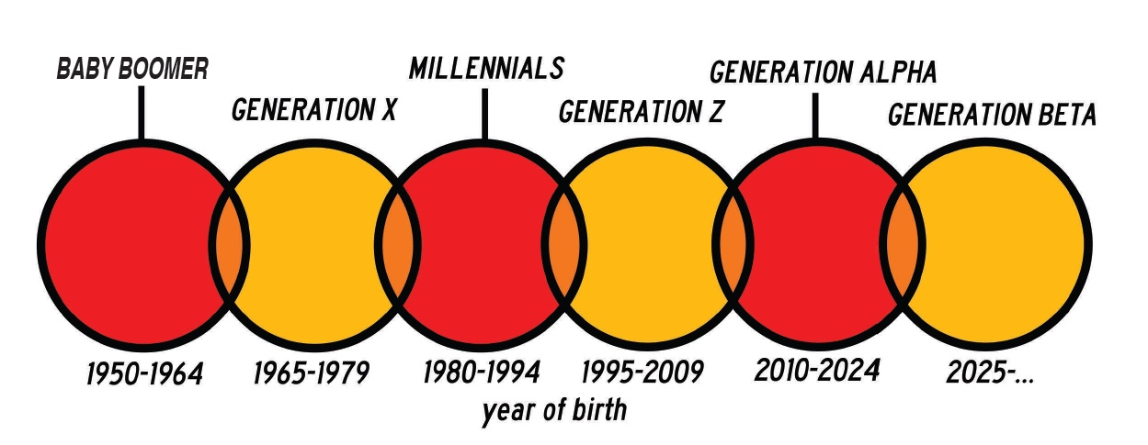
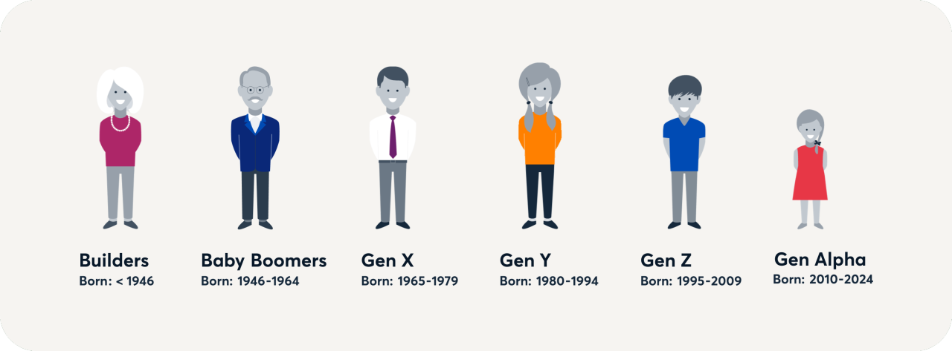
FINALLY !!

Slide 115
For any Query post program 9923755499 is the number to ask the Question

Slide 116
Or you can refer to the our authored book

