Slide 1
Interventions and Strategies for Effective Cyber Parenting
Geetesh Kumar Singh

Slide 2
Learning Outcome
Upon completion of this module, you will learn about
Landscape of the cyber space
Trend of cybercrime in India
Importance of cyber parenting
Strategies for cyber parenting
Reporting of cybercrime incidents

Slide 3
Brief overview of the cyber space
India has one of the youngest populations globally with an average age of 29 years. Over a quarter of its population – 25.78% to be precise – falls in the 0-14 age group. Children constituted about 14 percent of the country's overall internet user population in 2021.
According to a survey in September 2023, about 46 percent of urban parents reported that their children spent three to six hours each day using social media, OTT, and online games in India. 15 percent of Indian parents stated their kids spent more than six hours using online media every day.

Slide 4
Cybercrime
A cybercrime is a crime involving computers and networks.
This includes a wide range of activities, from illegally downloading music files to stealing money from online bank accounts.
Cybercrimes include both monetary & non-monetary offenses.
It can include frauds such as job-related frauds, matrimonial frauds; stealing and misusing sensitive personal information (Aadhaar details, credit/debit card details, bank account credentials, etc.);
Defamation of an individual on social media; distribution of computer viruses etc.
Cybercrimes can also lead to physical or sexual abuse.

Slide 6
State/UT Wise Distribution of Cybercrime Incidents (2017-21)

Slide 7
Motives of Cybercrime in India (2017-21)
Cyber Crime Motives | Average incidents per year | Total incidents | % of Total incidents
Fraud | 23305 | 116527 | 59.3%
Others | 6629 | 33147 | 16.9%
Sexual Exploitation | 2721 | 13604 | 6.9%
Extortion | 1824 | 9121 | 4.6%
Causing Disrepute | 1502 | 7509 | 3.8%
Personal Revenge | 1165 | 5823 | 3.0%
Anger | 692 | 3461 | 1.8%
Prank | 499 | 2496 | 1.3%
Political Motives | 268 | 1340 | 0.7%
Spreading Piracy | 191 | 955 | 0.5%
Developing own business | 184 | 922 | 0.5%
Inciting Hate Against Country | 134 | 669 | 0.3%
Terrorist Activities | 95 | 477 | 0.2%
Disrupt Public Service | 47 | 236 | 0.1%
Steal Information | 44 | 221 | 0.1%
Sale Purchase of illegal drugs | 12 | 59 | < 0.1%
Psycho or Pervert | 5 | 25 | < 0.1%
Abetment to Suicide | 1 | 7 | < 0.1%
Total | 39320 | 196599 | 100.0%

Slide 10
Types of Cybercrime

Slide 11
IDENTITY THEFT
Identity theft is the act of wrongfully obtaining someone’s personal information (that defines one’s identity) without their permission. The personal information may include their name, phone number, address, bank account number, Aadhaar number or credit/debit card number etc. The fraudster can use stolen personal information and identity proofs to:
gain access to your bank accounts
apply for loans and credit cards or open insurance accounts
obtain a driver’s license, passport or immigration papers
assume your identity on social media

Slide 13
PSYCHOLOGICAL TRICKS
Psychological tricks are where attackers play with the minds of the user to trap them with lucrative offers. Once trapped, the attackers can exploit the victim by either stealing money or stealing sensitive personal information (name, Aadhaar details, bank account details etc.) or harm the victim in any other way. The entire basis of this kind of attack is to make the victim fall into their trap by sending fake e-mails, calls or SMSs.
Phishing is the act of sending fraudulent e-mail that appears to be from a legitimate source, for example, a bank, a recruiter or a credit card company etc. This is done in an attempt to gain sensitive personal information, bank account details etc. from the victim.
Vishing is similar to phishing. But, instead of e-mail, in this type of crime, the fraudster uses telephone to obtain sensitive personal and financial information.
Smishing is the SMS equivalent of phishing. It uses SMS to send fraudulent text messages. The SMS asks the recipient to visit a website/weblink or call a phone number. The victim is then tricked into providing sensitive personal information, debit/credit card details or passwords etc.

Slide 15
SOCIAL MEDIA FRAUDS
Social Media is the new way of communicating, sharing and informing people about the events in our lives. We share our day to day lives on social media in the form of self and family photographs, updates on our locations/whereabouts, our views/thoughts on prevalent topics etc. One can understand the entire history of an individual through their social media profile and can even predict future events based on patterns in the past. This poses a threat to an individual as unwanted access to social media profile can cause loss of information, defamation or even worse consequences such as physical/sexual assault, robbery etc.
Hence, protection and appropriate use of social media profile is very important. Let us look at some examples of social media frauds.

Slide 16
SOCIAL MEDIA FRAUDS
Sympathy Fraud: The attacker becomes friends with the victim on social media. The attacker gains trust by frequent interactions. The attacker later extracts money/harms the victim.
Romance Fraud: The attacker becomes friends with the victim on social media. Over a period, the attacker gains victim’s affection. The attacker later exploits the victim physically, financially and/or emotionally.

Slide 17
SOCIAL MEDIA FRAUDS
Cyber Stalking: Cyber stalking is a crime in which the attacker harasses a victim using electronic communication, such as e-mail, instant messaging (IM), messages posted on a website or a discussion group. A cyber stalker relies upon the fact that his/her true identity is not known in the digital world. A cyber stalker targets the victim with threatening/abusive messages and follows them/their activities in the real world.
Cyber Bullying: Cyber bullying is bullying that takes place over digital devices. Cyber bullying can occur through SMS, social media, forums or gaming apps where people can view, participate or share content. Cyber bullying includes sending, posting or sharing negative, harmful, false content about someone else. The intention is to cause embarrassment or humiliation. At times, it can also cross the line into unlawful criminal behavior.

Slide 18
Cyber Bullying Story

Slide 24
MOBILE APPLICATION FRAUDS
Mobile applications are widely used not only for entertainment but also for ease and convenience to perform day-to-day tasks such as bill payments, bank accounts management, service delivery etc. As a result, these applications are more prone to cyber-attacks. Users need to be aware of such attacks on commonly used mobile applications such as digital payment applications and gaming applications.

Slide 25
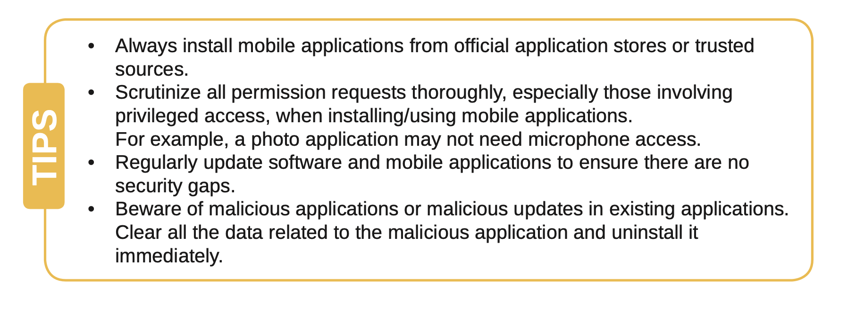

Slide 26
ONLINE BANKING FRAUDS
Nowadays, banking services are predominantly online, allowing tasks such as account statement retrieval, fund transfers, and cheque book requests to be easily completed from home. However, the shift to online platforms also brings an increase in cyber fraud.
Just as we secure our physical valuables with locks, protecting our online bank accounts with strong passwords is crucial.
Weak passwords can lead to account hacking, resulting in financial loss.
Examples of online banking fraud include attacks on digital payment applications and hacking due to weak or reused passwords.

Slide 28
VIRUS ATTACK ON PERSONAL COMPUTER
Personal computers and laptops are integral to our lives, storing crucial information like bank account numbers and personal files.
Protecting this data is essential, akin to securing a safe vault with a physical lock.
Viruses and malicious applications pose threats to our computers, entering through external devices, downloads from untrusted websites, or installation of dubious software. Such attacks can lead to computer slowdown, data corruption, deletion, or loss.

Slide 29
Virus Attack Story

Slide 30
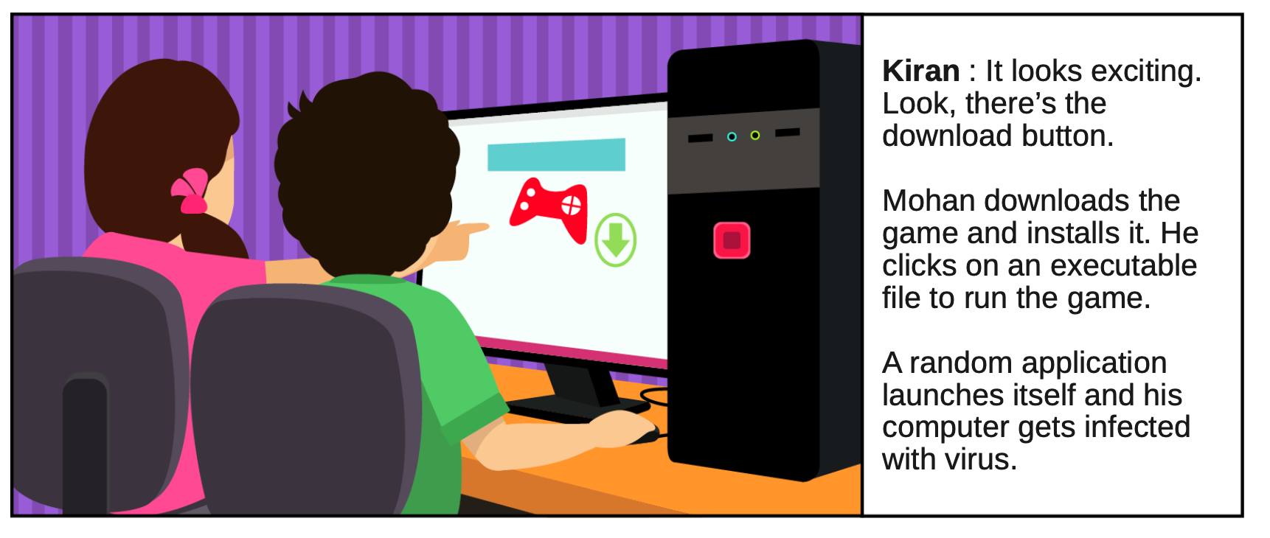

Slide 31
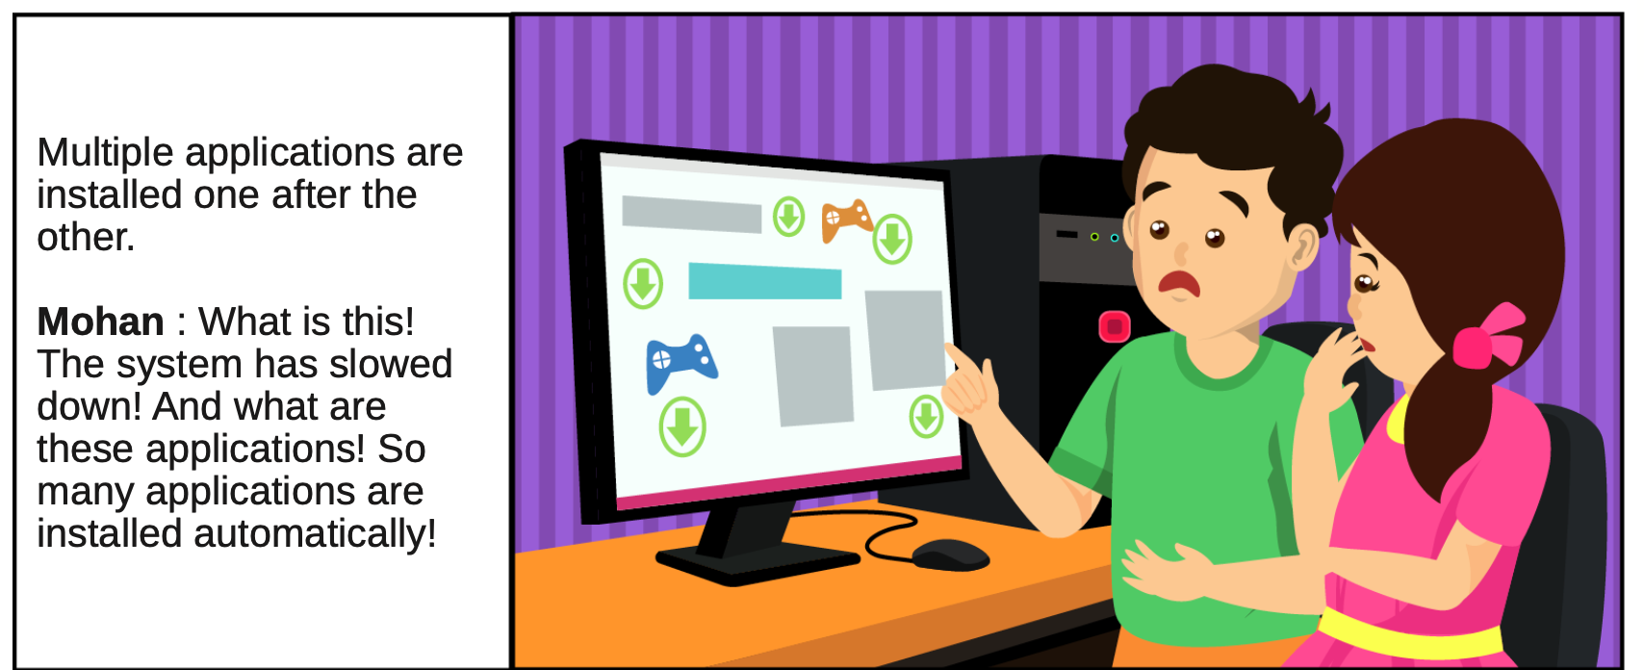

Slide 32
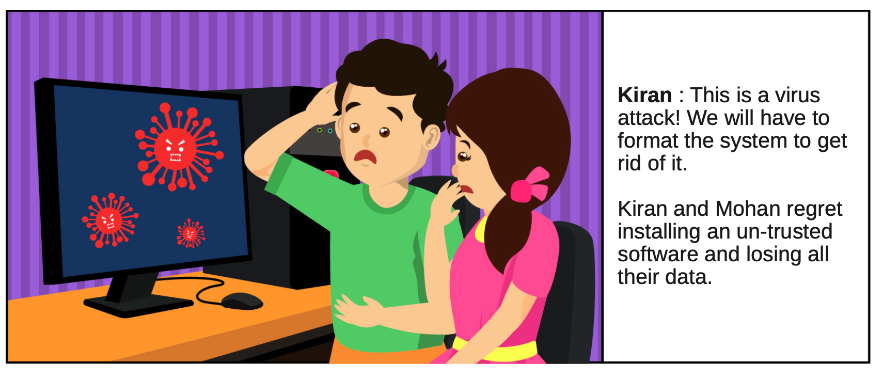

Slide 34
Understanding Cyber Parenting
Cyber parenting is the practice of guiding and monitoring children's online activities, such as browsing, gaming, socializing, and learning. Cyber parenting can be challenging, especially in the age of digital natives who are more adept and familiar with technology than their parents. However, cyber parenting is essential for ensuring children's safety, well-being, and development in the digital world.
Effective cyber parenting involves a combination of awareness, communication, and technological strategies to ensure a safe online environment for children.

Slide 35
Strategies for effective cyber parenting
1. Open Communication
Establish an open and non-judgmental line of communication with your child. Encourage them to share their online experiences, concerns, and questions.
Educate your child about the potential risks and consequences of online activities, including cyberbullying, privacy issues, and exposure to inappropriate content.
2. Set Clear Rules and Boundaries
Establish rules for screen time, online activities, and appropriate content. Clearly communicate these rules to your child and enforce consequences for violations.
Discuss and agree upon guidelines for social media usage, online gaming, and other internet activities.

Slide 36
Strategies for effective cyber parenting
3. Educate About Online Privacy
Teach your child about the importance of protecting personal information online. Emphasize the risks associated with sharing personal details, such as location, school, or contact information.
4. Monitor Online Activities
Regularly check your child's online profiles, friend lists, and posts to ensure they are following the established guidelines.
Instruct them on how to use privacy settings on social media platforms and other online services.
Use parental control tools and software to monitor and restrict access to inappropriate content. Many internet service providers and devices offer built-in parental controls.

Slide 37
Strategies for effective cyber parenting
5. Teach Online Etiquette and Responsible Behavior
Emphasize the importance of respectful and responsible behavior online. Discuss the potential impact of online actions on themselves and others.
6. Stay Informed about Current Trends and Apps
Stay updated on the latest trends, apps, and social media platforms your child may be using. This knowledge allows you to better understand the potential risks associated with specific online activities.
Encourage them to think before posting or sharing content and to consider the consequences of their online behavior.
Consider joining the same social media platforms your child uses to stay connected and understand their digital world.

Slide 38
Strategies for effective cyber parenting
7. Encourage Critical Thinking
Teach your child to critically evaluate online information. Discuss the importance of verifying information, recognizing misinformation, and being aware of potential online scams.
8. Model Healthy Online Behavior
Be a positive role model for your child by demonstrating responsible online behavior. Show them how to use technology in a balanced and mindful way.
Encourage them to report any suspicious or inappropriate behavior they encounter online.

Slide 39
Strategies for effective cyber parenting
9. Establish a Family Media Use Plan
Collaborate with your child to create a family media use plan that includes guidelines for screen time, device-free zones, and family activities.
10. Provide Emotional Support
Be supportive and understanding if your child encounters challenges online. Create an environment where they feel comfortable discussing any issues, they may face without fear of punishment.
By combining these interventions and strategies, you can promote a safe and positive online experience for your child while helping them develop responsible digital citizenship.

Slide 40
Do’s & Don’ts of Cyber Parenting
Do’s
Teach your kids how to be good digital citizens. It is never too early to start.
Continuously remind your kids how important their identity is, and how to protect it.
Protect your kids’ information, including any Personal Identifying Information (PII).
Configure both security and privacy settings on devices and applications and check those settings often.
Don’ts
Overshare information about your kids or family online.
Leave devices unlocked or unattended.
Use screen names with Personal Identifying Information (PII).
Use your date of birth or location in your profiles.
Use information about you as a password – i.e. dog’s name or birthday.

Slide 41
Do’s & Don’ts of Cyber Parenting
Do’s
Set time limits on device usage.
Use built in-controls to enforce where available.
Follow your kids’ social media profiles.
Be mindful of what you share about yourself, your family, and your friends.
Practice open communication with your kids.
Don’ts
Save billing information on devices to avoid accidental or non-permitted transactions.
Forget about gaming devices; those devices come with the same risks as any other device that accesses the Internet.
Underestimate the power of the digital world and associated tools.

Slide 42
Reporting Cybercrime
1. Immediate Action
Visit the nearest police station.
2. Online Reporting
National Cyber Crime Reporting Portal: https://cybercrime.gov.in/
3. Report Phishing
Use www.reportphishing.in for fraud SMS, emails, links, or calls.
4. Stay Informed
Check CERT-IN advisories at https://www.cert-in.org.in
5. Report to CERT-IN
Email: incident@cert-in.org.in
Helpdesk: +91 1800 11 4949
6. Lost or Stolen Phones
File FIR with police.
Inform DoT: https://ceir.gov.in

Slide 43
Thank You
Email ID: geeteshkumar.singh@rru.ac.in
Website: https://rru.ac.in/mr-geetesh-kumar-singh/
LinkedIn: https://www.linkedin.com/in/geeteshkumarsingh/
X (Twitter): https://twitter.com/geeteshksingh

