Slide 1
Financial fraud detection and recovery
Indian Cyber Crime Coordination Center (I4C)
Ministry of Home Affairs

Slide 2
modes of fraud & Recovery
Authorized Push Payment
Android Malware*
Unauthorized Payment
Card Cloning
Investment / Ponzi Schemes
Digital Arrest
Phishing
Biometric Cloning
Data Breach
Sim Swapping*

Slide 3
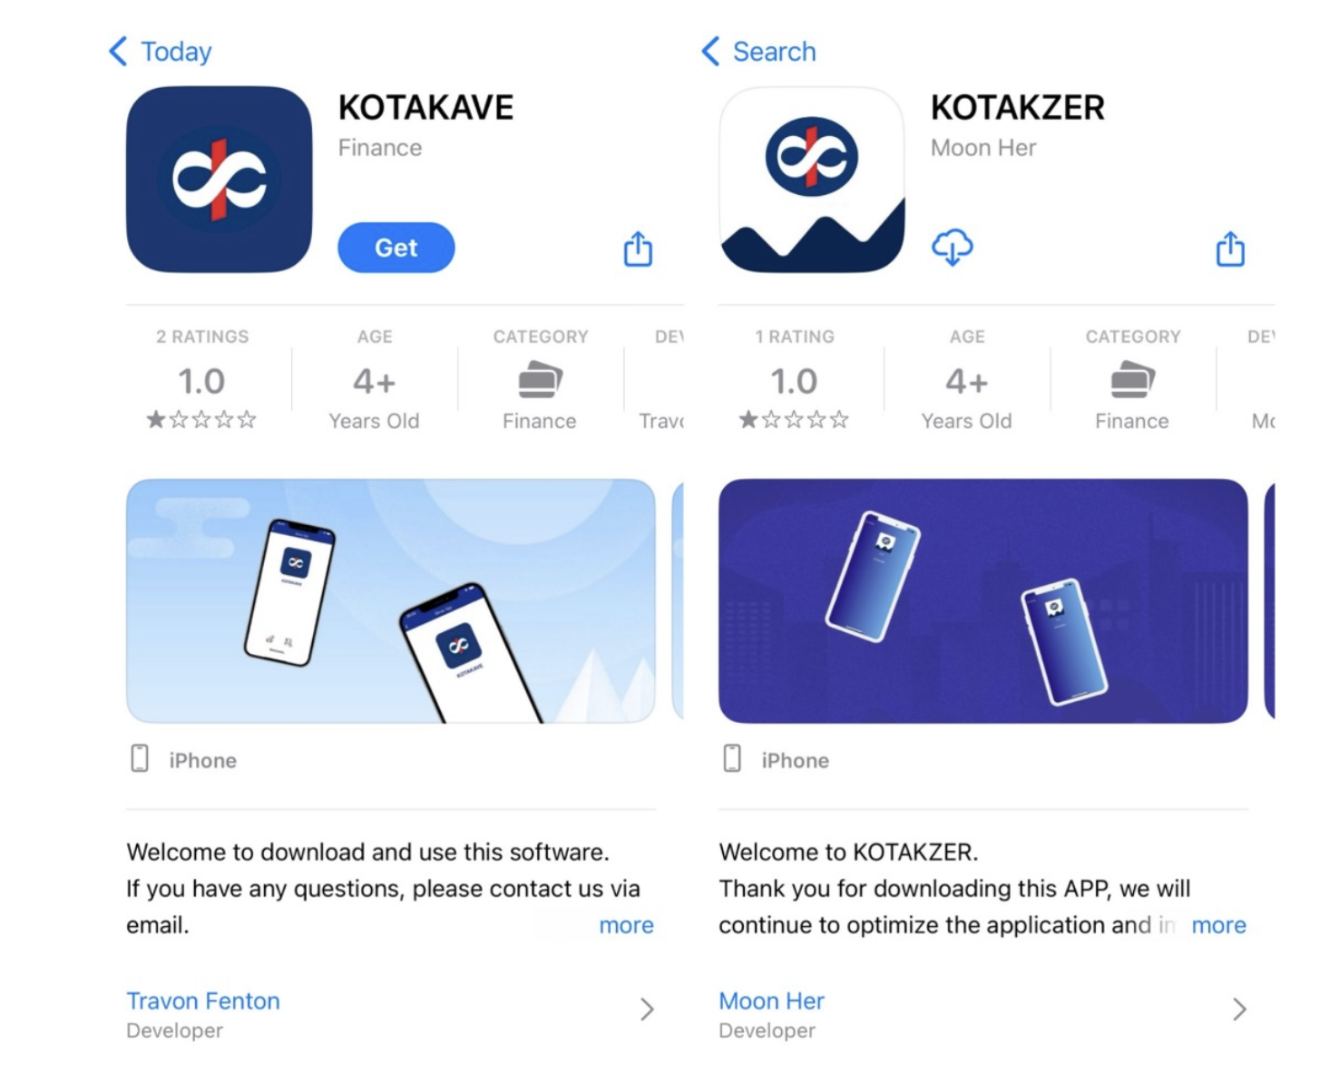
1. fake share market scam (1/4)
Fake Instagram / Facebook paid posts (advertisements)
Apps impersonating genuine stock brokers

Slide 4
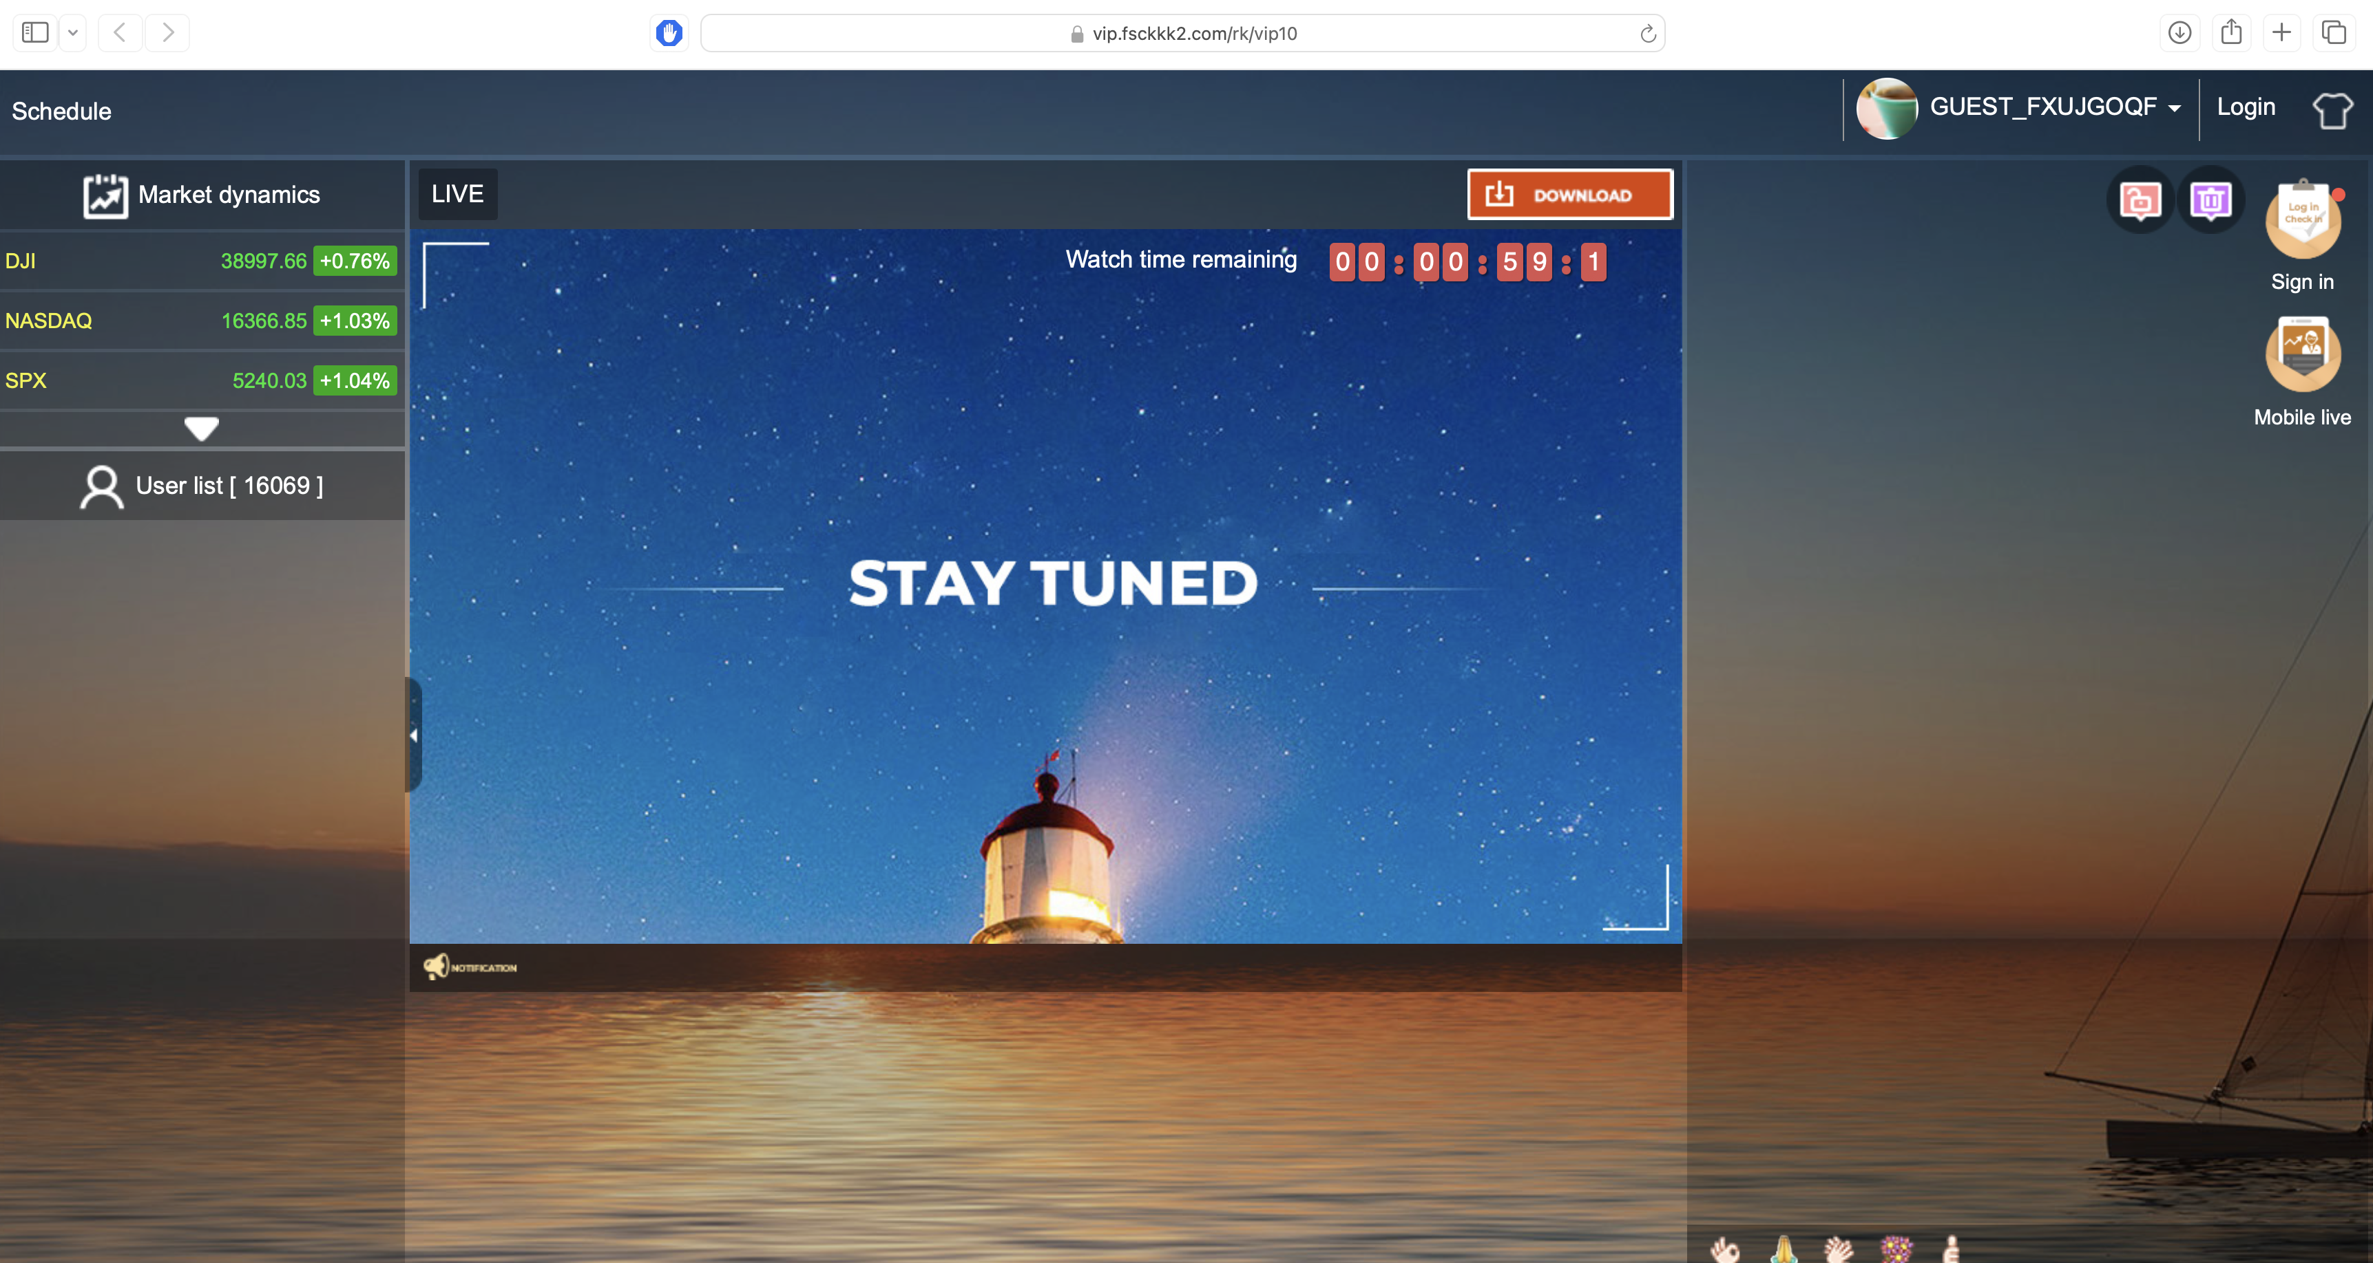
fake share market scam (2/4)
Online Classes to gain trust
Fake Users

Slide 5
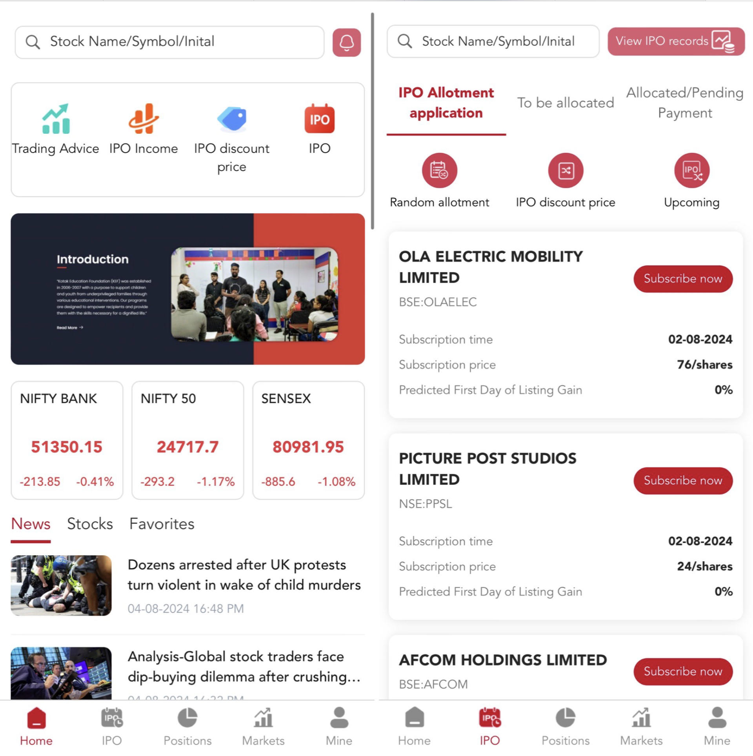
fake share market scam (3/4)
Fake Trading Platform with real time stock prices

Slide 6
fake share market scam (3/4)
Fake Trading Platform with real time stock prices

Slide 7
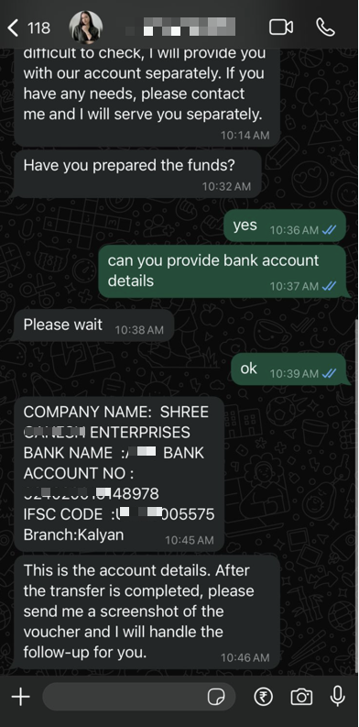
fake share market scam (4/4)
Fund deposit in rented / mule accounts.
After initial returns, freezes the funds

Slide 8
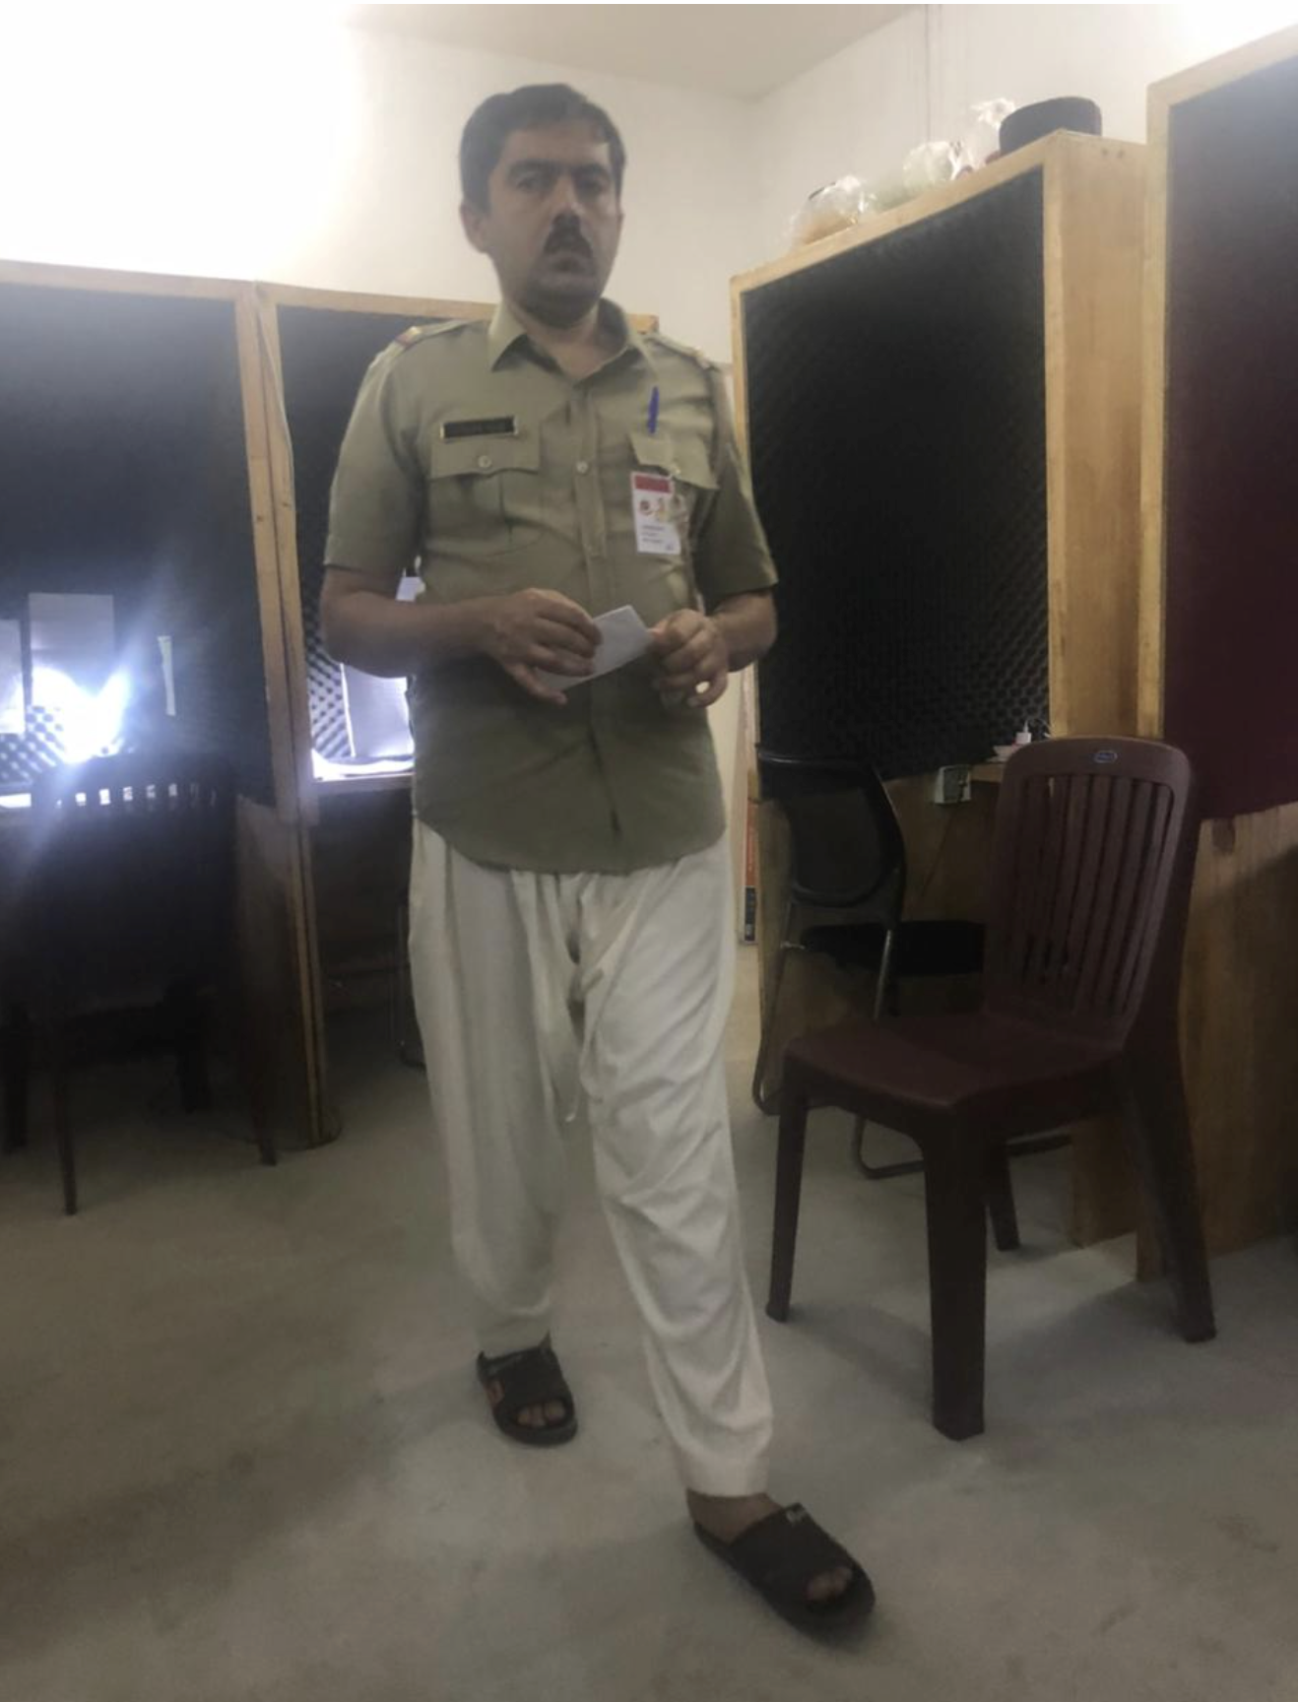
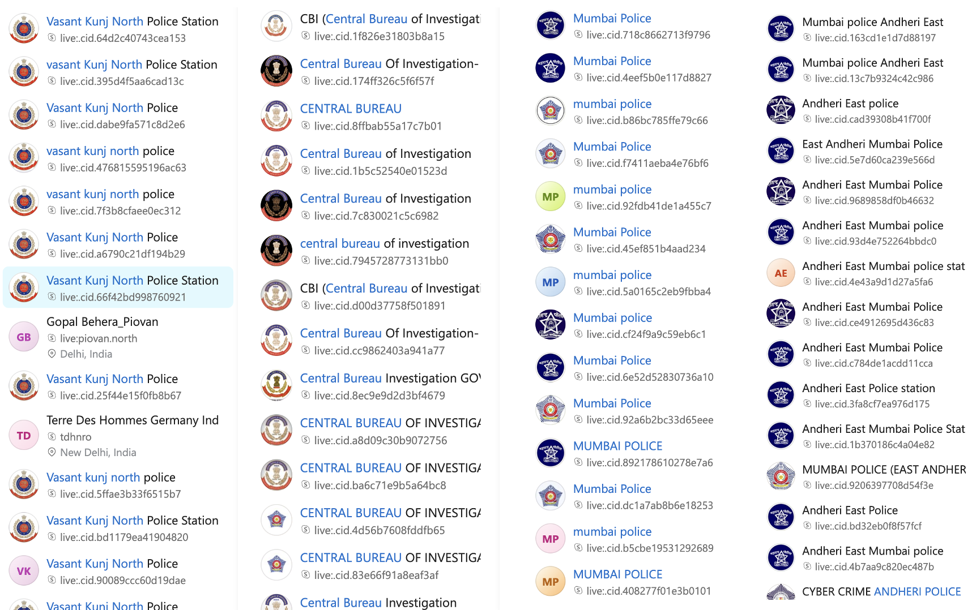
2. Digital Arrest

Slide 9
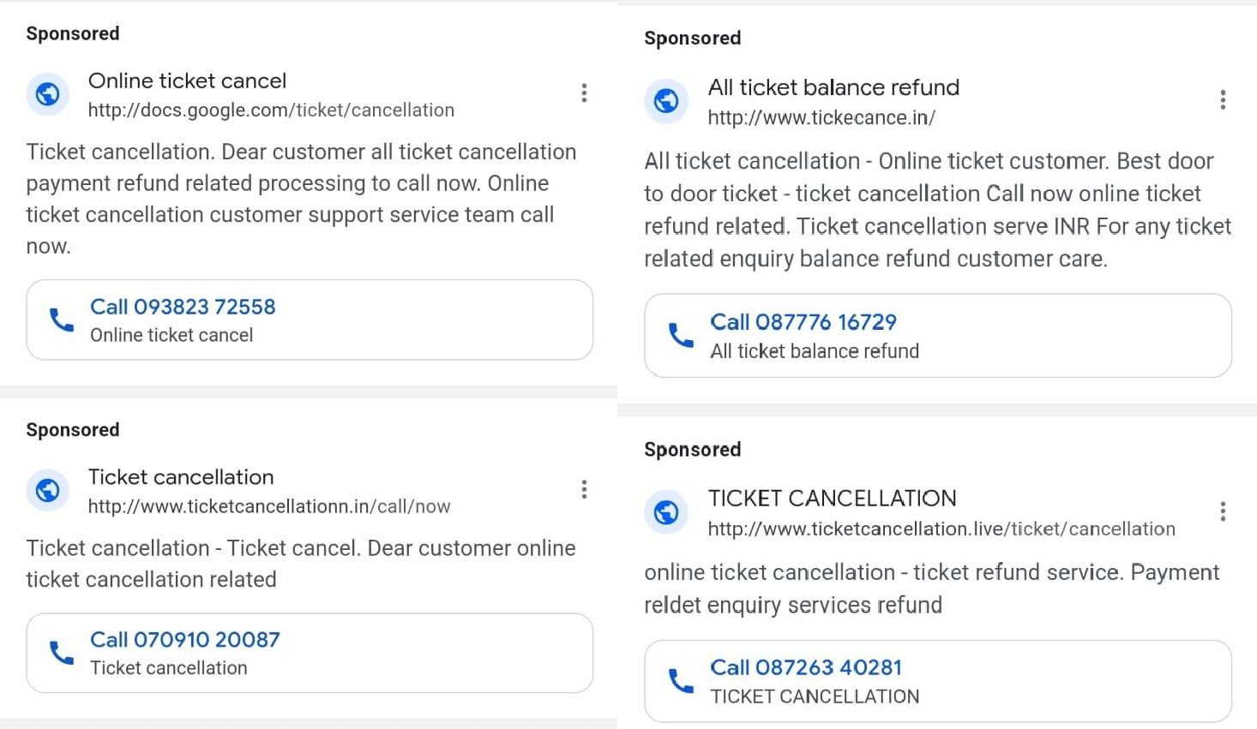
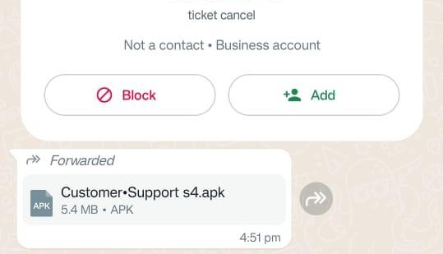
3. Android malware
Fault?

Slide 10
What Reserve bank guideline say?

Slide 11
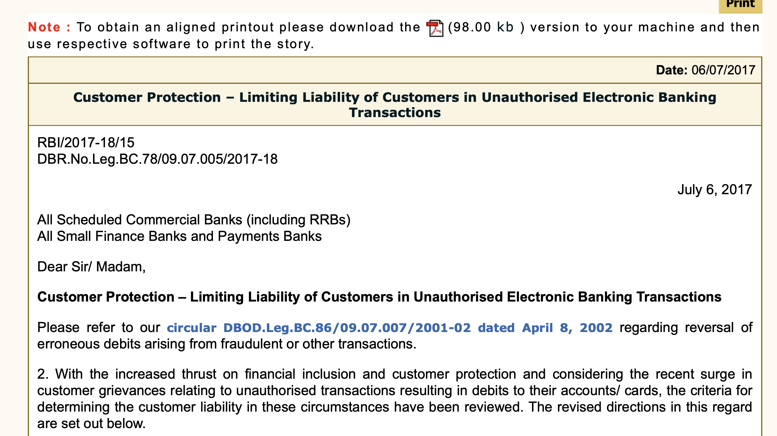
Customer Protection : Limited Liability of customers

Slide 12
Customer Protection : Limited Liability of customers

Slide 13
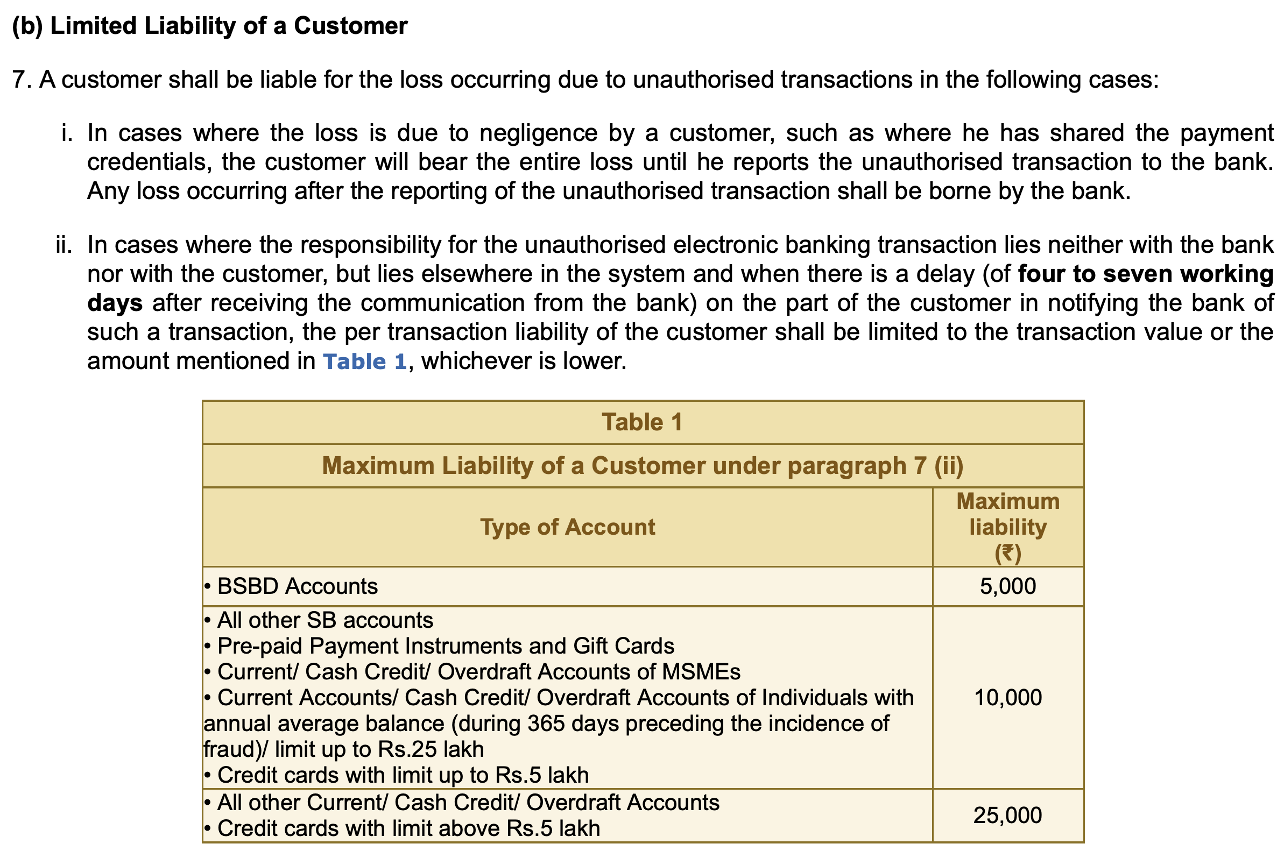
Customer Protection : Limited Liability of customers

Slide 14
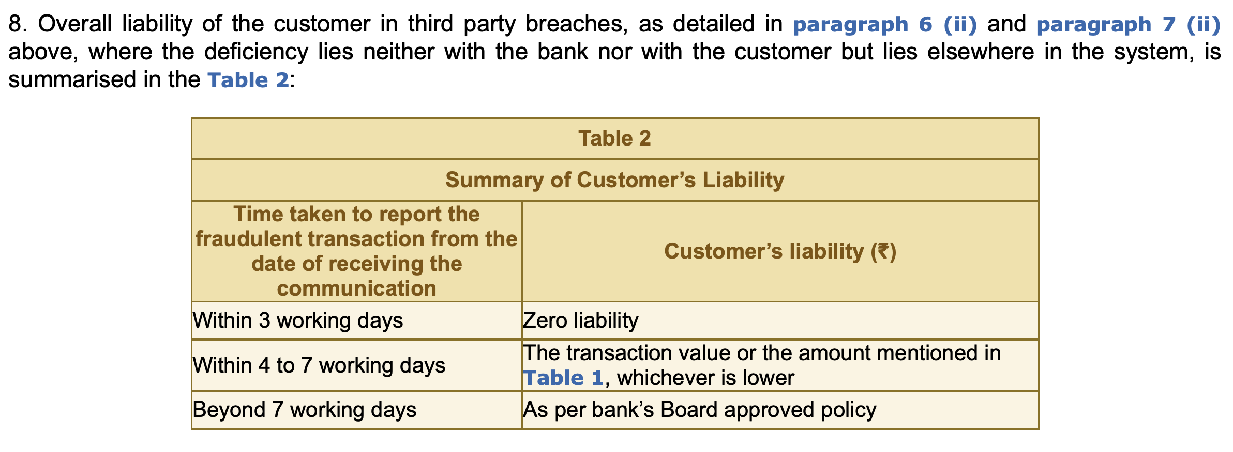
Customer Protection : Limited Liability of customers

Slide 15
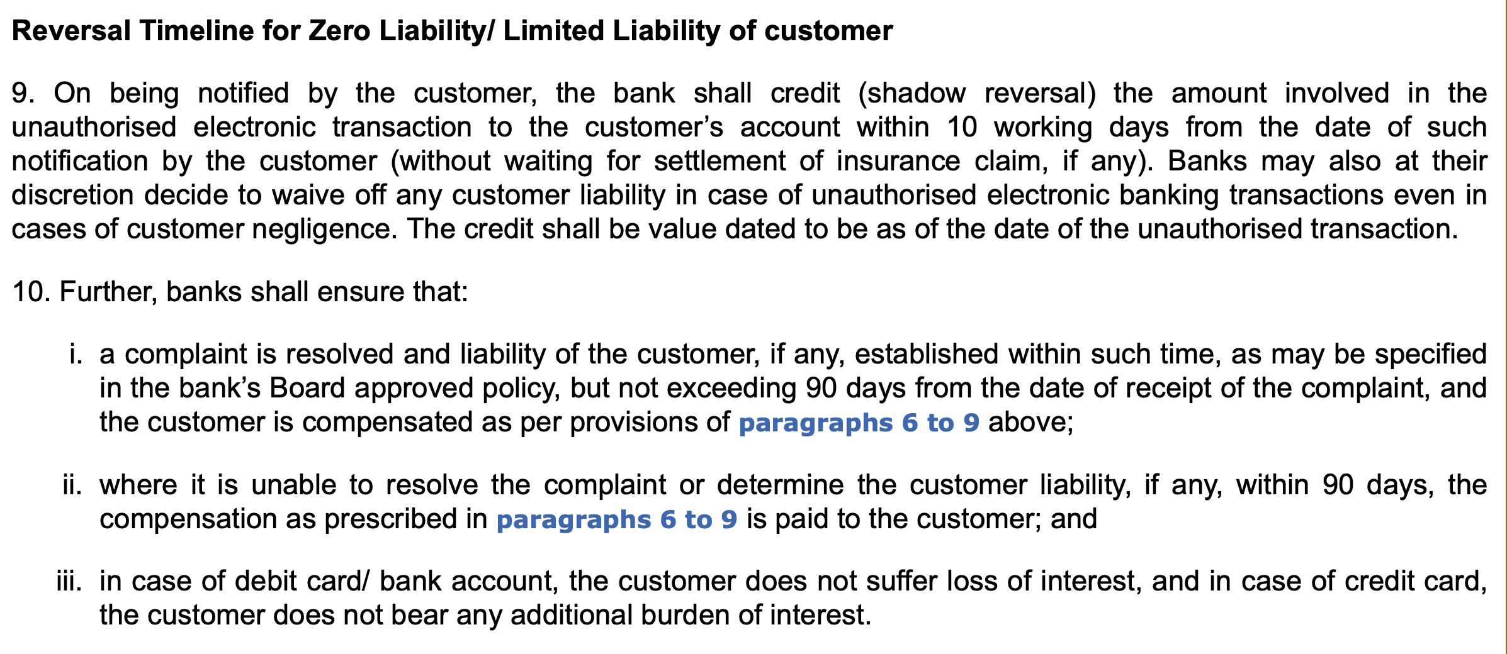
Customer Protection : Limited Liability of customers

Slide 16
Reporting of fraud transaction
Call 1930
Website: www.cybercrime.gov.in

Slide 17
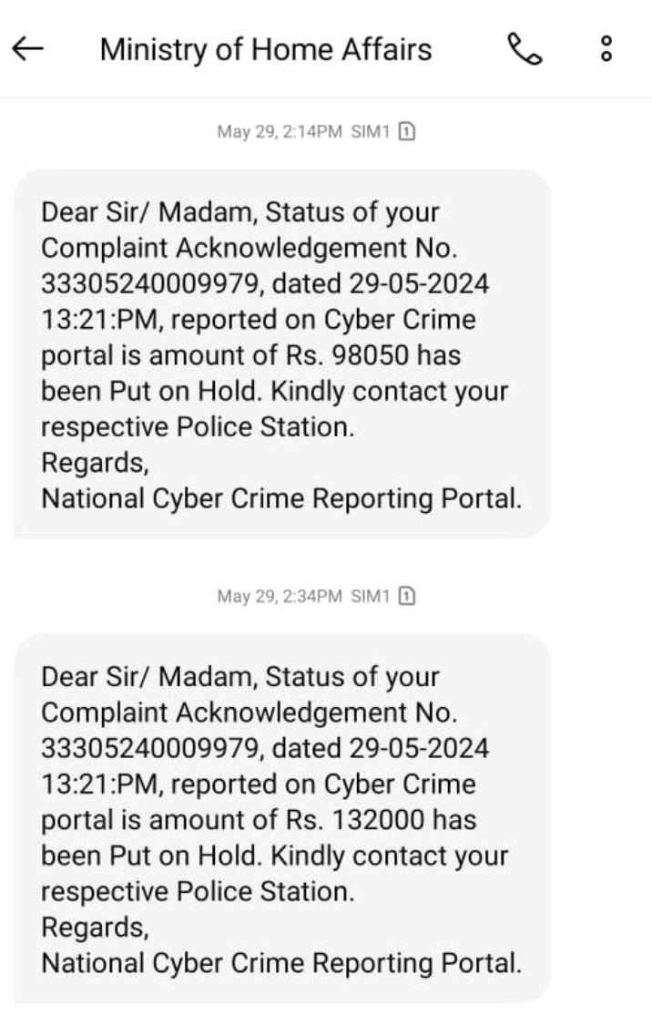
1930 based fraud reversal

Slide 18
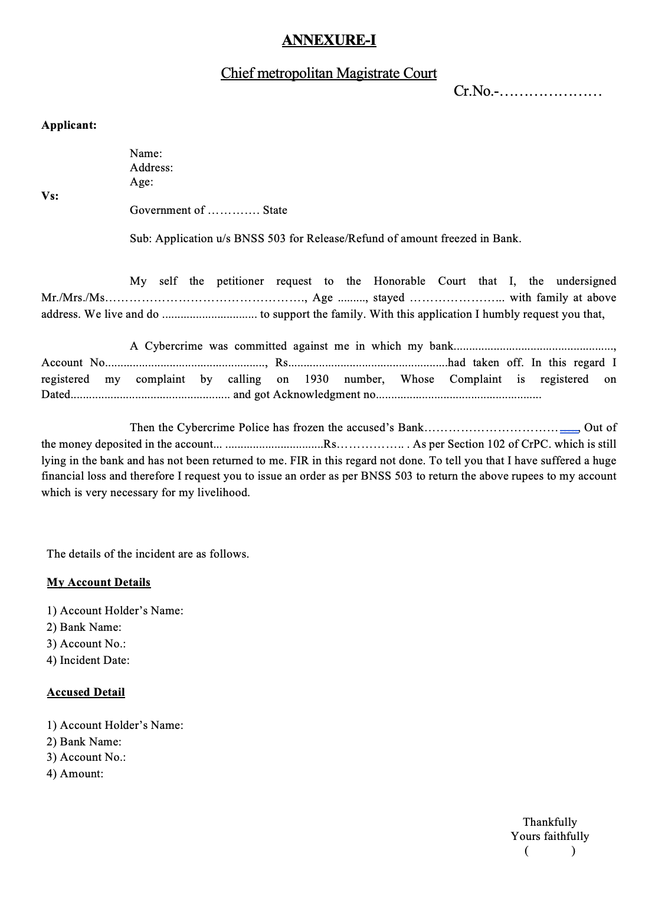
Application to initiate refund
Gujarat Police SOP

Slide 19
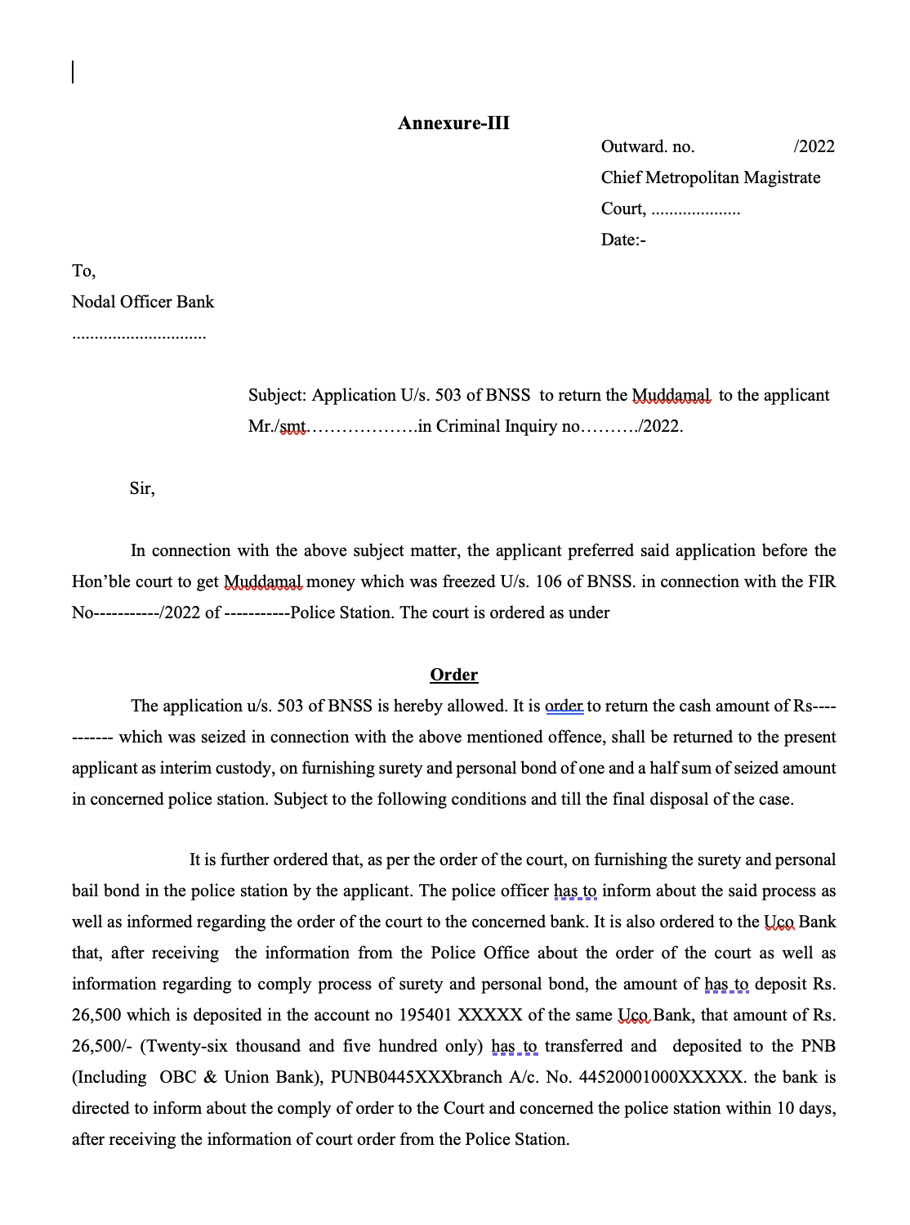
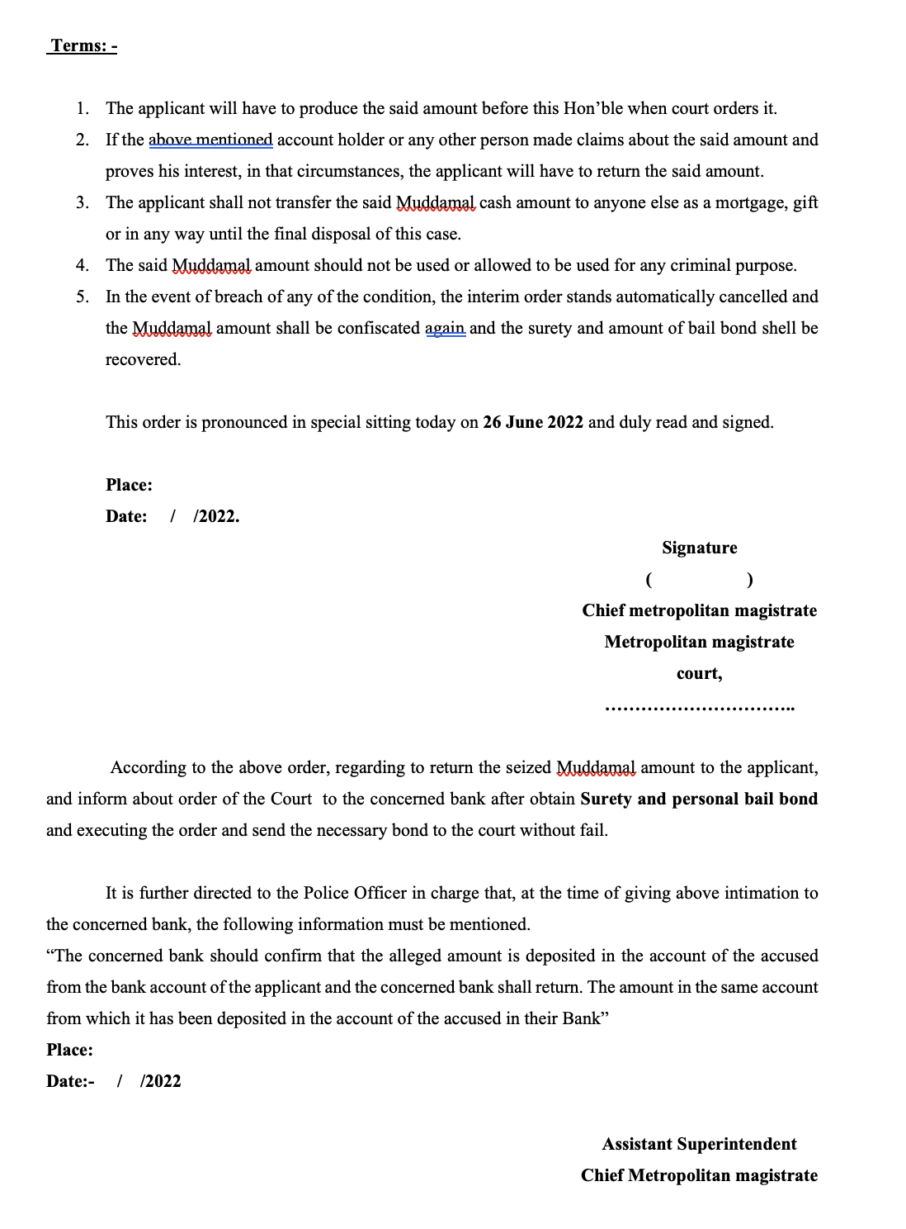
*Application to initiate refund
Gujarat Police SOP

Slide 20
Thank you

