Slide 1
Virtual Labs
on DIKSHA
Central Institute of Educational Technology
NCERT, New Delhi

Slide 2
Recommendation of NEP 2020
Access to quality practical and hands-on experiment-based learning experiences to each student
Virtual labs enhance actual laboratory experience
Lab based e-resources help students in visualizing the concepts

Slide 3
Advantages of Virtual labs
Available on DIKSHA for free
Accessed anytime and anywhere
Complements, supplements physical labs

Slide 4
Resources available on Virtual Labs
Theory and Procedure- concept related to the experiment
Animation and Video- help in visualizing theoretical concepts
Simulation- provides near to real experience of performing experiments
Viva voce- self evaluation for learners

Slide 5
Virtual labs help learners in following ways
perform experiments multiple times without consuming chemicals
revise theoretical concepts
obtain result of time consuming experiments
analysis of results thereby inculcating logical thinking skill

Slide 6
Pedagogical integration of Virtual labs
Virtual labs can help teachers in following ways:
Design lesson plan integrating Virtual labs
Use Virtual labs to demonstrate experimental skills and help learners in developing such skills

Slide 7
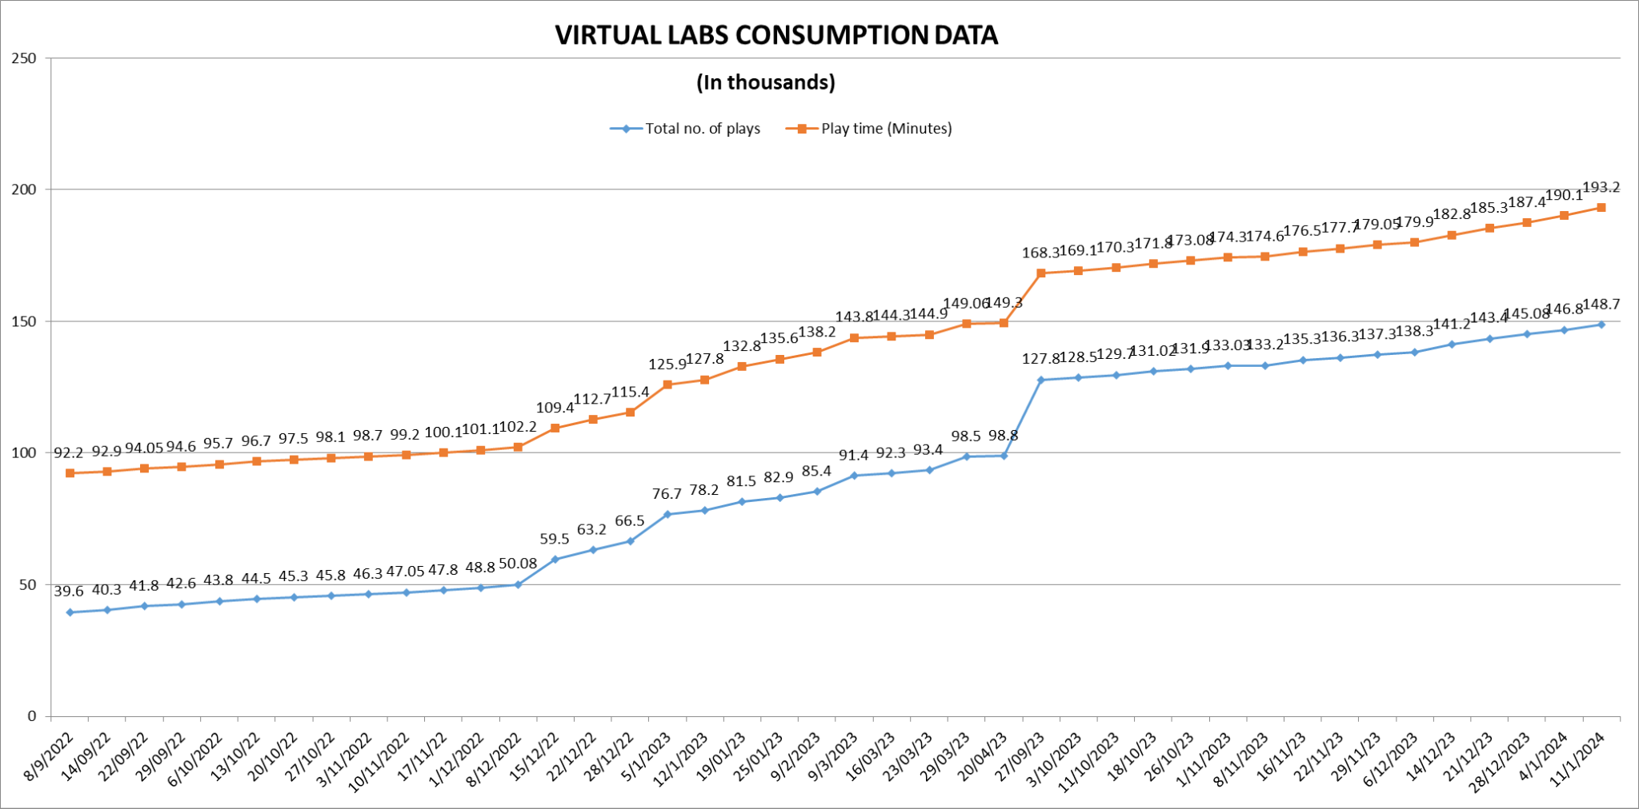
Following data shows that large no. of users are taking benefit of available resources
Virtual Labs was launched on 29th July, 2022

Slide 8
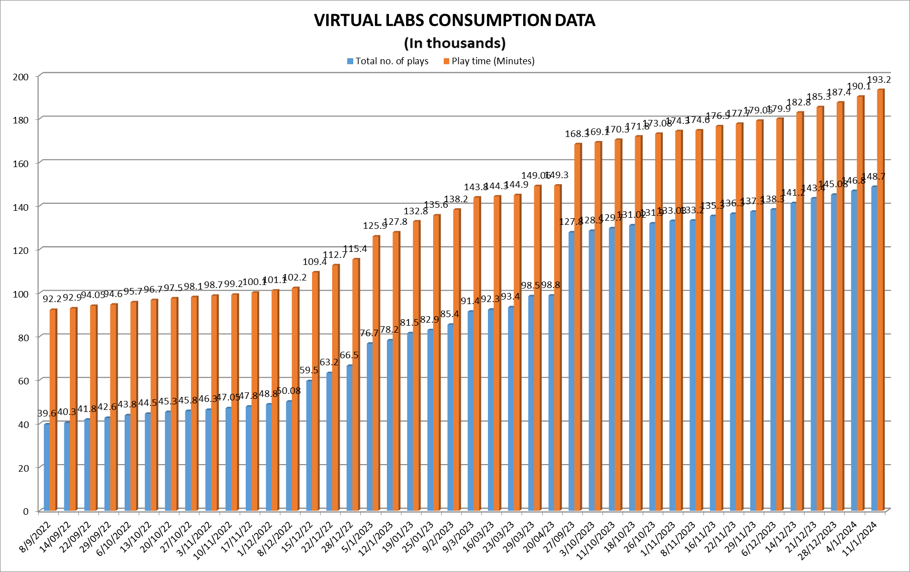
The data shows that large no. of users are taking benefit of available resources

Slide 9
Steps to reach at desirable resource
URL: https://diksha.gov.in/

Slide 10
Search https://diksha.gov.in/

Slide 11
Scroll banners to find Virtual labs vertical and click on its “Explore” icon.

Slide 12
Scroll down on the landing page of Virtual labs to reach eContent of classes 6-12.

Slide 13
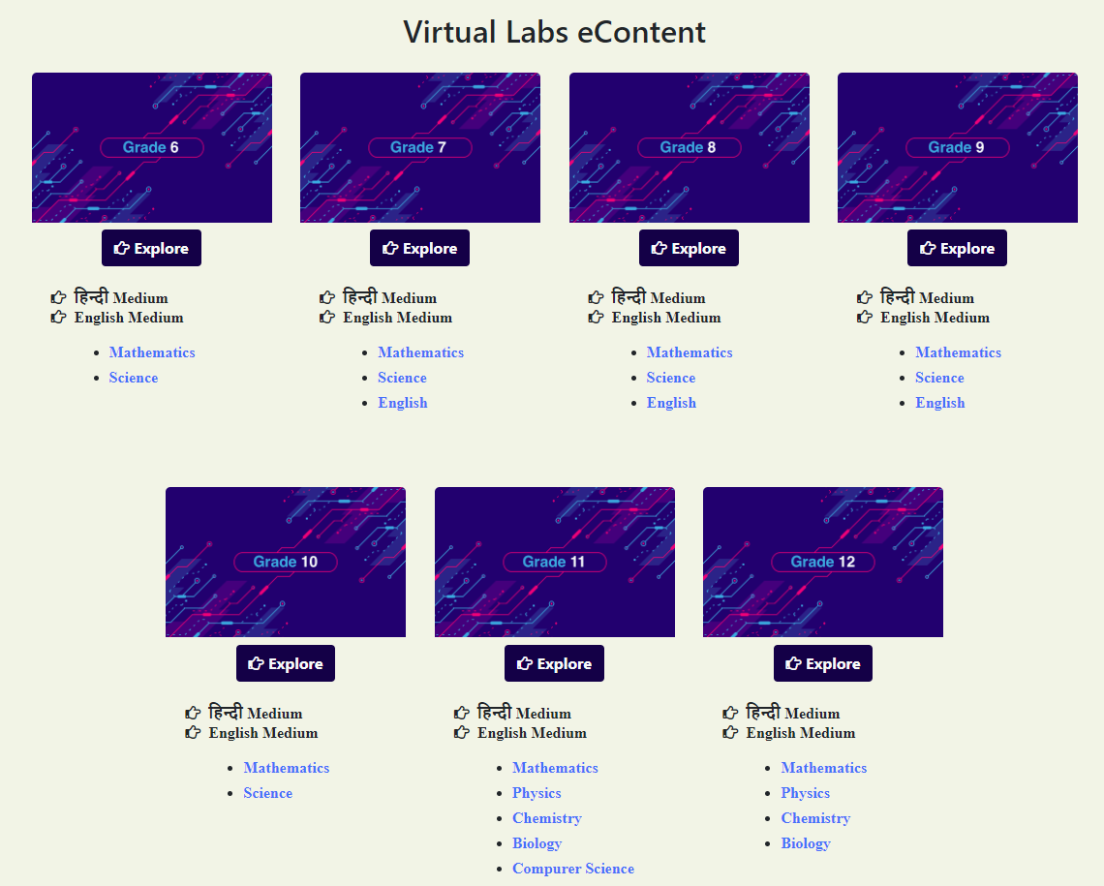
Click on the “Explore” icon of the desirable class, select the medium of interaction, then choose a subject you wish to study.

Slide 14
Click on the Explanation resource to reach the link for related resources

Slide 15
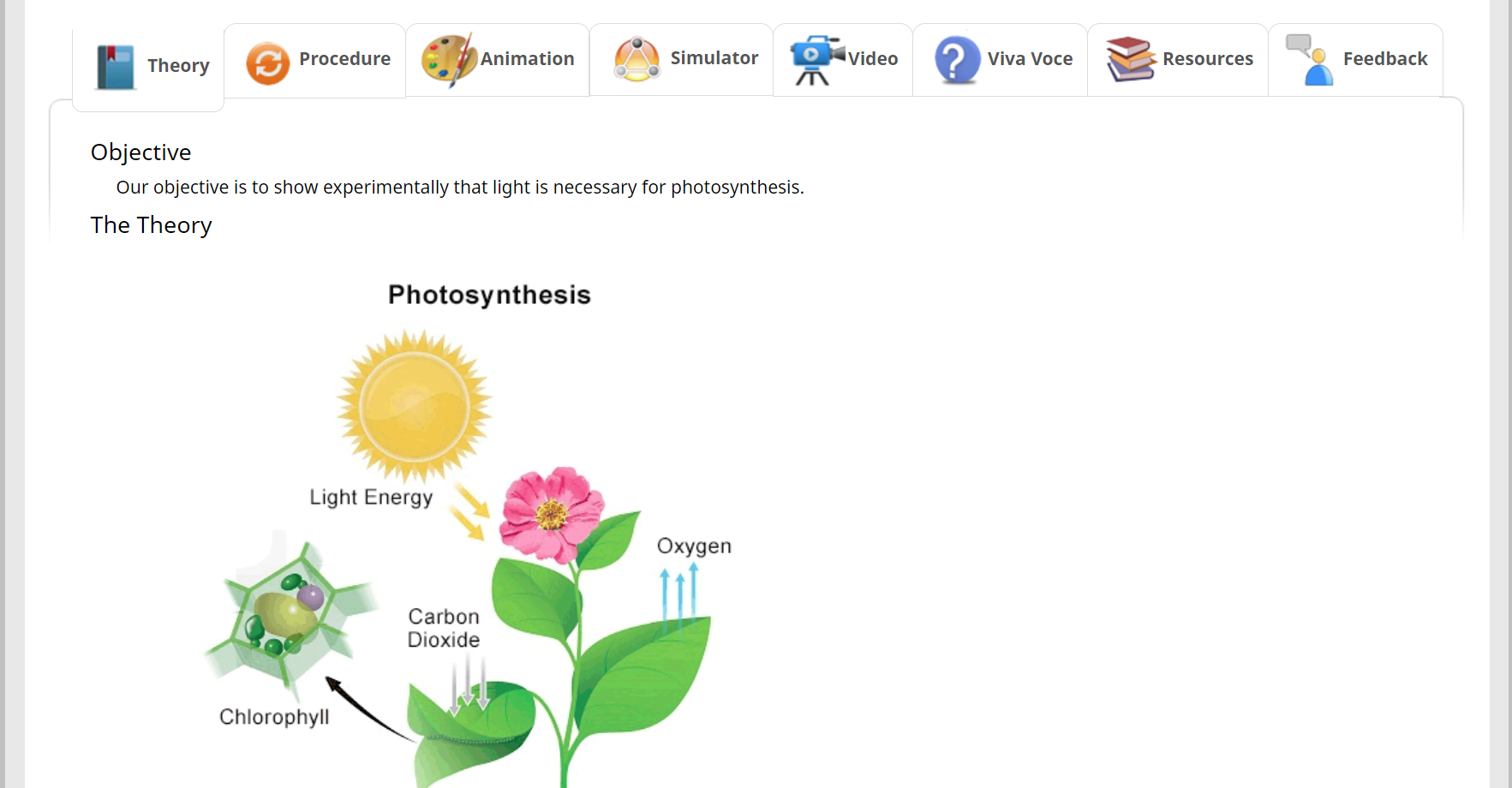
Variety of resources will help you in your learning journey.

Slide 16
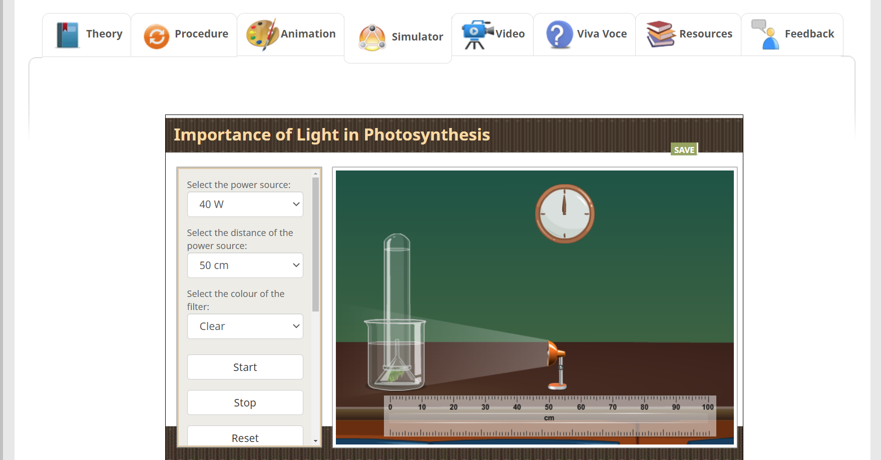
Variety of resources will help you in your learning journey.

Slide 17
Virtual Labs on DIKSHA
provide self paced
engaging learning experience

