Slide 1
VIRTUAL LABS
ON DIKSHA
Central Institute of Educational Technology
NCERT, New Delhi

Slide 2
RECOMMENDATION OF NEP 2020
National Education Policy (2020) recommends-
Creating virtual laboratories so that all students have equal access to quality practical and hands-on experiment-based learning experiences.
Though, there is no substitute to hands-on experience of physical laboratory, virtual labs have the great potential to enhance actual laboratory experience.
These lab based e-resources can help students in visualizing the concepts in a better manner.

Slide 3
IDEA BEHIND SETTING UP OF VIRTUAL LABS
The virtual labs are based on the idea that lab experiments can be taught using internet more efficiently in a cost-effective manner.
They will also benefit the students who do not have access to physical labs or schools where equipments are not available.
Experiments can be accessed anytime and anywhere.
Virtual labs overcome the constraints of time as physical labs are available only during school hours.

Slide 4
WHAT WILL YOU EXPERIENCE?
Following resources are available on Virtual Labs on DIKSHA to enhance your learning experience:
Theory and Procedure provide information of the concept related to the experiment.
Animation and Video help in visualizing theoretical concepts.
Simulation provides real time experience of performing experiments.
Viva voce is for self evaluation, you can assess how much you have grasped the concept.
Feedback is meant for improving the resources from user’s perspective.

Slide 5
PEDAGOGICAL INTEGRATION OF VIRTUAL LABS
Virtual labs can help learners in following ways:
perform experiments multiple times without consuming chemicals
revise theoretical concepts
obtain result of time consuming experiments
analysis of results improving logical thinking skill

Slide 6
PEDAGOGICAL INTEGRATION OF VIRTUAL LABS
Virtual labs can help teachers in following ways:
Design lesson plan integrating Virtual labs
Use Virtual labs to demonstrate experimentation skills and help learners in developing such skills
EXPERIMENTATION SKILLS
Observation | Prediction | Controlling variables
Interpretation | Communication | Forming conclusions

Slide 7
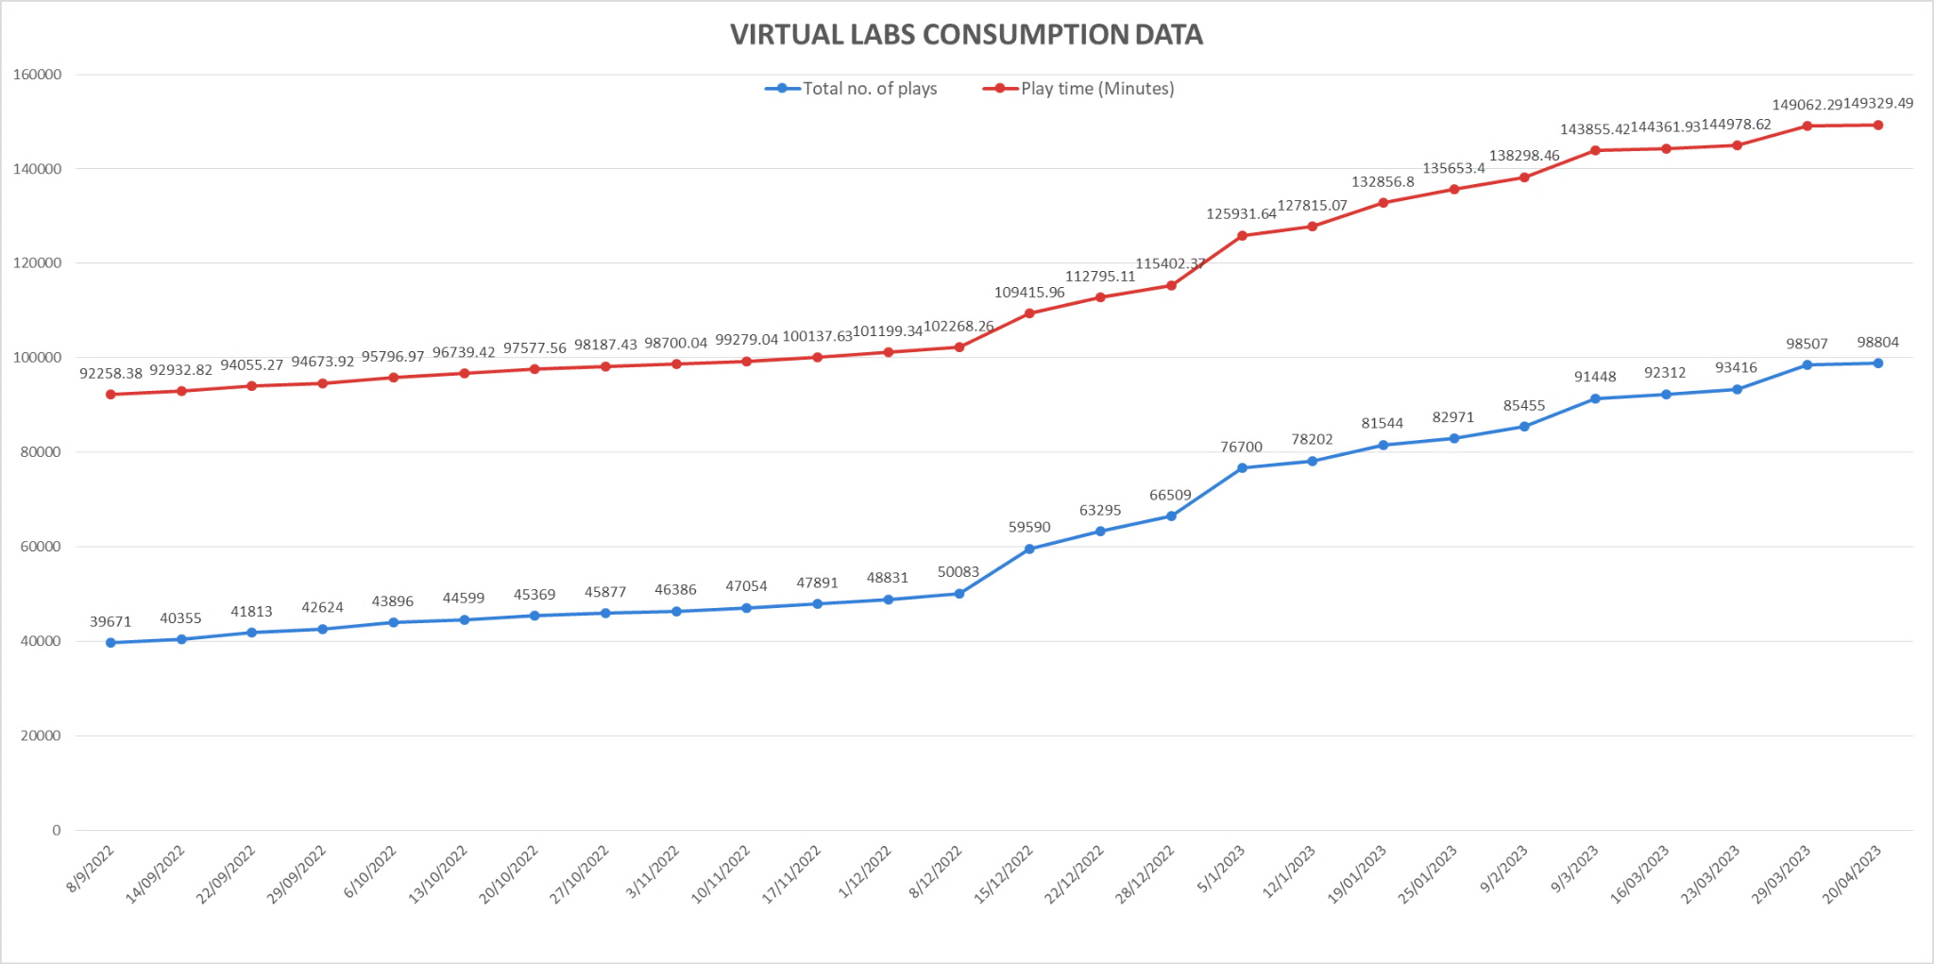
FOLLOWING DATA SHOWS THAT A LARGE NO. OF USERS ARE TAKING BENEFIT OF AVAILABLE RESOURCES
Virtual Labs was launched on 29th July, 2022

Slide 8
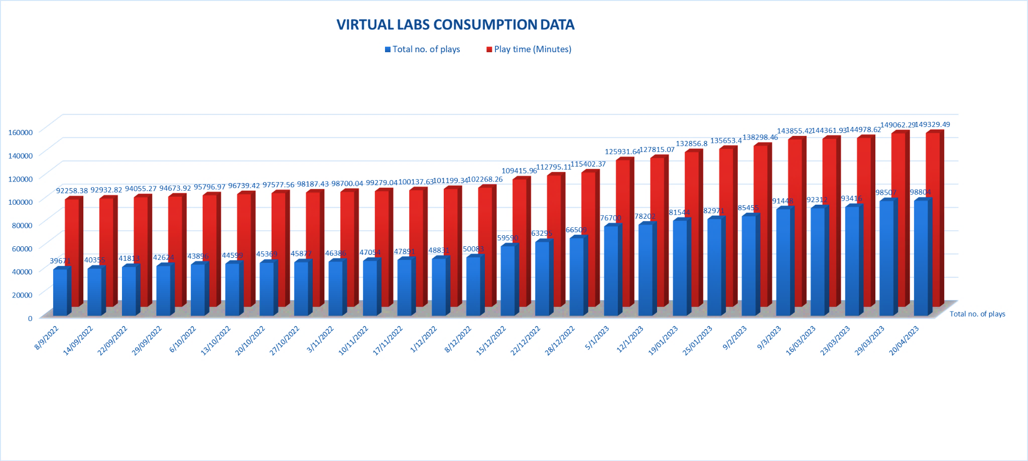
FOLLOWING DATA SHOWS THAT A LARGE NO. OF USERS ARE TAKING BENEFIT OF AVAILABLE RESOURCES

Slide 9
STEPS TO REACH AT YOUR DESIRABLE RESOURCE
URL: HTTPS://DIKSHA.GOV.IN/

Slide 10
SEARCH HTTPS://DIKSHA.GOV.IN/

Slide 11
SCROLL BANNERS TO FIND VIRTUAL LABS VERTICAL AND CLICK ON ITS “EXPLORE” ICON.

Slide 12
SCROLL DOWN ON THE LANDING PAGE OF VIRTUAL LABS TO REACH ECONTENT OF CLASSES 6-12.

Slide 13
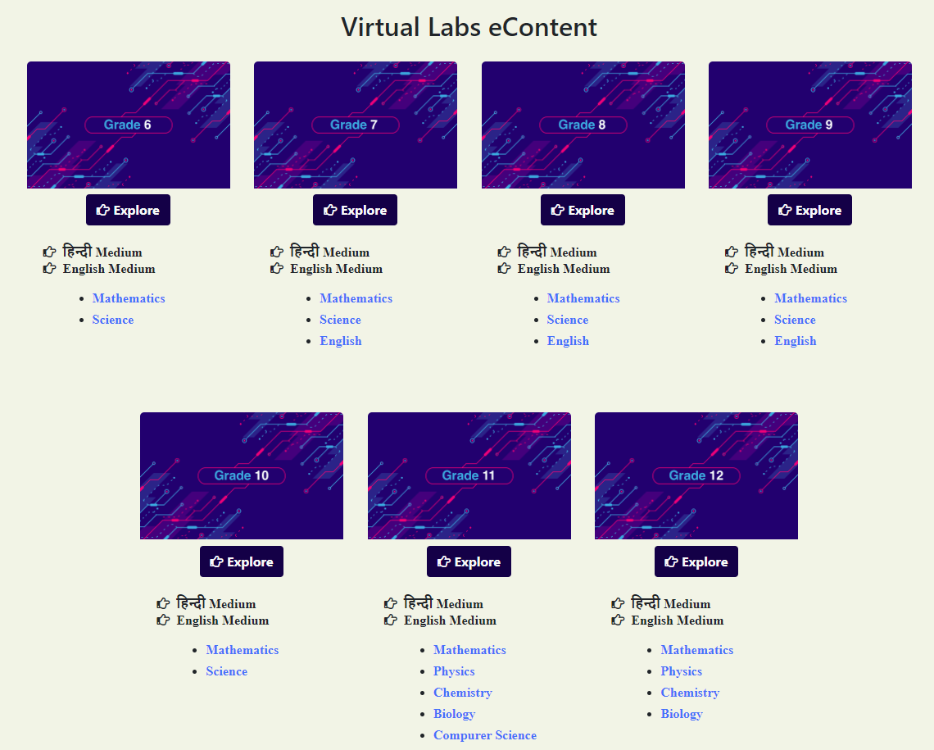
CLICK ON THE “EXPLORE” ICON OF THE DESIRABLE CLASS, SELECT THE MEDIUM OF INTERACTION, THEN CHOOSE A SUBJECT YOU WISH TO STUDY.

Slide 14
CLICK ON THE EXPLANATION RESOURCE TO REACH THE LINK FOR RELATED RESOURCES

Slide 15
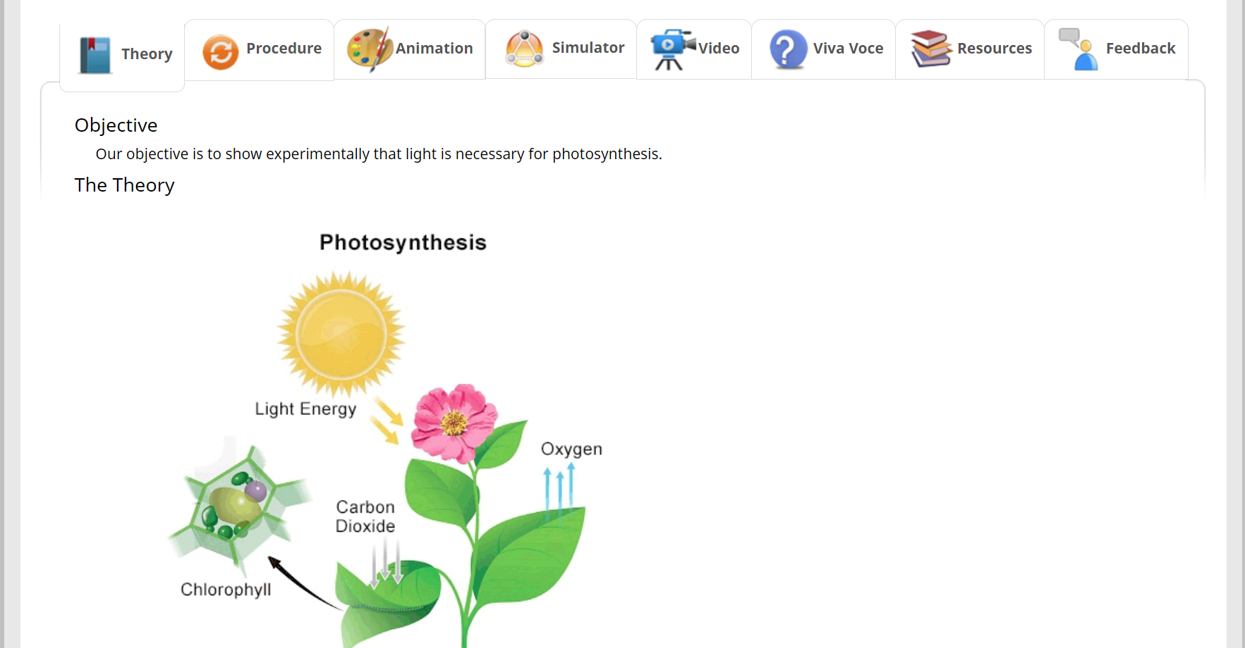
A VARIETY OF RESOURCES WILL HELP YOU IN YOUR LEARNING JOURNEY.

Slide 16
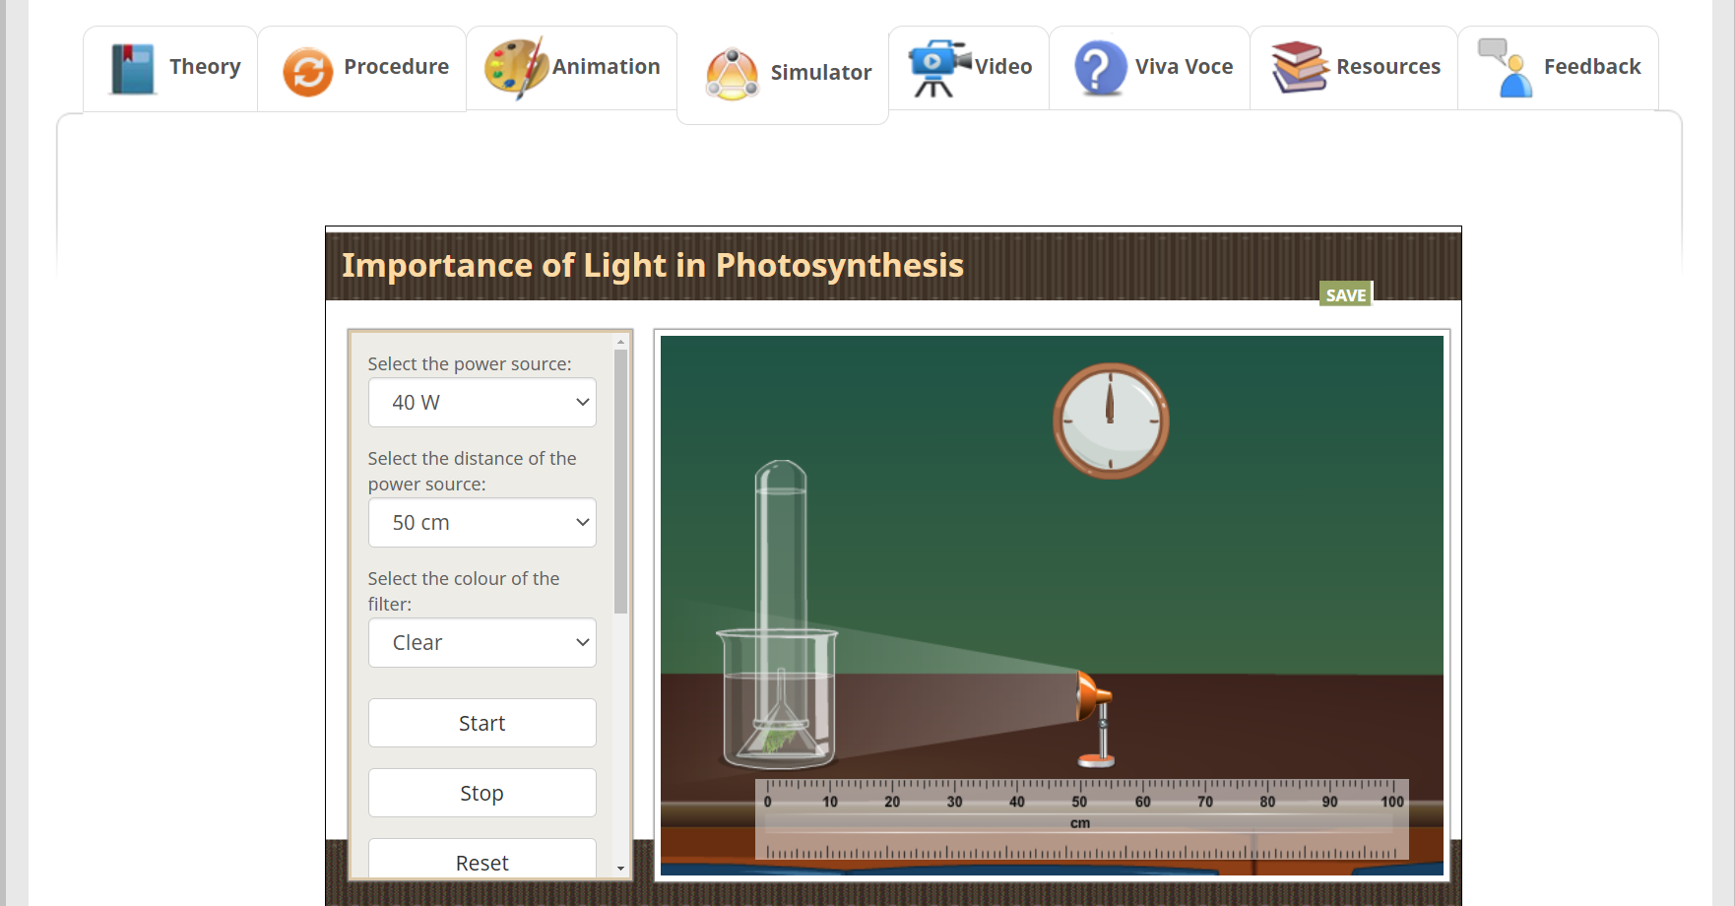
A VARIETY OF RESOURCES WILL HELP YOU IN YOUR LEARNING JOURNEY.

Slide 17
ENJOY SELF PACED
ENGAGING LEARNING EXPERIENCE
ON VIRTUAL LABS ON DIKSHA!

