Slide 1
Virtual Labs for Mathematics​ with special reference to their pedagogical usage
VAIBHAV SINGH, KARISHMA- C-DAC Mumbai

Slide 2
Background
Laboratory a key component
School education in India faces many challenges
Lack of infrastructure including labs.
Students come out with little practical knowledge of the concepts they learn.

Slide 3
Approach – Virtual Labs
Not meant to replace physical labs!
But augment and amplify them.
Virtual labs address deficiencies of physical labs.
Infinite repetitions at no cost.
It provides the ease and convenience of conducting experiments over the internet.
Aimed to bridge the constraints of geographical distances and time.
Technology can expand the boundaries of a physical Lab

Slide 4
Salient Features
Aligned to CBSE curriculum
Interactive 2D/3D simulations
Simulations model real life environment
Authentic content
Intuitive feedback and guidance

Slide 6
Eco-system
The core simulator
Theory relevant to the lab
Understanding of the process and its implications
Auxiliary requirements: plot, measurement and recording, etc
Review questions, references

Slide 7
Effective usage of Virtual Labs ( Math) in your school
Minimally, use it for demonstration in class
To prepare students for the physical lab
To reflect on the activities performed in the lab
Can get more by ensuring students are actively involved in the activity.
Active learning strategies can be interleaved with usual lecture
As Homework – Give inquiry-based activities
Encourage self-evaluation using “Viva-Voce” section of each lab.

Slide 8
Proposed Active Learning Strategy for Virtual Labs (Math)
Recommended time: 5-15 min
Predict Outcome - Ask students to make prediction: “What will happen if …”
Calculate Output - Ask students to calculate next step or output.
Devise explanation - Ask students to devise reason for process
Choose activity based on pedagogical purpose and learning objective of the Lab

Slide 9
Using Virtual Labs (Math) : Scenario
Teachers (In the classroom/Lab)
Explain labs before performing the practical/lab session
Explain a procedure
Demonstrate a phenomenon
Set expectation about a lab
Can frame review questions with the lab as the backdrop (after Lab Session)
Creative teachers and students can come up with many more innovative uses!

Slide 10
Usage Virtual Labs (Math)
Students
Familiarize with the Lab before physical lab session
Try variations available in the lab
Do revision
Use Lab to reinforce the concepts, answer question they may have, etc.

Slide 11
Mathematics Labs – Salient Features
3D representation for select labs
Facilitates drawing geometric figures on workbench with given dimensions
Tools provided relevant to lab
Show Scale
Cut triangle/rectangle
Rotate Clockwise
Rotate Anticlockwise
Drag/Drop
Superimpose

Slide 12
Mathematics Labs – Salient Features
Instructions provided on each step
Actions taken by student/system in ‘Workbench”, displayed in “Observations”.
Details inference and conclusion after completion of Lab. Also relevant illustration on workbench.

Slide 13
List of Labs
Class 6 –8 : 90+ labs
Class IX : 40+ Labs
Class IX : 40+ Labs
Class IX : 30+ Labs
Class IX : 25+ Labs

Slide 14
Screenshots
OLabs Phase II

Slide 15
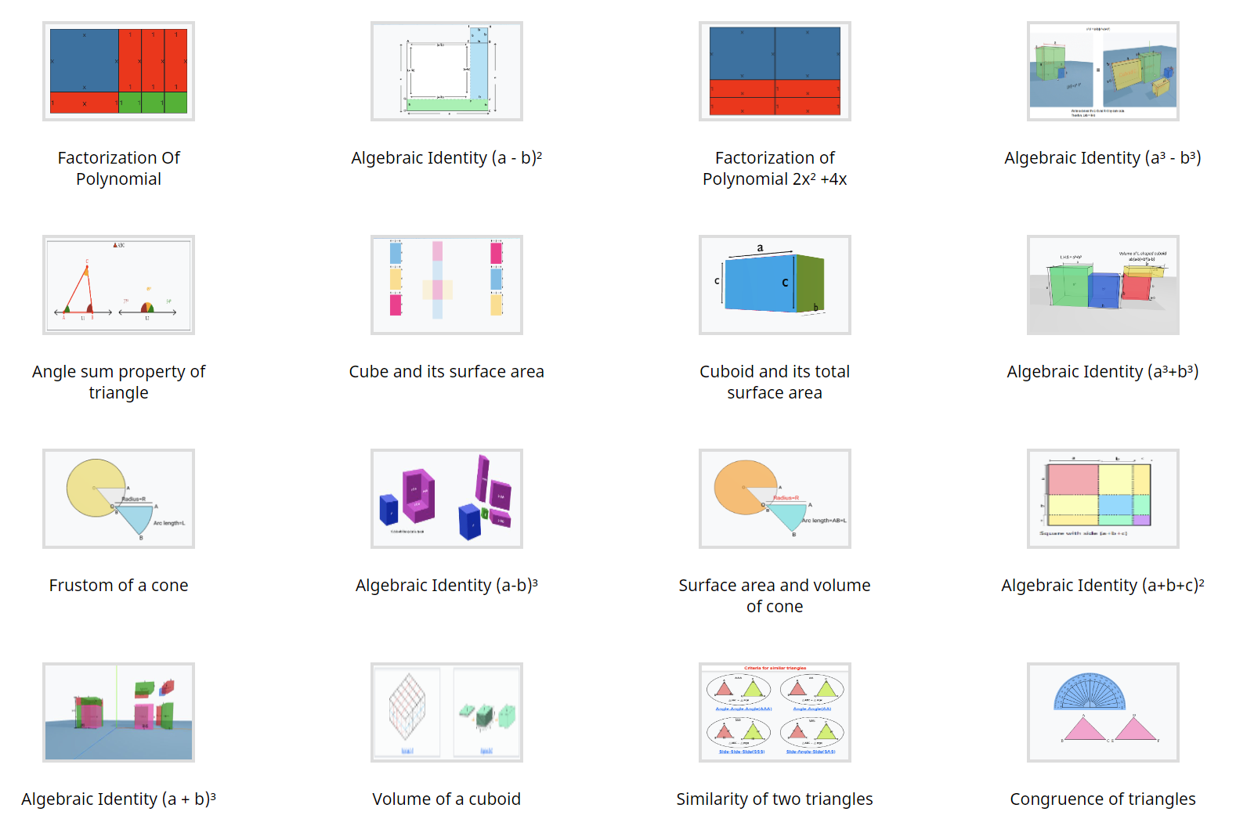
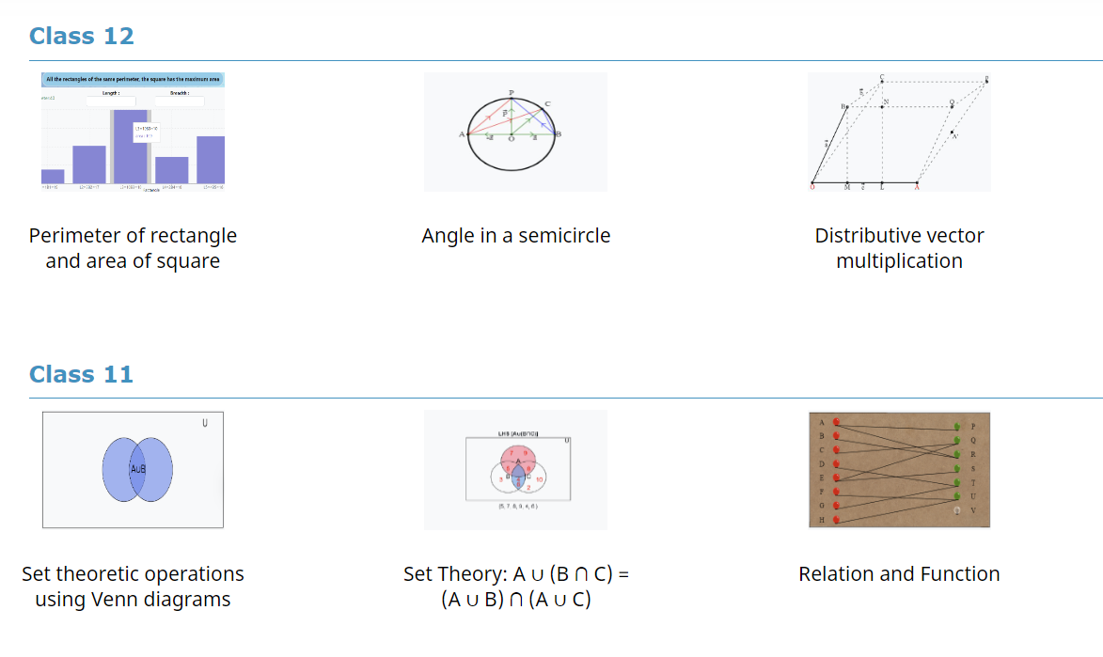
Screenshots
OLabs NextG

Slide 16
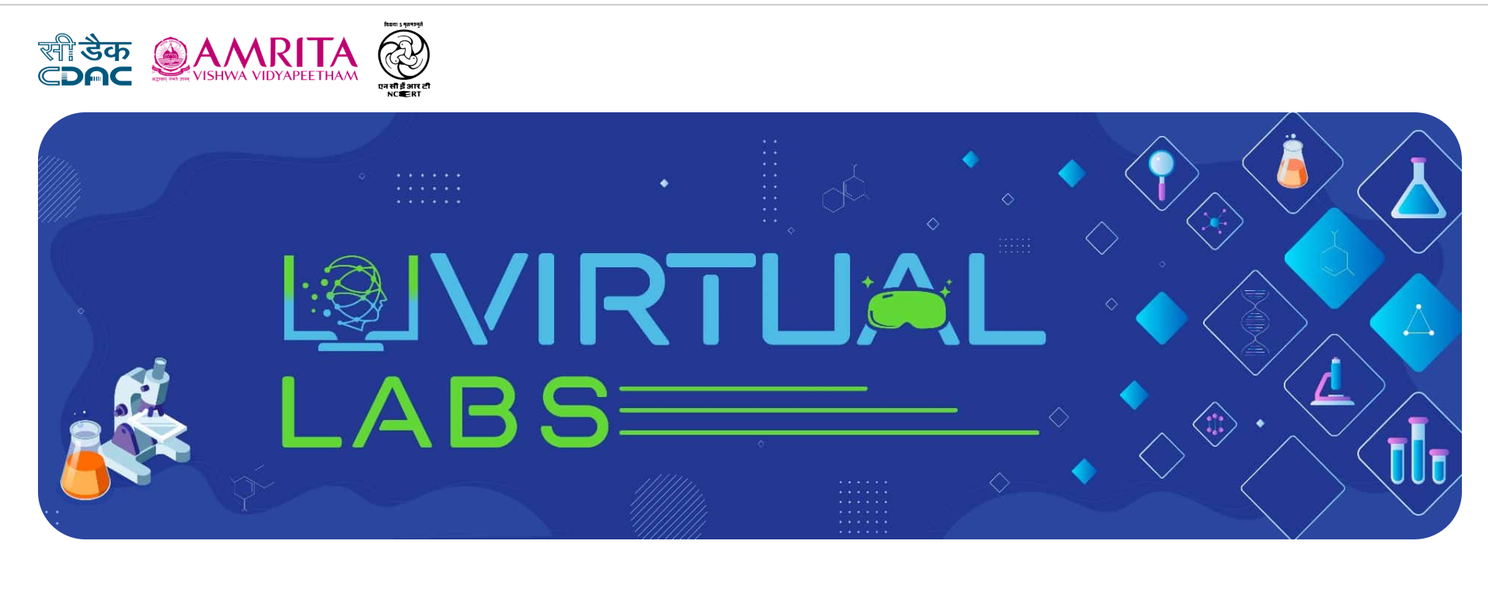
https://diksha.gov.in/virtuallabs.html

Slide 17
Demonstration of Mathematics Labs

Slide 18
List of Labs for Demo
3D Labs
Volume of Cylinder
Cube and Cuboids
Geometry
Cyclic Quadrilateral
Area of Circle
Algebra
Algebraic Identity
Polynomials
Fractions

Slide 19
Virtual Labs Ahead!
Yes, we are now on to add another 500+ labs to the pool.
Classes 6-12, and more subjects including languages, social science, etc.
Many improvements in light of the challenges mentioned earlier.
Learner tracking and analytics
Guidance in the lab
AR/VR capability
Richer simulation – variety within limits.
120+ Math labs to be added for classes 6-12

Slide 20
Help us help you….
Share the information to all fellow teachers…
1
Share your feedback on whatever you have explored in this regard.
2
Let us know if there are some concepts/topics on which you would like such a lab to be available.
3

Slide 21
Thank You
For any information, please write to us at:
Educational Technology Unit, C-DAC Mumbai
support[at]olabs[dot]co[dot]in
For more details
Email id: etu@cdac.in, vidyakashetu@gmail.com
Website: http://olabs.edu.in/
Facebook: https://www.facebook.com/onlinelabs/
Twitter: https://twitter.com/cdacmumbai
ETU portal: http://vidyakash.in/

