Slide 2
Session Objectives
To introduce interactive content and highlight its significance in teaching and learning.
To explore the Lumi platform as a tool for creating interactive learning content.
To demonstrate key features and content types available within Lumi.
To discuss best practices for designing effective and engaging interactive content.
To empower participants to develop their own interactive learning content using Lumi.

Slide 3
Content Outline
1
2
3
4
What is Interactive Content
Why are they required?
Types of Interactive Content
Tools for creating interactive Content
5
6
7
8
9
Introduction to Lumi
Key Features of Lumi
Interactive Content Types in Lumi
Demonstration of Some Features
Best Practices for Effective Implementation

Slide 4
What is Interactive Resources?
"Interactive resources" are learning tools or materials that actively engage users, allowing them to participate rather than just passively consume information. They're often used in education, training, and web design to make content more engaging and effective.

Slide 7
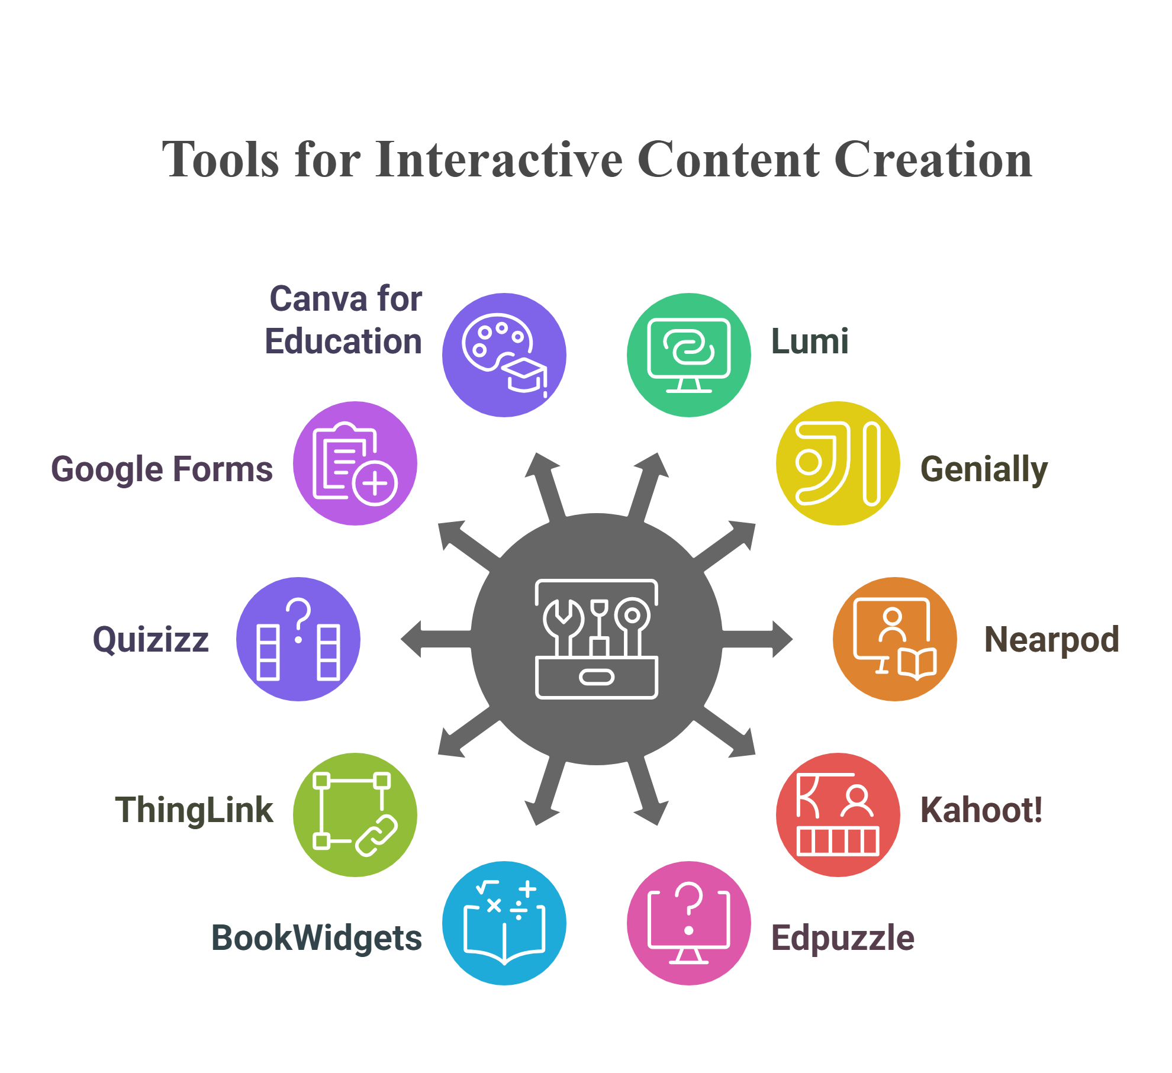

Slide 8
Developing Interactive Content through

Slide 9
What is Lumi?
Lumi is a free, open-source tool that allows educators to create, edit, and share interactive learning content using H5P formats.
What is H5P?
H5P stands for HTML5 Package. It refers to the framework's use of HTML5 technology to create interactive content that is accessible across various devices and platforms without the need for additional plugins.

Slide 10
Key features of Lumi:
H5P Content Creation: Lumi allows Users can easily create various H5P content like videos, quizzes, and flashcards.
Offline Usage: Lumi works offline, useful for areas with limited internet access.
Export Options: Content can be exported for integration with LMS platforms like Moodle and SCORM.
Ease of Use: Lumi has a simple interface, requiring no coding skills.
Free and Open-Source: It’s free and customizable, making it flexible for educators.

Slide 11
Interactive Content Types in Lumi
Quizzes and Assessments
Interactive Tools
Multiple Choice
Branching Scenario
True/False Question
Timeline
Fill in the Blanks
Interactive Book
Drag and Drop
Column
Essay
Accordion
Dictation
Documentation Tool
Arithmetic Quiz
Interactive Content Types in Lumi
Cornell Notes
Mark the Words
Question Set
Games and Puzzles
Interactive Media
Memory Game
Interactive Video
Flashcards
Course Presentation
Crossword
Image Hotspots
Find the Words
Virtual Tour (360)
Image Sequencing
Image Juxtaposition
Image Pairing
Surveys and Feedback
Questionnaire
Personality Quiz
Summary
Information Wall

Slide 12
Get Started with Lumi Today!

Slide 13
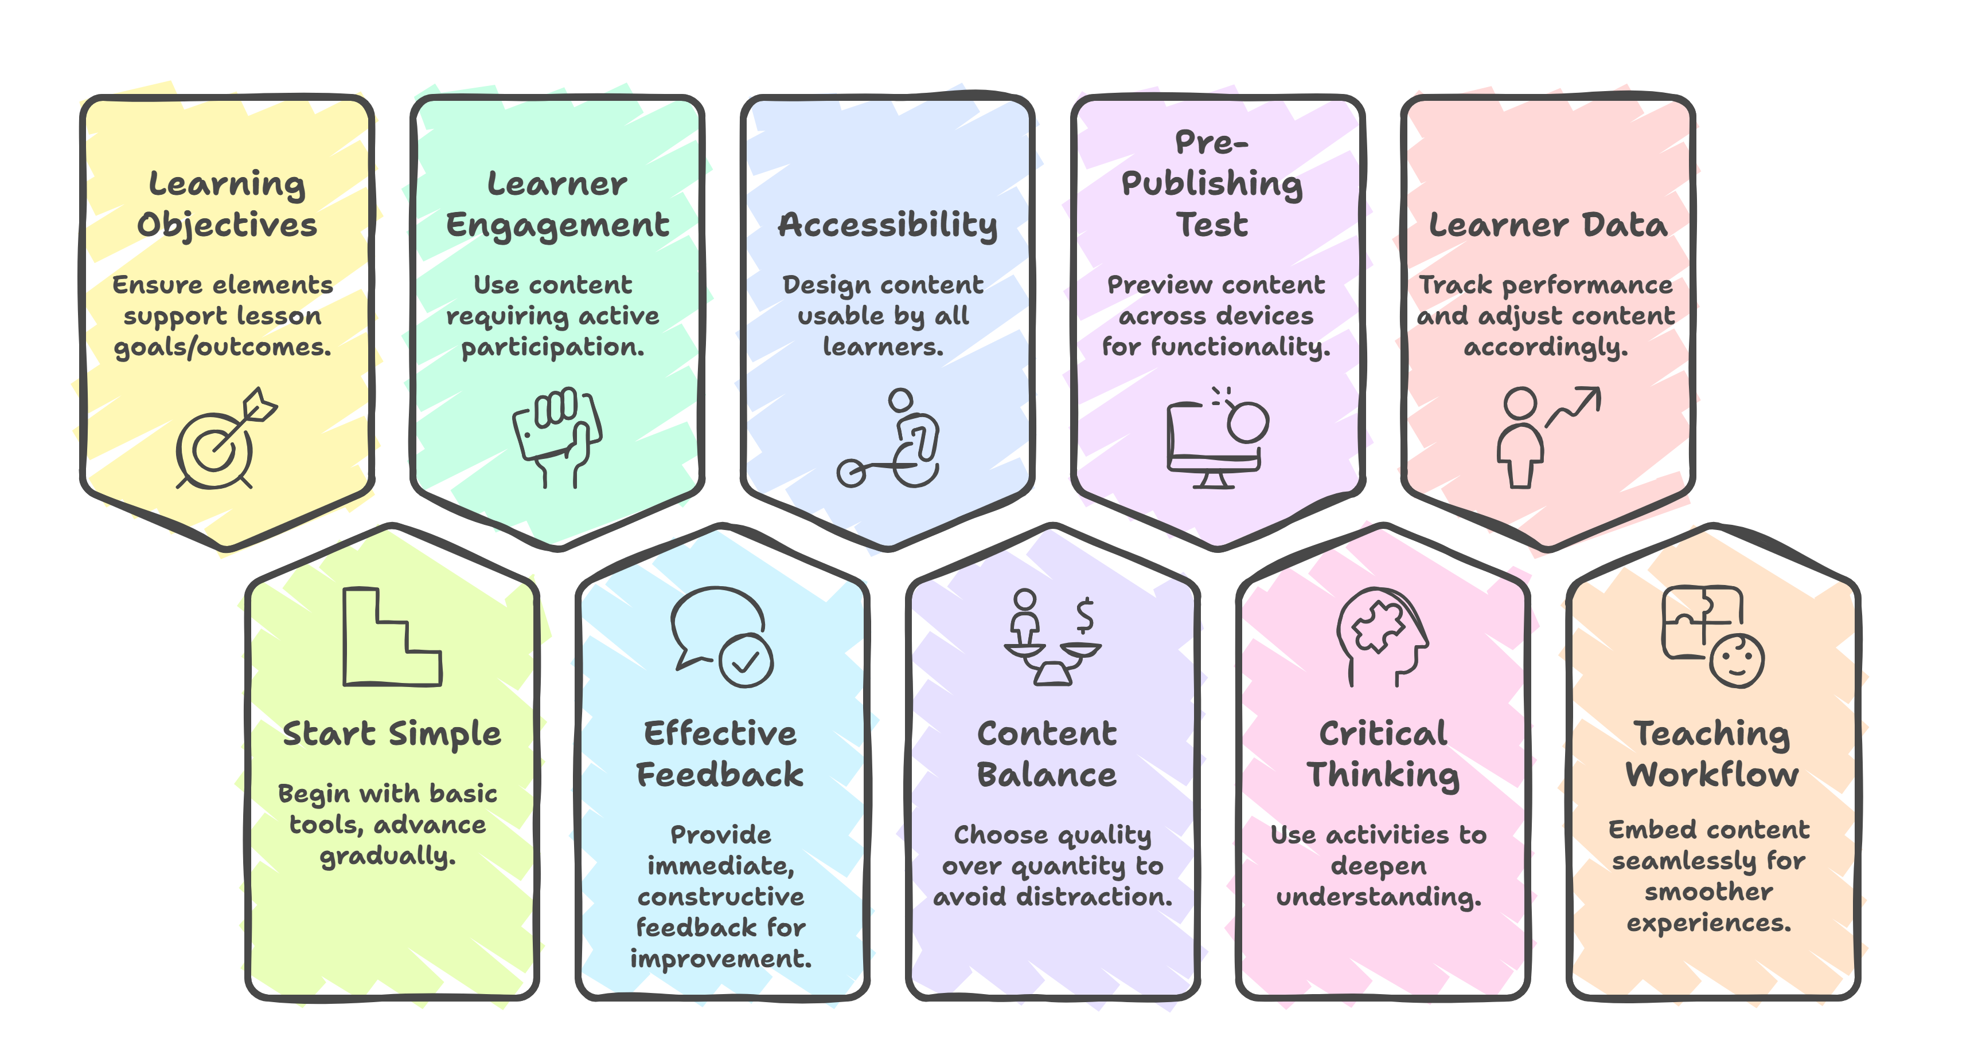
Best Practices for Effective Implementation

Slide 14
Q&A
Session

Slide 15
Thank You

