Slide 1
Digital Pedagogy as a lever for improving Students’ Learning: Role of School Leaders
Dr. Angel Rathnabai,
Associate Professor, CIET-NCERT

Slide 2
The National Education Policy (NEP) 2020 document outlines the essential roles and responsibilities of school leaders in driving educational transformation.
“School leaders are expected to be visionary and instructional leaders who set a clear vision for their schools and create a conducive environment for quality education. They are responsible for promoting innovative teaching methods, ensuring continuous professional development for teachers, and leveraging technology for improved learning outcomes.” (National Education Policy 2020, Government of India)

Slide 3
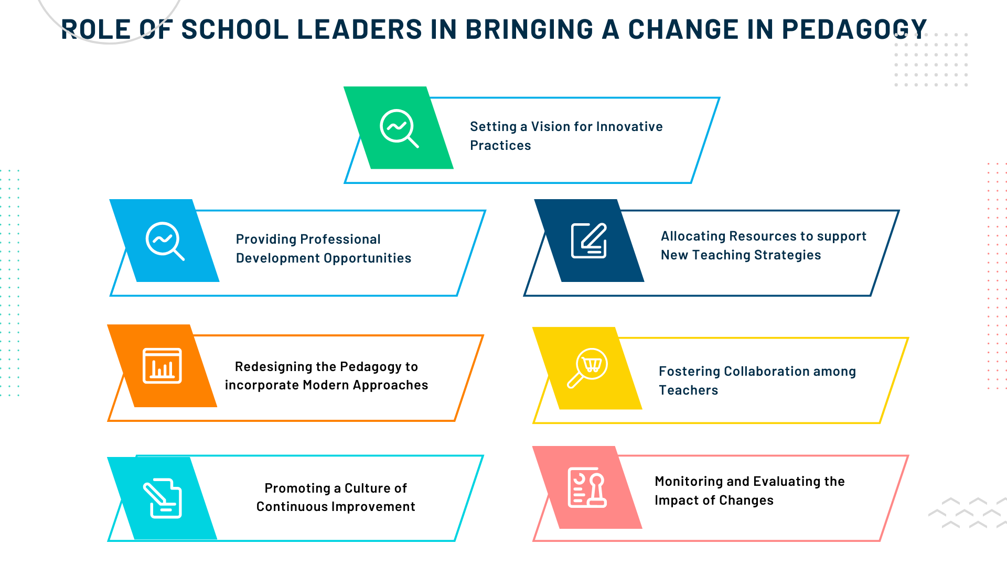
Role of School Leaders in bringing a change in pedagogy
Setting a vision for innovative teaching practices.
Providing professional development opportunities.
Redesigning the curriculum to incorporate modern approaches.
Allocating resources to support new teaching strategies.
Fostering collaboration among teachers.
Monitoring and evaluating the impact of changes.
Promoting a culture of continuous improvement.

Slide 5
Establishing Infrastructure
School Leaders can promote Digital Pedagogy by facilitating the arrangement of following in schools:
Reliable internet connectivity
Adequate computer hardware and software
Cybersecurity measures
Access to digital libraries and repositories
Technical support and maintenance services
Collaboration and communication tools
Scalable infrastructure to accommodate future technological advancements.

Slide 6
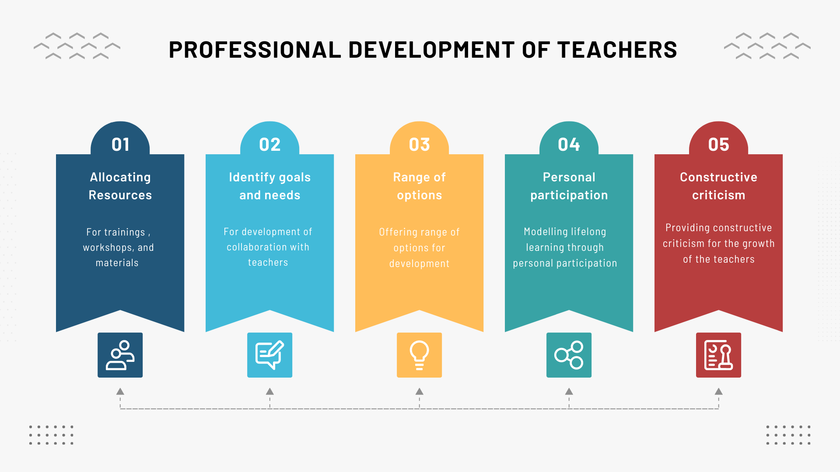

Slide 7
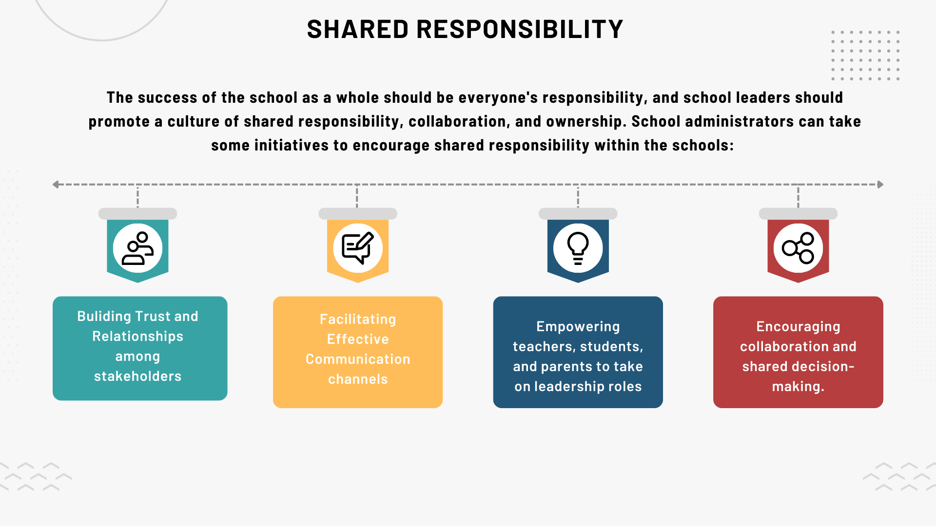
Shared Responsibility
The success of the school as a whole should be everyone's responsibility, and school leaders should promote a culture of shared responsibility, collaboration, and ownership. School administrators can take some initiatives to encourage shared responsibility within the schools:
Building trust and relationships among stakeholders.
Facilitating effective communication channels.
Empowering teachers, students, and parents to take on leadership roles.
Encouraging collaboration and shared decision-making.

Slide 8
Setting goals for innovative practices
Encouraging a culture of experimentation and risk-taking, where teachers feel empowered to explore new ideas and approaches.
Incorporating emerging technologies, such as virtual reality, artificial intelligence, or robotics, into the learning environment to enhance engagement and creativity.
Promoting interdisciplinary and project-based learning that allows students to apply knowledge and skills in authentic, hands-on contexts.
Prioritizing the development of critical thinking, problem-solving, and creativity skills among students through innovative teaching methods and assessment strategies.
Creating dedicated innovation spaces or makerspaces where students can collaborate, tinker, and prototype ideas.
Leveraging data and analytics to identify areas for improvement and inform innovative practices.

Slide 9
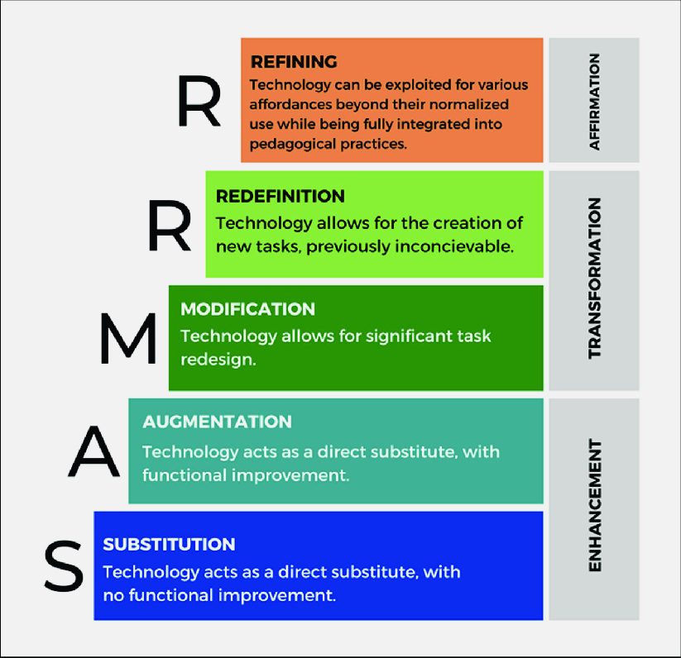
Redefining the learning with digital pedagogy: Transition from ‘Substitution’ to ‘Refining’
https://www.researchgate.net/figure/An-adapted-SAMR-R-model-considering-the-ERT-context_fig2_366201369

