Slide 1
Webinar Series on ET & ICT
Digital Equity & Inclusion: Essential Practices for Educators
Presenter:
Dr. Ruchi Dwivedi
Assistant Professor, CIET, NCERT
Date: 10.04.2025

Slide 2
Session Agenda
1.
Introduction to Digital Equity
2.
Addressing the Digital Divide
Conceptualization
Access Barriers
Importance for Education
Digital Literacy & Skills
Ethical Considerations
Strategies
Accessibility Standards & Inclusive Design
Promoting Equitable Participation
3.
4.
UDL & its Principles
Creating Inclusive Zone
Creating Accessible Content
Supporting Diverse Learners

Slide 3
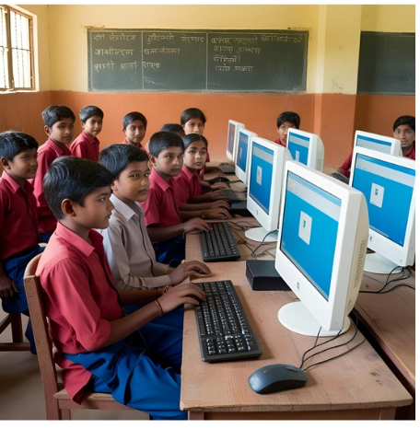
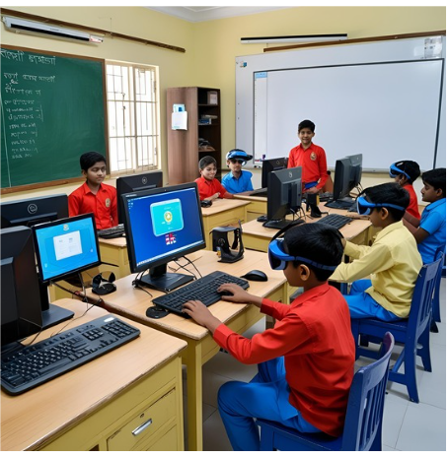
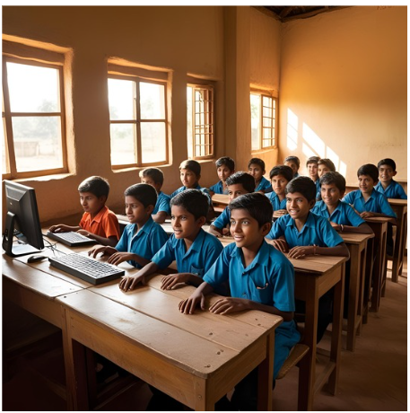
Digital India
Consider these three distinct learning environments. One exemplifies technological empowerment; another, technological scarcity; and the third, technological deprivation.
This pronounced visual contrast underscores the pervasive digital inequity that demands our immediate and concerted attention within education.

Slide 4
Leaving No One Behind:
From Digital Divide to Digital Equity
Digital divide is a problem!!!
Digital Equity is the Goal.
Refers to the disparity in access to, use of, & impact of information & communication technologies (ICT) across populations.
Extends beyond access to ensure all individuals & communities possess the ICT capacity for full participation in society, education, & the economy.
Key Dimensions include disparities in:
Access to devices & internet infrastructure
Digital literacy & skills
Affordability of technology
Availability of relevant content
Digital Equity encompasses:
Equitable access to affordable & reliable digital resources
Development of digital literacy & competencies
Inclusive & meaningful participation in digital environments

Slide 5
Digital equity extends beyond digital access to ensure all learners have the capacity, skills, & opportunity for full participation in the digital age. It is a fundamental right & a core tenet of social justice within education, empowering all to thrive in an increasingly digitized society.
Digital Equity
(Achieved when all components are in place)
Opportunity
(Equitable participation, access to quality content, personalized learning)
Skills
(Digital literacy, information literacy, media literacy)
Access
(Technological, internet, infrastructure)

Slide 6
Importance
For Education
Digital equity is crucial for contemporary education due to the increasing prevalence of online & blended learning.
Inequitable access & practices can lead to:
Widening achievement gaps
Marginalization of certain student groups
Digital equity is directly connected to learning outcomes, student success, & the development of future-ready skills.

Slide 7
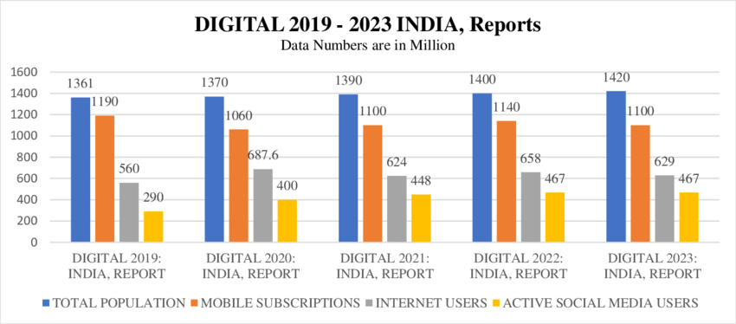
Ethical Foundations
of Digital Equity
This responsibility necessitating:
Proactive measures to prevent digital exclusion
Promotion of digital citizenship & ethical online behavior
Creation of learning environments that are accessible, inclusive, & respectful of diversity
NEP 2020 acknowledges the digital divide as a significant challenge & articulates a vision for digital equity, aiming to bridge disparities in access & empower learners through the strategic integration of technology & the development of digital literacy.
Data Source: DIGITAL 2019 -2023 INDIA

Slide 8
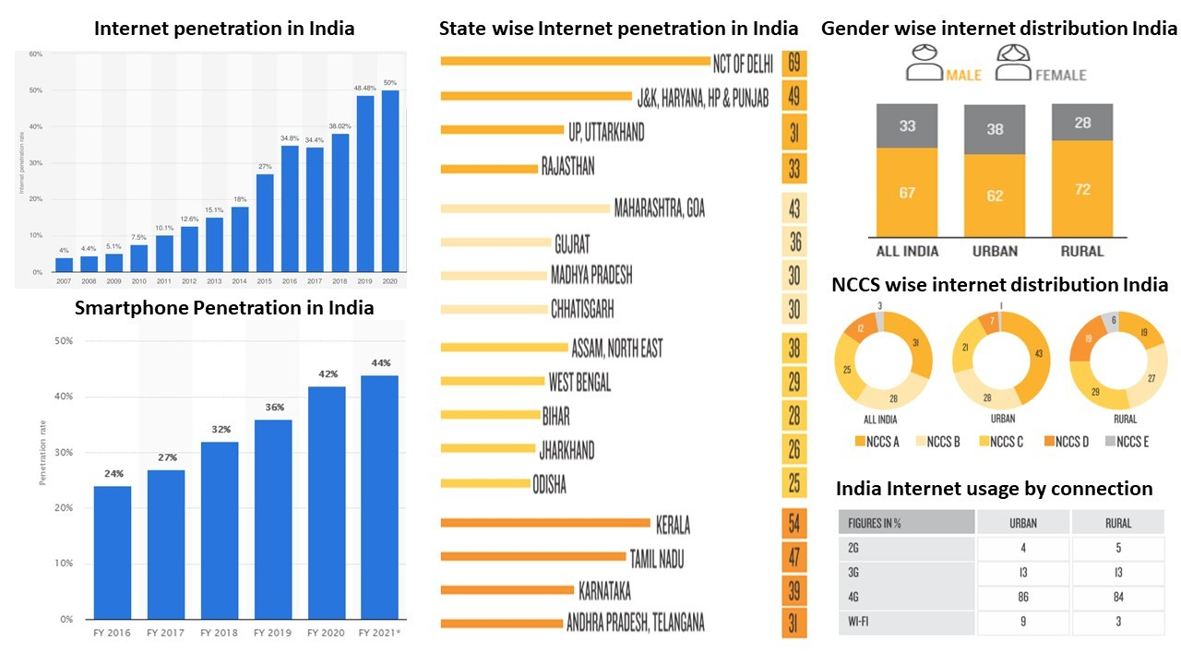
Addressing
The Digital Divide
Access Barriers
Socioeconomic Disparities
Geographic Disparities
Income & Affordability
Educational Attainment &
Digital Access
Social Caste & Marginalized Communities
Disability & Access
Rural vs. Urban
Regional
Connectivity
Language
Content Relevance
Source: https://www.linkedin.com/pulse/great-indian-digital-divide-ekansh-khatter

Slide 9
Beyond Access:
Digital Literacy & Skills
Just Think:
Access alone is insufficient.
Students also need the skills to use technology effectively & critically.
Digital Literacy Instruction is essential for:
Navigating online information
Evaluating digital sources Communicating effectively online
Participating in digital spaces responsibly
Address digital literacy gaps among educators to ensure they can effectively teach these skills.

Slide 10
Strategies for
Bridging the Digital Divide
Addressing the digital divide requires a multi-faceted approach involving:
Institutional Strategies
Policy Recommendations
Infrastructure & Technology
Classroom-Level Strategies
Flexible Learning Environments
Accessible Learning Materials
Low-Bandwidth Options
Digital Literacy Instruction

Slide 11
Institutional Strategies
Policy Recommendations
Infrastructure & Technology
Develop & implement policies that prioritize digital equity.
Advocate for funding & resources to support digital inclusion.
Establish partnerships with community organizations & internet service providers.
Invest in robust & reliable internet connectivity
Provide devices & technical support to students & educators.
Ensure accessibility of digital resources & platforms.

Slide 12
Classroom-Level Strategies
Flexible Learning Environments
Accessible Learning Materials
Use clear & concise language
Provide alternative formats (e.g., transcripts, audio versions)
Adhere to accessibility guidelines (e.g., WCAG).
Offer flexible deadlines & assignment formats.
Provide asynchronous learning options.
Low-Bandwidth Options
Digital Literacy Instruction
Integrate digital literacy skills into the curriculum
Teach students how to evaluate online information critically
Promote responsible online behavior
Offer text-based versions of videos or presentations.
Utilize low-bandwidth communication tools.

Slide 13
Pinpointing
Accessibility Standards & Inclusive Design
Web Content Accessibility Guidelines (WCAG) are internationally recognized standards for web accessibility.
(link: https://www.w3.org/WAI/standards-guidelines/wcag/)
Designed to ensure that web content (Information & user interface) is:
Perceivable
Operable
Understandable
Robust

Slide 14
Ensuring Legal Compliance
Accessibility for Educators
Educators play a crucial role in ensuring that learning environments, both physical & digital, comply with legal accessibility mandates.
International Framework: The UN CRPD
United Nations “Convention on the Rights of Persons with Disabilities” (CRPD) serves as a Foundational international treaty with
Key Educational Directives: (link: https://www.ohchr.org/en/instruments-mechanisms/instruments/convention-rights-persons-disabilities)
Right to inclusive education (article 24).
Obligation to provide reasonable accommodation (article 2).
Importance of accessible information & communication (article 9).

Slide 15
National Legal Obligations
Rights of Persons with Disabilities Act, 2016 (Act mandates specific actions from educational institutions & educators:
Providing accessible infrastructure (physical & digital).
Adapting curriculum & teaching methods to meet diverse needs.
Supplying assistive devices & technologies.
Ensuring accessible assessment practices.
Practical Steps for Legal Compliance
Educators must:
Know the specific accessibility standards relevant to their context
Utilize accessible technologies & platforms.
Create accessible learning materials (documents, presentations, videos).
Provide accommodations as needed for individual students.

Slide 16
Concern for
Ethical Imperative
Beyond legal compliance, accessibility is a core ethical responsibility within the educational profession.
Rooted in the fundamental principles of:
Equity: Ensuring fairness & impartiality in access to educational opportunities.
Dignity: Respecting the inherent worth & autonomy of all learners.
Inclusion: Creating learning environments where all students feel valued, respected, & empowered.
Excluding learners due to accessibility barriers is a form of discrimination that perpetuates social injustice.

Slide 17
Benefits of
Accessibility
Enhances the learning experience for everyone by promoting:
Clarity & comprehension: clear & structured content benefits all learners, regardless of their learning styles or preferences.
Usability: simplified navigation & intuitive interfaces improve the learning experience for all.
Flexibility: alternative formats (e.g., Captions, transcripts) are helpful in diverse learning contexts.
Examples: captions aid learners in noisy environments or when learning a new language. Structured headings improve navigation for all users. Clear & concise language benefits learners with cognitive differences & those who are new to the subject matter.

Slide 18
Universal Design for Learning (UDL)
A Framework for Inclusion
Framework that guides the development of flexible learning environments to accommodate individual learning differences.

Slide 19
Principles of
UDL
Multiple Means of Representation
Provide information in various formats (e.g., visual, auditory, tactile).
Offer options for customization (e.g., font size, color contrast).
Activate or supply background knowledge.
Multiple Means of Action & Expression
Offer diverse options for students to demonstrate their learning (e.g., writing, presentations, projects).
Provide scaffolding & support for different skill levels.
Allow for choice & autonomy in how students express themselves.
Multiple Means of Engagement
Offer choices to increase relevance, value, & authenticity.
Provide options for self-regulation (e.g., coping strategies, goal setting).
Foster collaboration & community.

Slide 20
Creating
Accessible Content
Text
Images
Audio & Video
Documents
Visual
Use clear, concise, & plain language.
Structure content with headings (H1, H2, etc.) for navigation.
Provide alternative text (alt text) for images & non-text elements.
Describe the essential information in images using alt text.
Avoid relying solely on color to convey meaning.
Provide transcripts for audio content.
Caption videos accurately & synchronously.
Consider audio descriptions for visual information in videos.
Use built-in accessibility checkers in word processors & presentation software.
Create accessible PDFs (tagged PDFs).
Examples of good & bad alt text.
Screenshot of a captioning interface.

Slide 21
Promoting
Equitable Participation
Strategies
Techniques
Address
Establish clear guidelines.
Address instances of disrespect or bias.
Encourage diverse perspectives & value all contributions.
Provide flexible participation options (e.g., text-based, audio, video).
Use varied discussion formats (e.g., small groups, asynchronous, synchronous).
Potential biases & microaggressions in online interactions.

Slide 22
Supporting
Strategies for differentiation & personalized learning in online settings:
Provide flexible learning pathways & choices in activities.
Offer a variety of learning materials (e.g., text, audio, video) to accommodate different learning styles.
Use adaptive learning technologies (if available) ethically & responsibly.
Diverse Learners
Addressing the needs of students with diverse:
Learning styles (visual, auditory, kinesthetic)
Cultural backgrounds
Levels of digital literacy

Slide 23
Closing Remarks
Ultimately, digital equity is about creating a future where technology serves as a tool for empowerment, not a source of division.
Educators play a vital role in realizing this vision by championing inclusive online learning environments that foster success for every student.

Slide 24
THANK YOU FOR YOUR ATTENTION
If you have any further questions, please don't hesitate to reach out to us.
Our Location
CIET, NCERT, New Delhi

