Slide 1
NCERT Webinar
On
Creating Online Puzzles using Puzzel.org
by
Dr Andleeb
Assistant Professor
Department of Teacher Training &
Non-Formal Education (IASE)
Jamia Millia Islamia, New Delhi

Slide 2
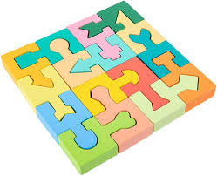
Contents
What is Puzzel.org?
Who can use Puzzel.org?
Why to use Puzzel.org?
How to use Puzzel.org?
Types of Online Puzzles in Puzzel.org
Free Benefits of Puzzel.org
Limitations of Puzzel.org

Slide 3
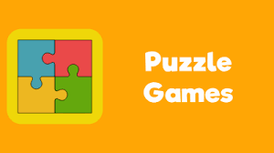
What is Puzzel.org?
Puzzel.org is a web tool for creating online puzzles that became popular particularly during COVID-19.
Remember its spelling – PUZZEL which is a Dutch word for Puzzle.
It offers a wide variety of online puzzles – at least 24 puzzles types currently – in Language, Maths, Reasoning, and Picture puzzles.

Slide 5
Who can use Puzzel.org?
Specifically teachers who want to make their teaching-learning a creative and interactive process.
Students who take part in online puzzles as participants and want to learn in a fun way.
Children who want to brainstorm for improving their mental abilities.
Anybody and of any age-group can create or play these online puzzles – be it for formal or informal teaching/learning.

Slide 6
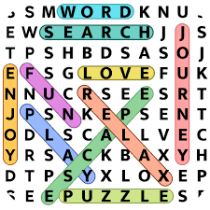
Why to use Puzzel.org?
Teaching
Learning
Assessment of Learning
For enriching vocabulary – offers puzzles in foreign languages only
For increasing general awareness
For enhancing mental abilities
For fun

Slide 7
How to use Puzzel.org?
Type puzzel.org in the search bar
There you will see four options on the homepage

Slide 8
Go to dashboard for creating puzzles. Here you can create puzzles by registering your account or by logging in via your Google account.
You can also use this tool without logging in by selecting temporary account.
For using this tool you should have text/image/math calculation as per the requirement of the puzzle you are using.
Puzzles created by you are automatically saved that you can access later if you do not delete.

Slide 9
Types of online Puzzles in Puzzel.org
There are 24 types of online puzzles
Categories of the Puzzles in Puzzel.org

Slide 10
Free Benefits of Puzzel.org
You can also use this tool without logging in by selecting temporary account.
Puzzles created by you are automatically saved. Puzzle creator can edit or delete the puzzle whenever required.
Puzzle creator can create 60 free puzzles in a month
One can publish the puzzle by either copy-pasting the URL or by generating QR code or by printing it.
One can commercially use the puzzles as in newspapers etc as created puzzles are not licensed.

Slide 11
Limitations of Puzzel.org
Puzzle creator can save only 2 puzzles in 24 hours in free usage of the tool.
Key: If you want to keep on making more than two puzzles in a day you will have to delete the earlier puzzles.
Teachers cannot see the results of the puzzles played by the participants.
Key: Teachers can ask the students to share the screenshots of the played puzzle answers.
Some of its features can be accessed in paid version only: seeing the results, creating 6000 puzzles per month, and many more related to changing settings and layouts etc of the puzzles.
Key: These features are not that important though.

Slide 12
THANK YOU!

