Slide 1
All India Children’s Educational eContent Competition (AICEeCC)
2024-25
Central Institute of Educational Technology, National Council of Educational Research and Training
Notes:
Thank you, ma’am! Thank you for providing us this platform to connect with the all creative minds on the other side of the screen. So, hello and a very good evening, to all our viewers! We are happy to inform you that we are back with All India Children’s Educational eContent Competition for the year 2024-25. Many of you might already be familiar with the competition so today we would like to bring to you the new features of this edition and to the ones who would be joining this community this year for the first time, we would like to take you through the details of the competition, its nature, objectives, categories and all.

Slide 2
About AICEeCC
CIET, NCERT has been organizing this competition for more than two decades as All India Children’s Educational Audio Video Festival (AICEAVF) and as All India Children’s Educational eContent Competition since 2022.
Notes:
So, CIET, NCERT has been organizing this competition for over two decades now, earlier it was known as All India Children’s Educational Audio Video Festival, but as we continued to get content in varied formats other than video and audio so we changed in to All India Children’s Educational eContent Competition since 2022. It has a proud legacy with many renowned media personals like Mr. Nasiruddin Shah, Mr. Amol Palekar, Mr. Manoj Bajpayee being the chief guests in the past editions.

Slide 3
It’s a unique competition organized at a national level, catering to a variety of eContent formats of educational content- a festival to celebrate prosumers of educational eContent and dedicated to the children of our country.
NEP 2020 recommends “...joint content development, holding joint activities such as art and science exhibitions, sports meets, quizzes and debates, and fairs. [7.5 (c)]”
Notes:
Its, UNIQUE as it acknowledges variety of eContent formats of educational content, it celebrates prosumers (a portmanteau or a blend of two words-consumers and producers, so one who are not just consuming but producing as well) and ofcourse as the name suggests its dedicated to the children of our country. The competition also tries to bring to life certain policy recommendations like National Education Policy’s suggestion to hold joint activities for content development.

Slide 4
2) In G20 New Delhi Leaders’ Declaration, focus was laid on delivering quality education by “...harness[ing] digital education to overcome the digital divide for learners…”¹, "Extend[ing] support to educational institutions and teachers to enable them to keep pace with emerging trends and technological advances…"², and “...reaffirm[ing] our commitment to promote open, equitable and secure scientific collaboration and encourage mobility of students, scholars, researchers, and scientists across research and higher education institutions”³
Notes:
Also in recent G20 leader’s declaration focus was laid on supporting educational institutions and teachers to help them keep pace with emerging technological trends and to promote collaboration, so the competition can be seen as an active step towards that

Slide 5
Objectives of the Competition
To encourage and incentivize the creation of quality eContent by students, teachers, teacher educators and independent eContent creators
To provide a national level platform for collaboration among different stakeholders in education
To ensure wider dissemination of OER to ensure access to quality eContent.
Notes:
So, with this competition we aim to encourage and incentivize quality eContent creation by different stakeholders like students, teachers, teacher educators and independent eContent creators and to provide them a national level platform for collaboration and to ensure not only production but also wider dissemination of eContent as Open Educational Resource on various platforms.

Slide 6
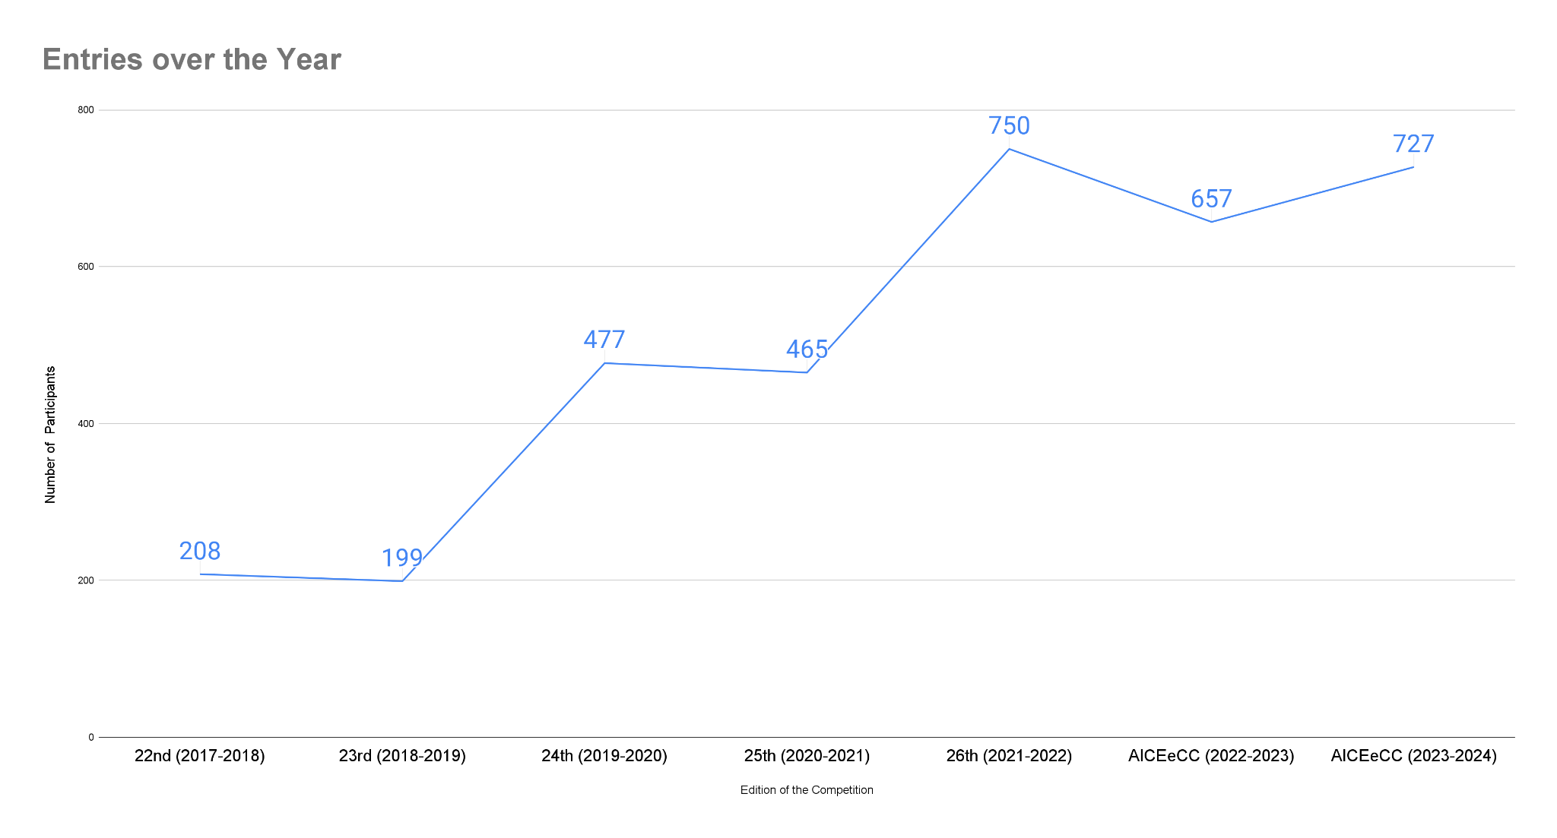
Notes:
We have received quite a positive response to the competition over the years as you can see a constant increase in the no. of entries received each year, and viewers we definitely want an exponential growth in the no.s here so keep the entries coming in…

Slide 7
Opening Date : 10th October 2024
Last Date for Sending Entries :
31st December 2024
Notes:
The competition for this year has already been announced, it form was opened for entries on 10th of October and it will remain open till 31st of December 2024, so viewers please take a note of the last date. Wait for the question

Slide 8
Who can Participate?
Government Organisations (NCERT/SIETs/EMMRCs/CEC/Others)
Independent eContent Creators/
Institutions (other than the Govt.)
Teachers/Teacher Educators
College Students (In Diploma/UG/PG programs or PhD Scholars)
Children
Notes:
You are eligible to participate if you fall any of these categories, if you are a goverment organization, or an independent eContent creator we know the potential of the youth of our country so we invite entries from College students and ofcourse Children….
This year for a greater clarity we have tried to define what we mean by these categories so I would request all the interested viewers to please visit our official website ciet.ncert.gov.in and read our Brochure carefully.

Slide 9
Who should be the target audience of the eContent?
Foundational Level Learner (3-8 years or ECCE & Class I and II)
Preparatory Level Learner (8-11 years or Class III to V)
Middle Level Learner (11-14 years or Class VI to VIII)
Secondary Level Learner (14-18 years or Class IX to XII)
Adult Education
Teacher Education (Pre & In-Service Teachers)

Slide 10
What type of eContent?
Audio
Video/Animations
New Media (Immersive and EduXR eContent/Digital Educational Games/Digital Educational Apps)

Slide 11
What’s New This Year…
Notes:
As I said earlier reading the brochure carefully should be your first step. The brochure would really help you in figuring out under which category to apply, from our experience in the past editions of the competition, we receive a lot of mis-aligned entries like basic videos are sent under New Media category, or a content appropriate for Adult learners is sent under Secondary category, therefore, understanding these categories is very important because the eContent is considered and evaluated under which-ever category you sent it in, and even a good content can lose its chances of winning just because it was sent in the wrong category. Moreover, for the people who would be creating content now can explore a variety of formats within a type of media like Videos come in the form of Documentaries, Animations, Instructional Videos, Interactive Lectures etc. we tend to bind ourself in set formats, even in Audio eContent there can be drama, docu-drama, magazine etc. So I would request you all to try different varieties of program format, a hint for which you can get in the brochure.

Slide 12
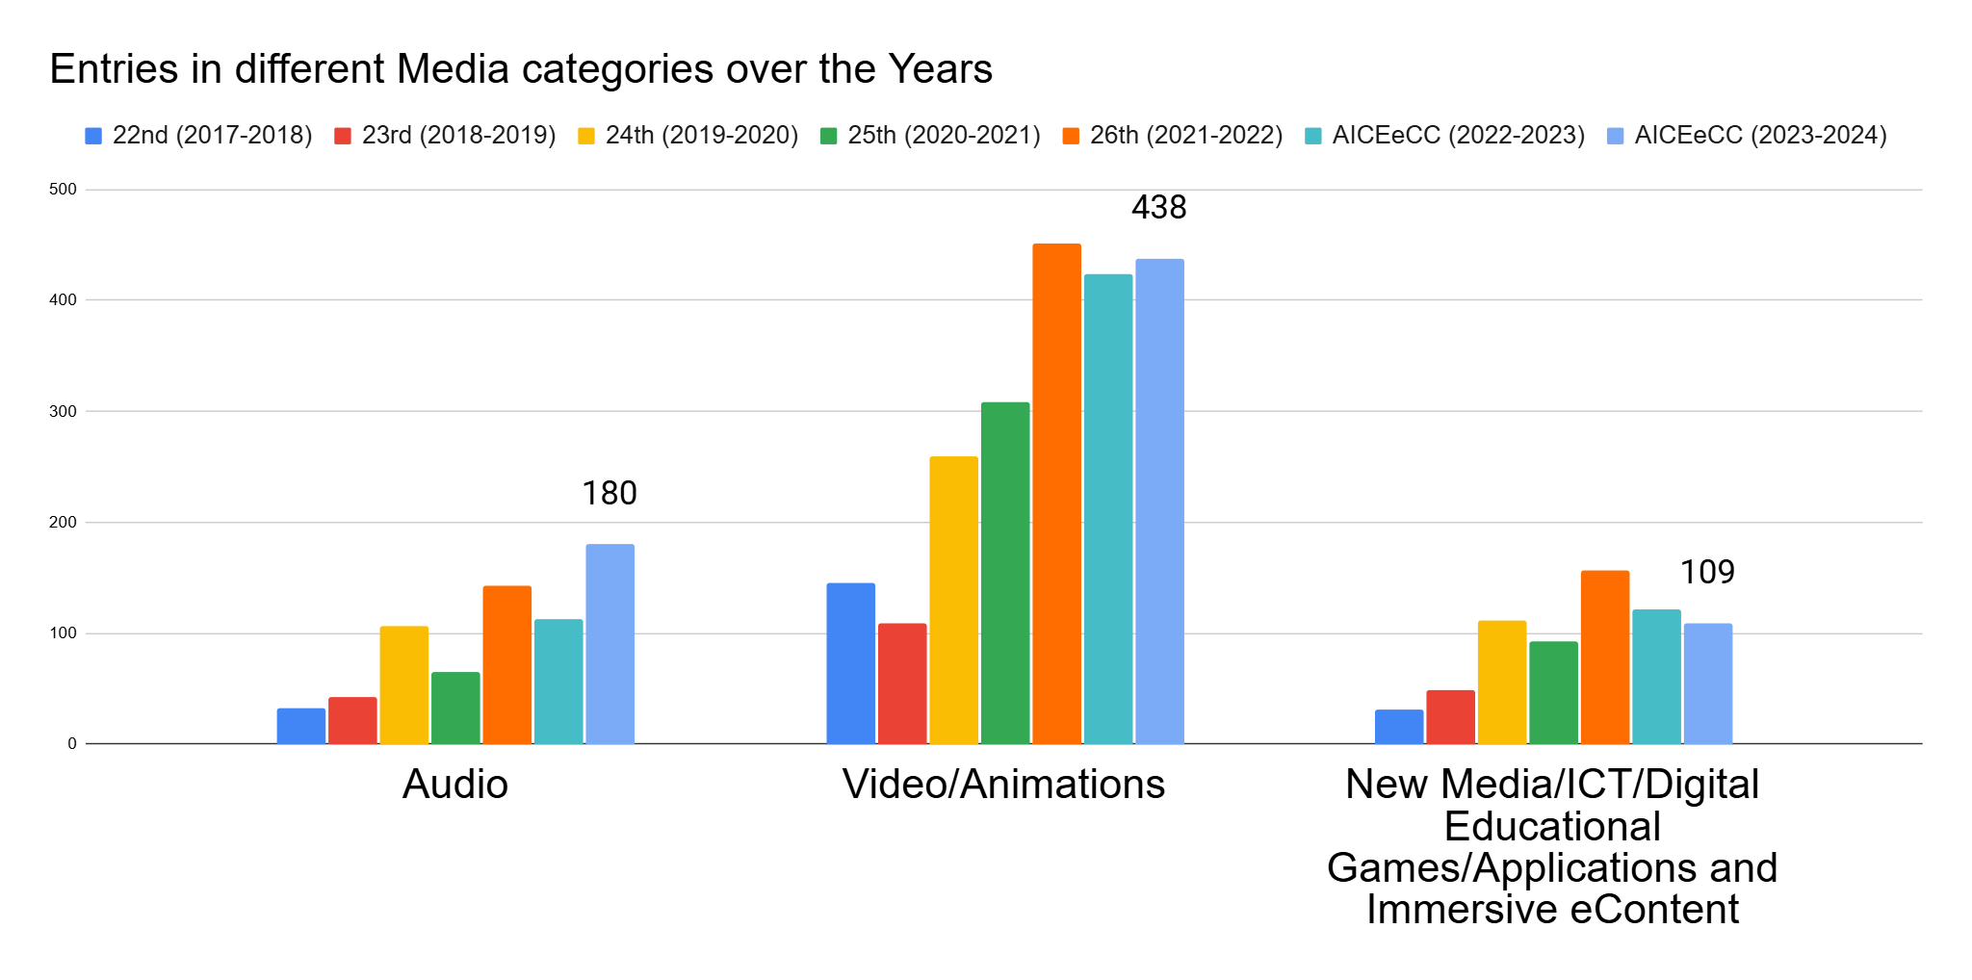
Notes:
As you can see there is more or less an increase only in all the categories with an exception in new media category

Slide 13
Problem Statements for New Media Category
AI-based assessment of learners; Students’ ePortfolio with data analytics; AI-based classroom simulator; Project Planning and Monitoring App/Software; Educational video content production process optimiser.
Notes:
So another thing that we have done this year is, we have also provided some problem statements for all the App/Games and Software Developers out there to develop there apps/games or softwares around it. We encourage our developers to present innovative solution for AI based assessment of learners, for developing students’ ePortfolio with data analytics; for a classroom simulator for practice teaching; an process optimiser for educational video content production and more such problems. With the advancement in Artificial Intelligence, we would encourage the judicious use of it in these solutions.

Slide 14
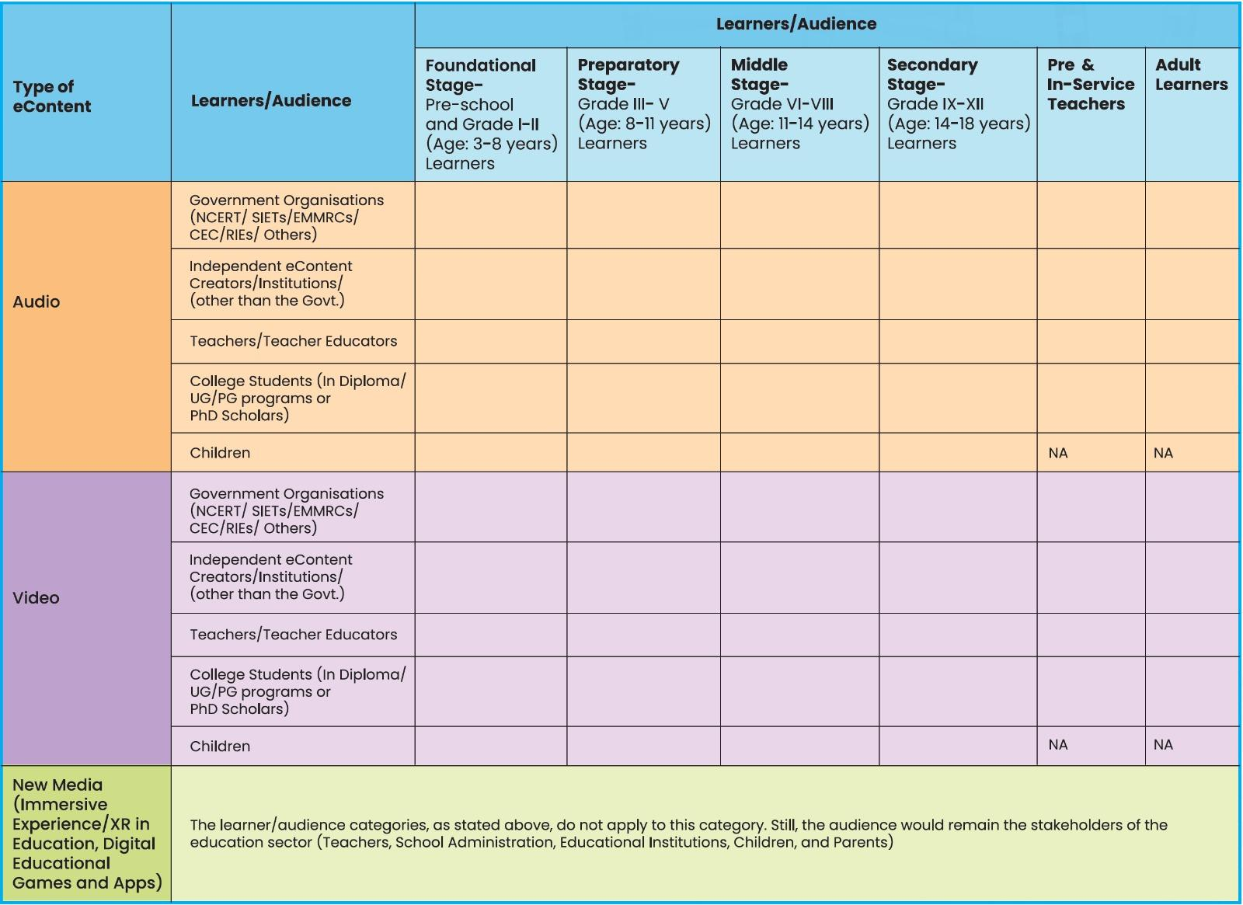
Category
Matrix
Notes:
This is the permutation and combination possible for the categories under which you can send the content.

Slide 15
Prize Categories
Best eContent
Individual Excellence
Rs. 40,000/-*
(*Not applicable to winning entries from NCERT)
&
Trophy and Certificates
Rs. 5,000/- &
Trophy and Certificates
Best Direction; Best Script; ….Best Set Designing; Best UI/UX/Graphics etc.
Jury Appreciation
Rs. 5,000/- &
Trophy and Certificates
Notes:
So we would be giving prizes under three categories:
The first is for Best eContent Given to the best quality eContent in various categories. Last year we gave 42 best eContent prizes, this includes prize money of 40,000 along with a trophy and certificate. The cash prize for 40,000 does not apply to entries from NCERT (its constituent units like CIET, NIE, RIEs, PSSCIVE)
but the rest of it remains the same.
The other one is for Individual Excellence which differs as per the media category for example Best Graphics is there in Video category and not applicable to Audio category and likewise. In this category prize money of 5000/- is given along with certificate and trophy. (27 individuals were given prize for showcasing their excellent skills in various categories)
Jury Appreciation is another category of prize that we give which is on the discretion of the Jury Members and for which again a prize money of 5000/- along with trophy and certificates are given. (Last year 6 Jury Appreciations were given) In case of more than one winning entry in any category, the prize money is divided equally among the winners while separate certificate and trophies are given.

Slide 16
Terms & Conditions
The eContent should have been produced/developed between January 1 2024, to December 31, 2024.
There should not be any conflict in the authorship of the eContent.
The eContent entries in other than Hindi/ English should be sent with subtitles in Hindi/English.
Notes:
Let’s discuss some of the terms and conditions.

Slide 17
Terms & Conditions
4. eContent should be creative, have broad appeal and demonstrate excellent artistic and technical skills.
5. Content should speak positively to and respect children of diverse backgrounds and cultures.

Slide 18
Terms & Conditions
6. For promoting inclusive education, eContent on and for Children with Special Needs (CWSN) will be given preference. This could mean an eContent produced by a person with special needs or an eContent on or for CWSN.
7. The duration of the eContent (Audio/Video Content) should be between 3 minutes to 30 minutes…
Notes:
There are more but to avoid the monotony of me reading them all out here, I would again request you all to please read them in the brochure on the website. But we would definitely see some of the crucial ones here

Slide 19
Terms & Conditions
Plagiarism of any sort is not acceptable.
Similarity index should be less than 10%.
No copyrighted content should be used. The use of the works of others within the permitted limit (10%) should appropriately be credited.
Free and Open Source Softwares should be used without compromising the creativity and originality of the eContent.
Notes:
And we can agree that a video demonstrating how to use a free and open source software definitely lacks creativity. Creatively using a FOSS or OER in the development of an eContent is ofcourse encourage by us.

Slide 20
Terms & Conditions
A copy of the eContent will be retained by CIET.
CIET would have the rights to telecast/broadcast the prize-winning eContent and upload it on DIKSHA/OER and other websites/portals managed by NCERT under the CC BY-SA 4.0 license.
In case of Games/Apps/Softwares, coding should have been done by the creators and the source file and copyrights will have to be transferred to CIET.

Slide 21
Terms & Conditions
Content will not be selected if it has:
excessive violence, sexual references, coarse language, use of substances or that advocates and supports racial, cultural, religious, or gender bias will not be selected.
technical glitches (e.g., poor audio/video quality, blank screen, resolution issues, frame rate problems, lags in app/games etc…)

Slide 22
Evaluation Criteria
Content Appropriateness
Age appropriateness
Language Used
Subtitling
Creativity
Programme pace
Sensitive, inclusive and aligns with constitutional values
Notes:
Is the content in the programme age appropriate as per the mentioned learning level (FL/PL/ML/SL/AE/TE) category?
Is the language clear, precise and comprehensive?
Does the programme have subtitles in English/Hindi, if the programme is in other than English/Hindi.
Does the eContent have a creative storyline?
Does the eContent capture and maintain the learners' attention throughout?
Is the content presented in a clear and understandable manner?
Is the programme pace correct with respect to the chosen learning level?
Is the content culturally sensitive and inclusive, avoiding stereotypes or biases and align with the constitution values?

Slide 23
2. Content Packaging
Choice of media
Sound and music production as per the theme
Used elements (visual and graphics) are clear and of high-quality
Technical soundness (avoid blank screens, lags, mic blasts etc.)
Notes:
Is the sound and music production in the programme appropriate as per the chosen theme of the programme?
Are visuals and audio clear, high-quality, and supportive of the educational content?
Does the game/app perform well technically, avoiding glitches and crashes?
Is the tone/genre appropriate to voiceover, character’s dialogue or any other background sound ?
Are sound effects relevant as per the shots/scenes in the programme?
Is the programme mood aptly described?
Is the volume of sound in the programme synchronized with the dialogues or as per required shots?
Is the programme packaging appealing to the audience?

Slide 24
3. Content Presentation
Clear representation of idea/concept
Innovative and out of the box
Flow of the program
Engagement
Notes:
3. Content Presentation
Is the programme ideation clearly reflected on the screen?
Are text/ visuals/graphics presentation/shots appropriate as per the different scenes?
Is the presentation innovative and presents out of the box ideas?
Does the program's flow establish the scene and deliver the director's message?
Do the usage of voice modulation and intonation making engaging programme content.

Slide 25
4. Effectiveness of the eContent
Overall impact on the audience
Educational implications of the programme- learning outcome/message, pedagogy, learning objectives?
Compatibility and reach across platforms (TV/Mobile etc.).
Notes:
4. Effectiveness of the eContent (Overall Production)
Is there any overall impact of the programme on the audience?
Is there any educational implications of the programme- learning outcome/message, pedagogy, learning objectives?
Can this programme be broadcast on television or on other learning media platforms?

Slide 26
Glimpses of the Previous Year’s Winning Program
Notes:
So you might have done a lot of jotting down of points, and a lot of talking has happened so now sit back and enjoy a glimpse of the previous year’s winning programs I hope you enjoyed it! Could see the nuances that we just discussed.
Later we would also discuss where you can access these programs.

Slide 27
APPLICATION FORM SUBMISSION
Before submitting the final form, please carefully read the brochure instructions with special attention to Categories of eContent, Criteria for Selection, and Rules & Regulations etc.
Fill out the Google Form for participation.
Notes:
So how can you send your entries for the competition.

Slide 28
APPLICATION FORM SUBMISSION
2. Upload your eContent in the highest possible resolution and share it through Google Drive at aiceavf.prd@ciet.nic.in. (Link)

Slide 29
APPLICATION FORM SUBMISSION
3. The fee for submitting an eContent for consideration as part of the All India Children’s Educational eContent Competition (AICEeCC) 2024-25 is Rs. 200/- (Rupees two hundred only) per application form. It should be paid only through NEFT.
Notes:
No cash payment will be accepted. Cash transfers to the Bank Account will also not be accepted..

Slide 30
APPLICATION FORM SUBMISSION
NEFT to:
Account No. 10137881284
Account Holder Name: Joint Director, CIET, NCERT
Bank Name: State Bank of India, NCERT, Sri Aurobindo Marg, New Delhi-110016
IFSC Code: SBIN0001690
Notes:
No cash payment will be accepted. Cash transfers to the Bank Account will also not be accepted..

Slide 31
APPLICATION FORM SUBMISSION
Keep these things ready :
1) Transaction receipt of the fee payment (₹ 200/- per entry). {maximum file size 10 MB, image/PDF}
Notes:
Keep these 9-10 documents handy is the mentioned size and format. Even better would be to either keep it in a folder on your computer system or on your google drive.

Slide 32
Keep these things ready:
2) eContent {Lesser than 1 GB} and google drive link of the eContent
3) Synopsis in English/Hindi {maximum file size 1 MB, Word Document}
4) Script in English/Hindi {maximum file size 10 MB, Word Document}

Slide 33
Keep these things ready:
5) Script in Original language (if applicable) {maximum file size 10 MB, Word Document}
6) Passport sized photo of the Producer of eContent {maximum file size 1 MB, image}
7) Thumbnail of the eContent {maximum file size 1 MB, image}

Slide 34
Keep these things ready:
In case of School/ College Students
1) Identity Card{maximum file size 10 MB, image/
PDF}
2) Endorsement letter by Principal of the College/School{maximum file size 10 MB, image/
PDF}
In case of Teacher or Teacher Educator
1) Institutional Identity Card

Slide 35
Keep these things ready:
Your Bank Details like Account No., Bank Name, Branch Name, IFSC, PAN Number.
Your Postal Address
Notes:
Incase you secure a prize these details will be used to transfer the prize money and certificate and trophies to you in case you are not present in the prize distribution event which is usually a 2-3 day event.

Slide 36
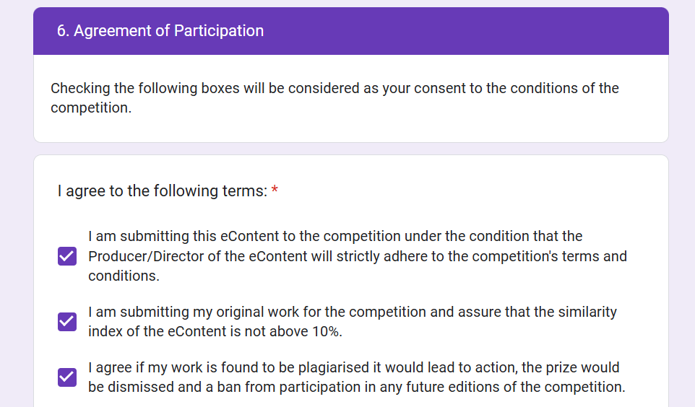
APPLICATION FORM SUBMISSION
Consent
Notes:
Let's quickly have a look at the section of the form
And how to generate a google drive link for the eContent

Slide 37
Keep an eye on:
Official Website: https://ciet.ncert.gov.in
Go to Activities>eContent Competition
NCERT’s Social Media Handles
Youtube Channels: NCERT Official
AlCEeCC Official
Notes:
Keep an eye on these spaces for Updates related to the competition
Moreover, you can also access our archives for inspiration or to get to know the initiative better. Directories, Winning programs Past events.

Slide 38
For Queries and Feedback, write to us at:
aiceavf.prd@ciet.nic.in

Slide 39
Thank You!
&
We look Forward to your participation

