Slide 1
Online Training
Latest version- 5.0.6
"Animation as Digital Resource for Teaching and Learning"
KRITA
GRAPHICS
ANIMATION
https://krita.org/en/
By- Santosh Kumar Bisen , Fulbright DAI Scholar- 9340089454

Slide 2
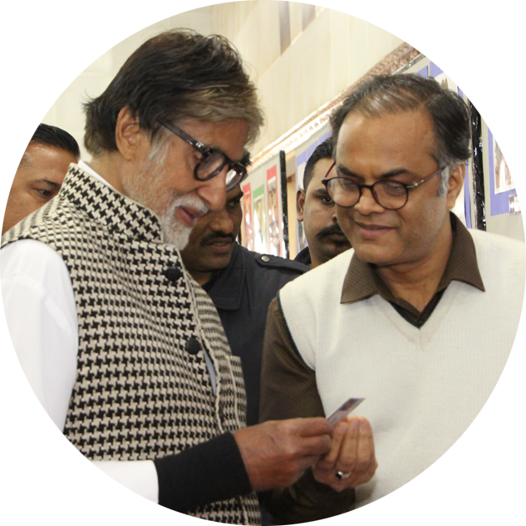
Online Training
"Animation as Digital Resource for Teaching and Learning"
Webinar by -
Santosh Kumar Bisen
Fulbright DAI Scholar and National ICT,NAT Awardee
PGT Biology at JNV RAIPR (CG)
KRITA By - Santosh Kumar Bisen , Fulbright DAI Scholar- 9340089454

Slide 3
Online Training on "Animation as Digital Resource for Teaching and Learning"
2D ANIMATION – KRITA
__________________________
Santosh Kumar Bisen
Fulbright DAI Scholar and National ICT + NAT Awardee
PGT Biology at JNV RAIPUR (CG)
KRITA By - Santosh Kumar Bisen , Fulbright DAI Scholar- 9340089454

Slide 4
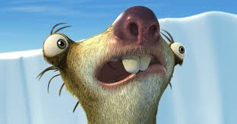
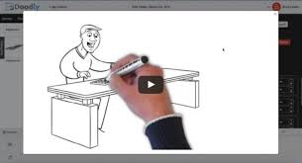
ANIMATION
2D animation
(Tom & Jerry)
3D animation
(Ice Age)
Stop motion [Wallace and Gromit)
Motion graphics
(Doodly)
KRITA By - Santosh Kumar Bisen , Fulbright DAI Scholar- 9340089454

Slide 5
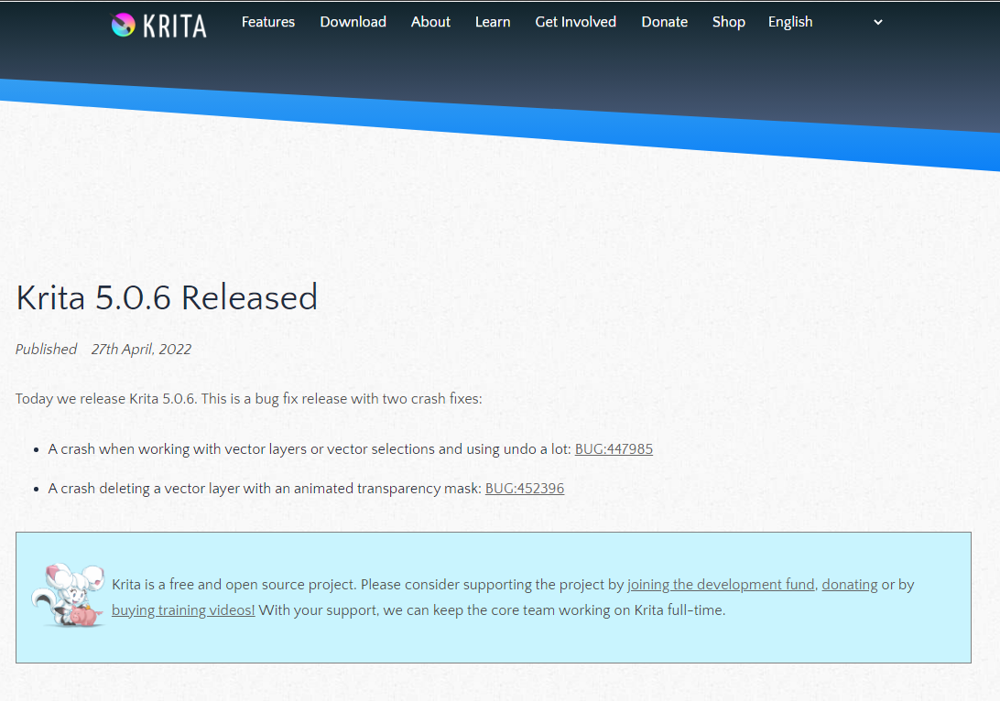
KRITA By - Santosh Kumar Bisen , Fulbright DAI Scholar- 9340089454

Slide 6
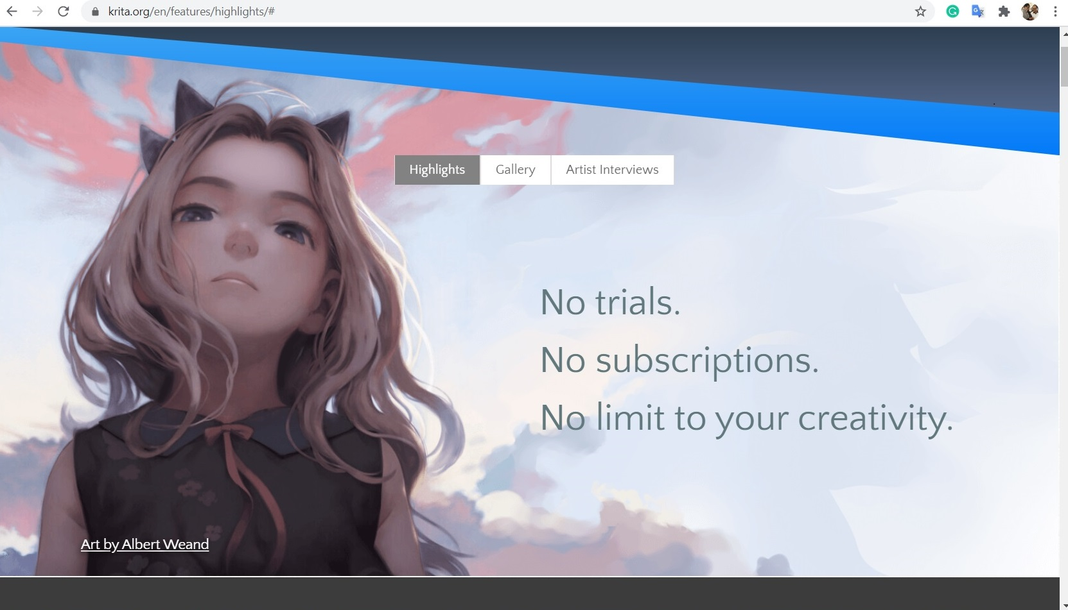
KRITA By - Santosh Kumar Bisen , Fulbright DAI Scholar- 9340089454

Slide 7
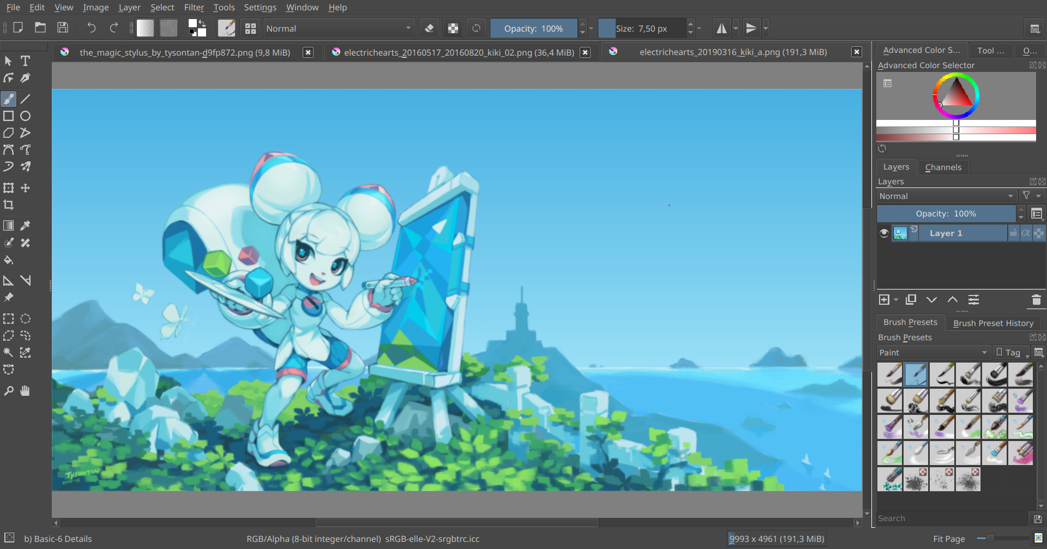
KRITA By - Santosh Kumar Bisen , Fulbright DAI Scholar- 9340089454

Slide 8
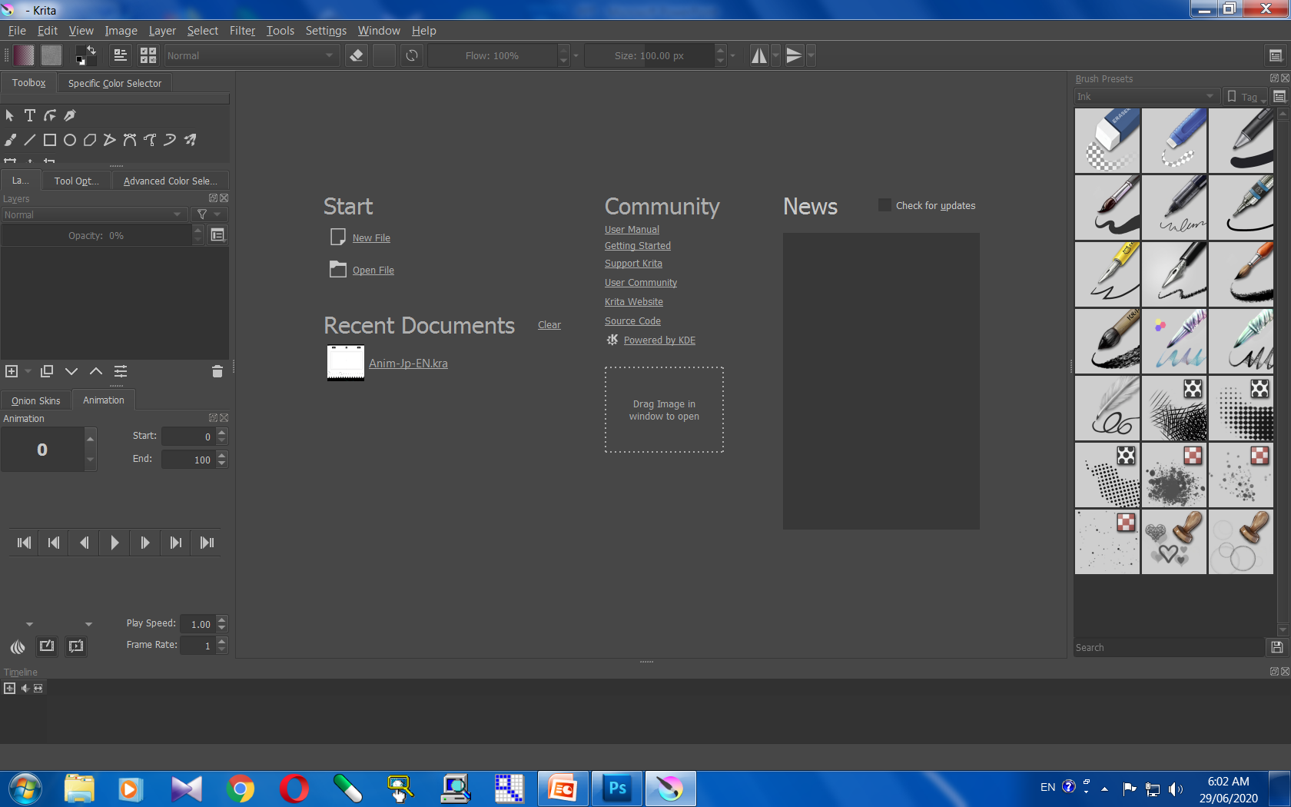
KRITA By - Santosh Kumar Bisen , Fulbright DAI Scholar- 9340089454

Slide 9
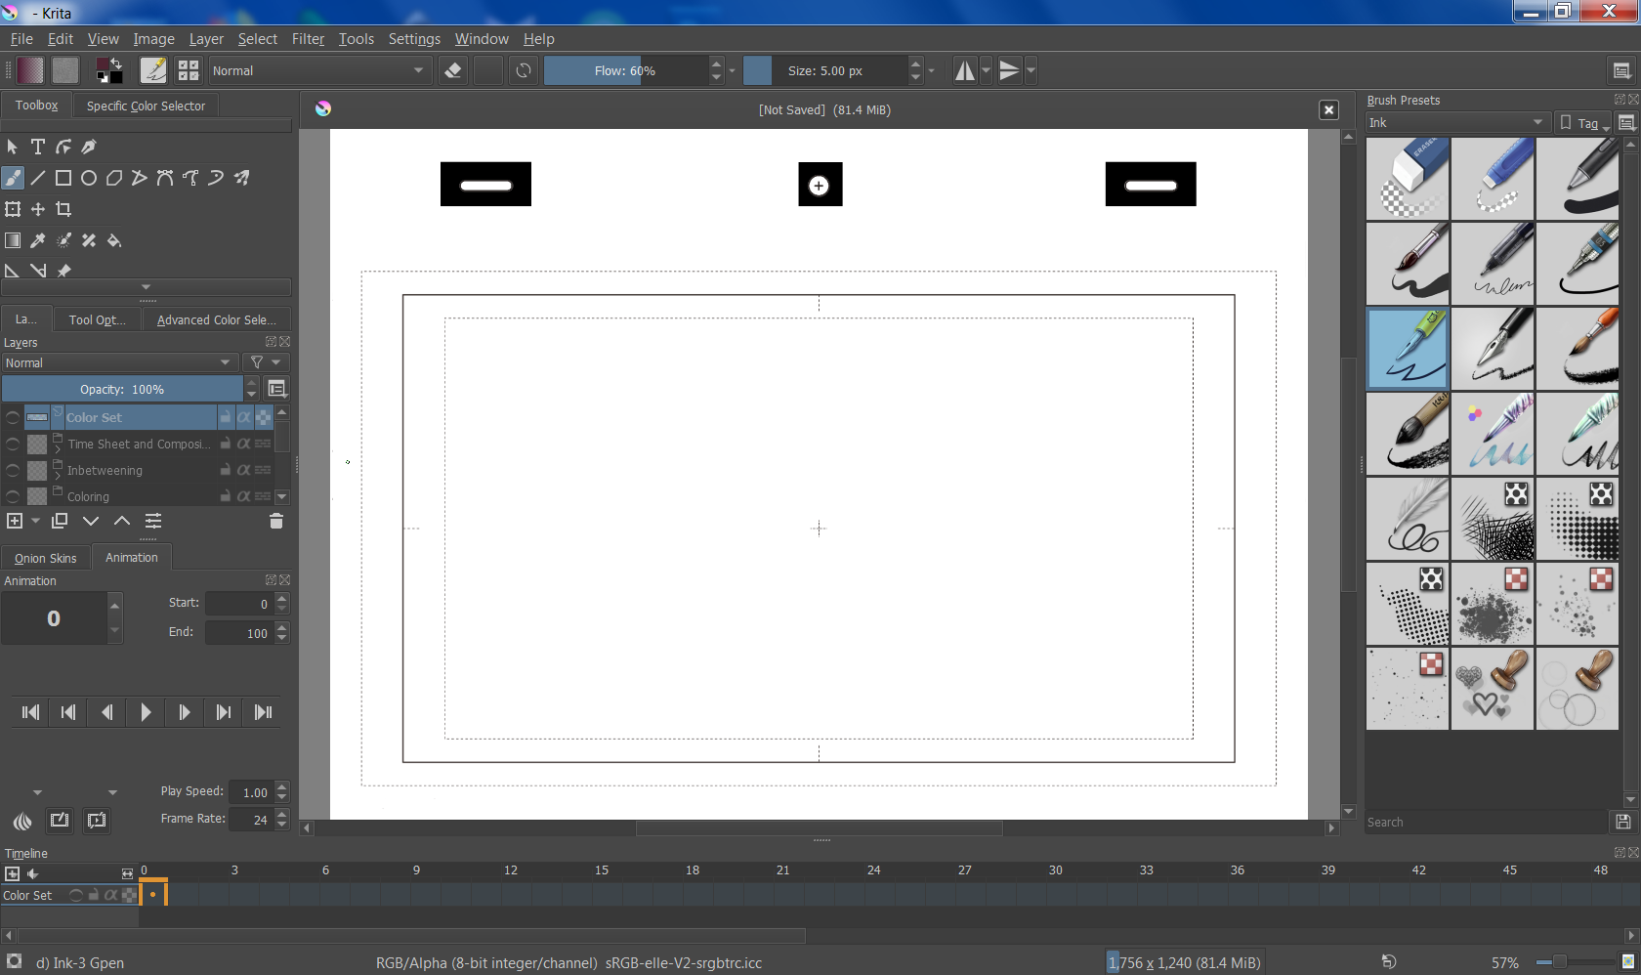
KRITA By - Santosh Kumar Bisen , Fulbright DAI Scholar- 9340089454

Slide 10
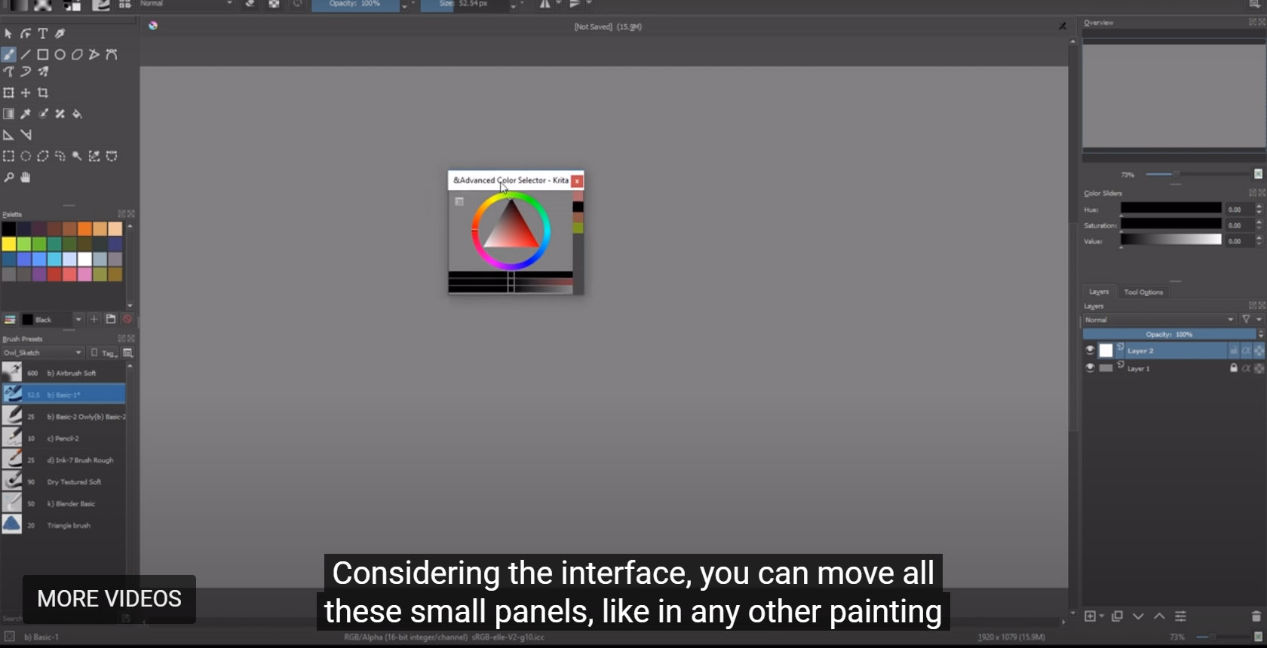
COLORS
KRITA By - Santosh Kumar Bisen , Fulbright DAI Scholar- 9340089454

Slide 11
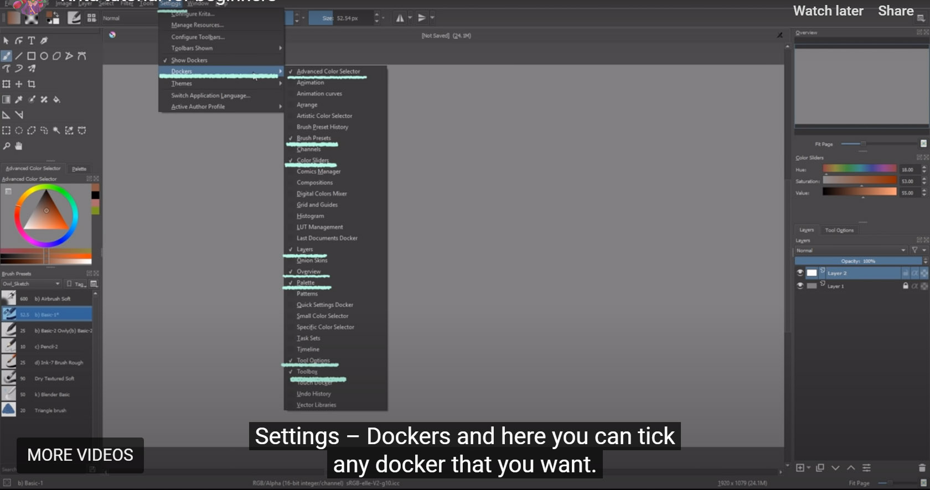
ALL THE TOOLS IN DOCKERS
KRITA By - Santosh Kumar Bisen , Fulbright DAI Scholar- 9340089454

Slide 12
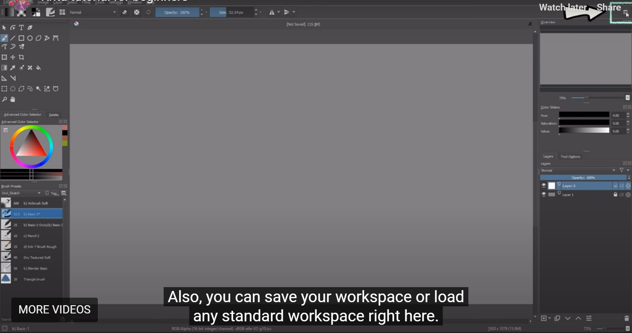
DOCKERS IN SHORT CUT
KRITA By - Santosh Kumar Bisen , Fulbright DAI Scholar- 9340089454

Slide 13
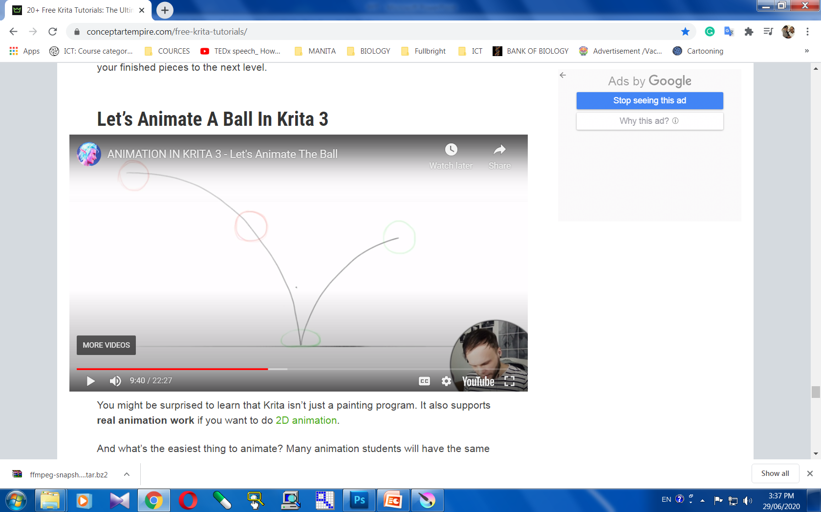
https://youtu.be/5mMQJVj0RYk
KRITA By - Santosh Kumar Bisen , Fulbright DAI Scholar- 9340089454

Slide 14
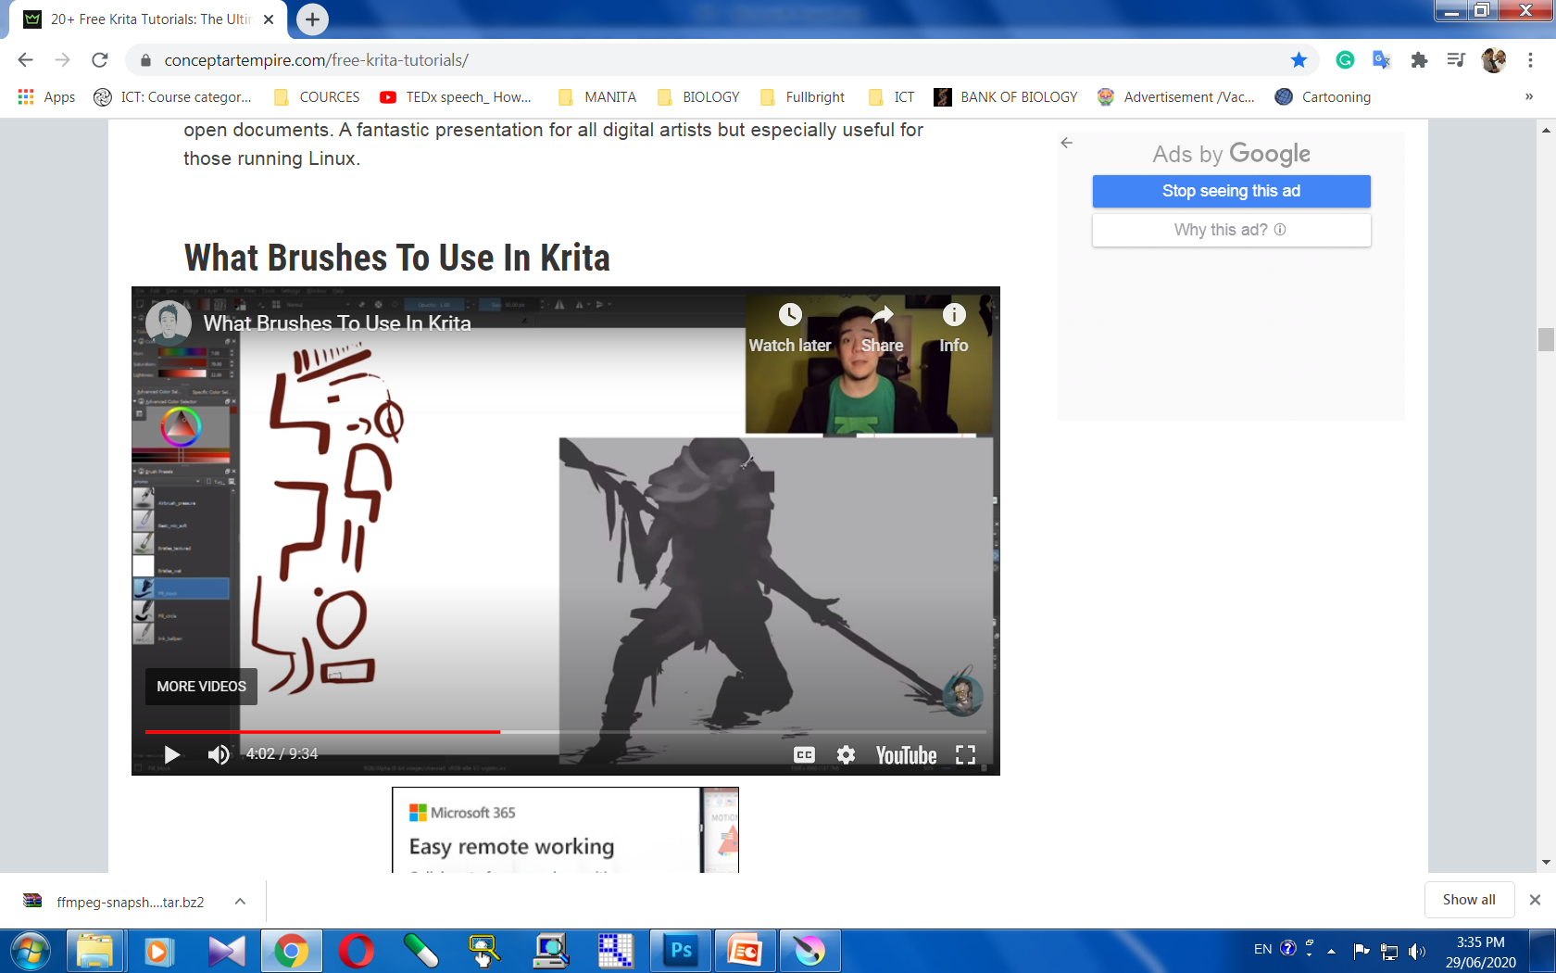
https://youtu.be/aS4Ng7SdIQM
KRITA By- Santosh Kumar Bisen , Fulbright DAI Scholar- 9340089454

Slide 15
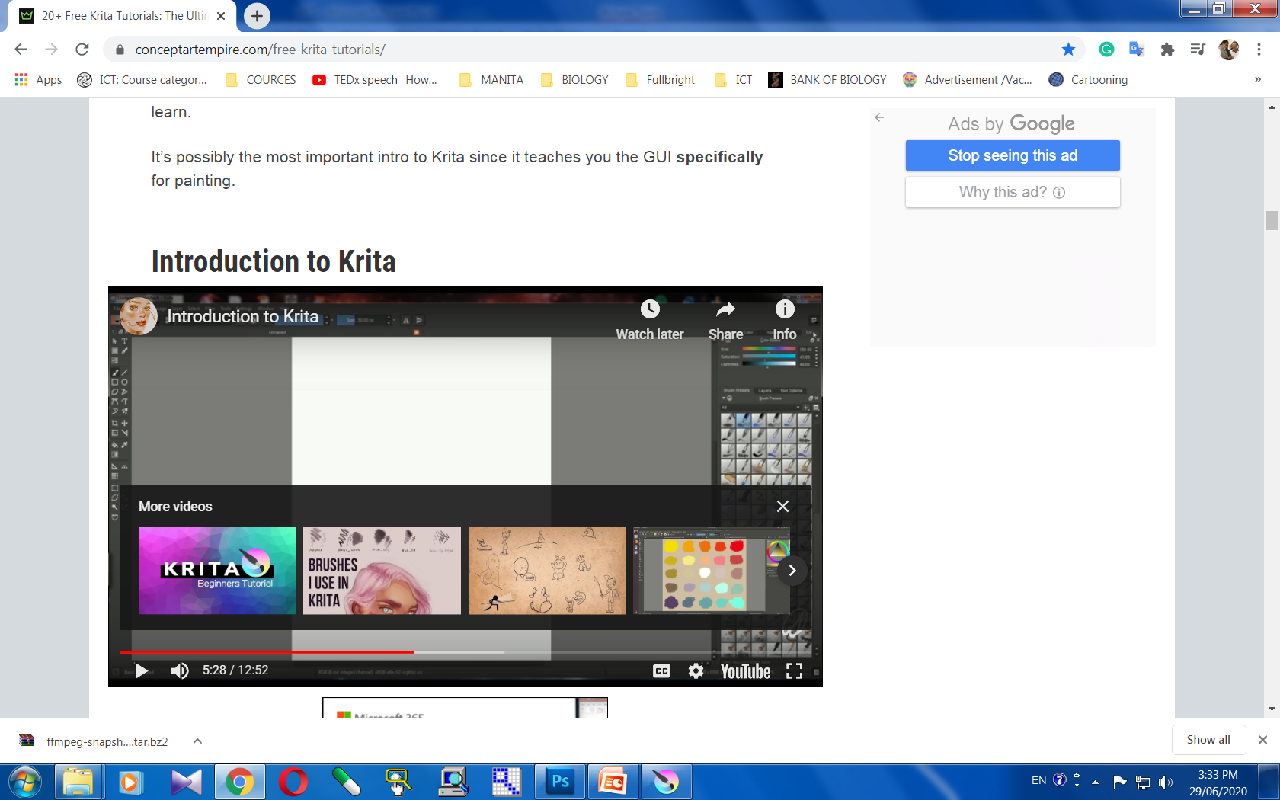
https://youtu.be/kUXNEK8awiY
KRITA By - Santosh Kumar Bisen , Fulbright DAI Scholar- 9340089454

Slide 16
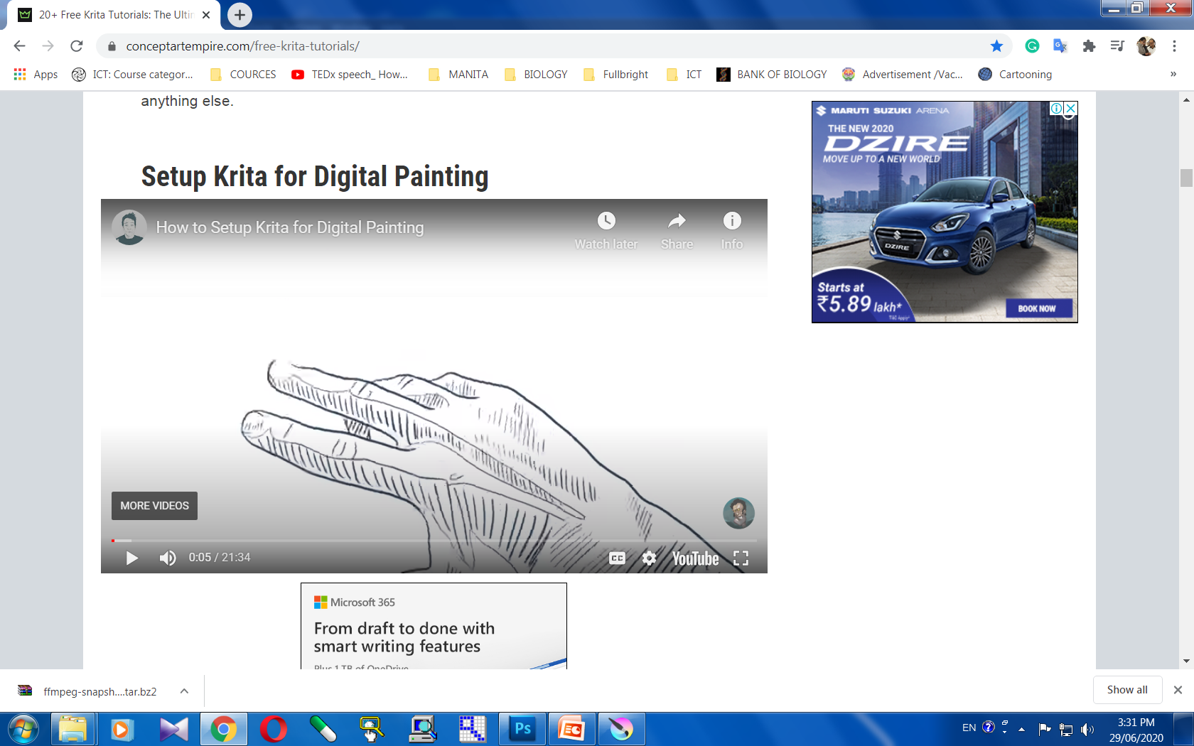
https://youtu.be/3dxRuXmRChs
KRITA By - Santosh Kumar Bisen , Fulbright DAI Scholar- 9340089454

