Slide 1
STOP MOTION ANIMATION

Slide 2
What will you learn?
What is Animation?
Types of Animation
What is Stop Motion Animation?
Steps in making Stop Motion
Demo on Stop Motion Studio
Techniques in Stop Motion Studio

Slide 4
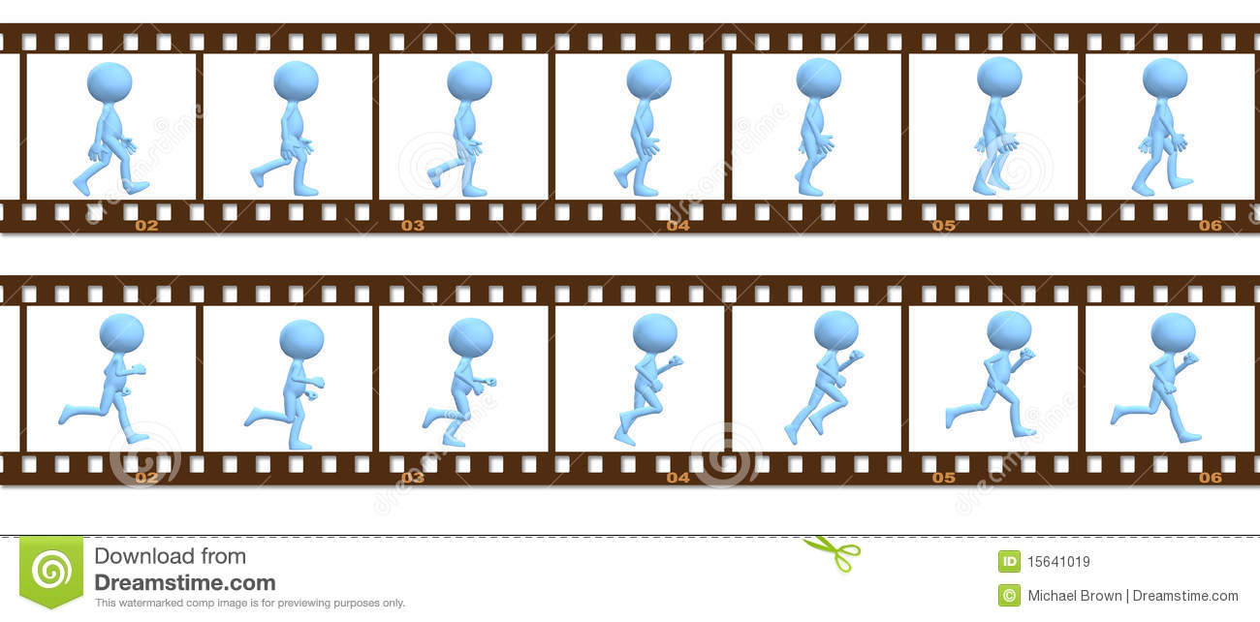
What is animation?
Animation is a process where pictures and images are arranged in sequential order to create the illusion of movement in a scene.

Slide 5
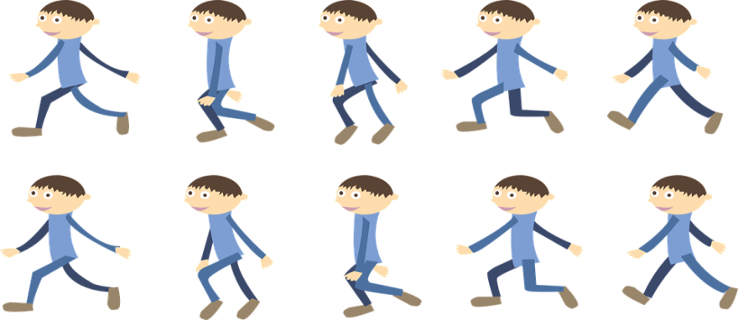
Types of animation
Traditional Animation
2D Animation
3D Animation
Stop Motion Animation

Slide 6
STOP MOTION ANIMATION
Stop motion animation is a technique to bring static objects to life on screen. This is done by moving the object inch by inch and photographing each frame(movement). When all the frames are played in sequence it shows movement as animation.

Slide 7
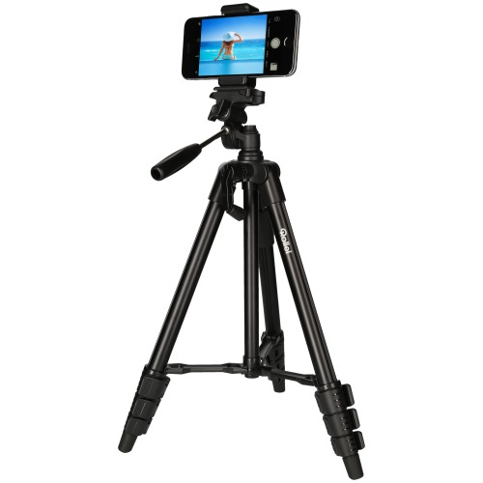
Required Equipment
Android Mobile
Tripod / Selfie Stick

Slide 8
Steps to make stop motion animation film
PRE-PRODUCTION
PRODUCTION
POST-PRODUCTION

Slide 9
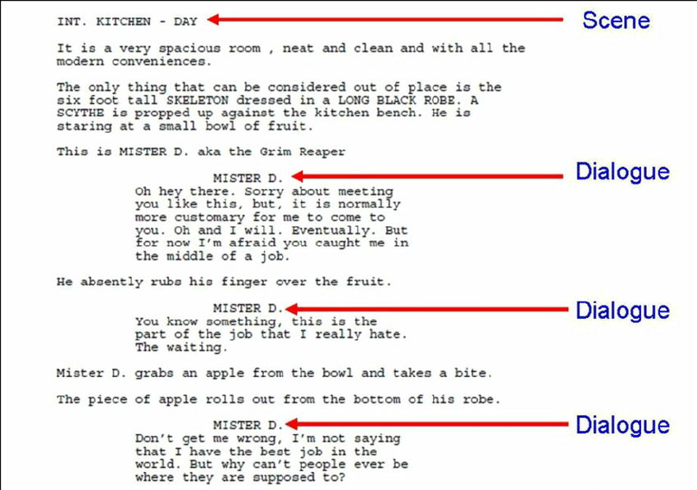
Steps to make stop motion animation film
PRE-PRODUCTION
PRODUCTION
POST-PRODUCTION
SCRIPT

Slide 10
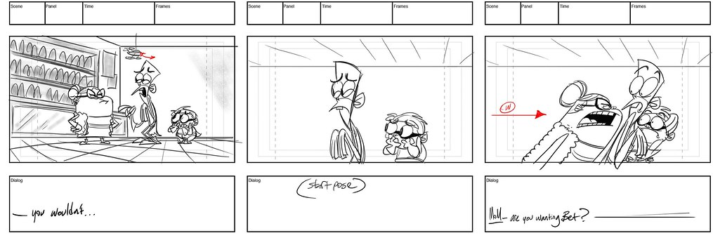
Steps to make stop motion animation film
PRE-PRODUCTION
PRODUCTION
POST-PRODUCTION
SCRIPT
STORYBOARD

Slide 11
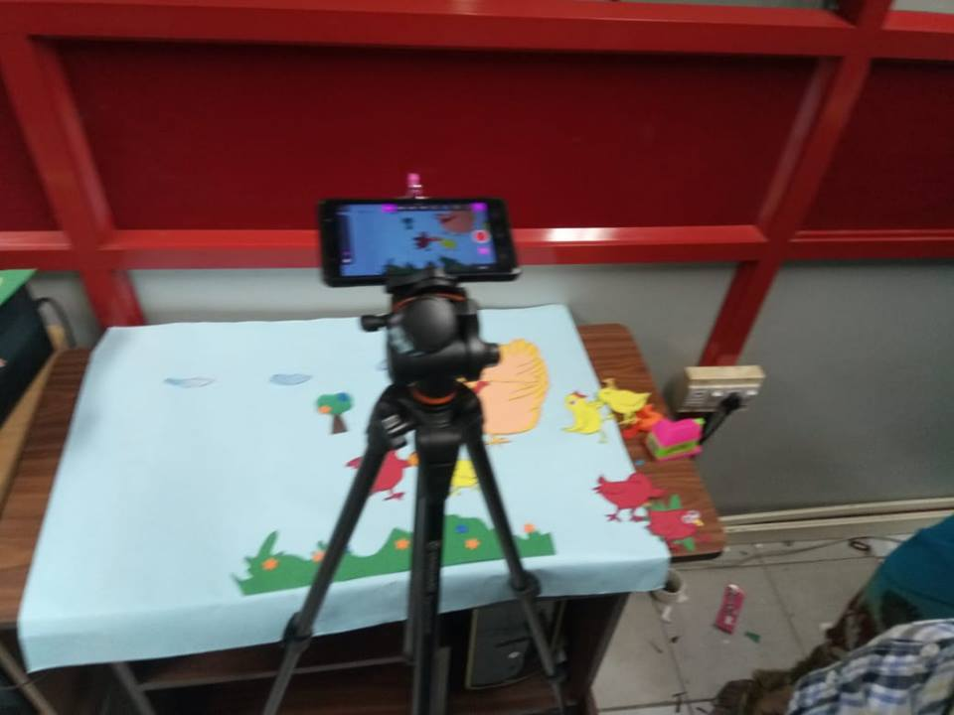
Steps to make stop motion animation film
PRE-PRODUCTION
PRODUCTION
POST-PRODUCTION
SCRIPT
VIDEO SHOOT
STORYBOARD

Slide 12
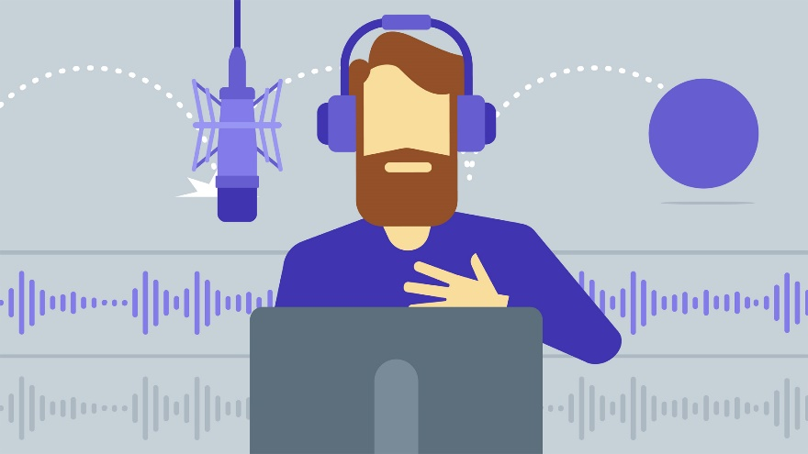
Steps to make stop motion animation film
PRE-PRODUCTION
PRODUCTION
POST-PRODUCTION
SCRIPT
VIDEO SHOOT
STORYBOARD
VOICE OVER

Slide 13
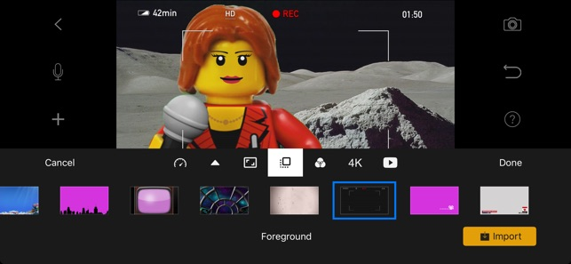
Steps to make stop motion animation film
PRE-PRODUCTION
PRODUCTION
POST-PRODUCTION
SCRIPT
VIDEO SHOOT
VIDEO EDITING
STORYBOARD
VOICE OVER

Slide 14
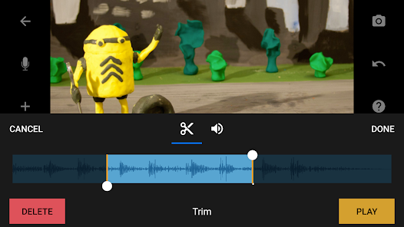
Steps to make stop motion animation film
PRE-PRODUCTION
PRODUCTION
POST-PRODUCTION
SCRIPT
VIDEO SHOOT
VIDEO EDITING
STORYBOARD
VOICE OVER
SOUND EDITING

Slide 15
Stop Motion Animation Android Application
Stop Motion Studio – Android App

