Slide 1
PRATIMA SINGH
ASSISTANT TEACHER
PM SHRI UPPER PRIMARY SCHOOL DHUSAH
BALRAMPUR
UTTAR PRADESH

Slide 2
WHY COMICS ?
A great visual Representation of Knowledge
Presents what is essential
Easier to remember a visual graphic containing key information
Engaging through thinking, creating and writing.
Perfect avenue for writing dialogue
Incites students with low interest in writing
Helps organization through storytelling and storyboarding
Using visual images convey meaning to a story or topic

Slide 3
Develops creative and higher level thought processes
Develops composition techniques through visual-verbal connections
Enriches reading, writing, and thinking
Serves as an assessment and evaluation tool
Sequencing promotes understanding

Slide 4
A comic strip is a sequence of images with a small amount of text in each box. This text is normally inside balloons or written as captions. Comic strips (or comic books) are a form of story-telling, which uses drawings or cartoon characters to tell a story.
Step 1: Write your ideas for your comic
Break into 3 parts. Awesome punchl ine for characters
Step 2: Draw the three-frames
Step 3 : Writing a Script
Step 4: Decide on a story that you want to publish.
Step 5: Decide on your format.
Step 6:Plan each panel.
Step 7 :Balance text and images.
https://youtu.be/ufOXBuGhVWg

Slide 5
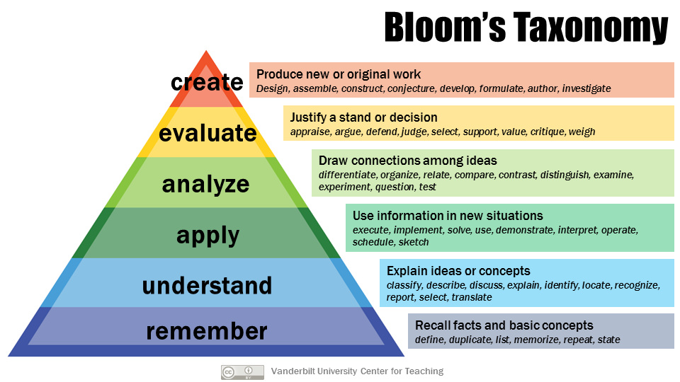
WHY WE NEED DIFFERENT TYPES OF TOOLS ?

Slide 6
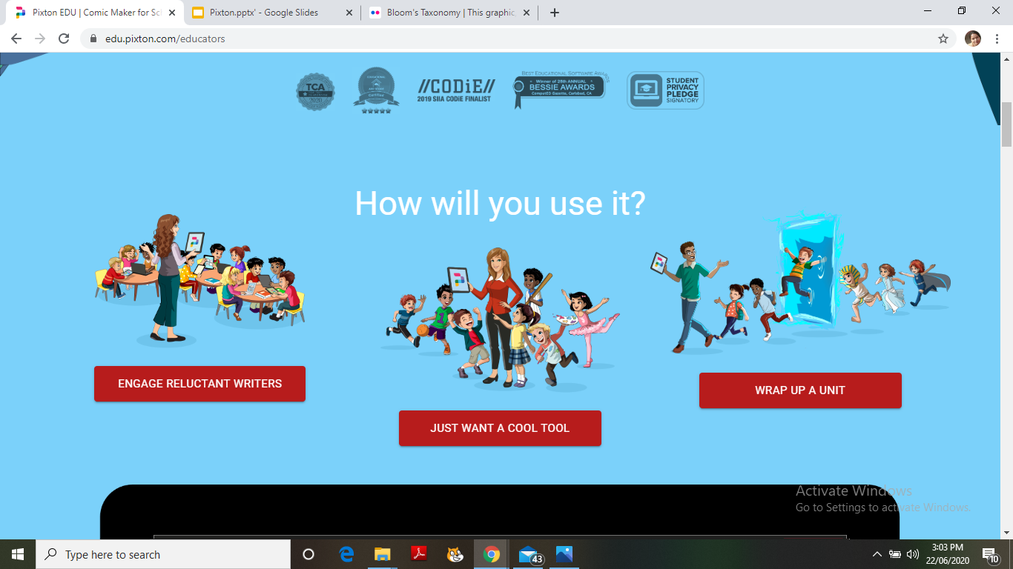
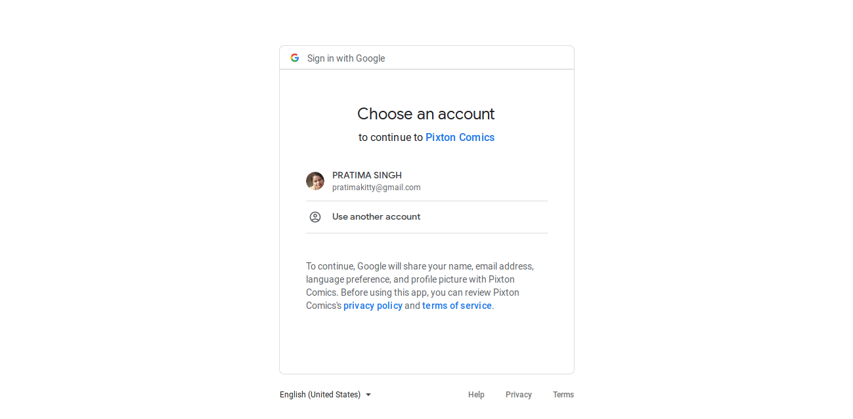

Slide 7
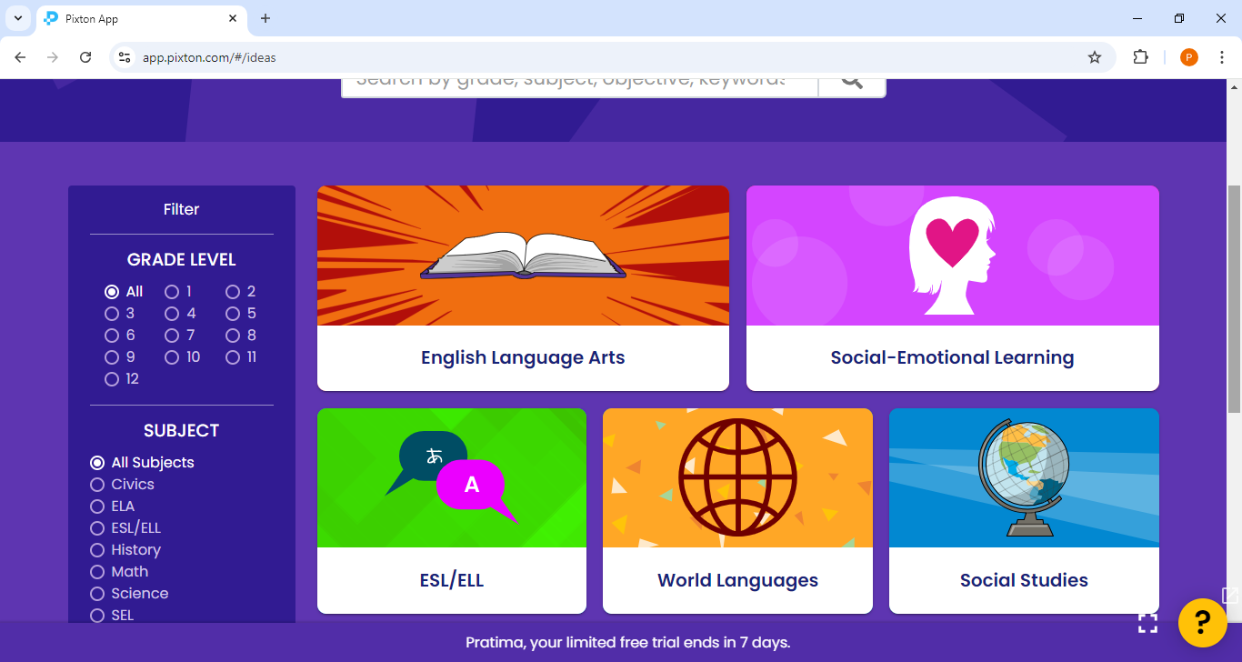

Slide 8
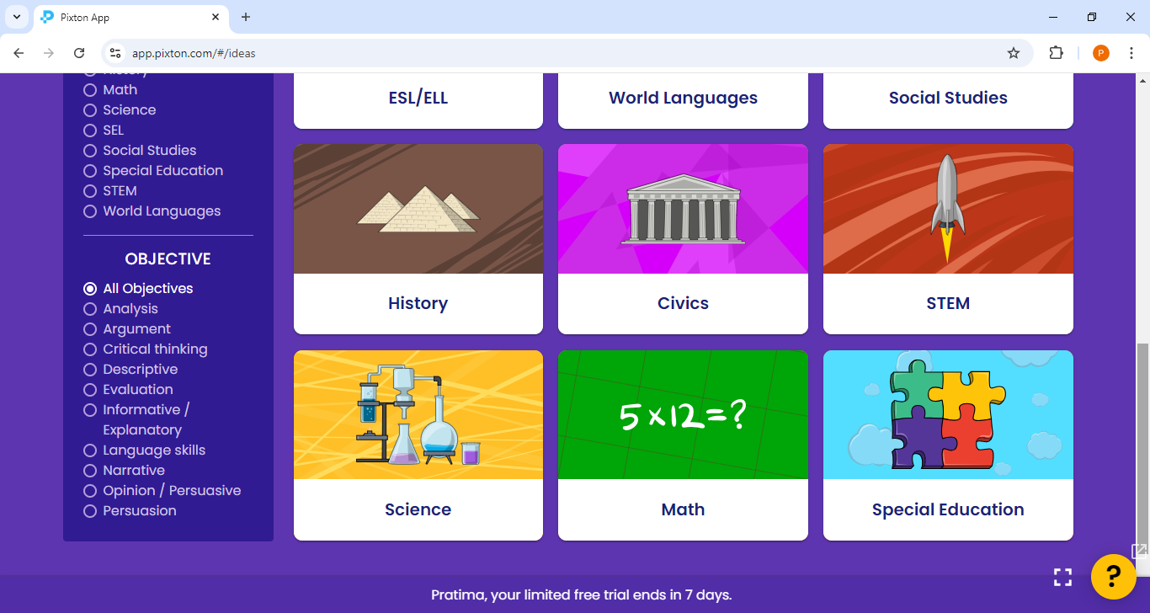

Slide 9
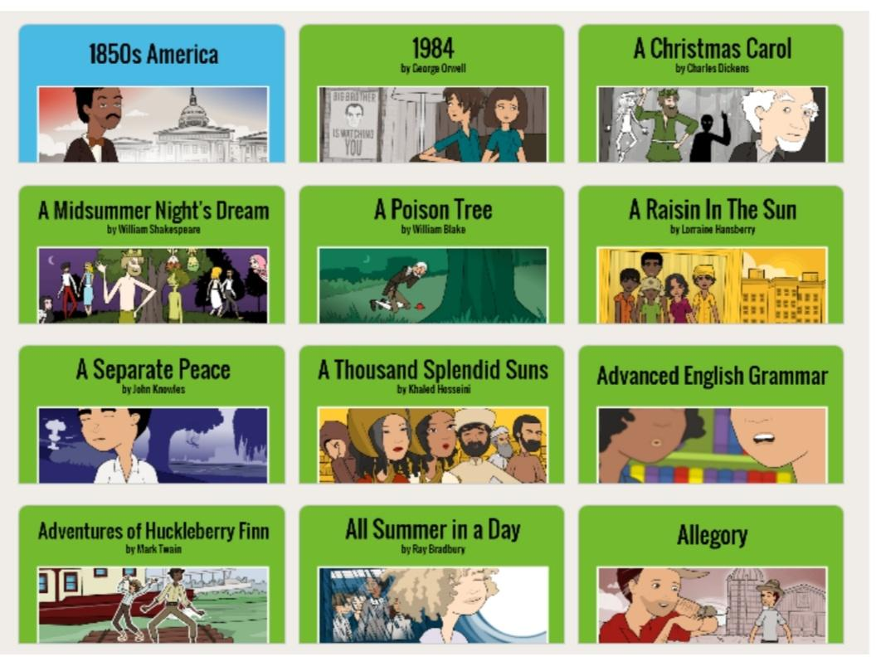
HISTORY

Slide 10
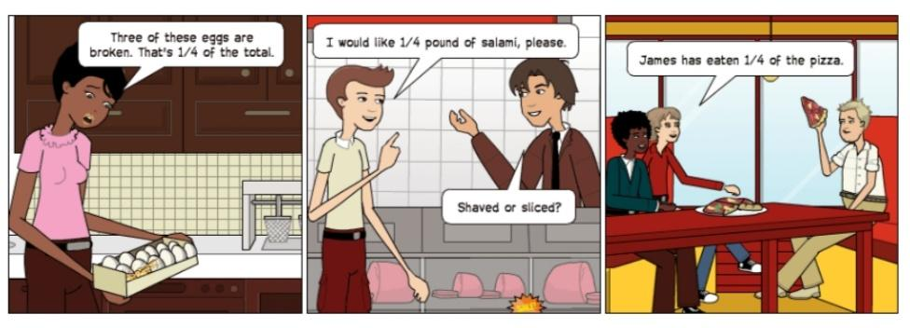
MATHEMATICS

Slide 11
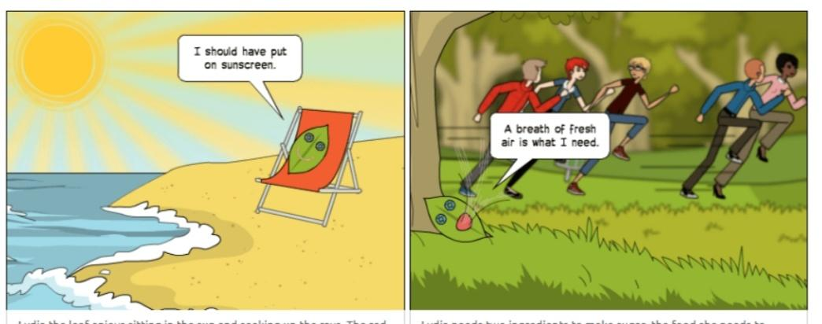
SCIENCE

Slide 12
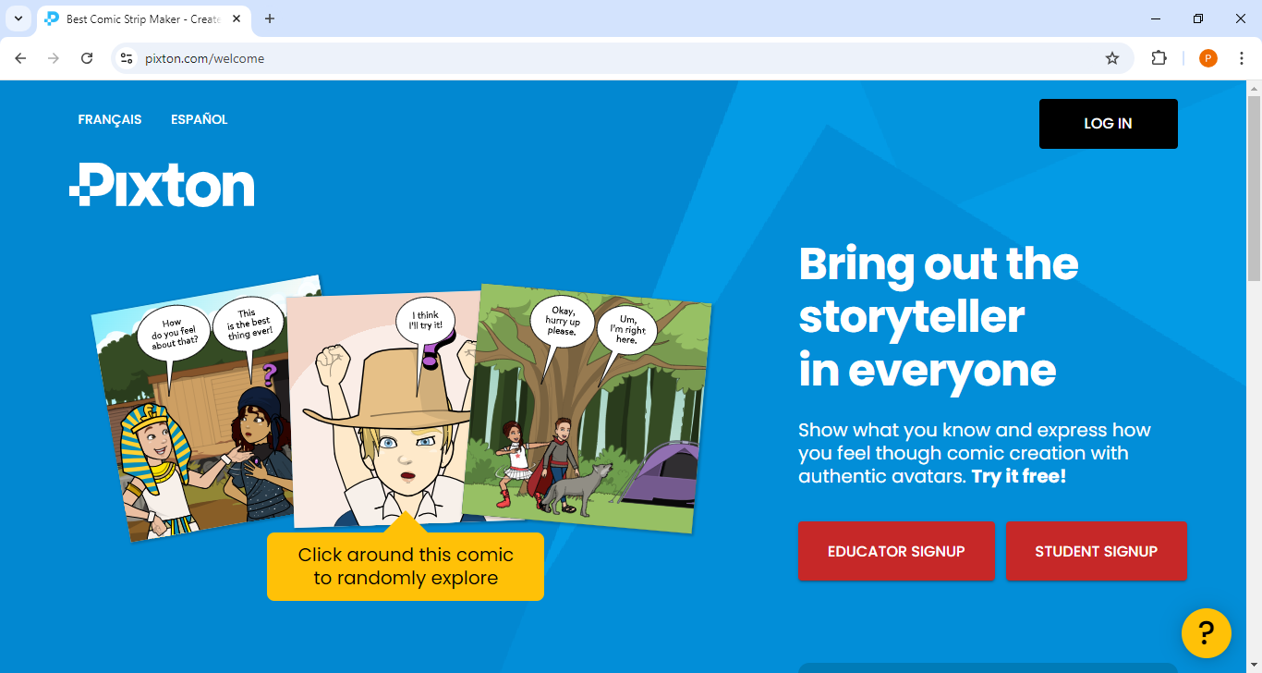

Slide 13
https://app.pixton.com/

Slide 14
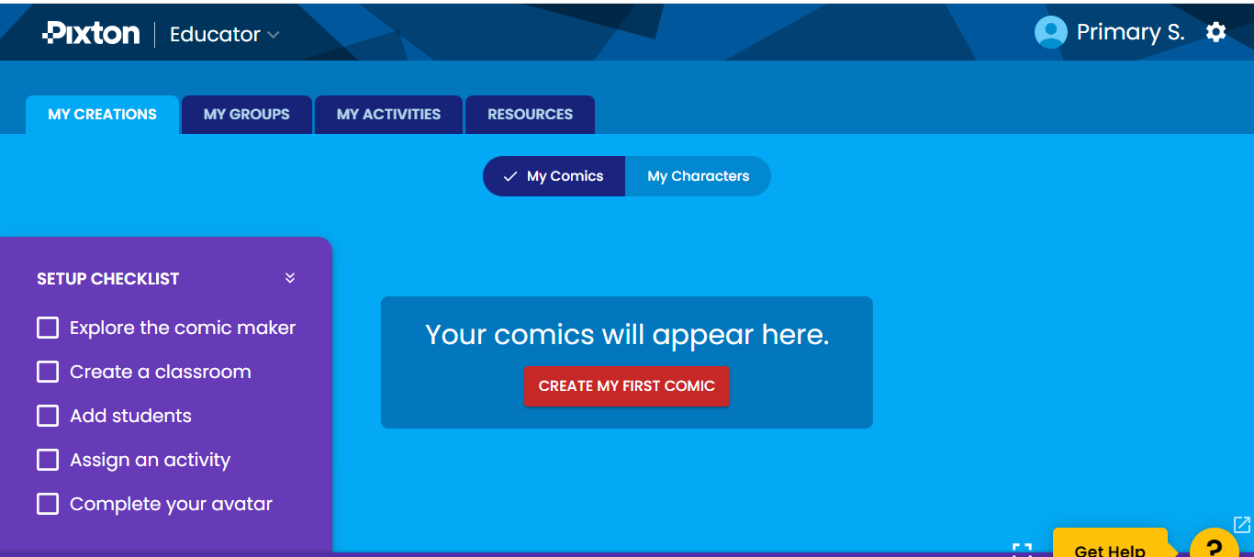

Slide 15
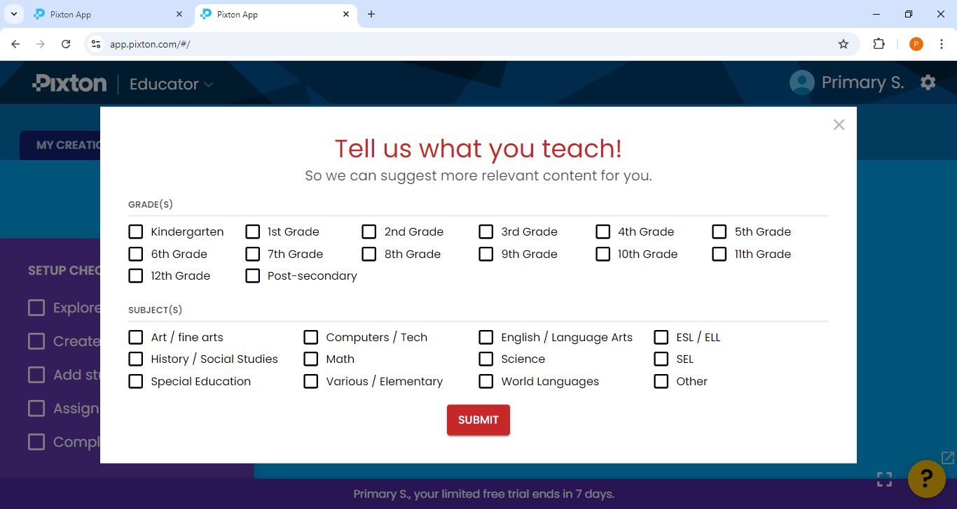

Slide 16
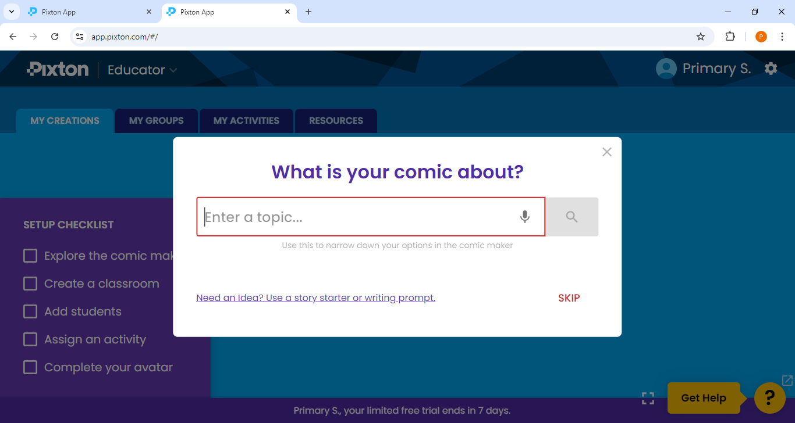

Slide 17
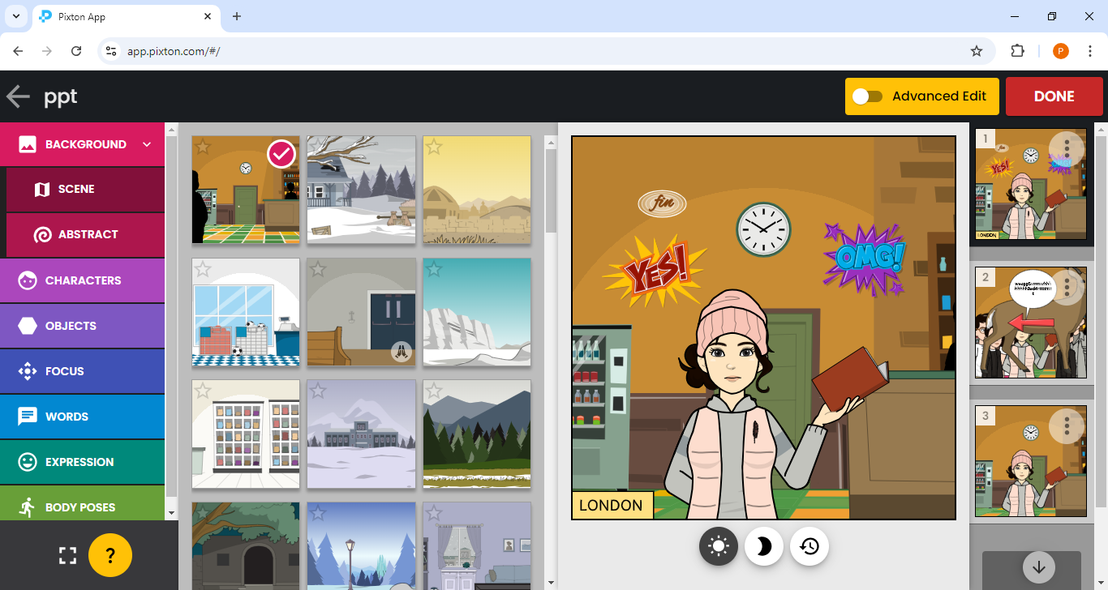

Slide 18
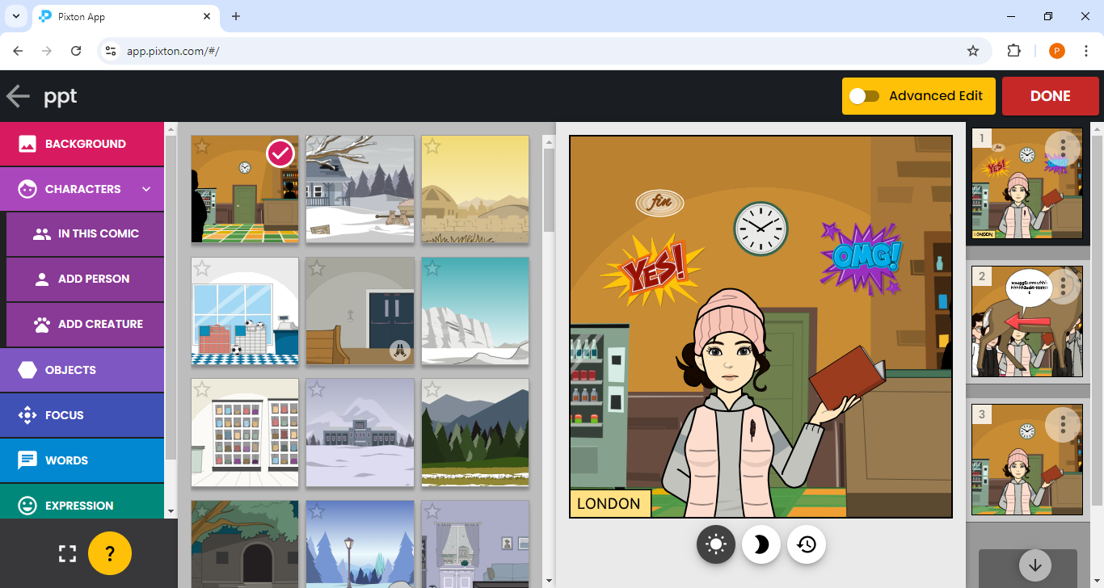

Slide 19
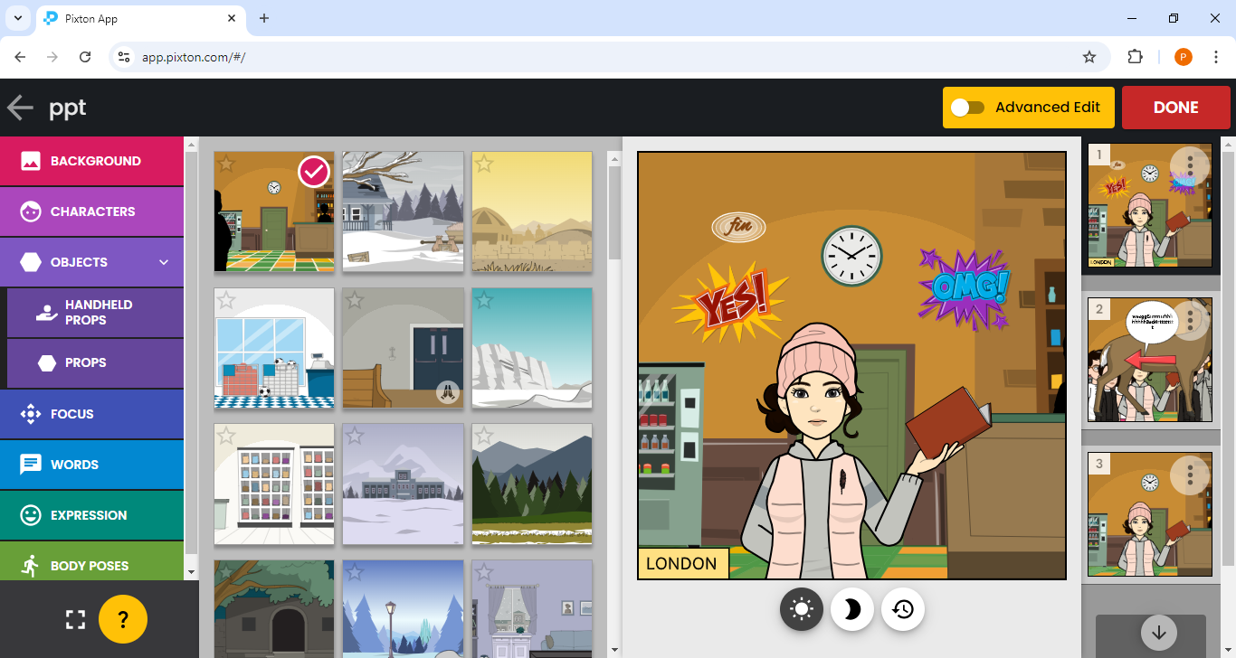

Slide 20
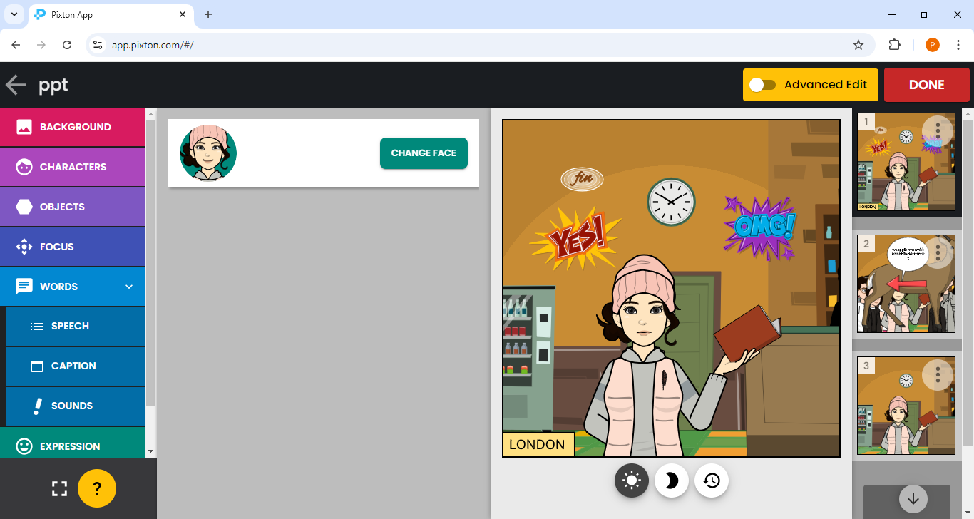

Slide 21
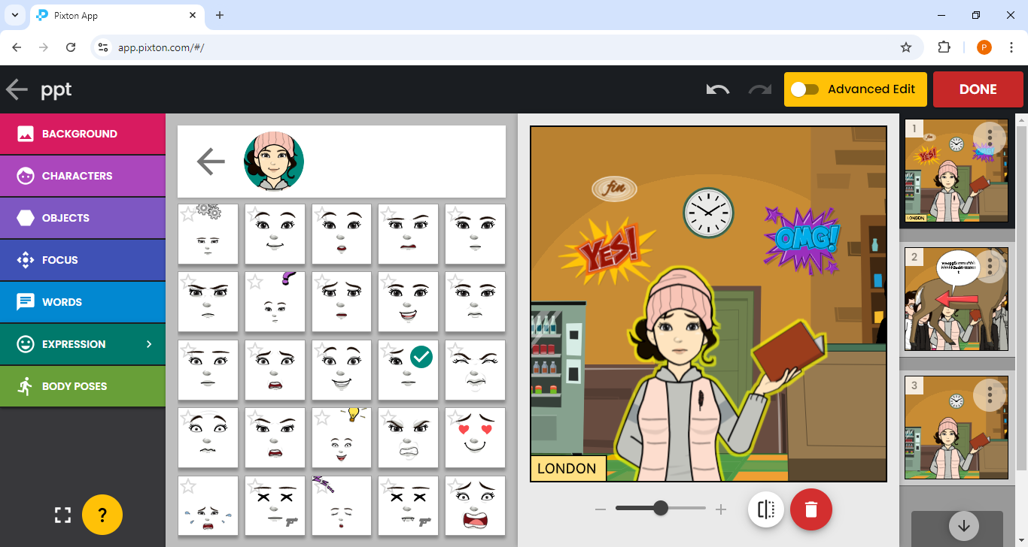

Slide 22
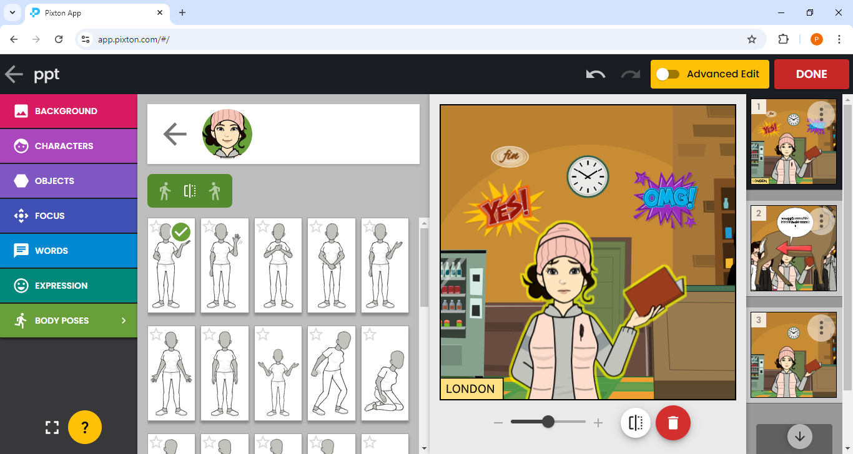

Slide 24
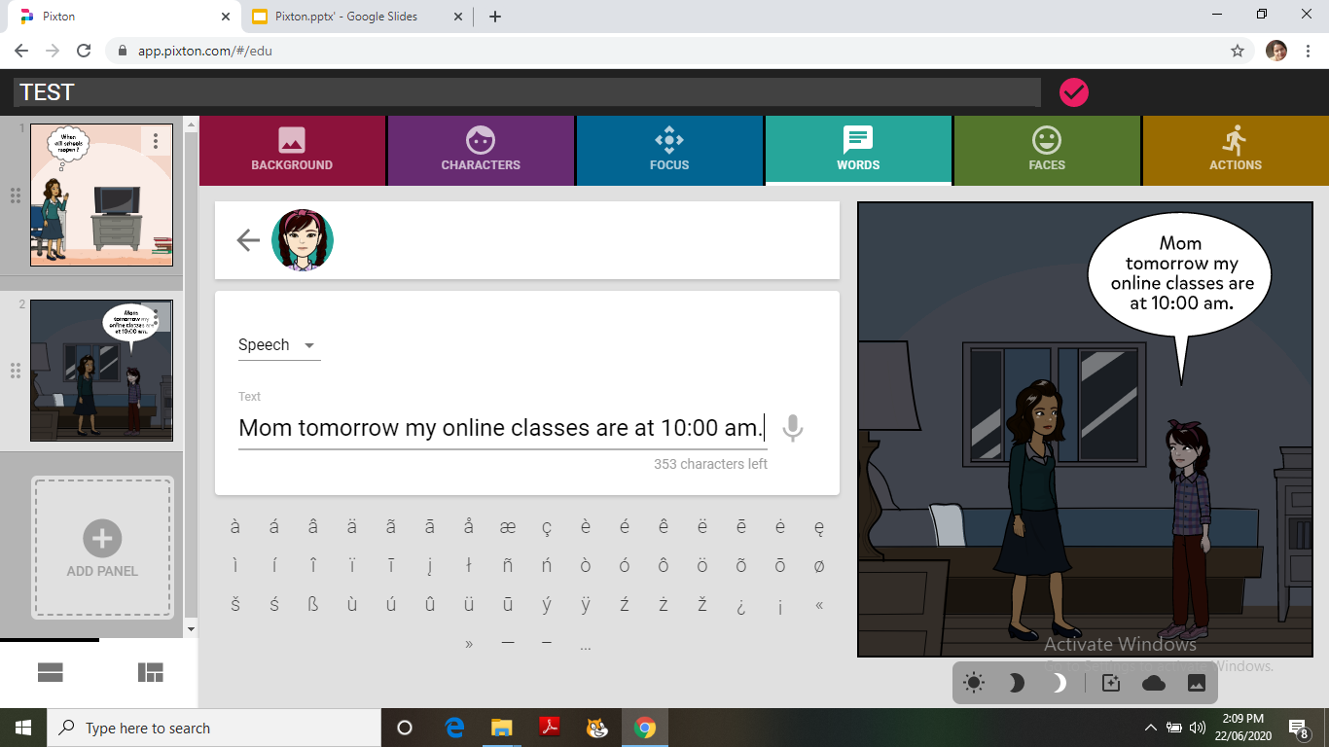

Slide 25
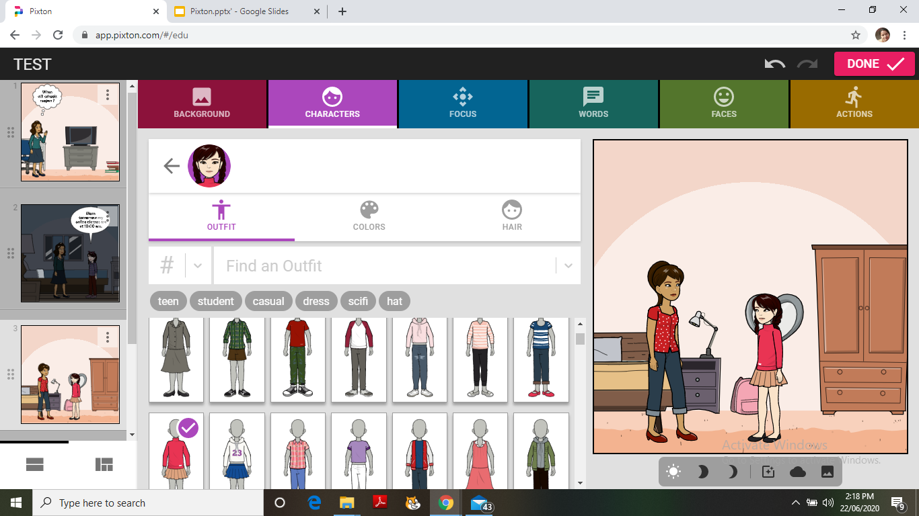

Slide 26
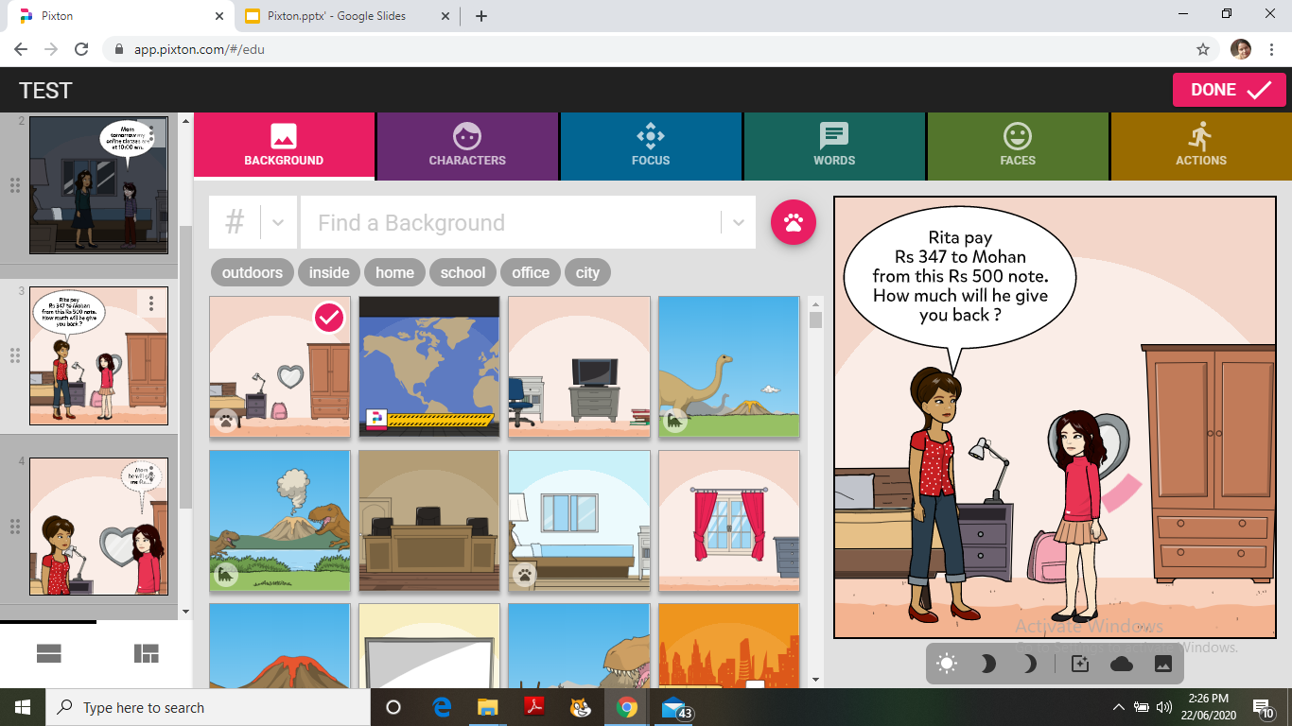

Slide 27
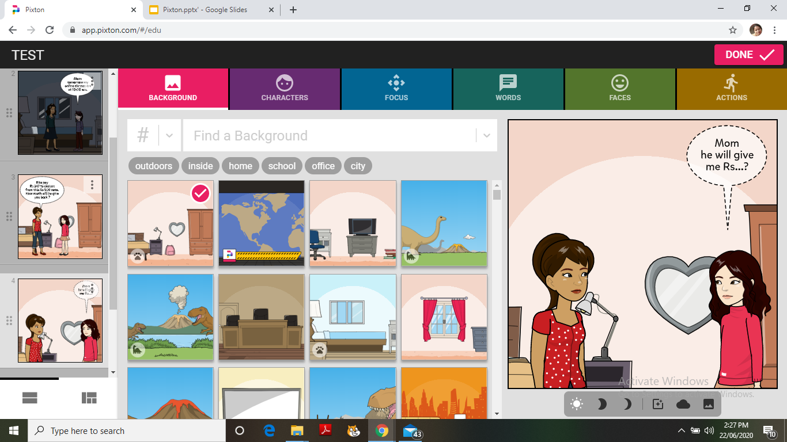

Slide 28
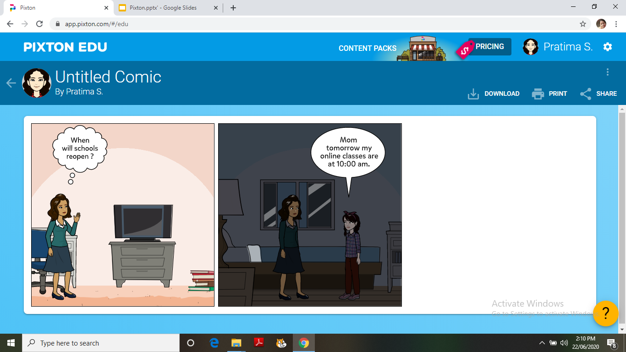

Slide 29
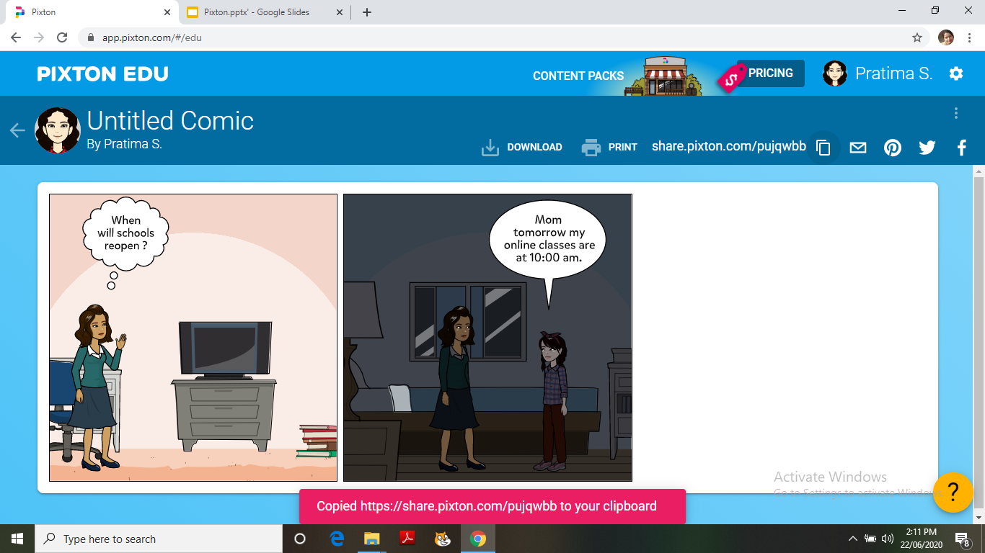

Slide 30
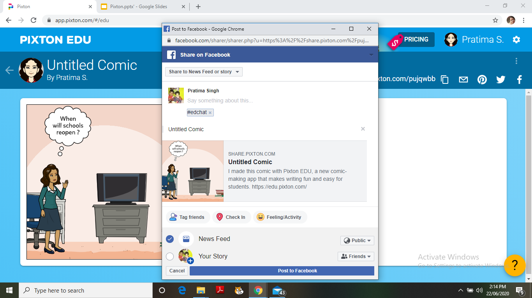

Slide 31
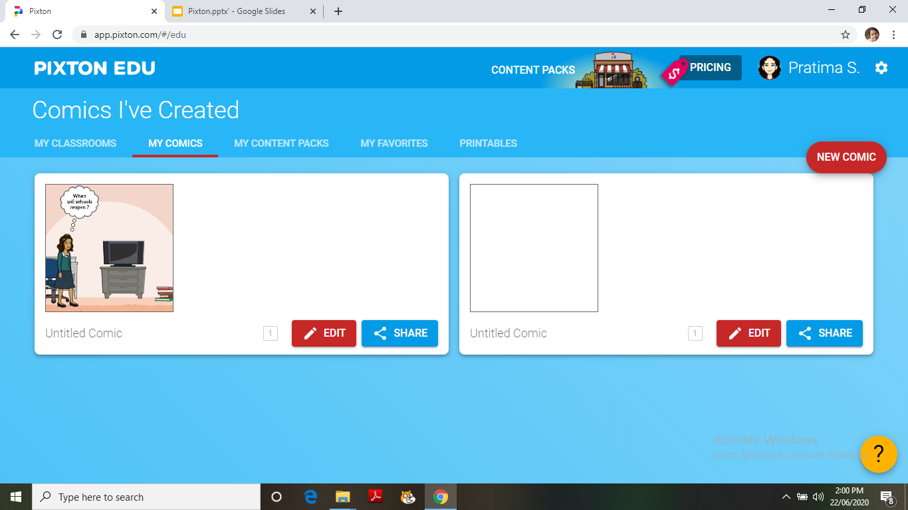

Slide 32
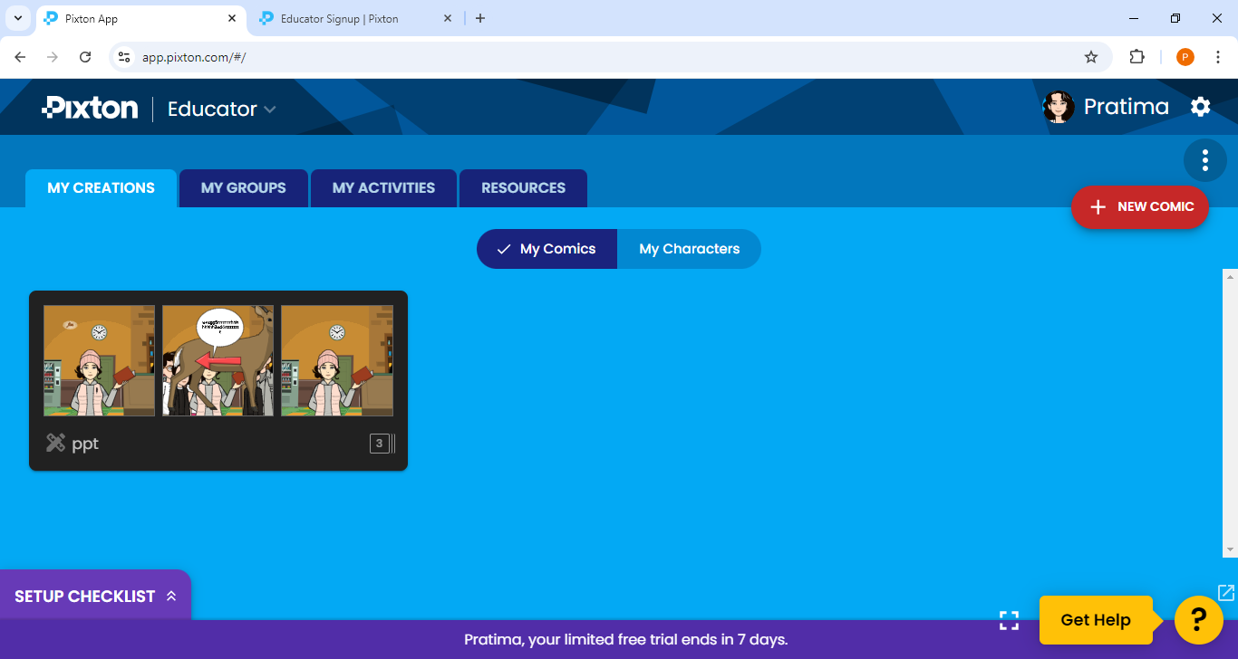

Slide 33
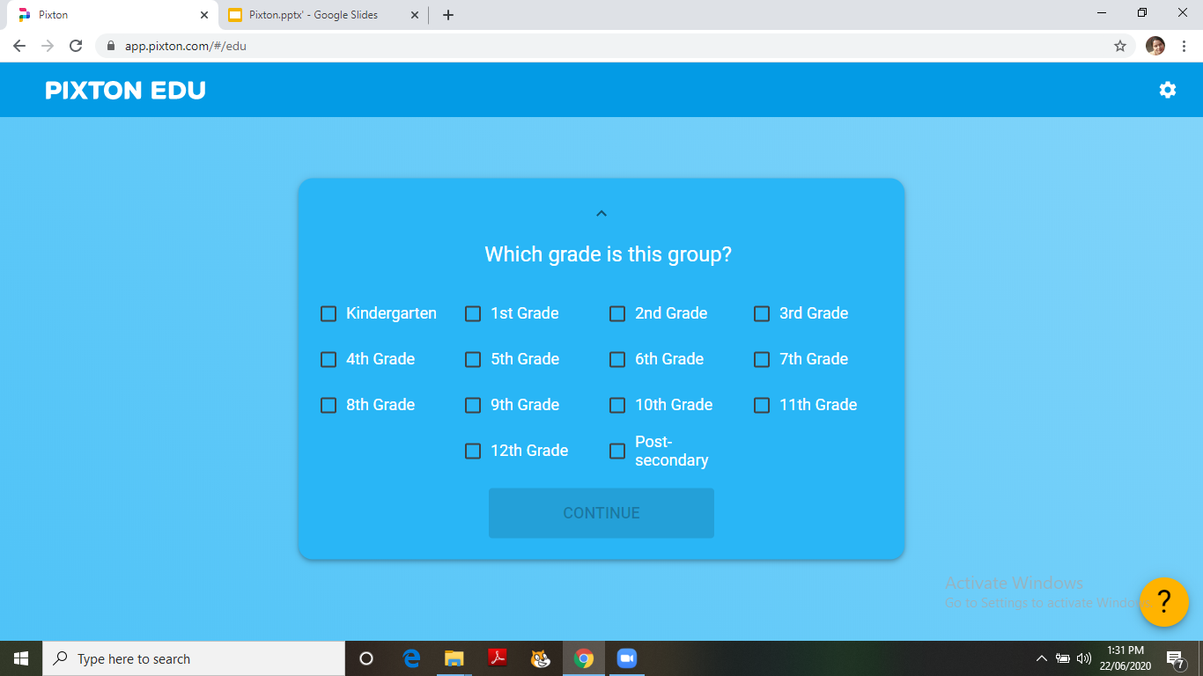

Slide 34
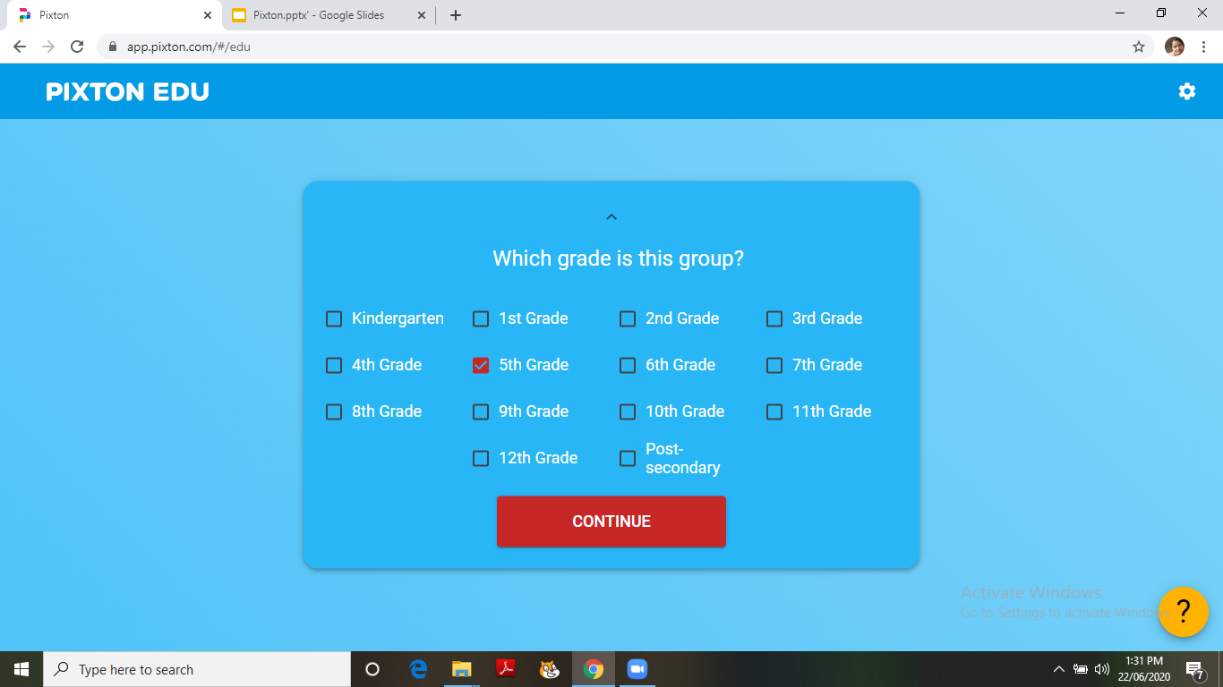

Slide 35
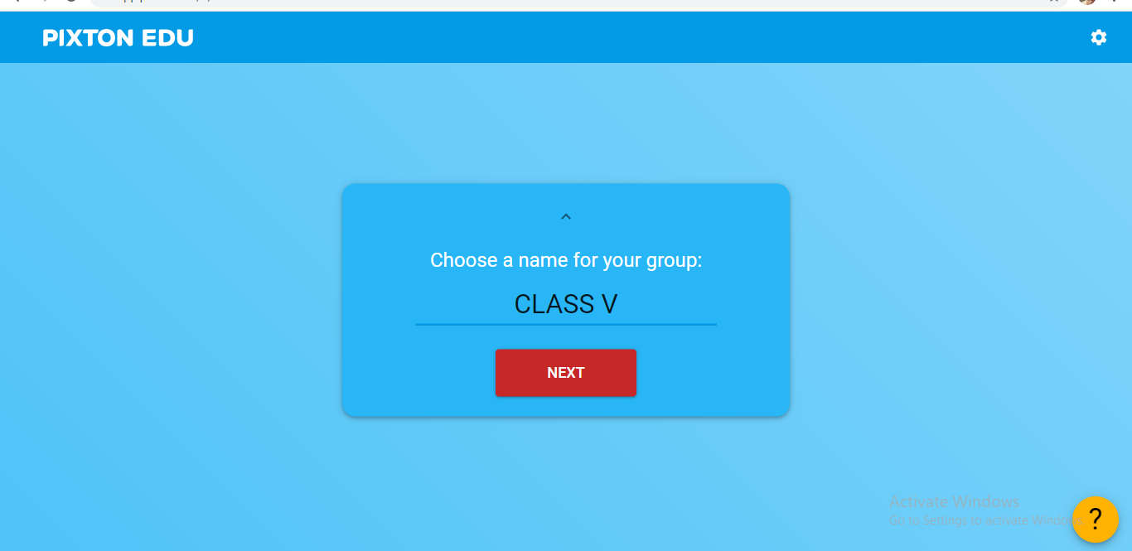

Slide 36
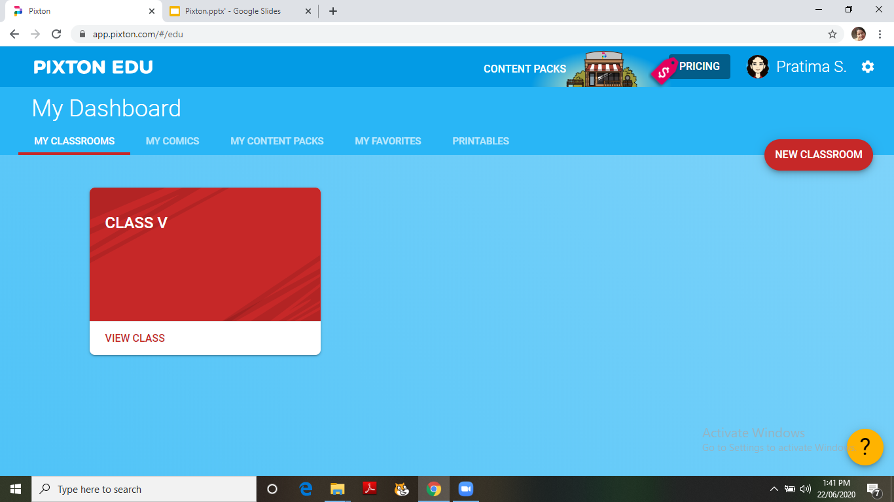

Slide 37
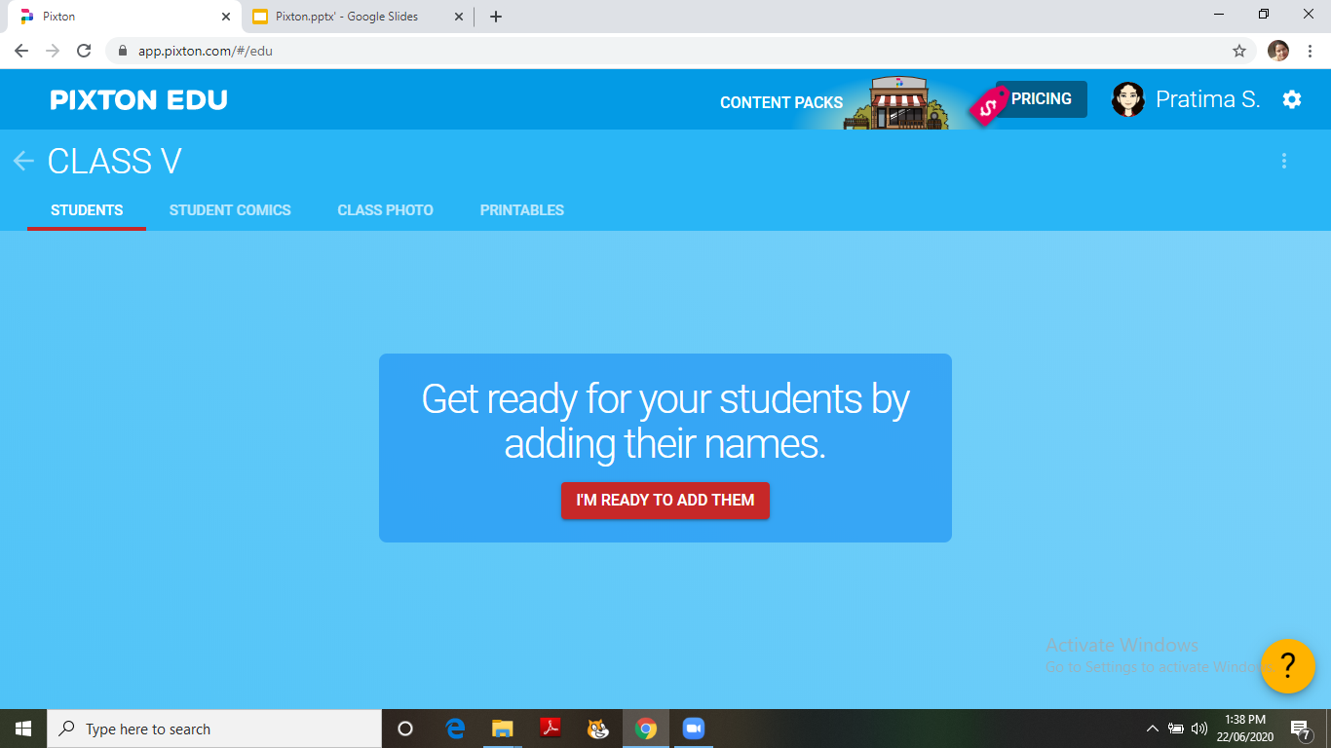

Slide 38
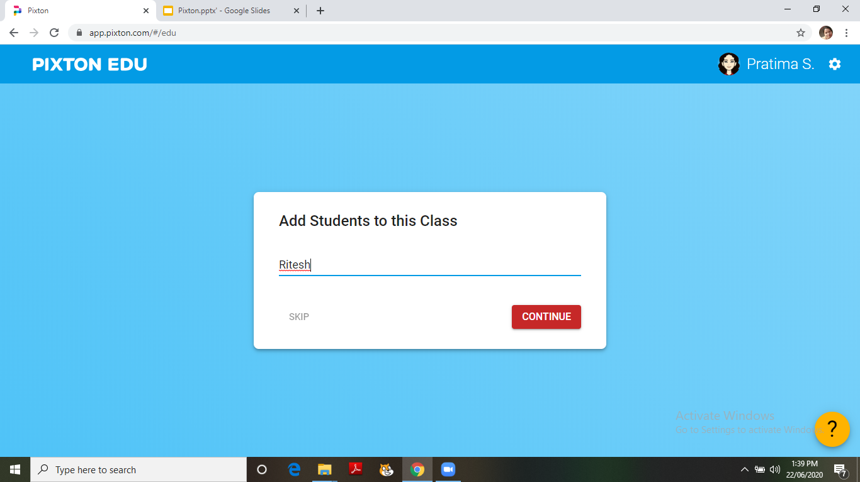

Slide 39
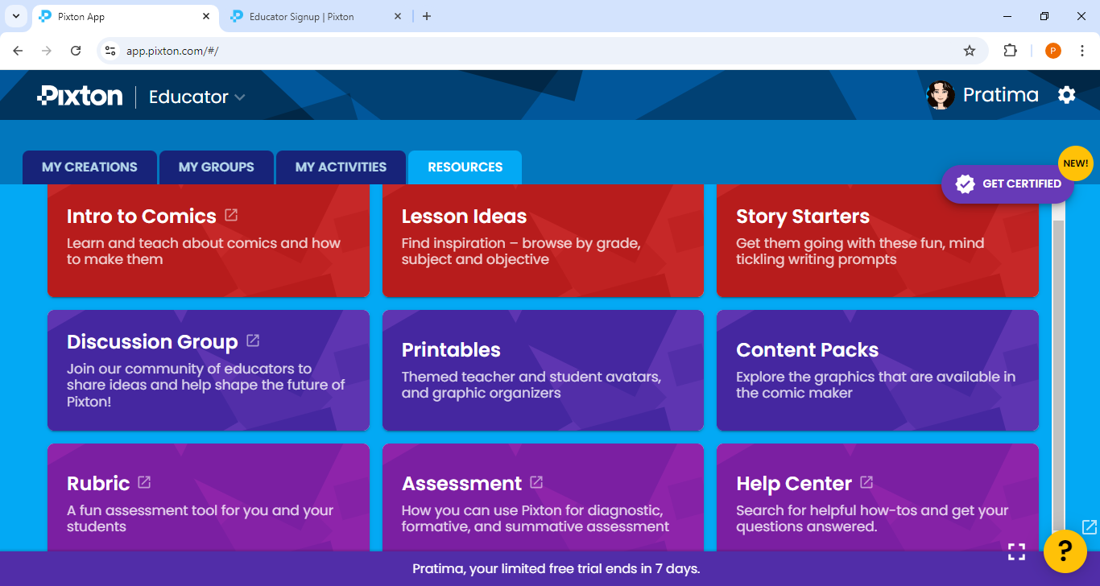

Slide 40
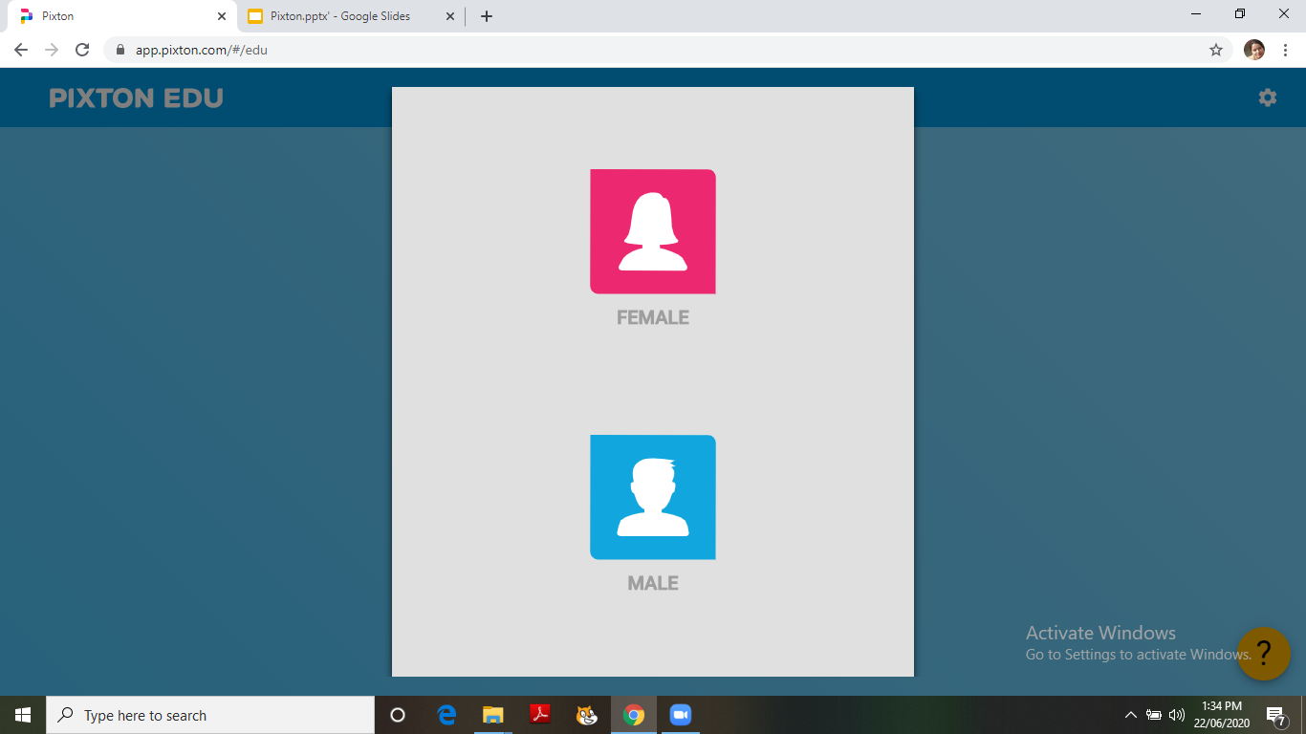

Slide 41
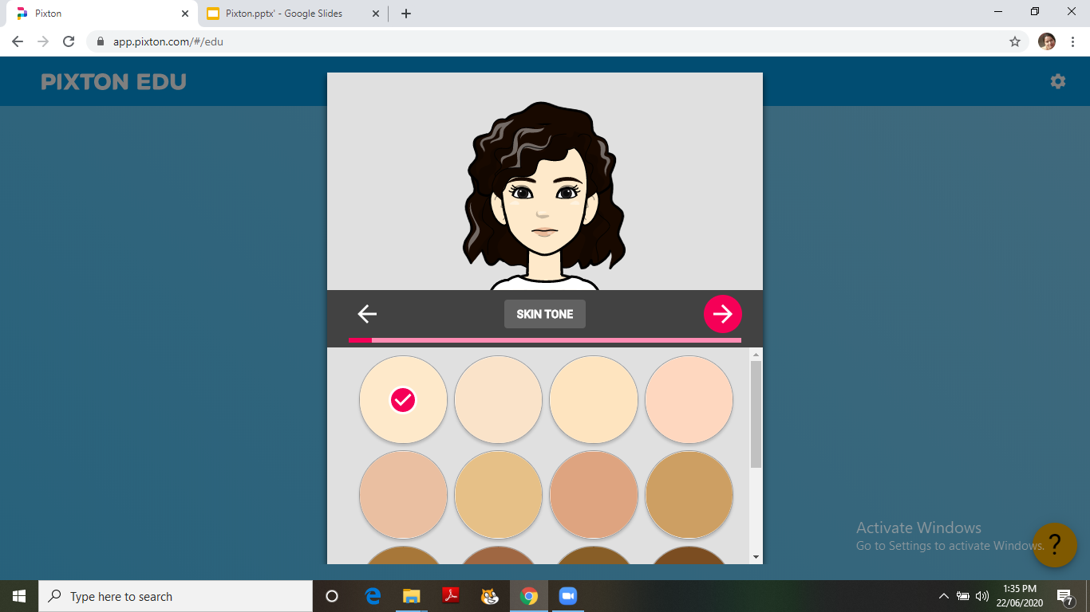

Slide 42
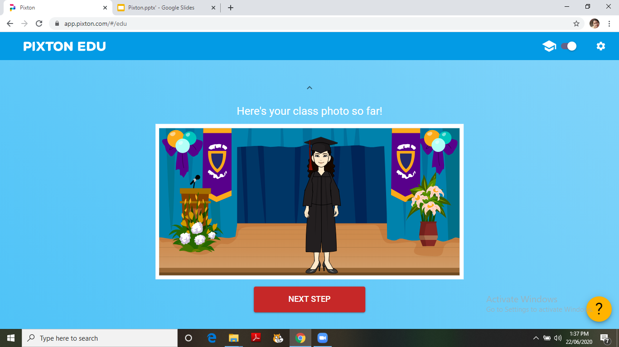

Slide 43
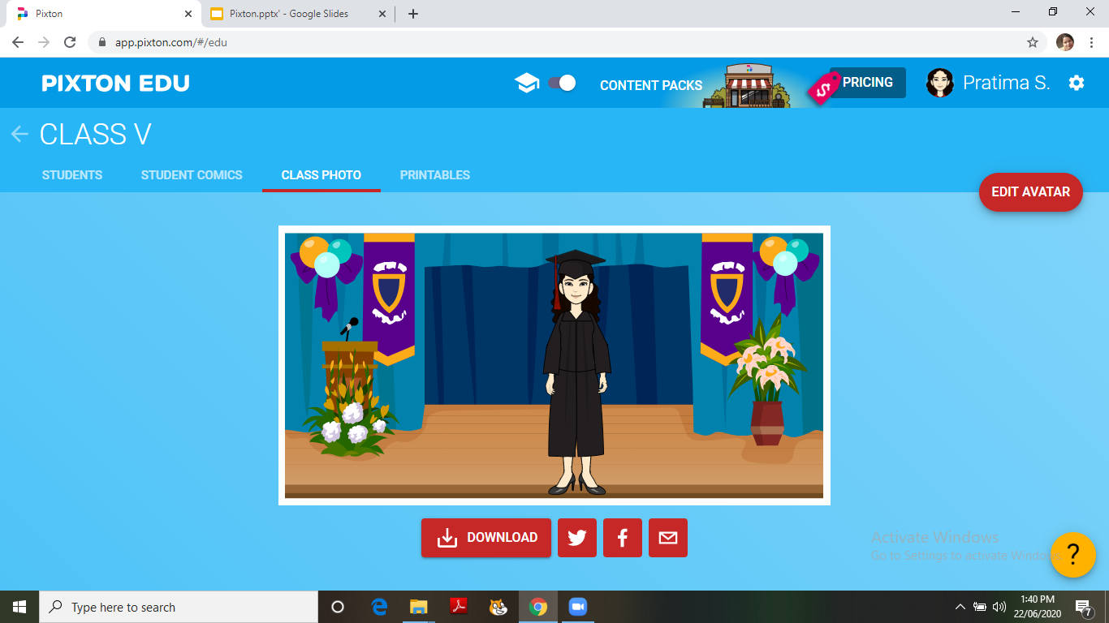

Slide 44
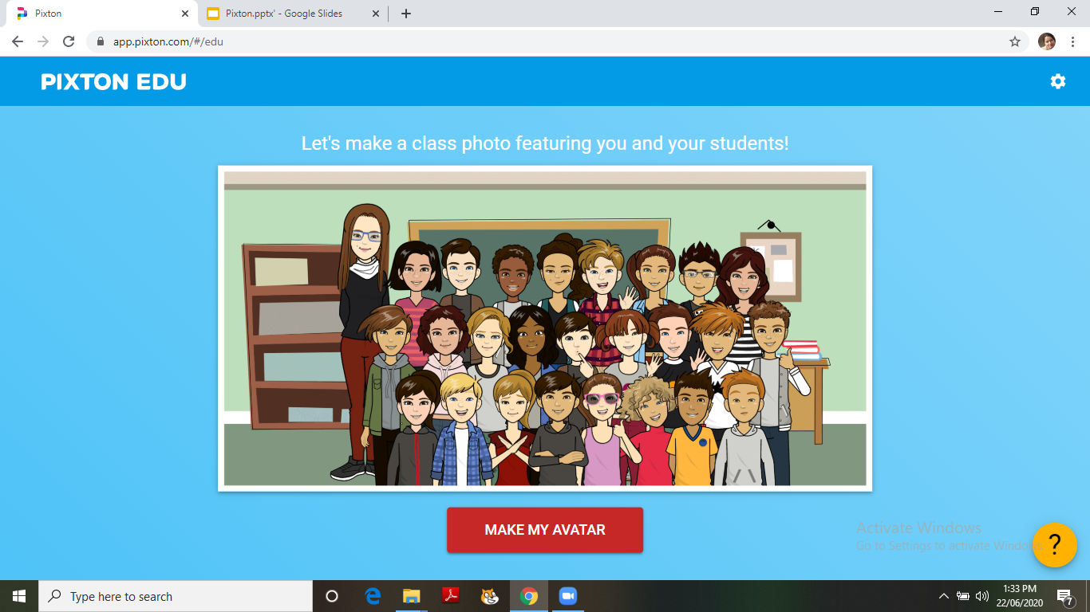

Slide 46
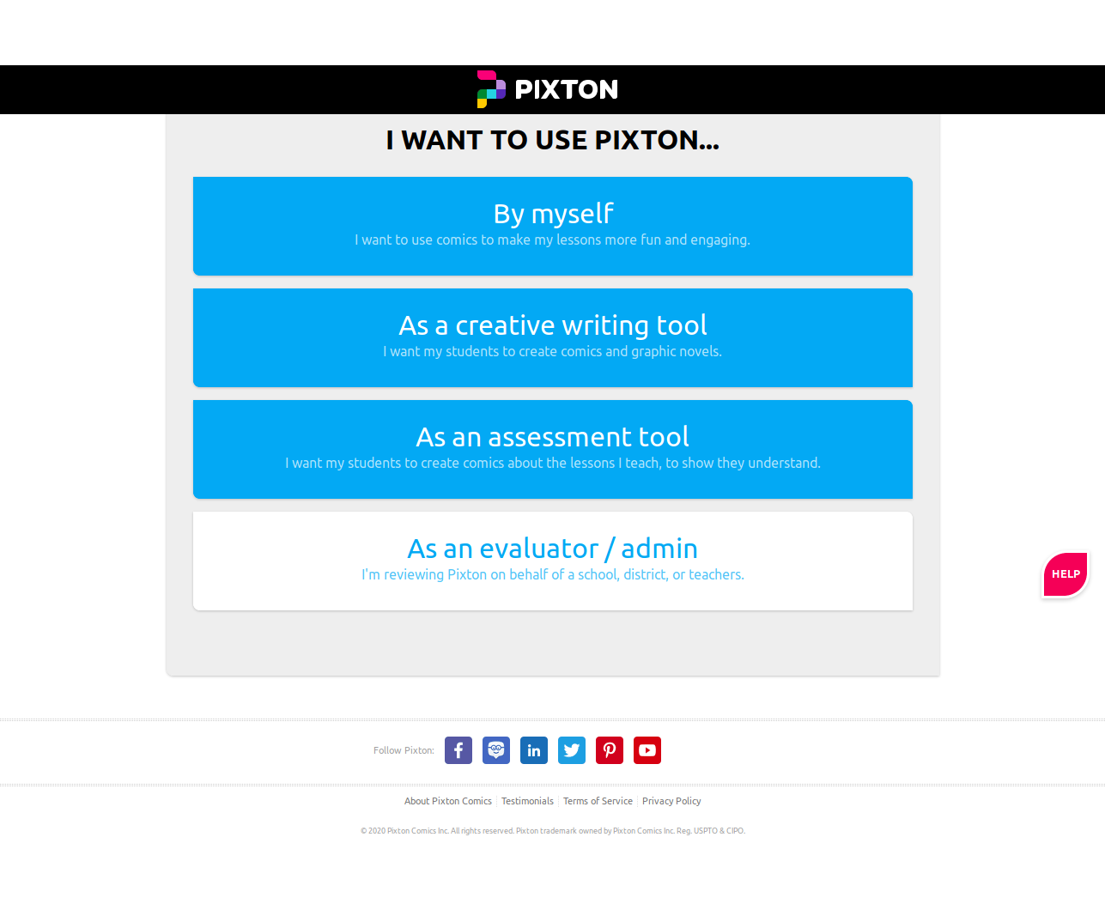
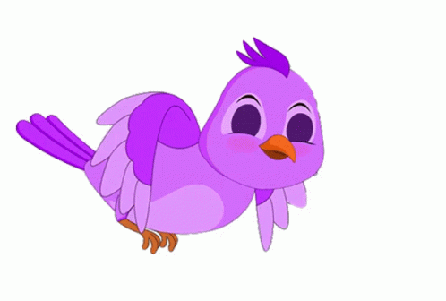
https://join.pixton.com/p6gr1m
TIME FOR
HANDSON

Slide 47
THANKYOU

