Slide 1
By: Chandni Agarwal
National ICT Awardee
22 April 2025

Slide 2
Why Audio?
Sound is universal – it reaches even where visuals can’t.
It helps visual + auditory learners.
Children learn stories better when narrated.
Audio allows learning beyond the screen – students can listen on the go.

Slide 3
The Role of Audio in Today’s Classrooms
Support for students with reading difficulties or visual impairment
Create multi-sensory learning
Promote independent learning through voice-recorded notes
Useful for language learning, storytelling, poems, and announcements.

Slide 4
The Problem for Teachers
We want to create voice resources — but…” ✅ We don’t have a quiet recording space ✅ Our voice may get tired or unclear ✅ Time-consuming process to re-record
“And that’s where AI steps in — not to replace, but to assist.

Slide 5
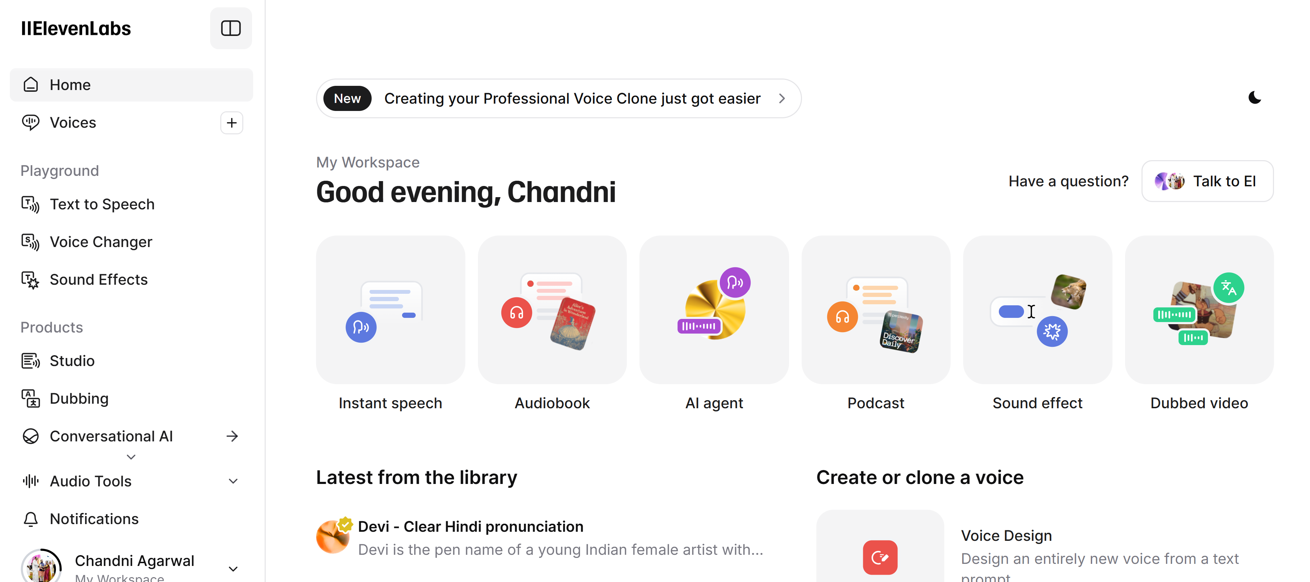
Meet ElevenLabs – Your Audio Assistant

Slide 6
Use It Responsibly
Only clone your voice (or with consent)
Don’t misuse voice tools for impersonation.
Use safe, copyright-free content

Slide 7
Podcast For Awareness

Slide 8
Your Turn ….
Audio boosts student focus and accessibility
ElevenLabs helps teachers save time + add quality
Try making your first narrated lesson this weekend

