Slide 1
Licensing OER: Open and CC Licenses

Slide 2
Copyright
Exclusive rights given by law to the original creator/author
To get credit
To copy
To distribute
To license
To sell/make economic transaction
To perform
Copyright gives only the owner of the right to control their own creation and to copy, share, and display their own creations. These exclusive rights can be given to another party through an agreement.

Slide 3
Fair Use
Brief excerpts of copyright material may, under certain circumstances, be quoted verbatim for purposes such as criticism, news reporting, teaching, and research, without the need for permission from or payment to the copyright holder.
Fair use is a part of US copyright Law that permits limited use of copyrighted material without having to first acquire permission from the copyright holder.

Slide 4
Public Domain
Public domain is the state of being available to the public and not subject to copyright. There are three main categories of Public Domain License.
Works that are automatically enter the public domain upon creation and are not copyrightable.
Works that have been assigned to the public domain by their creators.
Works that have entered the public domain because the copyright on them have expired.

Slide 5
Why consider licensing?
Copyright law allows licensing of works
Licensing enables others to use a copyrighted work in lawful manner
Licensing can be for economic considerations to free
It eases the process of greater use and distribution of a work

Slide 6
Open Licenses
Creative Commons
Concepts
CC-BY
CC-BY-SA
CC-BY-NC
CC-BY-NC-SA
CC-BY-ND
CC-BY-NC-ND
Attribution
Share Alike
Non-Commercial
Non-Derivative

Slide 7
Creative Commons conditions
Condition | Explanation
Attribution (BY) | All CC licences require that others who use your work in any way must attribute it – i.e. must reference the work, giving you credit for it – the way you request, but not in a way that suggests you endorse them or their use of the work.
Non-Commercial (NC) | You let others copy, distribute, display, perform and (unless you have chosen No Derivatives) modify and use your work for any purpose other than commercially.
No Derivative works (ND) | You let others copy, distribute, display and perform only original copies of your work.
Share Alike (SA) | You let others copy, distribute, display, perform and modify your work, as long as they distribute any modified work on the same terms.

Slide 8
Creative Commons licence: Attribution (CC-BY)
This licence lets others distribute, remix, tweak, and build upon your work, even commercially, as long as they credit you for the original creation.
This is the most accommodating of licences offered.
It is recommended for maximum dissemination and use of licensed materials.

Slide 9
Creative Commons licence: Attribution-ShareAlike (CC BY-SA)
This licence lets others remix, tweak, and build upon your work even for commercial purposes, as long as they credit you and license their new creations under the identical terms.
Often compared to “copyleft” free and open source software licences.
All new works based on yours will carry the same licence, so any derivatives will also allow commercial use. This is the licence used by Wikipedia.

Slide 10
Creative Commons licence: Attribution-NonCommercial-ShareAlike (CC BY-NC-SA)
This licence lets others remix, tweak, and build upon your work non-commercially, as long as they credit you and license their new creations under the identical terms.

Slide 11
Creative Commons licence: Attribution-NonCommercial-NoDerivs (CC BY-NC-ND)
This licence is the most restrictive, only allowing others to download your works and share them with others as long as they credit you, but they can’t change them in any way or use them commercially.

Slide 12
Creative Commons licence: Attribution-NonCommercial (CC BY-NC)
This license lets others remix, tweak, and build upon your work non-commercially, and although their new works must also acknowledge you and be non-commercial, they don’t have to license their derivative works on the same terms.

Slide 13
Creative Commons licence: Attribution-NoDerivs (CC BY-ND)
This license allows for redistribution, commercial and non-commercial, as long as it is passed along unchanged and in whole, with credit to you.

Slide 14
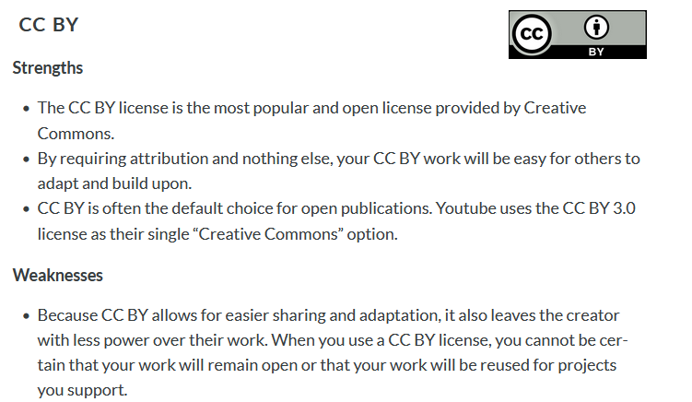

Slide 17
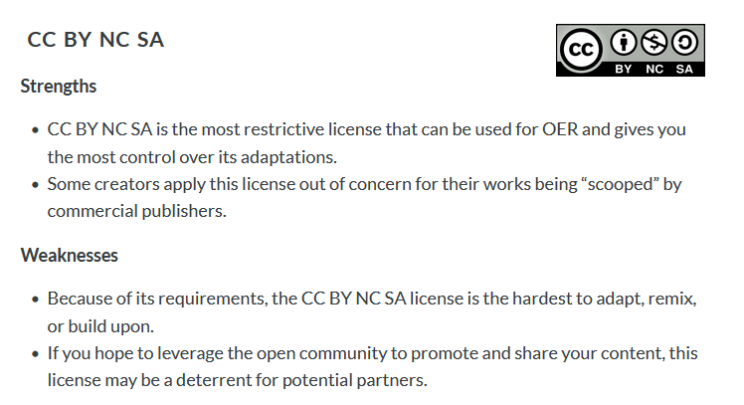

Slide 18
Spectrum of open licenses by Cable Green / http://www.slideshare.net/cgreen/goopen-with-creative-commons / CC BY

Slide 19
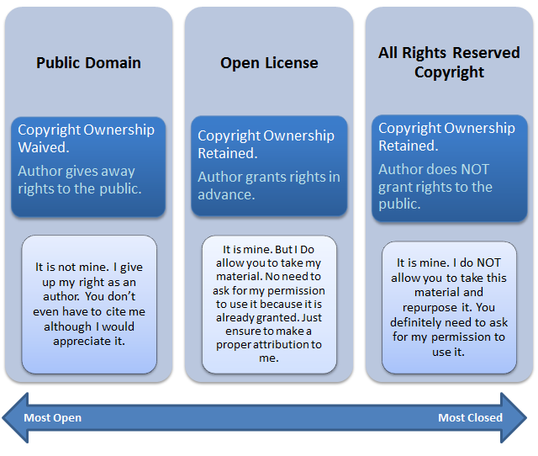
Difference between open license, public domain and all rights reserved copyright
“Difference between open license, public domain and all rights reserved copyright” by Boyoung Chae is licensed under CC BY 4.0

Slide 20
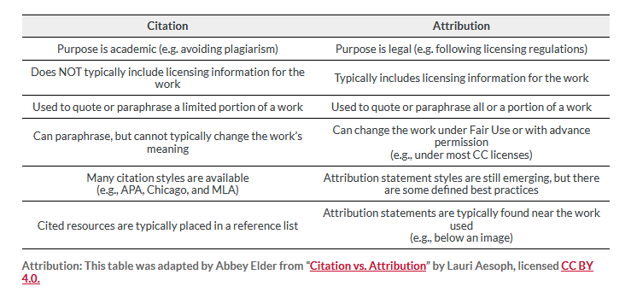
Citation Vs. Attribution

Slide 21
The Non-Commercial Discussion

Slide 22
Other Open Licenses

Slide 23
GNU General Public License (GNU GPL or simply GPL) is a family of CopyLeft software licenses that guarantee end users the right to run, study, share, and modify software. The licenses were originally written by Richard Stallman, founder of the Free Software Foundation (FSF), GNU Project, and were released in 1989.
licenses like the BSD and MIT Licenses.
GNU-General Public License (GPL)

Slide 24
MIT License
The MIT License was first developed at the Massachusetts Institute of Technology (MIT) in the late 1980s. The exact origins MIT license are bit of mystery. Like the Apache 2.0, and BSD family of licenses the MIT License is a permissive software license that places few restrictions of reuse. Users of software using an MIT License are permitted to use, copy, modify, merge publish, distribute, sublicense and sell copies of the software. Some notable projects use the MIT License including Ruby on Rails, and the X Windows System.
licenses like the BSD and MIT Licenses.

Slide 25
The Open Government License, used for a large amount of crown copyright data and content, is intended to be compatible with the Creative Commons Attribution License 4.0.licenses like the BSD and MIT Licenses.

Slide 26
Addressing Licensing Challenges

Slide 27
Addressing Licensing Challenges
Read and understand the licensing terms of each OER resource.
Be aware of any licensing conflicts when mixing materials.
Always provide proper attribution when required.
Seek legal advice if you're uncertain about licensing terms or potential conflicts.

