Slide 1
Demystifying ‘Focus Areas’ of DIKSHA

Slide 2
Focus Areas of DIKSHA
Foundational Literacy and Numeracy under NIPUN Bharat Mission
eJaadui Pitara
Education for All
Virtual Labs
Vocational Education

Slide 3
Cruciality of Foundational Literacy and Numeracy(FLN)
National Education Policy -2020 states “The ability to read and write, and perform basic operations with numbers, is a necessary foundation and an indispensable prerequisite for all future schooling and Lifelong learning”

Slide 4
Digital Resources for FLN
Stakeholders can Explore FLN resources on DIKSHA
Developmental goal wise learning outcomes from preschool to grade three need to be covered for developing FLN resources
DIKSHA houses digital resources such as Infographics, Worksheets, Assessment Sheets, Byte size videos and gamified assessment and Learning content for FLN.
Online Professional Development of Teachers for building understanding of FLN has also been addressed.

Slide 5
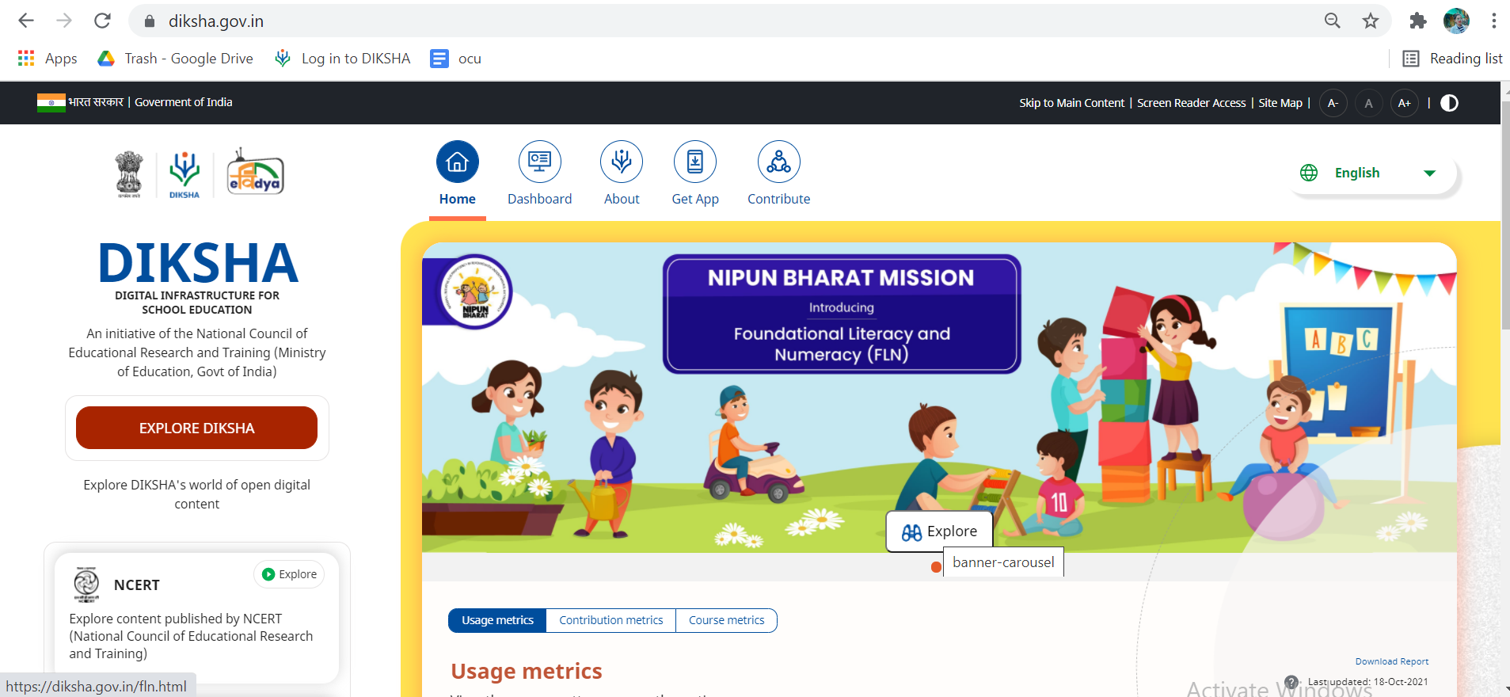
How to Explore FLN resources on DIKSHA
DIKSHA-FLN URL- diksha.gov.in

Slide 6
How to Explore FLN resources on DIKSHA (Contd.)
Page URL-https://diksha.gov.in/fln.html

Slide 7
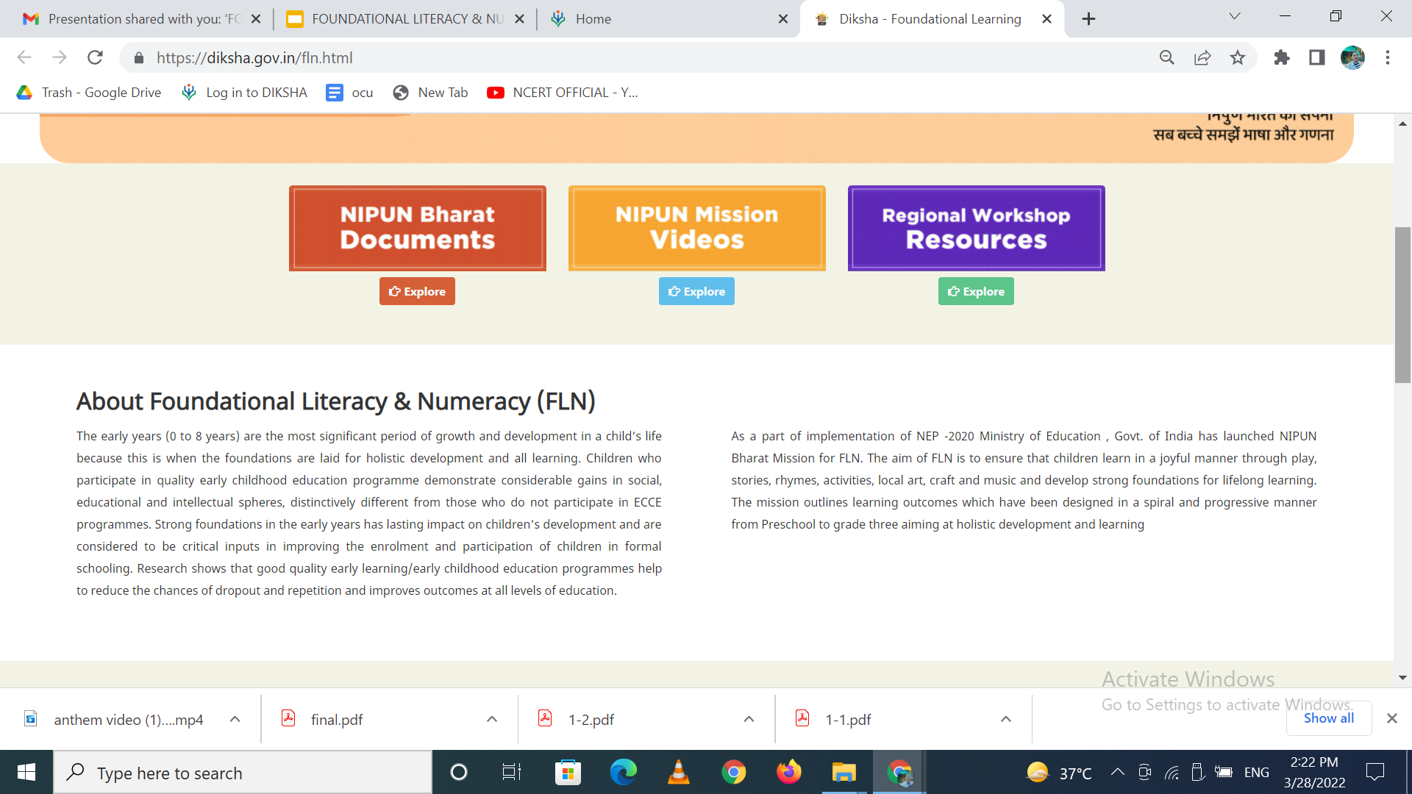
(Contd.)

Slide 8
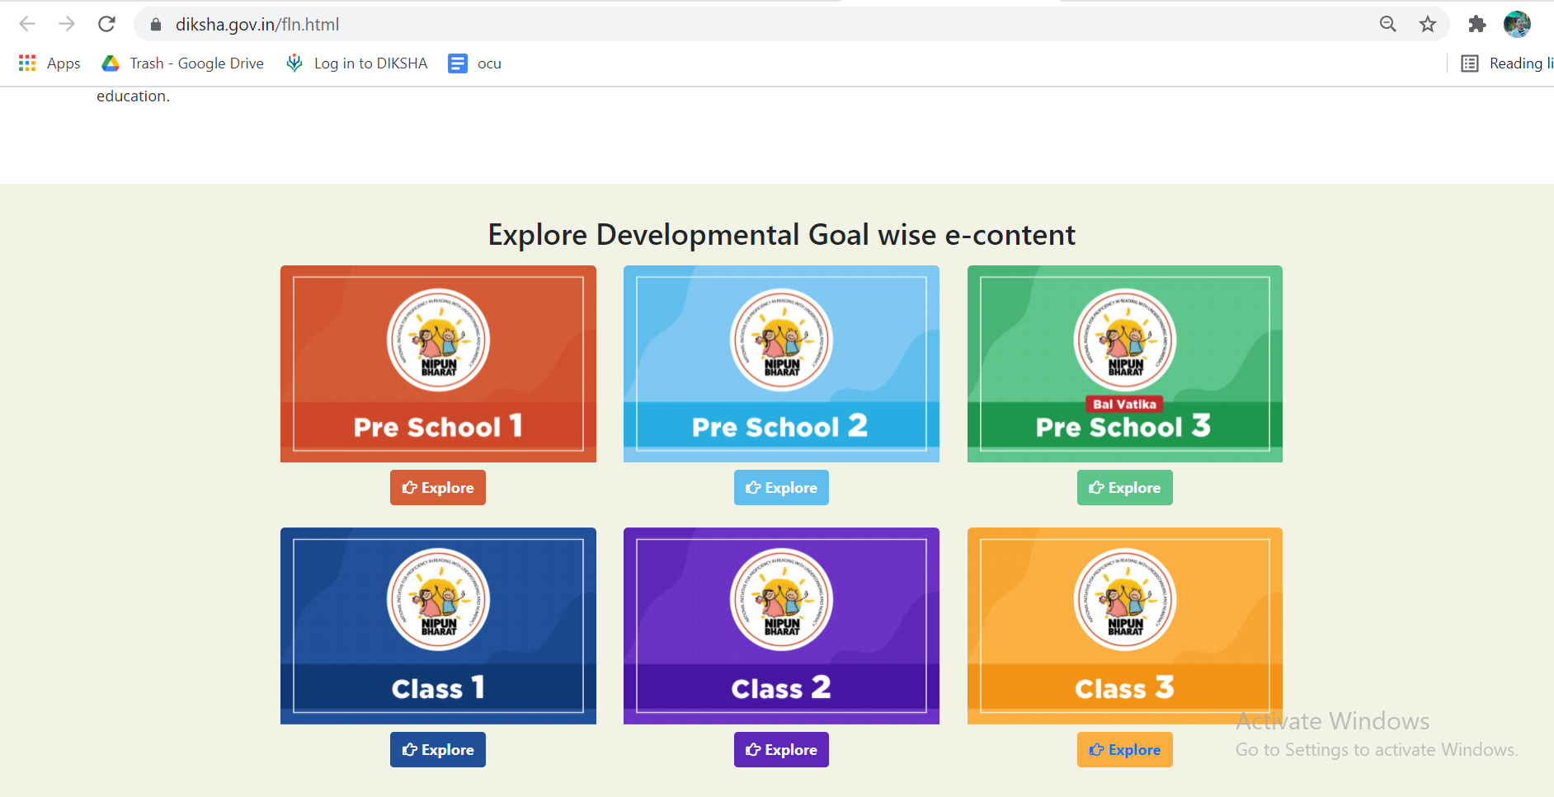
(Contd.)

Slide 9
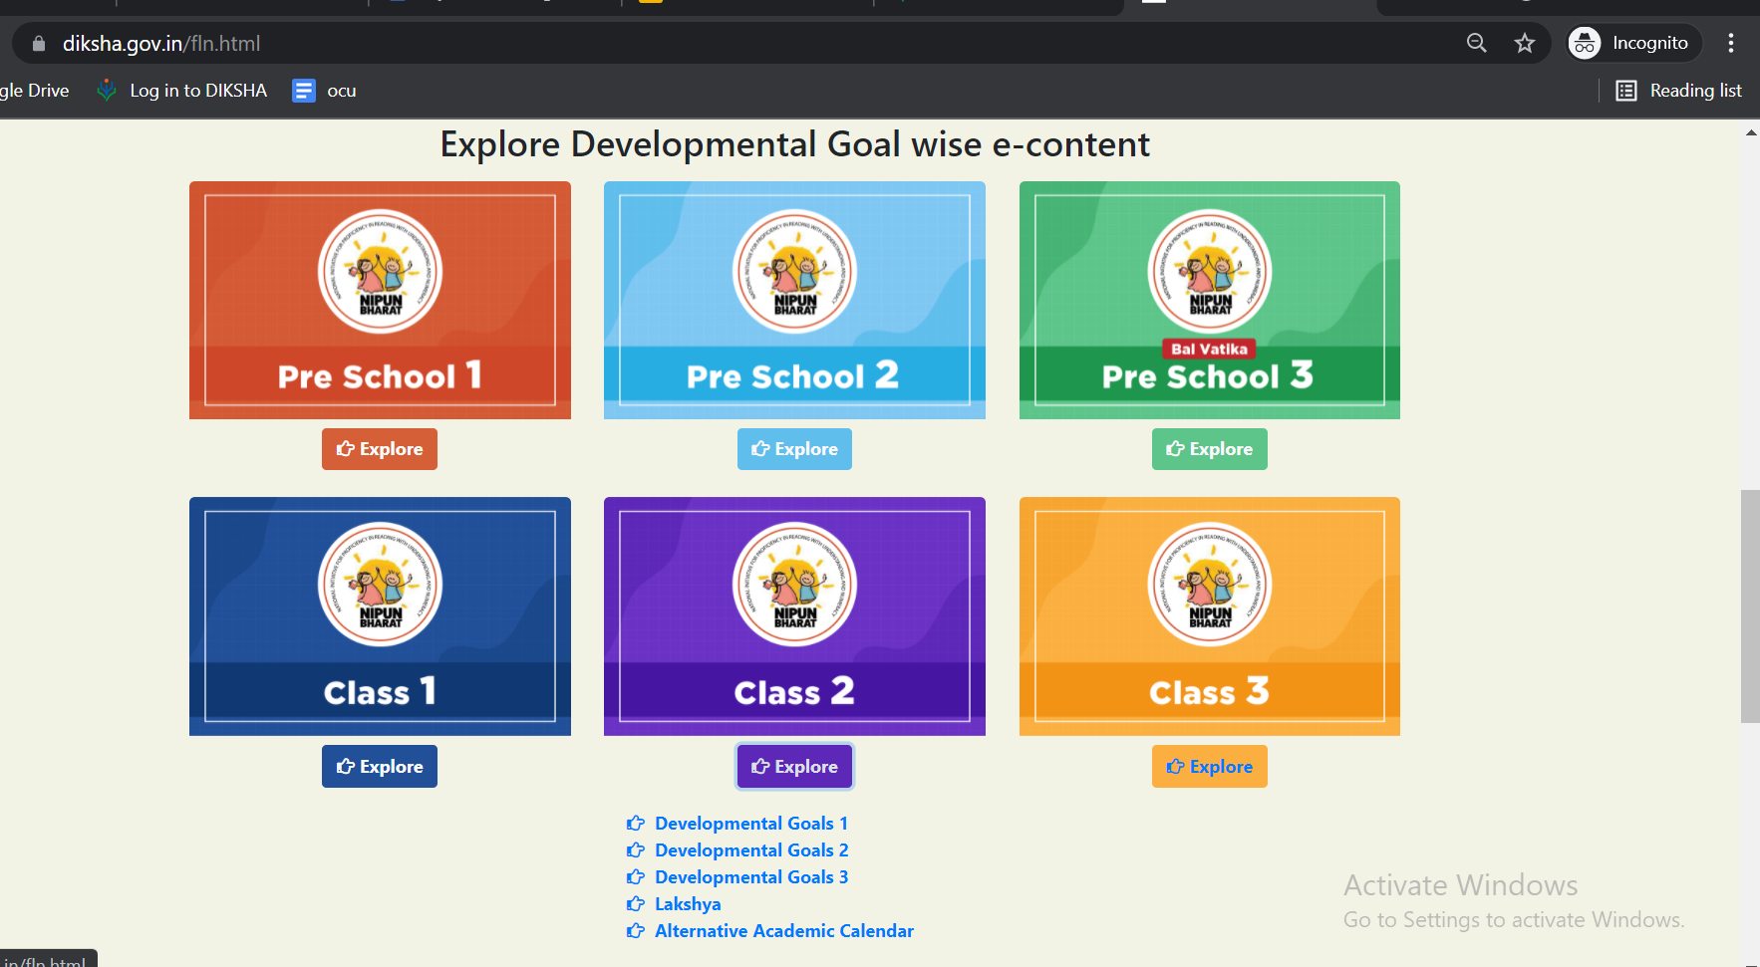
(Contd.)

Slide 10
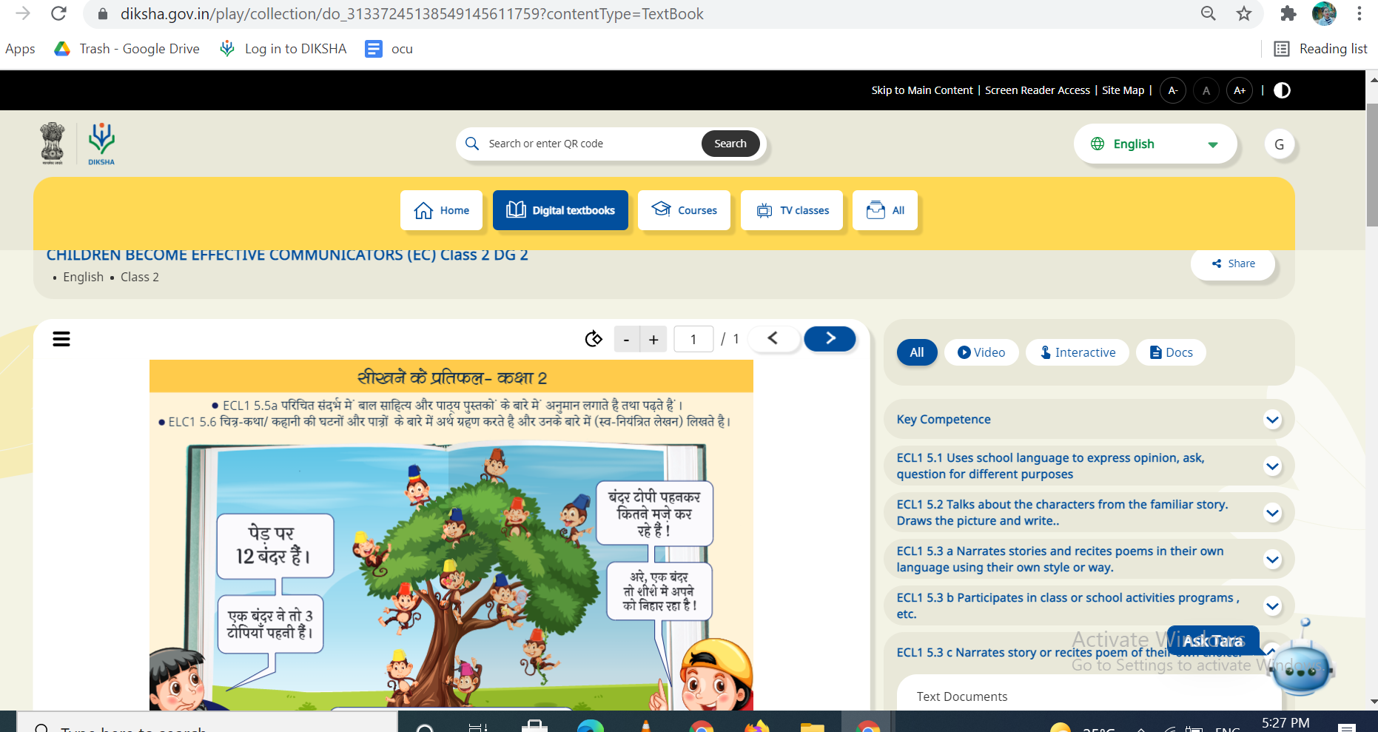
(Contd.)

Slide 11
(Contd.)

Slide 12
(Contd.)

Slide 13
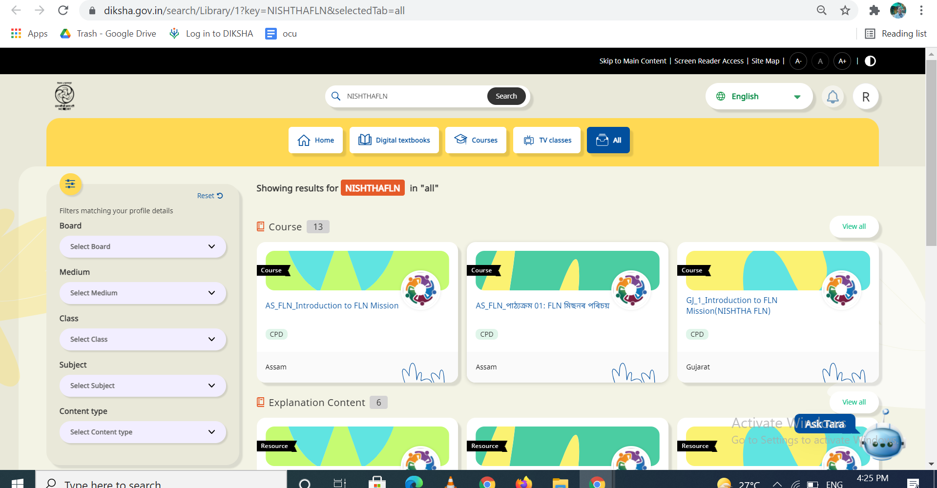
(Contd.)

Slide 14
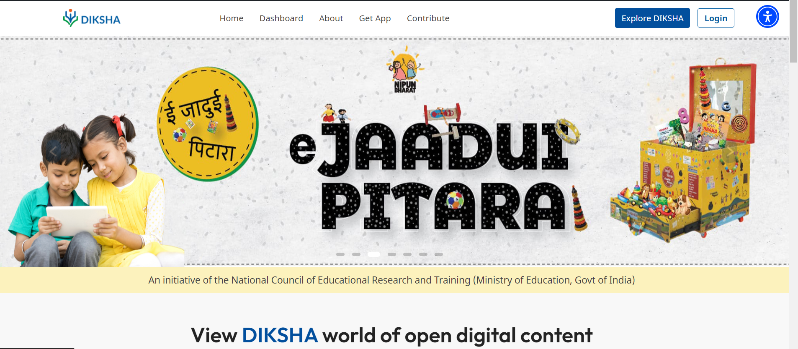
https://ejaaduipitara.ncert.gov.in/

Slide 15
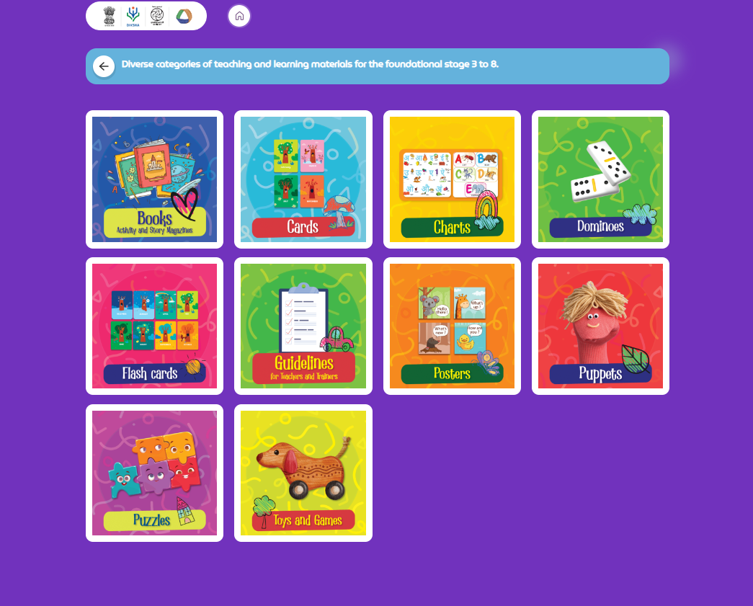

Slide 17
Cruciality of Adult Education & Lifelong Learning
India has the largest population of illiterate adults in the world – 257 million, which is approximately 37% of the global total
The NEP-2020 envisions that the opportunity to attain foundational literacy, obtain an education, and pursue a livelihood must be viewed as basic rights of every citizen.
Literacy and basic education open up whole new worlds of personal, civic, economic, and lifelong-learning opportunities for individuals that enable them to progress personally and professionally.

Slide 18
Digital Resources for ‘Education for All’
Stakeholders can explore resources on DIKSHA
DIKSHA houses variety of digital resources based on various focus areas for Adult Education
Documents (PDF),
Worksheets
Assessment Sheets
Videos,
Audios
Interactives

Slide 19
https://diksha.gov.in/adult-education.html

Slide 21
IDEA BEHIND SETTING UP OF VIRTUAL LABS
The virtual labs are based on the idea that lab experiments can be taught using internet more efficiently in a cost-effective manner.
They will also benefit the students who do not have access to physical labs or schools where equipments are not available.
Experiments can be accessed anytime and anywhere.
Virtual labs overcome the constraints of time as physical labs are available only during school hours.

Slide 22
WHAT WILL YOU EXPERIENCE?
Following resources are available on Virtual Labs on DIKSHA to enhance your learning experience:
Theory and Procedure provide information of the concept related to the experiment.
Animation and Video help in visualizing theoretical concepts.
Simulation provides real time experience of performing experiments.
Viva voce is for self evaluation, you can assess how much you have grasped the concept.
Feedback is meant for improving the resources from user’s perspective.

Slide 23
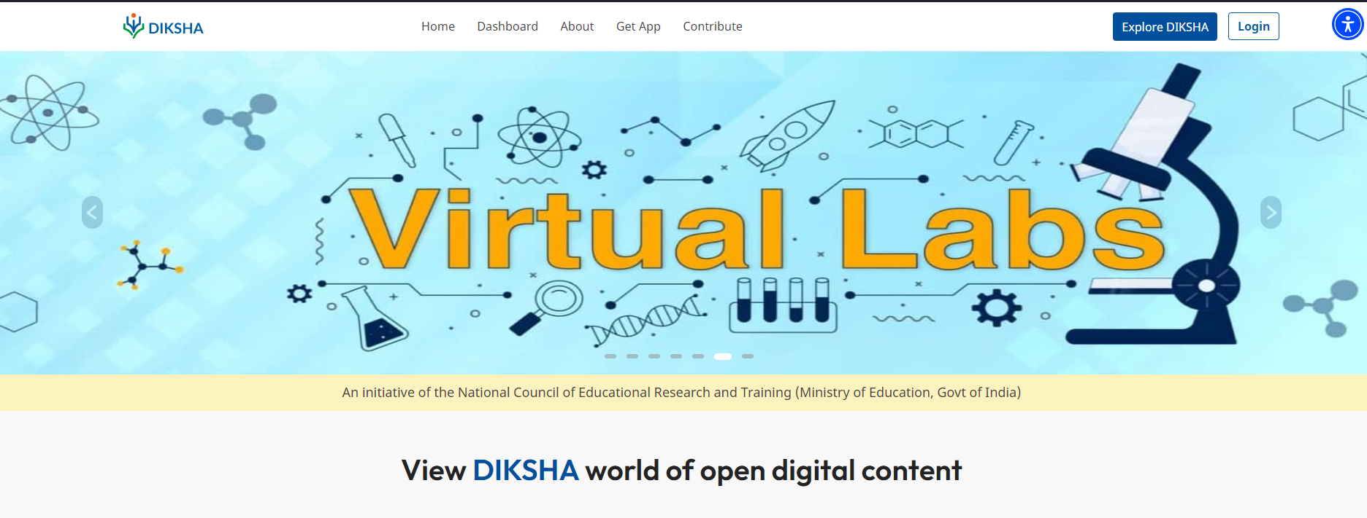
https://diksha.gov.in/virtuallabs.html

Slide 25
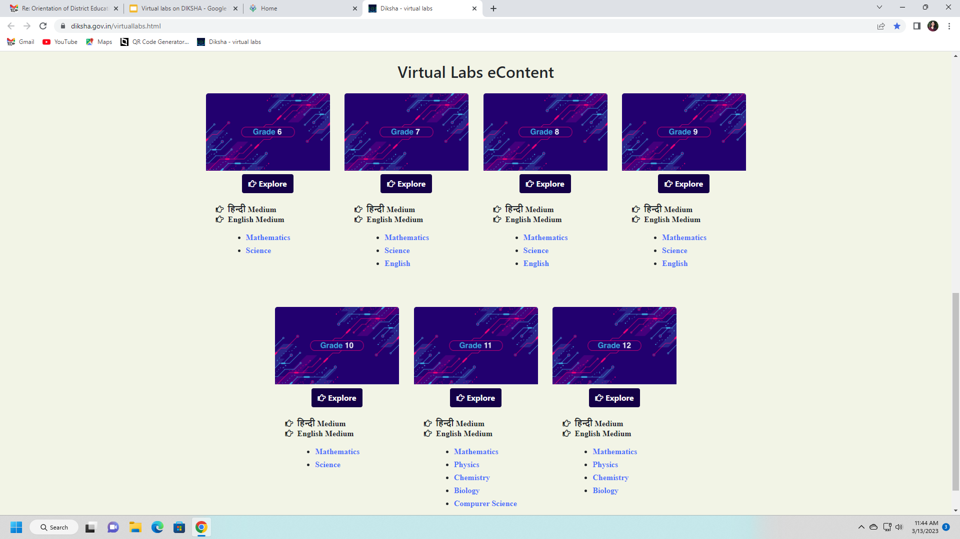

Slide 27
https://diksha.gov.in/vocational-education.html

Slide 29
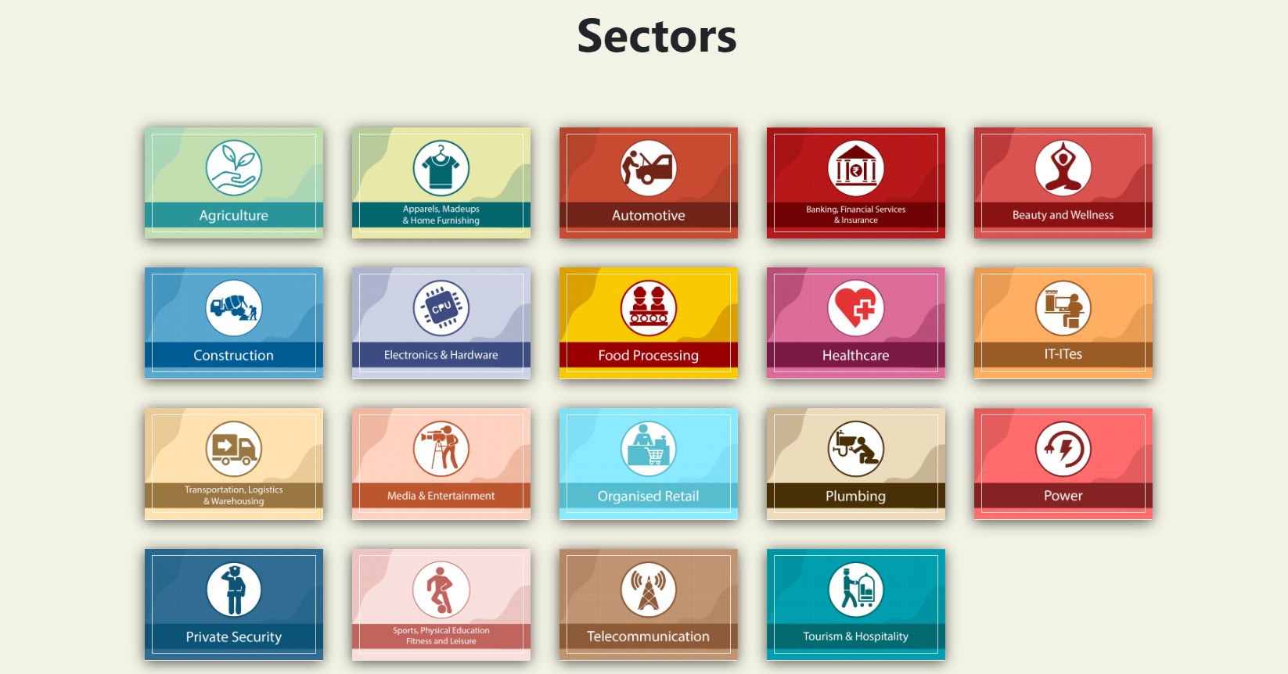

Slide 30
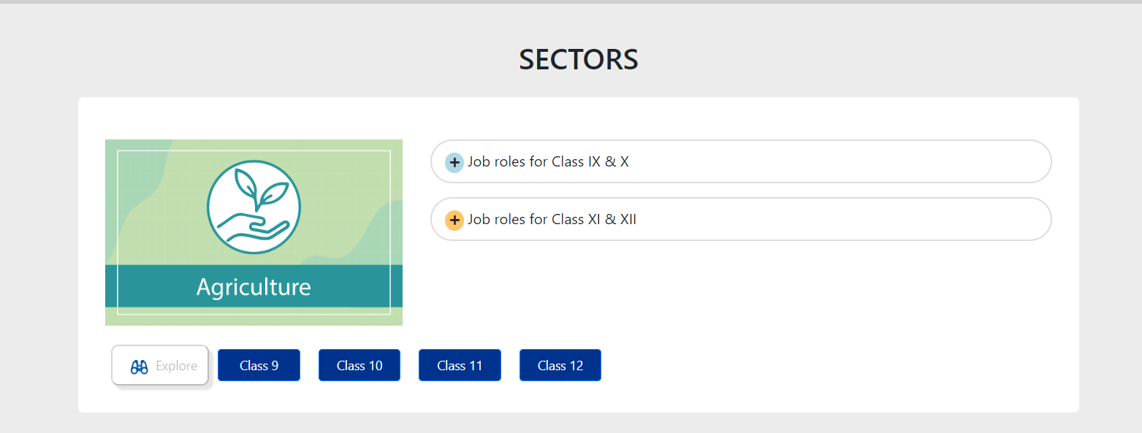

Slide 31
DIKSHA URL
https://diksha.gov.in/

Slide 32
THANK YOU

