Slide 1
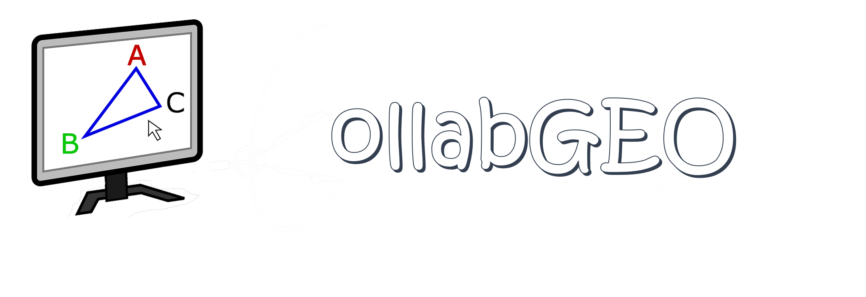
Leveraging CollabGEO tool in teaching Geometry on DIKSHA

Slide 2
Agenda
Introduction
DIKSHA with CollabGEO
Benefits
Objectives
User Interface
Real Time Collaboration
Adhering with NCERT Syllabus
Salient Features

Slide 3
Introduction
CollabGEO is a two-dimensional interactive web application created for understanding and teaching basic mathematical geometrical concepts.
CollabGEO designed, enhanced and implemented as per dynamic requirements of School Education especially NCERT adhering to NDEAR and NEP 2020 policies and standards of Ministry of education.
The purpose of creating Online Collaborative 2D geometry and mathematical tool is to help teachers, tutors and students to make their practical lessons with real time interactions.
These will help teachers to explain and practice theoretical concepts for students to understand and solve in a practical way.

Slide 4
DIKSHA with CollabGEO
The integration of CollabGEO, an innovative online 2D geometry creation tool, with DIKSHA marks a significant advancement in digital education.
This collaboration empowers educators and students alike to utilize CollabGEO's interactive features directly within the DIKSHA knowledge sharing digital platform.
Teachers, educators gain the ability to create dynamic geometry diagrams effortlessly, enhancing their teaching materials with engaging visualizations.
Students benefit from interactive learning experiences, enabling them to explore geometric concepts actively.
This integration of CollabGEO with DIKSHA enhances the educational landscape by providing collaborative and interactive tools that foster deeper learning in mathematics.

Slide 5
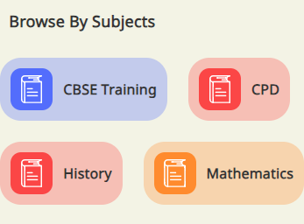

Slide 6
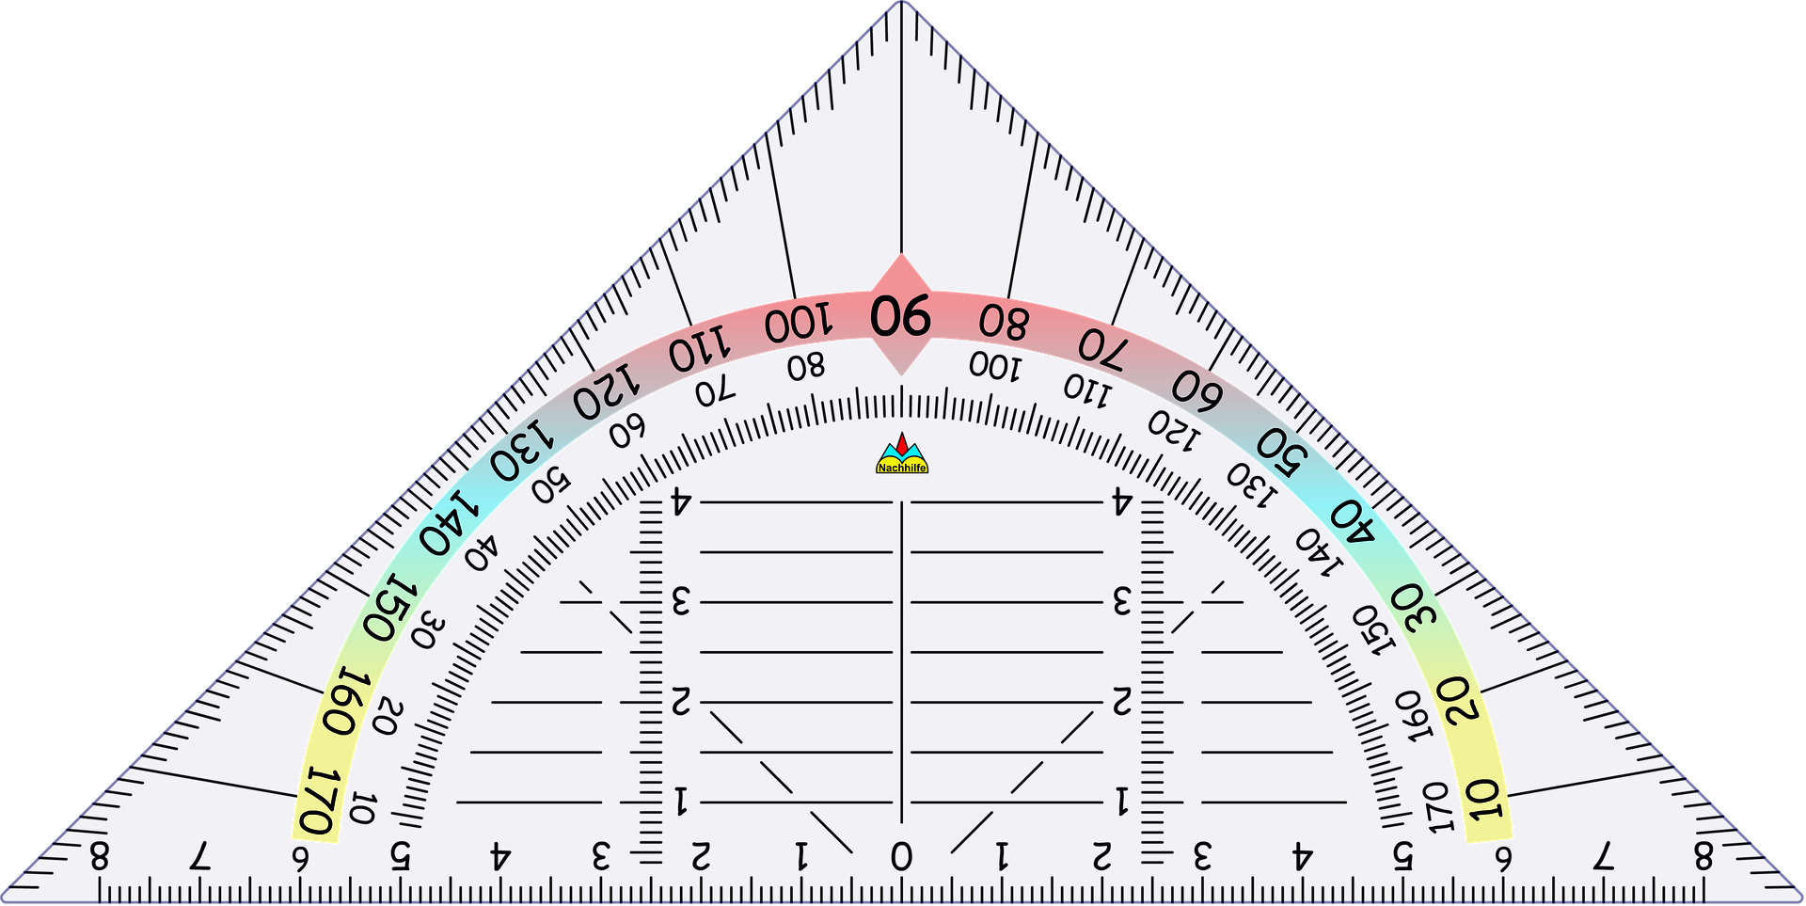
Benefits
Online sessions of teachers/students using real time collaboration feature
Simple, responsive and user friendly design with bi-lingual user interface
An indigenous tool which can be enhanced and customized
Digital tool compliant with classes 6th-10th NCERT syllabus
Works in an offline mode too in case limited internet connectivity
Bi-lingual user guide is available for better understanding of the application

Slide 7
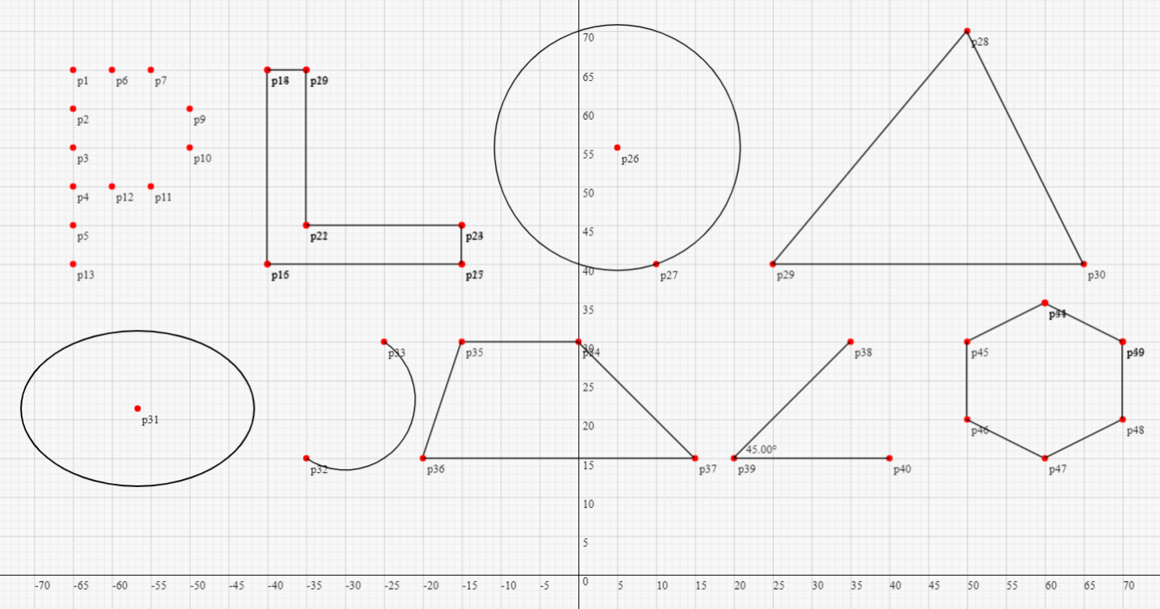
Objectives
Enable user to understand basic concepts of 2D geometry and draw interactively
Hands on geometry lessons and tasks
Collaborative and real time sharing of geometry and text data

Slide 8
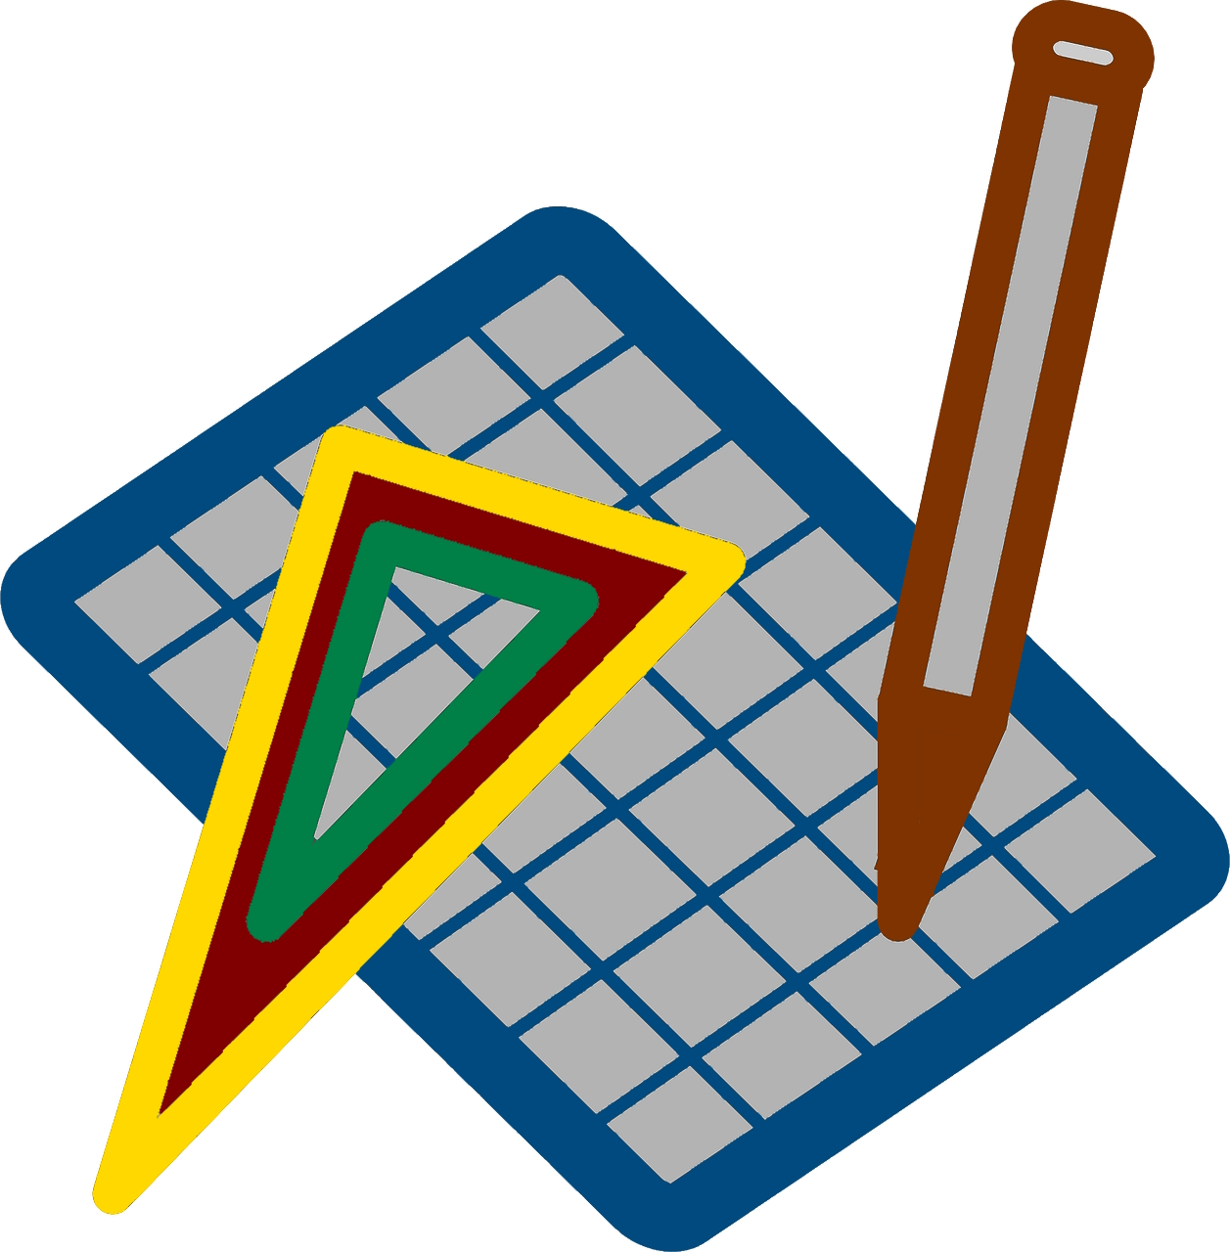
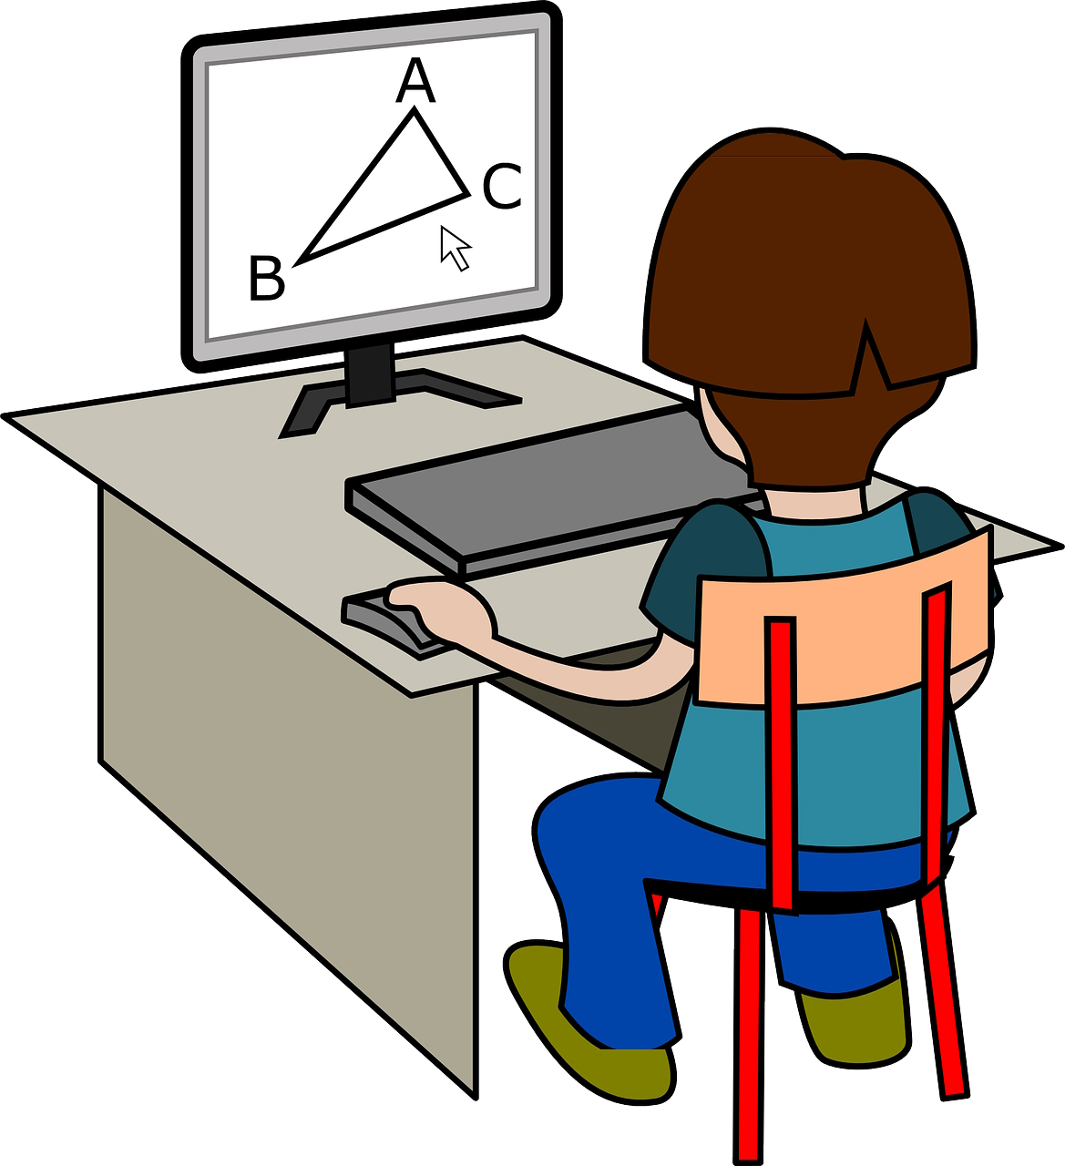
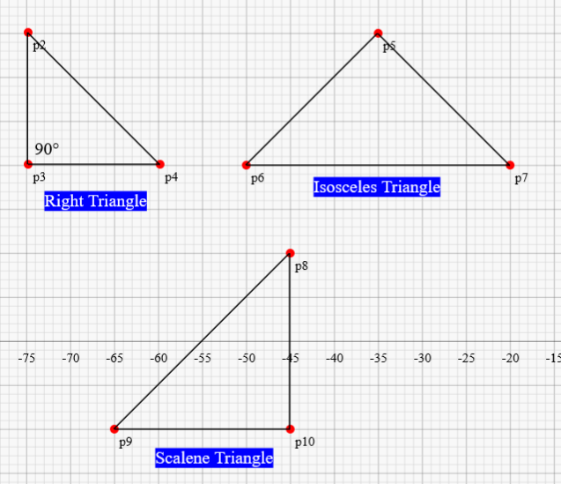
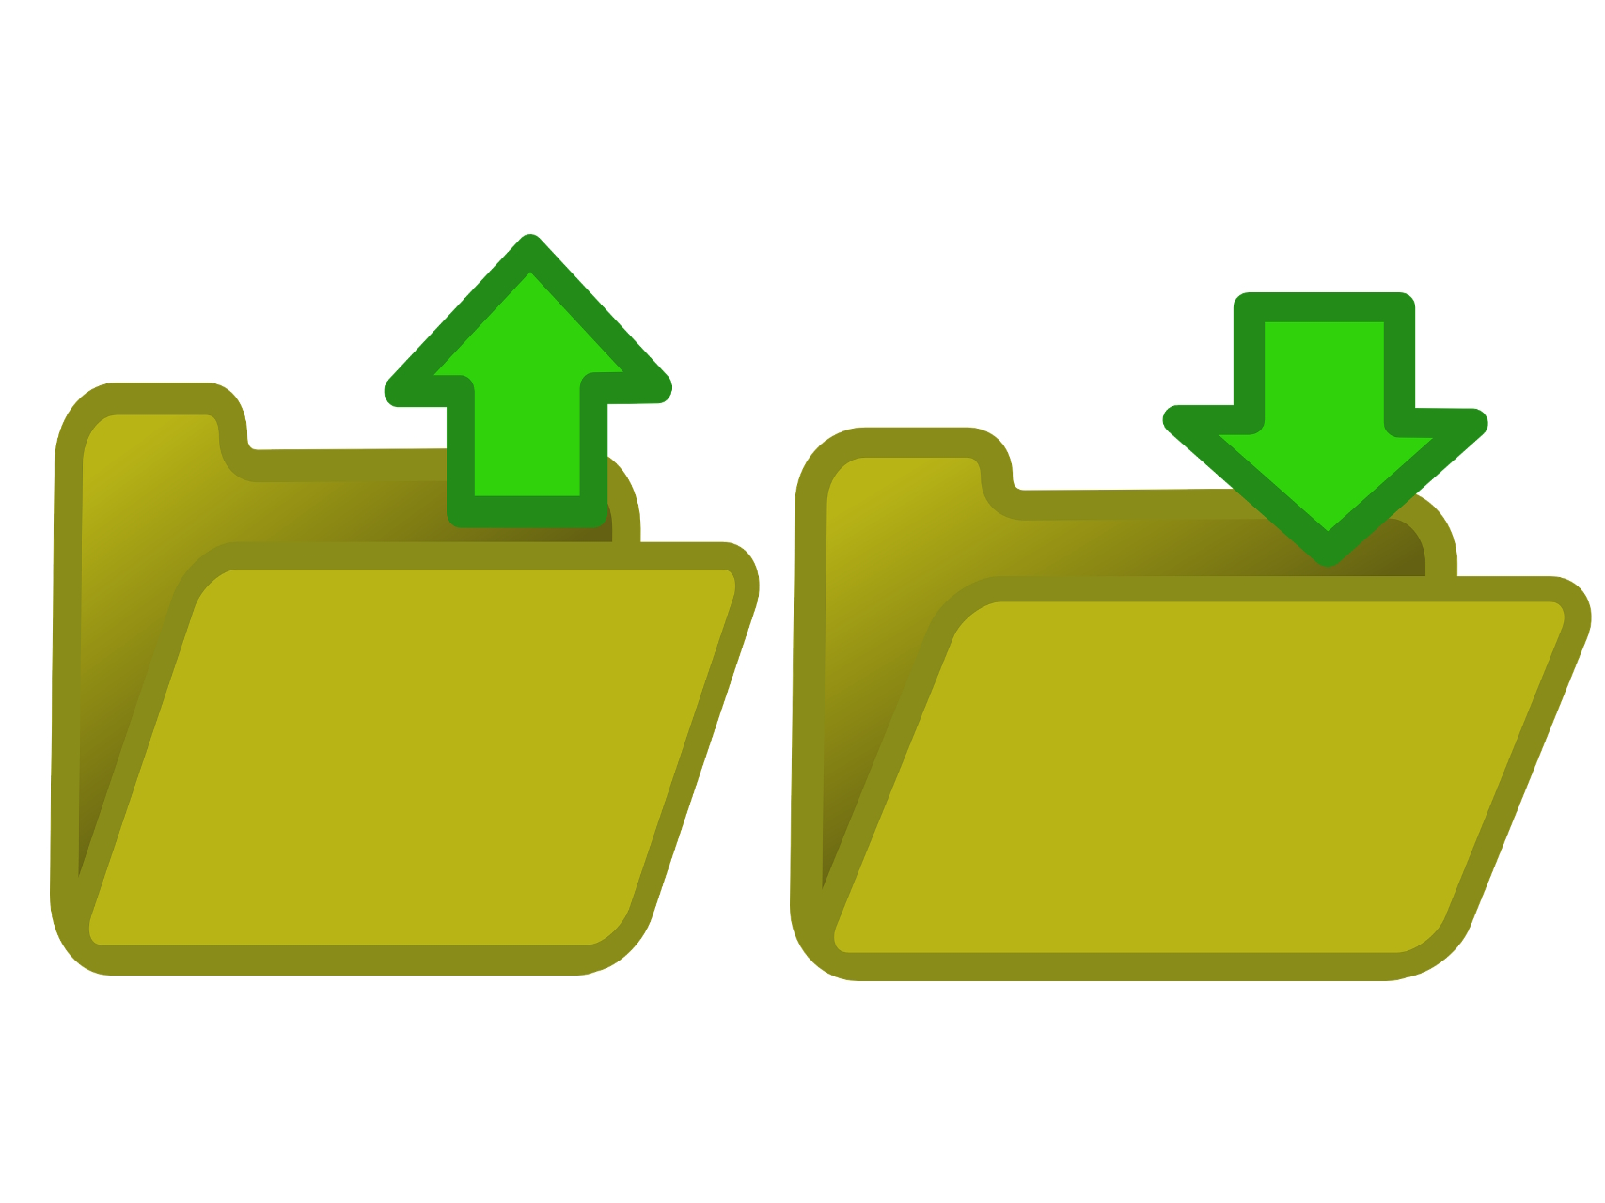
Assignment
Create
Collaborate
Interactive Geometry Creation
Open and Save
Multi Language Support

Slide 9
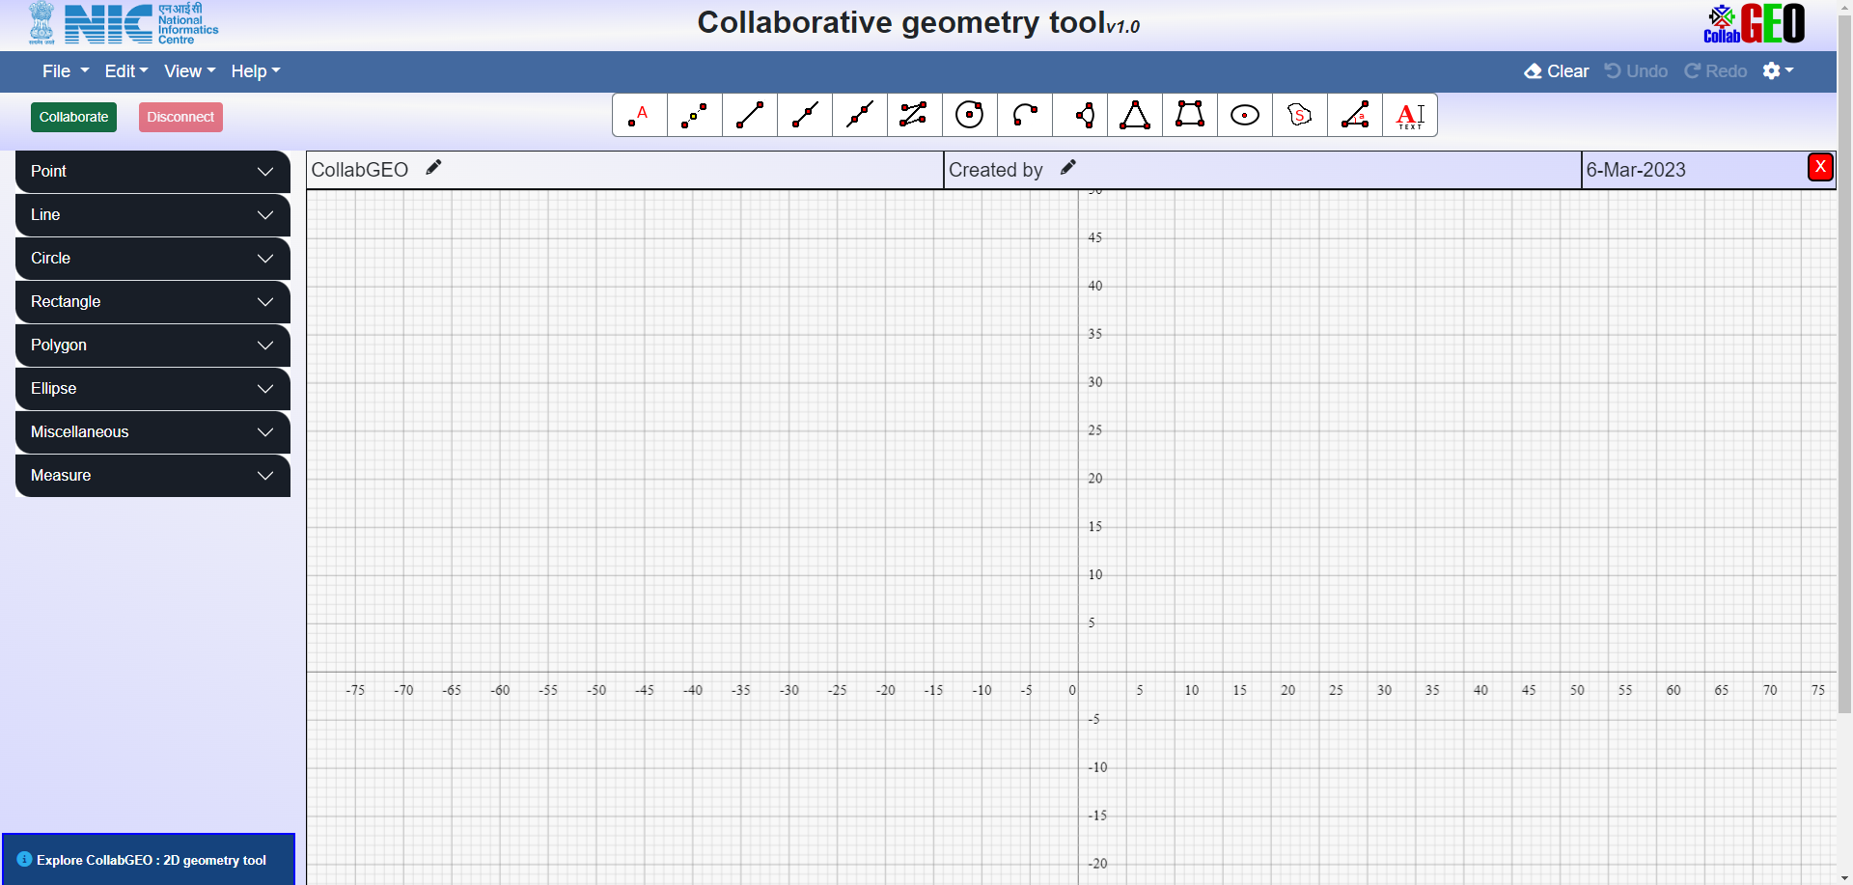
User Interface
Menu Bar
Real Time Collaboration
Settings
Shortcut Toolbar
Side Menu Tool Bar
Title Bar
2D Drawing Canvas
Status Bar

Slide 10
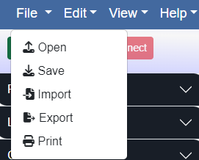
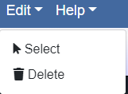
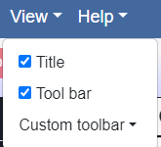
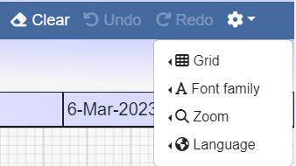
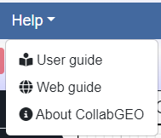
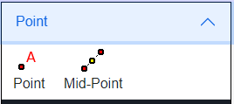
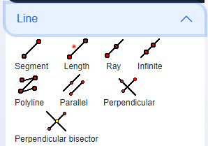
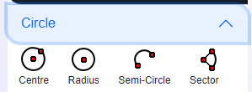
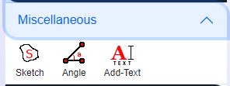
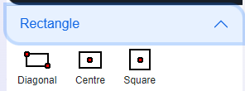
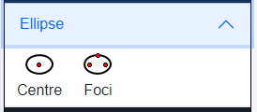
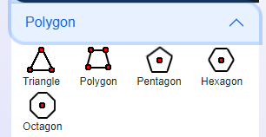
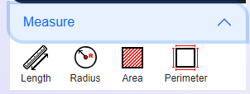
Menu Bar
Side Tool Bar

Slide 11
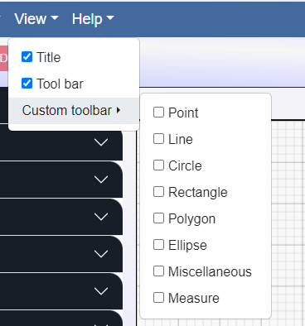
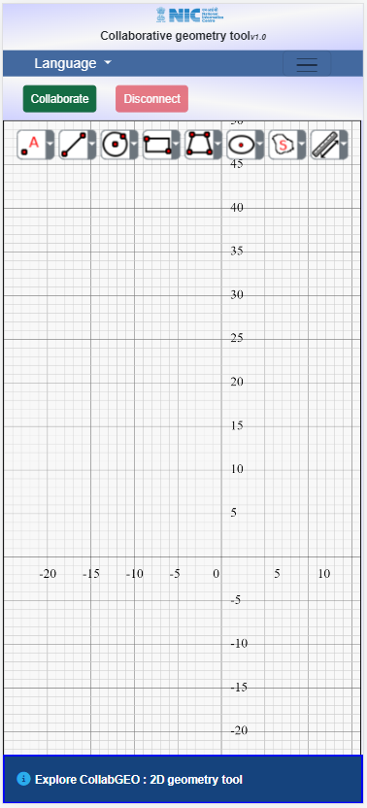
View
Custom Toolbar
Mobile Phone [Responsive View]
Title Bar

Slide 12
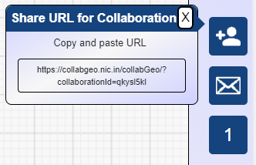
Real Time Collaboration
Click on Collaborate for real time collaboration
Invite users
Send Mail
No. of users
Share the generated URL for Real Time Collaboration to other users to join the online session

Slide 13
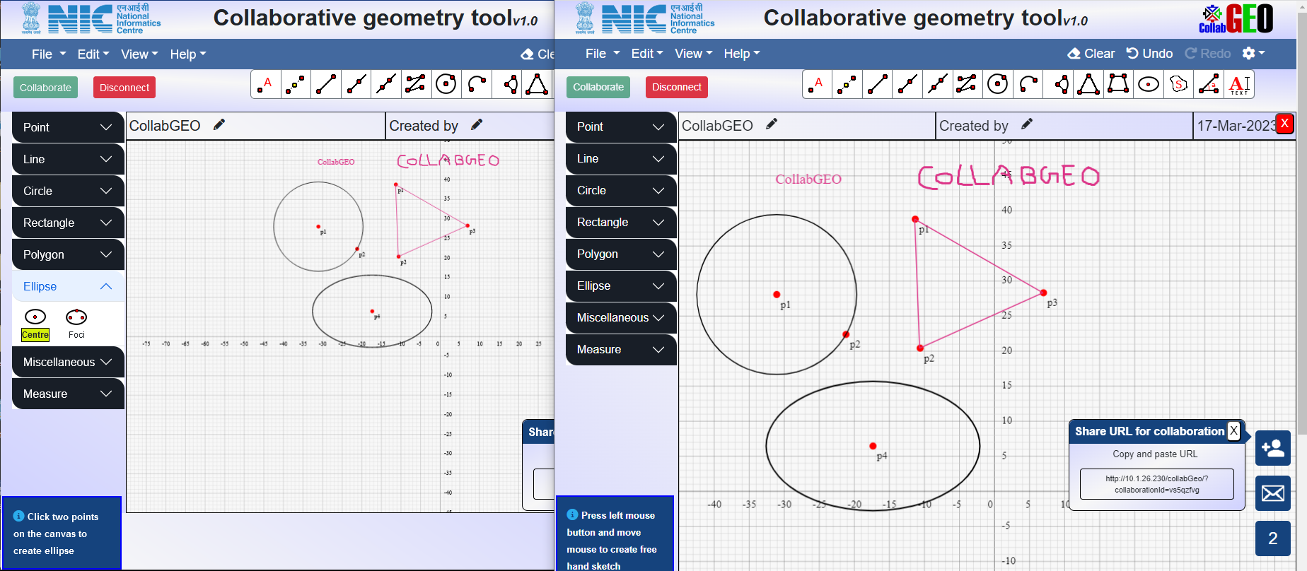
Entity created by second user
Entity created by first user
Auto –coloring of Geometry while Real Time Collaboration

Slide 14
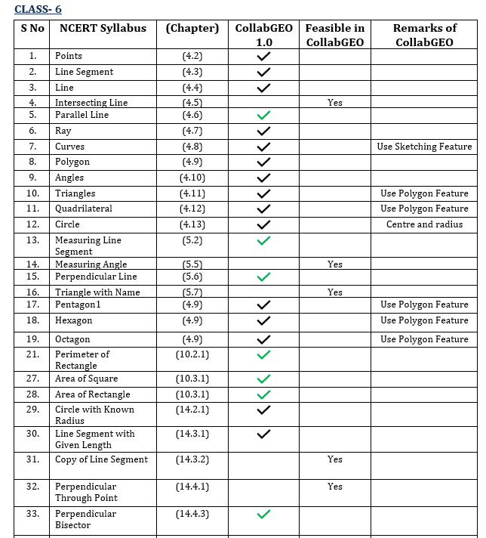
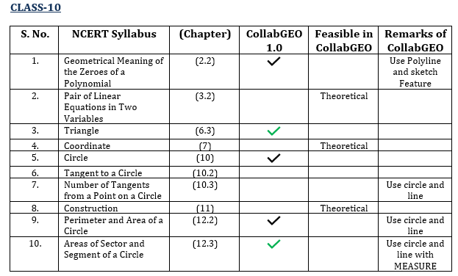
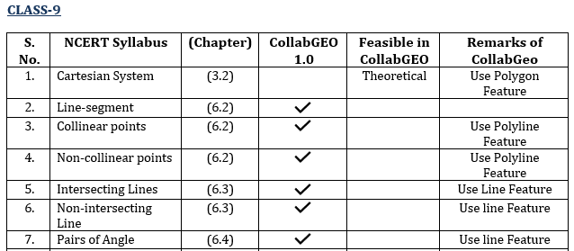
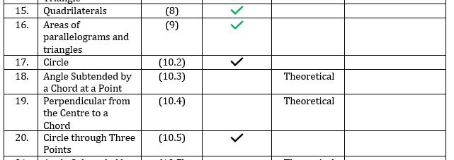
Comparison of CollabGEO with NCERT Mathematics (class6-10) Syllabus

Slide 15
Salient Features
Geometry creation tool such as point, line, circle, polygon, ellipse, triangle, polyline etc
Annotations can be added to the canvas in the form of text
Measurement tools such as length, radius, area and perimeter
Freehand sketch
Multiple font-family for web page text
Real time collaboration with other users
Created geometry can be saved as a CGJ file
Saved CGJ file can be re-loaded on the canvas
Import/Export of an image file in SVG format
Print feature is available for printing canvas
Collaboration URL can be shared through mail
Multilingual (English & Hindi) users guide
Quick reference web and PDF guide

Slide 16
Thank you
Web Links
https://collabgeo.nic.in
https://www.nic.in/products/collabgeo/
Social Media
https://www.facebook.com/NICIndia
https://www.youtube.com/nationalinformaticscentre
https://x.com/NICMeity
Any queries and feedback
collabcad@nic.in
Copyright © 2023 - Education Projects Division, NIC (Hqrs), New Delhi

