Slide 1
OS ticketing tool: Troubleshooting Guide for DIKSHA’s concern

Slide 2
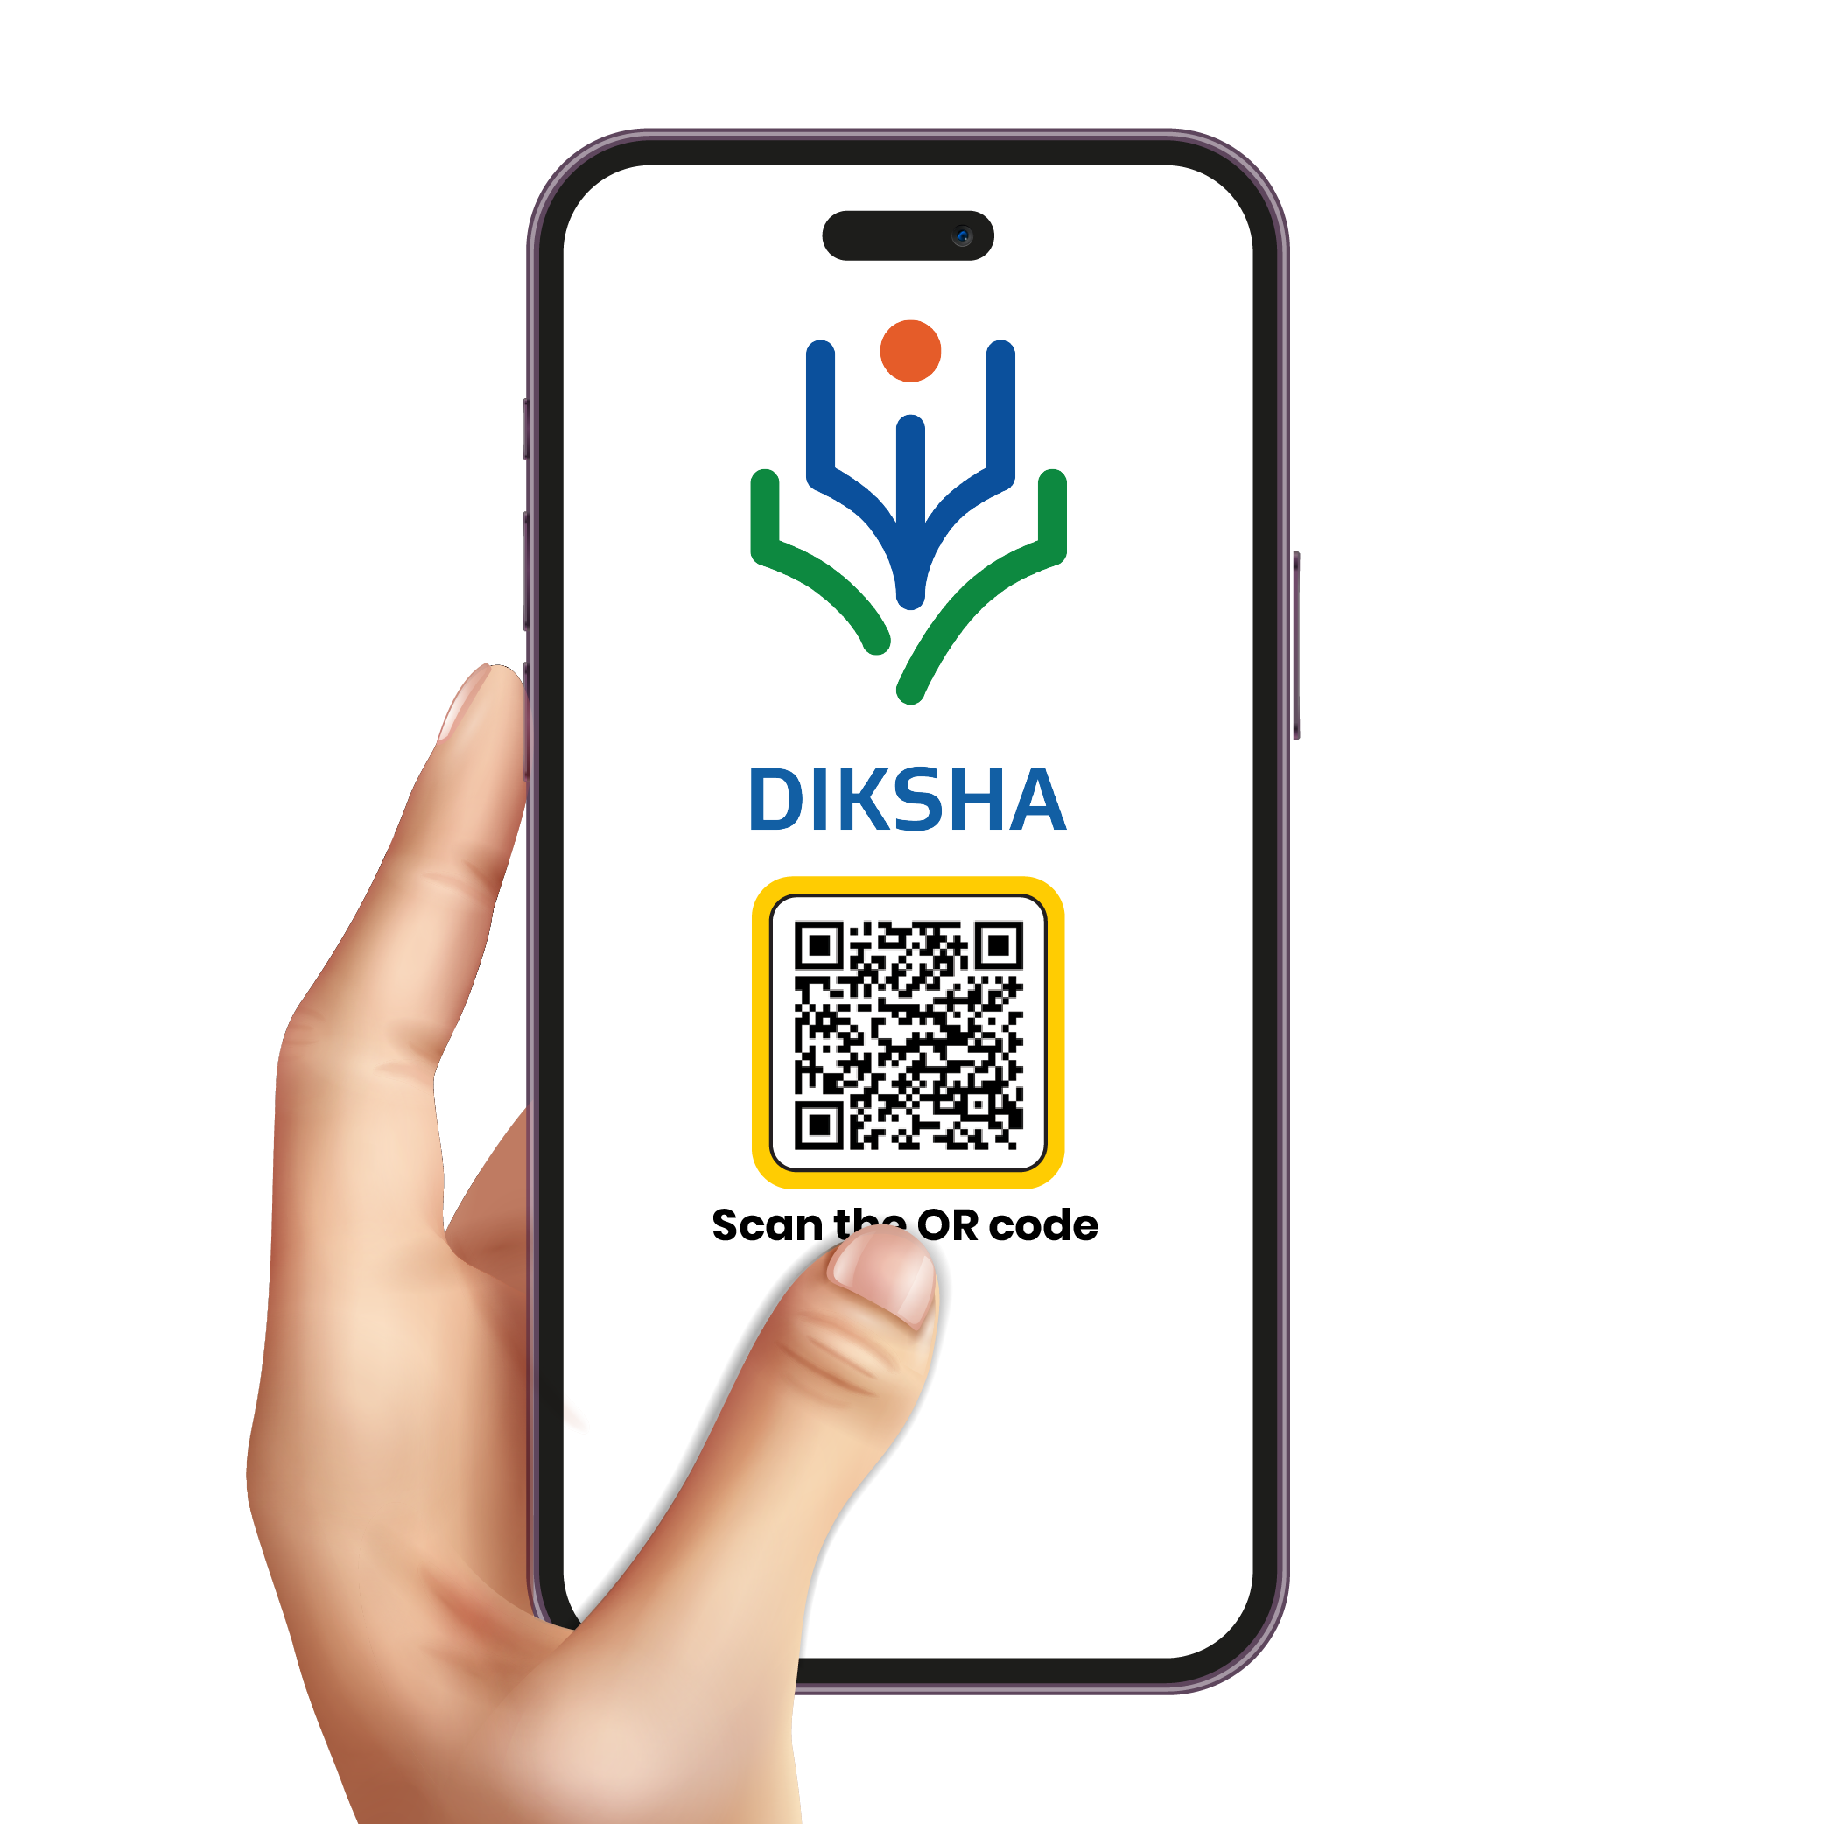
Troubleshooting DIKSHA Challenge’s
How to Troubleshoot Challenges on DIKSHA?
Tara Chatbot
DIKSHA help
OS Ticketing Tool

Slide 3
What is Tarachat Bot?
Type in your query or the specific content you're looking for, and TARA will provide direct links and guidance to access that content efficiently
TARA for help with common tasks such as course enrollment, finding resources, or troubleshooting issues, making it easier to reach your desired information

Slide 4
What is DIKSHA Help?
DIKSHA help is resource designed to assist users in navigating and utilizing the DIKSHA platform. It provides comprehensive guides on exploring content, selecting language and location, and using search other features of DIKSHA, ensuring users can easily find and access educational materials
Click on the URL- https://diksha.gov.in/help/getting-started/explore-diksha/index.html to explore and learn more about DIKSHA features and functionality.

Slide 5
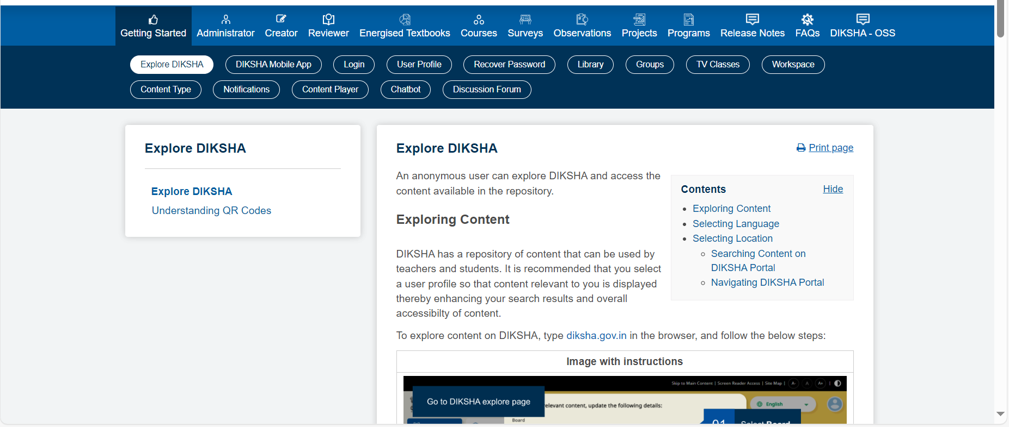
DIKSHA help has detailed step wise guide for each feature of DIKSHA

Slide 6
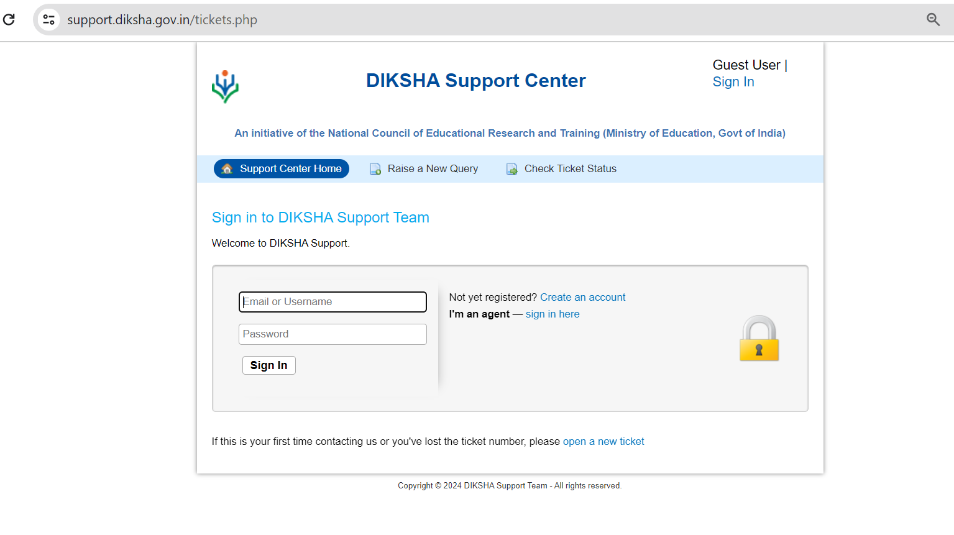
DIKSHA’s OS Ticketing Tool
Ticketing tool is used to manage and resolve support requests from users, DIKSHA has two ticketing tools
1. For Students/ users
2. For Teachers

Slide 7
How to access Ticketing Tool of DIKSHA?
Go to the home page of DIKSHA – diksha.gov.in
Scroll towards the end of the home page
If you are a teacher then choose – ‘Teacher help’ option
If you a learner with any other profile then choose – ‘Need help’option

Slide 8
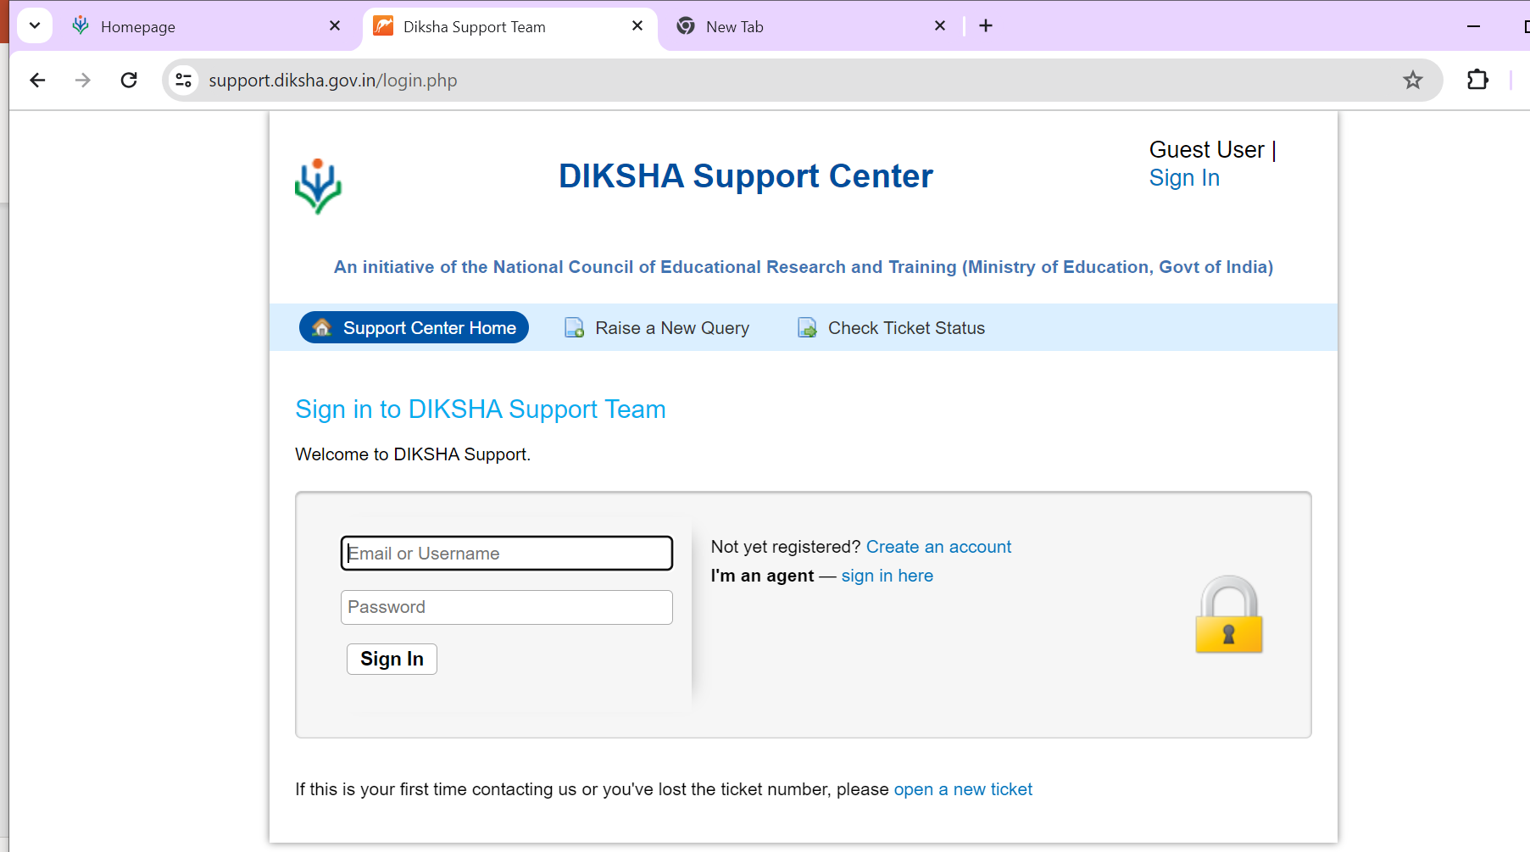
Create your Account on DIKSHA’s OS Ticketing Tool
Click on the create account option

Slide 9
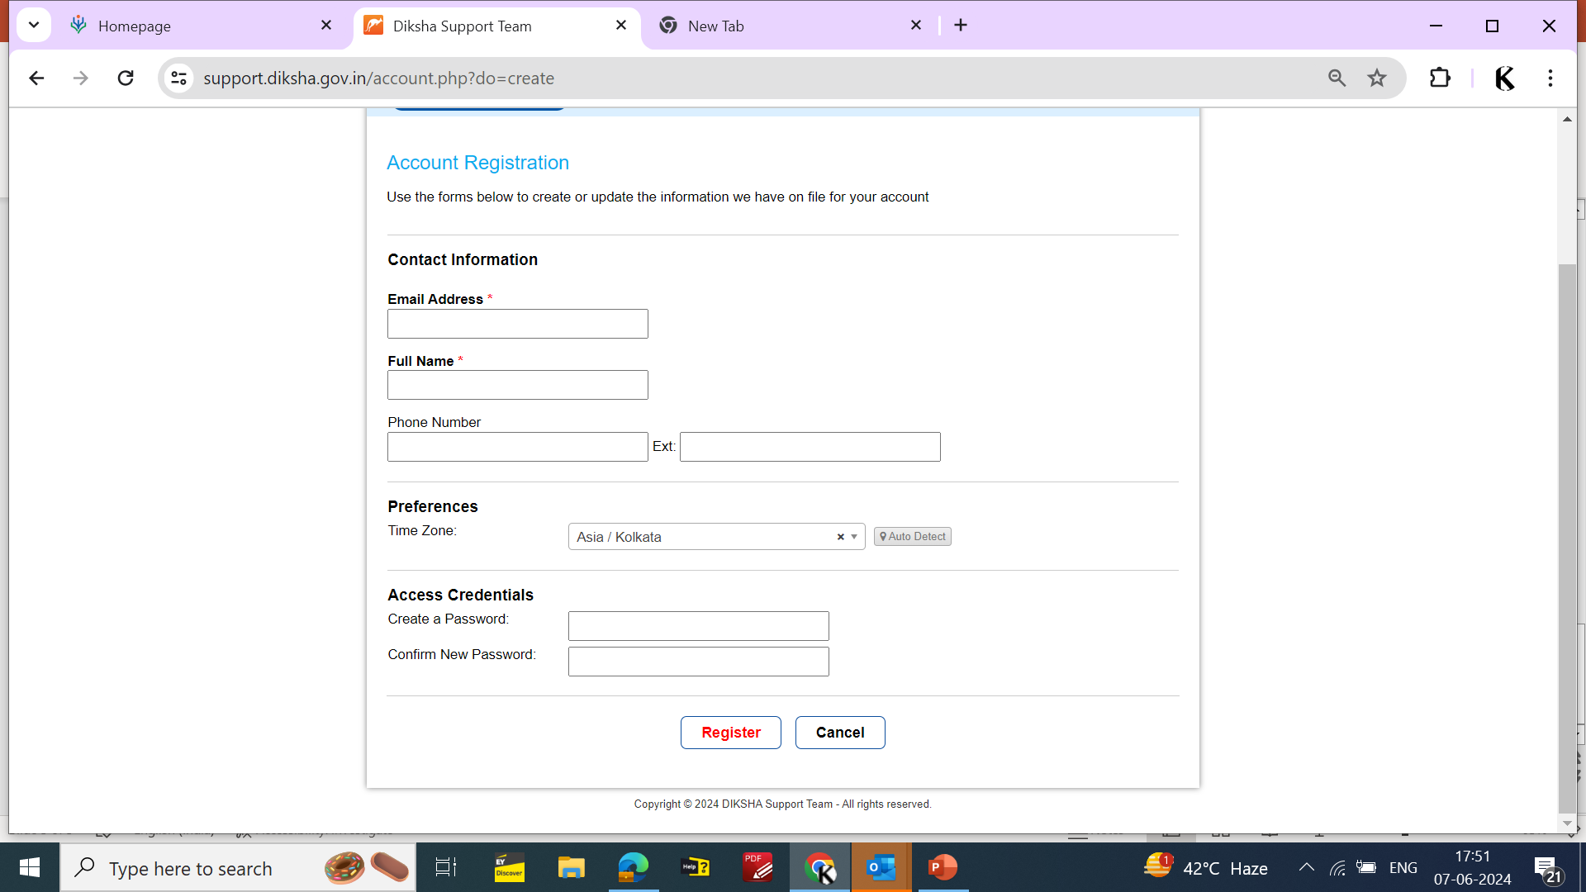
Fill in the Details for creating your Account and click on register
After Registration, you will receive a system generated email with authentication link on the registered email id to verify the account.

Slide 10
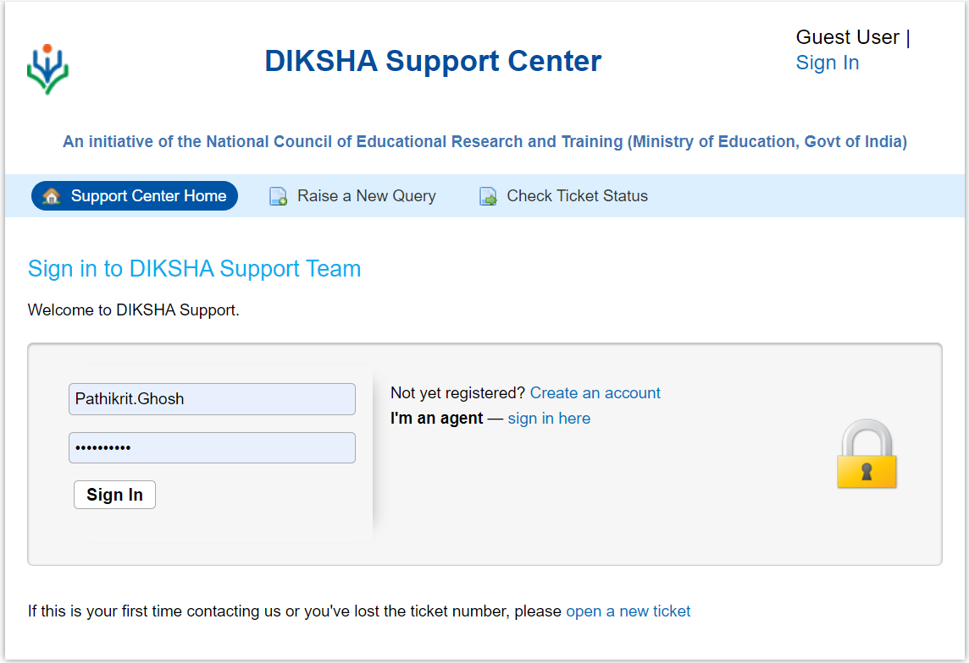
Enter your username and password set up at the time of registration to sign in

Slide 11
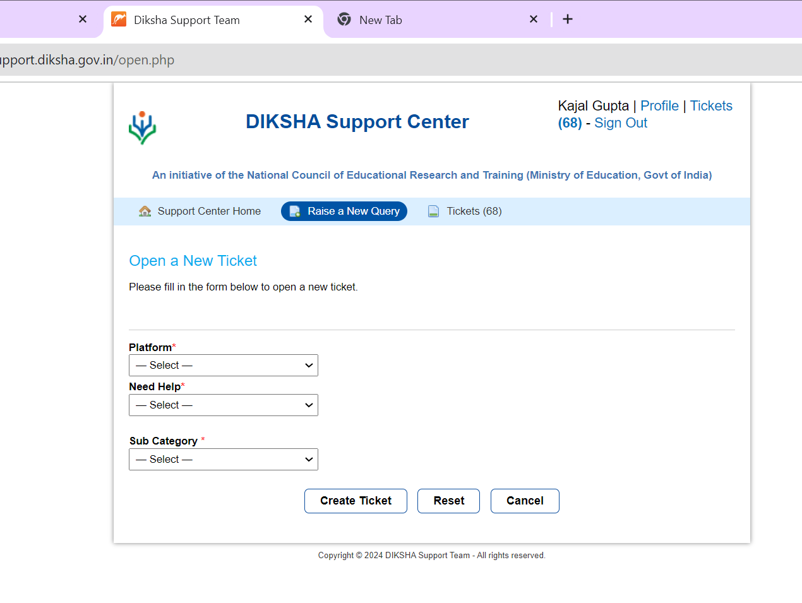
You can see your profile here
You can raise a query here
Click here to raise a new query

Slide 12
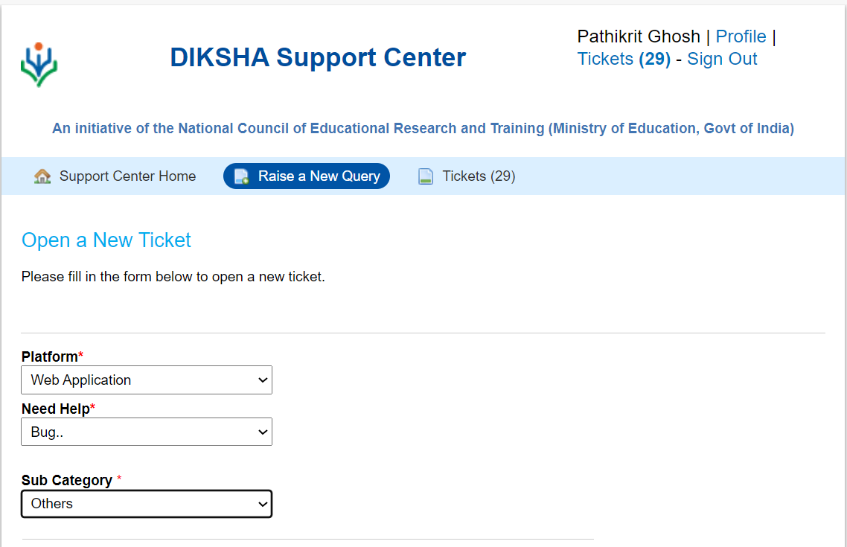
After selecting the platform type, Issue type and subcategory you can raise a new ticket.

Slide 13
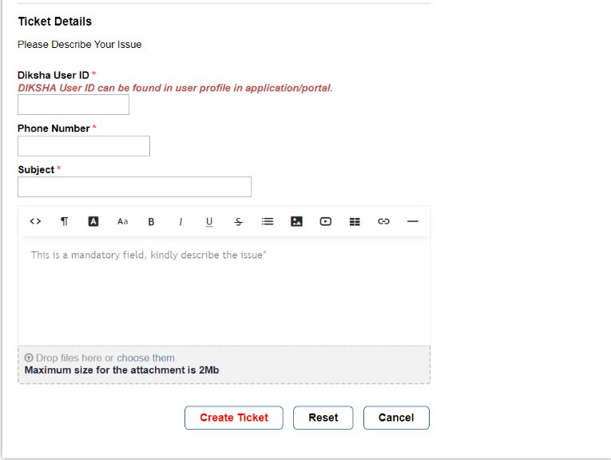
Provide your DIKSHA User ID which is available on DIKSHA profile, Phone Number , Subject and Issue description
Screenshots and other supporting documents can also be attached
Click on Create Ticket to raise the query

Slide 14
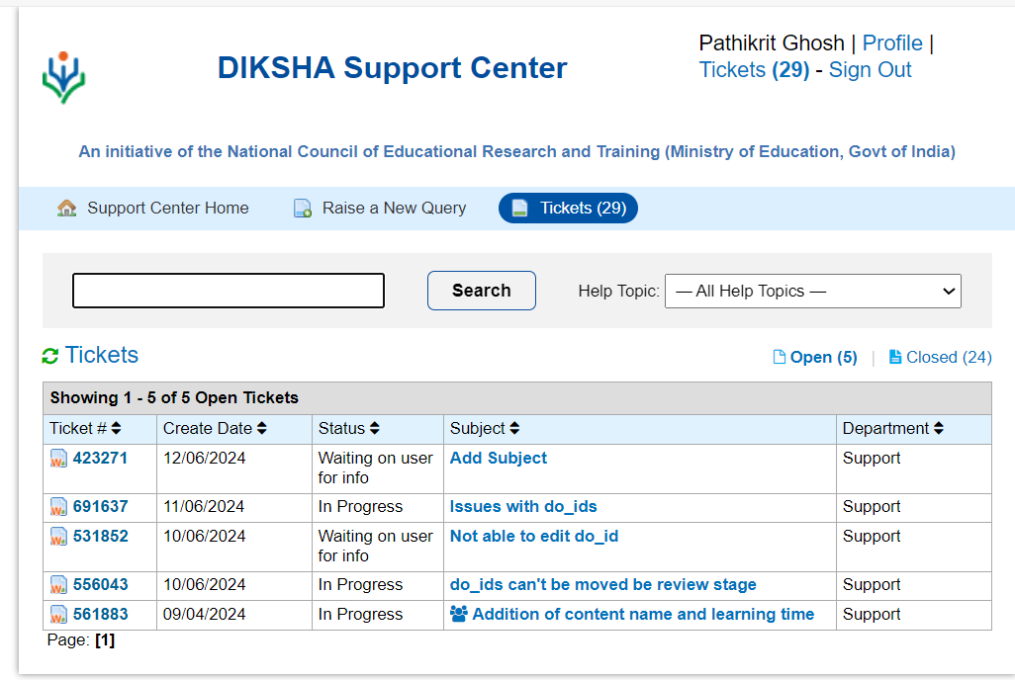
The status of the raised tickets will be visible under "Tickets" tab to monitor the progress

Slide 15
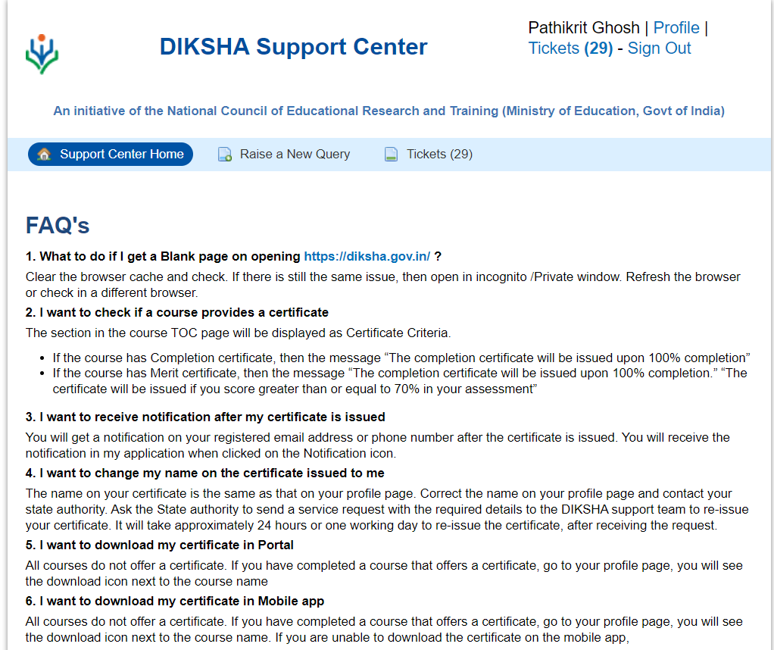
For any other FAQs you can visit Support Center Home tab

Slide 16
THANK YOU

