Slide 1
CYBER BULLYING:
Handling ThE
Digital Menace
Vineeta Garg
IT Head, SRDAV Public School
National Teacher Awardee, 2019

Slide 3
Billy was cyber bullied by her friends....

Slide 5
What Is Cyber Bullying?
Cyberbullying is the repeated misuse of technology to harass, intimidate, bully or terrorize another person by:
Sending/sharing nasty, hurtful or abusive messages or emails
Humiliating others by posting/sharing embarrassing videos or images
Spreading rumors or lies online
Setting up fake online profiles
Excluding others online
Repeated harassment and threatening messages (cyberstalking)

Slide 6
It was a Friday night. Ananya’s all friends told her that they were busy, so she was sitting at home, alone, mindlessly scrolling through Instagram. But then she saw a post that stops her in her tracks. It’s a picture of all of her friends hanging out together — without her.

Slide 8
Class mates of Meeta shared her some personal images and made fun about her vitals in harsh manner. Soon after Meeta kept being bullied and a class mate posted a story of Meeta's picture on IG with insensitive comments.

Slide 11
Reeta said that a few years ago someone posted a link to a tribute site on an online forum she regularly visited that told of 14-year-old twins who had been tragically murdered on the same day. "Later posts suggested that it was a murder-suicide," she says. "This naturally drew out lots of sympathy, including from mothers who lost their children very young also."
But it was later transpired that they were alive and well. The twins were appalled when they found out about the whole thing.
This Photo by Unknown Author is licensed under CC BY-NC
This Photo by Unknown Author is licensed under CC BY-NC

Slide 12
In another case, a police officer told reporters, "A man used to create fake profiles to send friend requests to people. After winning their trust he used to ask them for money to be transferred to fake e-wallet accounts citing some emergency. After receiving the money, he used to close down such accounts.”

Slide 13
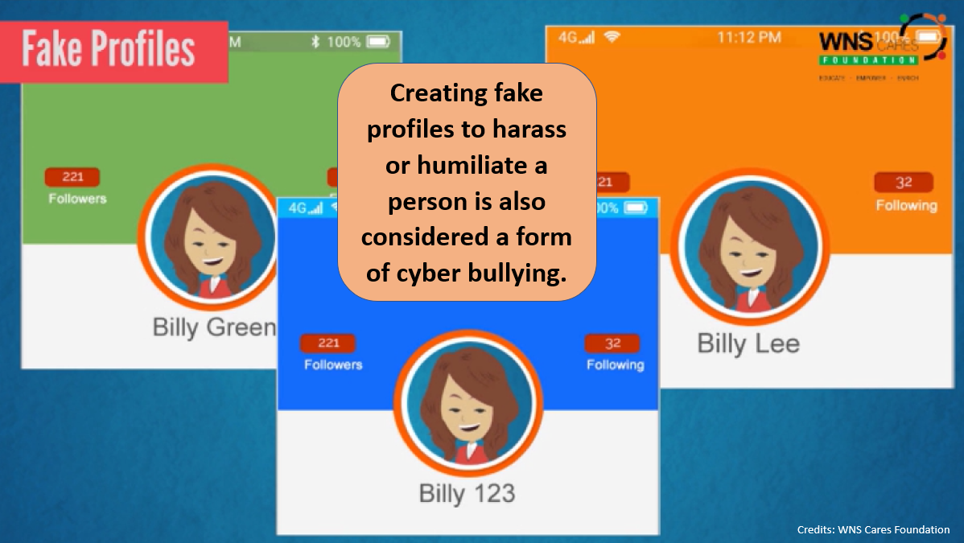

Slide 14
In another case, Sanjana has recently created her social media accounts. She is very excited as she waited so long to go online. When she logs into her social media a few days later, she finds that someone is posting negative, demeaning comments on her social media profile.

Slide 15
Trolling is the act of posting inflammatory or offensive comments, messages, or content on the internet in order to annoy someone with the intent to engage in a fight or argument.

Slide 17
Divya noticed that a random Instagram user liked nearly 200 of her photos. She disregarded it as harmless until he began making inappropriate remarks. “He then started sending her DMs asking if she wanted to go on a date with him, which she continued to ignore,”. He became enraged and started abusing her.

Slide 18
In another case, a housewife started receiving obscene calls from across the world after a hacker flashed her details on the Net.

Slide 20
6 Questions To Be Answered About
Cyber Bullying

Slide 21
1
Credits: UNICEF

Slide 22
Credits: broadbandsearch.net

Slide 23
2
Credits: UNICEF

Slide 24
The effects can last long and affect a person in many ways:
Mentally — feeling upset, embarrassed, stupid, even angry
Emotionally — feeling ashamed or losing interest in the things they love
Physically — tired (loss of sleep), or experiencing symptoms like stomach aches and headaches

Slide 25
Credits: broadbandsearch.net

Slide 26
3
Credits: UNICEF

Slide 27
4
Credits: UNICEF

Slide 28
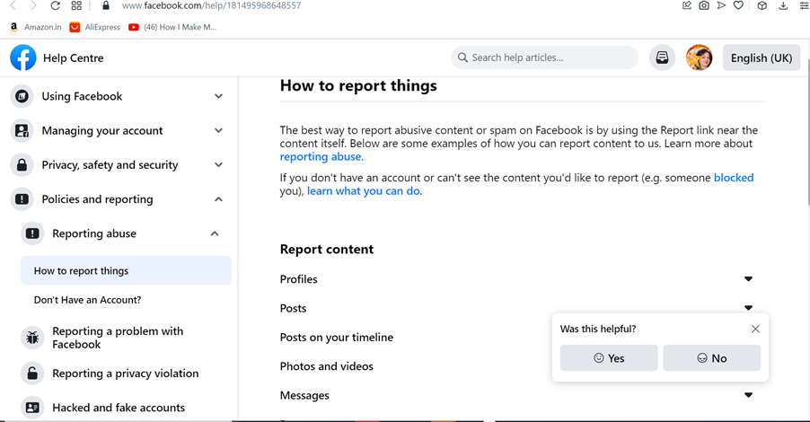
how to report

Slide 29
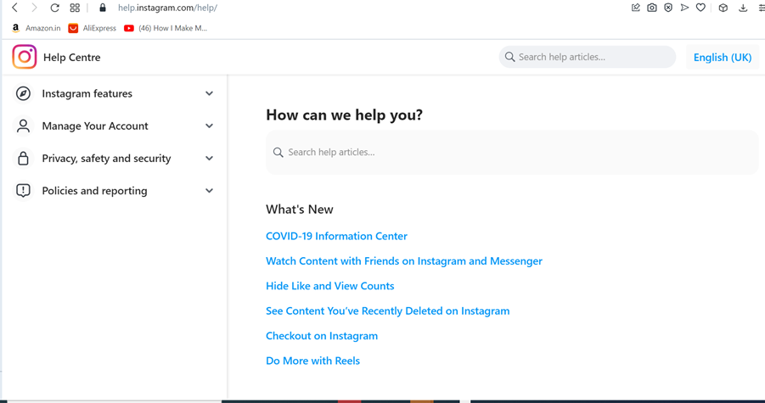
how to report

Slide 30
Tools on social media accounts for safety
1. Moderate Comments
2. Encourage positive Interactions (Reconsider and Restrict features)
3. Remove/Block/Mute

Slide 31
Moderate Comments
Instagram
Facebook
Adding words, phrases, numbers or emojis to your Custom Word List to be hidden from your comments or message requests

Slide 32
Unfollow/Block/Mute
Facebook
Twitter

Slide 33
5
Credits: UNICEF

Slide 34
Tips to Protect Yourself
1. Think twice before posting or sharing anything online.
2. Don’t give out personal details.
3. Learn about the privacy settings of your favourite social media apps:
Adjust your account privacy settings
Report hurtful comments, messages and photos
Unfriend or block people .
Let comments by certain people to appear only to them without completely blocking them.
Delete posts on your profile or hide them from specific people.
4. Keep strong passwords

Slide 35
6
Credits: UNICEF

Slide 36
IT Act, 2000
Up to three to five years in jail and a fine of one lakh rupees, or both, may be imposed for computer-related offences, and in extreme circumstances, even more.
Sections 66C, 66D, and 66E of the IT Act impose penalties on anybody found guilty of an offence involving disrespectful behaviour online, on social media, or with other digital media.
IT Act sections 67, 67A, and 67B address the publication and electronic transmission of content involving sexually explicit acts, etc.

Slide 37
POCSO Act 2012
In cases of online harassment involving minors, the Protection of Children from Sexual Offenses (POCSO) Act, 2012, can be invoked to protect children from sexual abuse and harassment.
The punishment for cyberbullying and online harassment can include imprisonment and fines, and it may vary based on the specific provisions applied and the circumstances of each case.

Slide 38
National cyber crime reporting portal

Slide 39
The victims of a crime can also register with a nearby cyber-crime cell as an alternative to making a formal complaint. Cyber Crime Portal State-wise, Nodal cyber cell officers and grievance officers’ contact details and e-mail IDs are provided on the website: https://cybercrime.gov.in

Slide 41
Punishment is not always the most effective way to change the behaviour of bullies. It is often better to focus on repairing the harm and mending the relationship.
This Photo by Unknown Author is licensed under CC BY-NC-ND

