Slide 1
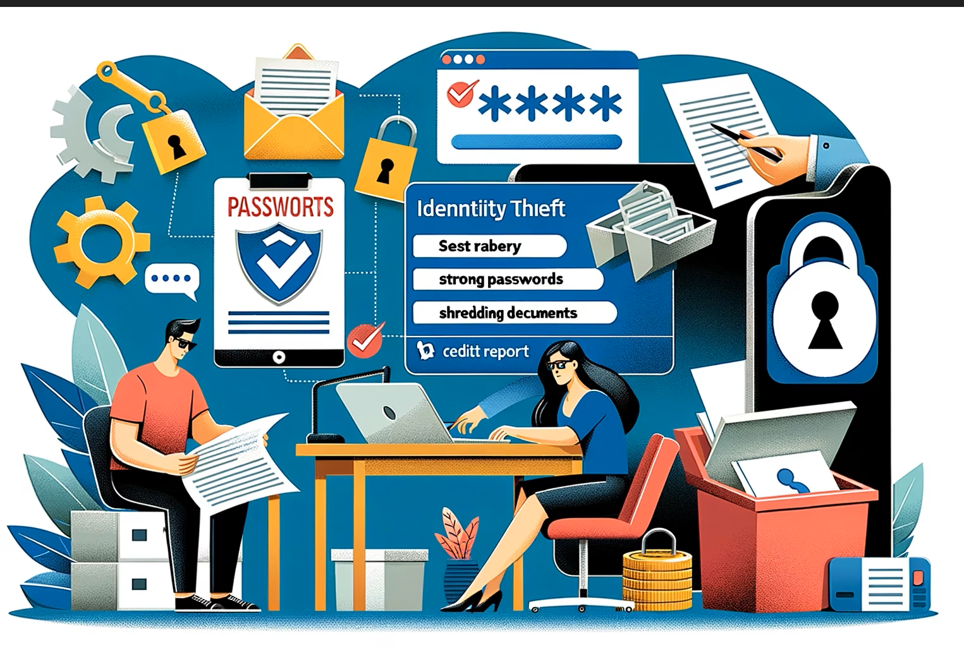
IDENTITY THREATS
Concept & Safety Concern

Slide 2
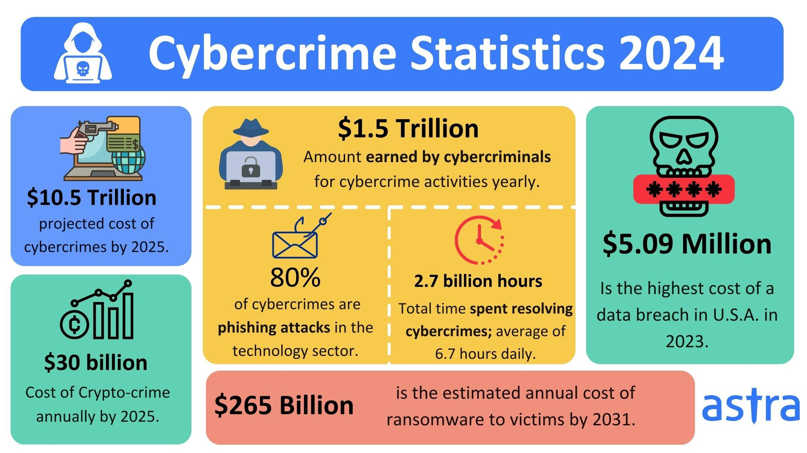

Slide 3
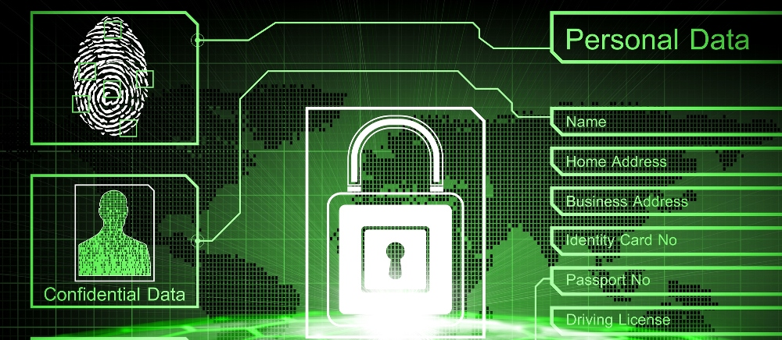
What defines our digital identity
one-to-one relationship between a human and their digital presence
DATE OF BIRTH
USER NAME
PASSWORD
AUTHENTICATION
EMAIL ID
BROWSER ACTIVITY
SOCIAL MEDIA CREDENTIALS
AADHAR CARD NUMBER
ATM CARD NUMBER
PAN CARD
PASSPORT NUMBER
EMAIL ID
PURCHASE HISTORY
FINANCIAL IDENTITY

Slide 4
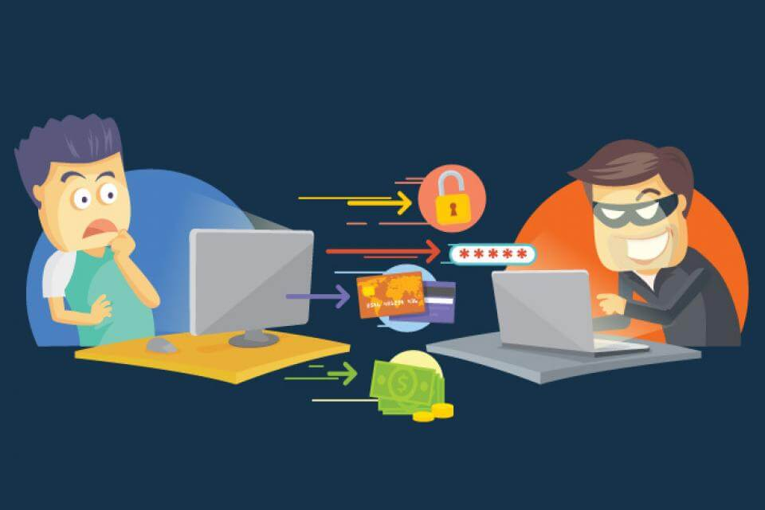

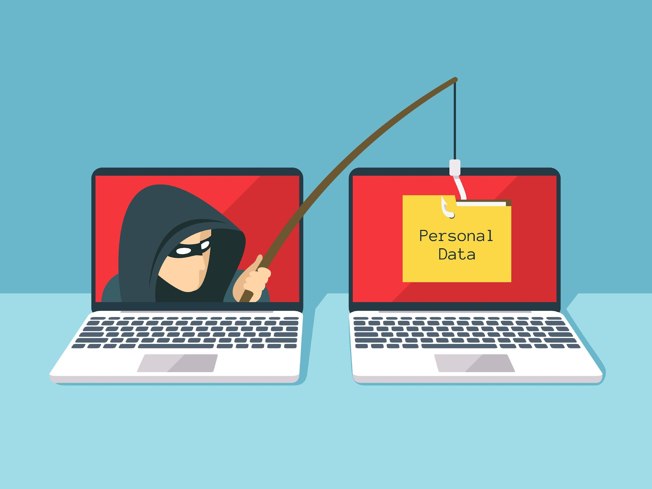
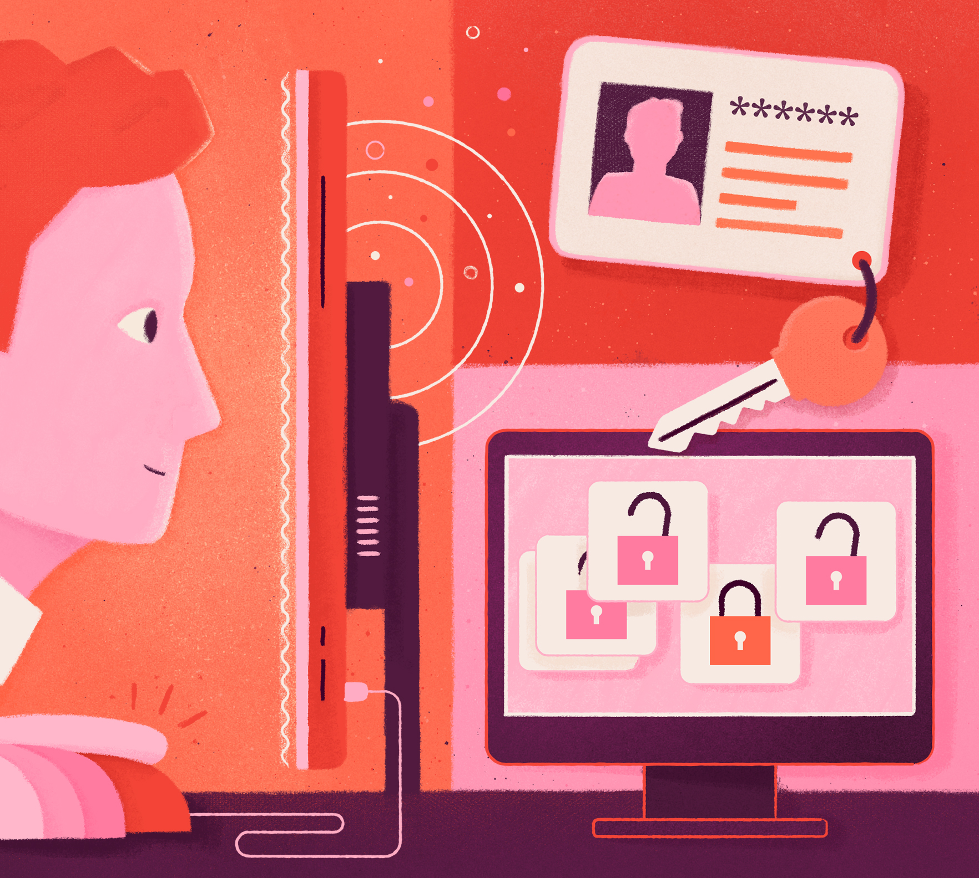
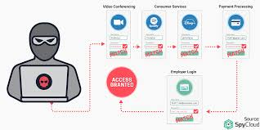
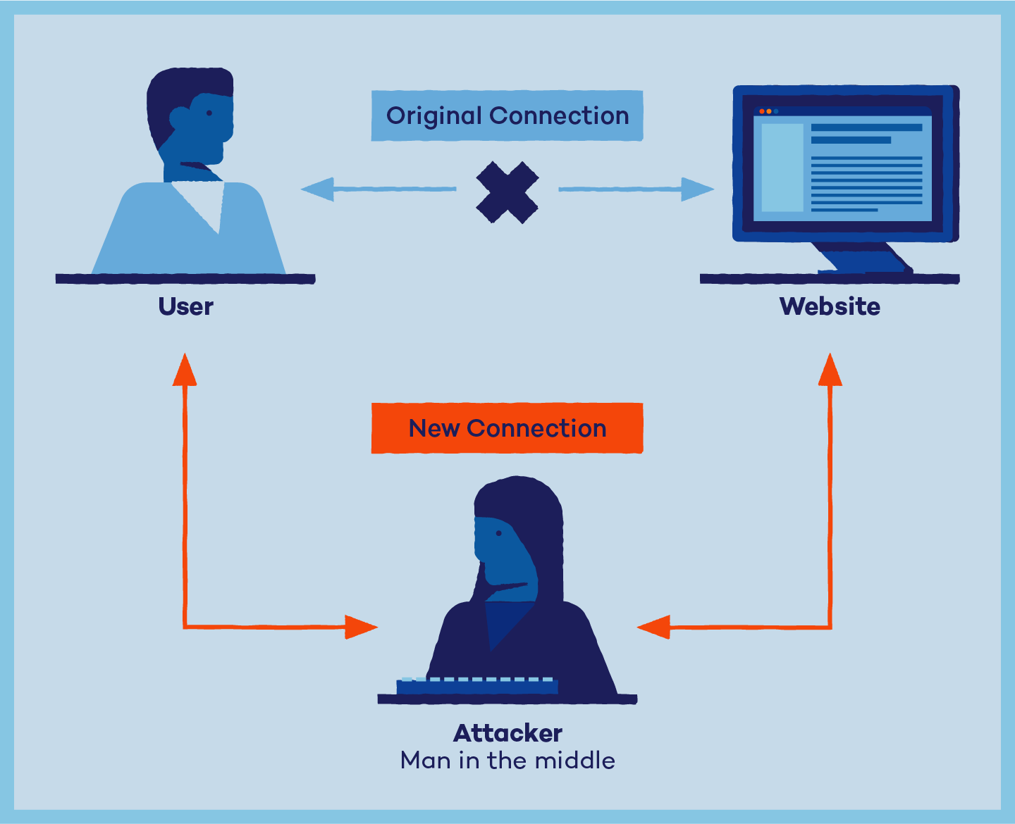
IDENTITY THREATS
IDENTITY THEFT
SOCIAL ENGINEERING
ONLINE FRAUDS
CREDENTIAL STUFFING
PASSWORD SPRAYING
MAN IN THE MIDDLE

Slide 5
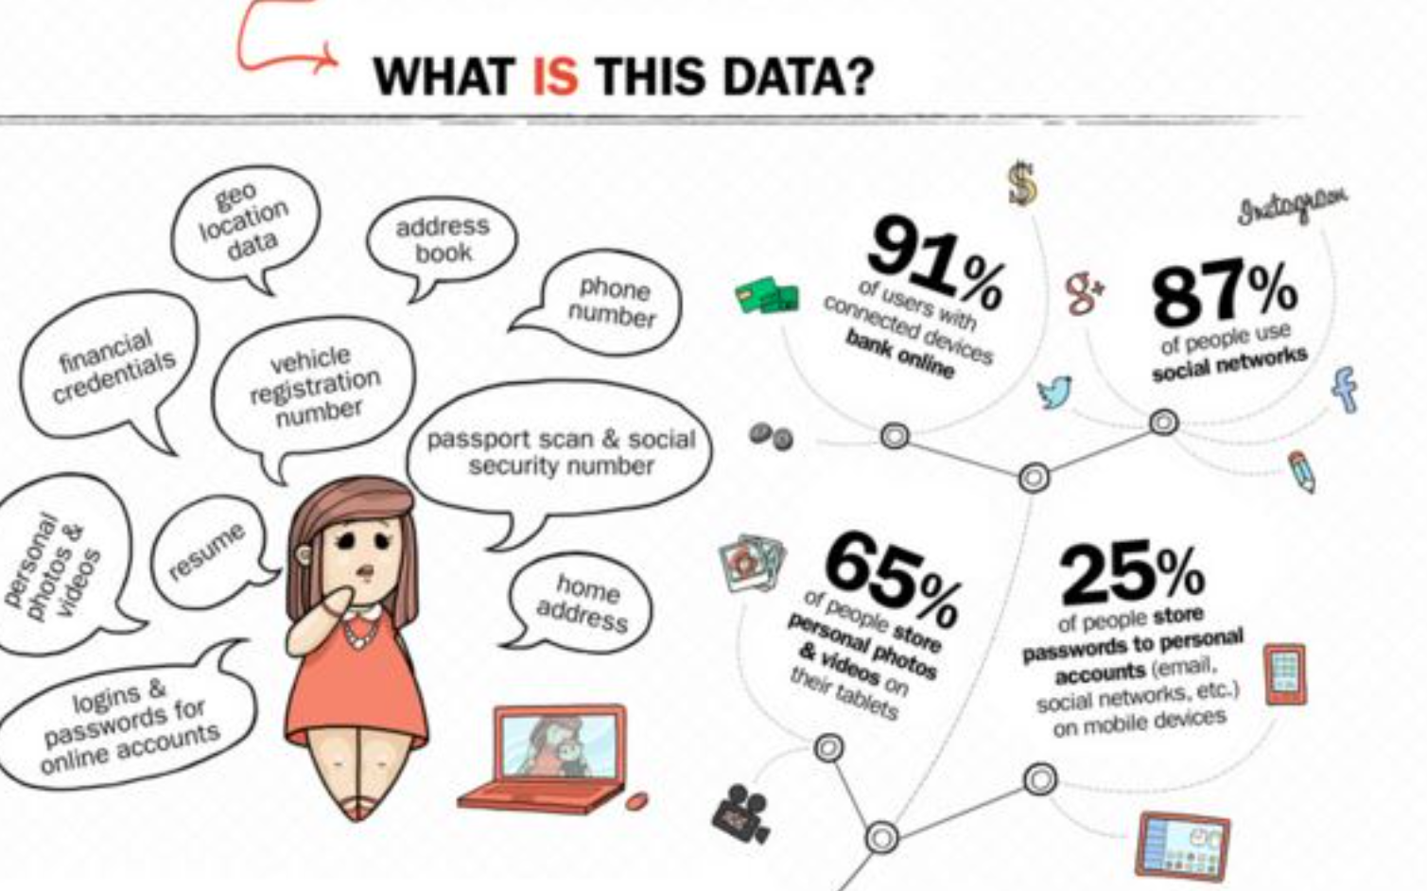
IDENTITY THEFT
Act of wrongfully obtaining someone’s personal information (that defines one’s identity) without their permission.

Slide 6
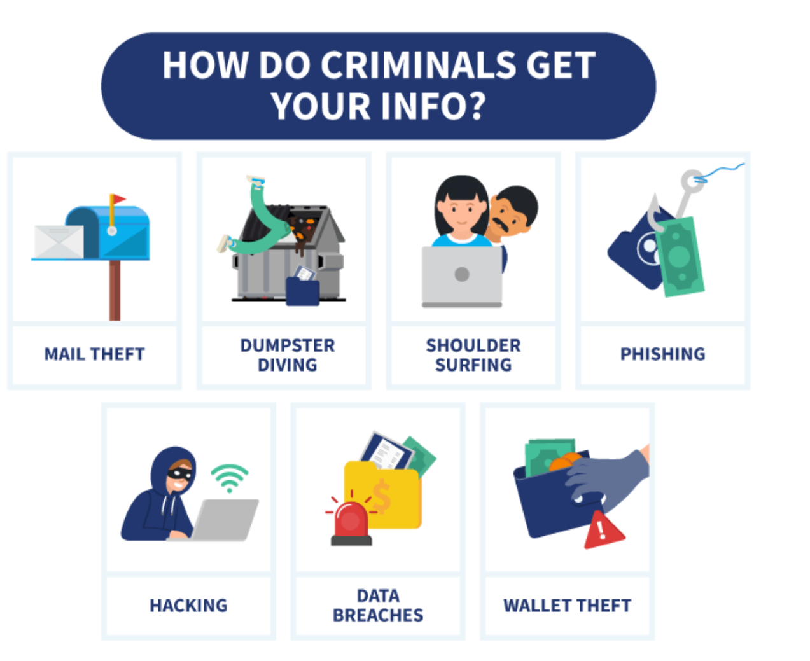

Slide 7
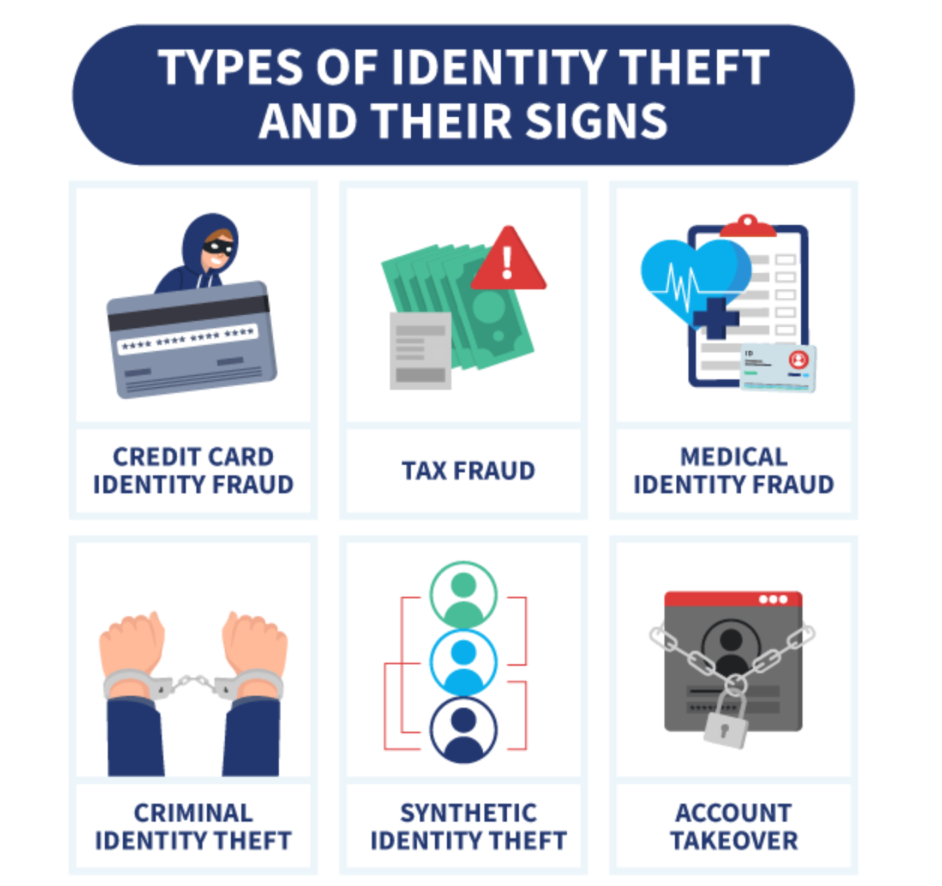

Slide 8
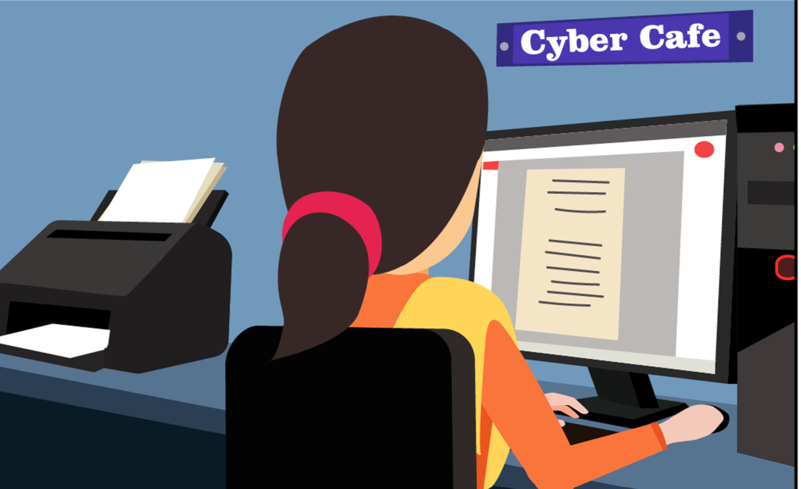
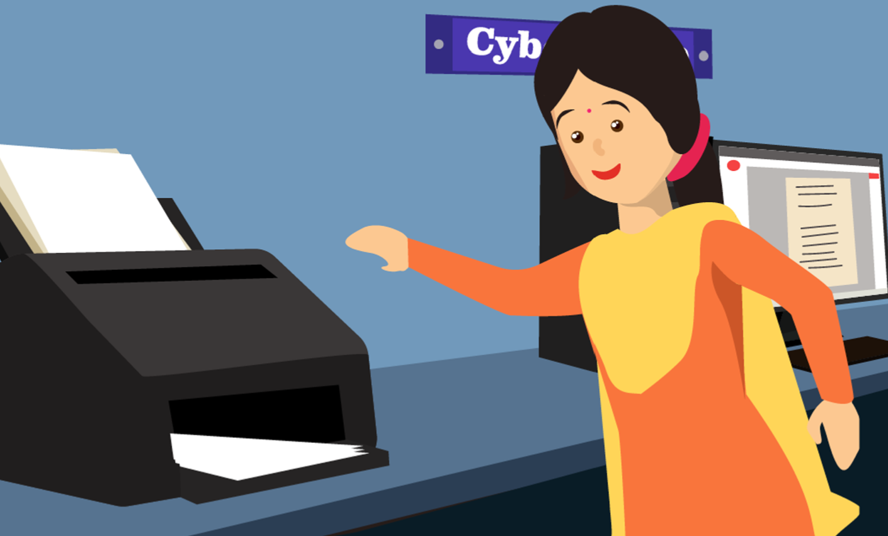
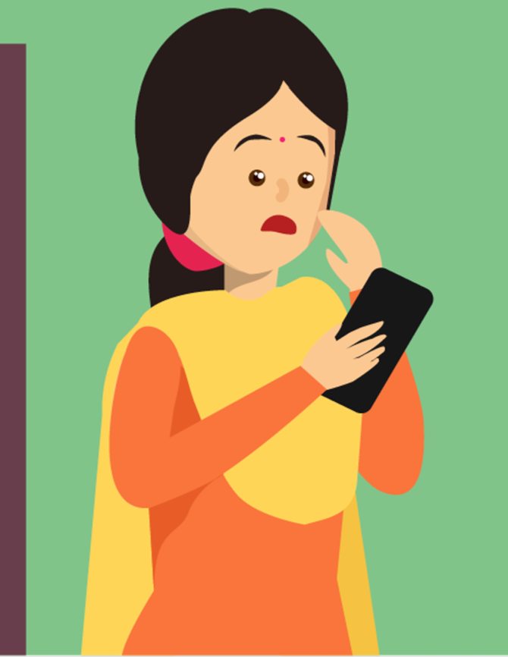
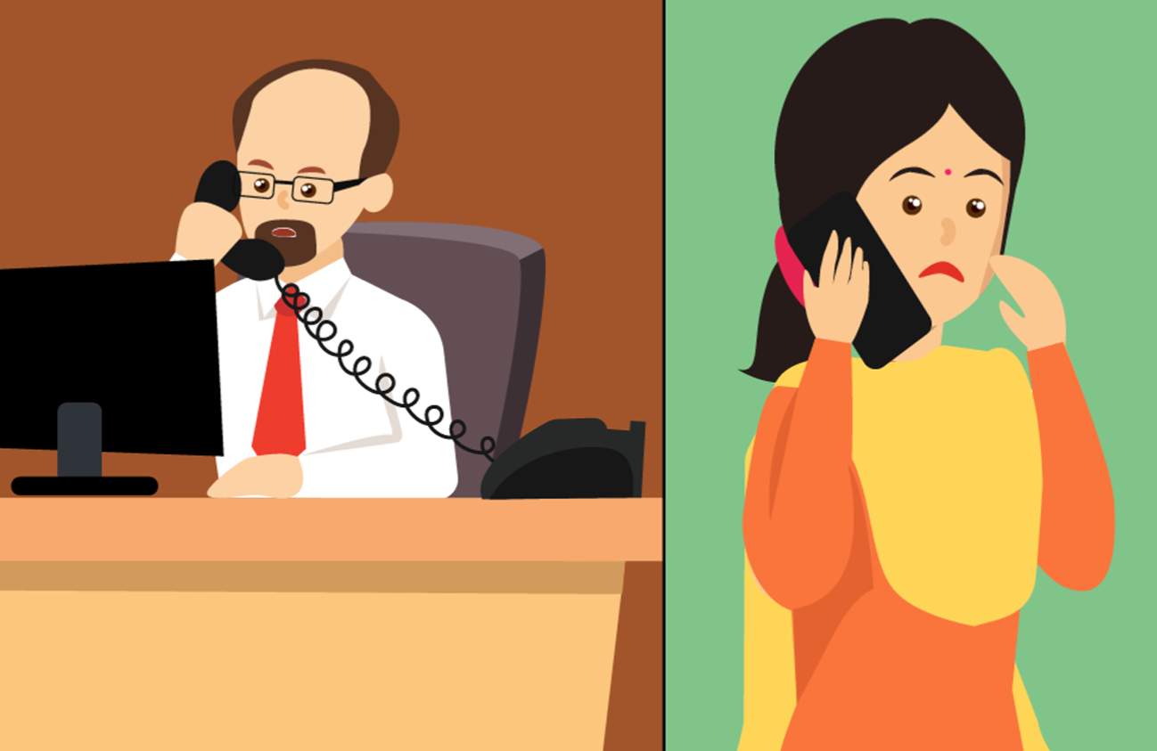

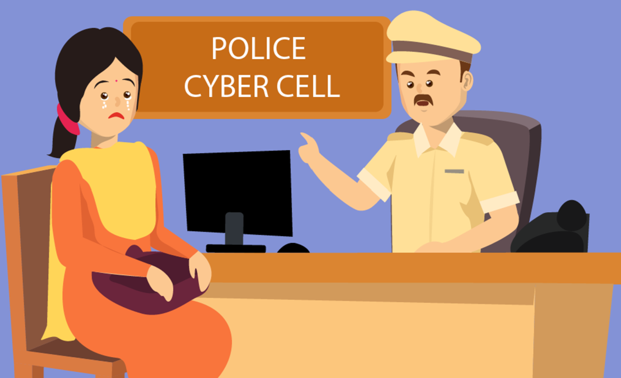
Hacking or gaining access to Social Media Accounts

Slide 9
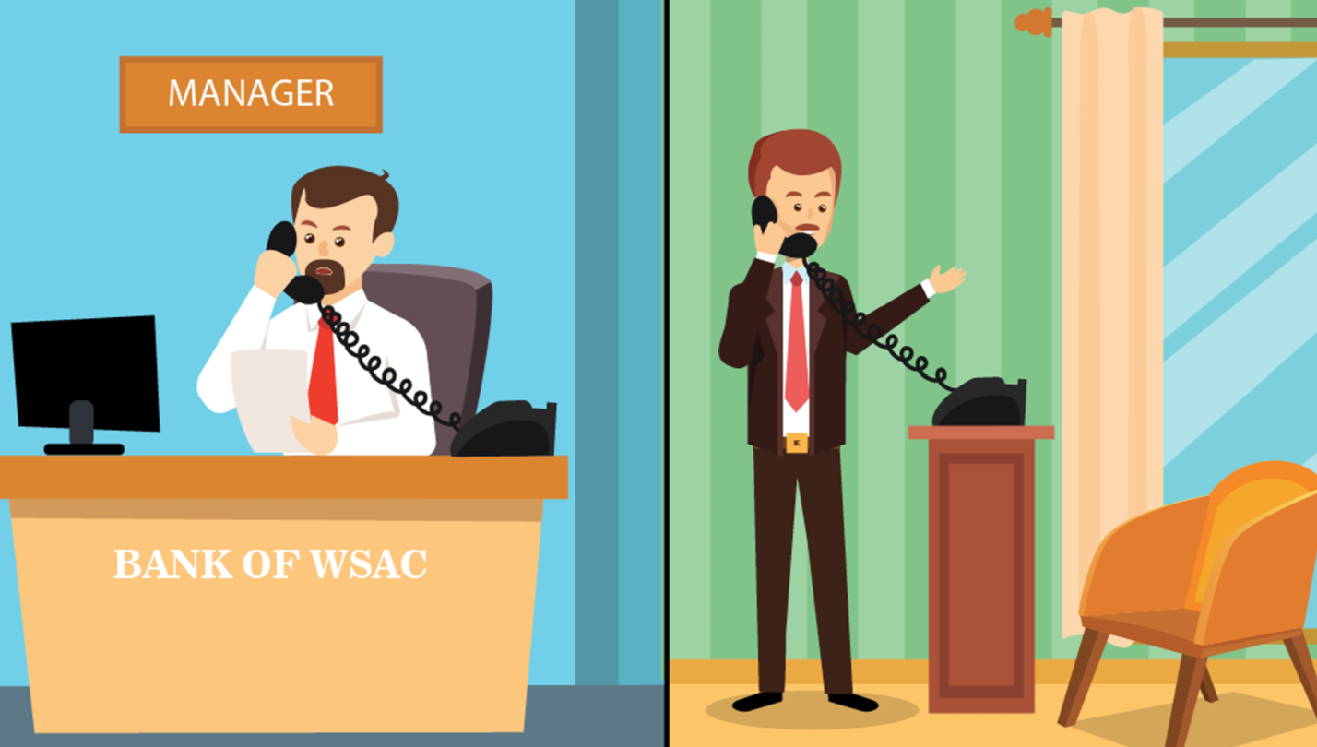
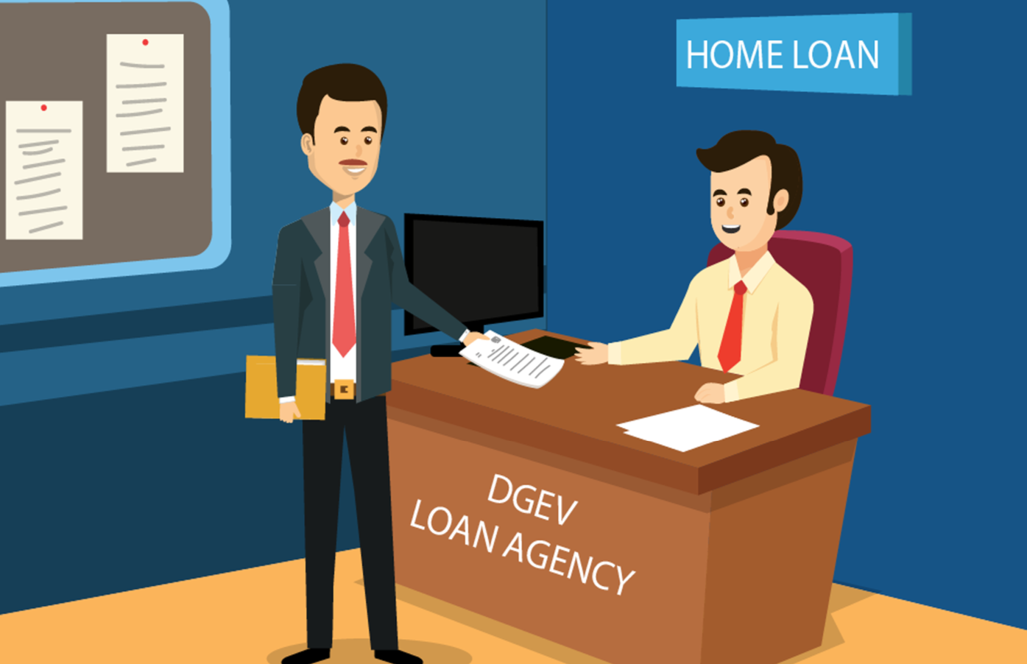
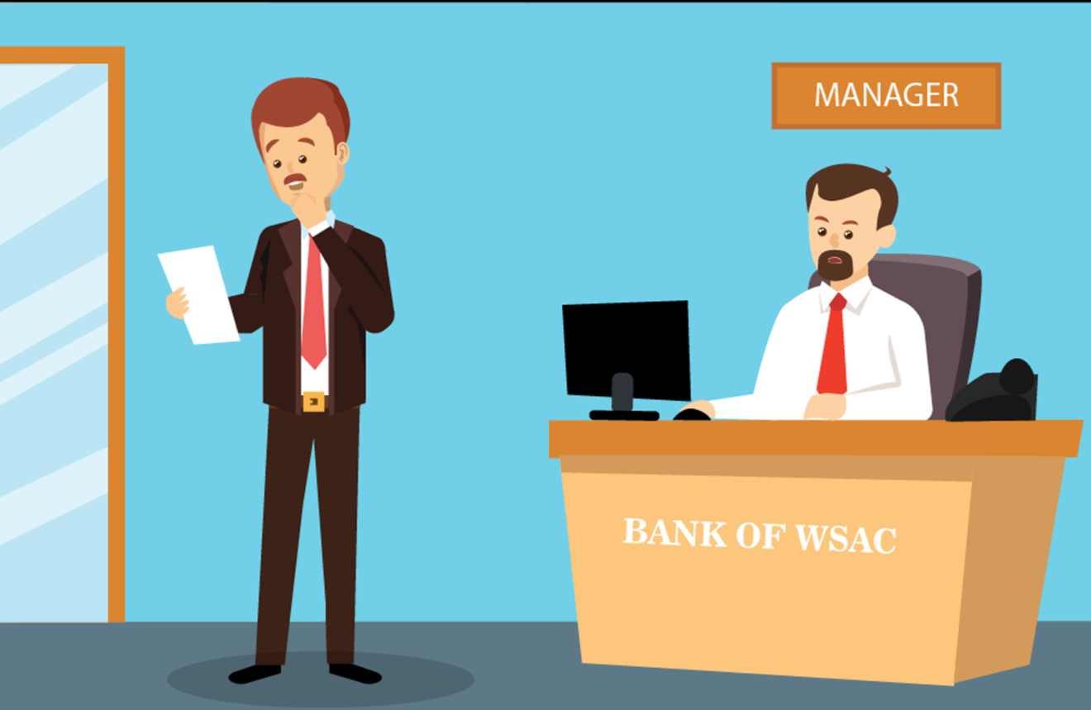
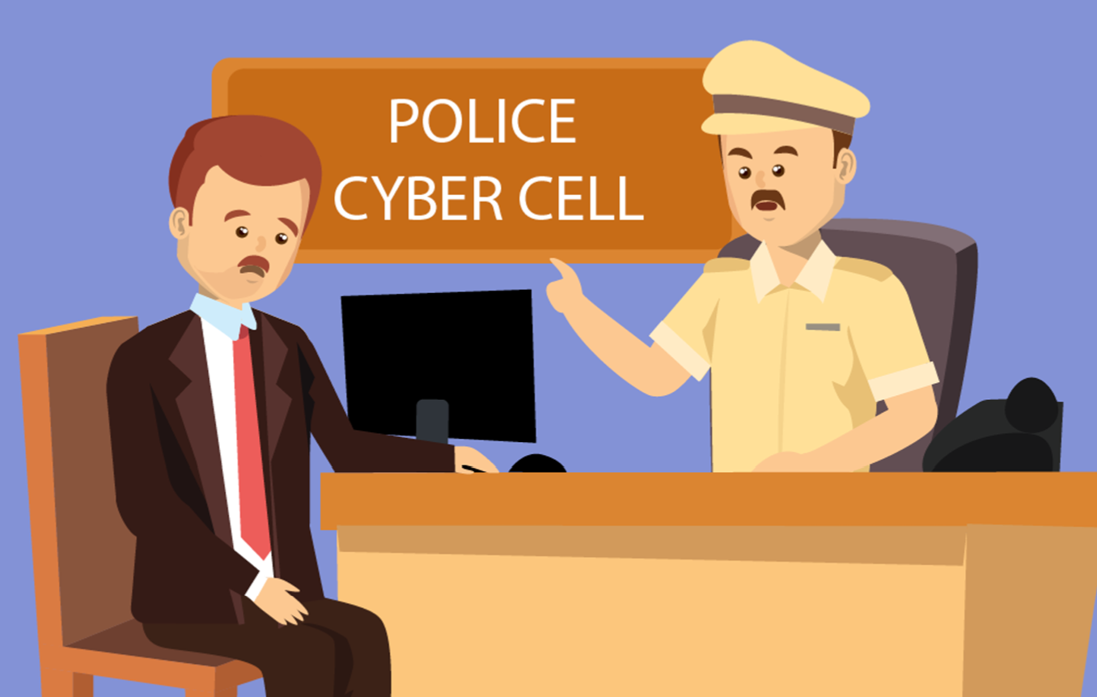

Misuse of photo copies of identity proofs

Slide 10

Social media fake profile scams

Slide 11
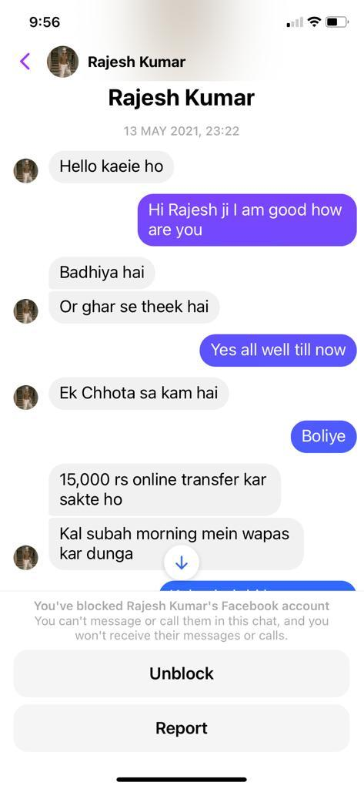
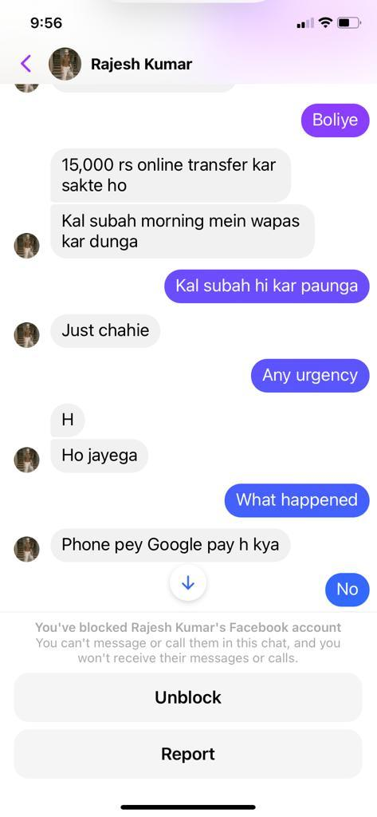
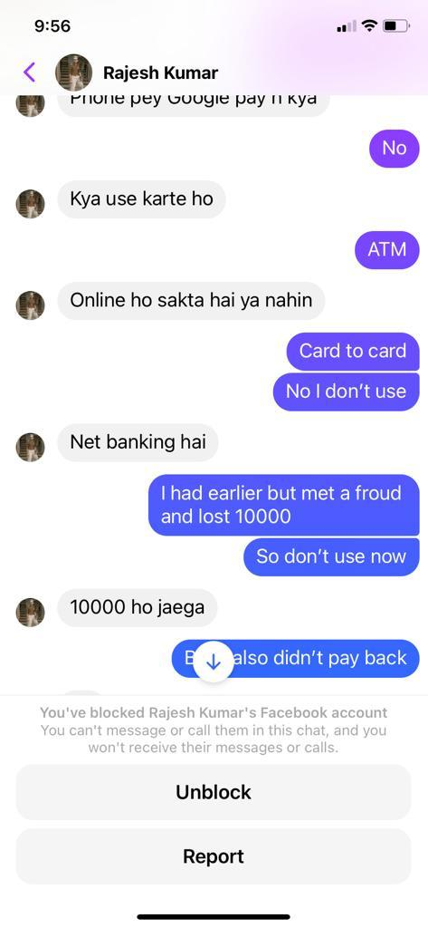
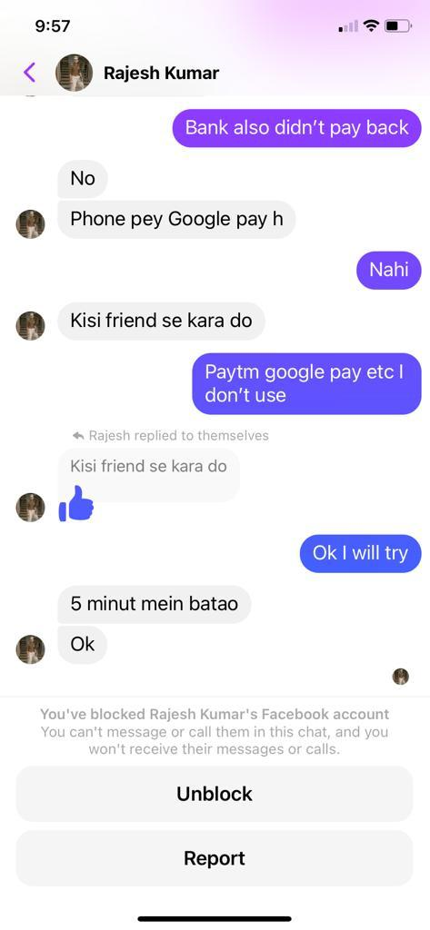

Slide 12
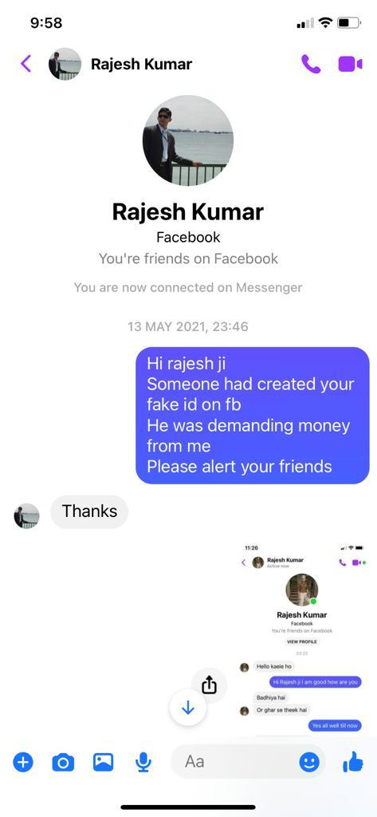
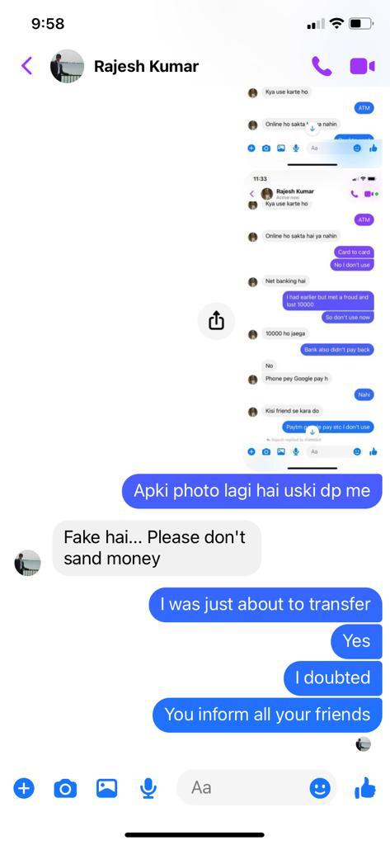
Conversation with Actual
person saved the victim

Slide 13
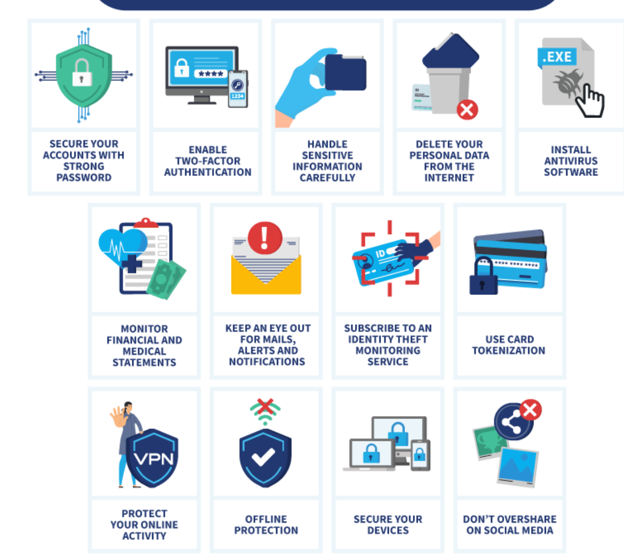
PROTECTION FROM IDENTITY THEFT

Slide 14
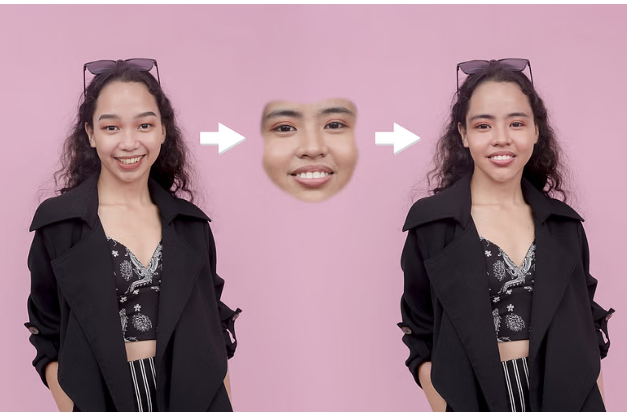
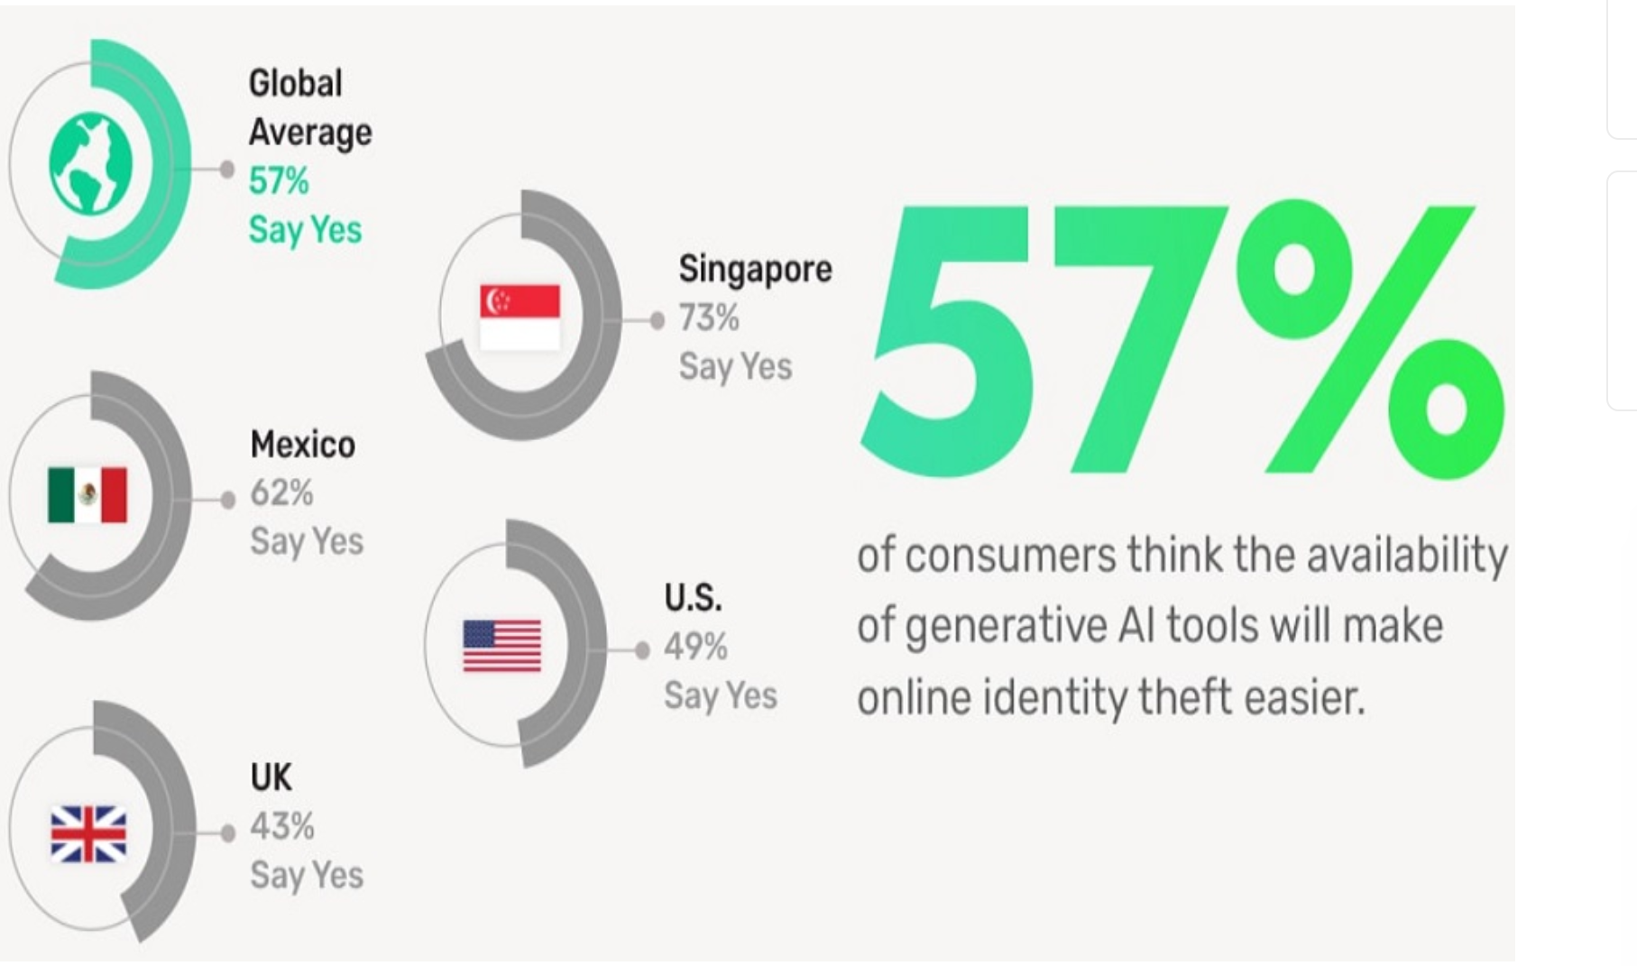
Deep fake – New Identity Threat

Slide 15
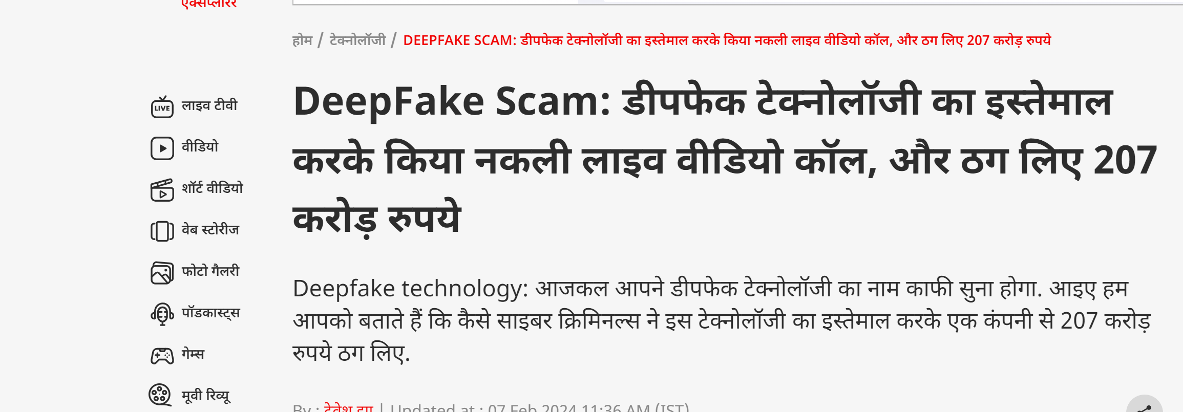

Slide 16
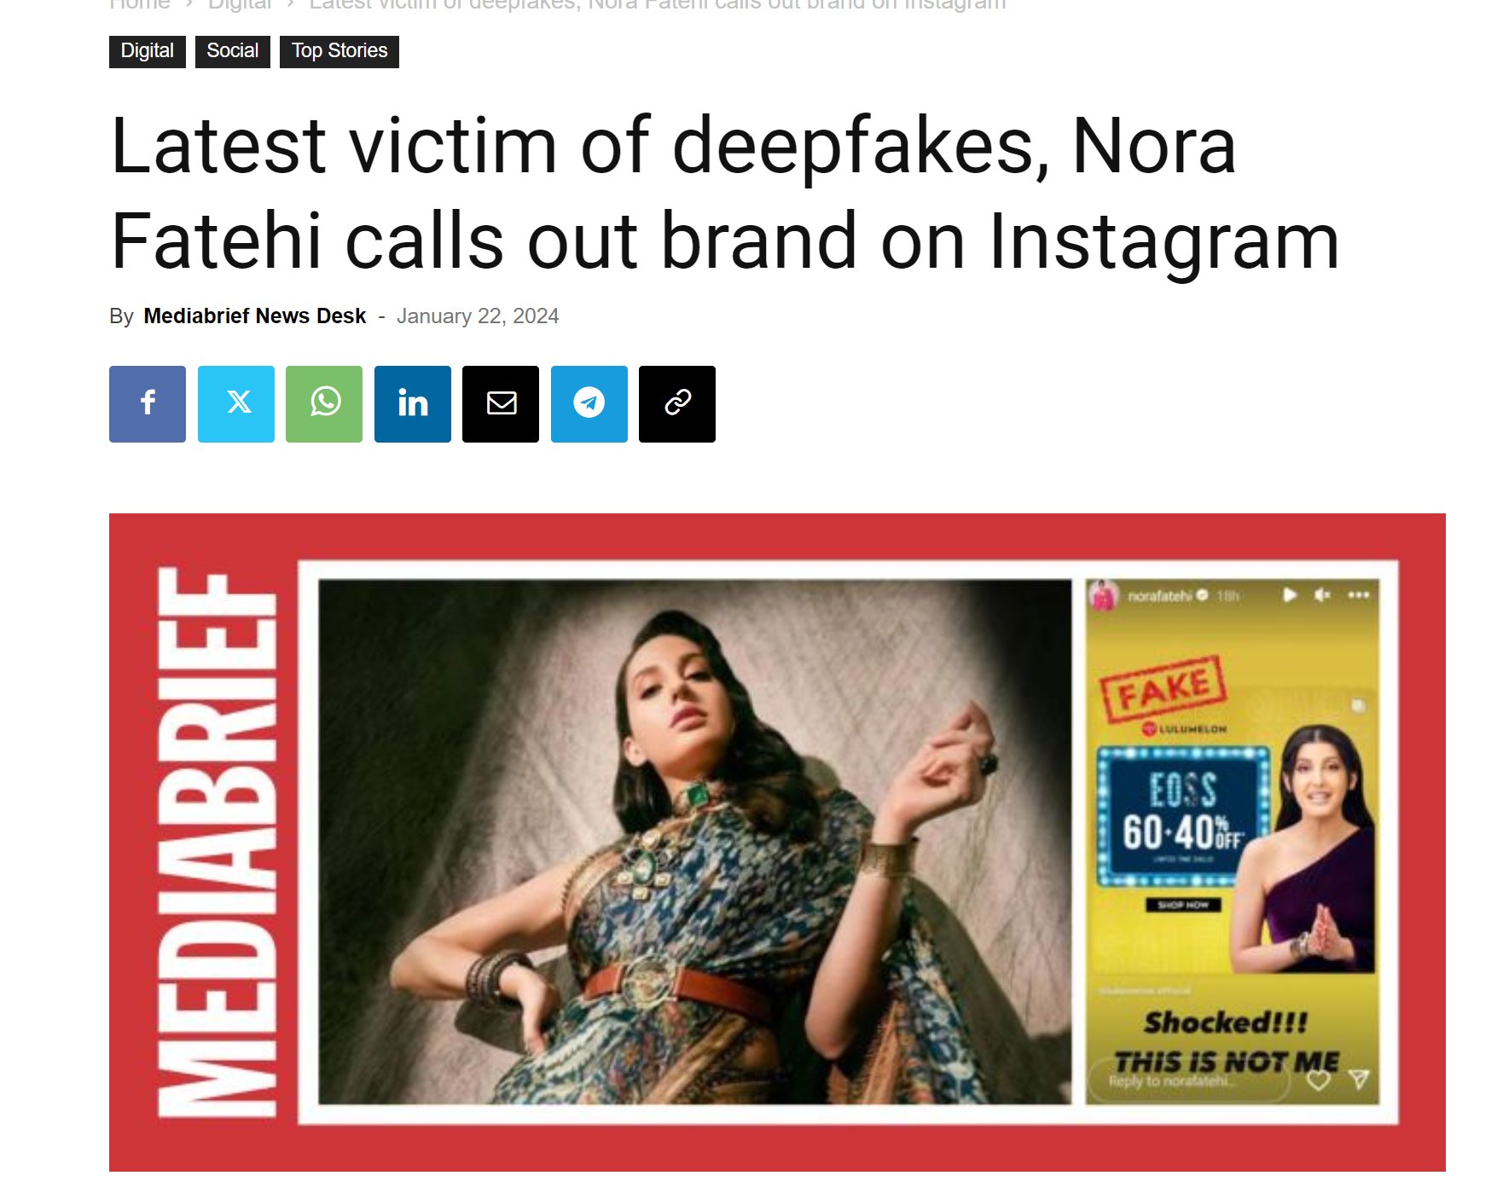


Slide 17




Keypoints of deepfake
Entertainment
Face swapping
Voice Clonning
AI Algorithm

Slide 18

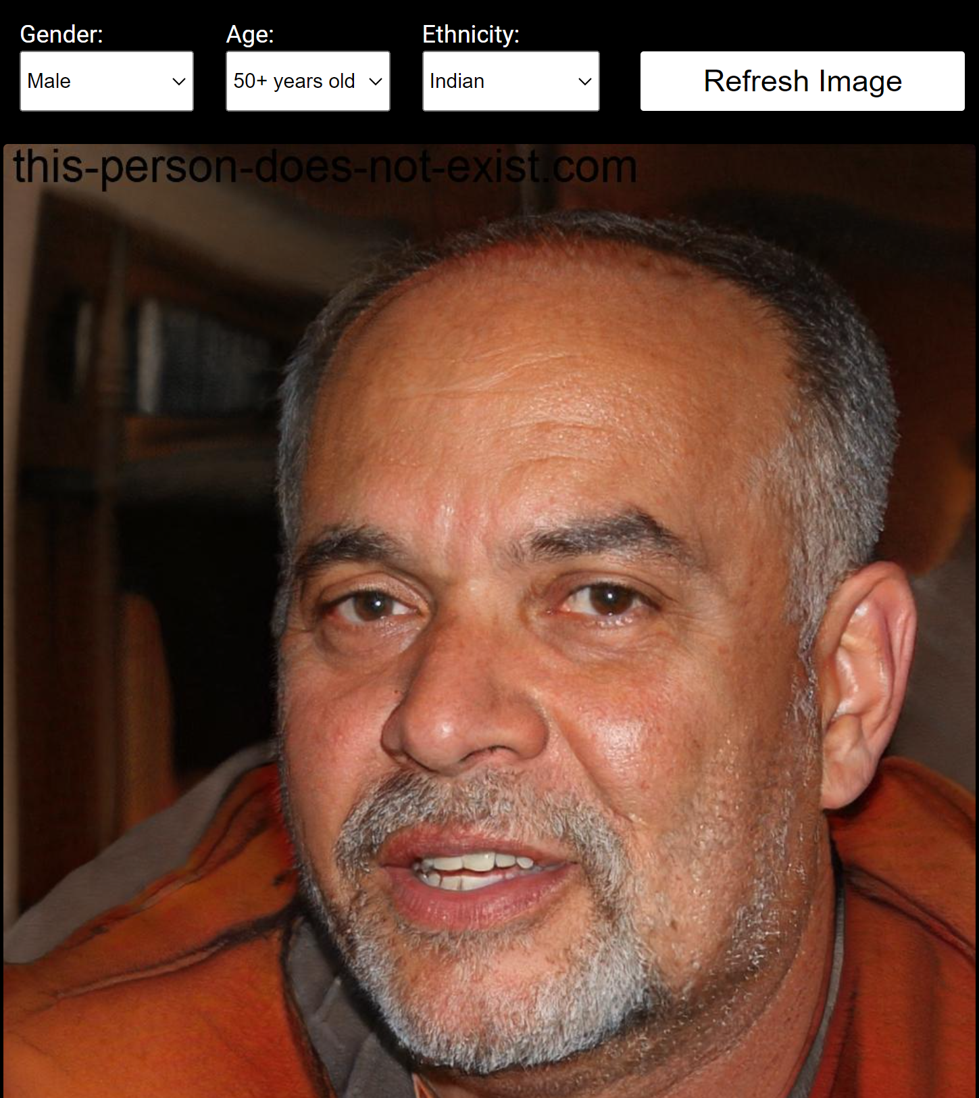
https://this-person-does-not-exist.com/en

Slide 19
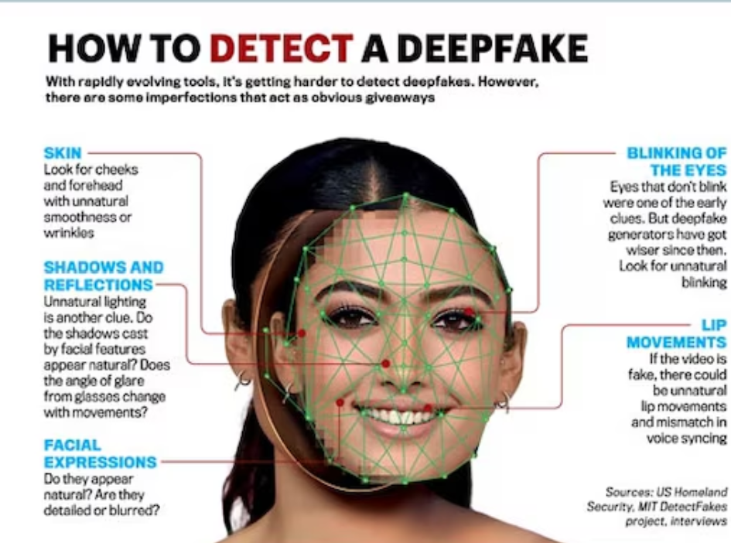

Slide 20
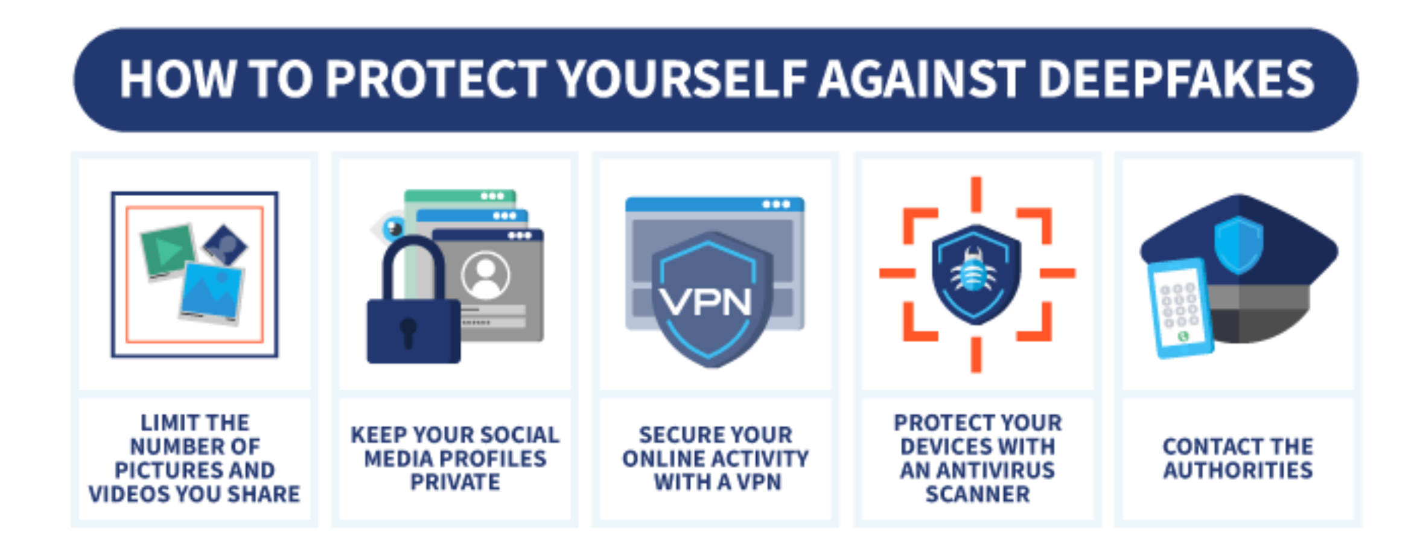

Slide 21
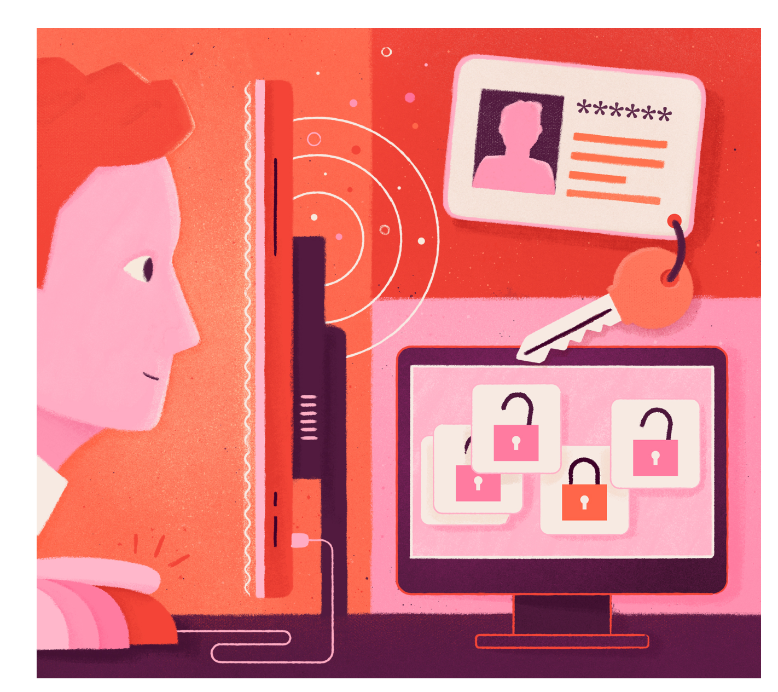
Credential Stuffing
cybercriminal uses stolen usernames and passwords from one organization to access user accounts at another organization.
most common causes of data breaches because 64% of all people reuse the same password on multiple (and sometimes all) accounts.
billions of compromised credentials are circulating on the dark web

Slide 22
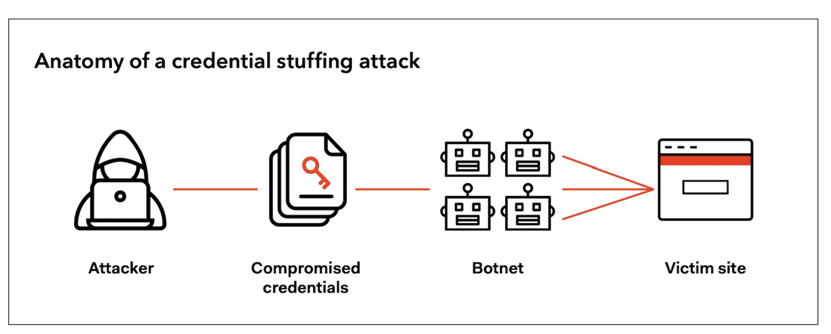
How Credential Stuffing Works

Slide 23
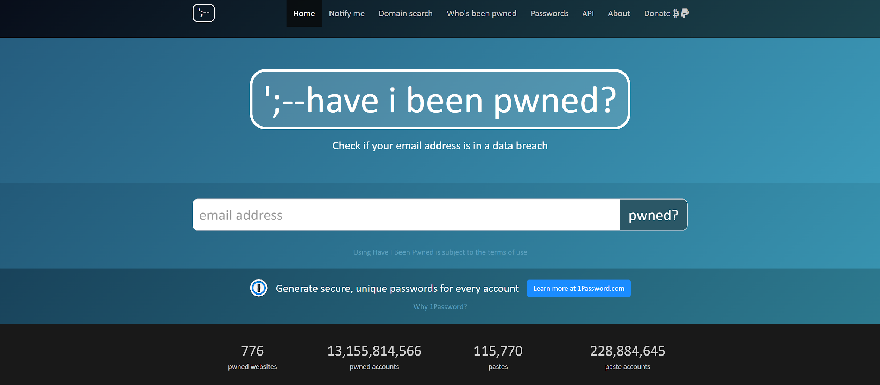
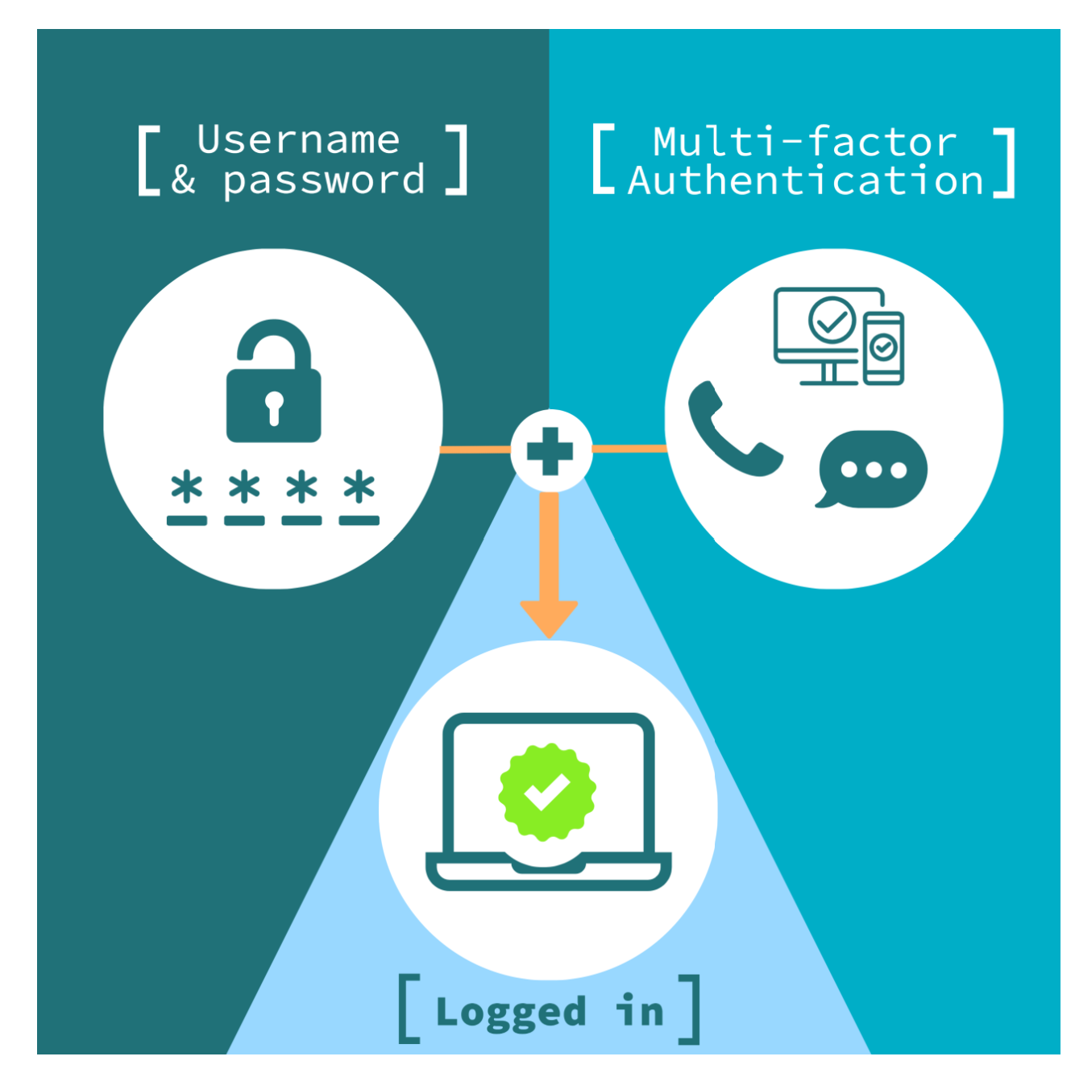
Prevention from Credential Stuffing
Breached Password Protection
Use Multi Factor Authentication

Slide 24
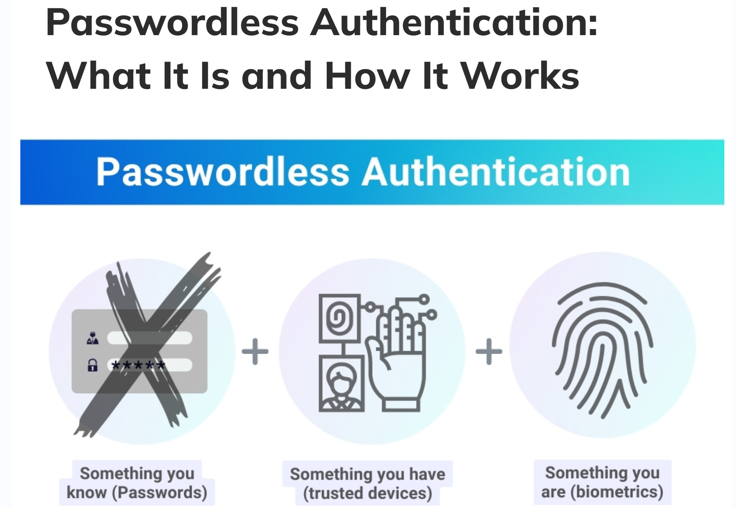
Prevention from Credential Stuffing
Passwordless Authentication = Something you have + Something you are

Slide 25
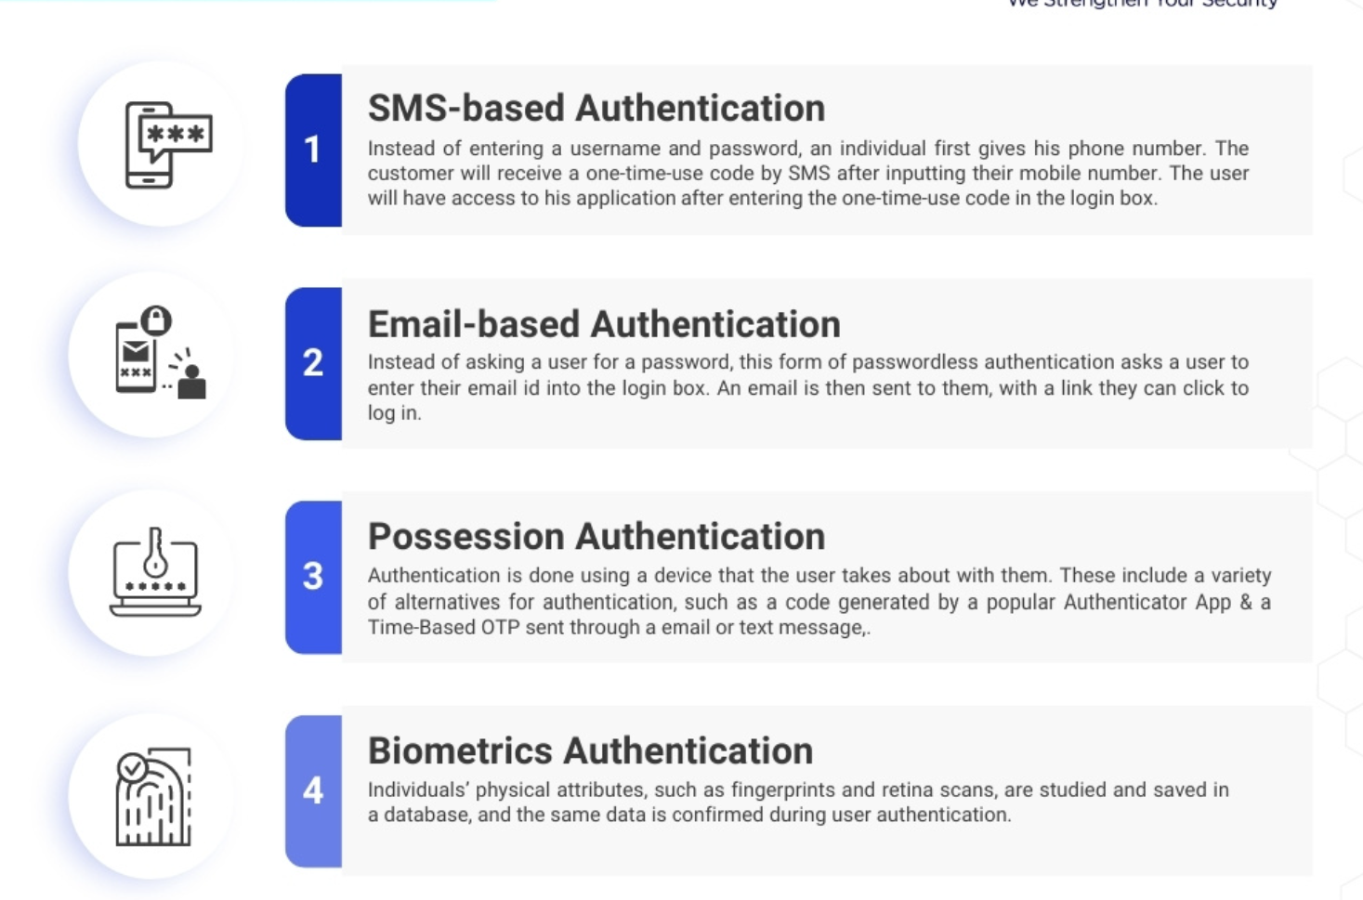
7 types of passwordless authentication

Slide 26
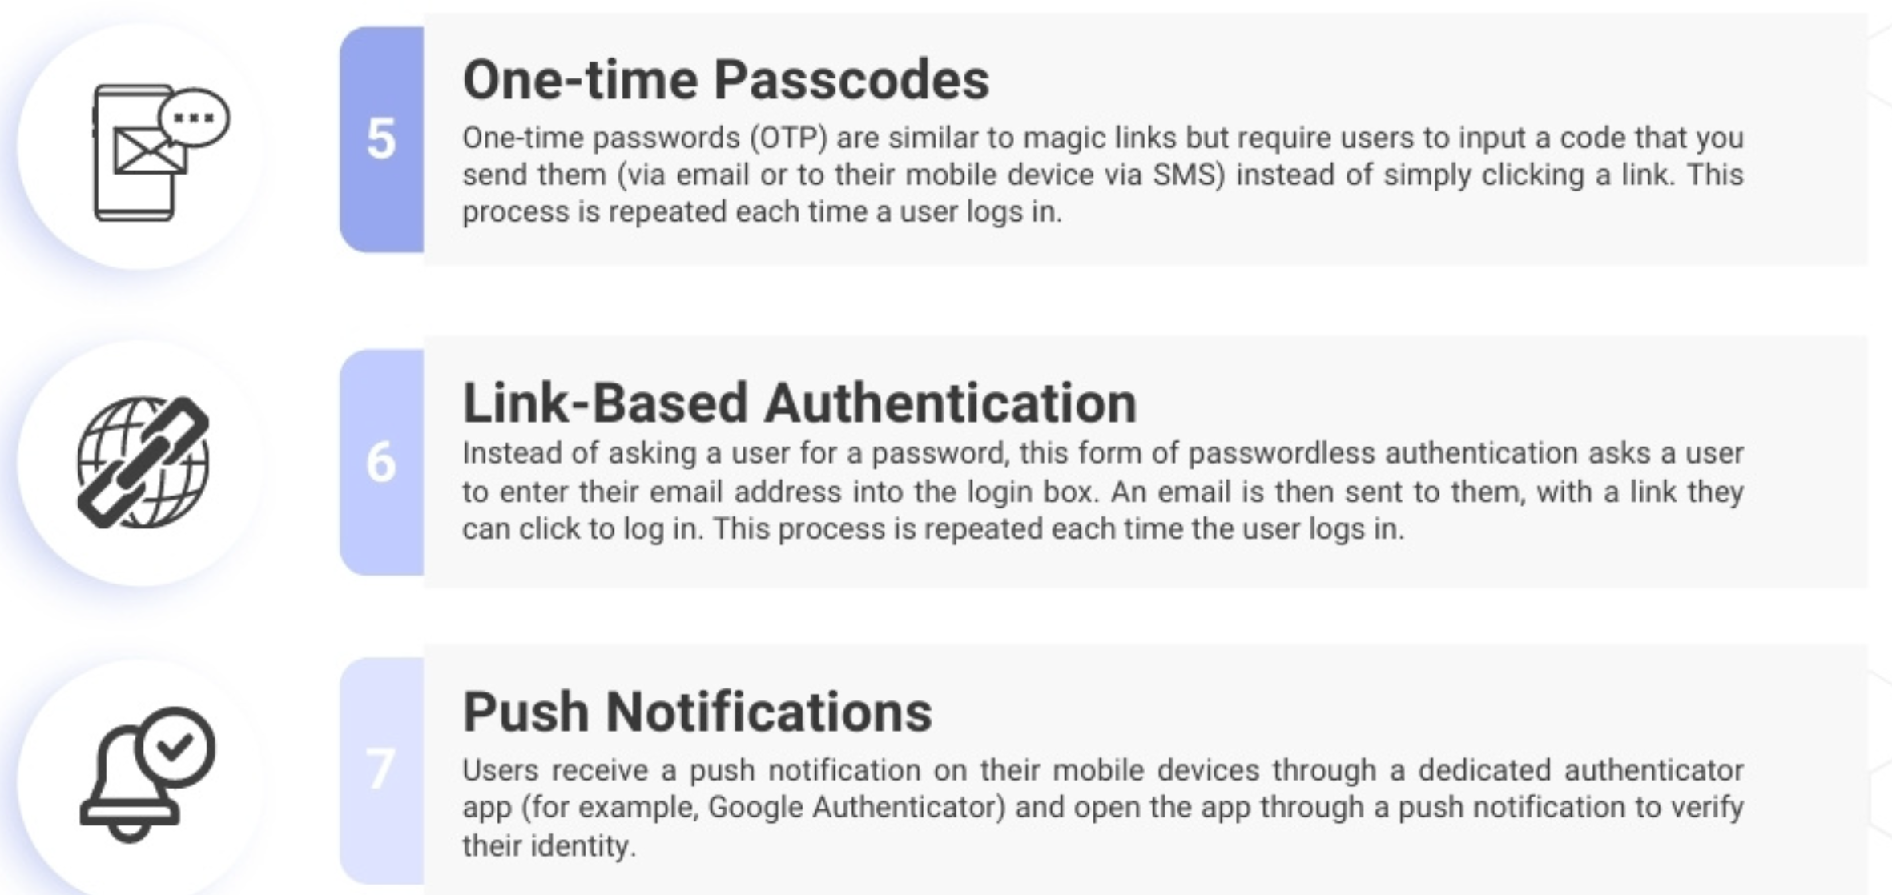
7 types of passwordless authentication

Slide 27
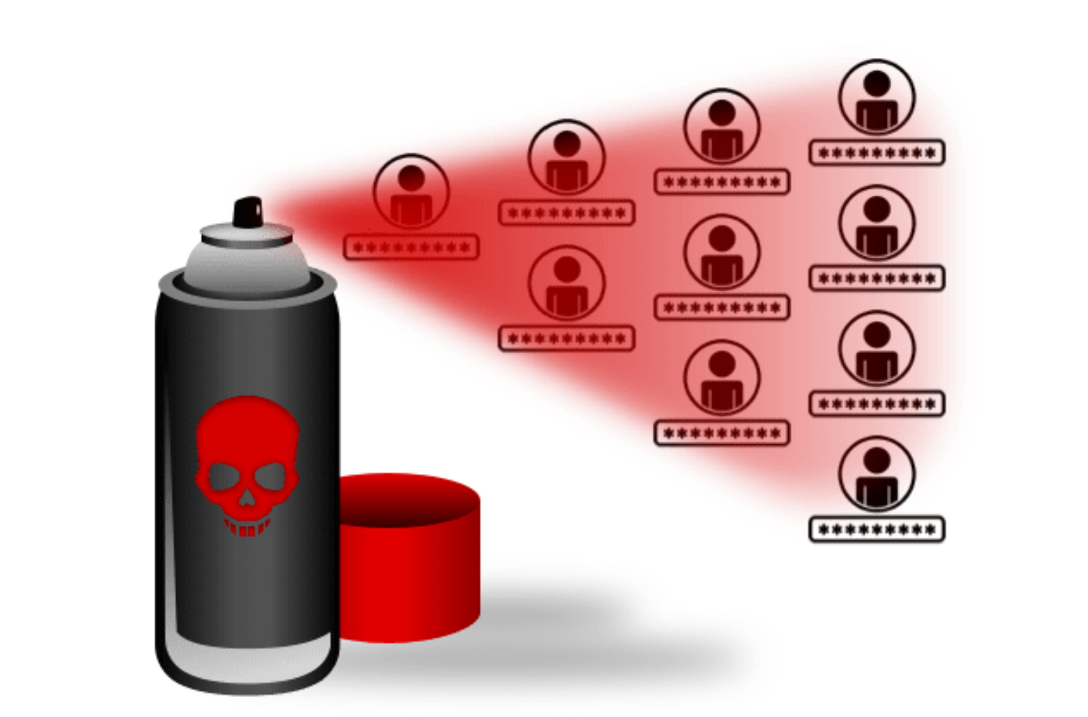
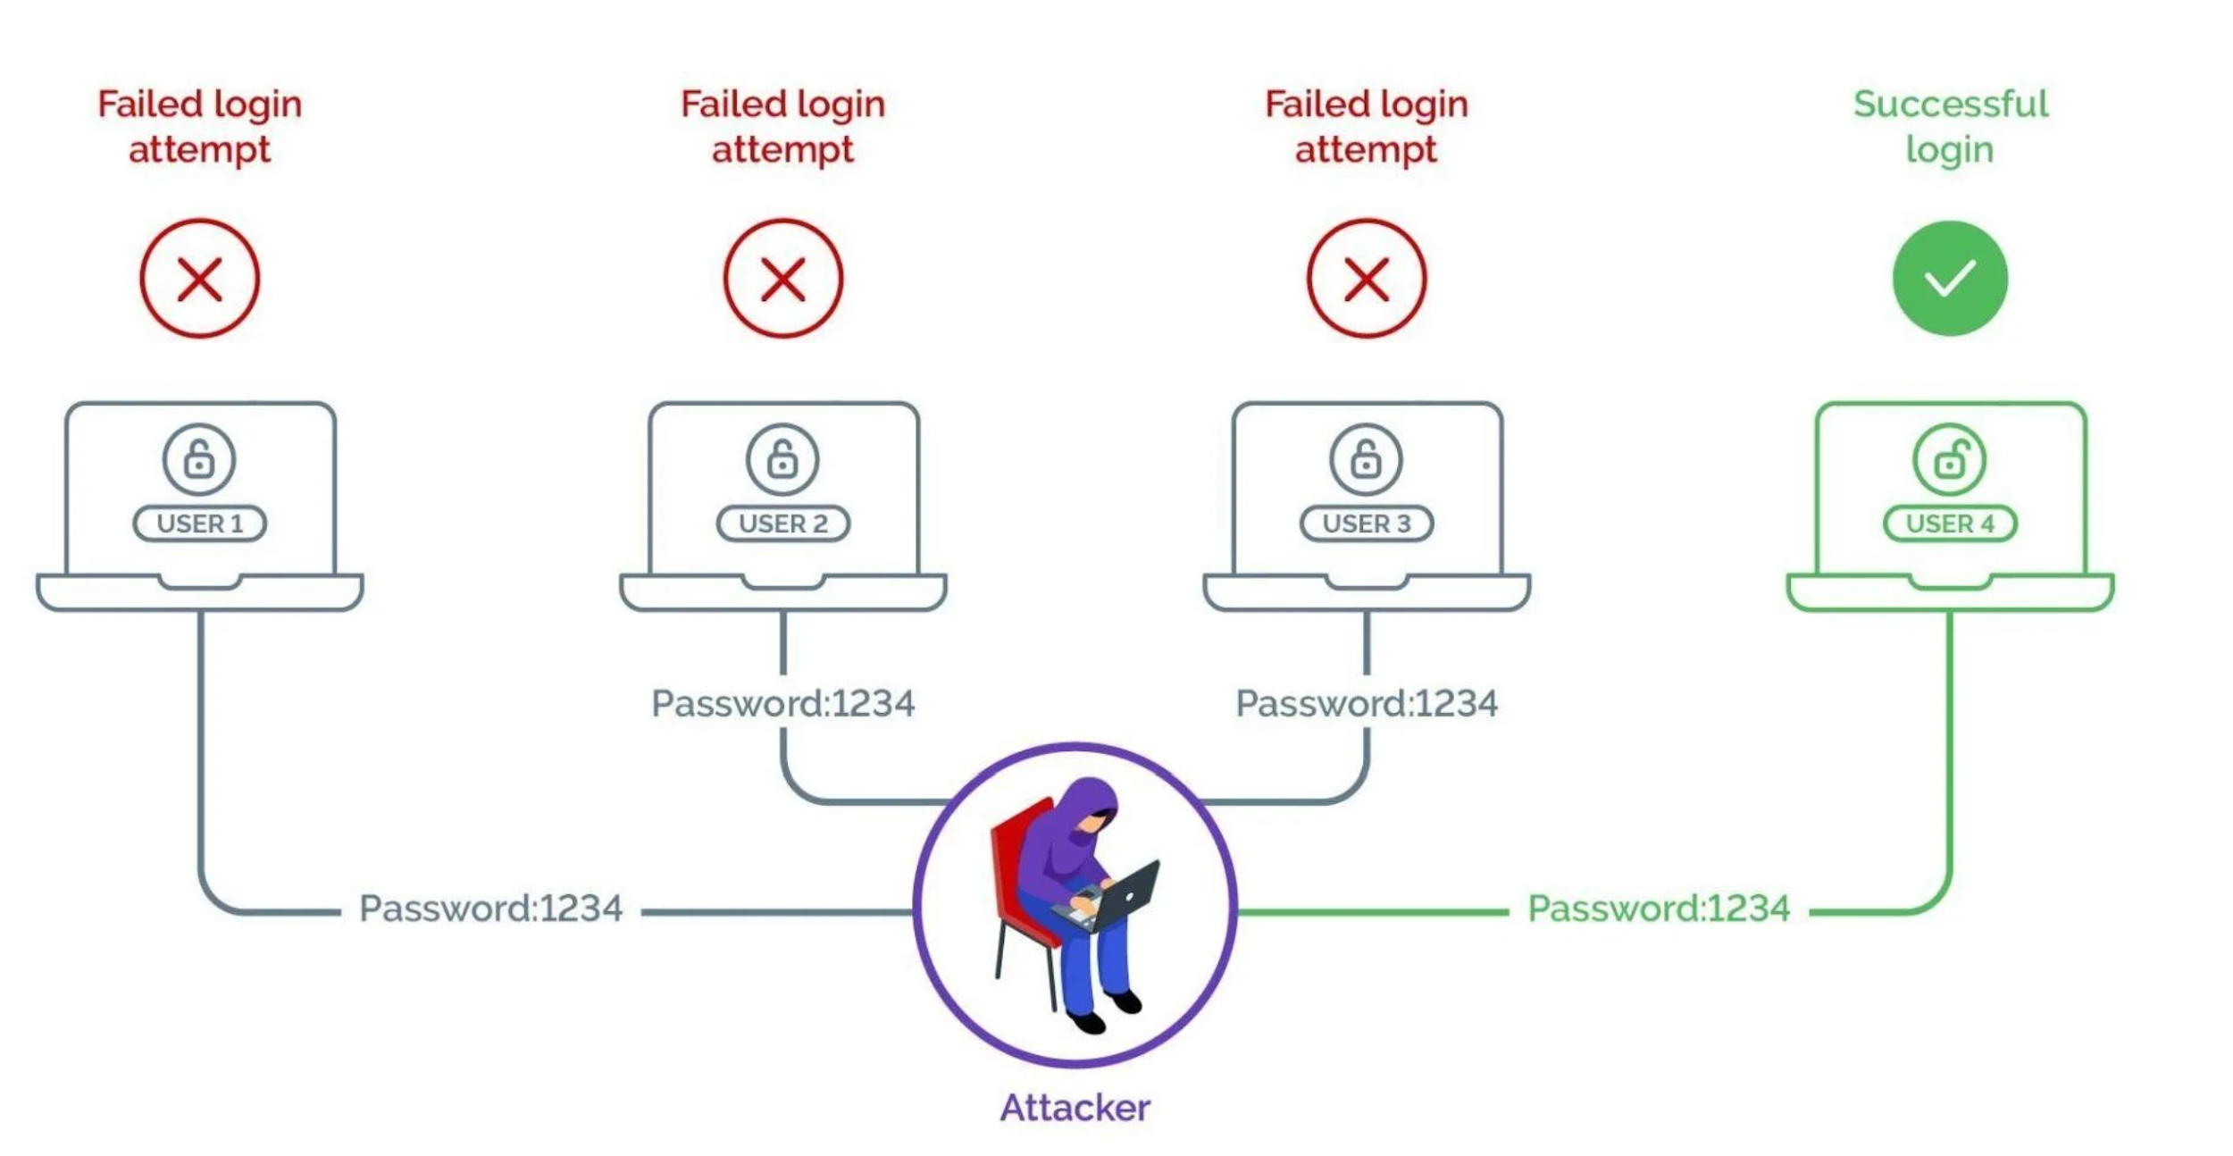
Password Spraying

Slide 28
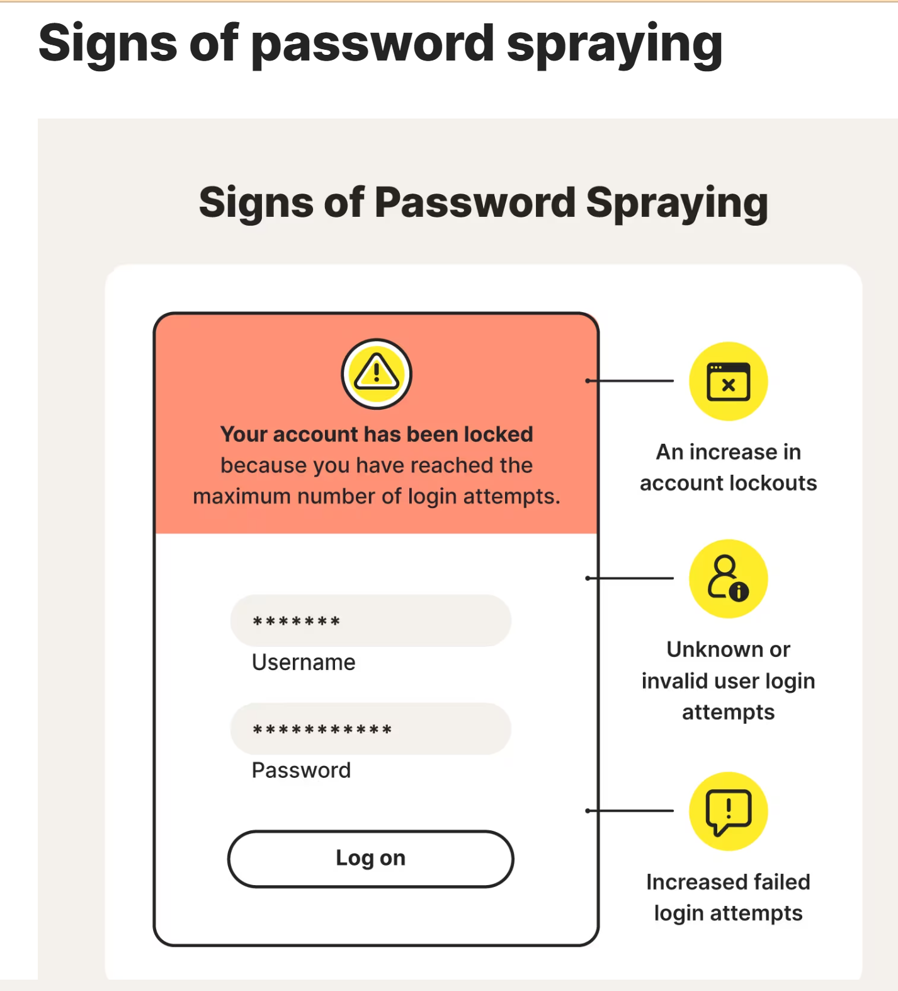
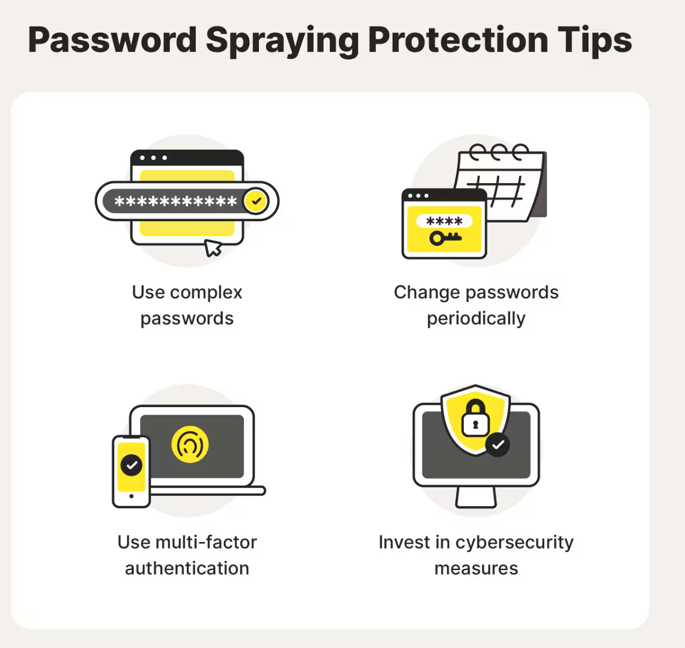

Slide 29
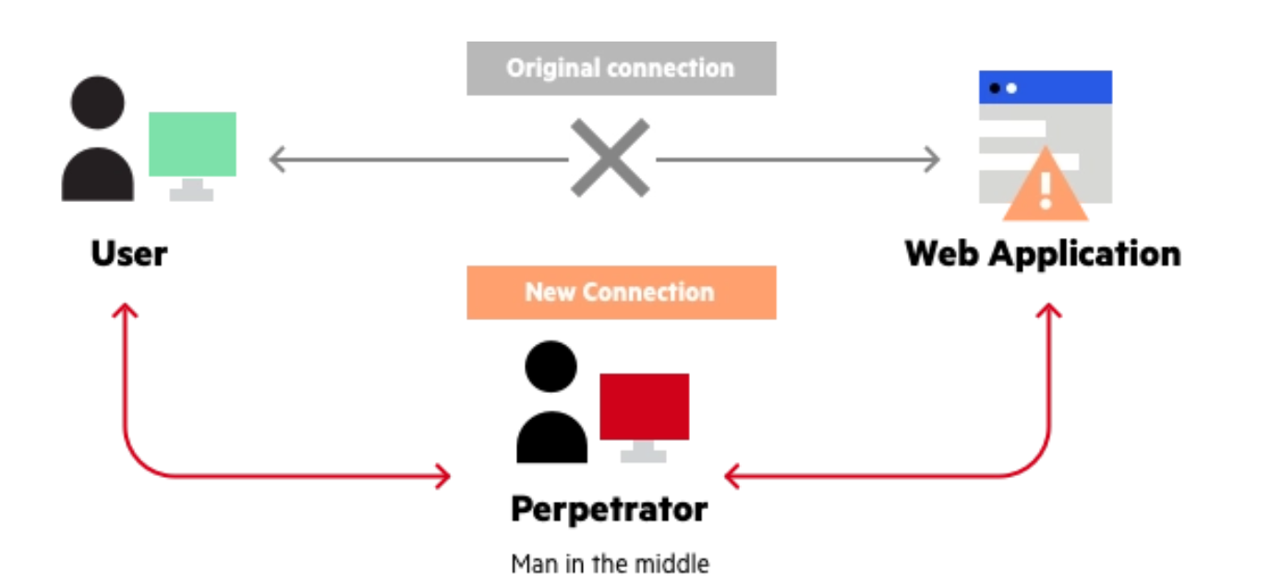
Man in the middle attack

Slide 30
Man in the middle attack
MITM
Interception
Decryption
IP Spoofing
DNS Spoofing
ARA Spoofing
HTTPS spoofing
SSL Hijacking
SSL stripping

Slide 31
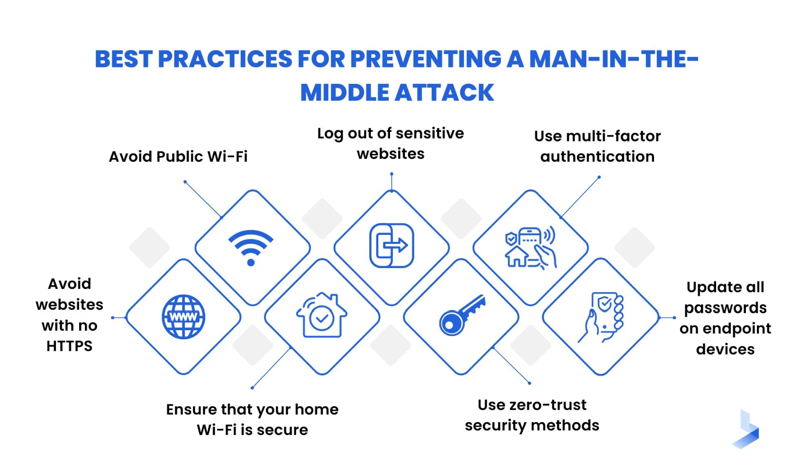

Slide 32
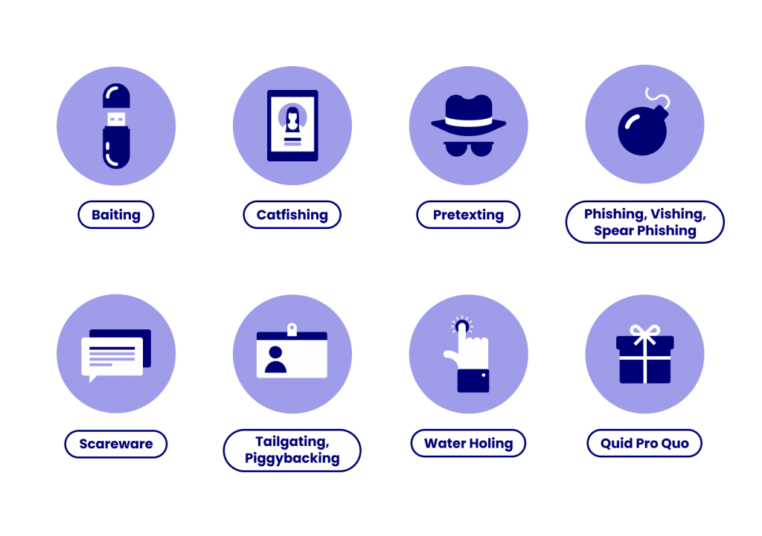
Social Engineering Attacks
A social engineering attack takes place in three steps. 1. targets a victim. 2. earn their trust. 3. breaking security practices or stealing information.
six principles:
Authority and trust: where the attacker poses as an authority figure.
Consensus and social proof: where peer pressure forces someone to commit an action.
Scarcity: the idea that a victim will miss out if they don’t act.
Urgency: the idea that the victim will miss out if they don’t act fast.
Familiarity and liking:
Notes:
Baiting: The victim usually see the promises for reward in return for sensitive information or knowledge of its whereabouts.
2. catfishing - catfishing is when someone uses images and information (often taken from other people’s social media accounts) to create a new identity online – sometimes using an individual’s entire identity as their own. Newly created social media accounts can then be used to damage the reputation of the true owner of the identity, or alternatively any fictional identities that are created using other people’s images and information can be used to form dishonest relationships online.
3. Pretexting: This type of attack involves the perpetrator assuming a false identity to trick victims into giving up information. Pretexting is often leveraged against organizations with an abundance of client data, like banks, credit card providers, and utility companies.
4. Phishing: The most pervasive way of leveraging social engineering tactics, hackers will use deceptive emails, websites, and text messages to steal sensitive personal or organizational information from unsuspecting victims.
4. Spear Phishing: This type of email scam is used to carry out targeted attacks against individuals or businesses. Spear phishing is more intricate than your average mass phishing email, as it requires in-depth research on potential targets and their organizations
4. Vishing: In this scenario, cyber criminals will leave urgent voicemails to convince victims they need to act quickly to protect themselves from arrest or another risk. Banks, government agencies, and law enforcement agencies are commonly impersonated personas in vishing scams.
5. Scareware A common scareware definition is a cyberattack tactic that scares people into visiting spoofed or infected websites or downloading malicious software (malware). Scareware can come in the form of pop-up ads that appear on a user’s computer or spread through spam email attacks. 6. Tailgating: This attack targets individuals who can give the criminal physical access to a secure building or area. These scams are often successful due to a victim’s misguided courtesy, such as if they hold the door open for an unfamiliar “employee.”
7. Water-Holing: This attack uses advanced social engineering techniques to infect both a website and its visitors with malware. The infection is usually spread through a site specific to the industry the victims operate in, like a popular website that’s visited regularly.
8. Quid Pro Quo: This attack centers around an exchange of information or service to convince the victim to act. Normally, cyber criminals who carry out these schemes don’t do advanced target research and offer to provide “assistance,” assuming identities like tech support professionals.

Slide 33
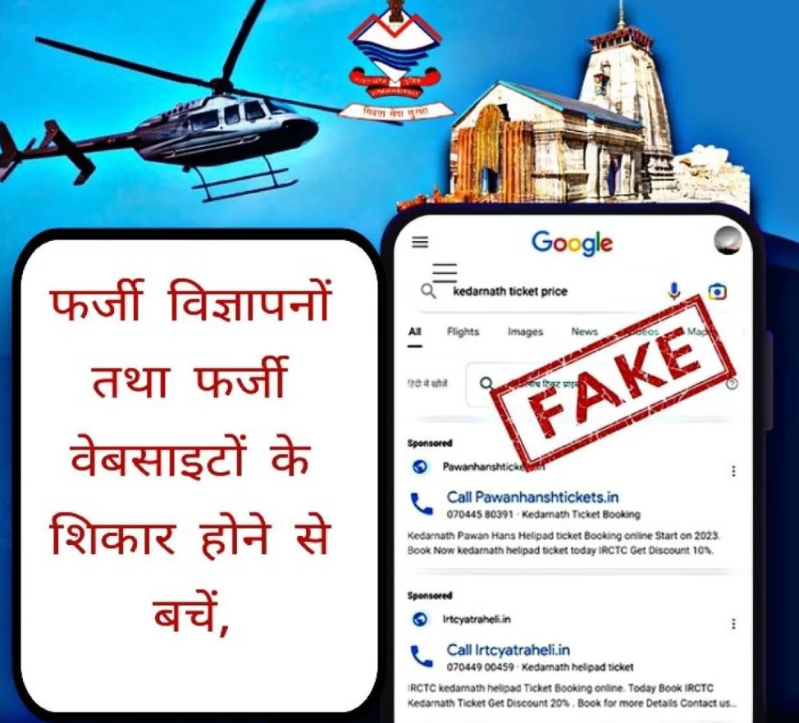
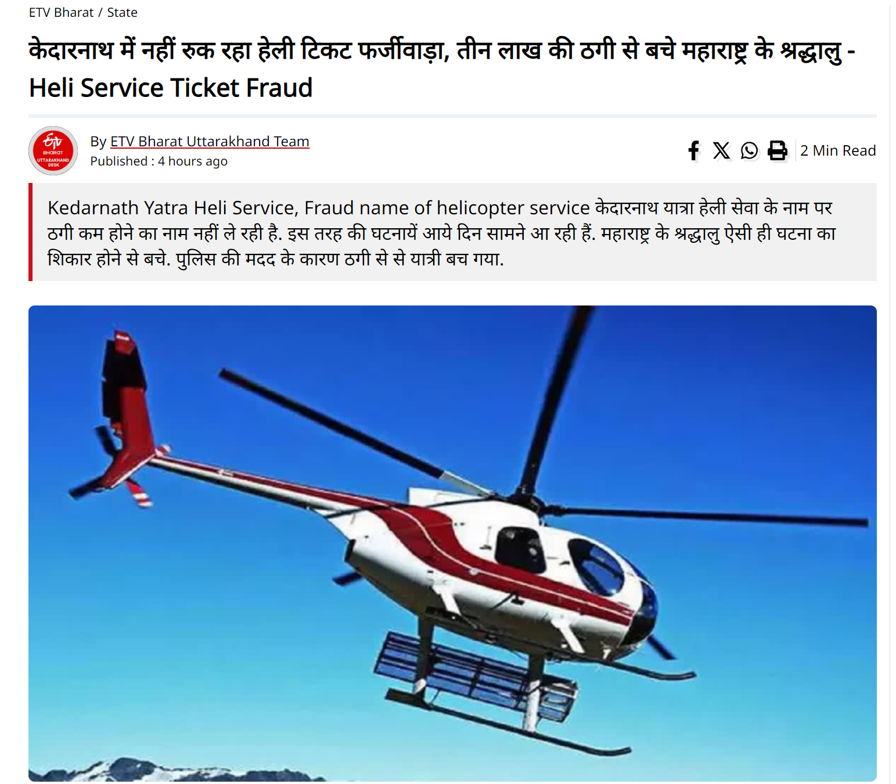



Slide 34

IS YOUR JOB REAL OR FAKE
Avoid opportunity on search engine advertisements
Check privacy policies of job sites
Beware of fake Government jobs
Check for spelling mistakes
Use verified job portals
Never pay for a job

Slide 35




Real life cases

Slide 36


Slide 37




Slide 38

Prevention from Phishing

Slide 39

SMISHING
Smishing is a cyber attack that uses SMS text messages to mislead its victims into providing sensitive information to a cybercriminal.
Notes:
Smishing is a cyber attack that uses SMS text messages to mislead its victims into providing sensitive information to a cybercriminal.
Sensitive information includes your account name and password, name, banking account or credit card numbers. The cybercriminal may also embed a short url link into the text message, inviting the user to click on the link which in most cases is a redirect to a malicious site.

Slide 40

Smishing Attacks

Slide 41

https://purplesec.us/smishing-attacks/

Slide 42
Preventive tips - SMISHING attack
Don’t respond to text messages that request private or financial information from you.
If you get a message that appears to be from your bank, financial institution, or other entity that you do business with, contact that business directly to determine if they sent you a legitimate request. Review this entity’s policy on sending text messages to customers.
Beware of messages that have a suspicious number in beginning or some other number that is not a cell number. Scammers often mask their identity by using email-to-text services to avoid revealing their actual phone number.
If a text message is urging you to act or respond quickly, stop and think about it. Remember that criminals use this as a tactic to get you to do what they want.
Never reply to a suspicious text message and verifying the source.
Never call a phone number from an unknown texter.

Slide 43

Vishing Attacks
An attacker creates a scenario to prey on human emotions, commonly greed or fear, and convinces the victim to disclose sensitive information, like credit card numbers or passwords.
vishing calls exploit the fact that we’re more likely to trust a human voice — and may target the elderly and technophobic who are naive and have no experience with these types of scams.
Notes:
Vishing attacks are a type of social engineering fraud where a fraudster convinces the user to provide critical information over the phone.
These types of attacks are ever prevalent and have been causing serious damage around the world. They’re particularly dangerous as they successfully bypass the usual second authentication methods (SMS, email codes and so on).
Vishing attack prevention comes from both the user and the company side.

Slide 44

Prevention from Vishing Attacks
Notes:
Be vigilant
Knowing that criminals and hackers use a range of different methods to scam individuals and employees means you can be on your guard to potential attacks. According to research, 75% of victims reported that the attacker already had some personal information on them when they made the call.
Be helpful but defensive
Assist the caller where you can, but remember you don’t know this person or what their motive is. Keep a level of healthy scepticism.
Don’t Panic
like all forms of social engineering vishing frequently uses fear and urgency to “bump” the listener into doing something they wouldn’t do if they thought about it more calmly. Stay calm, if you feel you are being emotionally overloaded put the caller on hold or use an excuse to remove yourself from the situation.
Call them back!
If you get a feeling that something isn’t wrong, act on it and ask to call them back. Then call them back on a publicly listed number – not the one they might give you.
Don’t give out valuable information over the phone
Don’t feel obliged to give out credentials or confidential information over the phone just because someone asks for it.
Treat urgency as a red flag
The fact that someone claims to need something urgently should be a small red flag that something could be amiss, not that you should automatically comply with the callers’ request.
Don’t be afraid to say NO
If a request is not justified, don’t be afraid to reject the request. You can do this by deferring authority, tell them you need to check this with your manager or politely decline and cite your company’s policy on information disclosure.
Don’t log in to a phishing site.
Don’t navigate to an unknown website that the caller asks you to log in to. Remember that the caller will be prepared for this, it is no good saying no to the first request if you give in on the second attempt- stand your ground!
Don’t trust caller ID
It is simple for attackers to change or spoof the number that is displayed on your handset. OFCOM advises that caller ID should not be used as a means of verifying a caller’s identification.

Slide 45

https://cybercrime.gov.in

Slide 46



Slide 47

Lets Create a Cyber Safe Society together !

