Slide 1
Phishing Attacks
Report Phishing attacks,
Do not ignore or let go!!

Slide 2
What is Phishing?
How does it happen?
Can it happen to me?
What can I do?

Slide 3
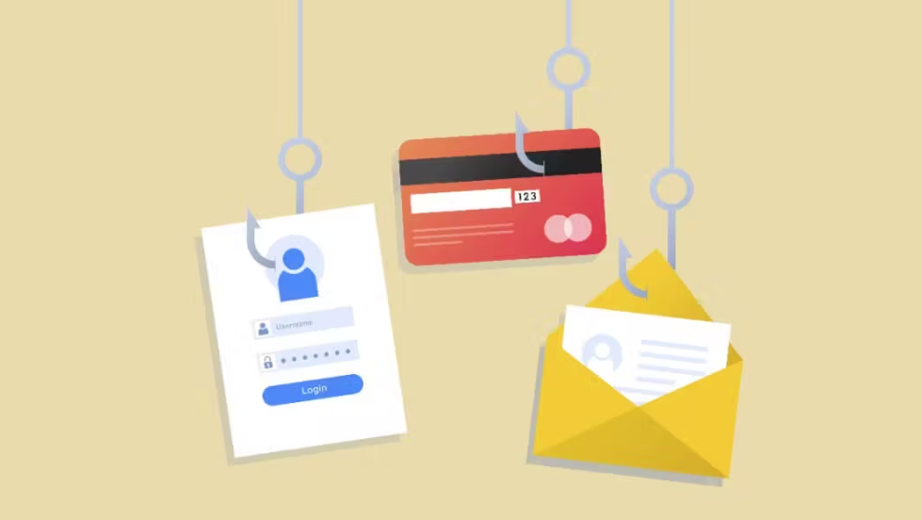
What is Phishing ?
Phishing is a cybercrime where attackers try to trick you into giving away personal information or clicking on malicious links. They use fake emails, texts, phone calls, or websites that look legitimate to lure you in.

Slide 4
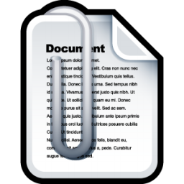
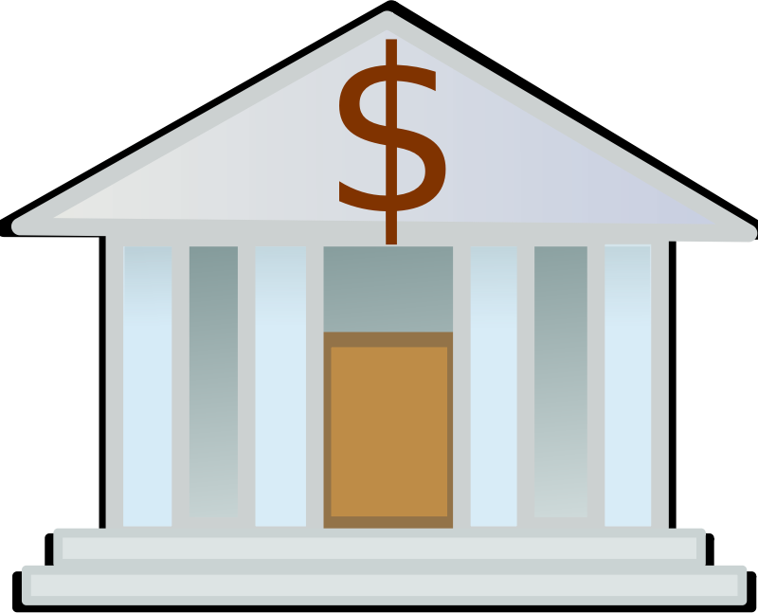
A phishing message is designed to trick you into doing one of these four things.
Click Here!
USERNAME
Click on an
Unsafe Link
Open an
Unsafe File
Type your
Password
Transfer
Funds

Slide 5
Cyber attackers phish for different reasons, But they all phish.
Criminals
Intelligence
Hacktivists
Money
Fraud
Identity Theft
Sensitive Data
Network Access
Infrastructure
Public Web Pages
Social Media

Slide 6
Understanding The Role of Emotions in Phishing

Slide 7
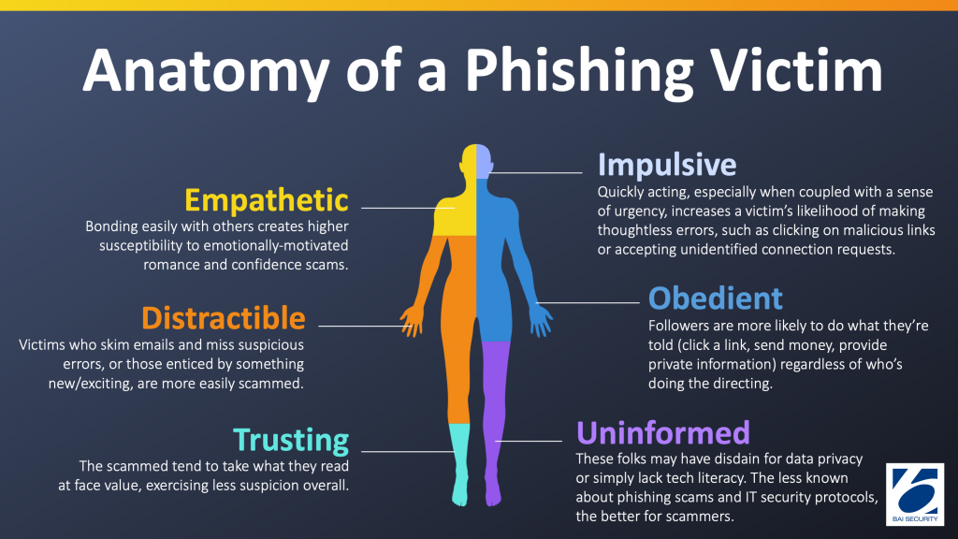
Phishing , Social Engineering Cyberattack
Phishing relies on social engineering, which is manipulating people. Unlike other cyberattacks that directly target computer systems, phishing scams target you, the human user. They use fake stories, pressure tactics, and a sense of urgency to trick you
Image source: https://www.linkedin.com/pulse/cracking-code-understanding-role-emotions-phishing-beamteknoloji-fsftf/

Slide 8
Frequently Manipulated Emotions
Curiosity: Emails with intriguing offers exploit our natural curiosity, tricking us into clicking malicious links.
Greed: Promises of easy money or great deals tempt us to ignore red flags and click on suspicious links.
Fear: Urgent emails threatening account suspension or legal action prey on our fear, making us act impulsively.

Slide 9
Frequently Manipulated Emotions
Helpfulness: Attackers manipulate our willingness to help by creating fake requests that exploit our helpful nature.
Authority: We tend to follow instructions from figures of authority, a tactic hackers use to trick us into performing actions.
Overconfidence: Overestimating our ability to spot phishing emails leaves us vulnerable to cleverly crafted attacks.

Slide 10
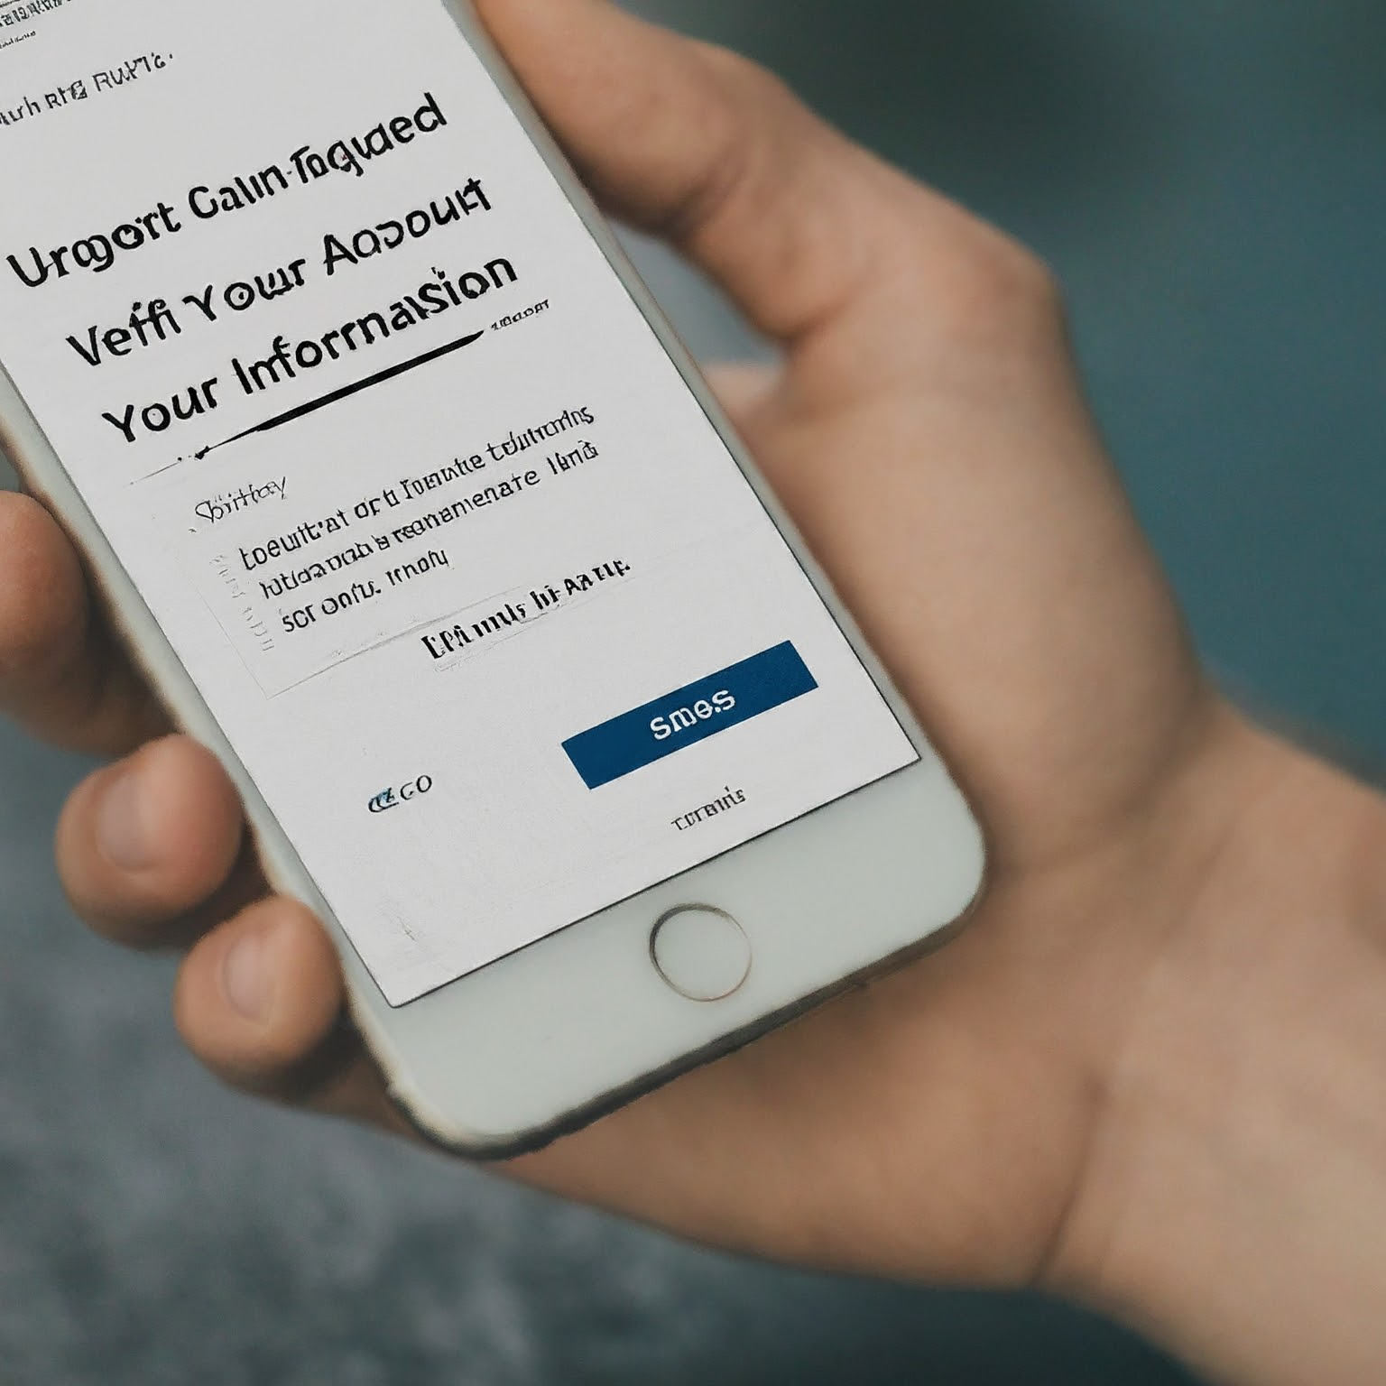
Types of Phishing Attacks
1. Email Phishing(spear phishing)
Description: The most common type of phishing. Attackers send emails disguised as legitimate companies (banks, credit cards, etc.) or people you know (colleagues, bosses).
Example: You receive an email from your "bank" claiming suspicious activity on your account. It urges you to click a link to verify your information. But clicking the link takes you to a fake website designed to steal your login credentials.

Slide 11
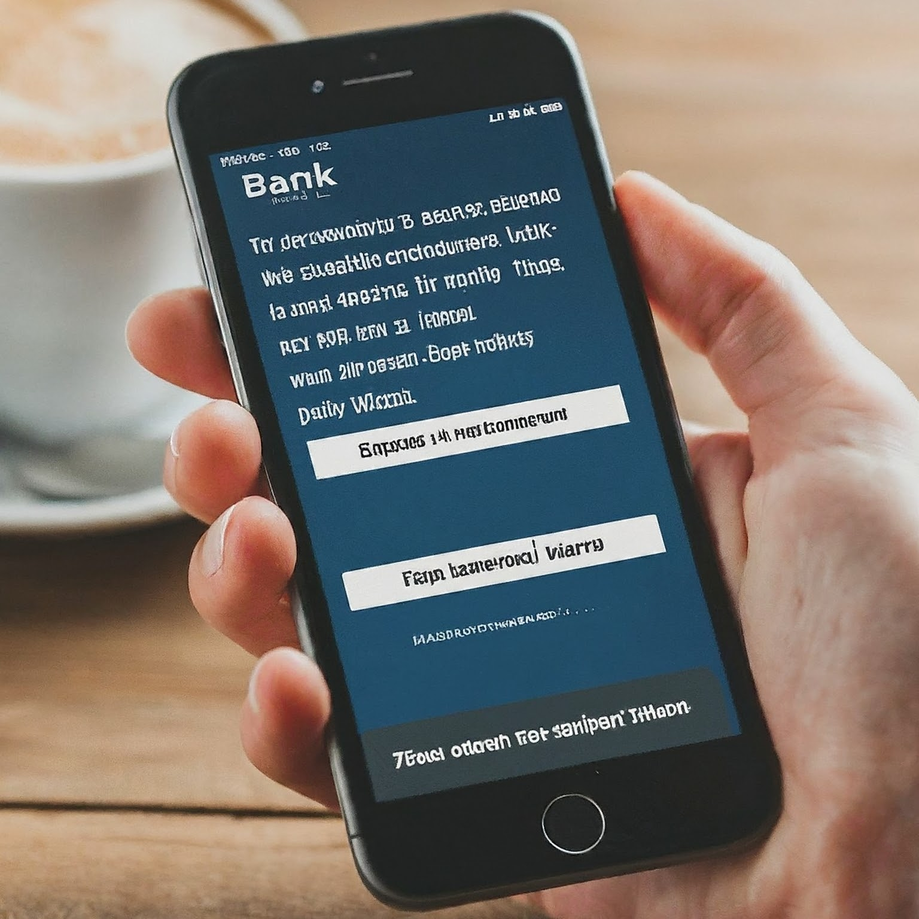
Types of Phishing Attacks
2. Smishing
Description: Phishing via SMS text messages. Attackers send messages that appear to be from your bank, mobile carrier, or other trusted sources.
Example: You receive a text from your "mobile carrier" stating your account is overdue and will be suspended if you don't click a link to make a payment. Clicking the link leads to a fake website to steal your credit card information.

Slide 12
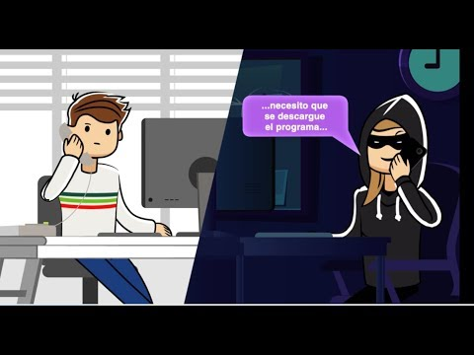
Types of Phishing Attacks
3. Vishing
Description: phishing over voice calls. Attackers impersonate representatives from banks, tech support, or other trusted organizations.
Example: you receive a call from someone claiming to be from "tech support" warning you of a virus on your computer. They ask you to give them remote access to fix the problem, but instead, they install malware to steal your data. Jamtara is a classic example.
This Photo by Unknown Author is licensed under CC BY-NC-ND

Slide 13
Types of phishing attacks
Types of Phishing Attacks
4. Angler Phishing
Description: Phishing attempts on social media platforms. Attackers create fake posts or profiles to lure victims.
Example: You see a social media post offering a free gift card from your favorite store. Clicking the link takes you to a fake login page designed to steal your account information.

Slide 14
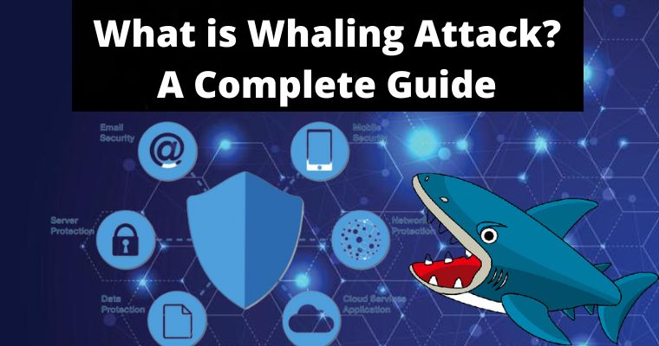
Types of phishing attacks
Types of Phishing Attacks
5. Whaling
Description: A targeted phishing attack aimed at high-profile individuals like CEOs or executives.
Example: A CEO receives a very convincing email that appears to be from the company chairman, requesting an urgent wire transfer for a confidential business deal. The email uses information obtained through social engineering to appear legitimate.

Slide 15
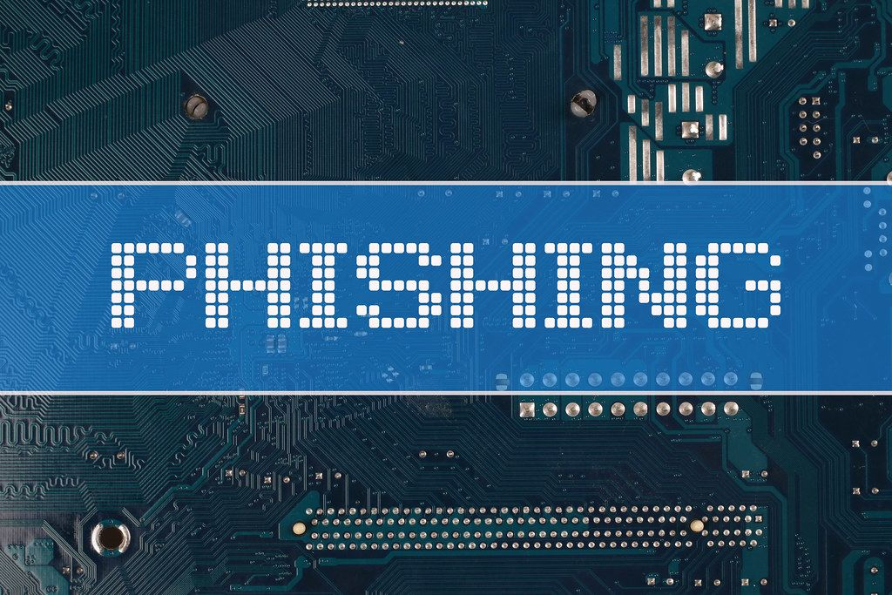
Types of phishing attacks
Types of Phishing Attacks
6. AI phishing
Description: leverages generative artificial intelligence (AI) tools to craft phishing messages. These tools produce customized emails and text messages that are free from spelling errors, grammatical inconsistencies, and other typical phishing red flags.
Generative AI also enables scammers to scale their operations significantly. According to IBM's X-Force Threat Intelligence Index, crafting a phishing email manually takes a scammer around 16 hours.

Slide 16
Types of phishing attacks
Types of Phishing Attacks
6. AI phishing
With AI, they can create even more convincing messages in just five minutes. Also scammers use image generators and voice synthesizers to enhance the credibility of their schemes.
Example: For instance, in 2019, attackers used AI to clone the voice of an energy company CEO, successfully scamming a bank manager out of USD 243,000.

Slide 17
Types of Phishing Attacks
Typo squatting: Creating fake websites using similar domain names by taking advantage of users' typos.
Business Email Compromise (BEC): Hijacking and fraud of business email accounts.
Website Spoofing: Creating fake copies of legitimate websites to deceive users.
Image-Based Phishing: Images that contain malicious links or are designed to deceive users are used..
Clone Phishing: Re-sending an email containing a malicious link or attachment by creating a copy of a real message.
Watering Hole Phishing: Placing malware on trusted sites frequented by a specific group or organization.

Slide 18
Statistics say…….
Phishing Is The Most Common Way Attackers Illegally Access Systems. with an estimated 3.4 billion spam emails sent every day.
The use of stolen credentials is the most common cause of data breaches.
Google blocks around 100 million phishing emails daily.
Over 48% of emails sent in 2022 were spam.
Source : https://aag-it.com/the-latest-phishing-statistics/

Slide 19
Statistics say…….
Statistics say…….
Millennials and Gen-Z internet users are most likely to fall victim to phishing attacks.
83% of UK businesses that suffered a cyber attack in 2022 reported the attack type as phishing.
Phishing was the most common attack type against Asian organisations in 2021.
The average cost of a data breach against an organisation is more than $4 million.
One whaling attack costs a business $47 million
Source : https://aag-it.com/the-latest-phishing-statistics/

Slide 21
Signs of Phishing

Slide 22
Phishing messages are designed to get you to react quickly without thinking too much.
Sense of Urgency
Offers of Money
Confirmations
Odd Requests
Rewards
IT Support

Slide 23
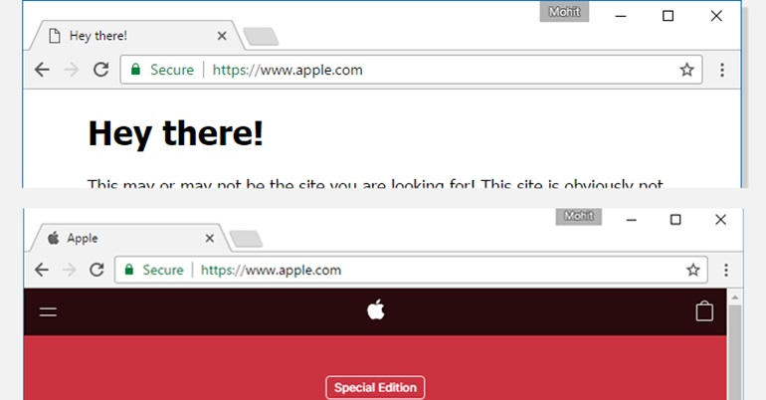
Phishing messages usually contain spelling errors, generic texts, fake URLs or websites.
Confirmations
Spelling Error
Generic Messages
Fake URLs

Slide 25
Email Phishing Attacks

Slide 26
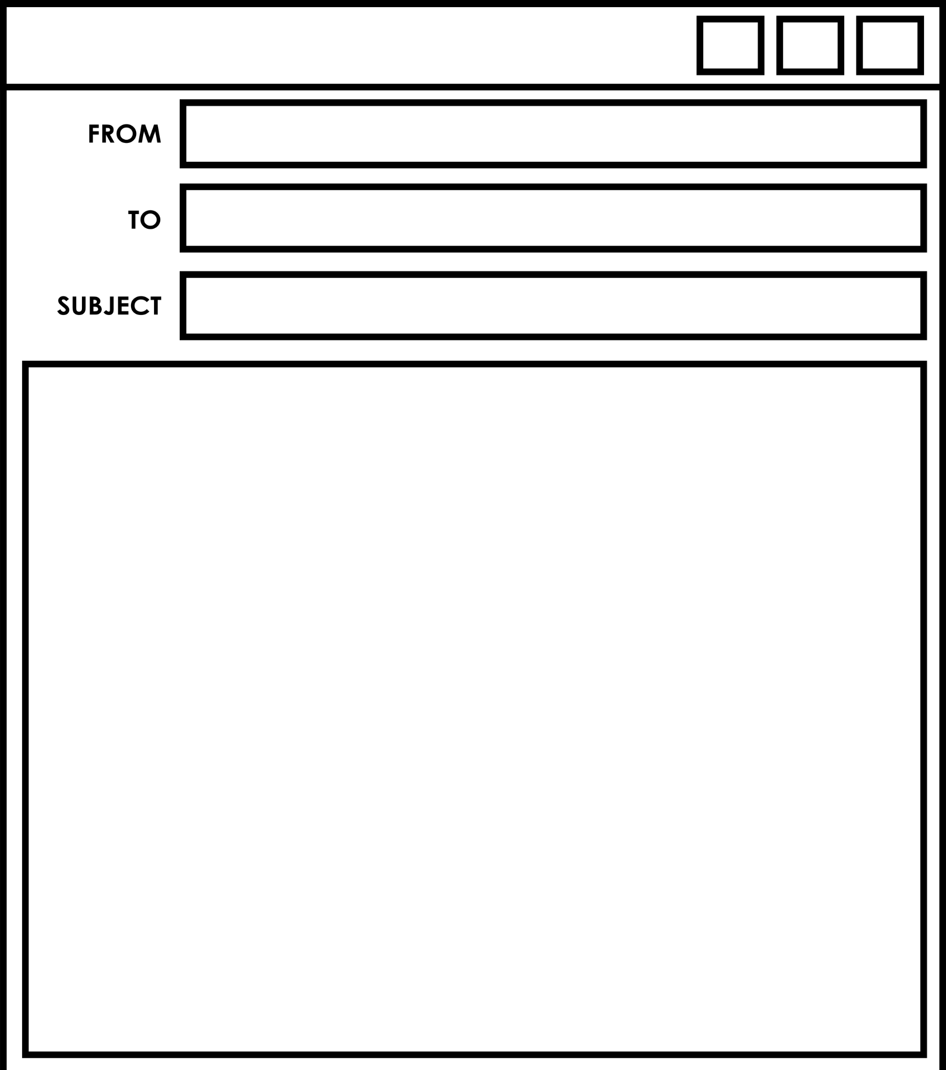
#1 The Wire Transfer
Manohar Majesh
Harleen Heena
Transfer Problem
Hello Manohar,
I am trying to get payment to
a vendor. It is important they get paid by close of business. Can you please transfer 17,540 to…

Slide 27
#2 The IT Support Alert
IT Help
Larry Page
Suspicious Activity
Hello Larry,
Your computer has been infected with the GoNowe2.0 Malware that you saw on the news. You must to use our scan
within 12 hours and be safe.
Click Here

Slide 28
#3 Confirm Now!
Amazon Shoppers
Parminder
Package Damaged
Dear Parminder,
We apologize in advance, but your recent order was damaged in delivery. We are unable to issue a refund until you confirm account details
with this form.

Slide 29
#4 Password Reset
safeonline@kiMail.Net
Mumtaz Baigh
Password Compromise
Dear Mumtaz,
Your account has been locked due to potential compromise. You must go to this site to secure your account.
kiMail Secure Reset

Slide 30
#5 Cry for Help
Preeti@g.ignou.edu
Latika Kumari
HELP!!!
HI,
I need to submit this file for class but it won’t open on my computer. Can you PLEASE (!) save it as a PDF and send to me???

Slide 31
#6 Commercial Attack
premiumService@opera.ly
Sandeep
Your account
Premium User,
Your electronic invoice is attached. This file is intended only for the recipient and is considered confidential.
This is not my document.

Slide 32
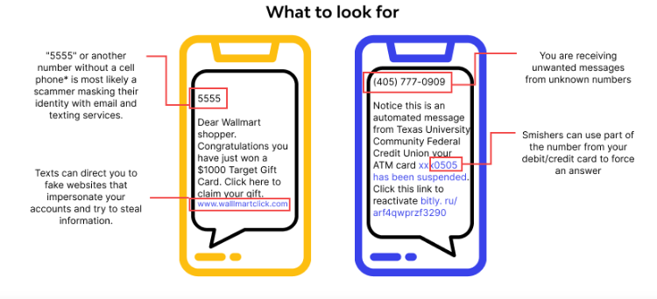
Smishing Attack

Slide 33
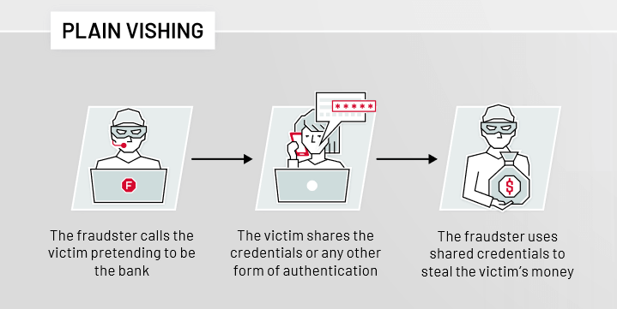
Vishing Attack

Slide 34
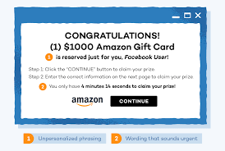
Angler phishing Attack

Slide 35
Real Life Examples

Slide 36
In early 2020, a branch manager of a Japanese company in Hong Kong received a call from a man whose voice he recognized—the director of his parent business. The director had good news: the company was about to make an acquisition, so he needed to authorize some transfers to the tune of $35 million. A lawyer named Martin Zelner had been hired to coordinate the procedures and the branch manager could see in his inbox emails from the director and Zelner, confirming what money needed to move where. The manager, believing everything appeared legitimate, began making the transfers.
Source: https://www.forbes.com/sites/thomasbrewster/2021/10/14/huge-bank-fraud-uses-deep-fake-voice-tech-to-steal-millions/?sh=5cb443947559

Slide 37
The European company, which operates shops under the Pepco, Poundland and Dealz brands, said that the company lost approximately €15.5 million in cash as a consequence of the attack.
“If this is the case, this type of attack is called business email compromise and it involves a fraudster spoofing the email address of a legitimate employee within an organization and then sending out correspondence to other people in the business, mostly those who work in accounting or finance departments, and asking them to urgently pay an invoice or process a payment.”
Source: https://www.helpnetsecurity.com/2024/02/28/pepco-phishing-bec-attack/

Slide 38
In 2022-23, a global scam targeting WhatsApp users with fake job offers has defrauded people out of an estimated €100 million. Victims received phishing messages impersonating reputable firms, promising lucrative jobs paid in cryptocurrency, leading to significant financial losses
Source : https://www.euronews.com/next/2023/10/23/behind-the-global-scam-worth-an-estimated-100m-targeting-whatsapp-users-with-fake-job-offe

Slide 39
What should I do if I get a phishing email?
.
Click
Delete
Report

Slide 40
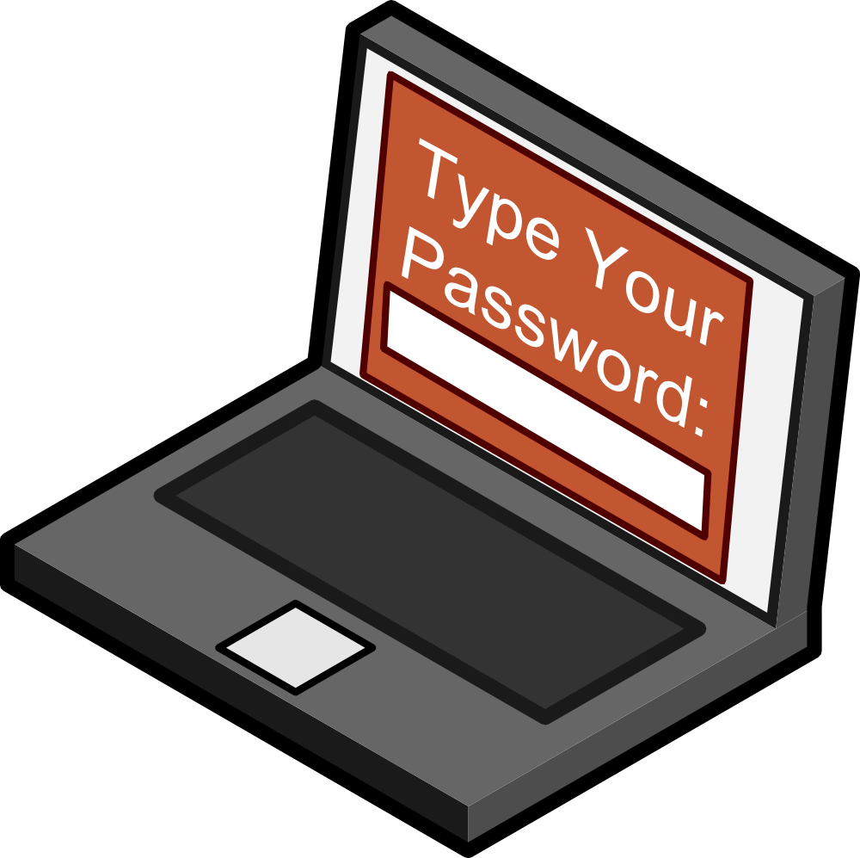
What happens if I click?
2
Stolen
Password
1
Data Leak
Ransomware
Identity Theft
Account Takeover
Remote Access
Data Destruction
Network
Compromise
Password Stolen
Malware Installed

Slide 41
What happens if I delete?
You’re safe…

Slide 42
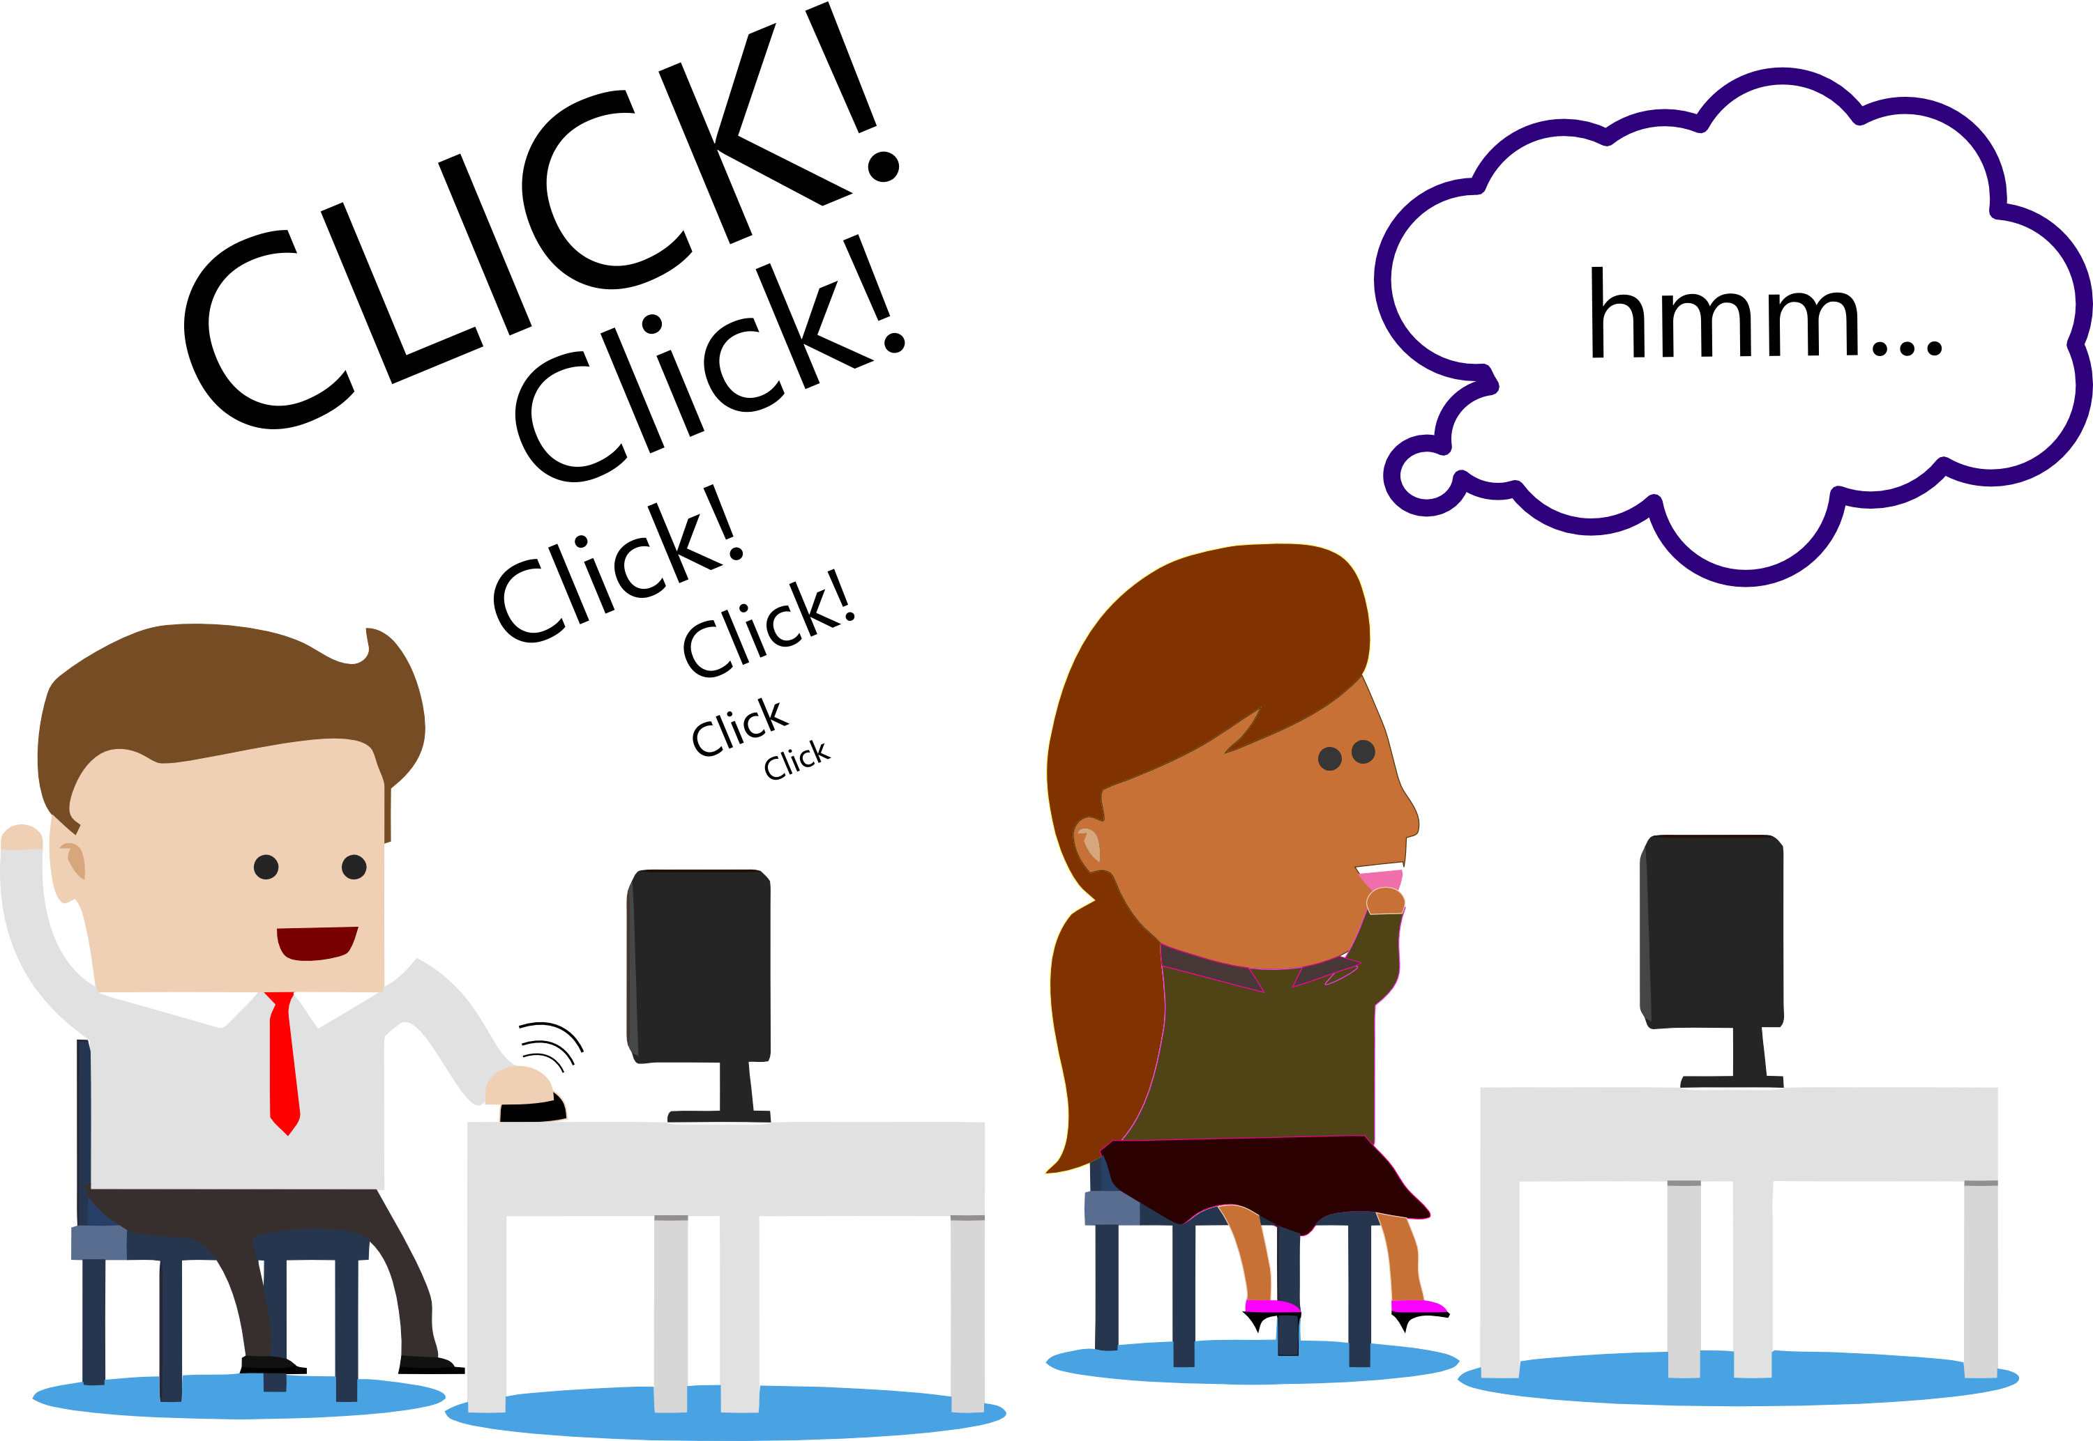
You’re safe…for now.

Slide 43
What happens if I report?
Review
Links
Block
Domains
Check
Accounts
Remove
Messages

Slide 44
Where to report?
The Chakshu portal is a platform developed by the Department of Telecommunications (DoT) to report suspicious communication, such as fraudulent calls, SMS, or messages on social media like WhatsApp.
https://sancharsaathi.gov.in/sfc/

Slide 45
How to Protect Ourselves
1. Keep Security Software Updated: Regularly update security software, firewalls, and network protections to defend against malware.
2. Implement Two-Factor Authentication: Use Multi-Factor Authentication (MFA) to add extra security to accounts.
3. Regularly Update All Software: Keep all software, including operating systems and applications, up to date with the latest security patches.
4. Educate : Inform and educate students, friends and family about the latest phishing techniques.
5. Verify Websites: Use reputable search engines and verify the authenticity of websites before entering sensitive information.
6. Adjust Social Media Privacy Settings: Limit who can view and contact you by adjusting privacy settings.
7. Verify Requests Through Secondary Channels: Confirm significant requests, especially those involving finances, through secondary means.

Slide 46
How to Protect Ourselves
8. Use Secure Communications: Ensure sensitive transactions are conducted over secure and encrypted communications.
9. Be Skeptical of Unsolicited Requests: Approach unsolicited requests for information with caution.
10. Monitor Accounts Regularly: Regularly check financial and personal accounts for unusual activities.
11. Regularly Change Passwords: Change passwords frequently and use strong, unique passwords for each account.
12. Use Anti-Malware Software: Deploy anti-malware solutions to detect and remove malicious software.
13. Mail Security for Organizations: Implement advanced mail security solutions like spam filters and email authentication protocols.

Slide 47
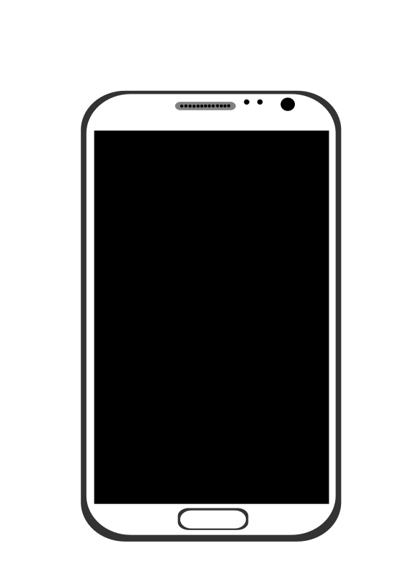
If you aren’t sure…
Please
Or
Click Here
To Confirm.
Skip the Link
Ignore the File
Go to The Source

