Slide 1
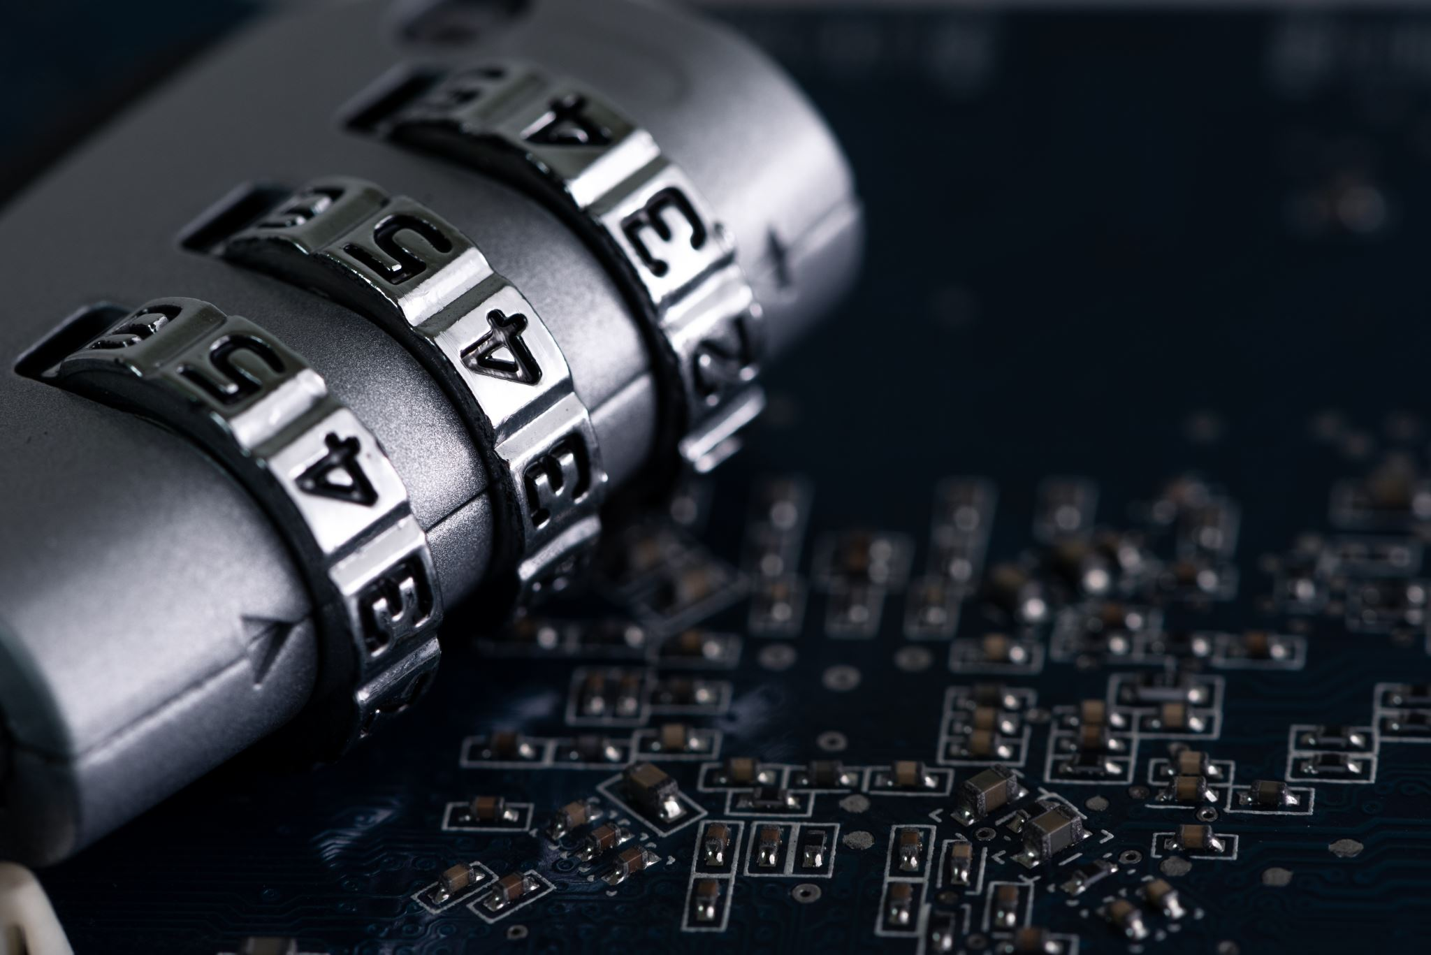
Cyber Threats Understanding the landscape
By Anni Kumar HoD Computer Science Vikas Bharati Public School, Delhi
Notes:
As more information technologies are developed, students are turning to the Internet for their studies more often than ever. Due to the COVID-19 pandemic, online courses and e-learning have become even more commonplace. However, these factors have encouraged cybercriminals to double their efforts at extorting personal information. These days, teachers, students, and even parents are facing increased danger.

Slide 2
What is Cyberspace?
Cyberspace encompasses everything related to the Internet. It’s where we communicate with friends and family, play video games, download music, and watch TV shows and movies once our homework is done. Adults also use it for essential tasks like banking and shopping.

Slide 3
Why cybersecurity awareness is crucial?

Slide 4
As many as 93% of children from ages 8 to 17 are on the internet, nearly three out of four experience at least one cyber threat.
Notes:
There is nearly 93 percent of the global population connected to the internet, and among them, approximately 60 percent- 4.8 billion individuals, are active social media users. This online presence on social media has become an integral part of people's lives, especially among the younger generation. However, this expanding presence in the digital realm is also giving rise to negative experiences.

Slide 5
What are Cyber Threats?
A cyber threat refers to an attack on important information stored on a computer or a network. In such attacks, an individual or a group gains unauthorized access to personal details with the intention to damage or steal sensitive data, such as intellectual property, IT assets etc.

Slide 6
Different Types of Cyber Threats
Cyber Threats
Job Frauds
Email Spoofing
Malicious File applications
Social Engineering
Cyber Bullying
Identity Theft
Banking Frauds
They are the different possible ways that can be used to attack using internet or mobile technology.
Hacker is anyone who uses / exploits technology operations or causing financial/ reputational loss to people.

Slide 7
Email Spoofing
Sending out e-mails that look like genuine and from a trusted e-mail ID but they are not.

Slide 8
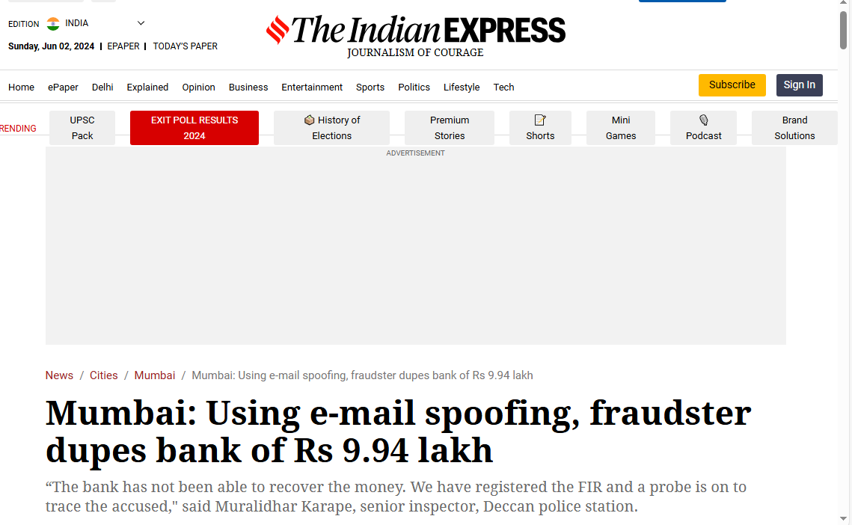
Notes:
cyber fraud, a nationalized bank was recently duped of Rs 9.94 lakh after a man, impersonating over phone as the director of a private company that has an account with the bank, tricked its employees into transferring the amount into his account by sending an official request using a fake email id, which looked similar to the company’s original email id.

Slide 9
Notes:
A former Seattle resident, Bryan Alan Sparks, defrauded federal COVID-19 benefit programs of more than $1 million. He pleaded guilty to wire fraud and aggravated identity theft. Sparks and his co-conspirator, Autumn Gail Luna, used stolen personal information to apply for Economic Injury Disaster Loans (EIDL) and unemployment benefits. They obtained approximately $521,900 from the Small Business Administration (SBA) and $519,700 from the Washington Employment Security Department (ESD). The victims suffered significant harm, including credit score drops due to fraudulent accounts opened in their names

Slide 10
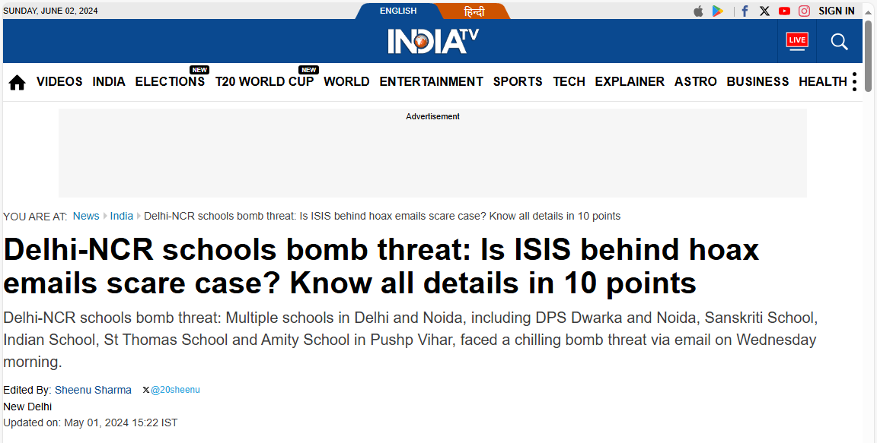
Notes:
Perpetrators of bomb hox emails sent to around 100 schools in Delhi-NCR used a Russian email service that effectively helps users stay anonymous and avoid detection of their illegal activities by law enforcement.

Slide 11
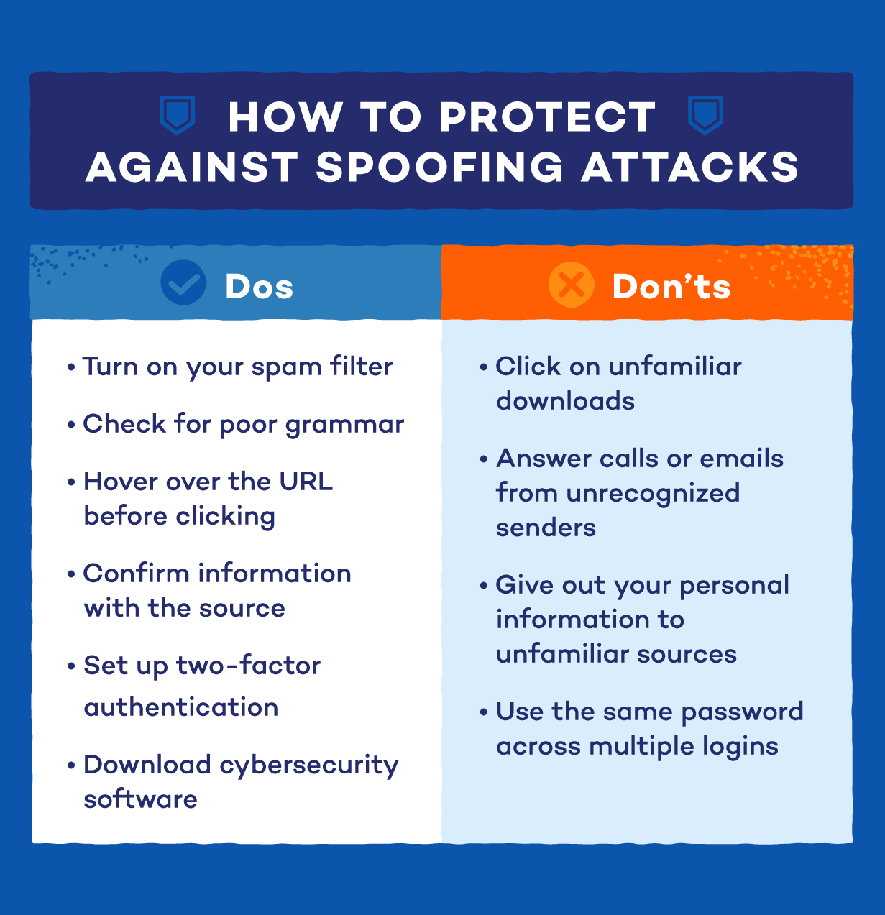
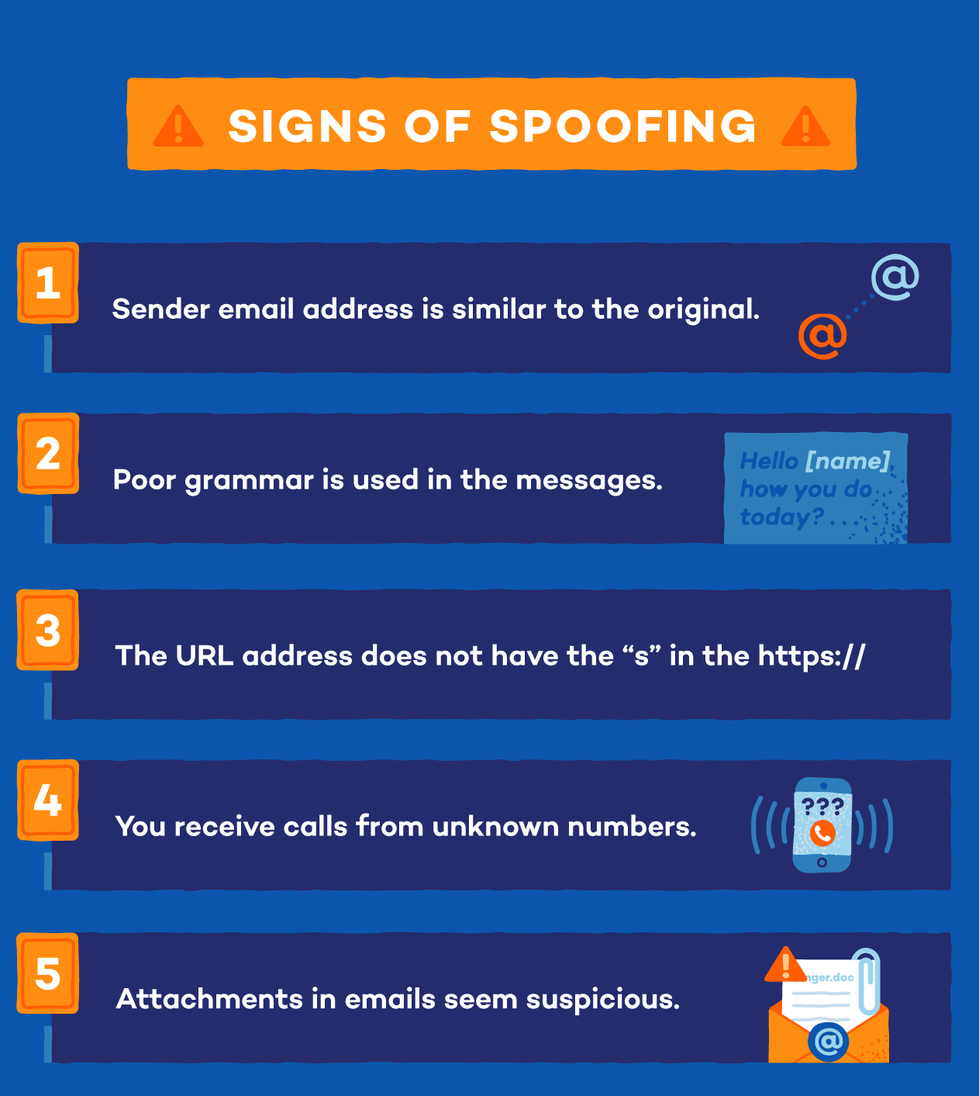

Slide 12
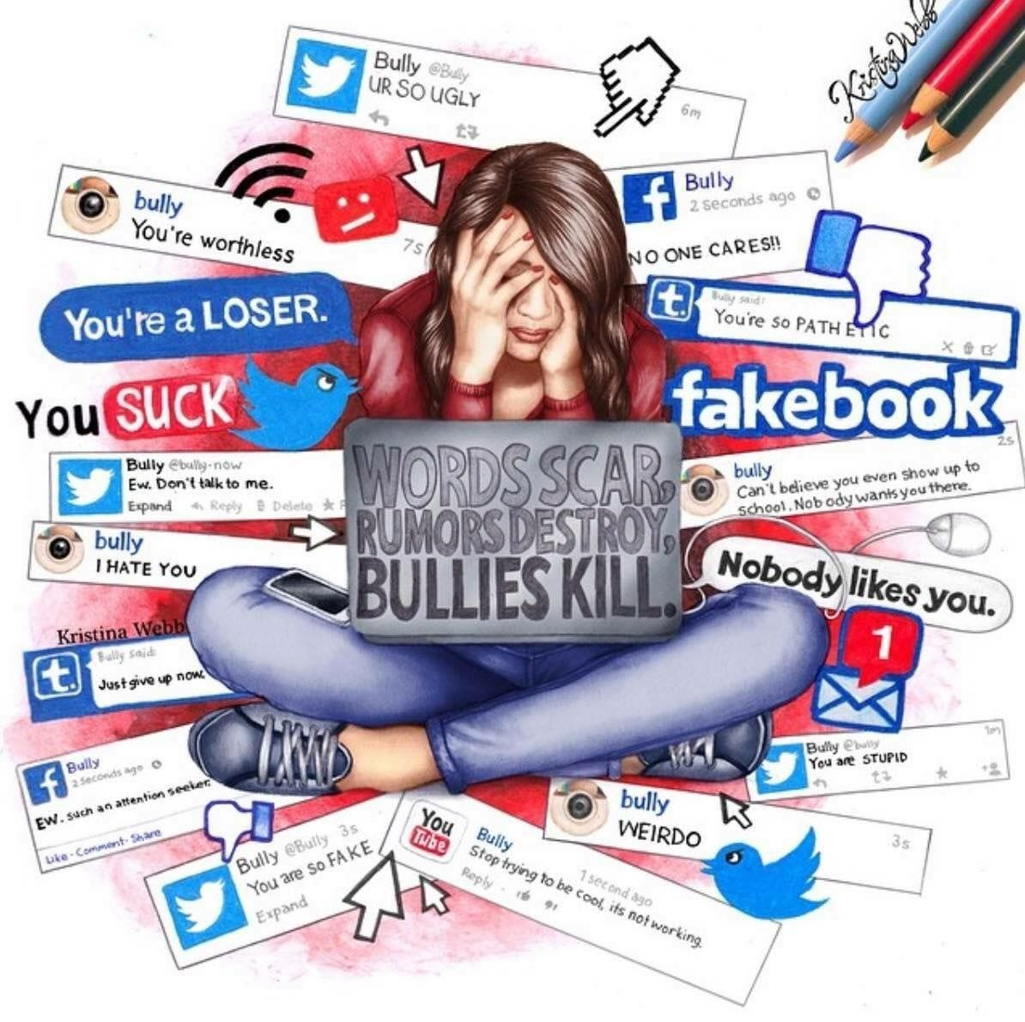
Cyber Bullying
Using internet or mobile technology to intentional harass or bully someone by sending rude, mean or hurtful messages, comments and images/videos.
A cyber bully can use text messages, emails, social media platforms, web pages, chat rooms etc. to bully others.
Notes:
You may be amazed to know that initially we don’t even realize that someone is bullying us online. A cyber bully can be a known person, friend, relative or even an unknown person whom we met online on social media platform, chat room or gaming portal.

Slide 13
Notes:
Indian children have the highest online risk exposure and are among the youngest to reach mobile maturity, reveals a new study by McAfee Corp, a global leader in online protection.
In India, smartphone use at the age of 10 to 14 is at 83 per cent, which is significantly 7 per cent above the international average of 76 per cent. This leads to high exposure to online risks as there is a substantial security gap between parents and children. Additionally, while the concern is relatively low among parents, 22 per cent of Indian children experienced cyberbullying at some time which is notably 5 per cent higher than the global average of 17 per cent.

Slide 14
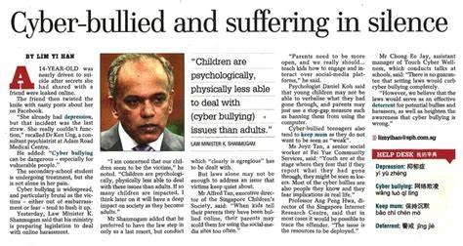
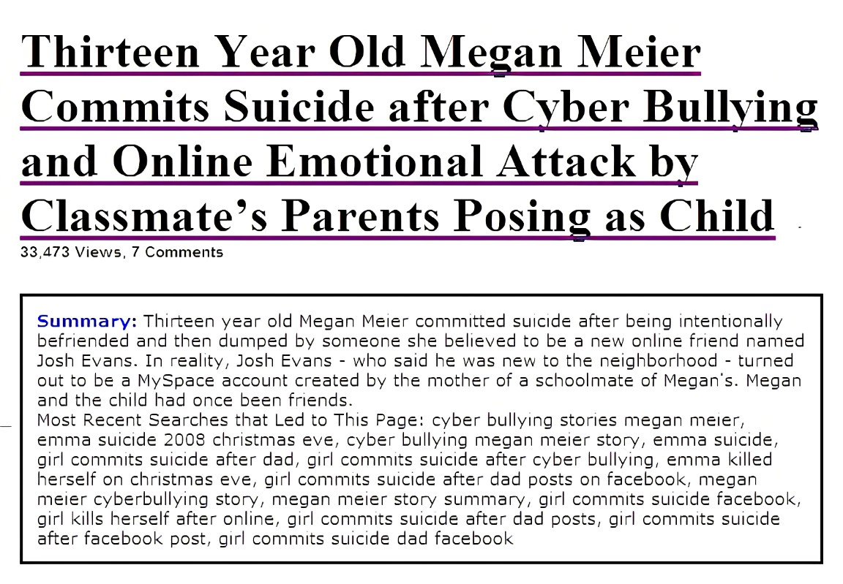

Slide 15
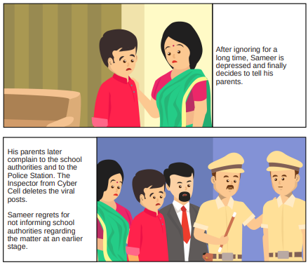
Let’s understand how Cyber Bullying takes place

Slide 17
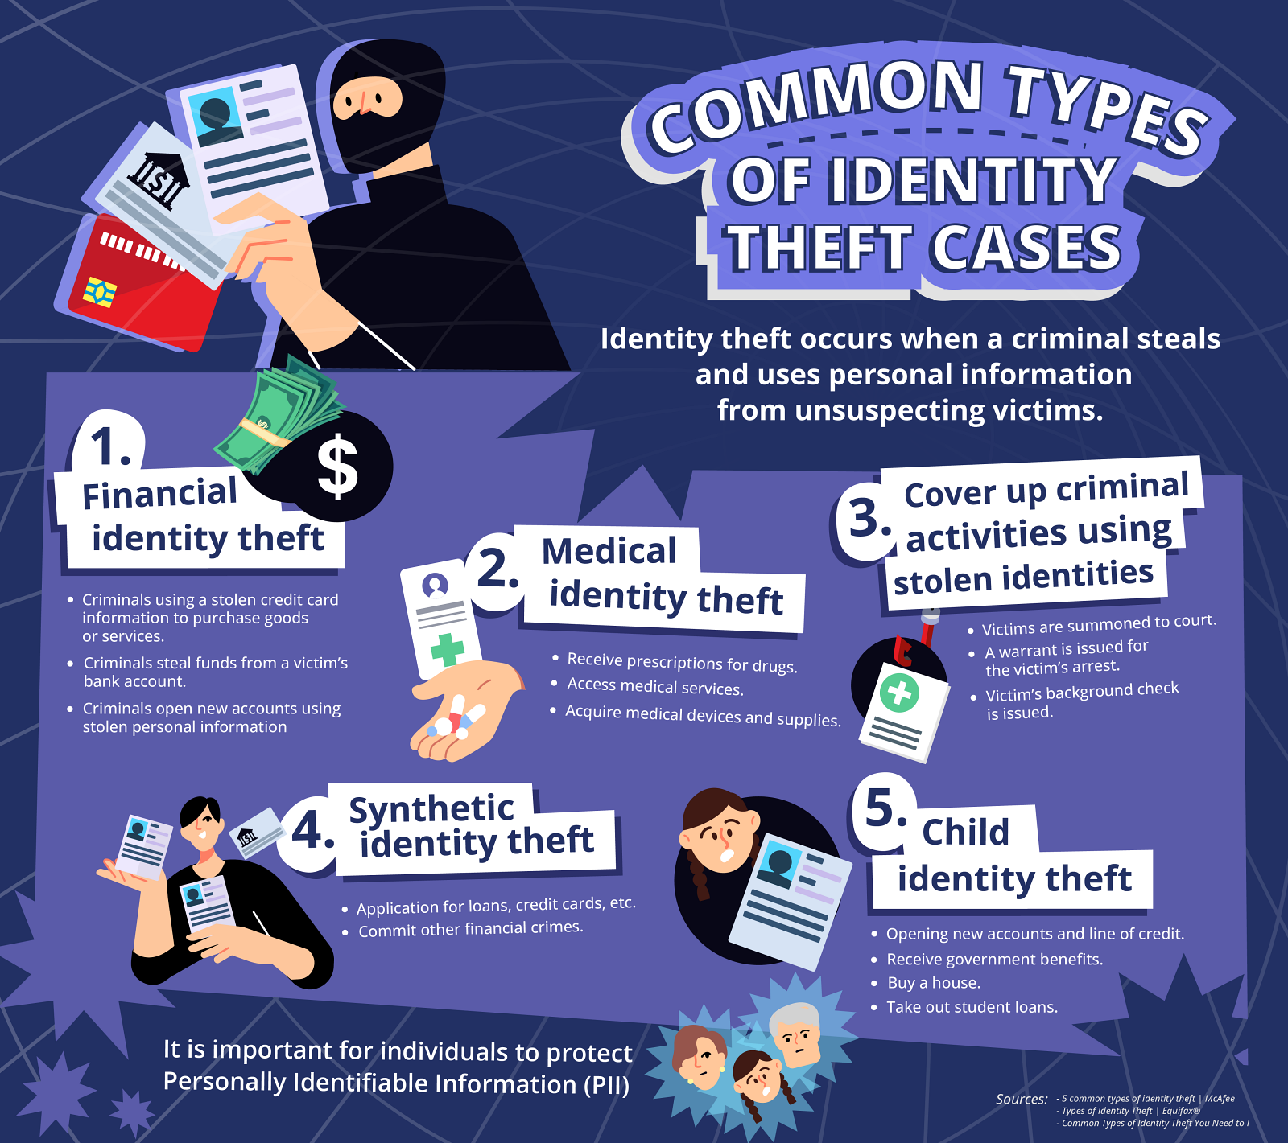
Identity Theft
Identity theft is the crime of using the personal or financial information of another person to commit fraud, such as making unauthorized transactions or purchases. Identity theft is committed in many ways and its victims are typically left with damage to their credit, finances, and reputation.

Slide 18
Notes:
It was a weekend in February 2018 when Martha Bedggood’s husband’s phone suddenly went dead1. Initially dismissed as bad reception, it turned out to be the first sign of identity theft that would haunt them for years2. The perpetrator had stolen her husband’s phone number and set up a new account using minimal ID, locking him out of his own account3. The situation escalated as the thief gained access to emails, driver’s licenses, and even attempted bank loans in their name. Despite reporting the theft to the police and taking precautions, the impact of identity theft remains, affecting their credit history and financial stability. The experience highlights the need for better protection and accountability for customers facing such situations

Slide 19
Notes:
Police are searching for the suspect in a fraud case that left a victim $75,000 in the red late last year.
The victim said his wallet was stolen in Burnaby in October, and his debit and credit cards were used shortly afterward to rack up a substantial sum of debt.
A debit card was used at a bank in the Metrotown area to withdraw a large sum of cash, while the credit cards were used at various businesses to buy expensive electronics, according to Burnaby RCMP.

Slide 20
Notes:
In conversation with Jalandhar Tribune, Sumit said he received a call from the loan department of ICICI Bank a few days back regarding a two-wheeler loan. He said he informed the bank official that he never availed this loan and there was definitely some misunderstanding, to which the bank officials asked him to visit the branch.
He said when he visited the branch, saw the documents attached with the loan papers, and checked the CCTV footage, he got to know someone has misused his identity proofs and availed the loan in his name.

Slide 21
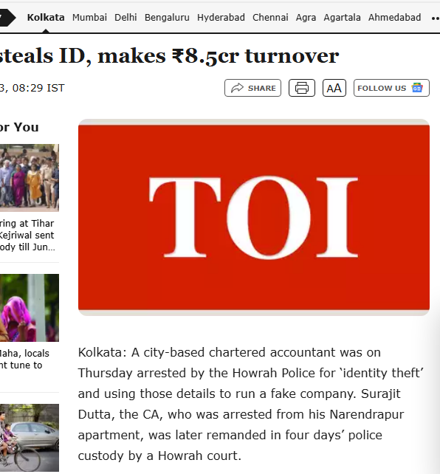
In 2018, a private employee, Naveen Jyothi, filed a police complaint alleging that fraudsters used his personal information to obtain a credit card from the State Bank of India in his name. Fraudsters used the credit card to spend Rs 88,654. Police conducted the investigation, and the fraudsters involved were apprehended.
Kim Kardashian was also a victim of ID theft in 2014. Luis Flores, Jr., 19, called American Express to be Kim Kardashian and modified her social security number and address to his own so he could receive new cards.
Notes:
Kolkata: A city-based chartered accountant was on Thursday arrested by the Howrah Police for ‘identity theft’ and using those details to run a fake company. Surajit Dutta, the CA, who was arrested from his Narendrapur apartment, was later remanded in four days’ police custody by a Howrah court.
Anupam Singh, DCP (North), Howrah said the arrest was made after a food-delivery partner lodged a complaint alleging that his PAN and Aaadhar details, were fraudulently used to set up a company with a GST number, and opening two bank accounts.
Souvik Ghosh, a 29-year-old resident of Liluah, discovered an unsettling truth when he approached a local accountant to apply for his trade license and prepare his Income Tax (I-T) file. On December 25, 2022, Souvik contacted his accountant to inquire about the status of his I-T files related to the trade license. To his surprise, the accountant informed him that an I-T file already existed in his name. Further investigation revealed that Souvik’s identity details had been used to establish a company named Shiva Trading at 20/A Armenian Street, with an impressive turnover of Rs 8.5 crore.
The police are now actively investigating this case. They intend to question the chartered accountant, Surajit Dutta, to determine his motive. Additionally, they are looking into the financial transactions associated with this situation to ascertain whether it is part of a larger racket.

Slide 23
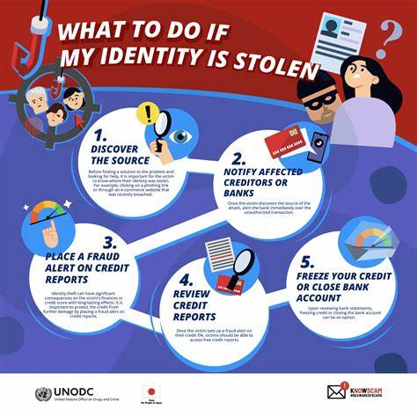

Slide 24
Banking Fraud

Slide 25
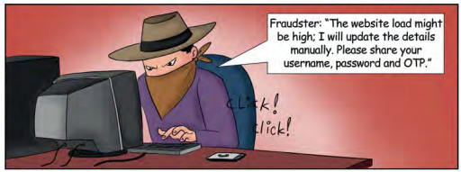
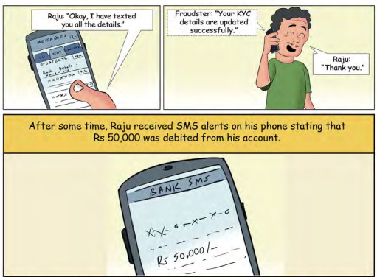
Let’s understand Financial Fraud take place through Phishing Links

Slide 26
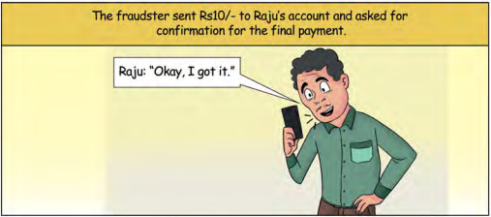
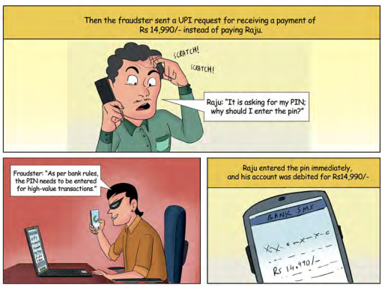
Financial Fraud using online Market places

Slide 27
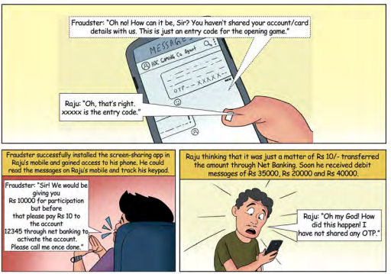
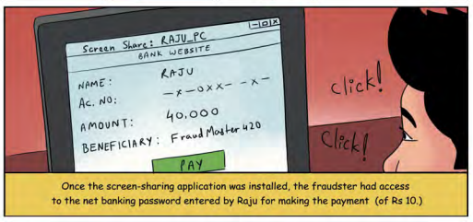
Financial Fraud using screen sharing app/ remote access

Slide 28
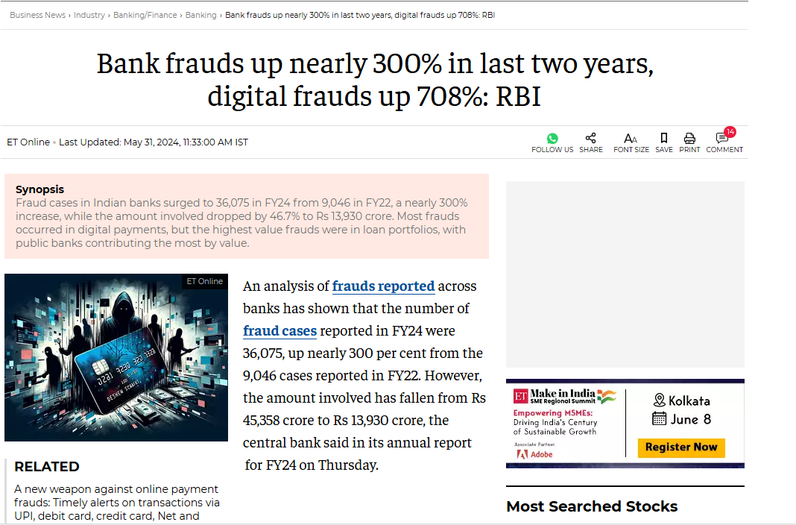
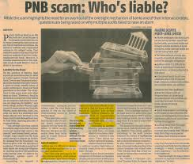
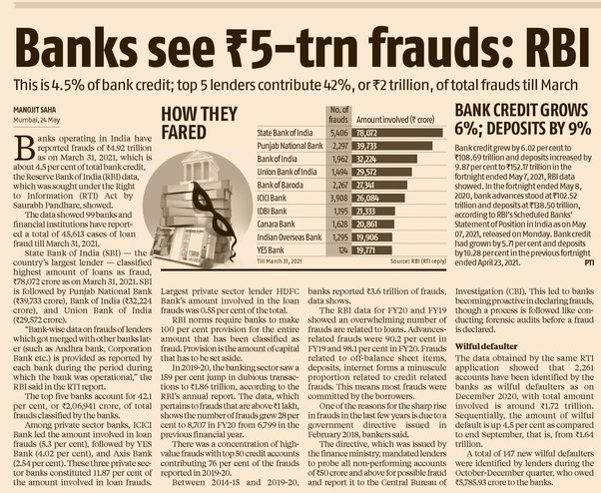
Financial Fraud
Fraud cases in Indian banks surged to 36,075 in FY24 from 9,046 in FY22, a nearly 300% increase, while the amount involved dropped by 46.7% to Rs 13,930 crore. Most frauds occurred in digital payments, but the highest value frauds were in loan portfolios, with public banks contributing the most by value.

Slide 30
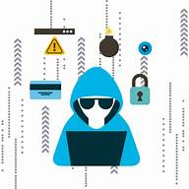
Emerging information security threats and challenges
Use of artificial intelligence (AI) by attackers
AI is a double-edged sword; it is improving security solutions but at the same time is leveraged by attackers to bypass those solutions. Part of the reason for this is the growing accessibility to AI. In the past, developing machine learning models was only possible if you had access to significant budgets and resources. Now, however, models can be developed on personal laptops.
This accessibility makes AI a tool that has expanded from major digital arms races to everyday attacks. While security teams are using AI to try to detect suspicious behaviour, criminals are using it to make bots that pass for human users and to dynamically change the characteristics and behaviours of malware.
Notes:
While AI improves security solutions, criminals also leverage it to bypass defenses. Security teams use AI to detect suspicious behavior, but criminals create bots that mimic human users and dynamically modify malware characteristics.

Slide 32
General Tips keep yourself safe
Always keep your systems/devices (desktop, laptop, mobile) updated with latest patches.
Protect systems/devices through security software such as anti-virus with the latest version.
Always download software or applications from known trusted sources only. Never use pirated software on your systems/devices.
Ensure all devices/accounts are protected by a strong PIN or passcode. Never share your PIN or password with anyone.
Do not share your net-banking password, One Time Password (OTP), ATM or phone banking PIN, CVV number etc. with any person even if he/she claims to be an employee or a representative of the bank and report such instances to your bank.
Always change the default admin password on your Wi-Fi router to a strong password known only to you. In addition, always configure your wireless network to use the latest encryption (contact your network service provider, in case of any doubt).
Be cautions while browsing through a public Wi-Fi and avoid logging in to personal & professional accounts such as e-mail or banking on these networks.
Always use virtual keyboard to access net-banking facility from public computers; and logout from banking portal/website after completion of online transaction. Also ensure to delete browsing history from web browser (Internet Explorer, Chrome, Firefox etc.) after completion of online banking activity.
Do scan all e-mail attachments for viruses before opening them. Avoid downloading e-mail attachments received in e-mails from unknown or un-trusted sources.
Be careful while sharing identity proof documents especially if you cannot verify the authenticity of the company/person with whom you are sharing information.
Note the IMEI code of your cell phone and keep it in a safe place. The operator can blacklist/block/trace a phone using the IMEI code, in case the cell phone is stolen.
Observe your surroundings for skimmers or people observing your PIN before using an ATM.
Discuss safe internet practices and netiquettes with your friends and family regularly! Motivate them to learn more about cybercrimes and safe cyber practices.
Do not save your card or bank account details in your e-wallet as it increases the risk of theft or fraudulent transactions in case of a security breach.
If you think you are compromised, inform authorities immediately.

Slide 33
Where to Report a Cyber Fraud?
Visit the nearest police station immediately.
To report cybercrime complaints online, visit the National Cyber Crime Reporting Portal.
This portal can be accessed at https://cybercrime.gov.in/. In this portal, there are two sections. One section is to report crimes related to Women and Children (where reports can be filed anonymously as well). Another section is to report other types of cybercrimes. You can also file a complaint offline by dialing the helpline number .

