Slide 1
Unlocking Educational Synergy: DIKSHA & Google Classroom

Slide 2
Classroom brings together the best of Google Workspace for Education
Simple, time-saving tools
Interoperability and extensibility
Collaboration and productivity
Docs
Jamboard
SIS sync
How Google helps
Sheets
Slides
Calendar
Sites
Forms
AppSheet
Grade export
Storage
Plagiarism detection
Drive
Originality reports
Email and messaging
Add-ons and APIs
Visibility, analytics, and access
Gmail
Looker Studio
Groups
Consolidating a school’s tech stack into a unified solution reduces cost, improves security, and saves educators time.
BigQuery
Chat
Admin
My Account
Security
Center
Vault
Privacy and security
Device and mobile application management
Notes:
Google provides a full environment of products which just work better together. While we’ll be exploring specifically what Google Classroom offers in our session today, it’s important for us to highlight the difference that Google’s unified solution provides institutions and how it’s one of the ways it sets us apart from others.
The tools can be used day-to-day by:
Educators for professional workflows,
Students to learn and collaborate,
Education leaders to analyze and make more informed decisions,
And IT admins to manage and secure school data
Think about all of the benefits your school can experience with a single, comprehensive solution:
Reduce costs: Have multiple EdTech tools with many of the same capabilities? Gain significant cost savings by retiring redundant software, consolidating security management in the cloud, and accessing your collaboration tools – all in one platform.
Improve security: Your institution is only as safe as your weakest vendor. With GWfE, all of your tools and protected with Google-grade privacy and security standards.
Save educators time: Google Workspace for Education products have the same look and feel, reducing the need to learn how to navigate tools with different designs. They have one single sign on, which means you won’t have to set up unique accounts for each tool. And tight integrations between Google Workspace products lead to seamless product experiences, ultimately making them easier to use. For example, you can start a Google Meet from within Classroom, and meeting recordings and attendance reports are automatically saved to Drive.
In addition, having the Google Workspace tools alongside Classroom opens up a world of learning possibilities.
Google Classroom is a powerful tool on its own for class management, but couple it with Google Meet, and Drive you can host live lessons with other educators from around the world and record them for future use. At the same time, your live class is secure and your recorded content is private. You’ll be in complete control of who can access that lesson.
Google Workspace provides so many of the necessary tools for education. And all of them are backed by Google’s industry-leading security.
We’re strongly positioned to protect our communities most vulnerable assets; our students.
Not only is it about the cloud-first software tailored to also support offline productivity, it’s also about the devices we support. ChromeOS and Android have a strong adoption in education across the globe.
The Google identity is also valuable. It’s built to keep everyone safe online with alerts on suspicious activity, account security checkups, and preemptive protections.

Slide 3
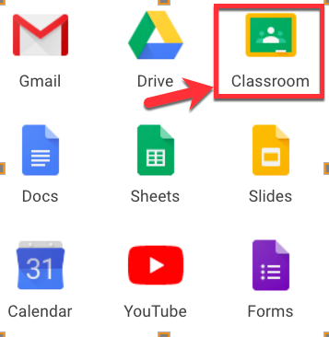
Login to the Google Classroom
Type in the address
www.classroom.google.com
OR
Find the icon for the app in the app grid
Notes:
As a regular user of Google workspace of education, you are aware that there are multiple ways of signing in to the Google Classroom.Sign in with your GWfE email id and look for the icon of GC in the app waffle. or type in www.classroom.google.com and sign in

Slide 4
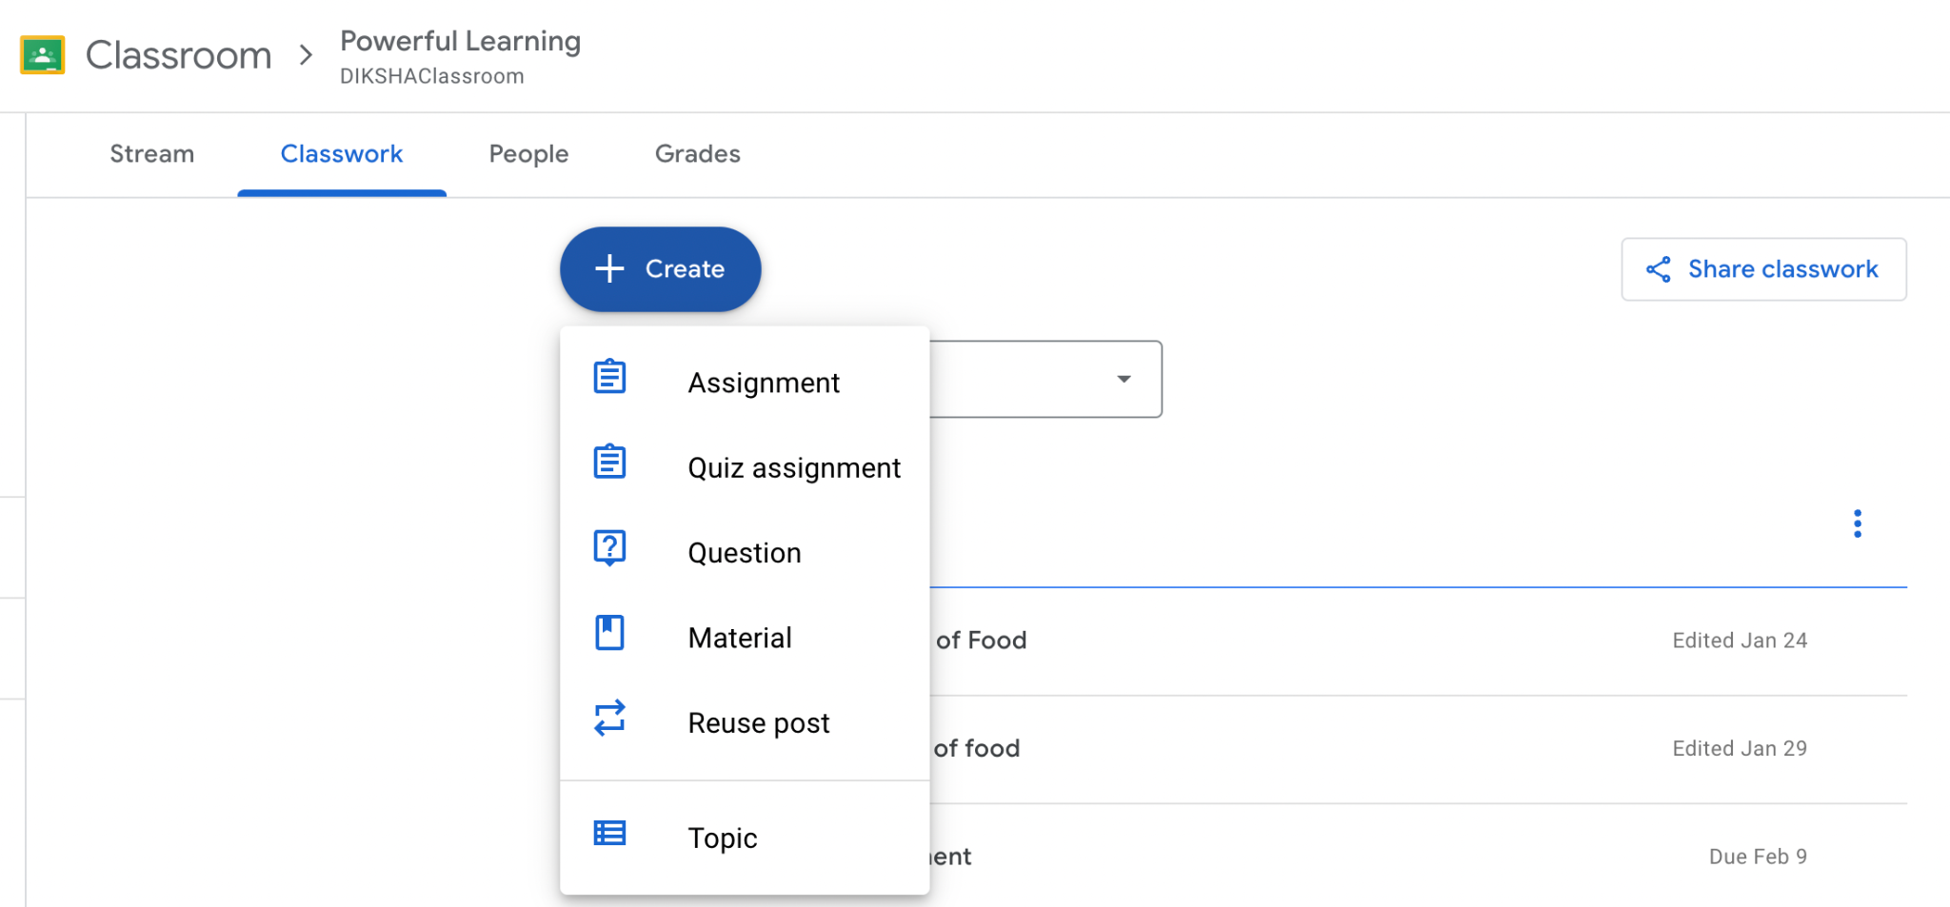
Create and Organize the work under Classwork
Notes:
GC is used to post assignment for students, assessment tasks, a simple question for quick formative assessment and also for sharing resources like PDF , videos and weblinks as material for the reference of students.

Slide 5
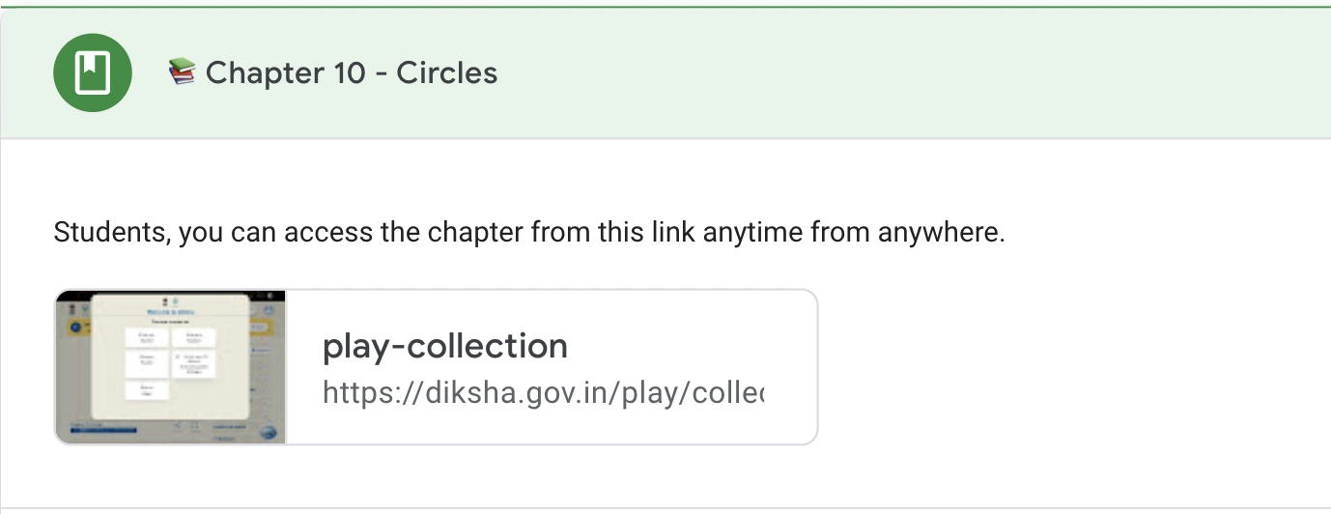
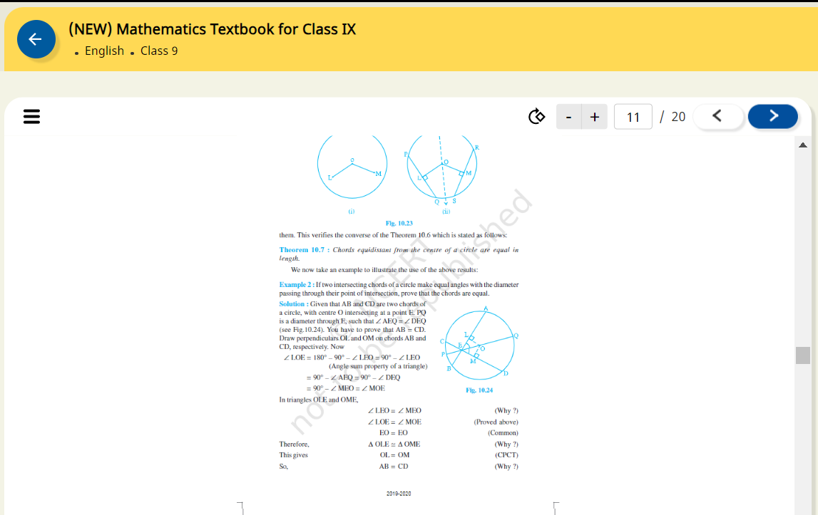
Content shared from DIKSHA as a Material is useful for review and reference by the students anytime from anywhere
https://diksha.gov.in/play/collection/do_31307360993998438412496
Notes:
This is the sample for Mathematics subject content from Diksha Portal shared to Google Classroom.

Slide 6
Written work can be assigned with the help of the assessment material available in DIKSHA
https://diksha.gov.in/play/collection/do_31307360993998438412496

Slide 7
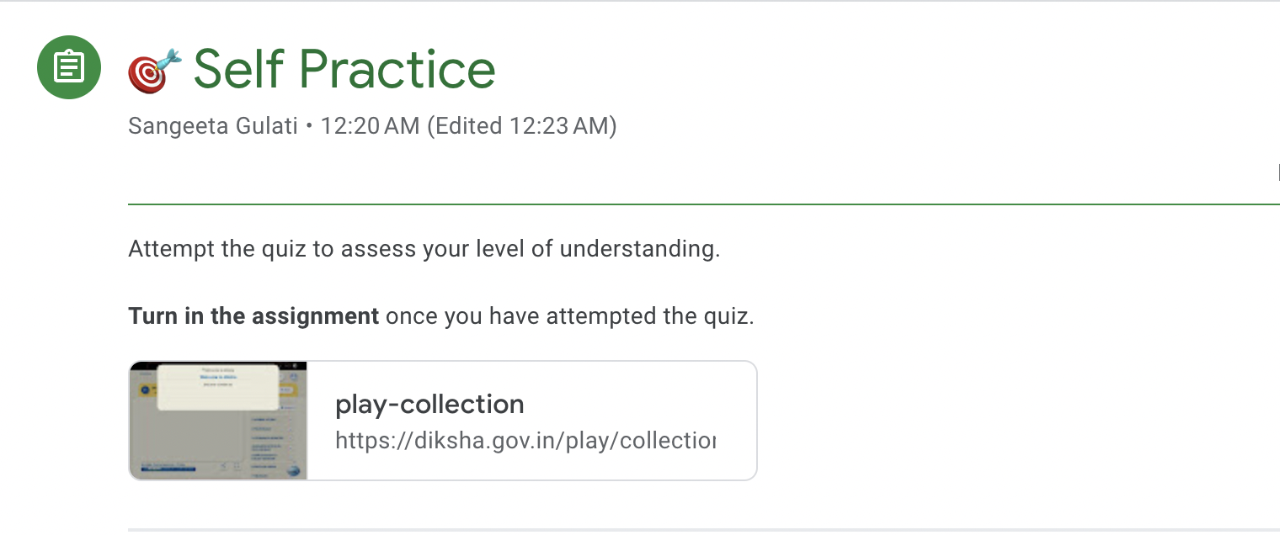
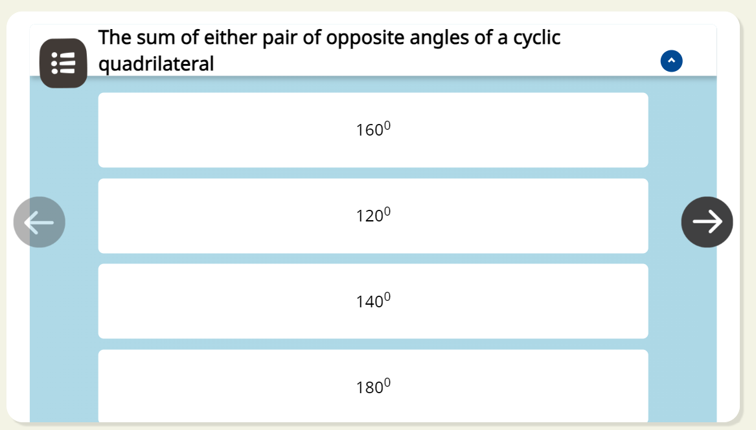
Self Assessment with Feedback
https://diksha.gov.in/play/collection/do_31307360993998438412496?contentId=do_31279916292733337617721
Notes:
Google Classroom Premium Features - YouTube video will be added as an assignment where the questions can be added in between the video. It will be shown live during the session.

Slide 8
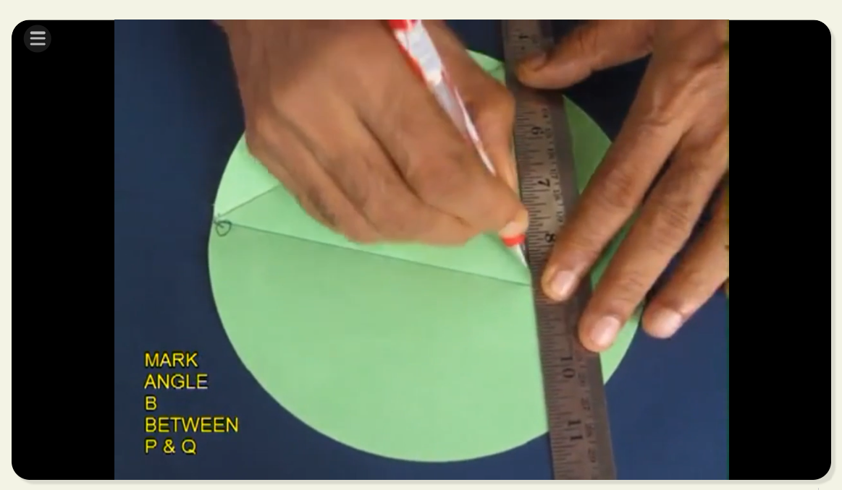
Math Lab Activity : Watch and Do
https://diksha.gov.in/play/collection/do_31307360993998438412496?contentId=do_31290669406420992013114

Slide 9
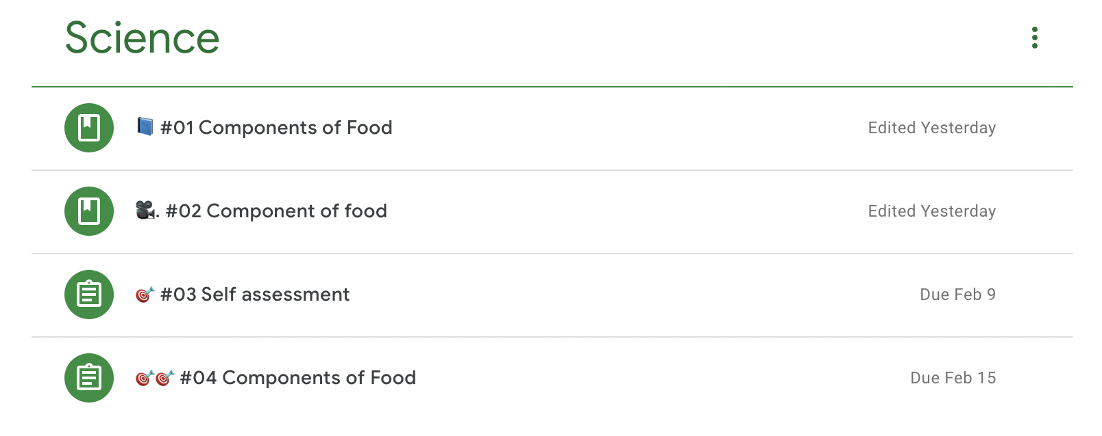
Preview of the Classwork in the Stream
Notes:
This is what GC looks like , here we have pdf content , interactive activities , self assessment and some engaging tasks which a teacher can create based on the lesson. Live Google Classroom will be shown.

Slide 10
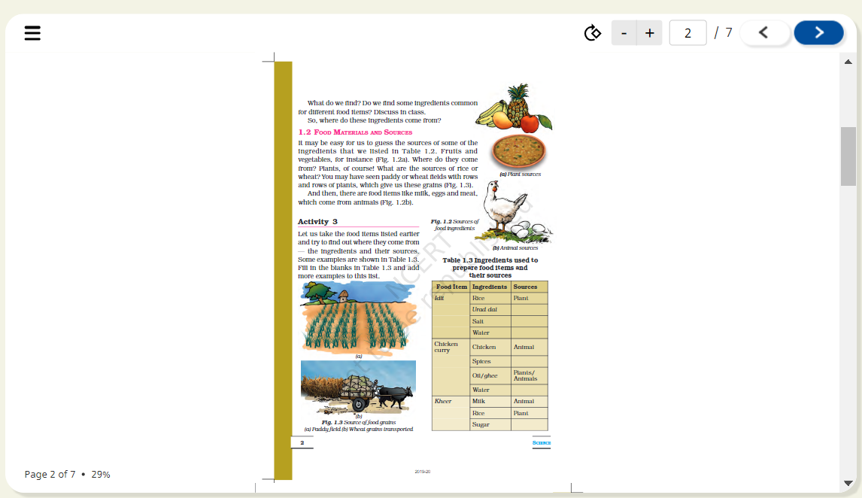
DIKSHA Resource for Teaching - Digital Book
https://diksha.gov.in/play/collection/do_31307360990084300813077?contentId=do_3129911202709504001140
Notes:
https://diksha.gov.in/play/collection/do_31307360990084300813077?contentType=TextBook

Slide 11
DIKSHA Resource : Watch and Answer
https://diksha.gov.in/play/content/do_313066328631836672110519
Notes:
Video shared from DIKSHA platform is shared in the “Question” in Google Classroom. Student watches the video and then answer the question based on the concept(s) covered in the video.

Slide 12
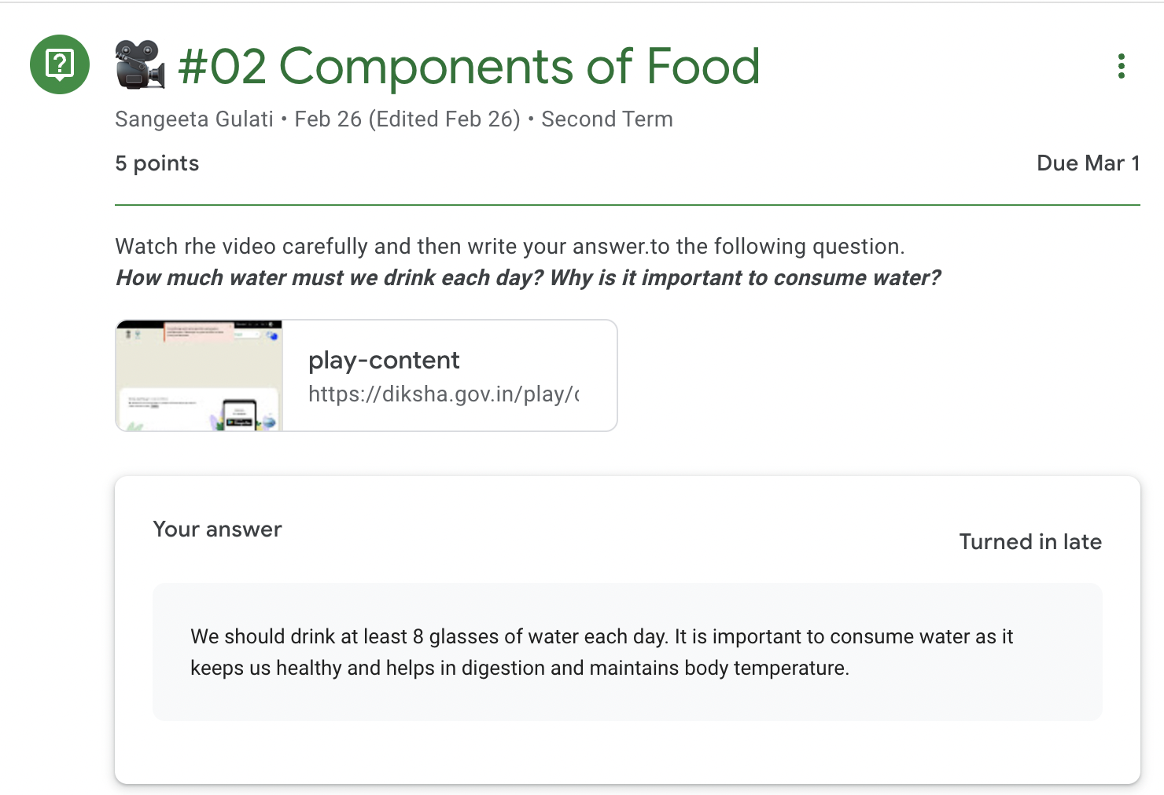
DIKSHA Resource : Watch and Answer(Student’s view)
Notes:
Video shared from DIKSHA platform is shared in the “Question” in Google Classroom. Student watches the video and then answer the question based on the concept(s) covered in the video.

Slide 13
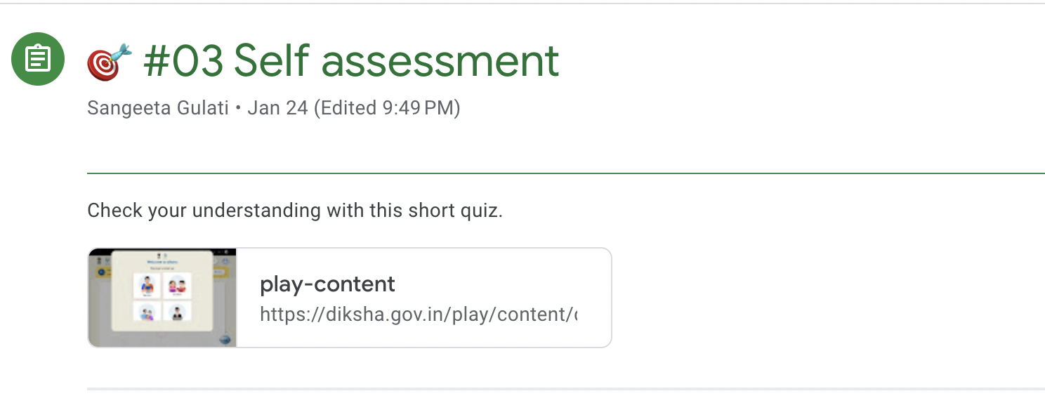
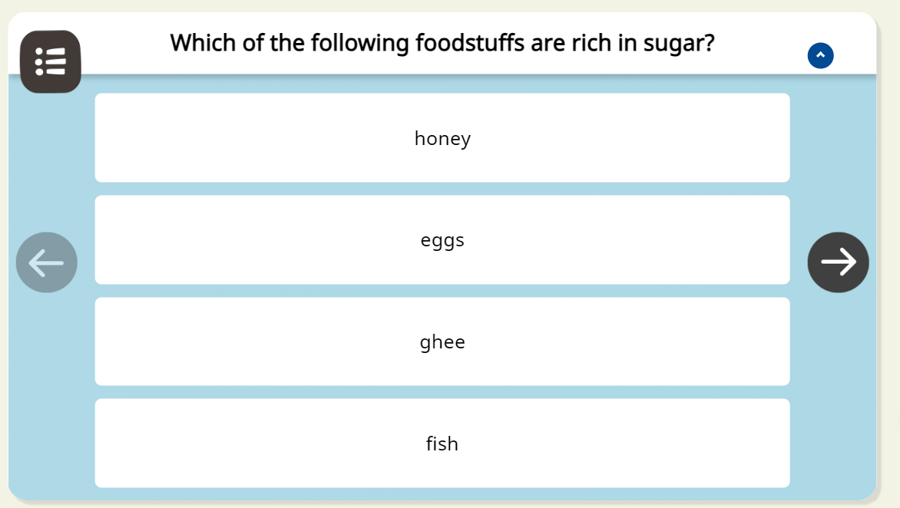
Check your Understanding: Short Quiz
https://diksha.gov.in/play/collection/do_31322176371097600014280?contentId=do_31279855762848972817052
https://diksha.gov.in/play/collection/do_31307360990084300813077?contentId=do_31279855747741286417050
Notes:
https://diksha.gov.in/play/collection/do_31322176371097600014280?contentId=do_31279855762848972817052
Self assessment quiz based on the lesson

Slide 14
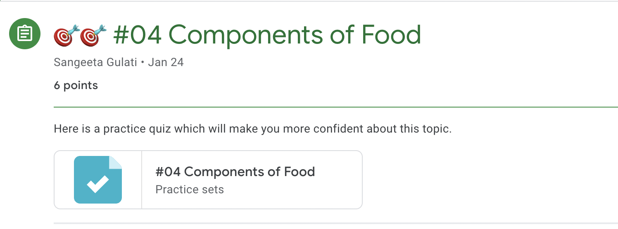
Formative Assessment with Practice Set in Google Classroom
Notes:
Google Classroom Premium Feature - Practice Set - Where questionnaire is created in various ways with hints. Practice sets is created in Demo gfe account - Live demo will include showcase of the same.

Slide 15
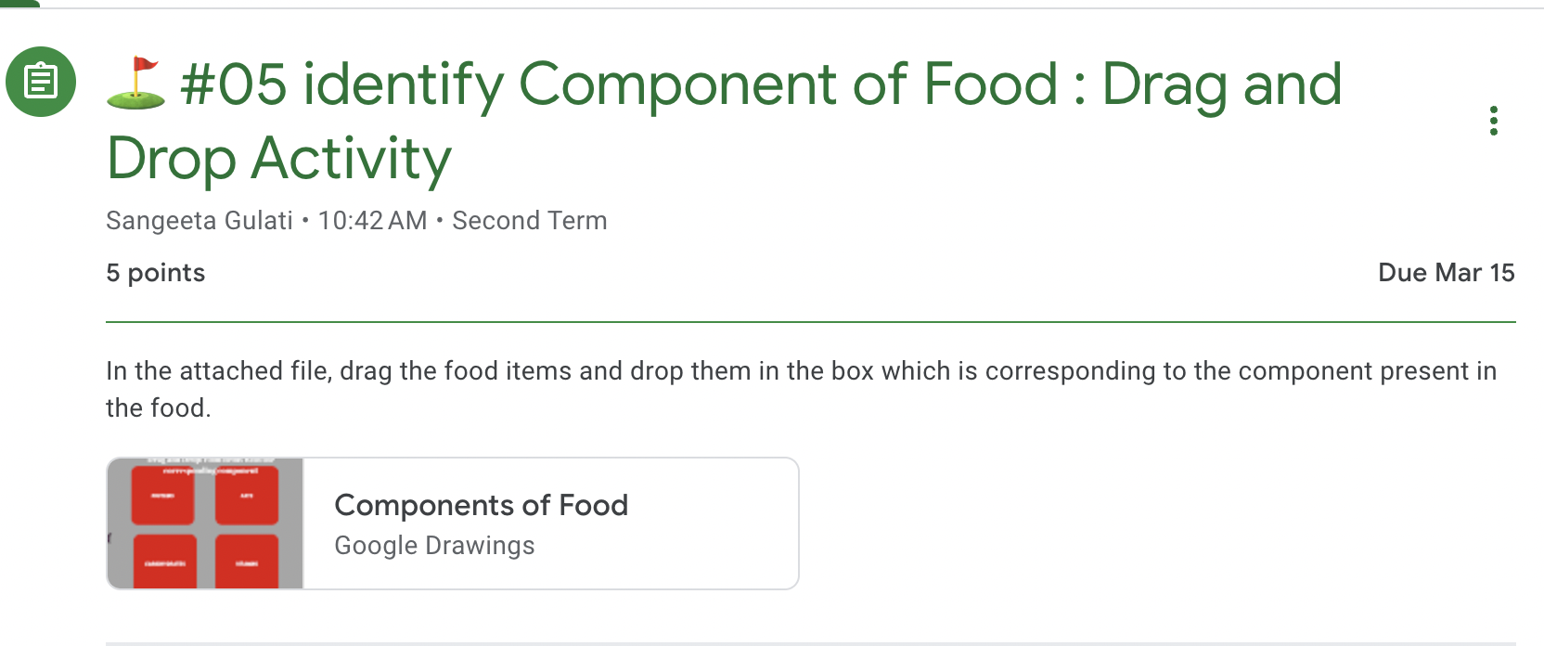
Drag and Drop Activity: Google Drawings
Interactive task to reinforce the concept using Google apps
Notes:
Google Drawings is a versatile tool for creating diagrams, charts, illustrations, and more. It can be easily incorporated into Google Classroom.
Assignment with a copy of the file for each student. It will be shown Live

Slide 16
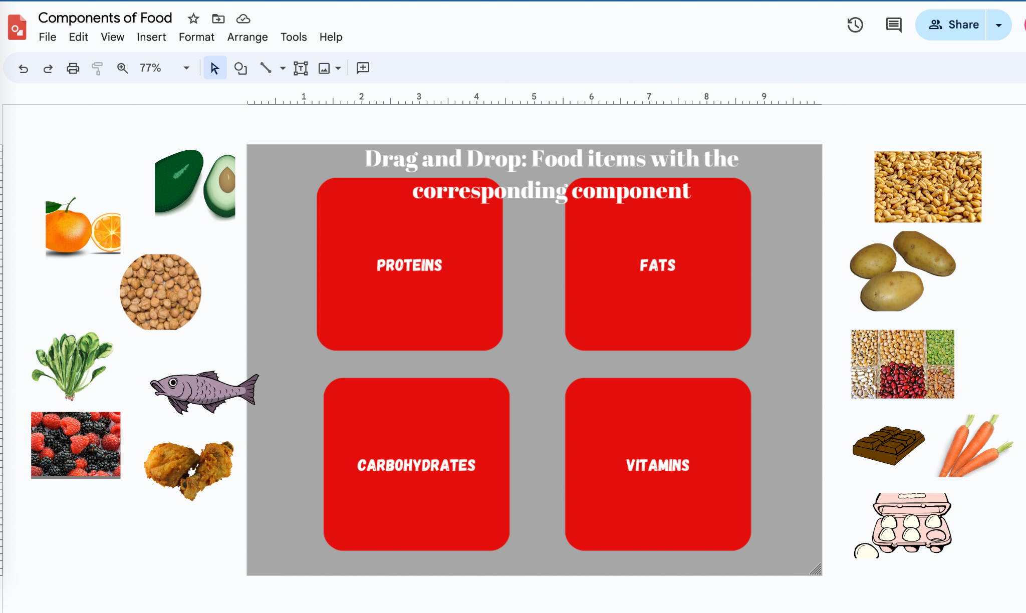
Drag and Drop Activity: Google Drawings
Notes:
Copy for each student in GC - gives each student an opportunity to engage with the benefit of teacher being able to see the work of students and give feedback

Slide 17
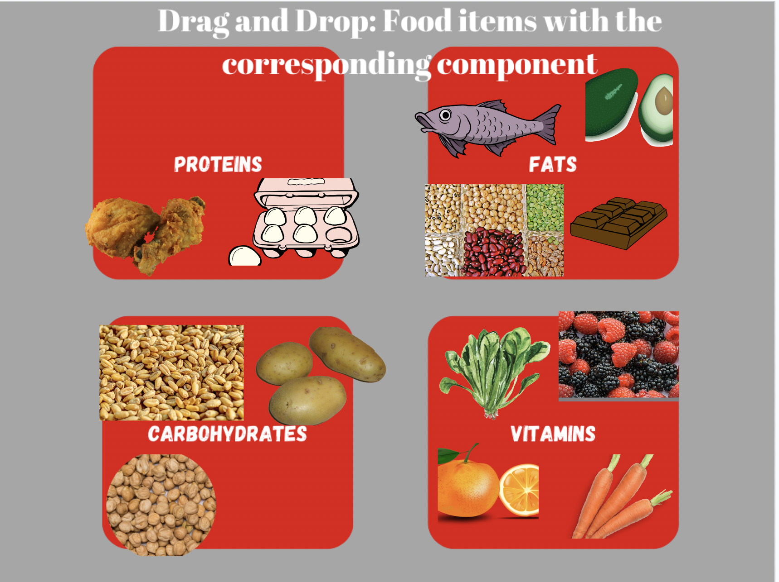
Drag and Drop Activity: Google Drawings
Student attempts the activity and submit it in the classroom
Notes:
Submission of Student’s work will be shown.

Slide 18
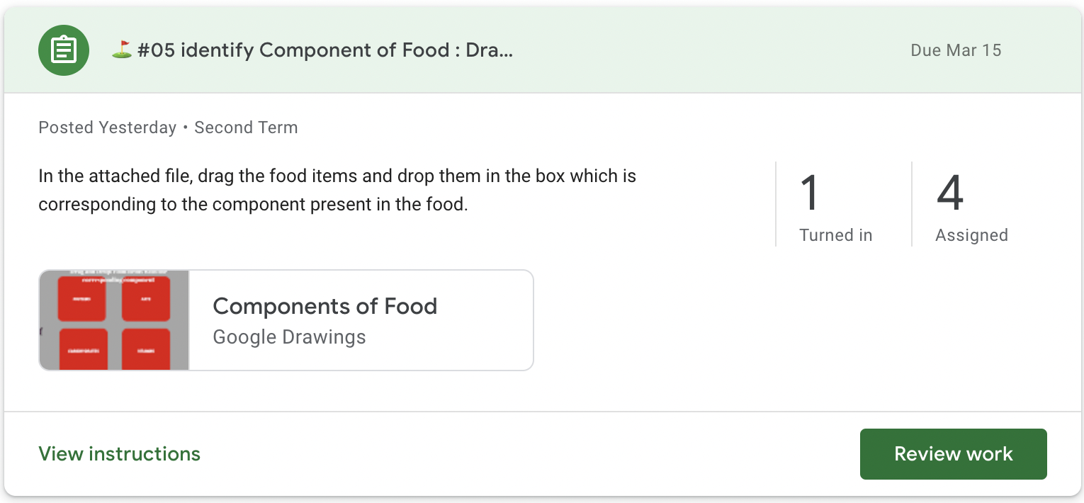
Teacher’s view of students’ submission of work.
Notes:
Submission of Student’s work will be shown.

Slide 19
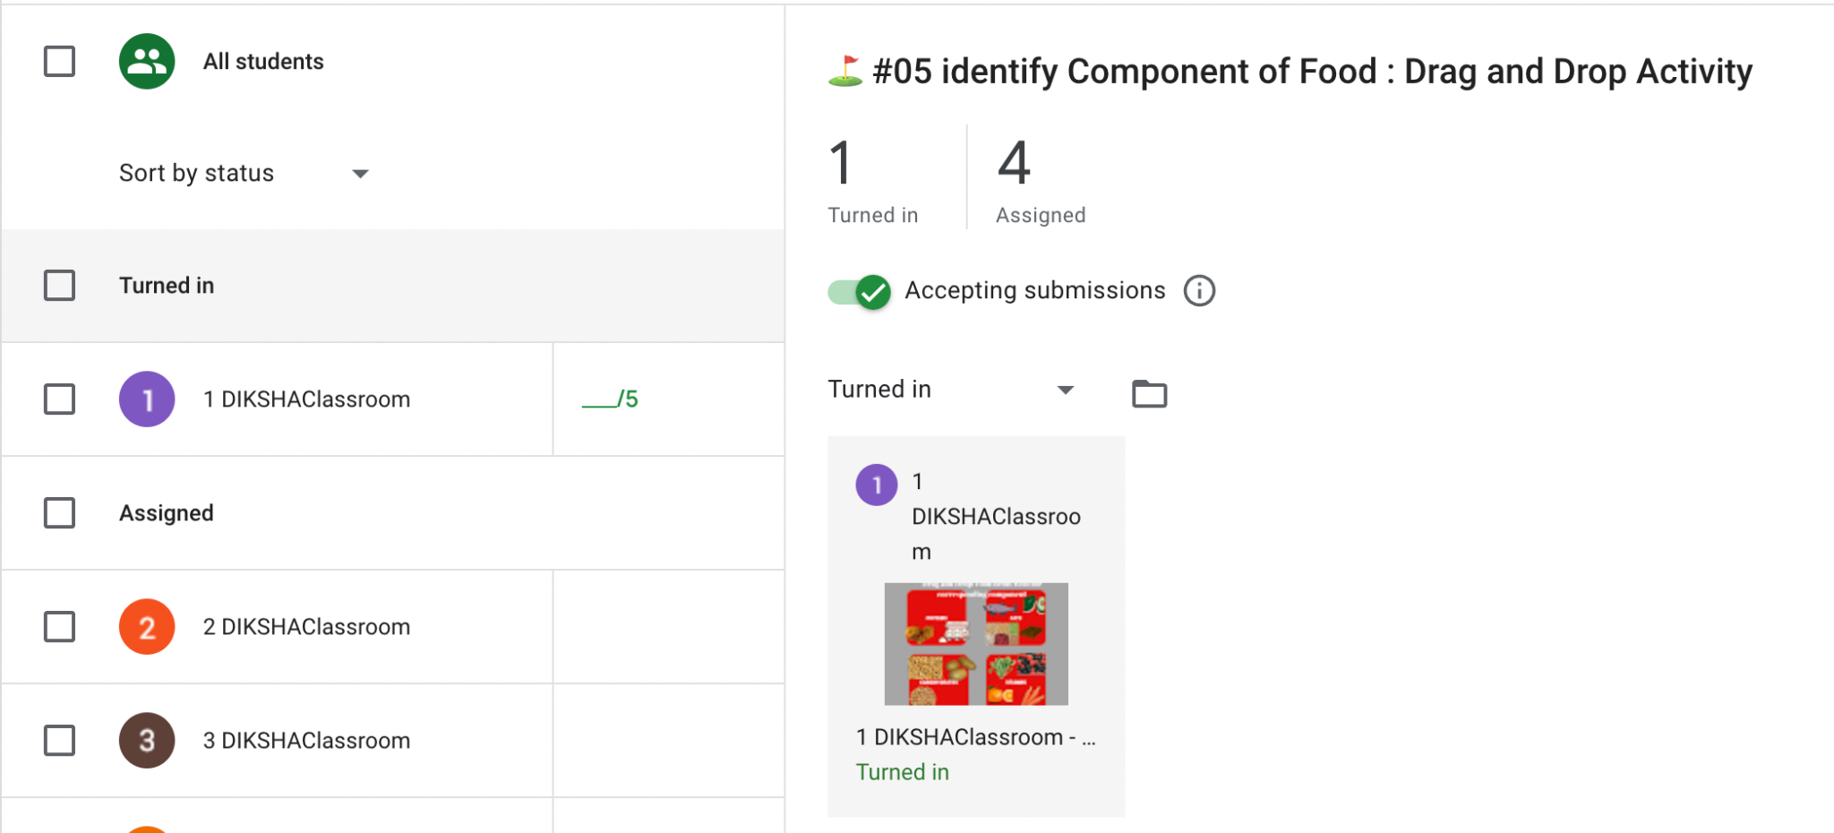
Teacher’s view for grading students’ work.
Notes:
Submission of Student’s work will be shown.

Slide 20
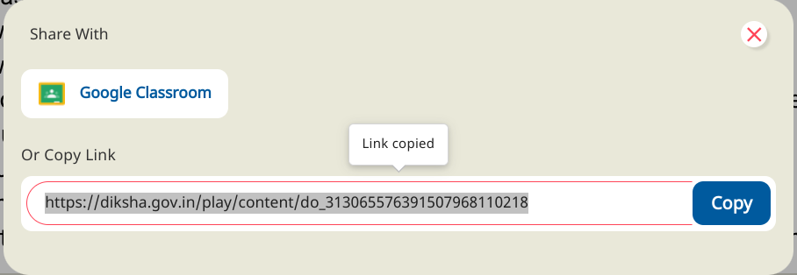
Sharing Content from DIKSHA to Google Classroom
Notes:
Step by step navigation from Diksha Portal to Google Classroom will be shown.

Slide 21
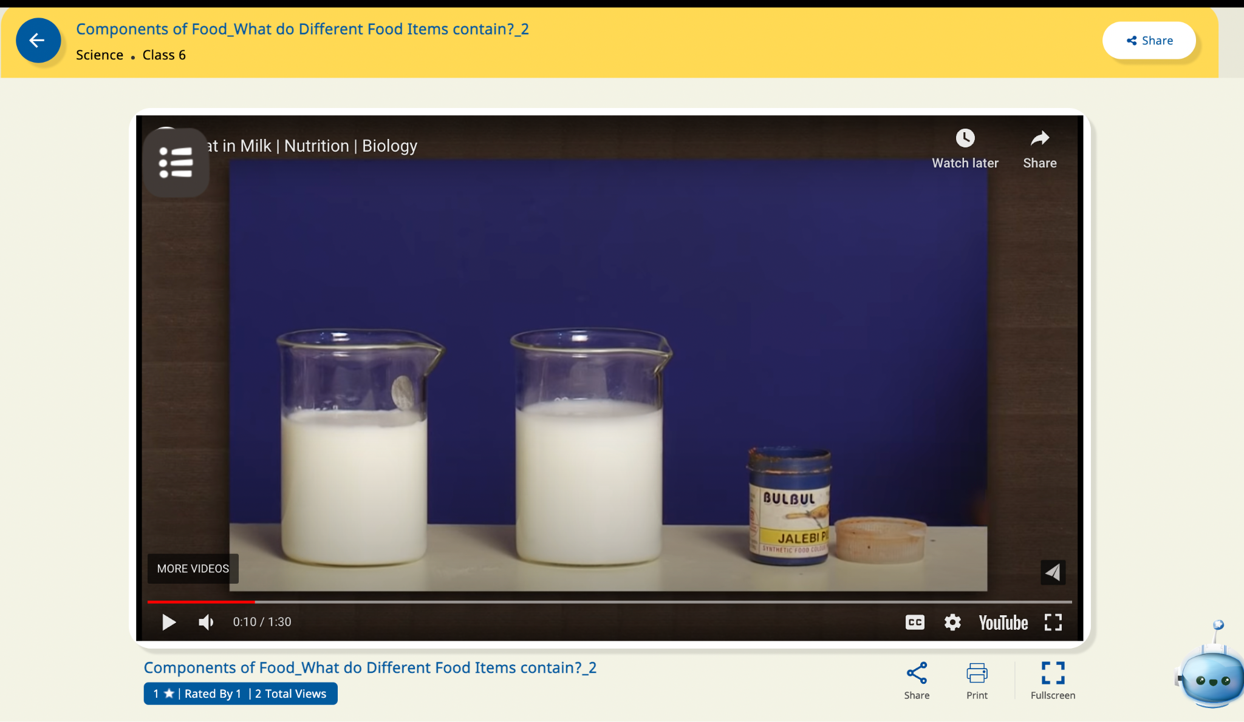
Step 1: Identify the resource
Notes:
With the option of Share to Classroom, we will now be able to post the content directly into a selected classroom. Step 1 : identify the resource https://diksha.gov.in/play/content/do_312580362418749440211582

Slide 22
Step 2: Click the Share Icon
Notes:
With the option of Share to Classroom, we will now be able to post the content directly into a selected classroom. Step 1 : identify the resource https://diksha.gov.in/play/collection/do_31322176371097600014280?contentId=do_31279855762848972817052

Slide 23
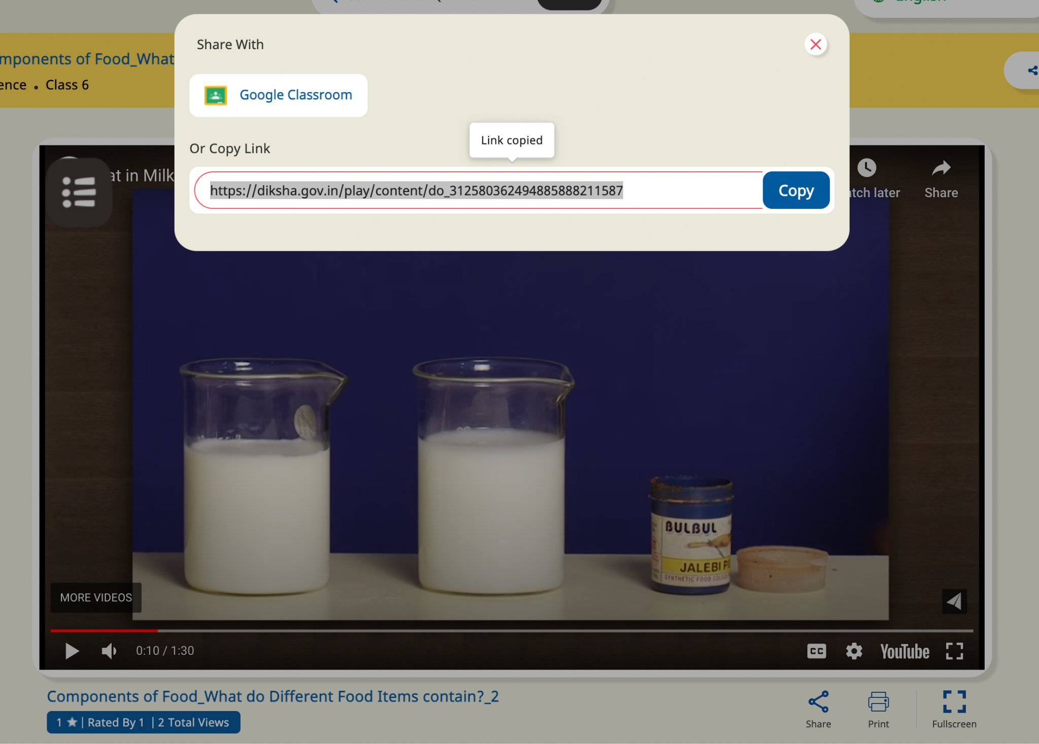
Step 3: Share with “Google Classroom”
Notes:
With the option of Share with Classroom, we will now be able to post the content directly into a selected classroom.

Slide 24
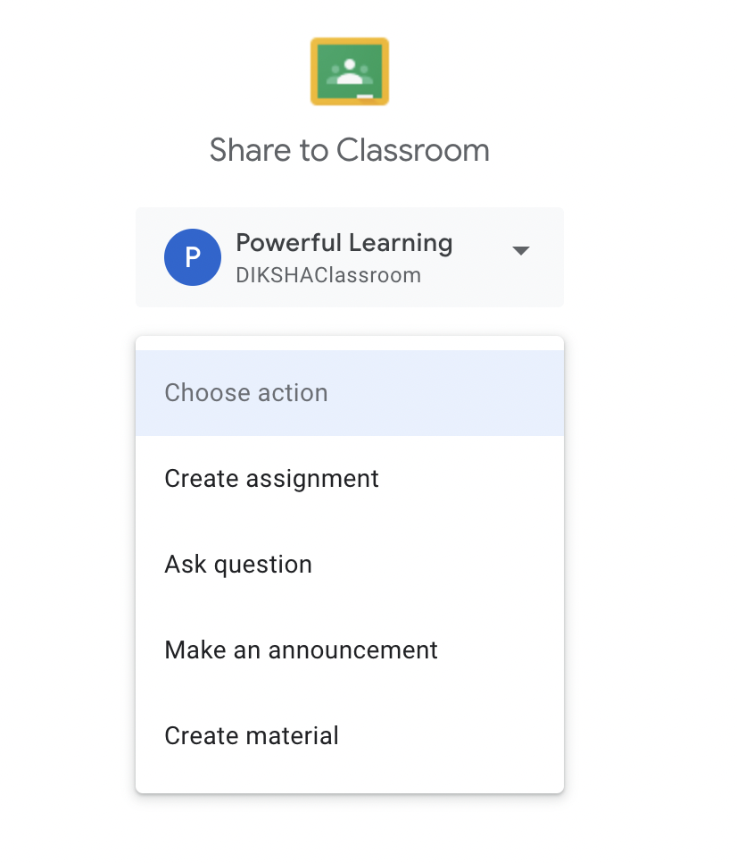
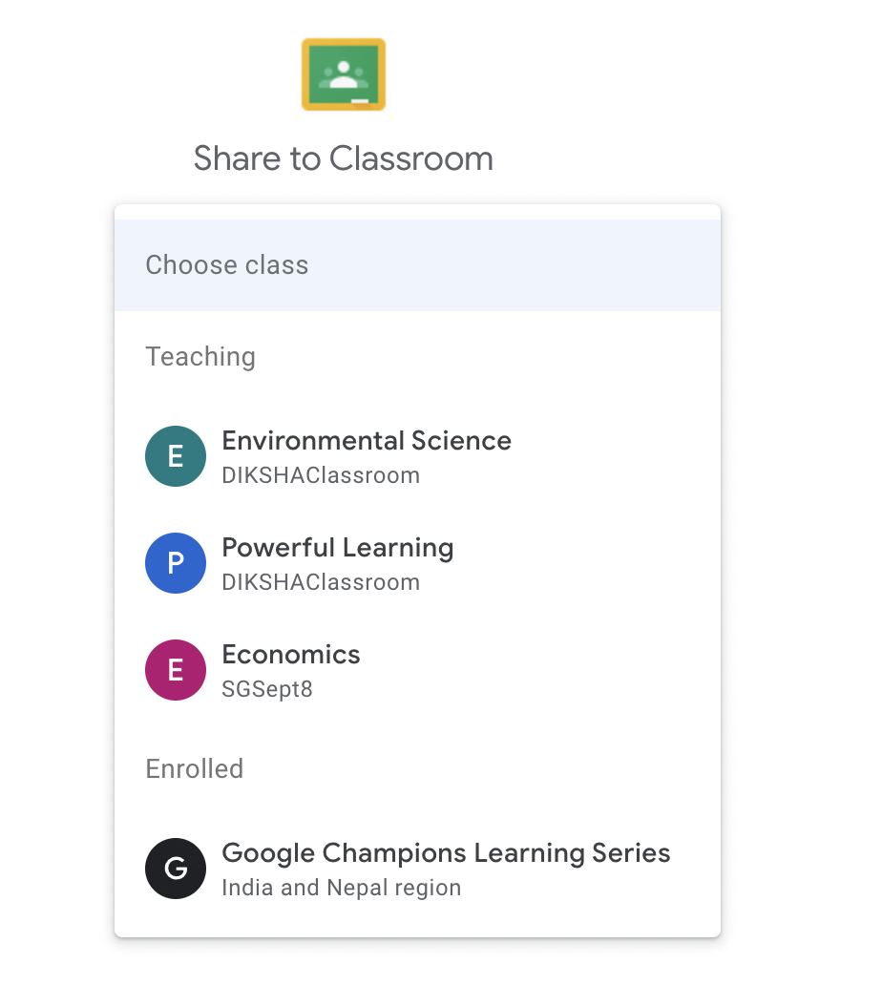
Step 4: Select the “Google Classroom” and create a Post
Notes:
Once the classroom is selected, teacher can post the link as part of an assignment, ask a question based on the content of the link , share it as a reference material or use it as part of the announcements.

Slide 25
Select and use Resources from DIKSHA and more
Notes:
Virtual lab will be the focus area

Slide 26
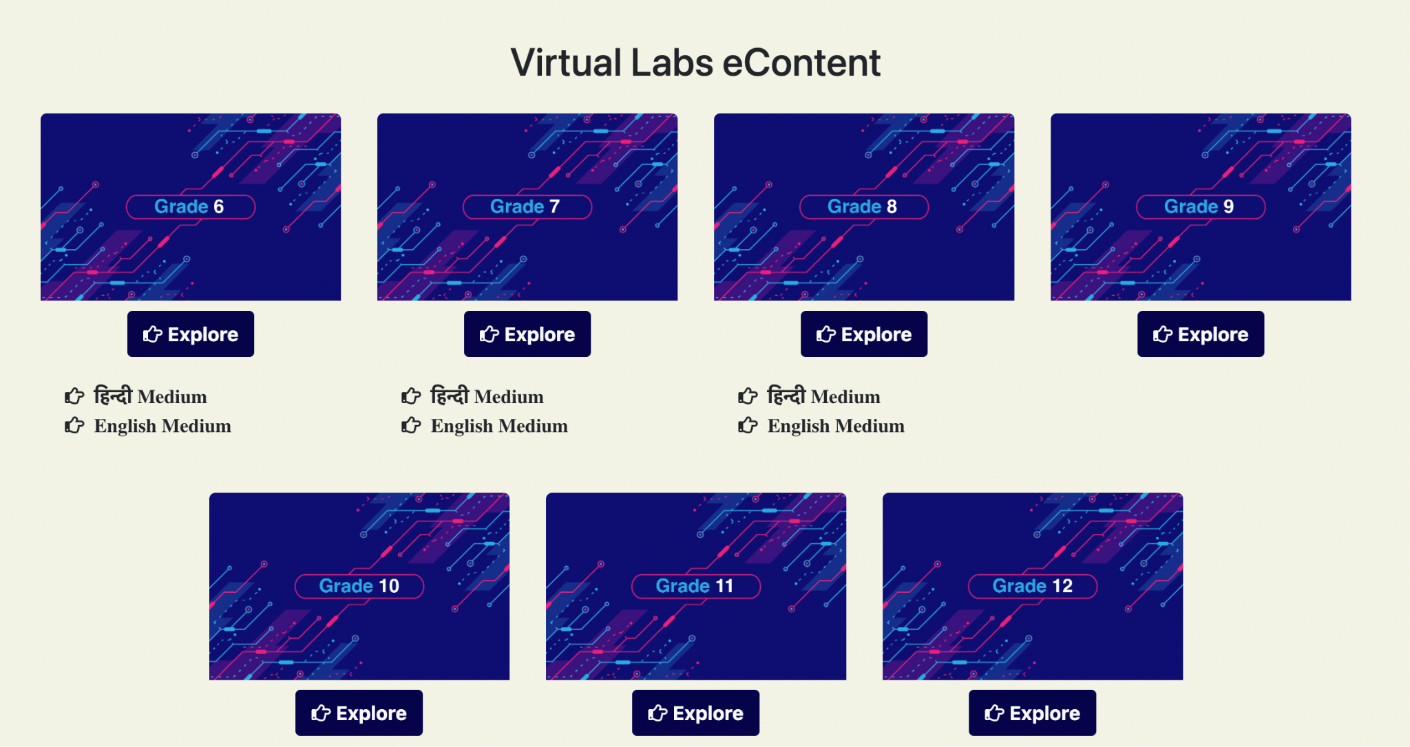
Virtual Lab
Notes:
https://diksha.gov.in/virtuallabs.html

Slide 27
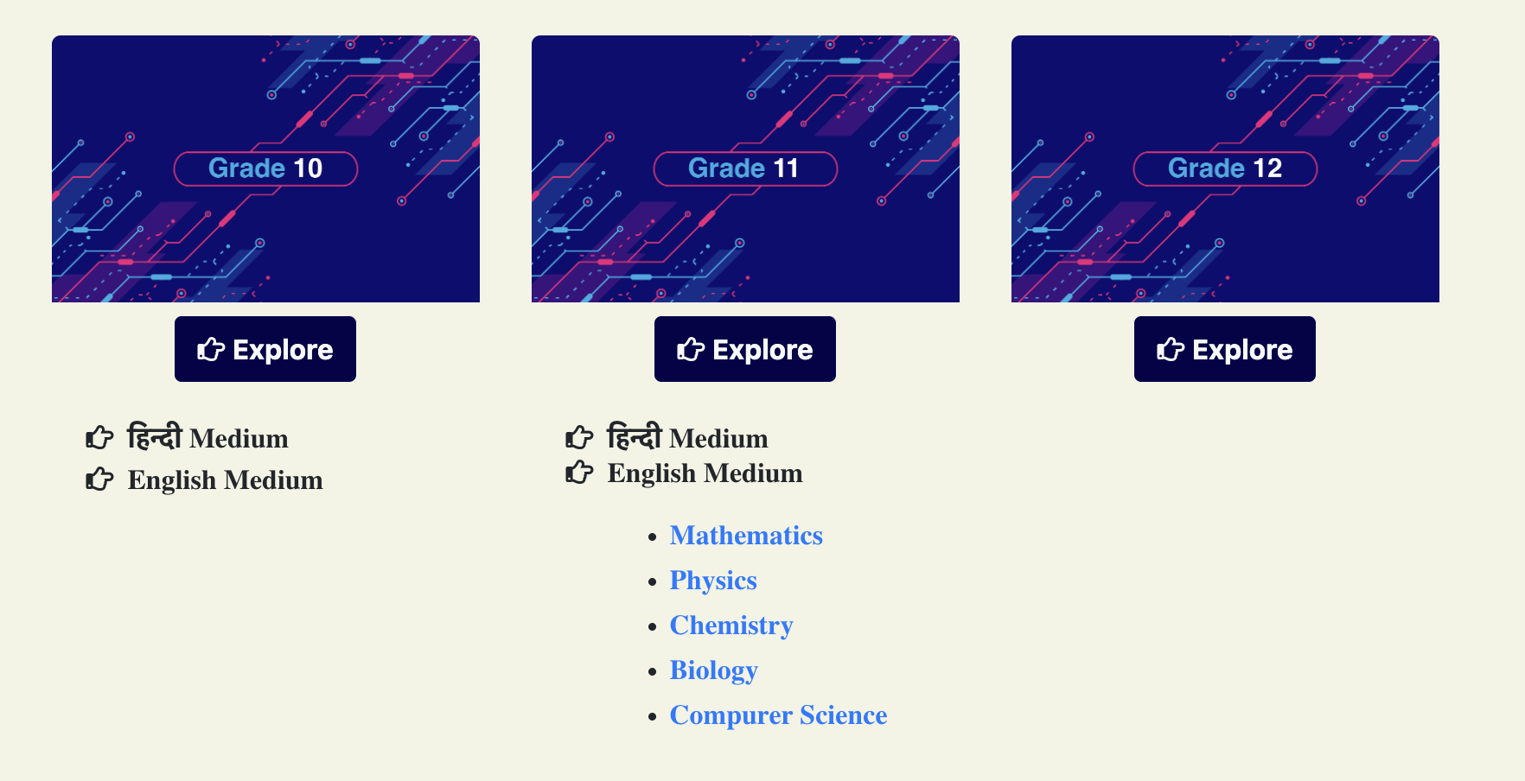
Select the topic and find interactive content
Notes:
https://diksha.gov.in/play/collection/do_3135615460891770881992?contentId=do_31396494180063641612539

Slide 28
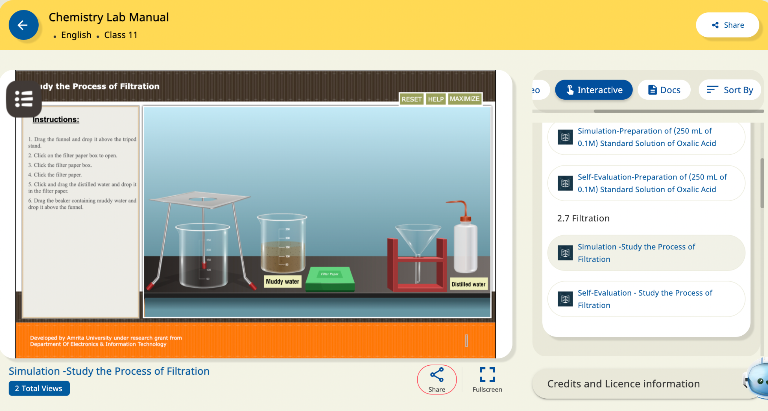
Share Simulation of the Chemistry Practical with Students

Slide 29
Thank You!

