Slide 1
Learning with Olabs
Sasikumar M
CDAC Mumbai
sasi@cdac.in

Slide 2
OLabs – virtual labs for schools
The OLabs project, supported by Meity, has produced over 511 virtual labs covering Science, Maths, Languages (English, Hindi and Sanskrit), and Social science for school students.
Freely accessible on the web (olabs.edu.in).
A 14-year long journey till date.
Physics
Chemistry
Biology
Mathematics
English
Hindi
Sanskrit
Comp Science
Social Science
www.olabs.edu.in
https://diksha.gov.in/virtuallabs.html
Notes:
Subject specific sessions from tomorrow – will discuss general today.

Slide 3
Landing page of OLabs

Slide 4
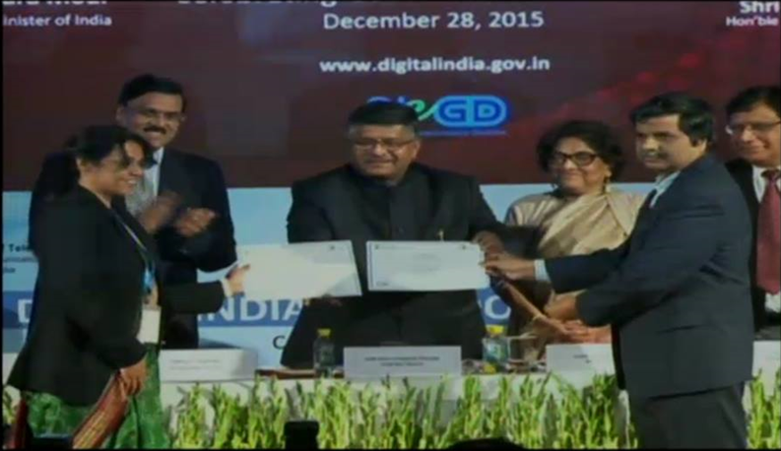
OLabs:
The journey so far
2021: Olabs
NG commencing
With 500 new
labs
2020: Pandemic enhances demand manifold.
2015-20: Launch of rollout, 40000 teachers trained across India
2013-16: 170+ labs; CBSE review;
NKN hosting
2011-12: 30 labs phase I; CBSE endorses quality

Slide 5
Labs in education…
Laboratories recognized as important devices in the learning process:
Hands on feel of the lessons learned.
Connecting the theory to the real-life.
Focus on experiment as a key paradigm in science.
Better internalization of the content
Tell me, I will forget;
Show me, I may remember;
Involve me, I will understand.

Slide 6
But….
Cost and space requirements for physical infrastructure and equipments.
Cost of raw material.
Limited access, that too in group mode.
Support for divyang students?
Not all activities amenable to physical labs:
Pendulum with gravity change
Dangerous reactions
Time-taking tasks

Slide 7
Virtual labs
Aka simulation labs (e.g. OLabs).
Unconstrained availability; trivial cost once developed.
Development cost can be high!
Simulations attempt to mimic the reality – but not actually the reality
There are boundaries ignored (spring’s linearity region)
Simplifications introduced
Can manipulate the timescale (slow down very fast reactions, speed up the very slow)
There are also new opportunities (pendulum in Moon or Jupiter)
Can be a very powerful instructional device

Slide 8
How effective..
Many believe them to be education enablers…
Particularly in cases where education infrastructure is not adequate.
But there are also those who believe these can be inhibitors.
Real-life experiences are important for a complete picture!
See as amplifiers, not replacements!
Meanwhile, there is a lot we can do to make it a positive experience….

Slide 9
…. Such as…
Provide a comprehensive eco-system to reduce time to use.
1
Understand the pedagogical aspects and adopt relevant usage pattern.
2
Provide rich set of affordances and guidance.
3
Integrate into the curriculum.
4

Slide 10
Eco-system
The core simulator
Theory relevant to the lab
Understanding of the process and its implications
Auxiliary requirements: plot, measurement and recording, etc
Review questions, references

Slide 11
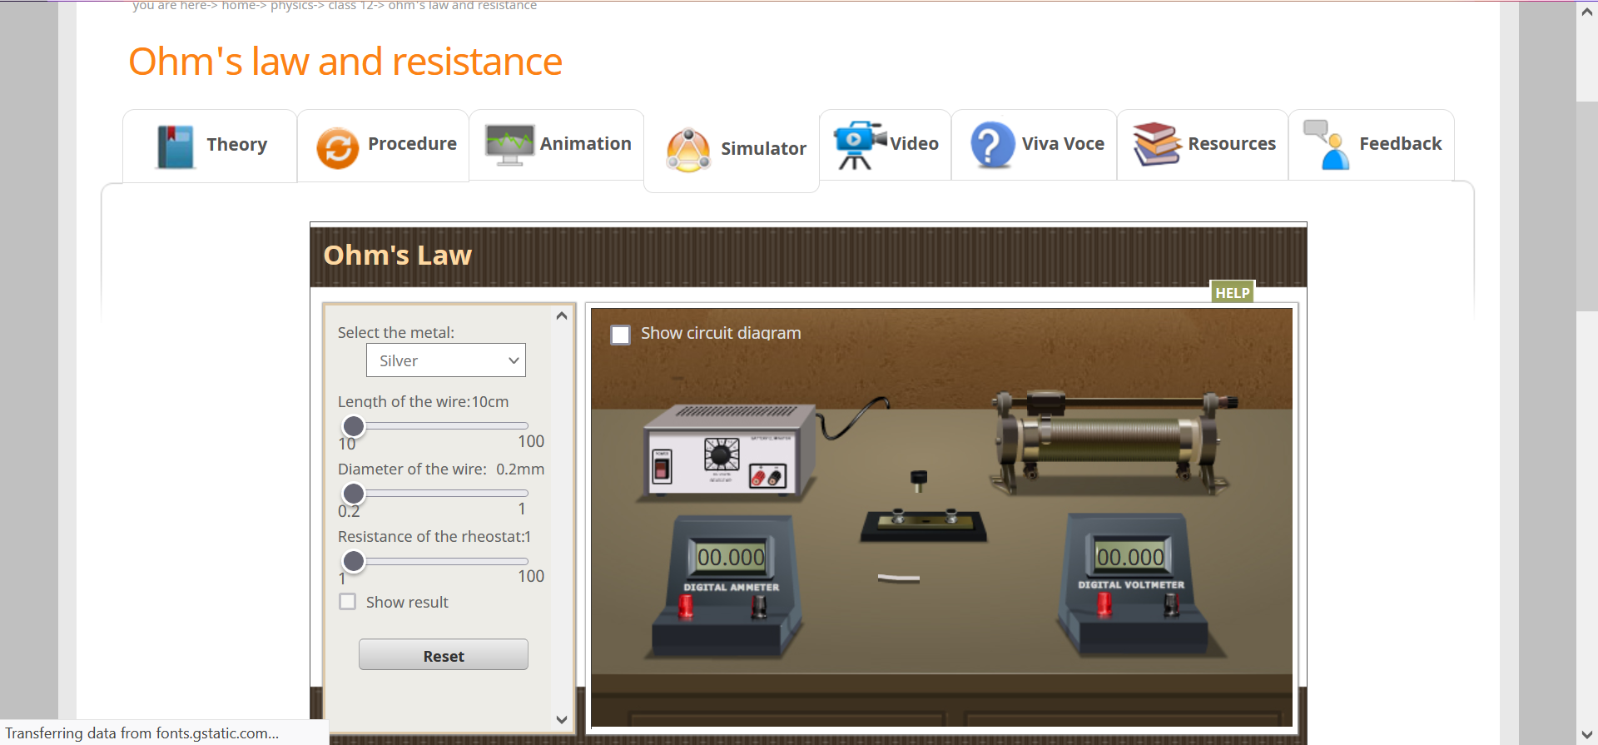
OLabs: A view of a lab
Affordances

Slide 12
Subjects available

Slide 13
Current status of OLabs
511 labs available (more being added)

Slide 14
OLabs Availability
1. Online:
Olabs Portal
url: www.olabs.edu.in​
Diksha Portal
url: https://diksha.gov.in/virtuallabs.html
2. Offline:
Windows Installer (Laptop/Desktop)
OLabs App (Smart board/ Android Devices)

Slide 15
OLabs Usage Scenarios
Compared to the many simulators available online, Olabs provide a complete eco-system for the lab.
Consistency in terminology across the tabs
Compliance with the NCERT curriculum.
Content reviewed and approved by CBSE teachers.
High degree of interactivity for the learner and multiple affordances.
OLabs is ready for use…

Slide 16
Usage mode-1
Before the physical lab….
Usually students have no idea of what to expect in the lab, till they reach there.
Being prepared will help to use the limited lab time more effectively.
OLabs mimics the experimental setup with high fidelity.
Use the virtual lab as a preparatory ground before the lab.

Slide 17
Usage mode-2
After the physical lab
Physical labs provide limited options to explore..
due to resource constraints
and time constraints.
In the lab environment, adequate time to reflect may not be there.
Ask the learner to explore the virtual lab in more detail and try out more scenarios.
Use reflection in the class, with specific scenarios.

Slide 18
Usage mode-3
As an instructional device….
Explaining concepts like hooks law, focus length of a lens, etc hard without a lab setup.
Olabs can function as a replica of lab setup for this purpose.
Demonstrate the intended behavious using Olabs.
Use affordances provided to try select use cases.
Encourage the learners to try them out on their own.

Slide 19
Usage mode-4
For active learning strategies…
Active learning strategies like flipped classroom require mechanisms to engage a class without lectures.
A lab setup replicated in the classroom can provide a fertile ground…
Stop the experiment arbitrarily and ask learners to predict what happens?
What happens if a weight of 25Kg is put on the spring in Hook’s law?
What happens to image, as the candle moves closer to the focal point of a lens?
Deepens learning and encourages reflection.

Slide 20
Usage mode-5
When there is no physical lab – e.g. pandemic, lack of infra.
Can also function as replacement of physical lab in
Performing the activities envisaged.
Maintain lab records.
Getting a feel of the lab activities
Only appearance and activities though.

Slide 21
Lab specific affordances
In each lab, a set of affordances are provided.
These are chosen based on the expectation and requirements of the lab.
For simple pendulum, you can change
The wire length, value of ‘g’, material of bulb, etc.
For tense conversion, you can choose
The source and target tenses.
List of words provided to minimize typing overhead and errors.
Tables to record data, where there is multiple iterations of the experiment is required.
Plotting provision where applicable.
Click to perform, where fine grained mouse control may be difficult.
Connectors in electric circuits.

Slide 22
Non-science subjects
Mathematics
Languages
Social sciences
No real concept of a lab in these.
Creating a lab environment could be useful.

Slide 23
Language labs?
Can we use the same idea for languages -- English, Hindi?
Four aspects to language: Reading, Writing, Listening, Speaking.
Two components to consider: grammar and pronunciation.
At higher level: coherence, organization, style
Pronunciation required good quality ASR and TTS with Indian accent -- so deferred.
For grammar:
Voice conversion, tense conversion, proposition, etc
Already part of Olabs.

Slide 24
OLabs Maths

Slide 25
OLabs Maths

Slide 26
OLabs English

Slide 27
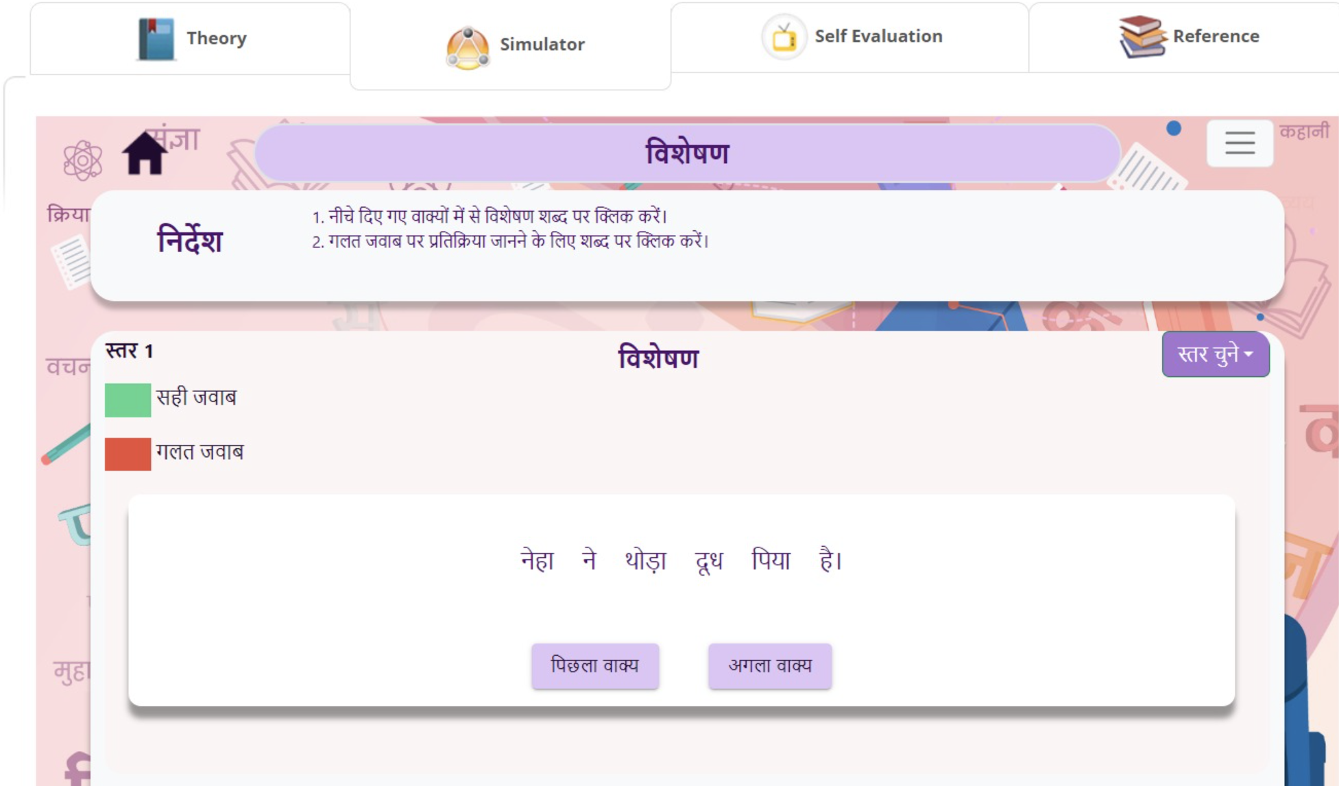
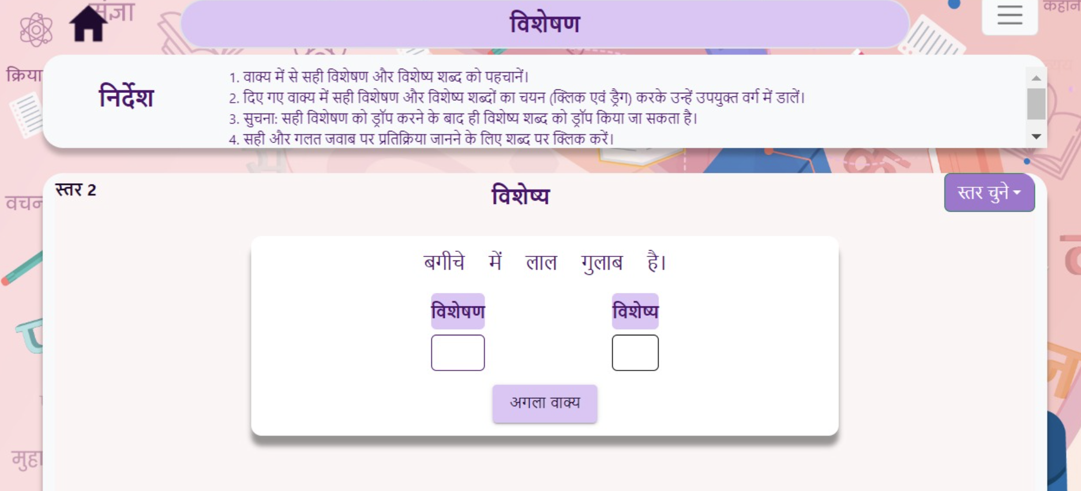
OLabs Hindi

Slide 28
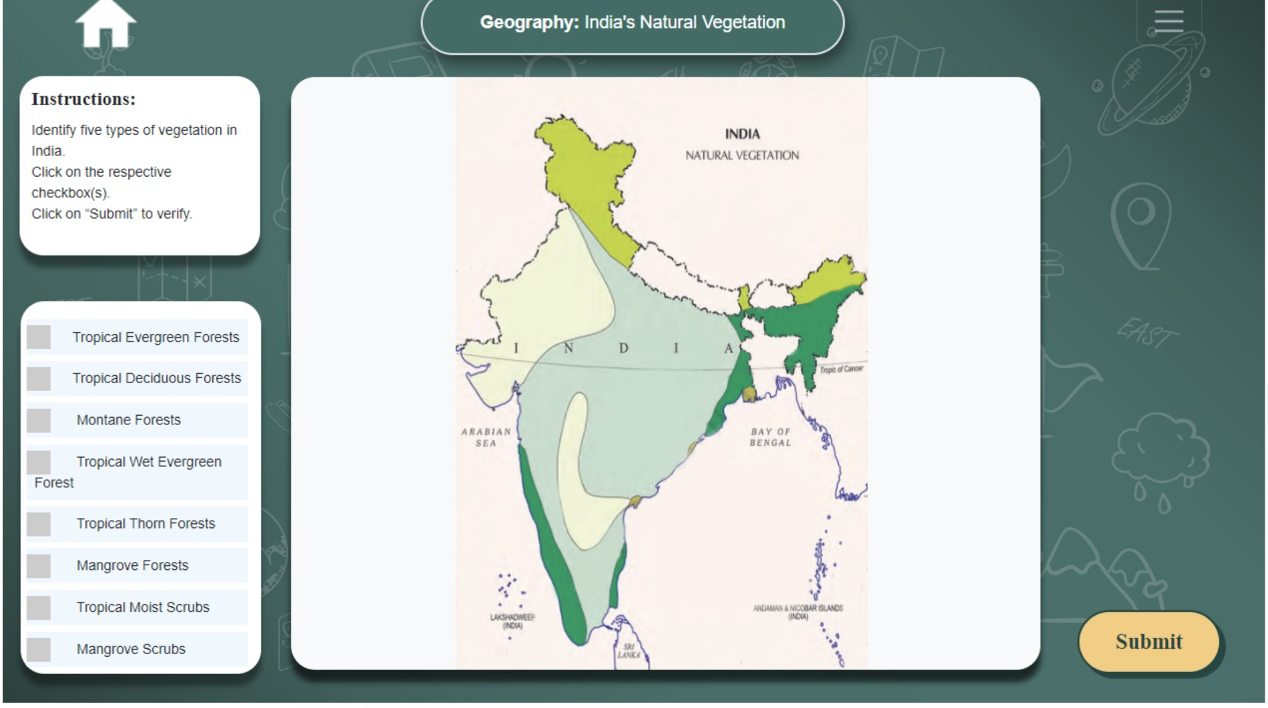
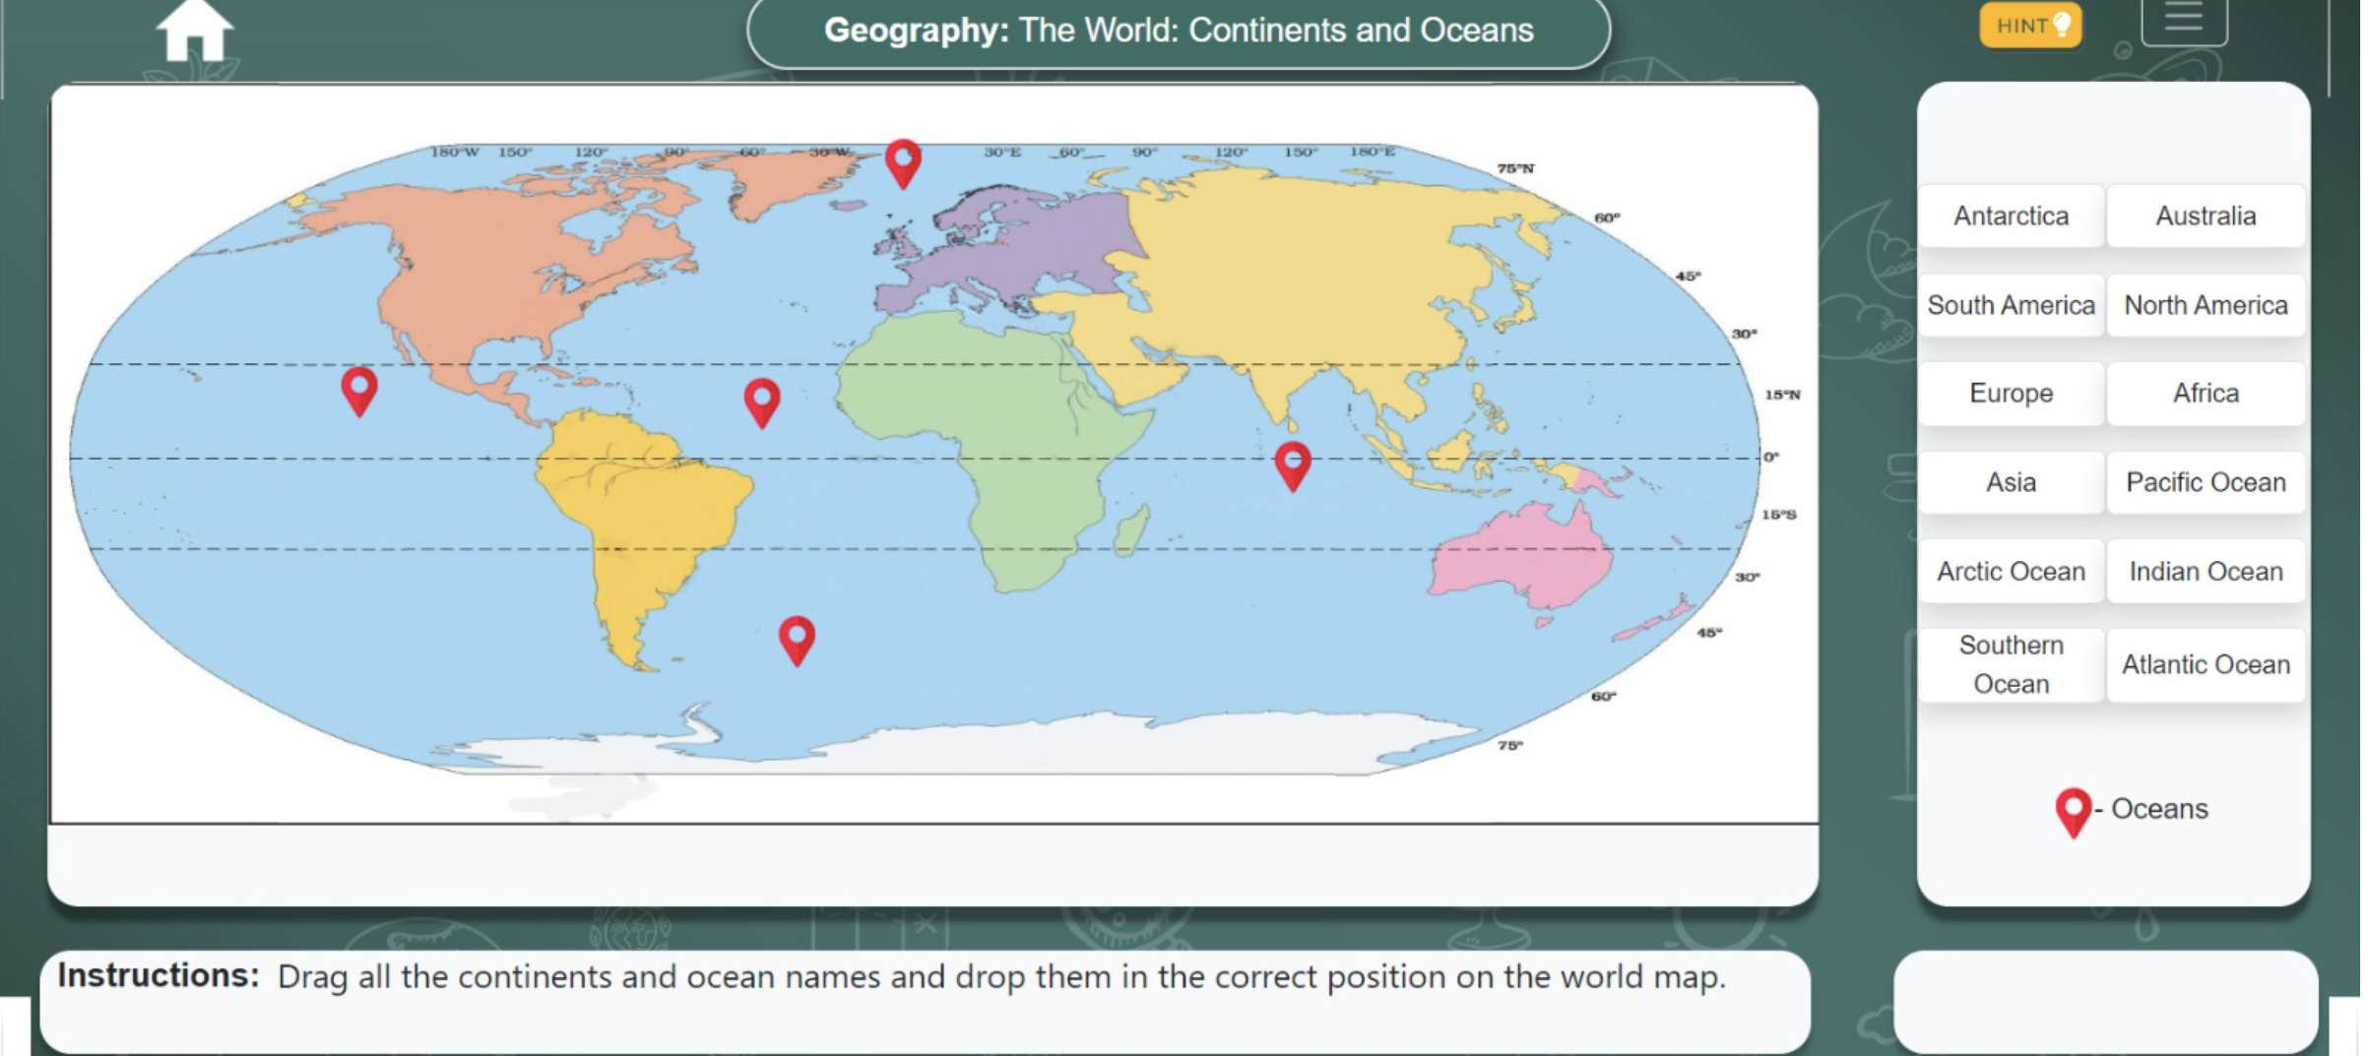
OLabs Social Science

Slide 29
Challenges
Evaluation of labs
No accepted standards yet for this. Can do cost effectively with Olabs.
Proper and timely guidance in the lab
Collaboration
Immersive experience
Retaining interest
Non-science subjects
Our plans for future: Olabs NG!

Slide 30
Looking ahead
A very satisfying experience so far. CBSE and NCERT and schools happy and looking for more.
Further work required in more classes and subjects.
And more innovations to improve effectiveness.?

Slide 31
OLabs Training
Every month CDAC Mumbai is conducting two online sessions for the teachers to orient them about OLabs.

Slide 32
Thank you….
M Sasikumar, CDAC Mumbai
sasi@cdac.in
Access OLabs at
www.olabs.edu.in
Access OLabs page at
https://www.facebook.com/onlinelabs/

Slide 33
Olabs NG!
Yes, we are now on to add another 500 labs to the pool.
Classes 6-12, and more subjects including languages, social science, etc.
Many improvements in light of the challenges mentioned earlier.
Learner tracking and analytics
Guidance in the lab
AR/VR capability
Richer simulation – variety within limits.

Slide 34
Further in this training
In subsequent trainings, we look at subject specific Olabs.
Physics – Tuesday
Chemistry and Biology – Wednesday
Maths and English – Thursday
Security practices – Friday
Keeping the perspective shared today, will help you get more out of these sessions.

Slide 35
Immersive experience
Now lab is in the screen only.
A lab environment can be provided by putting the student in a virtual world and navigating.
Or a virtual reality headset to provide a more immersive experience…
Sense the direction of view to simulate a 3-D perspective.

Slide 36
Guidance in the lab
Modelling labs for automated guidance is hard.
Having a physical teacher around is expensive, not feasible.
Need to look at
Guided lab (an agent advising appropriately depending on student activity)
Peer lab (two or more students in the lab at the same time, with provision to converse)
Currently in Olabs, we have a procedure tab and animation tab for help.

Slide 37
Improved user(age) experience
Mouse to manipulate everything in the lab…
Provide more realistic and natural manipulators?
Gesture: turn the knob of the burner.
Speech
Haptic devices – two-way user interface
can help feel pressure, etc.

Slide 38
Retaining interest
Gamification is a known technique to bring elements of a game to non-game environments.
Help maintain a degree of ‘flow’ for the user.
Gamify virtual labs
Structural
Content
Provide a competitive environment for students to compete in scoring points and badges.
Accumulate records over time to build a portfolio.

