Slide 1
Cyber Hygiene in Education
Speaker
Dr. Suresh G. Isave
Associate Professor
Tilak College of Education,
Pune
Template courtesy - FPPT.com

Slide 2
What is Hygiene ?
Hygiene refers to practices and behaviors aimed at maintaining cleanliness and promoting health.
In the context of personal hygiene, this includes activities like washing hands regularly, brushing teeth, bathing, and keeping one's living environment clean. These practices help prevent the spread of germs, bacteria, and diseases, ultimately contributing to overall well-being.

Slide 3
What is Cyber Hygiene
Cyber hygiene refers to the practices and measures individuals and organizations take to maintain the health and security of their digital systems and data.
It involves adopting behaviors and protocols to prevent cyber threats such as cyber hygiene practices like regularly updating software, using strong and unique passwords, implementing multi-factor authentication, backing up data, being cautious of suspicious emails or links, and staying informed about emerging cybersecurity threats.
Just like personal hygiene keeps us healthy and prevents illnesses, cyber hygiene helps keep digital environments secure and resilient against cyber threats.

Slide 4
Cyber Hygiene : Concept
Cyber Hygiene - Users
Cyber Security - Experts
Cyber hygiene primarily emphasizes proactive practices and habits that individuals and organizations adopt to maintain the health and integrity of their digital systems and data.
It includes day-to-day routines and measures such as updating software, using strong passwords, avoiding suspicious links and emails, regular data backups, and educating users about cybersecurity best practices.
Cybersecurity, on the other hand, encompasses a broader range of strategies, technologies, and practices designed to protect digital systems, networks, and data from cyber threats.
It involves not only preventive measures (like those in cyber hygiene) but also detection, response, and recovery mechanisms to defend against sophisticated cyber attacks and mitigate their impact

Slide 5
Cyber Hygiene in Education

Slide 6
Cyber Hygiene in Education
Real Incident: Data Breach at a Large School District
Incident:
In 2019, a large school district in the United States fell victim to a significant data breach that compromised the personal information of thousands of students, parents, and faculty members. The district served several schools across multiple locations, providing education to a diverse student population.
Hackers gained unauthorized access to the school district's database containing sensitive information, including student records, parent contact details, social security numbers, and financial information. The breach occurred through a vulnerability in the district's student information system, which was exploited by cybercriminals.

Slide 7
Cyber Hygiene in Education
Immediate Impact:
Privacy Concerns: The breach exposed highly sensitive personal information, leading to concerns about identity theft, fraud, and privacy violations among affected students and parents.
Disruption of Services: The school district's operations were disrupted as IT teams worked to contain the breach, investigate the extent of the damage, and implement measures to prevent further unauthorized access.
Legal and Regulatory Ramifications: The incident triggered investigations by regulatory authorities, including state attorneys general and the U.S. Department of Education, to determine the school district's compliance with data protection laws and regulations.

Slide 8
Cyber Hygiene in Education
Conclusion
This real-life incident underscores the importance of cyber hygiene and robust cybersecurity measures in educational institutions.
By prioritizing the protection of sensitive student and staff data and implementing proactive security measures, schools can mitigate the risk of data breaches, safeguard privacy, and maintain trust within their communities.

Slide 9
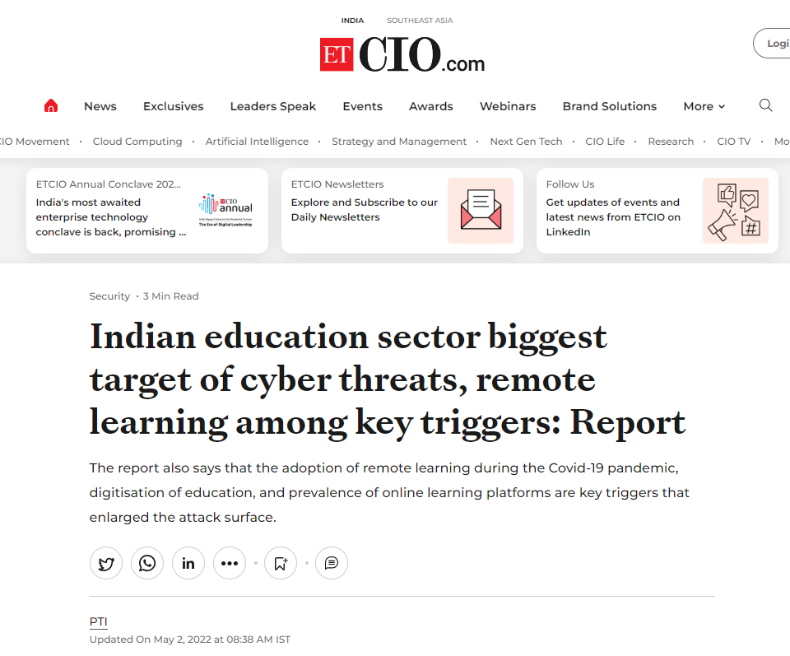
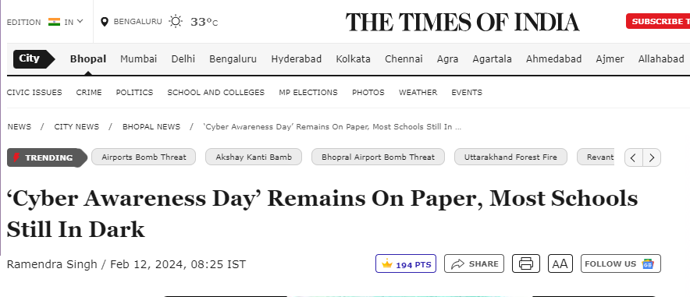
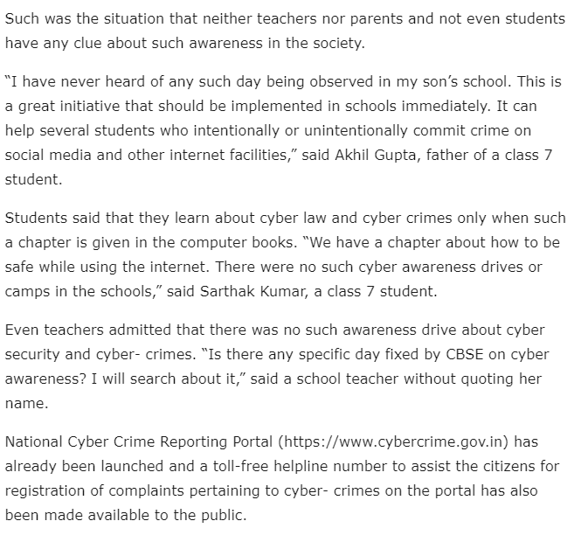
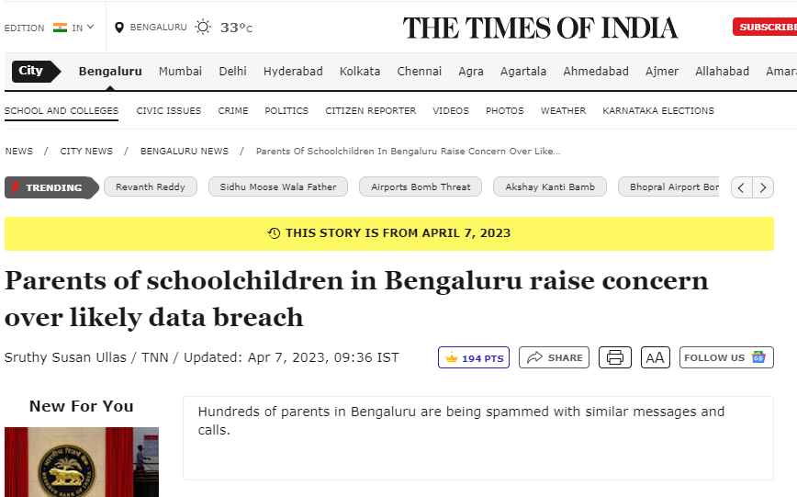
Cyber Hygiene in School

Slide 10
Cyber Hygiene in School
Students
Teachers
Parents
Admins
Management
IT Experts

Slide 11
Need of Cyber Hygiene
1. Students
Cyberbullying and Online Harassment
Privacy Invasion
Identity Theft
Distraction and Addiction
Physical and Psychological Issues

Slide 12
Need of Cyber Hygiene
2. Teachers
Professional Reputation Damage
Data Breaches
Phishing Attacks
Work-Life Balance Disruption
Important role in e-governance

Slide 13
Need of Cyber Hygiene
3. Administrators
Ransomware Attacks
System Intrusions
Compliance Violations
Insider Threats

Slide 14
Need of Cyber Hygiene
4. Parents
Social Engineering Scams
Misinformation
Privacy Concerns
Psychological Stress
Kids safety

Slide 15
Need of Cyber Hygiene
Cross-cutting Issues
Physical Health
Psychological Effects
Mindset and Behavior Changes
Security Fatigue

Slide 16
Cyber Hygiene for Students

Slide 17
Cyber Hygiene for Students
Understanding Gen Z
Digital Dependency
Limited Experience with Cybersecurity
Tendency to Trust Online Platforms
Desire for Social Media Validation
Inadequate Privacy Settings
Overexposure to Online Risks
Digital Natives
Edutainment
Use of AI
FOMO – Fear of Missing Out

Slide 18
Cyber Hygiene Practices for Students
1. Awareness of Cyberbullying and its Effects
Impact: Cyberbullying can lead to significant psychological distress, including anxiety, depression, and a decrease in academic performance. Students may feel isolated, embarrassed, or fearful of engaging online.
Prevention: Education about the signs and effects of cyberbullying is crucial. Schools should promote a culture of respect and kindness online, and encourage students to speak up if they or their peers are being targeted.

Slide 19
Cyber Hygiene Practices for Students
2. Understanding Online Persona and Privacy
Impact: Over-sharing or having private information exposed online can lead to stress and anxiety. Students may worry about the judgments of their peers based on their online activity.
Prevention: Teach students about the importance of privacy settings and the long-term implications of their online posts. Discuss the concept of digital footprint and encourage them to think critically about what they share online.

Slide 20
Cyber Hygiene Practices for Students
3. Dealing with Information Overload
Impact: Constant notifications and the overwhelming amount of information available online can lead to cognitive overload, reducing focus and increasing stress levels.
Prevention: Encourage regular digital detoxes and promote healthy habits like setting specific times for checking notifications. Teach students to prioritize information and to take breaks from their devices to maintain mental clarity.

Slide 21
Cyber Hygiene Practices for Students
4. Social Media and Self-Esteem
Impact: High engagement on social media can affect self-esteem, with students possibly comparing themselves unfavorably to the curated images they see online. This can lead to feelings of inadequacy and depression.
Prevention: Schools can host workshops or discussions about media literacy and the reality behind social media portrayals. Promoting activities that build self-esteem offline can also help balance their online interactions.

Slide 22
Cyber Hygiene Practices for Students
5. Handling Online Peer Pressure
Impact: The need to conform or perform to peer expectations online can cause significant stress. The fear of missing out (FOMO) can also exacerbate anxiety and influence poor decision-making.
Prevention: Foster an environment where students feel valued for who they are, not what they post online. Encourage open discussions about peer pressure and provide strategies for making healthy choices.

Slide 23
Cyber Hygiene Practices for Students
6. Online Gaming and Behavior
Impact: Excessive gaming can lead to addictive behaviors, disrupted sleep, and reduced physical activity, impacting mental and physical health.
Prevention: Educate students and parents about setting healthy limits and the importance of balance. Discuss the potential psychological impacts of gaming and encourage diverse interests beyond the digital world.

Slide 24
Cyber Hygiene Practices for Students
7. Strategies for Cyber Resilience
Impact: Encountering cyber threats can lead to fear and distrust of digital environments, affecting learning and social interactions.
Prevention: Teach students about cybersecurity basics and encourage them to speak openly about any concerns with trusted adults. Building a resilient mindset helps them to navigate online challenges more effectively.

Slide 25
Cyber Hygiene Practices for Teachers

Slide 26
Cyber Hygiene Practices for Teachers
1. Data Handling on Government Websites:
Secure Password Management: Use strong, unique passwords for each government website account and avoid sharing login credentials.
Encryption and Secure Transmission: Ensure that any data submitted to government websites, such as student attendance or assessment records, is transmitted securely using encrypted connections (HTTPS).
Regular Security Updates: Keep all software and browsers up-to-date to mitigate vulnerabilities that could be exploited by cyber attackers targeting government websites.

Slide 27
Cyber Hygiene Practices for Teachers
2. Psychological Aspects:
Online Reputation Management: Be mindful of the content shared on social media platforms, as it can impact professional reputation and relationships with students, parents, and colleagues.
Cyberbullying Awareness: Recognize the signs of cyberbullying among students and provide support and resources to those affected.
Digital Well-being: Set boundaries for digital use and prioritize offline activities to maintain a healthy work-life balance. Encourage open communication about digital stressors and provide resources for managing technology-related anxiety.

Slide 28
Cyber Hygiene Practices for Teachers
3. Professional Use of AI:
AI Literacy Training: Stay informed about the latest developments in AI technology and undergo training to enhance AI literacy and understanding of its applications in education.
Ethical Considerations: Consider the ethical implications of using AI-powered educational tools and ensure that they align with professional standards and values.
Data Privacy: Adhere to data protection regulations when using AI systems that collect or process student data. Only use reputable AI tools and platforms that prioritize data security and privacy.

Slide 29
Cyber Hygiene Practices for Teachers
4. Secure Communication and Collaboration:
Encrypted Communication Channels: Use encrypted email services and messaging platforms for communicating sensitive information
Verify Sender Identity: Be cautious of phishing emails and verify the authenticity of requests for personal or financial information before responding.
Secure File Sharing: Use secure file-sharing platforms with access controls to share documents and resources with colleagues and students securely.

Slide 30
Cyber Hygiene Practices for Teachers
5. Continual Professional Development:
Stay Informed: Keep up-to-date with cybersecurity best practices and attend professional development sessions or workshops on cybersecurity awareness and data protection.
Report Security Incidents: Promptly report any security incidents or suspected breaches to school administration or IT support to mitigate potential risks and prevent further damage.

Slide 31
Cyber Hygiene Practices for Teachers
6. Backup and Disaster Recovery:
Regular Data Backups: Backup important teaching materials, lesson plans, and student records regularly to an encrypted external drive or cloud storage service.
Disaster Recovery Plan: Develop a disaster recovery plan outlining steps to restore data and operations in the event of a cyber attack, data loss, or system failure.

Slide 32
Cyber Hygiene Practice for Teachers
8. Ambassador of Cyber Hygiene :
Teachers serve as ambassadors for cyber hygiene by integrating essential cybersecurity education into their curriculum and fostering a culture of digital responsibility.
Through engaging discussions, workshops, and resources, teachers equip students with the knowledge and critical thinking abilities needed to navigate the digital world safely and ethically.
By modeling good cyber hygiene practices and providing guidance and support, teachers play a vital role in promoting a secure and positive online environment for their students and parents.

Slide 33
Cyber Hygiene Practices for Parents

Slide 34
Cyber Hygiene Practices for Parents
1. Mindful Sharing:
Consider Consent: Always seek the child’s consent before sharing their photos or videos online, explaining the potential reach and permanence of digital content.
Think Before Posting: Evaluate whether sharing a photo or video could expose the child to risks or unwanted attention. Avoid posting images that could be embarrassing or harmful in the future.

Slide 35
Cyber Hygiene Practices for Parents
2. Use Privacy Settings:
Adjust Settings: Use privacy settings on social media platforms to control who can see posts featuring your child. Opt for more private settings to limit exposure to friends and family only.
Review Tags and Mentions: Regularly check tags and mentions from friends and family to ensure they also respect your child’s digital privacy.

Slide 36
Cyber Hygiene Practices for Parents
3. Promote Digital Literacy and Safety:
Encourage Critical Thinking: Teach your children to critically evaluate what they see online and to be skeptical of online requests or interactions.
Safe Online Interactions: Discuss the importance of maintaining privacy and boundaries online, especially in public forums like social media platforms and YouTube comments.

Slide 37
Cyber Hygiene Practices for Parents
4. Monitor and Engage:
Stay Informed: Use parental control tools judiciously to monitor your child’s online activity while respecting their privacy and promoting trust.
Open Dialogue: Maintain an open line of communication about online experiences and encourage your child to share their online interactions and concerns.
Rapport with Respect: While fostering a friendly rapport online, ensure that all interactions respect the privacy and boundaries of others, teaching the same values to your children.

Slide 38
Cyber Hygiene Practices for Admins
Data Handling and Security
Network Security
Staff Training and Awareness
Secure Communication and Collaboration
Incident Response and Reporting
Vendor and Third-Party Security
Promote Cyber Hygiene Culture

Slide 39
Thank You !
Knowledge
HEAD
Skill
HAND
Awareness
HEART

