Slide 1
PM eVIDYA
Central Institute of Educational Technology (CIET)
NCERT

Slide 2
Background
COVID-19 outbreak
Safety of citizens on priority
Educational Institutions nursery – tertiary: closed

Slide 3
Need
To deliver digital contents for all stakeholders
To enable them to learn from home &
be safe
MHRD (now MoE), GoI and states/UTs administration initiated multifarious activities

Slide 4
Initial efforts
Existing digital platforms- supplemented
34 Free to Air DTH TV Channels
NIOS & NCERT- school students

Slide 5
Stumbling blocks in reaching out
Unstable internet connectivity
Inadequate no. of smart handheld devices with households
Existing geographical, linguistic & socio-cultural conditions

Slide 6
Plan
Use low cost satellite technologies - TV Channels & FM Radios
Reach the unreached - time bound manner

Slide 7
Plan conti…
Addressing simultaneously
Triple concerns
Skill
Scale
Speed

Slide 8
May, 2020- Atma Nirbhar Bharat
Start 12 DTH TV Channels- PM eVIDYA “One Class One Channel”- Video
Use services of radio stations- Audio
01 September, 2020

Slide 9
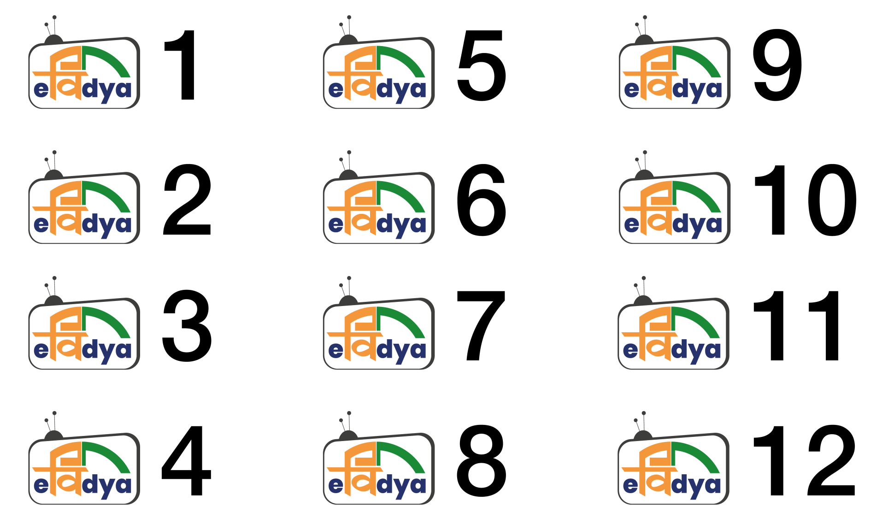

Slide 10
PM eVIDYA
Multi-modal access to education
Reach the masses
Access quality education sitting at home

Slide 11
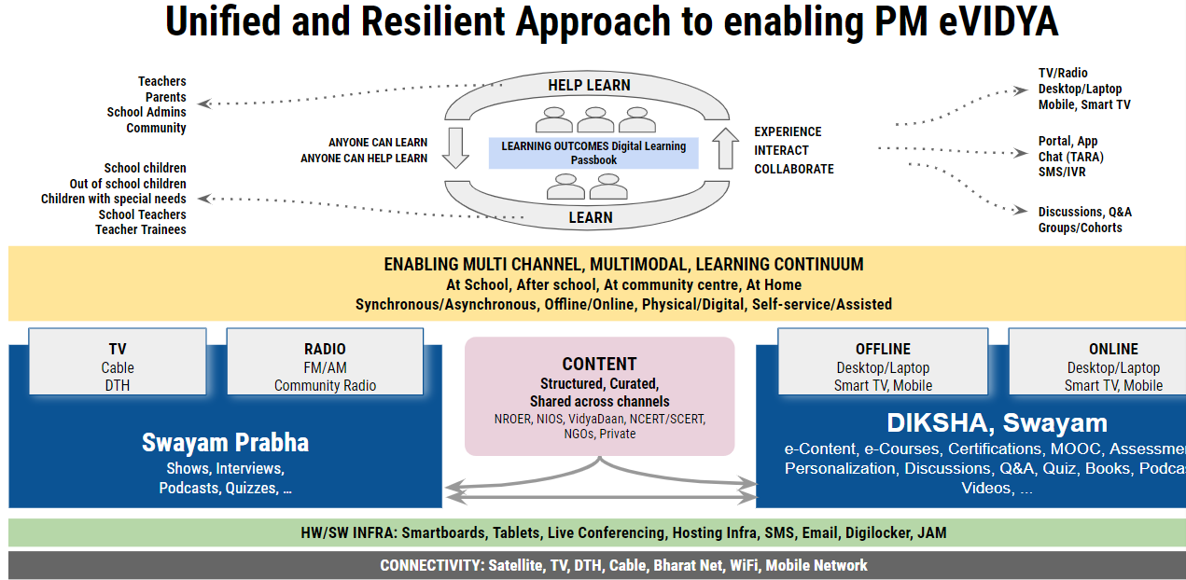

Slide 12
Purpose
To deliver digital education to:
260 million school students
8.5 million teachers

Slide 13
PM eVIDYA
NCERT, NIOS, CBSE, KVS & NVS and other stakeholders like, RILM, INFLIBNET, BISAG- Unified
To create, curate and collate quality educational contents

Slide 14
PM eVIDYA
Television
Radio
DIKSHA
Special
eContent
Online Courses
One Class, One TV Channel
Classes 1-12
(12 channels) 5,854 programmes
One Class, One Radio Channel FM Radio, Community Radio (76 stations) & Podcasts
3,166 programmes
One Nation, One Platform
School Education States/UTs:
e-content & QR coded Energized Textbooks - all grades
(4,694 TBs)
E-content for specially DIVYANG
(CWSN)
380 programmes
2,350 audio books
Top 100 Universities to start online courses

Slide 15
Content for TV telecast
Invocation & patriotic song
Chapter-based subject videos
General awareness & co-curricular videos
Weekly once live interaction
Medium- Hindi & English

Slide 16
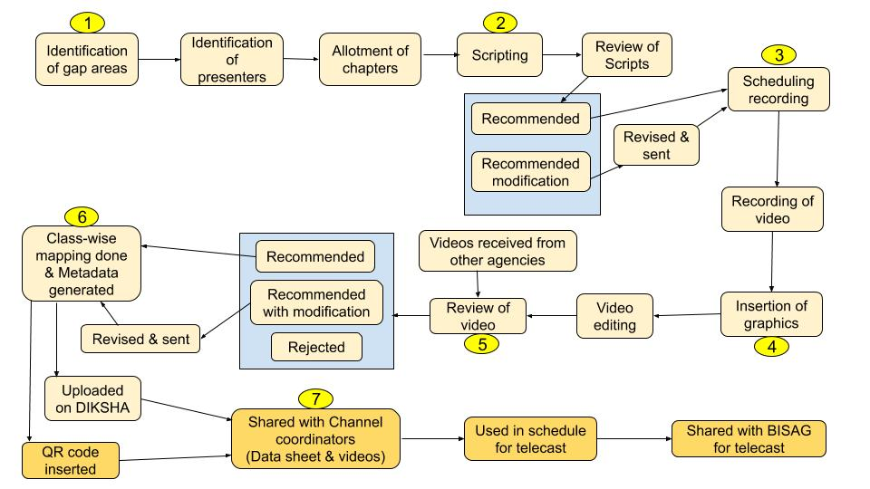
Process of TV telecast

Slide 17
Transmission strategies
Classes I-X
Classes XI-XII
03 Hrs. fresh telecast & Repeat
Live interactive session- 01 Hr. (Saturday & Sunday)
02 Hrs. fresh telecast & Repeat
(+ 30 min ISL/Vocational videos)
Live interactive session- 01 Hr. (Monday-Classes 1&2; Tuesday-Classes 3&4; Wednesday-Classes 5&6; Thursday-Classes 7&8; Friday-Classes 9&10)
General
Webinar on ICT tools- 01 Hr.
SAHYOG (Manodarpan)- 30 min.
States’ telecast- Assam & UP
NIOS- 3Hrs.

Slide 18
Transmission strategies conti…

Slide 19
Content for Radio broadcast
Chapter-based subject audio programmes- Dhwanishala
Enrichment programmes
Medium- Hindi & English

Slide 20
Radio broadcast

Slide 21
Broadcast strategies
Lockdown: 1Hr. fresh - Chapter-based (Dhwanishala) & enrichment programmes - Repeat (1Hr. forenoon & 1Hr. afternoon)
Now: 1Hr. Dhwanishala & 30min. enrichment programmes

Slide 22
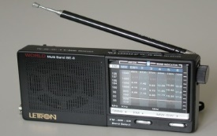
Broadcast strategies conti…
76 Community radio stations
400
AIR stations
18 Gyan Vani FM radio stations
JioSaavn App & iRadio
(internet based)

Slide 23
Coherence on DIKSHA

Slide 24
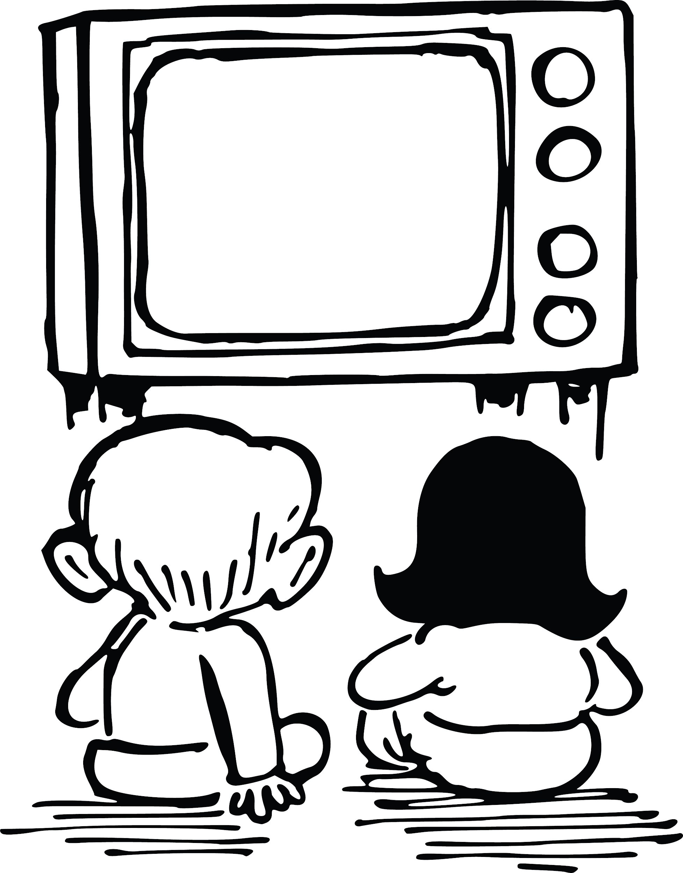
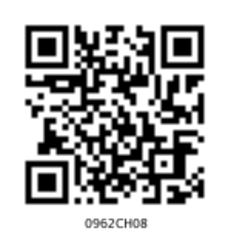
Coherence on DIKSHA conti…
e-Textbooks
Explanation Resources
I have missed the first half of this session, what should I do?
Don’t worry! Just scan the QR code on screen using DIKSHA app on your phone
- TV session
Practice Resources
Learning Resources
Teacher Focused Resources
0962CH08
On phone
Phone
On PC

Slide 25
Feedback Mechanism
TV telecast
Email:
dth.class1@ciet.nic.in
dth.class2@ciet.nic.in
dth.class3@ciet.nic.in
dth.class4@ciet.nic.in
dth.class5@ciet.nic.in
dth.class6@ciet.nic.in
dth.class7@ciet.nic.in
dth.class8@ciet.nic.in
dth.class9@ciet.nic.in
dth.class10@ciet.nic.in
dth.class11@ciet.nic.in
dth.class12@ciet.nic.in

Slide 26
Feedback Mechanism conti…
PM eVIDYA IVRS no.(8800440559)
Manodarpan IVRS no. (8448440632)
Audio broadcast- Email & WhatsApp group

Slide 27
Thank you

