Slide 1
Digital Education through Online Courses
& Online Trainings
Dr. Angel Rathnabai

Slide 2
Barriers for Continuing learning
Time Constraints
No proper Guidance
Lack of Motivation
Fear of Failure
Lack of Resources
BARRIERS
Health Issues
Financial Constraints
Work Life Balance
Language Barriers
Lack of Support

Slide 3
Need & Scope
Online courses/ trainings are programs offered over the internet.
They provide a platform for individuals to acquire knowledge, develop skills, and earn qualifications without the need to attend traditional physical classrooms.
Online learning have revolutionized the way people learn by providing accessible, flexible, and diverse educational opportunities.
It has become a valuable way for personal and professional growth in our increasingly digital and interconnected world.

Slide 4
Why Online Courses/ Trainings
Flexibility
Affordability
The learner can attend at any time of the day allowing flexibility in schedule
They are cost effective for the learners
Content Variety
Personalized Education
There are diverse courses available online, giving a choices to the learners
Convenience
Online courses are free from the boundations of time and place
Every individual learner attends the course in their own choice of environment

Slide 5
NEP Policy Perspectives
Flexible Learning
NEP encourages the integration of online courses to provide flexible learning opportunities, allowing students to learn at their own pace and convenience.
Digital Platforms
The policy advocates for the development of digital platforms and repositories to host high-quality online courses across various subjects and levels.
Blended Learning
NEP envisions a blended learning approach, combining online courses with traditional classroom teaching to create a more comprehensive and effective learning experience.
Teacher Training
The policy suggests providing training to teachers to effectively use online courses and digital tools to support their teaching methods.
Continuous Professional
Development
Online courses are promoted as a way for teachers and educators to engage in continuous professional development to stay updated with the latest educational practices and advancements

Slide 6
Modes of Online Learning
Live Trainings
MOOCs
Online Learning
ONLINE TRAINING
ONLINE COURSES
Recorded Sessions
SPOCs

Slide 7
Leveraging Online Courses/Trainings
MENTOR SUPPORT
POSITIVE REINFORCEMENT
1
2
3
4
5
LEARNING CAPSULE
PEER GROUP SUPPORT
DISCUSSION GROUPS

Slide 8
Components of Online Courses
eTutorial (Videos)
Assessment (Problem/ solutions, MCQs, Short answers type, Quizzes, Assignments etc.)
eContent (PDF, Text, e-Books, Illustrations and Documents) including Web resources (Related Links, Wikipedia, Open Content etc.)
Discussion Forum
Certification

Slide 9
Initiative : Online Courses & Trainings
NISHTHA
CPD Courses
National Initiative for School Heads and Teachers Holistic Advancement
Online courses for continuous Professional Development (CPD)
Online Capacity Building on ET & ICT
MOOCs for School Education
Webinar/ live interaction and online training on ET/ ICT
Online courses for students for learning enrichment

Slide 10
NISHTHA
Target: 42 Lakh
33 States and UTs
Certification: 17,73,312
NISHTHA
(ELEMENTARY) Face to Face
Target: 42 Lakh
33 States/ UTs & 7 Autonomous Organization
Certification: 22,64,539
NISHTHA
(ELEMENTARY) Online
Target: 10 Lakh
33 States/ UTs & 8 Autonomous Organization
Certification: 7,49,352
NISHTHA
(SECONDARY)
Online
NISHTHA
(FLN)
Online
Target: 25 Lakh
33 States/ UTs & 5 Autonomous Organization
Certification: 12,97,621
NISHTHA
(ECCE)
Online
Target: 90 Thousand
33 States/ UTs
Certification: 30,572 (Ongoing)

Slide 11
CPD Courses on DIKSHA
Cyber Hygiene Practices: Personal Digital Devices
.
Action Research
Environmental Hazards of Electronic Waste
Urdu Language Script Writing
CAPACITY BUILDING COURSES
COVID 19 - Responsive Behaviour
Catch the Rain
Enrolment
6,44,360
Certification
3,91,664

Slide 12
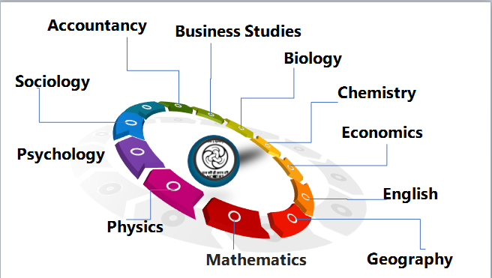
Online Courses offered by NCERT on SWAYAM
28 courses for Class XI and XII across 11 subjects
Yearly two cycle:
April to September
October to March
Who can join?
Students
Teachers
Parents
Any one

Slide 13
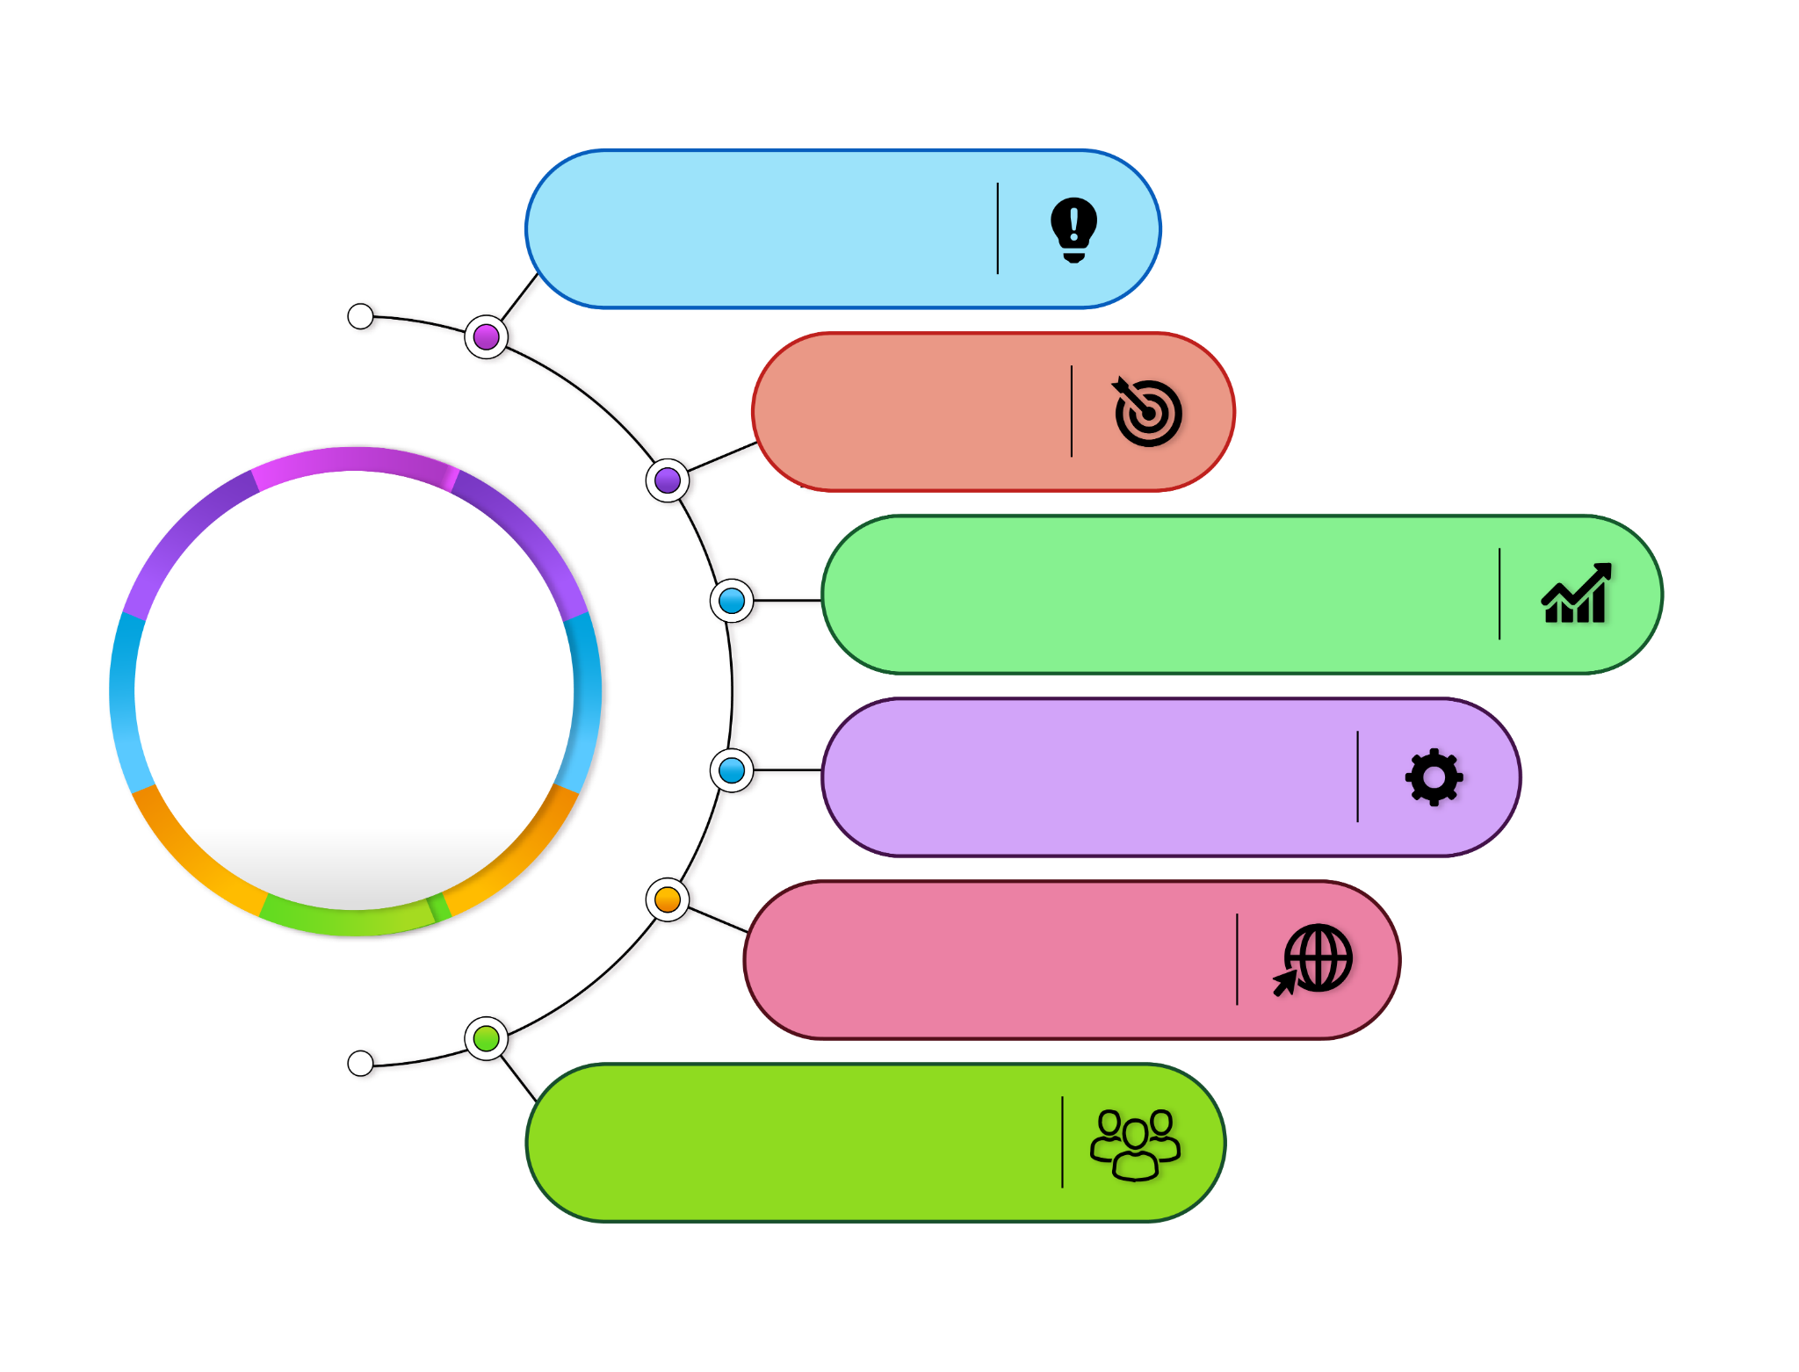
ICT Curriculum
Programming
Graphics
Data Processing and Representation
Themes
Subject Specific Tools
Internet & ICT Environment
Audio Video Communication
https://ictcurriculum.gov.in/

Slide 14
Online Training
Theory Based Training
Practical Based Training
Eg: Training series on NEP 2020: ET & ICT
Eg: Training on Development of eContent
01
02
Live Vs Recorded

Slide 15
Cyber Safety and Security in School Education
NEP 2002 emphasizes that ‘Children and adolescents enrolled in schools must not be forgotten in this whole process; after all, the school system is designed for them. Careful attention must be paid to their safety and rights’ (Para 8.11).
According to the report – “Cyber Threats Targeting the Global Education Sector” – education and research were the most targeted sectors in India, with an average of 1,605 weekly attacks, an increase of 75% from previous years. Data also shows that there has been a 20 per cent increase in cyber threats to the global education sector in the first three months of 2022 when compared to the corresponding period of 2021.

Slide 16
Various Aspects of Cyber Safety and Security in Educational Institutions
Technical Aspects
Ethical Aspects
Aspects of Cyber Safety and Security in Educational Institutions
Psychological Aspects
Social Aspects
Legal Aspects

