Slide 1
Leveraging Digital Platforms for Education

Slide 2
Characteristics for Online Learning Platform
Simplicity
User Friendly
Attractive Interface
Integration
Clear Course-Content

Slide 3
Tracking and Reporting
Easy to Flip
Automated Evaluation
Socially Driven
Gamification

Slide 4
Accessibility
Visual Accessibility
Auditory Accessibility
Multilingual Support
Assistive Technology Compatibility
Inclusive Content Design

Slide 5
How Digital Platform can support Students & Teachers

Slide 6
Access to Digital Learning Resources
Personalized Learning
Assessments and Quizzes
Multilingual Support

Slide 7
Enhanced Access to Education
Democratizing Education
Improved Quality of Education
Fostering Innovation and Creativity

Slide 8
Digital Platforms of NCERT

Slide 9
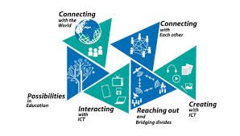
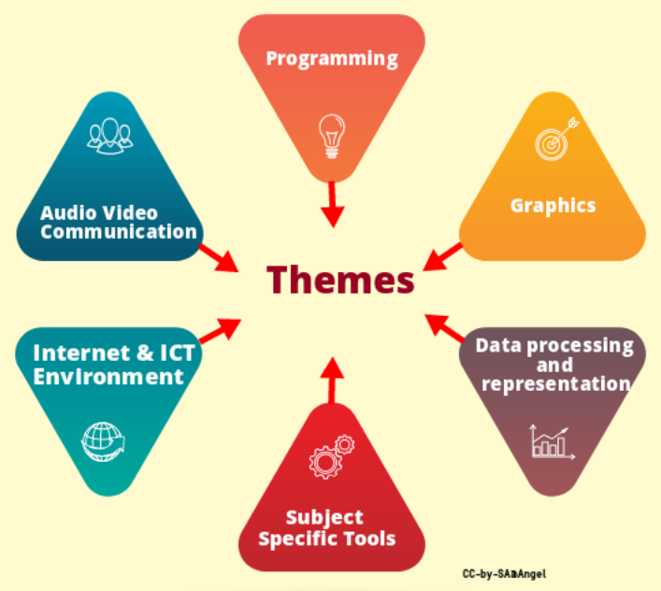

Slide 12
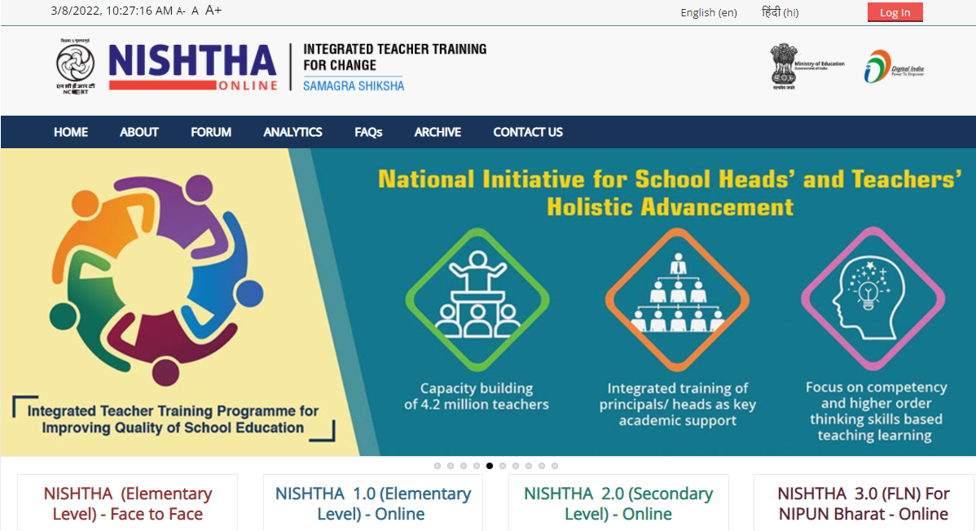

Slide 13
http://itfdigitalgames.ncert.org.in/

Slide 14
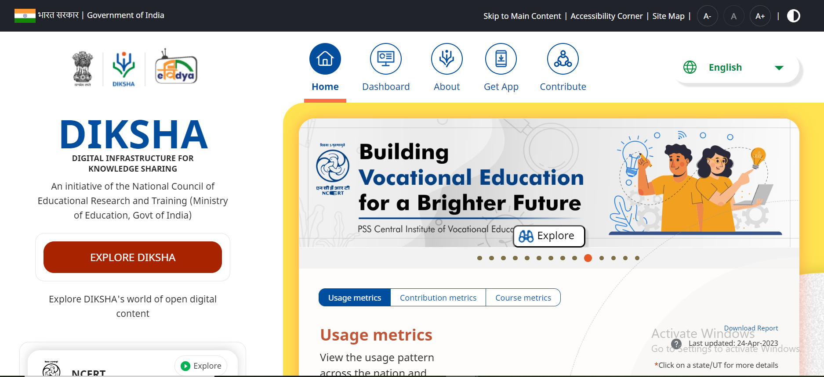

Slide 15
Way Forward
Personalised Adaptive Learning (PAL) based on Learning Outcomes/Developmental Goals
Virtual School platform in a blended mode- with synchronous and asynchronous communication.
AI based Chatbot for education with features of language translation tool, image recognition, text, voice etc
Strengthening of Learning Management System

Slide 16
Online Tutoring for personalised learning focusing on 'Just-in+time" interventions.
Enhancing user experience by improving UI/l IX,/discoverability on DIKSHA.

