Slide 1
Virtual Labs: Policy Perspective,
Need and Scope
Central Institute of Educational Technology
NCERT, New Delhi

Slide 2
NEP 2020 –Technological Thrust Areas
Teaching-Learning,
Evaluation
Enhancing Educational
Access
Increasing Access for Divyang students
Removing
Language Barriers
Supporting Teacher preparation & Professional Development
Streamlining Educational
Management and Administration

Slide 3
NEP-2020: Recommendations for Online and Digital Education
Digital Infrastructure
Building Digital competencies of Students
Portals, Apps and Tools
Content-Pedagogy-Technology Integration, Use of Assistive Technologies
Digital Resources
Educational Technology & ICT
Capacity building of Teachers,Teacher Educators
Telecast and Broadcast
Laying down Standards
e-Governance/Management
Online Assessment and Examination
Intensive Research in ET

Slide 4
Policy Perspective (NEP 2020 vision)
Technology use and Integration
Ensuring Equitable use of technology
Extensive Use of technology in teaching and learning
Content Creation, digital repository and Dissemination
Blended mode of learning
Addressing digital divide

Slide 5
Policy Perspective (NEP 2020 Vision) and Virtual Labs
Empowering Students with Digital Tools
Equity and Inclusivity
Blended Learning Approach
Experiential
Learning Goals

Slide 6
Recommendation of NEP 2020
Access to quality practical and hands-on experiment-based learning experiences to each student.
Virtual labs enhance physical laboratory experience.
Lab based e-resources help students in visualizing the concepts.

Slide 7
Virtual Laboratory (Virtual Labs)
A virtual laboratory is a computer-based activity where students interact with an experimental apparatus or other activity via a computer interface.
Key Features of Virtual Labs
Collaboration: Virtual labs can enhance the learning experience by promoting teamwork, communication, and problem-solving skills.
Simple and Responsive Interface: helps users navigate easily and interact smoothly.
Accessibility: Virtual environments, or hands-on labs, are accessible from a computer with a primary web browser with internet connectivity.
Real-time Guidance: delivered in real-time, allowing students to receive feedback immediately.
Instructor control: enables teachers to digitally track their students' progress, similar to how they do in traditional classrooms.

Slide 8
Advantages of Virtual labs
Available anytime, anywhere with internet access.
Real time interactive and accessible simulations and experimentation
Accommodates large audiences without location constraints.
Reduces costs of physical equipment, materials, and maintenance.
Simulates risky experiments without real-world hazardous or complex procedures.
Hands-on learning with immediate feedback.

Slide 9
Virtual Labs helps Students in following ways
Perform experiments multiple times without any risk of hazardous experiments and activities.
Revise, retry and review theoretical concepts for better understanding.
Obtain immediate result of time-consuming experiments.
Analysis of results to draws conclusions.
Receive immediate feedback to track learning improvement.
Writing reports, error analysis and completing post-labs assignments.

Slide 10
Pedagogical Integration of Virtual labs
Pre-Lab Session:
Teachers can introduce the theoretical concepts, objectives, and procedures of the lab activity, using instructional materials, demonstration videos, or preparatory assignments to ensure students are familiar with the lab setup.
Performance Session:
Teachers can guide students through the experiment on the virtual lab platform, overseeing the procedures, data collection, and observation processes, ensuring it mirrors a physical lab experience.
Post-Lab Session:
Teachers can help students analyze the collected data, draw conclusions, and compare results with theoretical expectations, facilitating a reflective and consolidating learning experience.

Slide 11
Virtual Labs help teachers in following ways
Design lesson/instructional plans incorporating Virtual Labs.
Access and integrate virtual simulation to demonstrate experiments that may be complex or difficult procedure to perform in a physical lab.
Leverage Virtual Labs for Online and Blended Classrooms and allows student to participate in practical activities from any where.
Integrate virtual labs into assessments, to evaluate students practical understanding of concepts through interactive simulations and activities.
Provide safe experimentation: Use virtual labs to simulate risky or complex experiments safely without physical hazard/ accidents.

Slide 12
Following data shows that large no. of users are taking benefit of available resources
Virtual Labs was launched on 29th July 2022

Slide 13
The data shows that large no. of users are taking benefit of available resources

Slide 14
The Spectrum of Reality-Virtuality Continuum
Reality
Augmented Reality
Virtual Reality

Slide 15
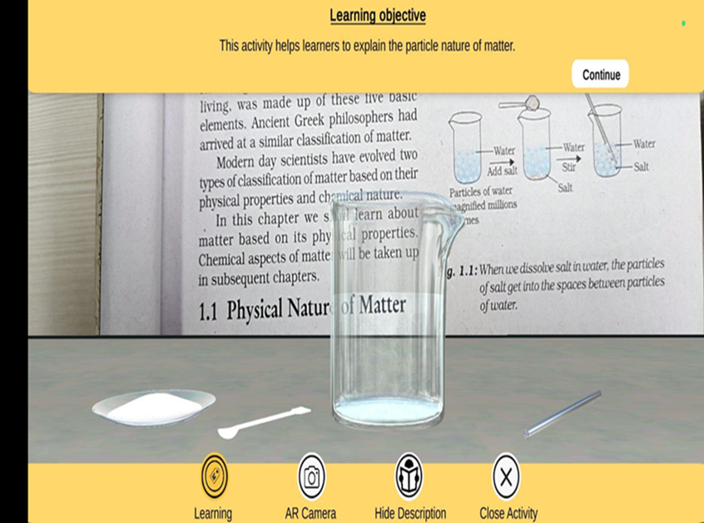
Augmented Reality
Virtual Reality
A Superimposition of computer-generated perceptual information over the existing physical surroundings is called Augmented Reality (AR).
Augmented Reality Devices
Smartphones and tablets are the most common AR devices.
Augmented Reality (AR) Glasses
Augmented Reality (AR) Headsets
Virtual Reality (VR) is a simulated experience created by computer technology that immerses users in an interactive, three-dimensional environment.
It allows users to experience and interact with a virtual world as if they were physically present through VR Head Mounted Device

Slide 16
Pedagogical Benefits
Increased Engagement- Immersive experiences make learning more exciting and interactive, boosting student motivation and interest.
Improved Retention- Hands-on experiences in virtual environments lead to deeper understanding and improved knowledge retention.
Personalized Learning- Students can learn at their own pace and adapt the simulation to their individual needs and learning styles.
Enhanced Collaboration-Virtual environments facilitate collaborative learning, allowing students to work together and learn from each other.

Slide 17
Steps to reach at desirable resources of Virtual labs
URL: https://diksha.gov.in/

Slide 18
Virtual Labs in DIKSHA
Step 1: Search https://diksha.gov.in/
Step 2: Scroll banners to find Virtual Labs vertical and click on its “Explore”
icon.
Step 3: Scroll down on the landing page of Virtual labs to reach eContent of
class 7.
Step 4: Click on the “Explore” icon of the class 7, select the English medium,
then choose a Science as subject.
Step 5: Click on the Explanation resource to reach the link for related resources

Slide 19
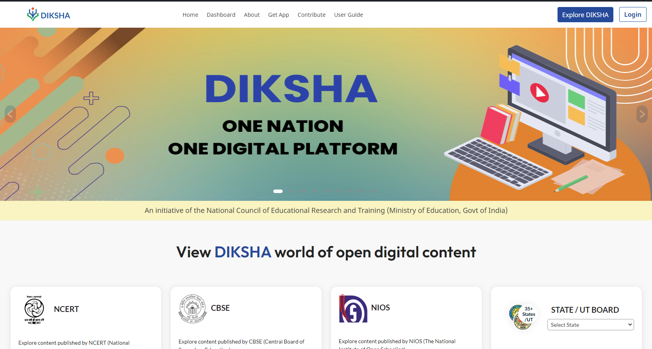
Search https://diksha.gov.in/

Slide 20
Scroll banners to find Virtual labs vertical and click on its “Explore” icon.

Slide 21
Scroll down on the landing page of Virtual labs to reach eContent of classes 6-12.

Slide 22
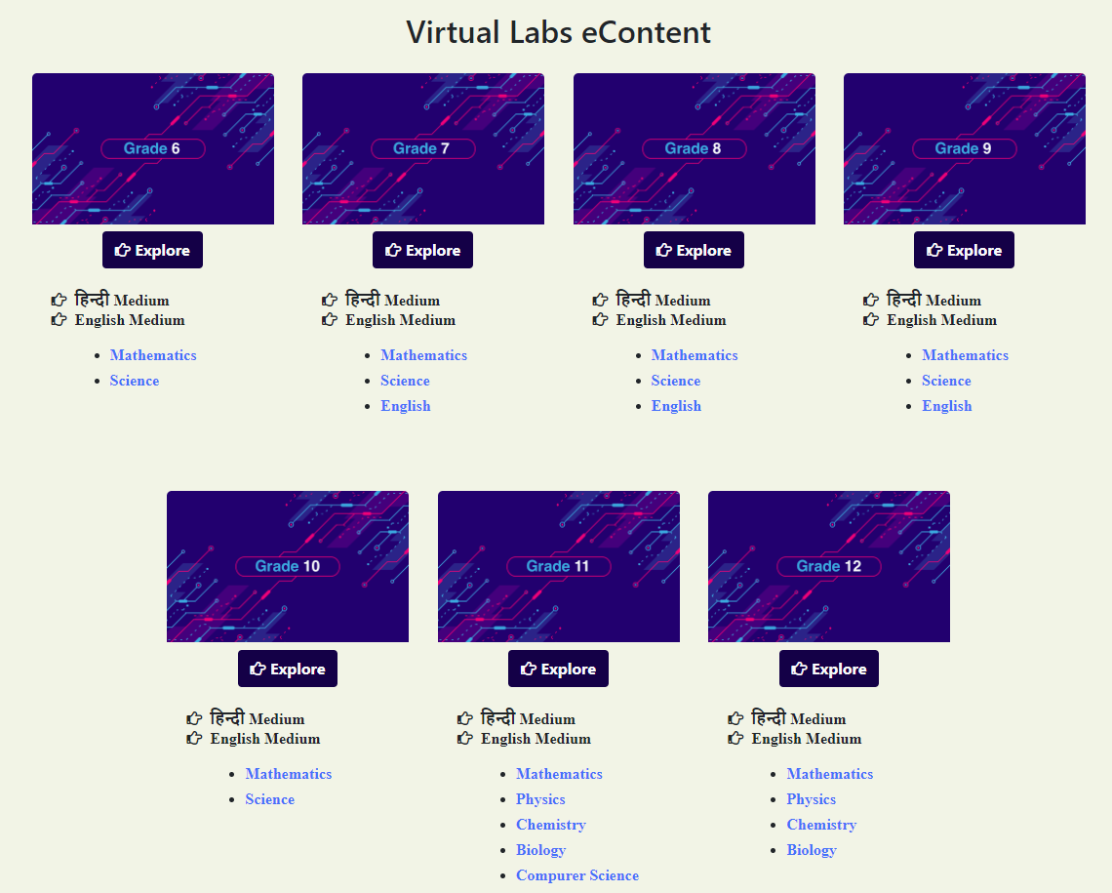
Click on the “Explore” icon of the desirable class, select the medium of interaction, then choose a subject you wish to study.

Slide 23
Click on the simulation to perform experiment.

Slide 24
Virtual Labs provide self paced
engaging learning experience

Slide 25
Thank You

