Slide 1
Virtual Labs as a Learning tool for Mathematics
Central Institute of Educational Technology
NCERT, New Delhi

Slide 2
Recommendation of NEP 2020
Access to quality practical and hands-on experiment-based learning experiences to each student
Virtual labs enhance actual laboratory experience
Lab based e-resources help students in visualizing the concepts

Slide 3
Policy Perspective (NEP 2020 vision) and Virtual Labs
Experiential Learning - Virtual labs provide hands-on, interactive experiences that align with the policy's focus on activity-based learning, making concepts more engaging and easier to understand
Integration of learning competencies - By leveraging digital tools, virtual labs provide personalized learning experiences that support the development of learning competencies for complex mathematical topics in an interactive and enjoyable way.
Equity and Accessibility - Virtual labs ensure that students from diverse backgrounds, including those in remote areas, have access to high-quality educational resources, bridging the digital divide and promoting inclusive learning.

Slide 4
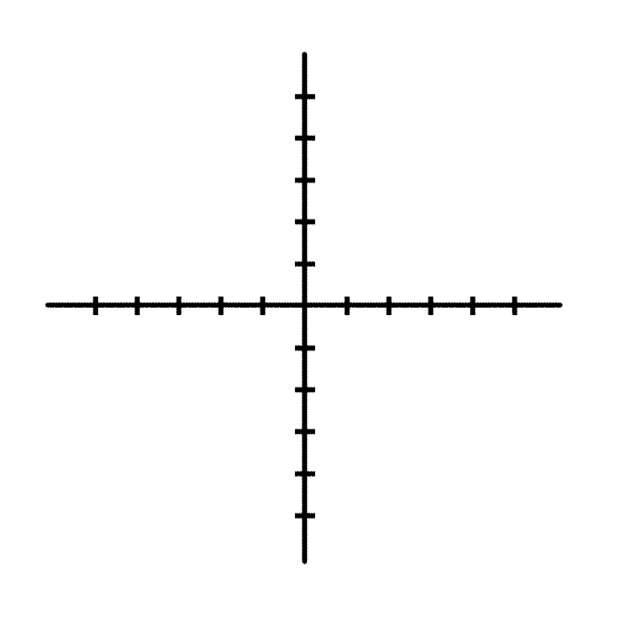
Need and Scope of Virtual Labs
Concept of Virtual Labs-Virtual labs are simulated environments that allow students to conduct experiments and explore mathematical concepts interactively, enhancing understanding through practical application.
Educational Objectives-The primary purpose of virtual labs is to provide a safe, flexible, and engaging platform for students to learn mathematics, fostering critical thinking and problem-solving skills.
Integration with Curriculum-Virtual labs serve as a complementary tool in mathematics education, aligning with curriculum standards to facilitate deeper learning experiences and promote student engagement.

Slide 5
Advantages of Virtual labs
Availability and Cost-Effectiveness – Virtual labs can be accessed anytime, anywhere with an internet connection. They reduce the need for physical equipment, materials, and maintenance, making them a budget-friendly solution.
Enhanced Engagement – Interactive and immersive experiences in virtual labs make complex mathematical concepts easier to understand and more enjoyable to learn.
Immediate Feedback – Students receive real-time feedback on their performance, helping them identify mistakes, reinforce learning, and develop self-directed learning skills.
Safe Exploration – Virtual labs provide a risk-free environment for students to explore mathematical theories and solve problems without the fear of failure, fostering creativity and innovation.

Slide 6
Virtual labs help learners in following ways
Practice lab experiments: Review & practice in virtual simulations
Experiment freely: Explore variables in a virtual lab
Learn from mistakes: Build confidence without fear of failure
Self-paced learning: Master concepts before the real lab
Post-lab assessment: Reinforce learning

Slide 7
Virtual labs help teachers in following ways
Design instructional plans that incorporate Virtual Labs to enhance learning experiences.
Utilize virtual simulations to demonstrate complex or challenging experiments that may be difficult to conduct in a physical lab.
Implement Virtual Labs in online and blended classrooms, enabling students to engage in practical activities from any location.
Integrate virtual labs into assessments to evaluate students' practical understanding of concepts through interactive simulations and activities.
Ensure safe experimentation by using virtual labs to simulate risky or intricate experiments

Slide 8
Pedagogical Benefits
Increased Engagement-Immersive experiences make learning more exciting and interactive, boosting student motivation and interest.
Improved Retention-Hands-on experiences in virtual environments lead to deeper understanding and improved knowledge retention.
Personalized Learning-Students can learn at their own pace and adapt the simulation to their individual needs and learning styles.
Enhanced Collaboration-Virtual environments facilitate collaborative learning, allowing students to work together and learn from each other.

Slide 9
Pedagogical Integration of Virtual lab
Pre-Lab Preparation: Teachers introduce key concepts and lab objectives through resources like videos, assignments, or lectures, ensuring students understand the lab setup.
Hands-On Lab Engagement: Teachers guide students through the experiment on the virtual platform, supporting data collection and observations in physical lab experience.
Post-Lab Reflection: Teachers help students analyze their data, draw conclusions, and compare results with theoretical and practical expectations, reinforcing their learning.

Slide 10
Steps to reach at desirable resources of Virtual labs
URL: https://diksha.gov.in/

Slide 11
Virtual Labs in DIKSHA
Step 1: Search https://diksha.gov.in/
Step 2: Scroll banners to find Virtual Labs vertical and click on its “Explore”
icon.
Step 3: Scroll down on the landing page of Virtual labs to reach eContent of
class 7.
Step 4: Click on the “Explore” icon of the class 7, select the English medium,
then choose a Science as subject.
Step 5: Click on the Explanation resource to reach the link for related resources

Slide 12
Search https://diksha.gov.in/

Slide 13
Scroll banners to find Virtual labs vertical and click on its “Explore” icon.

Slide 14
Scroll down on the landing page of Virtual labs to reach eContent of classes 6-12.

Slide 15
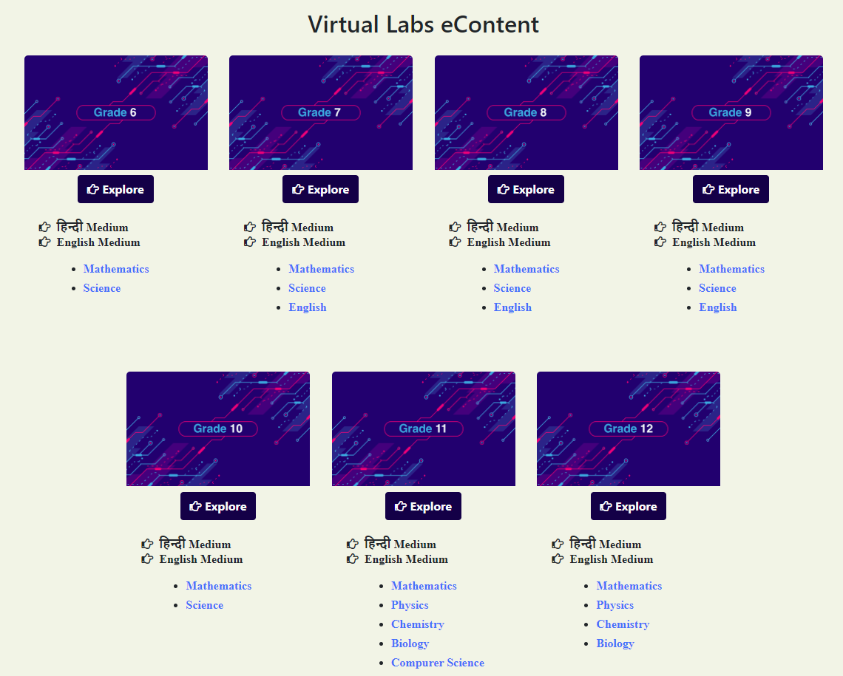
Click on the “Explore” icon of the desirable class, select the medium of interaction, then choose a subject mathematics

Slide 16
Click on the simulation to perform experiment

