Slide 1
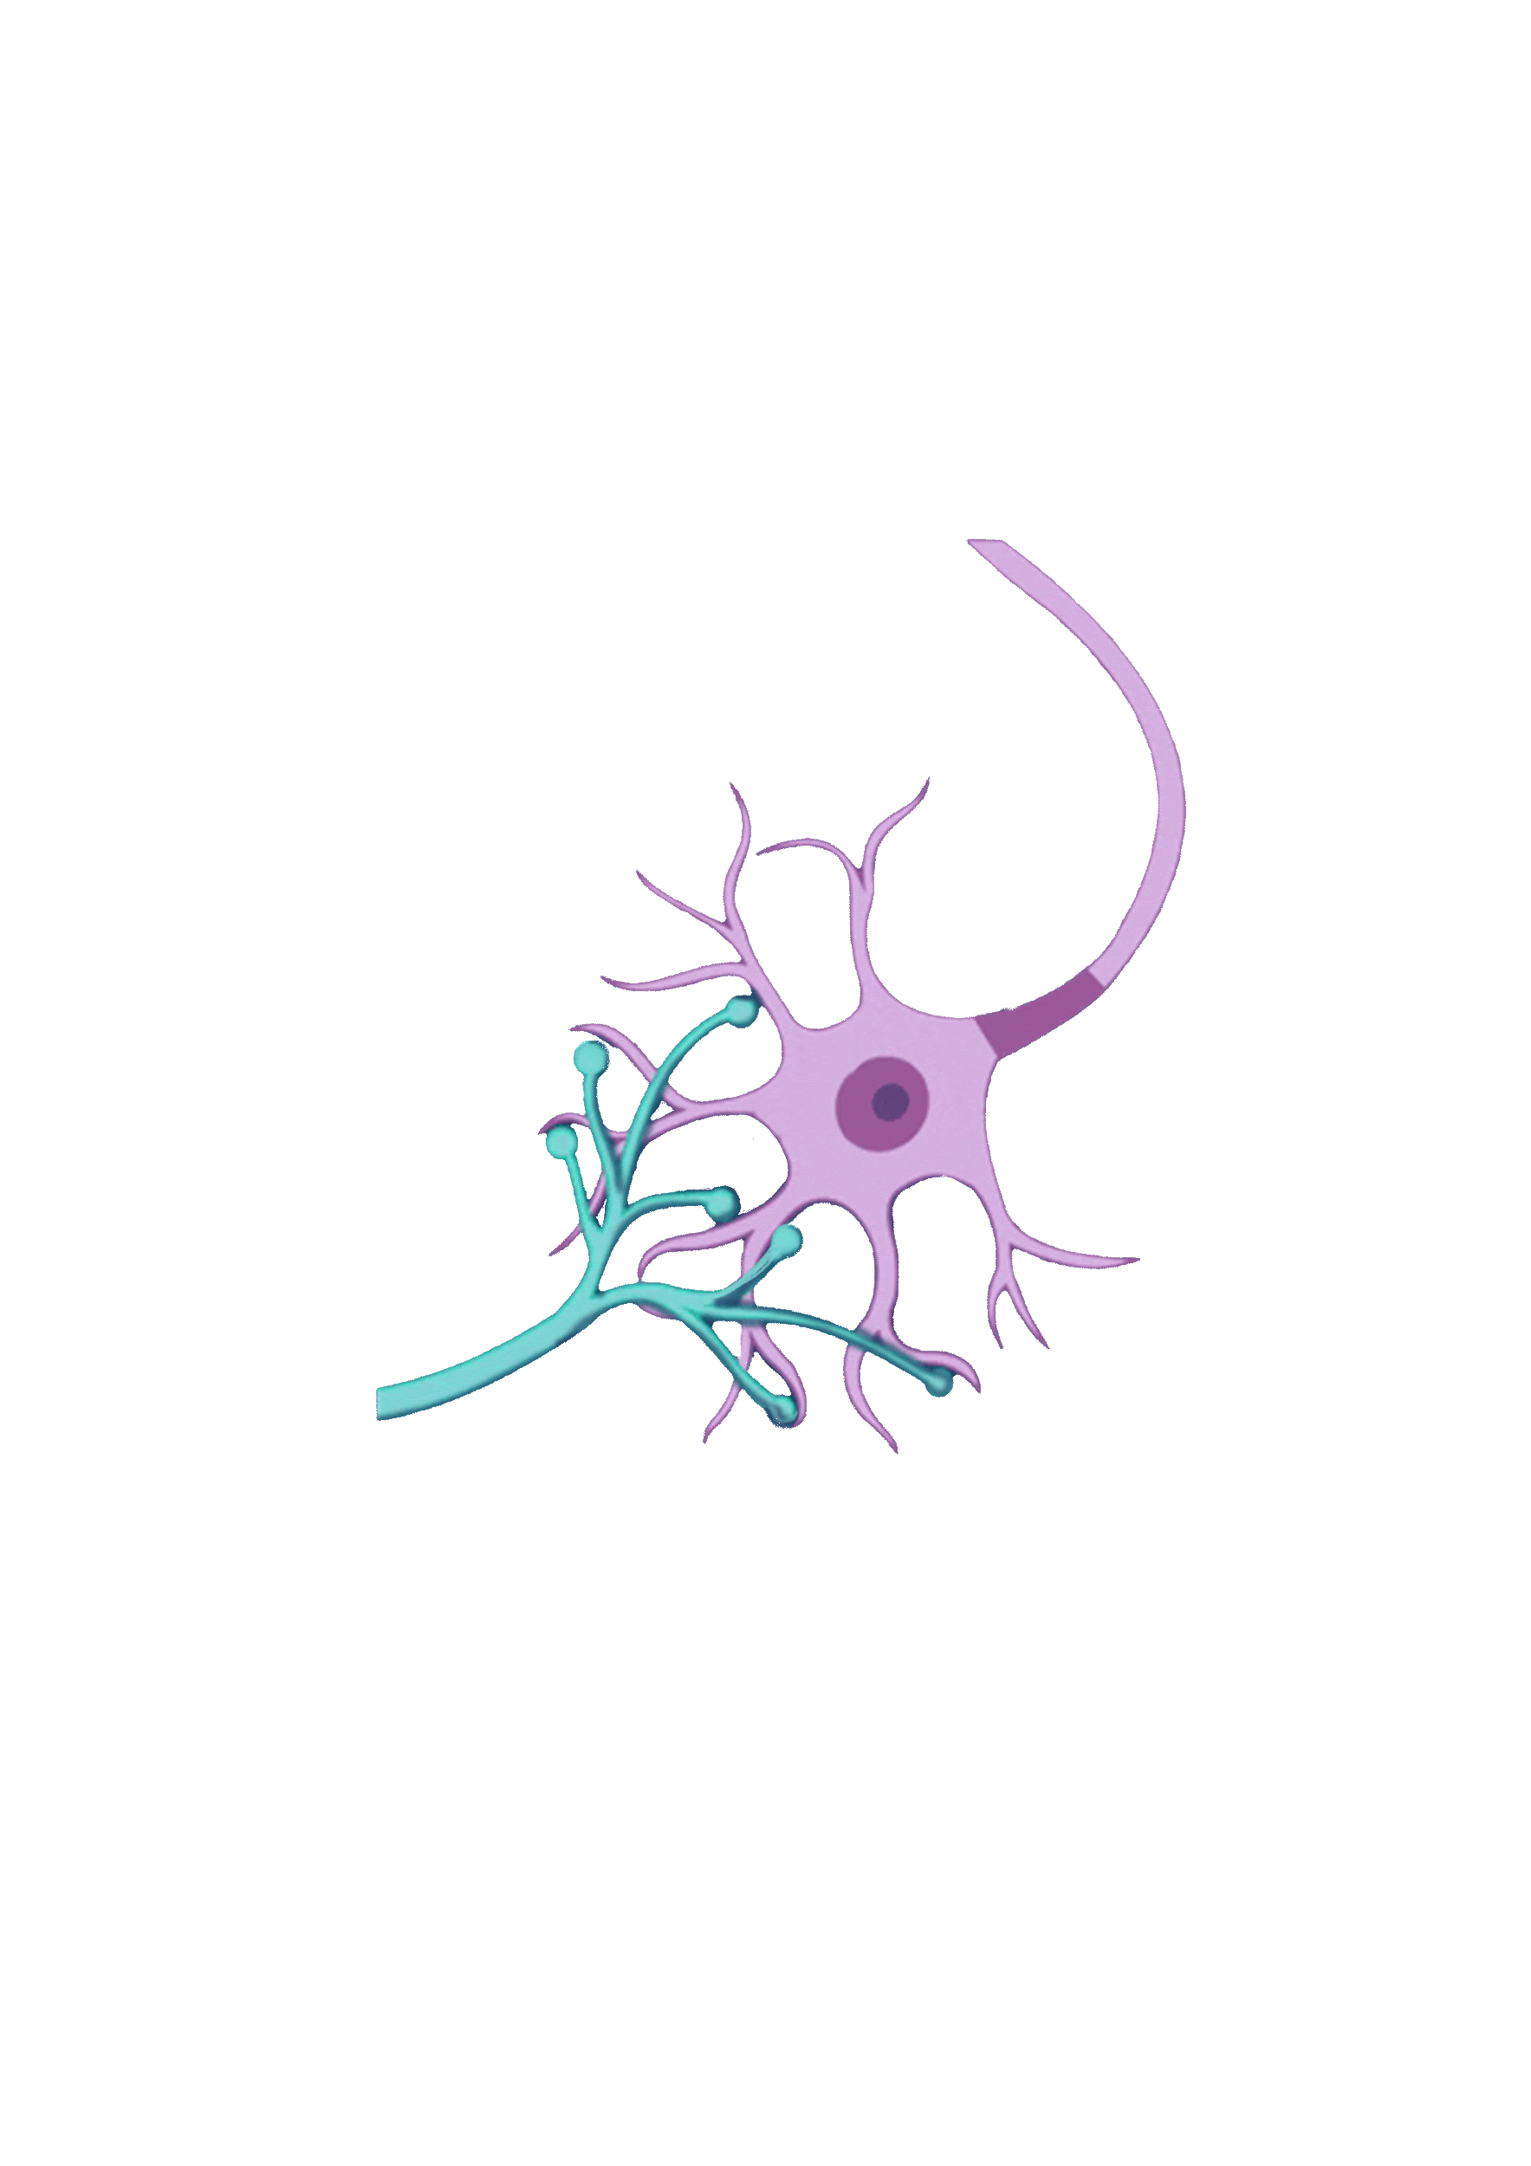
Virtual Lab as a Teaching Learning Tool for Biology
Central Institute of Educational Technology
NCERT, New Delhi

Slide 2
Policy Perspective (NEP 2020 vision)
Technology use and Integration
Ensuring Equitable use of technology
Extensive Use of technology in teaching and learning
Content Creation, digital repository and Dissemination
Blended mode of learning
Addressing digital divide

Slide 3
Recommendation of NEP 2020
Access to quality practical and hands-on experiment-based learning experiences to each student
Virtual labs enhance actual laboratory experience
Lab based e-resources help students in visualizing the concepts

Slide 4
Virtual Laboratory (Virtual Labs)
A virtual laboratory is a computer-based activity where students interact with an experimental apparatus or other activity via a computer interface.
Advantages of Virtual labs
Available anytime, anywhere with internet access.
Real time interactive and accessible simulations and experimentation .
Reduces costs of physical equipment, materials, and maintenance.
Simulates risky experiments without real-world hazardous or complex procedures.
Hands-on learning with immediate feedback.

Slide 5
Integration of Virtual Labs with Physical Labs
Pre-Lab Session:
Preparation: Review required materials and procedures.
Understanding: Familiarize with the lab objectives and concepts to be explored.
Performance session :
Execution: Perform virtual experiments by following the outlined procedure.
Engagement: Gain hands-on experience with lab techniques in a virtual environment.
Observation: Collect data through interactive simulations.
Post-Lab Session:
Data Analysis: Analyze the recorded data from the simulation.
Interpretation: Draw conclusions based on experimental results.
Comparison: Compare results with theoretical expectations to validate learning.

Slide 6
Virtual labs enhance science process skills
Observation
Recording data
Controlling variables
Data analysis
Interpretation
Inference

Slide 7
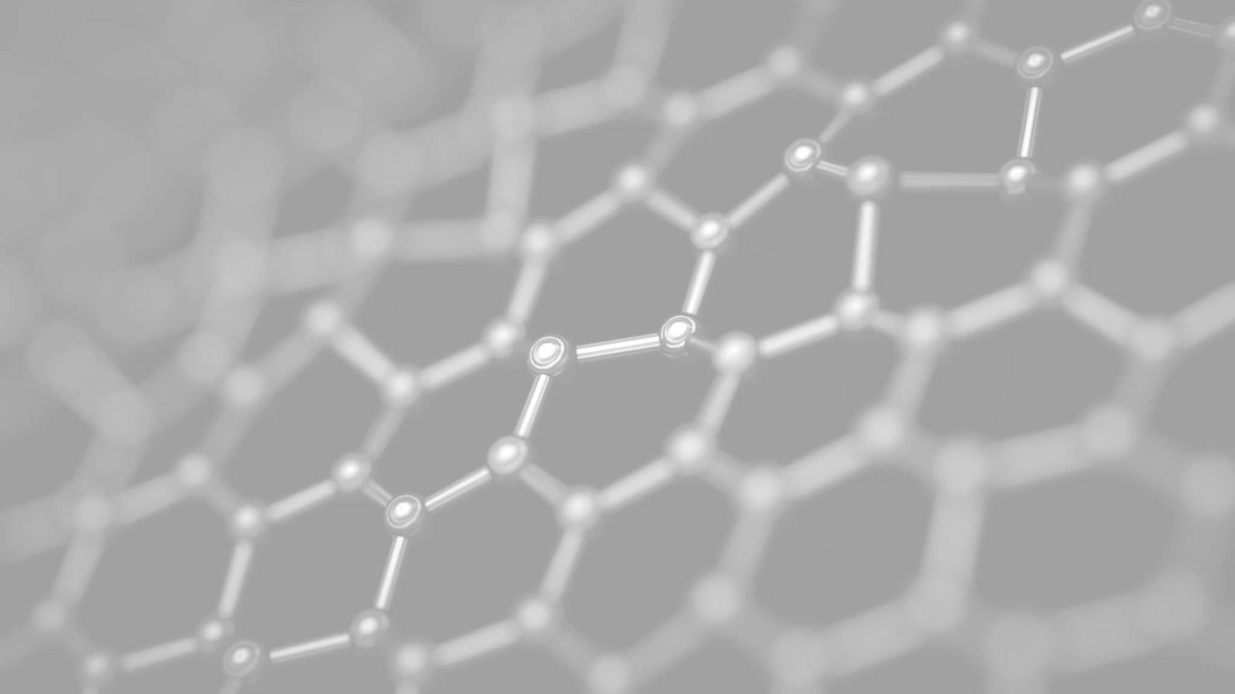
Virtual Labs for Teachers
Efficient Resource Management:
No need for expensive equipment or supplies
Easy to access a variety of experiments
Time-Saving:
Pre-designed experiments, less time spent setting up
Quick demonstrations of complex concepts
Effective Assessment Tools:
Built-in quizzes, interactive assessments
Real-time tracking of student progress
Flexible Learning:
Teachers can use virtual labs in remote or hybrid learning setups
Accessible for diverse learners with different needs

Slide 8
Virtual Labs for Learners
Individualised Learning:
Self-paced experiments and simulations
Ability to repeat experiments as needed
Active Engagement:
Interactive elements such as virtual instruments, diagrams, and simulations
Learning through trial and error in a safe environment
Fostering Curiosity:
Learners can explore various biological processes in-depth
Encourages exploration beyond the curriculum

Slide 9
Pedagogical Application: Integrating Virtual Labs with Learning Goals
Aligning Objectives: Support specific learning goals .
Concept Reinforcement: Interactive simulations to strengthen key concepts.
Lab Skill Development: Practice techniques and data analysis.
Encouraging Inquiry: Promote critical thinking and hypothesis testing.
Instant Feedback: Immediate analysis to reflect and improve understanding.
Accessibility: Learn anytime, anywhere, at your own pace.

Slide 10
Steps to reach at desirable resources of Virtual labs
URL: https://diksha.gov.in/

Slide 11
Virtual Labs in DIKSHA
Step 1: Search https://diksha.gov.in/
Step 2: Scroll banners to find Virtual Labs vertical and click on its “Explore”
icon.
Step 3: Scroll down on the landing page of Virtual labs to reach eContent of
class 7.
Step 4: Click on the “Explore” icon of the class 7, select the English medium,
then choose a Science as subject.
Step 5: Click on the Explanation resource to reach the link for related resources

Slide 12
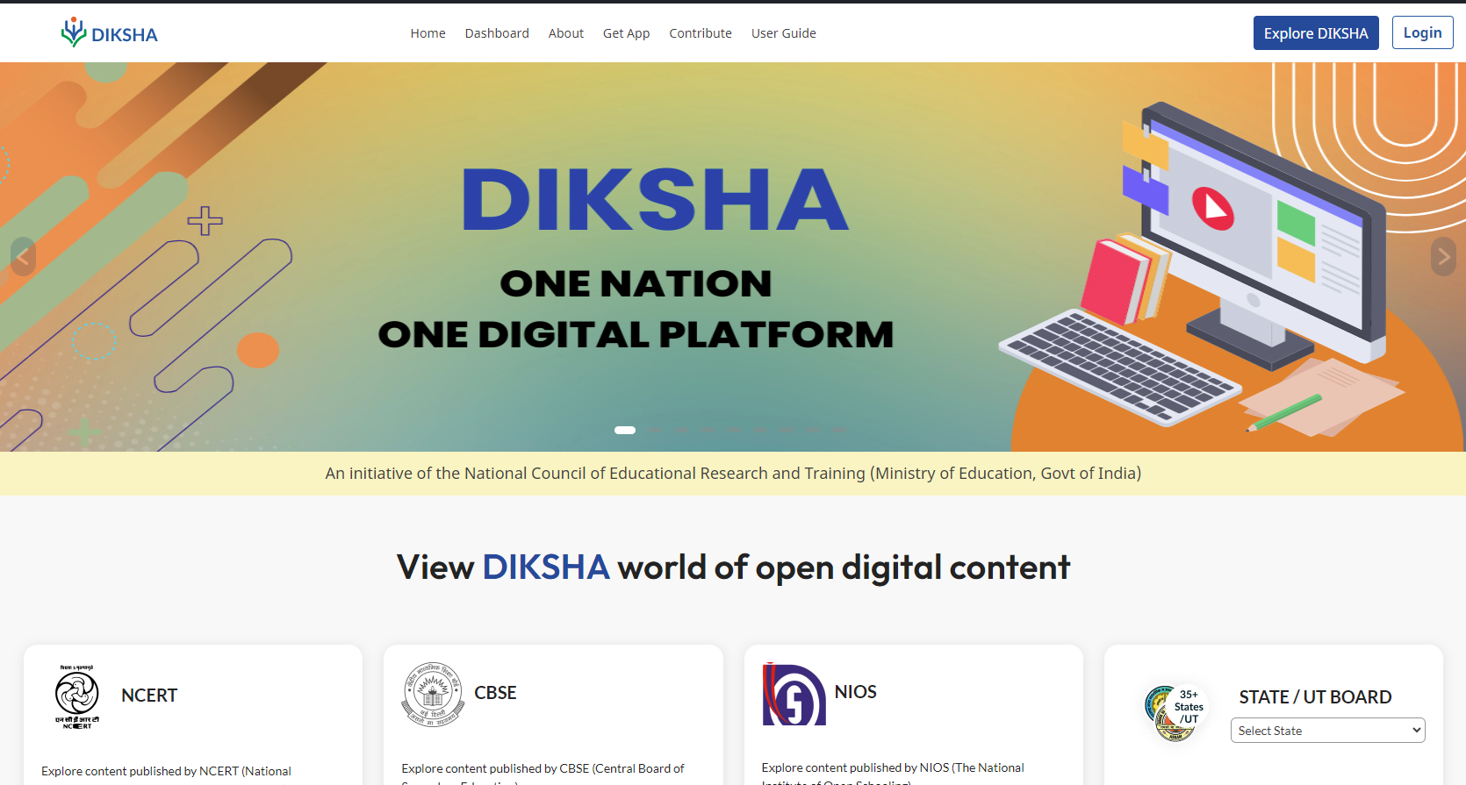
Search https://diksha.gov.in/

Slide 13
Scroll banners to find Virtual labs vertical and click on its “Explore” icon.

Slide 14
Scroll down on the landing page of Virtual labs to reach eContent of classes 6-12.

Slide 15
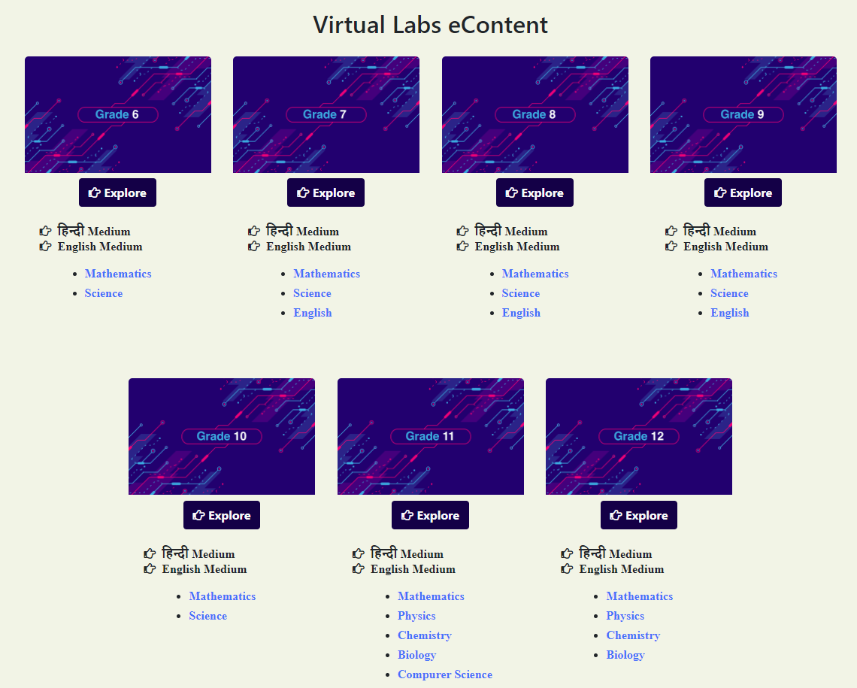
Click on the “Explore” icon of the desirable class, select the medium of interaction, then choose a subject you wish to study.

Slide 16
Demonstration of Virtual Experiments

Slide 17
Parts of a flower (Distinguish between Unisexual and Bisexual flower)
simulation link
Class VII

Slide 18
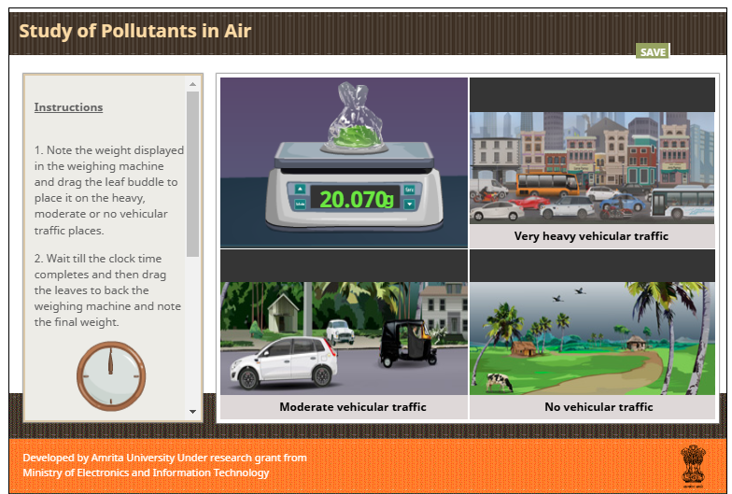
Study of Pollutants in Air
simulation link
Class XII

