Slide 1
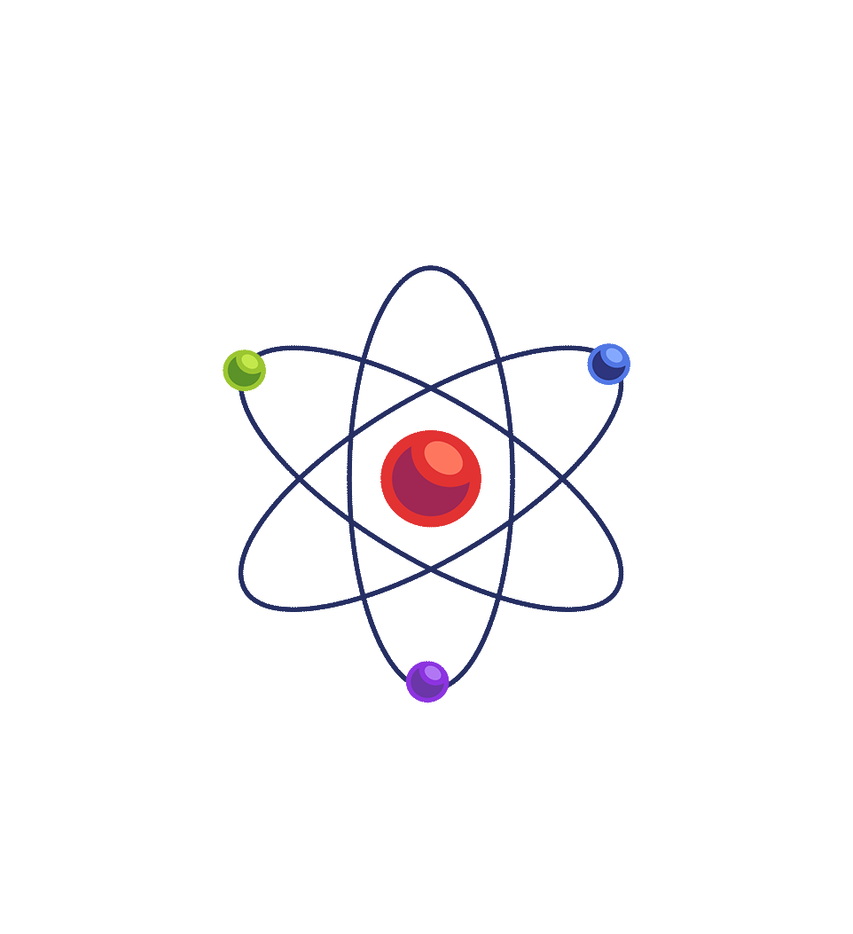
Virtual Labs as a Teaching Learning Tool for Physics
Central Institute of Educational Technology
NCERT, New Delhi

Slide 2
Recommendation of NEP 2020
Access to quality practical and hands-on experiment-based learning experiences to each student.
Virtual labs enhance physical laboratory experience (Testing theory and concept).
Lab based e-resources help students in visualizing the concepts.

Slide 3
Virtual Laboratory (Virtual lab)
A virtual laboratory is a computer-based activity where students interact with an experimental apparatus or other activity via a computer interface.
Anyone can perform experiments and explore scientific concepts through digital tools. It provides a flexible and convenient way to learn practical skills and conduct experiments from anywhere.

Slide 4
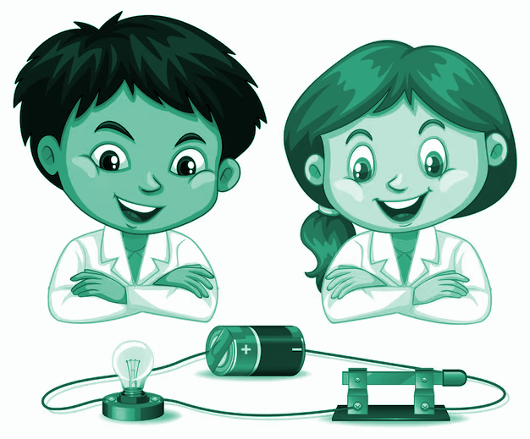
Physics
deals with
universal laws, behaviors
and
relationships
for
physical concepts
Physics
relies
on
experiments,
questioning, interpretation
and
logical analysis
Physics
is about
understanding by
observing
physical events around us

Slide 5
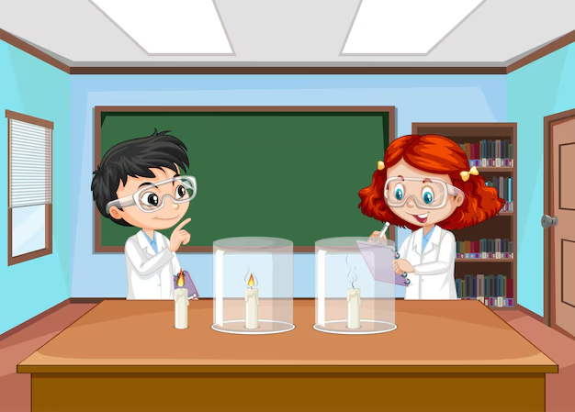
SIGNIFICANCE OF EXPERIMENTS
Experiments
Physics relies on experimentation
to validate scientific theories, establish the facts
Hypothesis Testing
Concepts in Physics are difficult to grasp without hands on experience.
Experiments allow students to visualize concepts for better understanding
Data Interpretation
Develops essential scientific skills of data collection, analysis, critical thinking, and problem-solving techniques
Engaging Students
Ignites curiosity, foster innovation and inspire learners for further inquiry, leading to technological advancements

Slide 6
Need of Virtual Lab in Physics
1. Bridge theory and practice by applying concepts to real-world.
For eg. Experiments with inclined planes and projectiles are great ways to verify Newton's laws of motion.
2. Develop practical skills in apparatus handling, precise measurement, data analysis, and decision-making.
3. Develop critical thinking by analyzing experiments, identifying variables, and drawing logical conclusions.
4. Gain hands-on experience with the scientific method, from hypothesis to experimentation and analysis.
5. By actively engaging with the practicals, students are more likely to remember and apply what they have learned.
Virtual Labs can also make learning more enjoyable and engaging, leading to increased motivation and interest in physics.

Slide 7
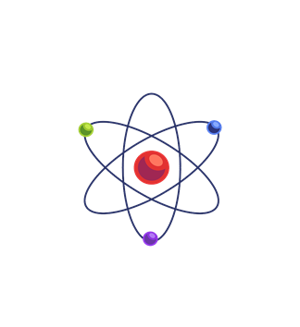
Virtual Labs in Physics
SAFE EXPLORATION RISK FREE
REDUCES COST OF PHYSICAL EQUIPMENT, MATERIALS AND MAINTENANCE.
VISUALIZATION OF INVISIBLE, COMPLEX CONCEPTS
(Sound Waves, Gravitational Fields)
PERSONALIZED LEARNING PROGRESS AT OWN PACE
(Electric Circuits)
SCALABILITY
(Accommodates large audiences without location constraints.)
CONTROLLED ENVIRONMENTS, UNMATCHED PRECISION, ACCURACY
(Free Fall, Ohm’s Law)
AVAILABLE ANYTIME, ANYWHERE WITH INTERNET ACCESS.
MANIPULATE VARIABLES AND REAL-TIME DATA PROCESSING FOR IMMEDIATE RESULTS
STREAMLINING LONG EXPERIMENTS
(Thermal Physics, Pendulum Motion,)

Slide 8
Pedagogical Integration of Virtual labs
Pre-Lab Session:
Teachers can introduce the theoretical concepts, objectives, and procedures of the lab activity, using instructional materials, demonstration videos, or preparatory assignments to ensure students are familiar with the lab setup.
Performance Session:
Teachers can guide students through the experiment on the virtual lab platform, overseeing the procedures, data collection, and observation processes, ensuring it mirrors a physical lab experience.
Post-Lab Session:
Teachers can help students analyze the collected data, draw conclusions by doing calculation, and compare results with theoretical expectations by error analyses.

Slide 9
Virtual Labs aids Students in following ways:
Perform experiments multiple times without any risk of hazardous experiments and activities.
Revise, retry and review theoretical concepts for better understanding.
Obtain immediate result of time-consuming experiments.
Analysis of results to draws conclusions.
Receive immediate feedback to track learning improvement.
Writing reports, error analysis and completing post-labs assignments.

Slide 10
Steps to reach at desirable resources of Virtual labs
URL: https://diksha.gov.in/

Slide 11
Virtual Labs in DIKSHA
Step 1: Search https://diksha.gov.in/
Step 2: Scroll banners to find Virtual Labs vertical and click on its “Explore”
icon.
Step 3: Scroll down on the landing page of Virtual labs to reach eContent of
class 10.
Step 4: Click on the “Explore” icon of the class 10, select the English medium,
then choose a Physics as subject.
Step 5: Click on the Explanation resource to reach the link for related resources

Slide 12
Search https://diksha.gov.in/

Slide 13
Scroll banners to find Virtual labs vertical and click on its “Explore” icon.

Slide 14
Scroll down on the landing page of Virtual labs to reach eContent of classes 6-12.

Slide 15
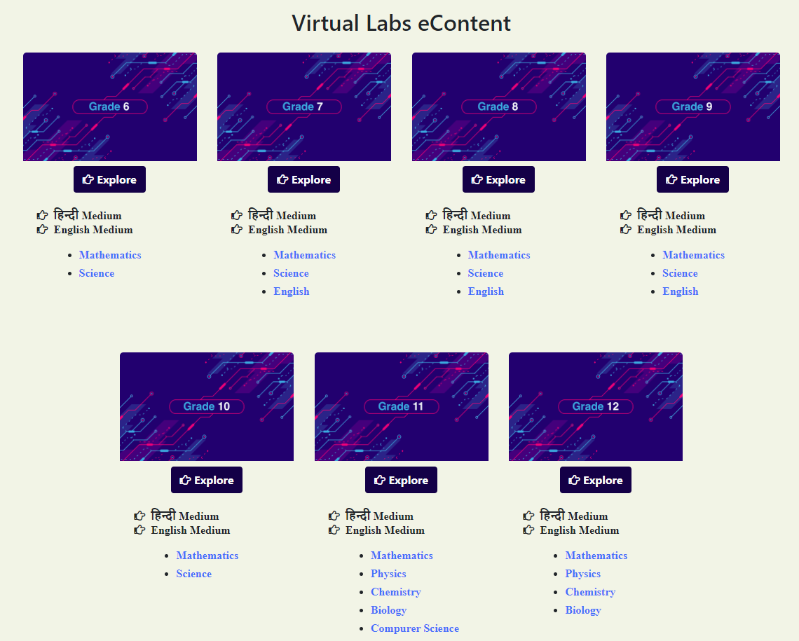
Click on the “Explore” icon of the desirable class, select the medium of interaction, then choose a subject you wish to study.

Slide 16
Electrostatic Shielding Demonstration
Class XII
Electrostatic shielding is a technique that protects a specific area from the effects of an external electric fields by using a conductive enclosure.
Electrostatic shielding works by placing a grounded enclosure around the component or circuit to be protected. It is derived from the principle that electric field lines or electric flux penetrating through the walls of metal containers is zero.

Slide 17
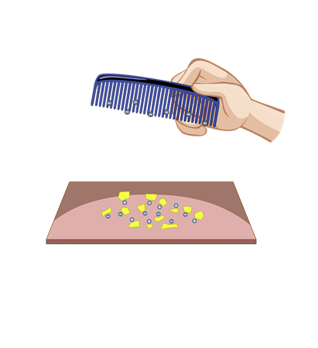
Virtual Lab Experiment – Class XII
AIM - To demonstrate the Electrostatic Shielding
To access this Virtual Lab Experiment you can directly go to the URL mentioned below :
https://diksha.gov.in/play/collection/do_31356155014016204811000?contentId=do_43139629002143825921100617

Slide 18
Virtual Lab Experiment – Class XII
AIM - To determine the resistance per cm of a given wire by plotting a graph of potential difference versus current, and hence to determine its resistivity.
To access this Virtual Lab Experiment you can directly go to the URL mentioned below :
https://diksha.gov.in/play/collection/do_31356155014016204811000?contentId=do_31358351661458227211478

Slide 19
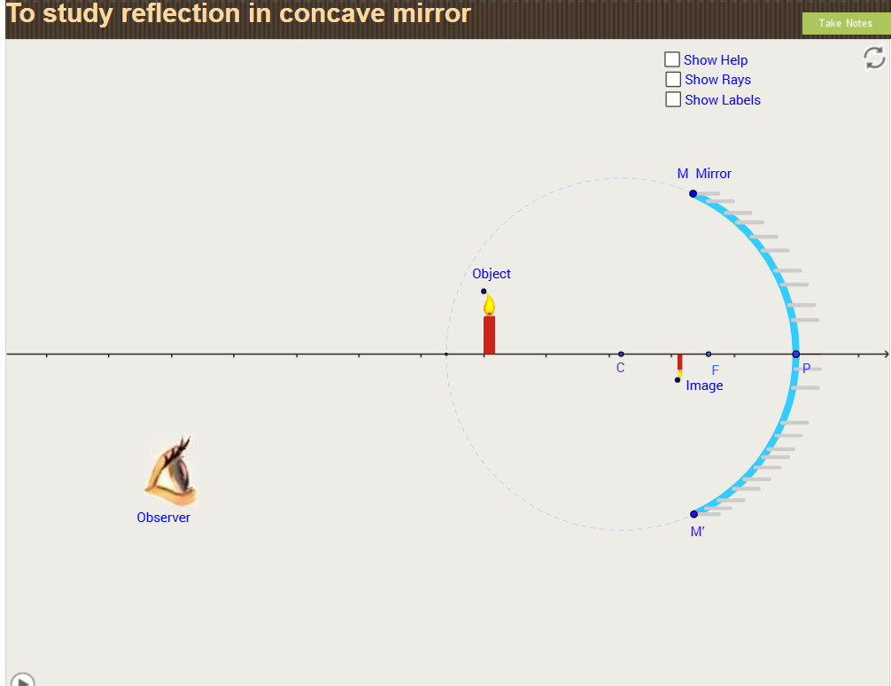
Virtual Lab Experiment – Class X
AIM - To study reflection in concave mirror and observe image formations for different positions of the object.
To access this Virtual Lab Experiment you can directly go to the URL mentioned below :
https://diksha.gov.in/play/collection/do_3135614393797099521445?contentId=do_3135806317306101761237

Slide 20
Virtual Lab Experiment – Class XII
AIM - To study the magnetic field pattern of various material using a bar magnet

Slide 21
Virtual Lab Experiment – Class XII
AIM - To determine the angle of minimum deviation for a given glass prism
To access this Virtual Lab Experiment you can directly go to the URL mentioned below :
https://diksha.gov.in/play/collection/do_31356155014016204811000?contentId=do_3135840083702087681257

Slide 22
Thank You

