Slide 1
Virtual Labs as a Teaching Learning Tool for Chemistry
Central Institute of Educational Technology
NCERT, New Delhi
Central Institute of Educational Technology
NCERT, New Delhi

Slide 2
Policy Perspective (NEP 2020 vision)
Technology use and Integration
Ensuring Equitable use of Technology
Extensive Use of technology in teaching and learning
Content Creation, Digital Repository and Dissemination
Blended mode of learning
Addressing digital divide

Slide 3
Recommendation of NEP 2020
Access to quality practical and hands-on experiment-based learning experiences to each student
Virtual labs enhance actual laboratory experience
Lab based e-resources help students in visualizing the concepts

Slide 4
Virtual Laboratory (Virtual Labs)
Unlocking Virtual Labs: The Terms that Shape Science Learning
Simulation
Accessibility
Scalability

Slide 5
Key features of Virtual Labs
On-demands Labs
(learn and perform at your own pace and time)
Integrated blended learning
(content at one place)
Self evaluation
(pre/post lab quiz)
Demonstrate experiment through simulations/animation/ videos tutorials
(better insights)
Virtual Laboratory
Freedom to repeat experiment
(understanding of abstract concepts)
Freedom to make mistake
(can experiemnt with experiemnts)

Slide 6
Pedagogical Integration of Virtual lab
Pre-Lab Preparation
Teachers introduce key concepts and lab objectives through resources like videos, assignments, or lectures, ensuring students understand the lab setup
Hands-On Lab Engagement
Teachers guide students through the experiment on the virtual platform, supporting data collection and observations in physical lab experience
Post-Lab Reflection
Teachers help students analyze their data, draw conclusions, and compare results with theoretical and practical expectations, reinforcing their learning

Slide 7
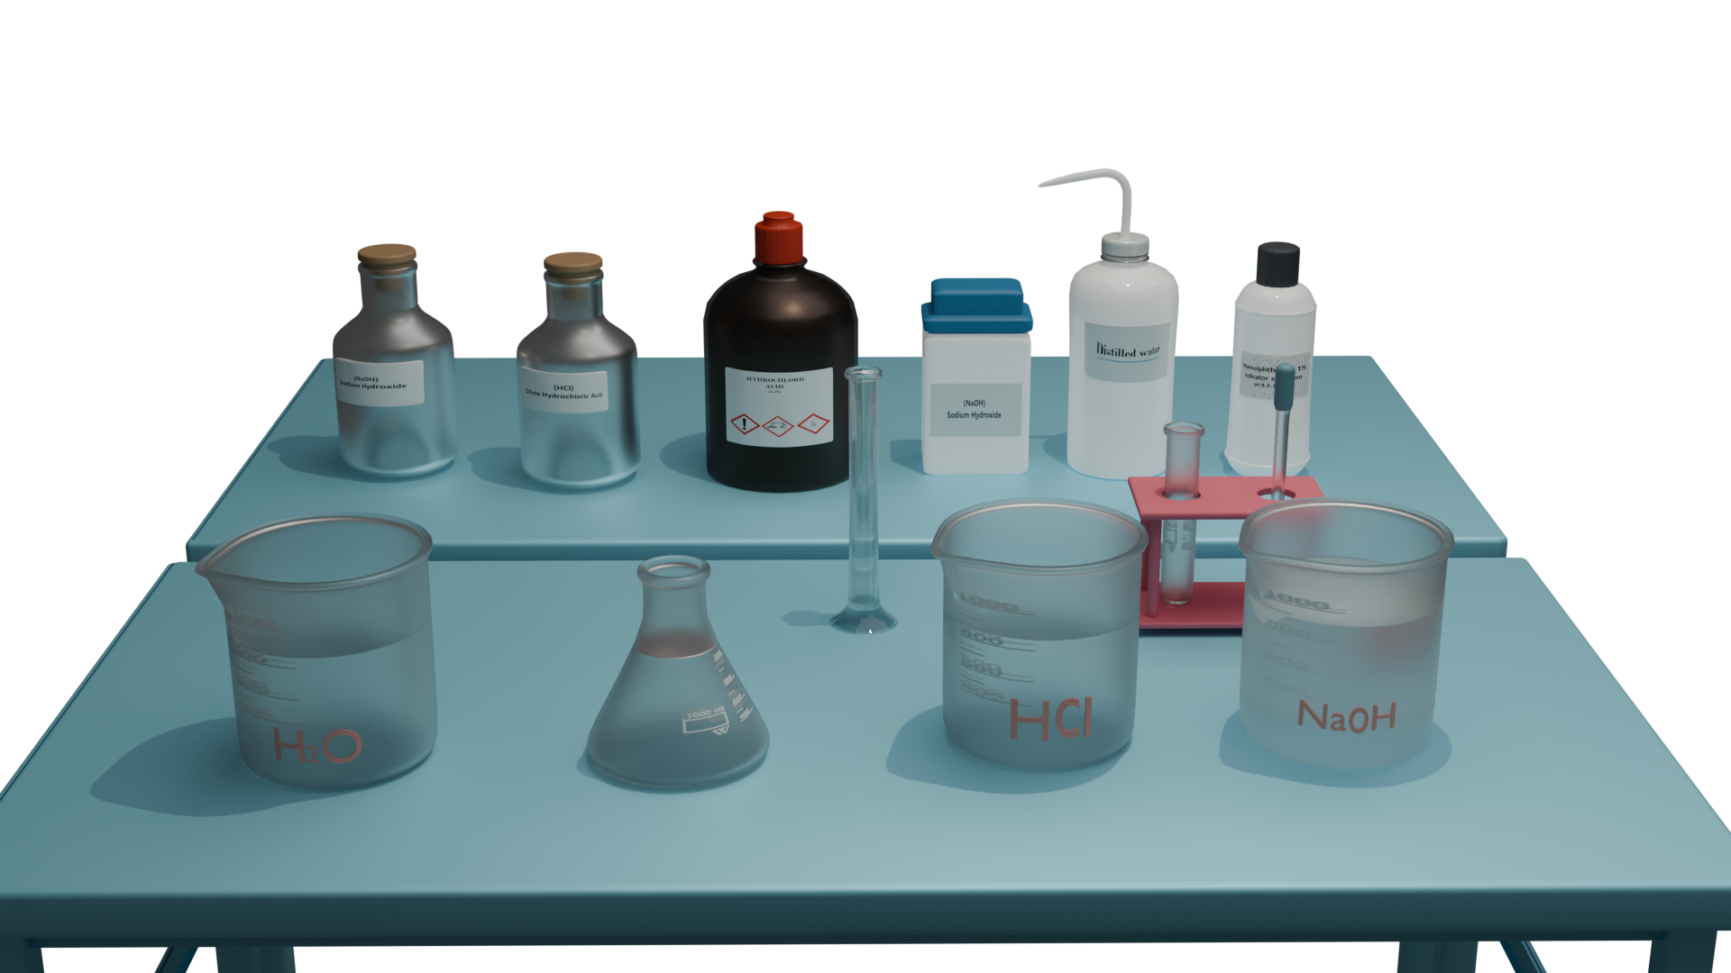
Empowering Chemistry via Virtual Labs
Simulating Complex or Hazardous Reactions
Safety in Experimentation: Virtual labs allow students to safely conduct and observe explosive reactions and high-temperature processes, without any risk.
Visualizing Dangerous Chemicals: Virtual labs can simulate the use of dangerous chemicals like concentrated acids or reactive metals.

Slide 8
Contd….
Replicating Real-World Lab Conditions
Unlimited Resources: Experiments can be run multiple times without wasting materials or incurring extra costs.
Consistency and Precision: Temperature, pressure, and volume can be controlled with precision, which allows for more accurate experiments and results.
Replication of Experiments: Students can replicate their experiments as often as needed, giving them the chance to learn from mistakes and improve their techniques.

Slide 9
Contd….
Preparation for Real Lab Work
Pre-Lab Simulations: This helps reduce mistakes in the physical lab and makes students more confident when handling real chemicals and equipment.
Reinforcing Real Lab Skills: While virtual labs offer a different environment, they can still teach foundational lab skills such as data collection, graphing results, identifying experimental errors, and analyzing outcomes. This makes them complementary to hands-on lab experiences.

Slide 10
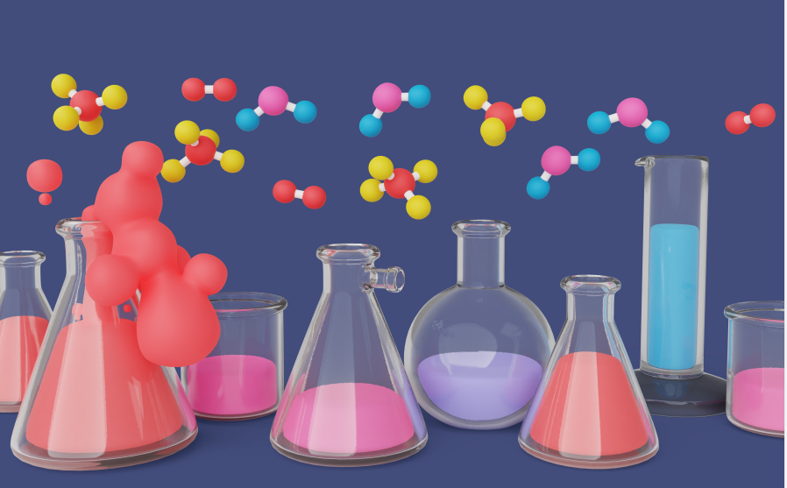
Contd….
Visualizing Molecular Structures and Reactions
Chemical Reaction Simulations: Students can visualize chemical reactions at the molecular level, observing how atoms and molecules interact, bond, and change.

Slide 11
Contd….
Enhancing the Understanding of Abstract Concepts
Visualization of Atomic and Subatomic Particles: Virtual labs provide dynamic simulations that show electrons orbiting nuclei, atoms forming bonds, or molecular vibrations, making abstract ideas more concrete.
Macroscopic vs. Microscopic View: Virtual labs help bridge the gap between macroscopic observations (e.g., color change in a reaction) and microscopic processes (e.g., electron transfers or molecular collisions) by allowing students to switch between different levels of observation.

Slide 12
Contd….
Offering Real-Time Feedback
Instant Feedback on Mistakes: For instance, if students incorrectly measure chemicals or miscalculate concentrations, the virtual lab may alert them or provide suggestions for improvement.
Step-by-Step Guidance:. This is especially useful for novice learners who are unfamiliar with laboratory protocols.

Slide 13
Steps to access the Virtual Lab on the DIKSHA portal URL: http://diksha.gov.in/

Slide 14
Virtual Labs in DIKSHA
Step 1: Search https://diksha.gov.in/
Step 2: Scroll banners to find Virtual Labs vertical and click on its “Explore”
icon.
Step 3: Scroll down on the landing page of Virtual labs to reach eContent of
class 7.
Step 4: Click on the “Explore” icon of the class 8 , select the English medium,
then choose a Science as subject.
Step 5: Click on the Explanation resource to reach the link for related resources

Slide 15
Search https://diksha.gov.in/

Slide 16
Scroll banners to find Virtual labs vertical and click on its “Explore” icon

Slide 17
Scroll down on the landing page of Virtual labs to reach eContent of classes 6-12

Slide 18
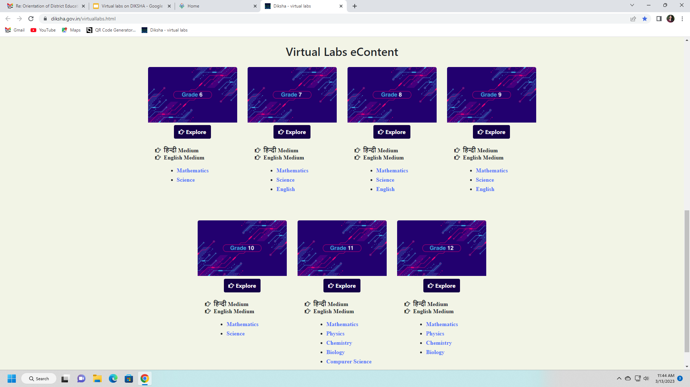
Click on the “Explore” icon of the desirable class, select the medium of interaction, then choose a subject Science

Slide 19
Chemistry Virtual Lab on DIKSHA
Class VIII

Slide 20
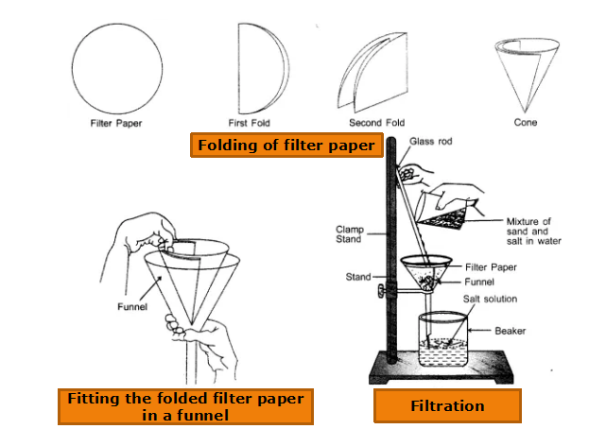
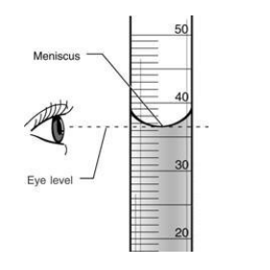
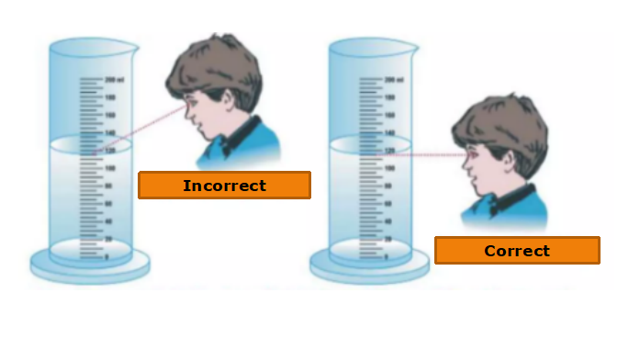
Basic Laboartory Techniques
Filtration technique
Measuring volume
Pouring
Measuring
Filtering
Making standard solutions
Preparing reagents
Use of a gas burner
Handling of laboratory glassware
Making a solution of known concentration

Slide 21
Chemistry Virtual Lab on DIKSHA
Class XI

Slide 22
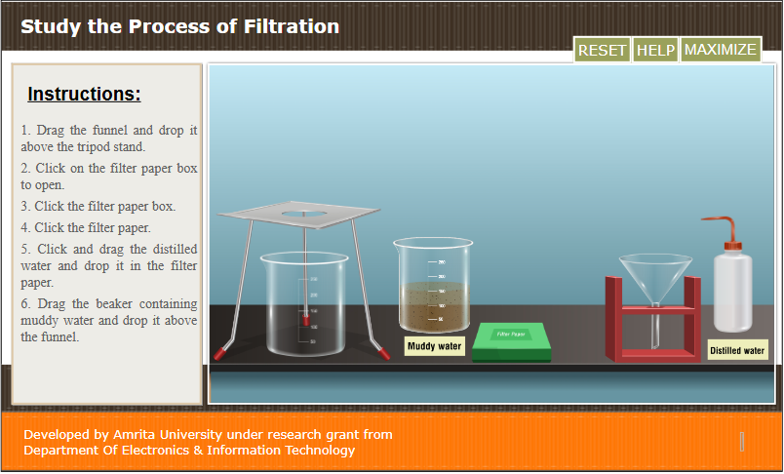
Chemistry Virtual Lab on DIKSHA
Class XI

Slide 23
Chemistry Virtual Lab on DIKSHA
Class X

Slide 24
Acids, Bases and Salts as Electrolytes
Acid, bases and salts dissociate in water
ions conduct electricity
HCl NaOH NaCl

Slide 25
Chemistry Virtual Lab on DIKSHA
Class X

