Slide 1
Virtual Labs for Language Learning
Dr. Amit Ranjan
Assistant Professor,
CIET, NCERT

Slide 2
Roadmap
Introduction to Virtual Labs
Evolution of Language Lab
Virtual Labs at a glance
Virtual Labs for Language Learning
Demonstration

Slide 3
Introduction : Virtual Labs
VIRTUAL
Virtualis (Latin) – “excellence, potency, efficacy” – 14th Century – “Virtue”
“Being something in essence or effect, though not actually or in fact” – 15th Century – via sense of capable of producing a certain effect” [Early 15th C]
Computer sense of “not physically existing but made to appear by software” – 1959.
LABORATORY
Laboratorium (Med. Latin) – “A place for labour or work” (from laborare – labor)
Room or building set apart for scientific experiments” – 16th Century

Slide 4
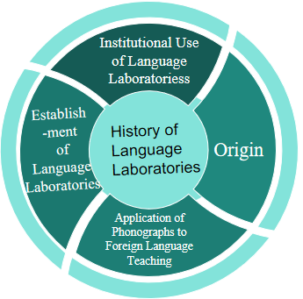
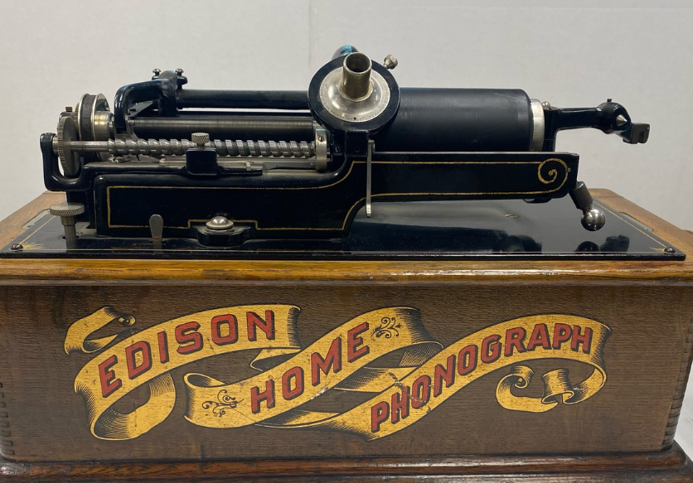
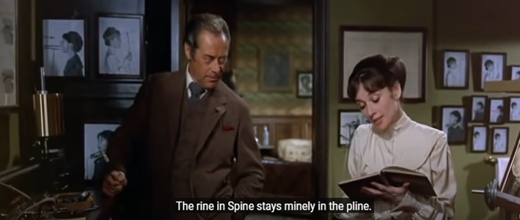
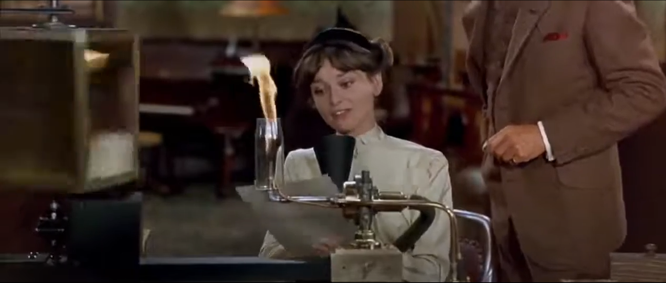
Evolution of Language Laboratories
My Fair Lady (1964)

Slide 5
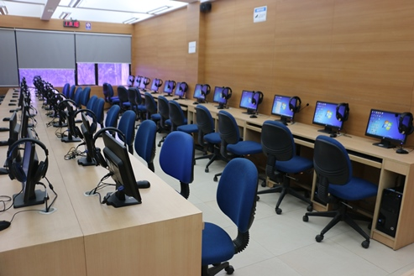
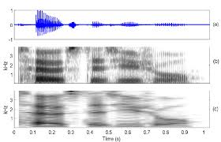
A Language lab set-up
Spectrogram:
A visual representation of speech
Time Frequency Amplitude

Slide 6
Virtual Labs at a glance
Lab experiments can be taught using the internet.
More efficiently in a cost-effective manner.
Beneficial for the students with no access to physical labs or schools where equipment are not available.
The Virtual Labs can be accessed anytime and anywhere, overcoming the constraints of time as physical labs are available only during school hours.

Slide 7
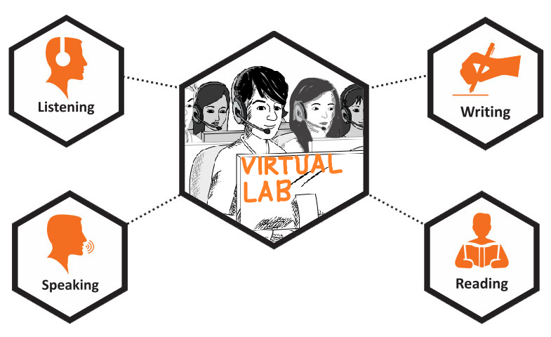
Key Features of a Virtual Language Lab
Thinking
Multimedia Support: Audio, video, text, and interactive activities.
Flexible Learning: Accessible from anywhere, at any time.
Student-Centered Approach: Personalized learning paths and interactive exercises.
Monitoring and Evaluation: Teachers can track progress and offer real-time feedback.

Slide 8
Virtual Language Lab: Revolutionizing Language Learning through technology
DIKSHA’s Virtual Lab
Real-time quizzing
Role play videos
Gaming
Collaborative learning & creating
e.g., writing a poem/story together
Exercises on:
Comprehension
Art integrated language learning (e.g., Preposition)
Instant feedback

Slide 9
Integration of Virtual Language Labs
in
Classroom Teaching

Slide 10
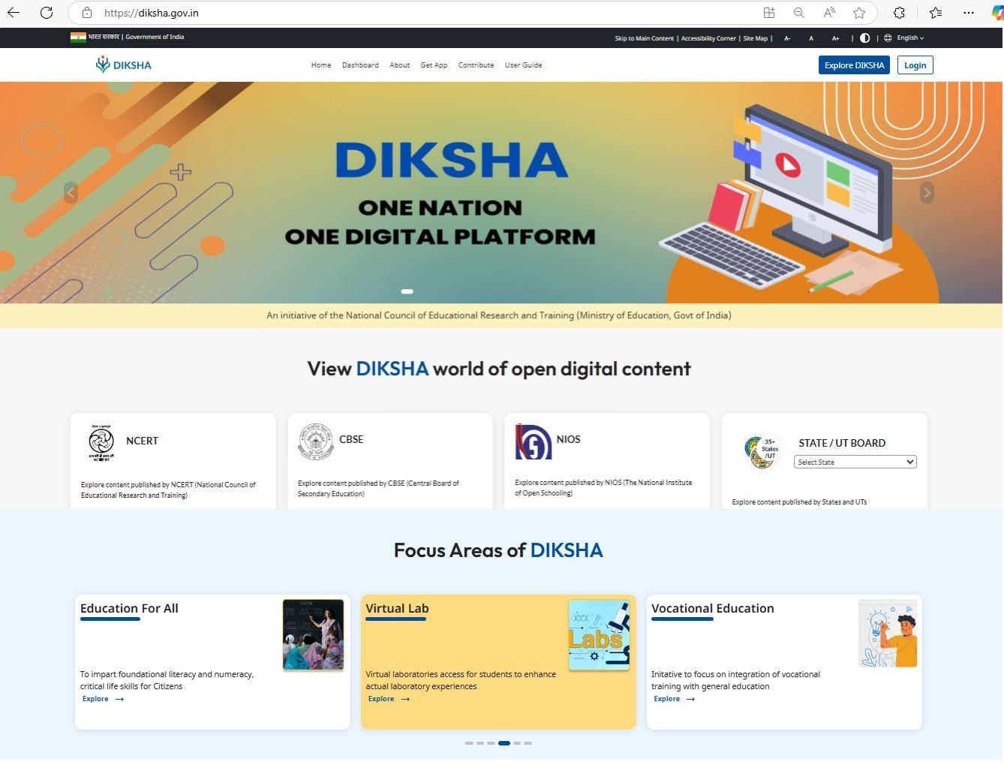

Slide 11
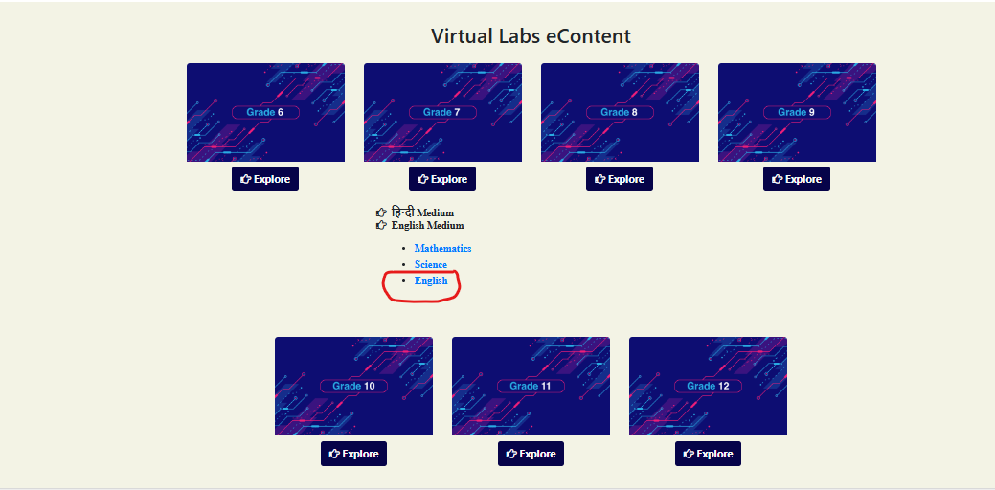

Slide 13
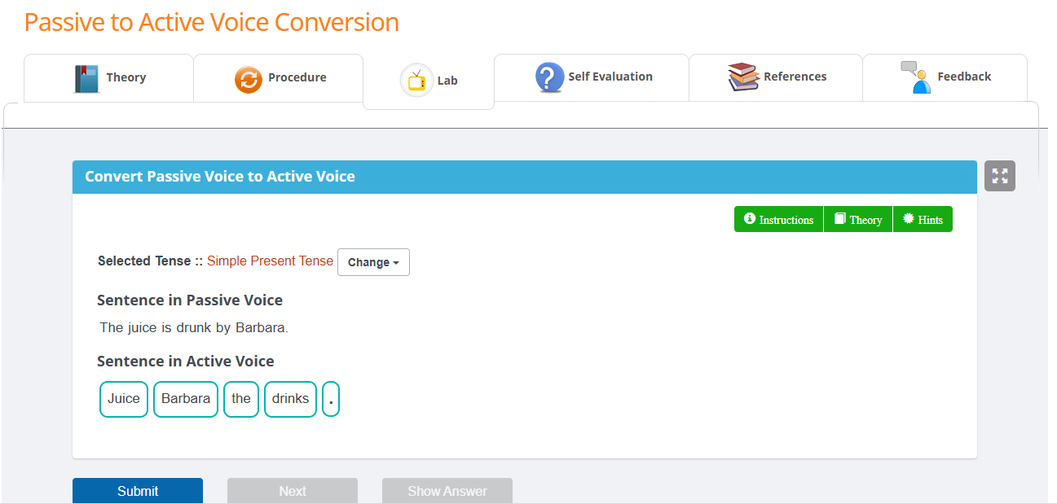

Slide 14
How to access Virtual labs ??
www.diksha.gov.in
Select Virtual Labs from the Focus Areas of DIKSHA
Select Class and Subject from Virtual Labs e-Content

Slide 15
Thank you Virtually yours Dr. Amit Ranjan

