Slide 1
Virtual Labs: Policy Perspective,
Need and Scope
Central Institute of Educational Technology
NCERT, New Delhi

Slide 2
NEP 2020 –Technological thrust areas
Teaching-learning,
evaluation
Enhancing educational
access
Increasing access for divyang students
Streamlining educational
management and administration
Supporting teacher preparation & professional development
Removing
language barriers

Slide 3
NEP-2020: Recommendations for Online and Digital Education
Digital Infrastructure
Building Digital competencies of Students
Portals, Apps and Tools
Content-Pedagogy-Technology Integration, Use of Assistive Technologies
Digital Resources
Educational Technology & ICT
Capacity building of Teachers,Teacher Educators
Telecast and Broadcast
Laying down Standards
e-Governance/Management
Online Assessment and Examination
Intensive Research in ET

Slide 4
Policy Perspective (NEP 2020 vision)
Technology use and Integration
Ensuring Equitable use of technology
Extensive Use of technology in teaching and learning
Content Creation, digital repository and Dissemination
Blended mode of learning
Addressing digital divide

Slide 5
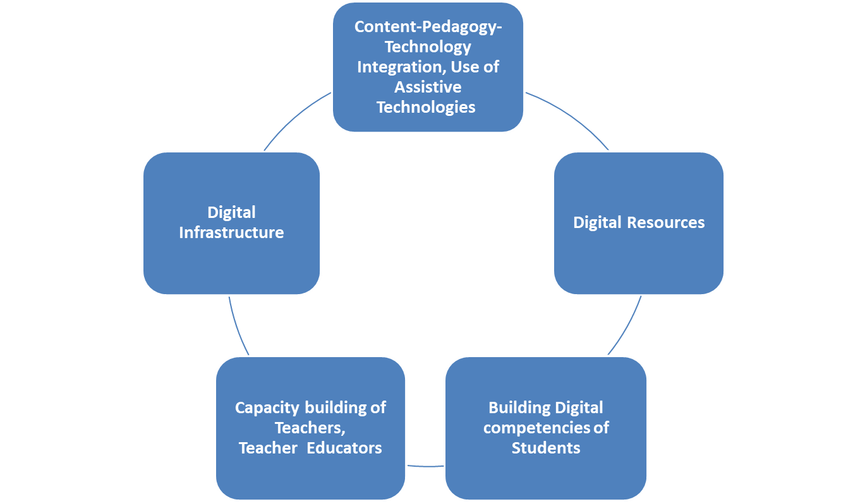

Slide 6
Policy Perspective (NEP 2020 Vision) and Virtual Labs
Empowering Students with Digital Tools
Equity and Inclusivity
Experiential
Learning Goals
Blended Learning Approach

Slide 7
Recommendation of NEP 2020
Access to quality practical and hands-on experiment-based learning experiences to each student
Virtual labs enhance actual laboratory experience
Lab based e-resources help students in visualizing the concepts

Slide 8
Advantages of Virtual labs
Available on internet for free
Accessed anytime and anywhere
Can be accessed even in the absence of physical labs

Slide 9
Virtual labs help learners in following ways
perform experiments multiple times without consuming chemicals
revise theoretical concepts
obtain result of time consuming experiments
analysis of results thereby improving logical thinking skill

Slide 10
Pedagogical integration of Virtual labs
Virtual labs can help teachers in following ways:
Design lesson plan integrating Virtual labs
Use Virtual labs to demonstrate experimental skills and help learners in developing such skills

Slide 11
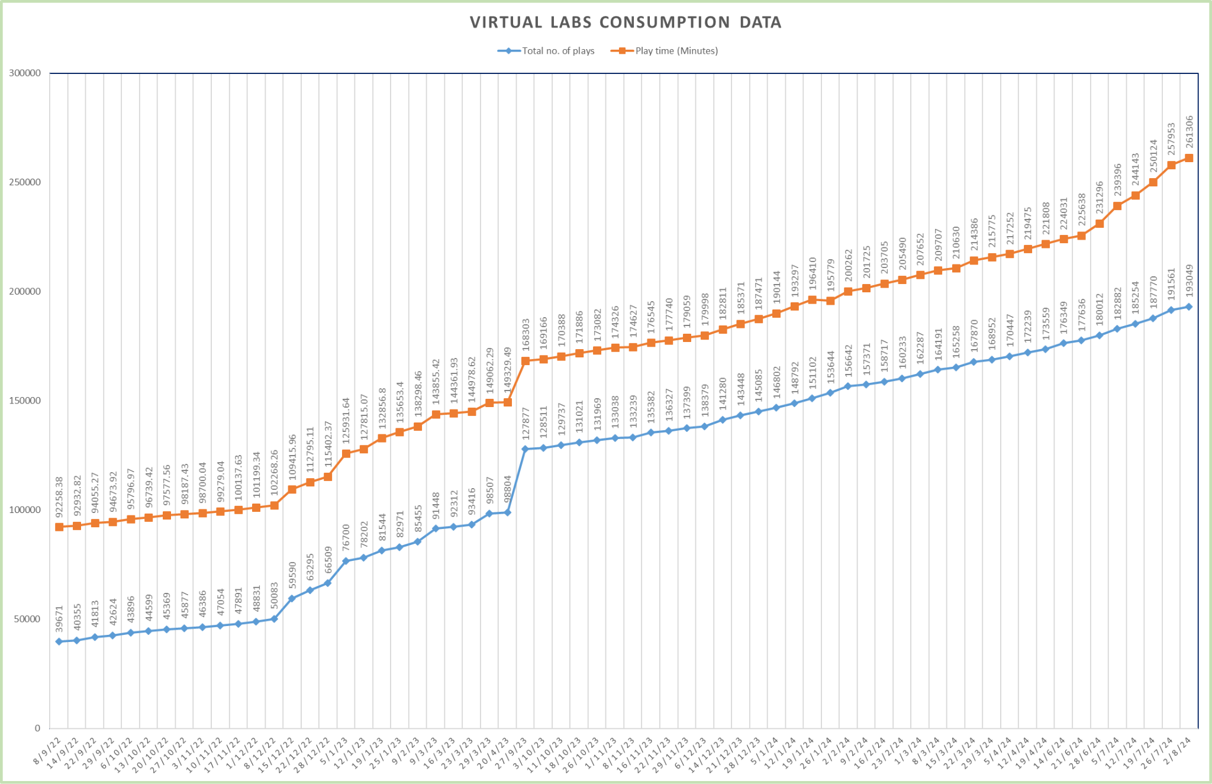
Following data shows that large no. of users are taking benefit of available resources
Virtual Labs was launched on 29th July, 2022

Slide 12
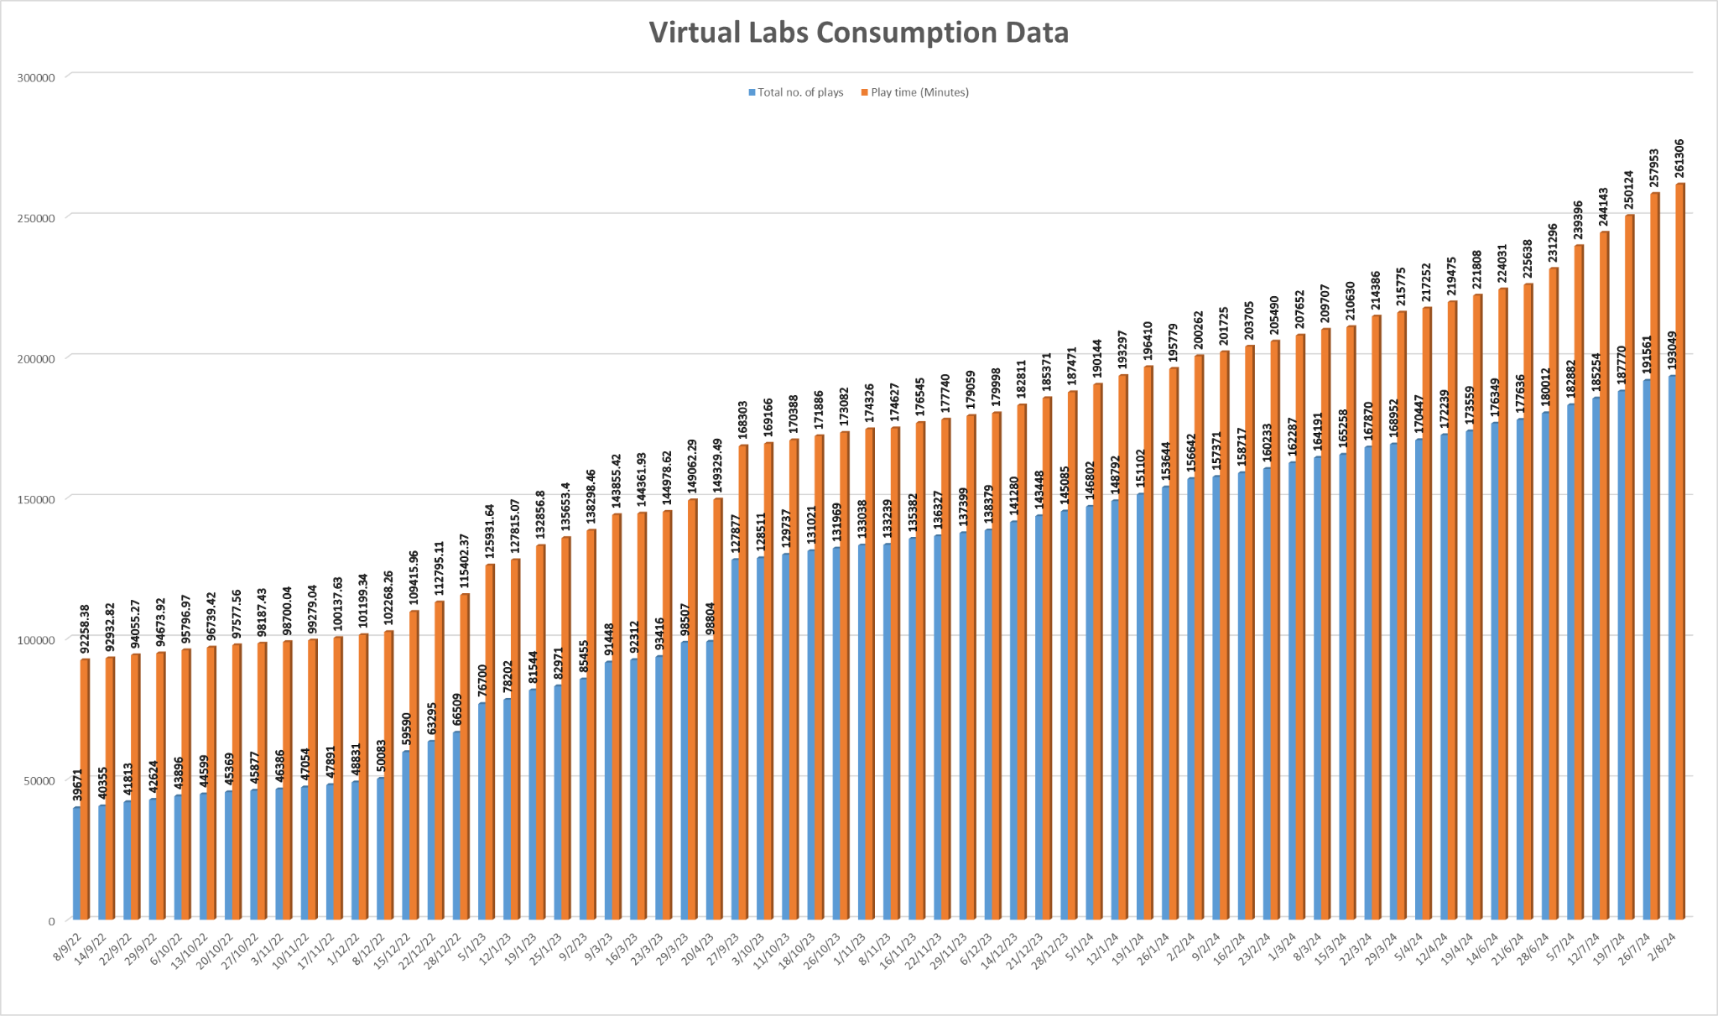
The data shows that large no. of users are taking benefit of available resources

Slide 13
The Spectrum of Reality-Virtuality Continuum
Reality
Augmented Reality
Virtual Reality

Slide 14
Augmented Reality
Virtual Reality
Augmented reality (AR) refers to the real-time integration of digital information into a user’s environment.
AR technology overlays content onto the real world, enriching a user’s perception of reality rather than replacing it.
Virtual Reality (VR) is a simulated experience created by computer technology that immerses users in an interactive, three-dimensional environment.
It allows users to experience and interact with a virtual world as if they were physically present.

Slide 15
Pedagogical Benefits of Extended Reality
Increased Engagement-
Immersive experiences make learning more exciting and interactive, boosting student motivation and interest.
Improved Retention-
Hands-on experiences in virtual environments lead to deeper understanding and improved knowledge retention.
Personalized Learning-
Students can learn at their own pace and adapt the simulation to their individual needs and learning styles.
Enhanced Collaboration-
Virtual environments facilitate collaborative learning, allowing students to work together and learn from each other.

Slide 16
Steps to reach at desirable resources of Virtual labs
URL: https://diksha.gov.in/

Slide 17
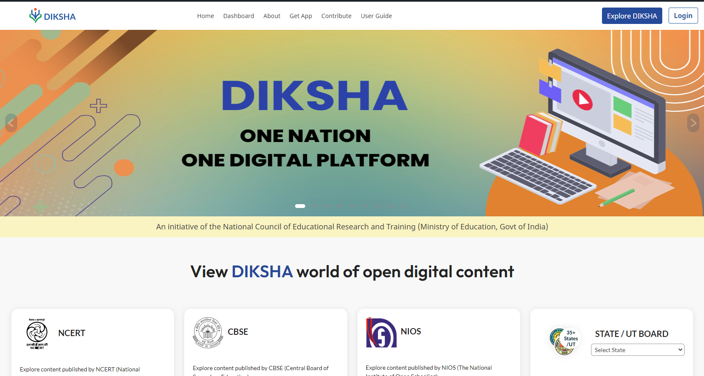
Search https://diksha.gov.in/

Slide 18
Scroll banners to find Virtual labs vertical and click on its “Explore” icon.

Slide 19
Scroll down on the landing page of Virtual labs to reach eContent of classes 6-12.

Slide 20
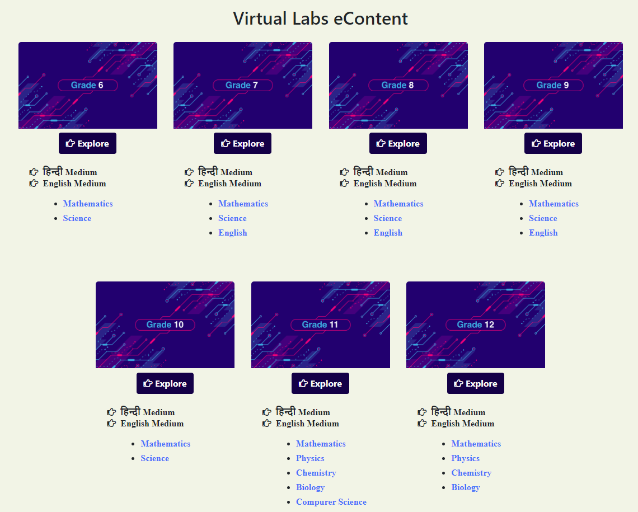
Click on the “Explore” icon of the desirable class, select the medium of interaction, then choose a subject you wish to study.

Slide 21
Click on the simulation to perform experiment.

Slide 22
Virtual Labs provide self paced
engaging learning experience

