Slide 1
virtual lab for Language
Ms. Suman Ninoriya
Education Technology Unit
CDAC Mumbai
Notes:
Thank you!
Namaskar and Good Morning to all the viewer!
As u know we are exploring the virtual labs since last three days, today is the day for Language. Virtual lab on languages. This sound something interestin..am I correct.Yes..SO let see what is there in virtual lab for language leaning and how it is pedagogical support.

Slide 2
Outline
Language learning
Lab as an affordance for language learning
Eco-system of virtual labs
Current available language labs
How to use these?
Demonstration of labs

Slide 3
Language Learning
Reading
Writing
Listening
Speaking
Effective Instruction requires attention to all 4 aspects

Slide 4
Reading
To help familiarise with constructs and usages.
To build vocabulary with context
Improve comprehension

Slide 5
Writing
Knowledge of grammar and spelling
Vocabulary and how/when to use
Mapping ideas to words/sentences
Most energy usually spent here in LL

Slide 6
Speaking
Pronunciation of words
Intonation in sentences
Impromptu sentence formation

Slide 7
Listen
Pronunciation – decoding
Comprehension from oral input

Slide 8
More in Language learning
Composition
Review a writing
Speech
Conversation
Research paper

Slide 9
Language Labs
No experiments as in science lab to do!
But LL requires large amount of practice…
Prompt constructive feedback essential…
Language Lab as a way to achieve this!
Need a large repository

Slide 10
Virtual labs for Language learning
Approach used:
Drill and practice, Game based labs
Data set used is easy to extended for more sentences and words.
Hints and help as required
Intuitive Feedback
Subject based affordance
Word repository
Sanskrit - Inflection, Hindi translation etc.
Levels are added (based on difficulty) in most of the activities for maximum coverage of topic

Slide 11
Eco-system
The core simulator
Theory relevant to the lab
Understanding of the process and its implications
Lab affordance : words repository, hints, images etc.
Review questions, references

Slide 12
Language lab under Diksha
English
Currently 20 labs developed focussed on mostly the 'W' aspect.
Hindi
Focus on Grammer: Noun, Adjective, Samas, varn vichar etc.
Sanskrit-
4 activities released and more developed under review
Few labs developed on listening also (under review)

Slide 13
English Labs
Learning Prepositions of Location
Learning Prepositions of Location (Picture Dictation)
Correction and Omission Activity
Learning Preposition of direction
Passive to Active Voice Conversion
Active to Passive Voice Conversion
Tense Conversion
Improving Comprehension Skills
Direct to Indirect Speech
Reported Speech
Subject-Verb Agreement
Singular to Plural Conversion

Slide 14
संस्कृत
धातु-रूपाणि
सर्वनाम शब्द रूप
संज्ञा शब्दरूप
एकवचन - बहुवचन शब्द --[वचन परिवर्तन]
Under review
उचित रुपम्
संधि:
वर्ण विच्छेद
पत्रलेखनम्
चित्रवर्णनम्

Slide 15
हिन्दी
विशेषण
विशेषण के प्रकार
संज्ञा
संज्ञा के प्रकार
Under Review
वर्ण विचार
संधि विच्छेद
पत्र लेखन
क्रिया
सर्वनाम
समास

Slide 16
Using the Language Labs-1
When explaining concepts in class….
Use to show demonstrations, to prompt students to guess answer, etc.
Consciously giving wrong answers can be used to show the error responses and corrections.

Slide 17
Using the Language Labs-2
Assign practice sessions for out of classroom activities.
Try 10 sentences
Can ask them to submit the report generated by system

Slide 18
Using the Language Labs-3
Encourage students to practice online, till they reach a correctness level above 90%.
Logs can be used to check (if needed) for internal evaluation, etc.

Slide 19
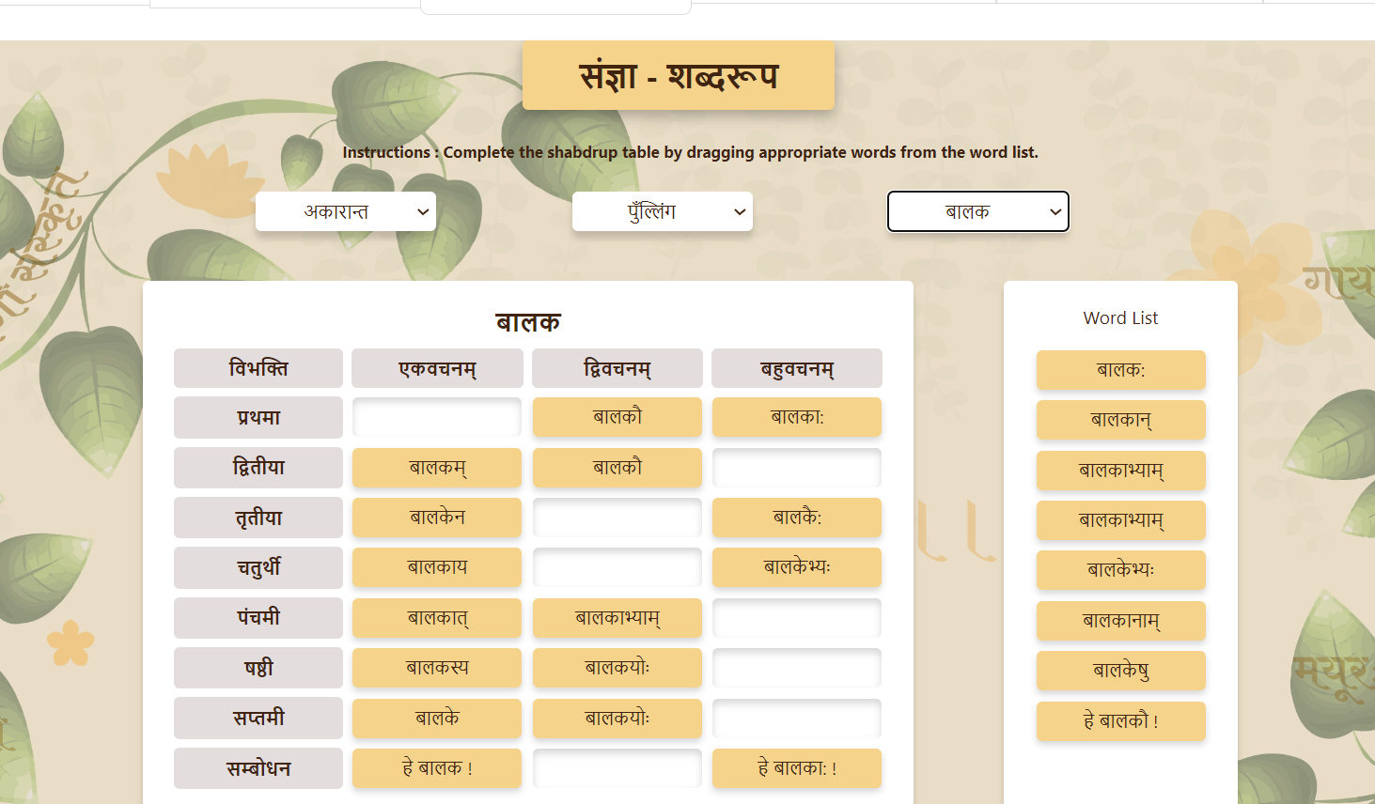
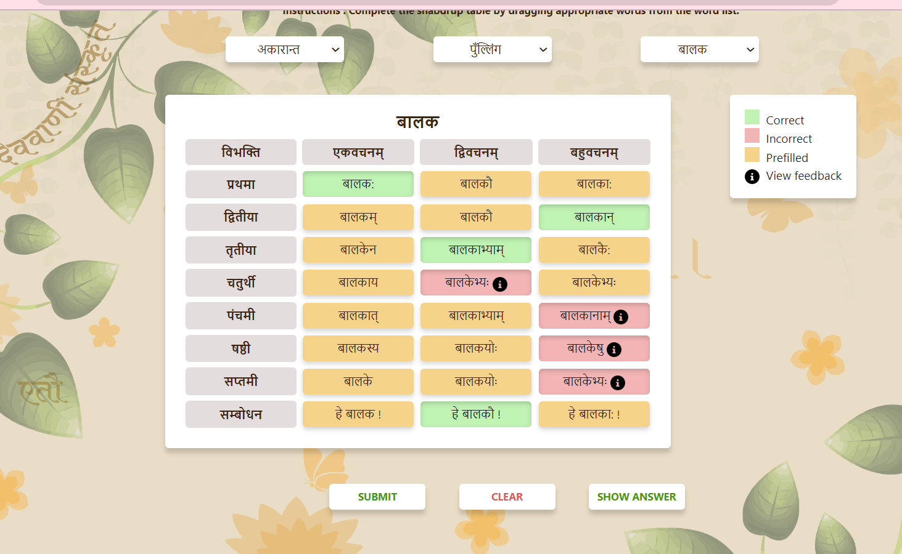

Slide 20
Teachers can contribute to language labs
Contribute ideas
Help in identification of hard spots
Volunteer to add more examples/data in the existing labs.

Slide 21
Demo
https://diksha.gov.in/virtuallabs.html

Slide 22
Thank you
Reach us at: etu@cdac.in and vidyakashetu@gmail.com

Slide 23
Conclusion
Under the MoE virtual lab initiative, a good collection of labs for a range of subjects is coming, including languages.
We invite you to try this, and share your feedback.
If there are areas of language learning which you think are difficult areas for students, kindly share with us.
Contact us at etu@cdac.in, vidyakashetu@gmail.com

