Slide 1
VIRTUAL LAB AS A TEACHING LEARNING TOOL FOR PHYSICS

Slide 2
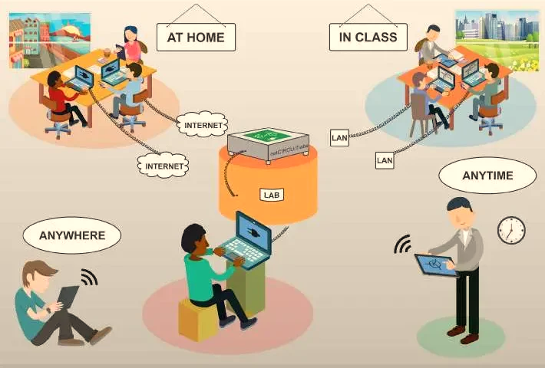
VIRTUAL LABS
AUGMENT
THE PHYSICAL LABS
BASED ON THE CONCEPT OF
REMOTE EXPERIMENTATION
IT’S A COMPUTER-BASED ACTIVITY
VIRTUAL LABS
HAVE A
RESOURCE-RICH
LEARNING
ENVIRONMENT
INTERACTION WITH
AN EXPERIMENTAL
APPARATUS OR
OTHER ACTIVITY
VIA A
COMPUTER INTERFACE

Slide 3
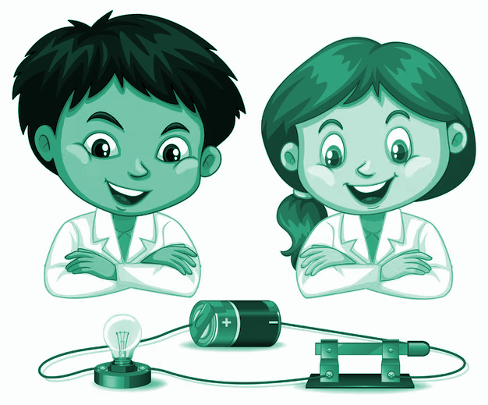
Physics
deals with
universal laws, behaviors
and
relationships
for
physical concepts
Physics
relies
on
experiments,
questioning, interpretation
and
logical analysis
Physics
is about
understanding by
observing
physical events around us

Slide 4
SCIENTIFIC METHOD
OBSERVATION: PHYSICAL PHENOMENA
HYPOTHESIS
PREDICTION
TESTING HYPOTHESIS/EXPERIMENTATION
THEORY
ANALYSIS QUESTIONS
NO
YES

Slide 5
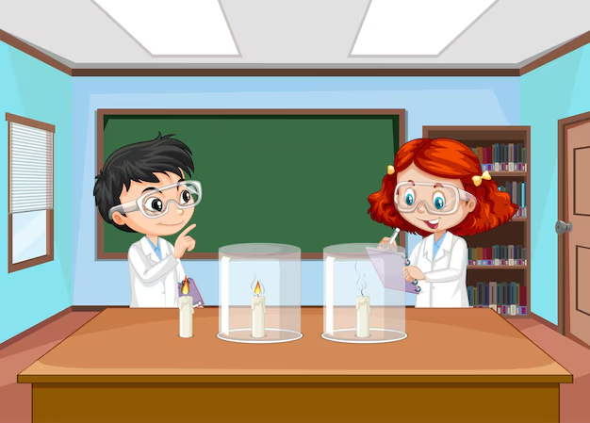
SIGNIFICANCE OF EXPERIMENTS
Experiments
Physics relies on experimentation
to validate scientific theories, establish the facts
Hypothesis Testing
Concepts in Physics are difficult to grasp without hands on experience.
Experiments allow students to visualize concepts for better understanding
Data Interpretation
Develops essential scientific skills of data collection, analysis, critical thinking, and problem-solving techniques
Engaging Students
Ignites curiosity, foster innovation and inspire learners for further inquiry, leading to technological advancements

Slide 6
FREE ACCESS
COST EFFECTIVENESS
INTERACTIVE SIMULATIONS
BRIDGING CONSTRAINTS
-
DEMOGRAPHICALLY
INCLUSIVITY
&
EQUITY
Virtual Labs in Physics
Anytime
Anywhere Access
COMPLETE LAB LEARNING ENVIRONMENT
LEARNERS AUTONOMY

Slide 7
COMPLEX PHYSICS CONCEPTS
(Pendulums or the conservation of momentum during collisions)
SAFE EXPLORATION, RISK FREE
(High Voltage Experiment)
VISUALIZATION OF INVISIBLE PHYSICS CONCEPTS
(wave interference or electromagnetism)
Controlled Environments
and
Unmatched Precision and Accuracy
VIRTUAL LABS IN PHYSICS
-
SCALABILITY
(Large Group of Students)
PERSONALIZED
LEARNING
PROGRSS AT
OWN PACE
OFFERS PRE-LAB , POST LAB SESSIONS
(Assign virtual lab activities as homework)
STREAMLINING LONG EXPERIMENTS
(Thermal Physics)
REAL-TIME DATA
PROCESSING
FOR IMMEDIATE
RESULT
(Mass, force, or angle)

Slide 8
EXEMPLARS
Mechanics
Optics
Magnetism
Electricity

Slide 9
NEP 2020 – Technological Thrust
Teaching-Learning Evaluation
Enhancing Educational Access
Increasing Access For Divyang Students
Removing Language Barriers
Supporting
Teacher Preparation & Professional Development
Streamlining Educational Management Administration

Slide 10
BLENDED LEARNING
PERSONALIZED LEARNING
COLLABORATIVE LEARNING
DEMONSTRATIVE LEARNING
EXPERIMENTATION LEARNING
INTERACTIVE VISUALS
FLIPPED LEARNING

Slide 11
Virtual Labs were launched on DIKSHA PORTAL in 2022, which helps learners and educators for Experiential learning
Using simulator students understand concepts by performing experiments online, not merely by watching videos or reading text.
To access the Virtual labs Vertical on DIKSHA, you can Go to : https://diksha.gov.in/virtuallabs.html
Click the Explore icon for different classes

Slide 12
FORMATIVE
DIAGNOSTIC
SUMMATIVE
INTERACTIVITY
Virtual simulations allow students to actively engage with scientific concepts, providing real-time feedback and opportunities for experimentation.
IDENTIFY MISCONCEPTION
Virtual lab diagnostics can pinpoint specific areas where students struggle, allowing teachers to address misconceptions.
AUTHENTIC
Virtual experiments can replicate real-world scientific scenarios, allowing for authentic assessment of student understanding and skills.
DATA COLLECTION
Virtual labs can capture detailed performance data, enabling teachers to track student progress and identify areas for improvement.
PERSONALIZED FEEDBACK
Diagnostic assessments in virtual labs can provide tailored feedback to students, guiding them towards mastery.
STANDARDIZED
Virtual labs can provide consistent, controlled environments for summative assessments, ensuring fairness and reliability.
ADAPTIVE FEEDBACK
Simulations can adapt to student actions, providing personalized guidance and scaffolding to support learning.
DATA DRIVEN INTERVENTION
Insights from virtual lab diagnostics can inform targeted interventions and personalized learning plans
DATA DRIVEN INSIGHTS
Detailed performance data from virtual experiments can inform teaching practices and curriculum development.

Slide 13
Notes:
Virtual labs in the DIKSHA framework are designed to supplement traditional learning by providing simulations and interactive experiments that help students grasp complex scientific concepts.

Slide 14
VIRTUAL LABS
(DEMONSTRATION)
Notes:
Virtual labs in the DIKSHA framework are designed to supplement traditional learning by providing simulations and interactive experiments that help students grasp complex scientific concepts.

Slide 15
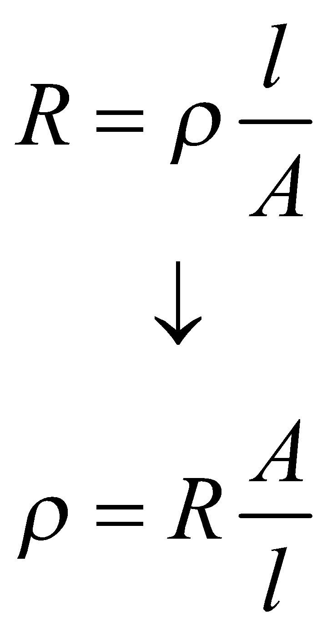
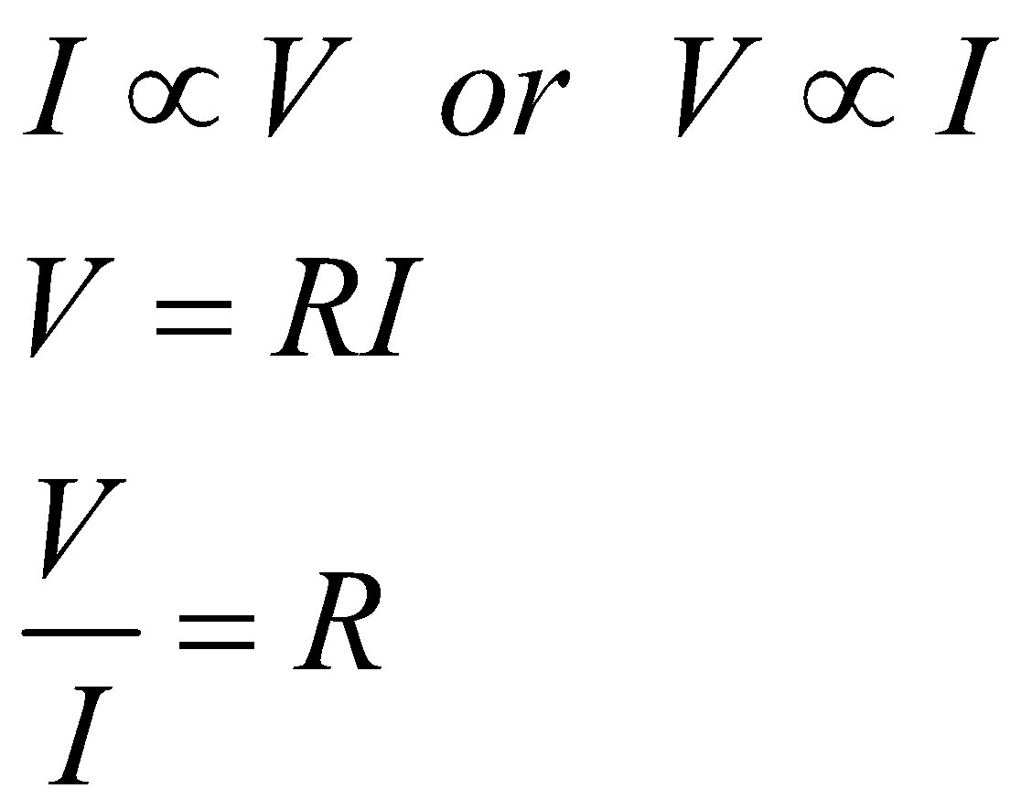
Virtual Lab Experiment – Class XII
OHM’S LAW The current flowing through a conductor is directly proportional to the potential difference across its ends provided the physical conditions (temperature, dimensions, pressure) of the conductor remains the same. If I be the current flowing through a conductor and V be the potential difference across its ends, then according to Ohm's Law

Slide 16
Virtual Lab Experiment – Class XII
AIM - To determine the resistance per cm of a given wire by plotting a graph of potential difference versus current, and hence to determine its resistivity.
To access this Virtual Lab Experiment you can directly go to the URL mentioned below :
https://diksha.gov.in/play/collection/do_31356155014016204811000?contentId=do_31358351661458227211478

Slide 17
Worksheet For Observations and Automated Result

Slide 18
Virtual Lab Experiment – Class IX
When sound travels in a given medium, it strikes the surface of another medium and bounces back in some other direction, this phenomenon is called the reflection of sound.
LAWS OF REFLECTION OF SOUND
First Law of Reflection:
The incident wave, the reflected wave, and the normal at the point of incidence lie on the same plane.
Second Law of Reflection:
The angle of incidence is equal to the angle of reflection.

Slide 19
Virtual Lab Experiment – Class IX
AIM - To verify the Laws of Reflection of Sound
To access this Virtual Lab Experiment you can directly go to the URL mentioned below : https://diksha.gov.in/play/collection/do_3135614369279098881943?contentId=do_3135805695232819201132

Slide 20
Virtual Lab Experiment – Class IX
S. No. | Angle of incidence | Angle of reflection
1
2
3
4
5

Slide 21
Virtual Lab Experiment – Class XII
AIM - To determine the angle of minimum deviation for a given glass prism
To access this Virtual Lab Experiment you can directly go to the URL mentioned below :
https://diksha.gov.in/play/collection/do_31356155014016204811000?contentId

